Slide 1
World of Warcraft: Objects everywhere

Slide 2
OOP Example: The Character Class

Slide 3
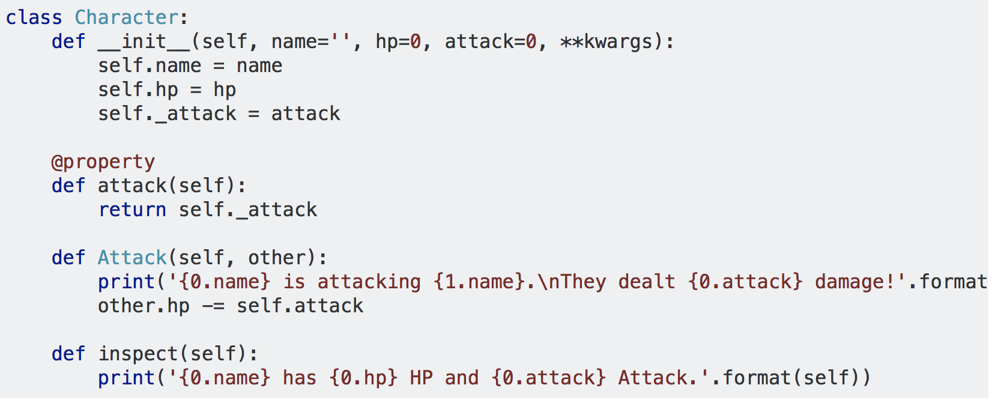
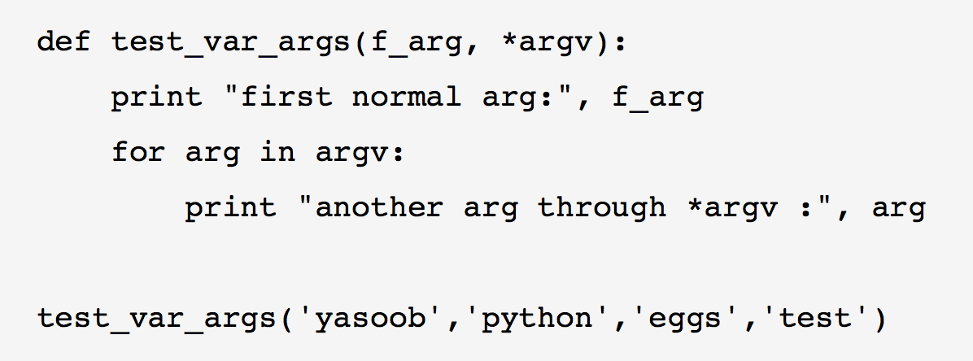
Character Class example
http://book.pythontips.com/en/latest/args_and_kwargs.html

Slide 4
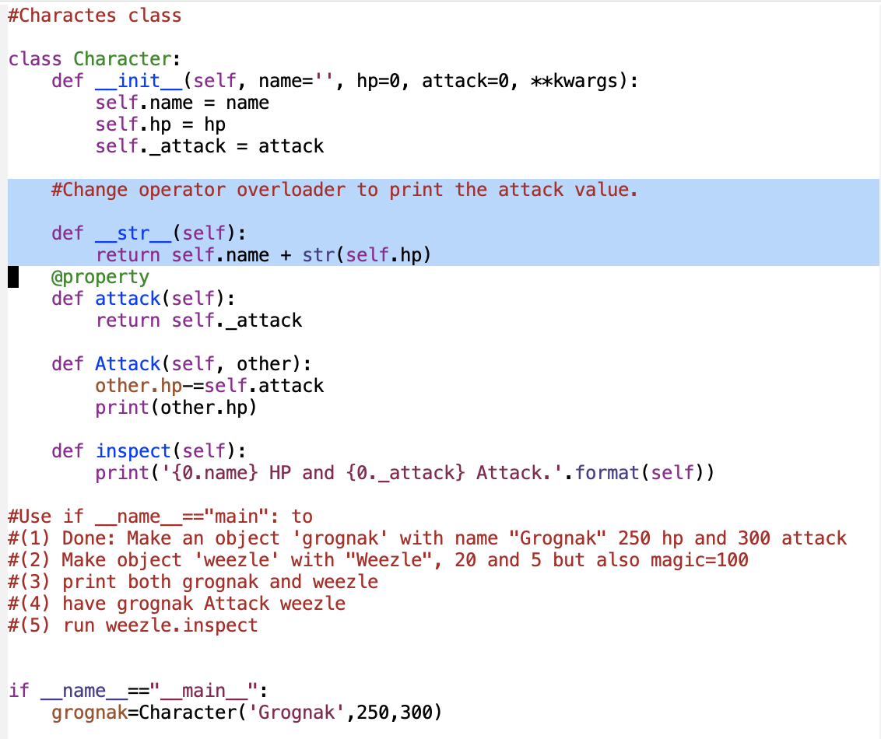
Operator Overloading
Overloading the
print function
How would we use print with the
grognak object? And what would it print?
This trick for
running as a script
Use of if __name__==“__main__”:
https://www.effbot.org/pyfaq/tutor-what-is-if-name-main-for.htm

Slide 5
Go to character_class.py
Improve the operator overload for print
Do some more manipulations of objects
Make new objects and call the functions

Slide 6
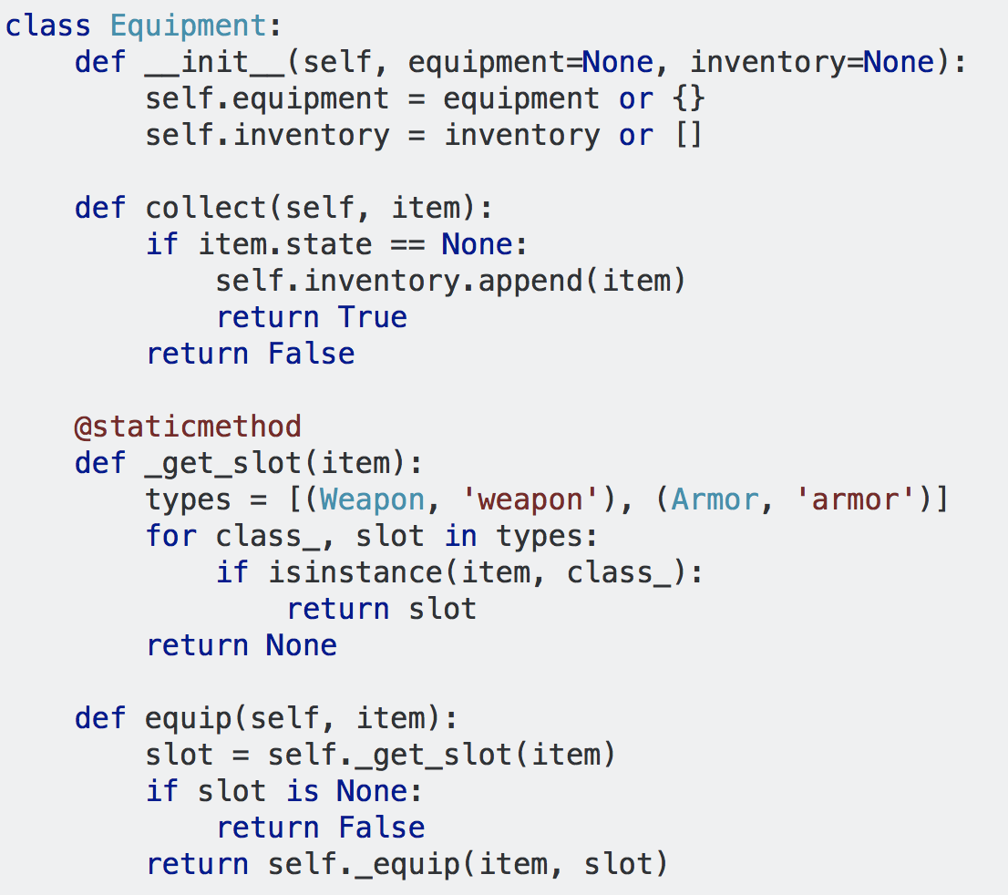
Equipment Class
The Constructor
A method that works to add inventory.
Looks for item in equipment

Slide 7
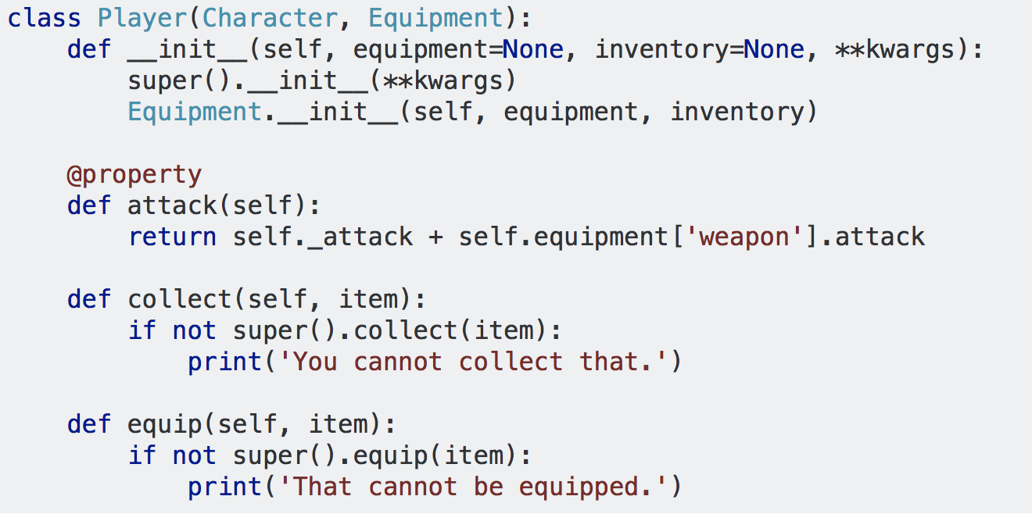
Inheritance: New class builds on old classes

Slide 8
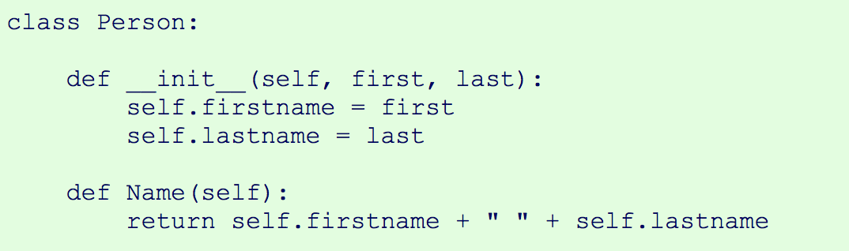
Inheritance Example (Python 3)
PYTHON COURSE, Python 3 Tutorial: http://www.python-course.eu/python3_course.php
BASE CLASS from tutorial Inheritance : http://www.python-course.eu/python3_inheritance.php

Slide 9
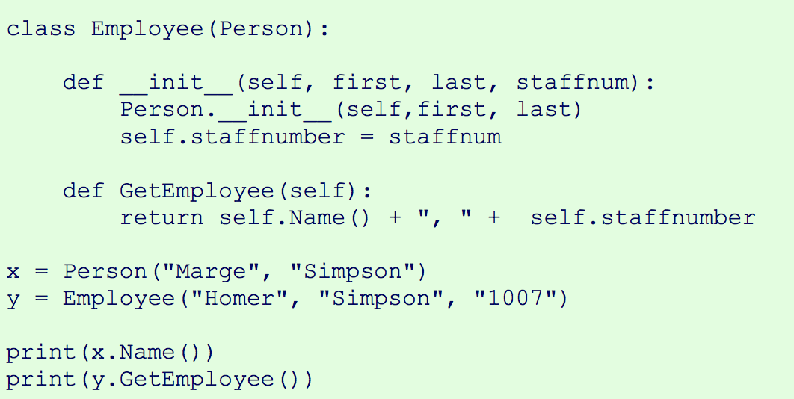
BASE CLASS
INHERITING
CLASS

Slide 10
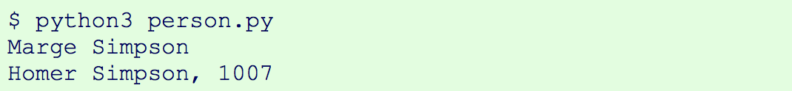
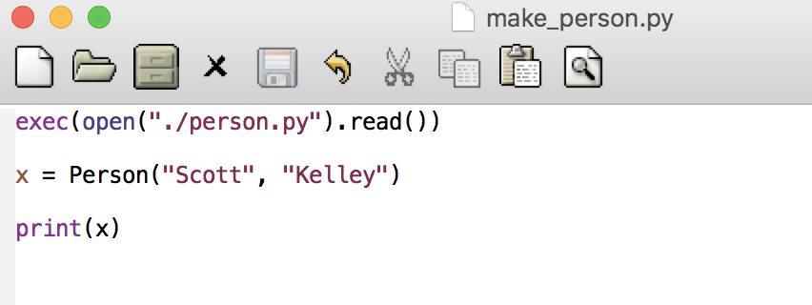
LET’s SAVE THE CODE AND RUN THE CLASS
ALTERNATIVE WAY TO RUN IT: New script that loads up the class and runs the code
Code for testing out python code:
exec(open("./filename").read())

Slide 11
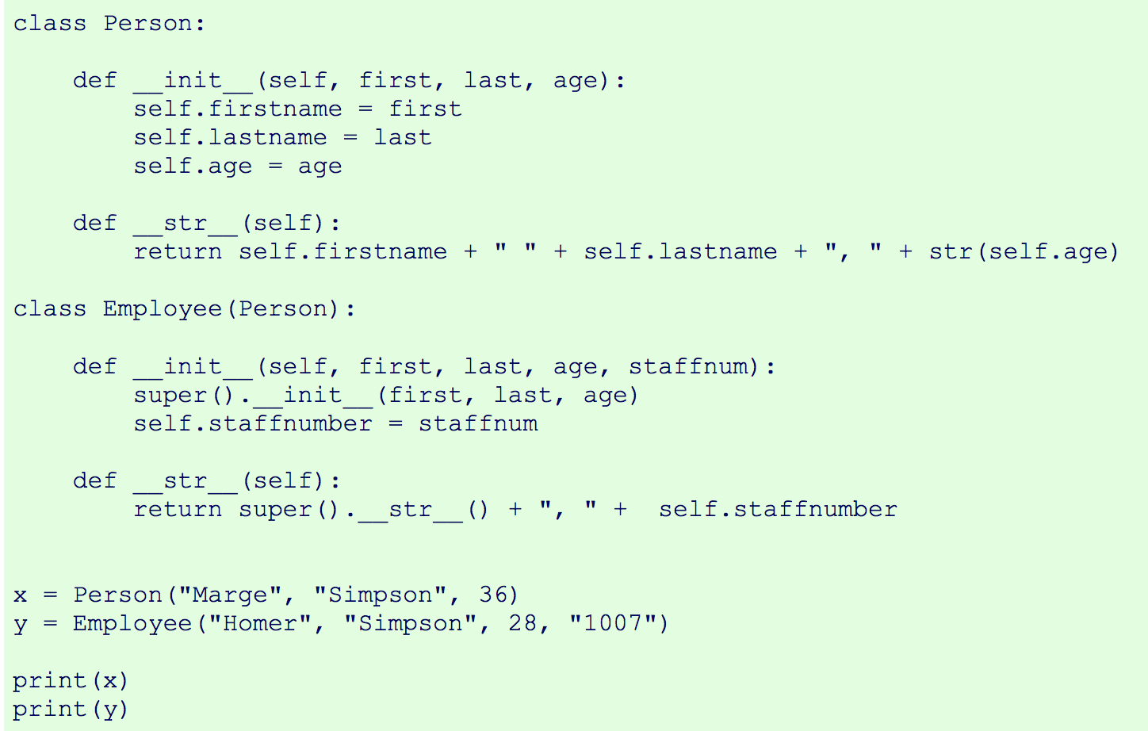
NEW and IMPROVED
overloading
super()

Slide 12
The super() function
This function is used to gain access to inherited methods from a parent or a sibling class
Called upon to refer to parent class or multiple classes without explicitly naming them.
Advantage 1: You don’t have to know the name of the parent class (or sibling) – just use super!
Advantage 2: You can add another base class and

Slide 13
Save time and $$!
OLD WAY:
class MyParentClass(object):
def __init__(self): pass
class SubClass(MyParentClass):
def __init__(self):
MyParentClass.__init__(self)
SUPER WAY:
class MyParentClass(object):
def __init__(self): pass
class SubClass(MyParentClass):
def __init__(self):
super()

Slide 14
More Super()
http://www.pythonforbeginners.com/super/working-python-super-function
https://rhettinger.wordpress.com/2011/05/26/super-considered-super/
SUPER WAY with arguments:
class MyParentClass(object):
def __init__(self, x, y): pass
class SubClass(MyParentClass):
def __init__(self, x, y):
super().init__(x,y)

