Slide 1
Python Review Lecture
Ready to Rumble

Slide 2
Tips on Variables
1. Make the names meaningful:
Don’t overuse x, y, z
DNA = “GAATCTA”
RNA = “GAAUCUA”
counter = counter+1
GC_percentage = 32.445
2. Re-setting variables:
DNA=‘’
counter=0
GC_percentage=0.0
3. Names you CANNOT use (Python Keywords)
and
assert
break … and 25 more list on page 14 of text

Slide 3
String Types
>>> my_name = ‘Scott’
You can think of a string as a series of letters: ‘S—c—o—t—t’
>>> Protein_sequence = ‘HELPME’
Index of the string:
+---+---+---+---+---+---+
| H | E | L | P | M | E |
+---+---+---+---+---+---+
0 1 2 3 4 5 6

Slide 4
Cool Python Trick: Slicing
>>> Protein_sequence = ‘HELPME’
Index positions of the string:
+---+---+---+---+---+---+
| H | E | L | P | M | E |
+---+---+---+---+---+---+
0 1 2 3 4 5 6
-6 -5 -4 -3 -2 -1
>>> aa3 = Protein_sequence[3] # x = ‘P’
>>> peptide = Protein_sequence[0:2] # x = ‘HE’
Read the colon as “up to”.
peptide = Protein_sequence[0:2] -> In english this says, “peptide is assigned the slice of the string Protein_sequence from index position 0 up to index position 2.”

Slide 5
Simple Functions
Examples of function with two parameters (arguments):
To avoid confusion, put an “f” in front of all the variable names inside the function!
>>> def Add2Numbers(fx,fy):
fresult=fx+fy
return fresult
>>> output=Add2Numbers(3,4)
# to call a function, just use the name and the ()
The return command returns data from the function allowing you to assign it to a new variable.

Slide 6
Simple Functions
HOW FUNCTIONS WORK
>>> def Add2Numbers(fx,fy):
fresult=fx+fy
return fresult
One you create the function you can call it over and over again.
>>> output=Add2Numbers(3,4)
>>> output2=Add2Numbers(50,600)
>>> x=9
>>> output3=Add2Numbers(x,1000)

Slide 7
Importing Functions
Some built-in functions not automatically loaded. Lots of so-called “modules” that have useful functions. Example: math module
import math #PUT AT TOP OF FILE
mydata=100
mydatalog=math.log(mydata)
def BaseInfo(fx):
finfo=math.log(fx)
print finfo
Notice the “.” symbol

Slide 8
Boolean expressions
TRUE or FALSE
1 or 0
Comparison operator: the double equals sign ==
(Don’t confuse with the single equals sign for assignments.)
>>> 5==5 #Does 5 equal 5? Yes! True!
1
>>> 5==6 #Does 5 equal 6? No! False!
0

Slide 9
Double equals vs. Single equals
A VERY COMMON MISTAKE
Two equals signs “==“ check to see if values match.
A single “=“ is used to assign values to variables.
Assigning variables:
x=9 # Correct
x==9 # Incorrect
Conditionals:
if x==9: # Correct
if x=9: # Incorrect

Slide 10
More comparison operators
x != y # x is not equal to y
x > y # x is greater than y
x < y # x is less than y
x >= y # x is greater than or equal to y
x <= y # x is less than or equal to y
Logical operators
x > 10 and x < 100
y < 10 or y > 100
DNA_str==“GAAC” or DNA_str==“CTTG”

Slide 11
Conditional Execution
x = 10
if x >= 0: #boolean expression
print "x is positive"
x is positive
What would happen if x was –10?
HEADER:
FIRST STATEMENT
…
LAST STATEMENT

Slide 12
Alternative execution
if x>=0: #double equals
print x, "is positive"
else:
print x, "is negative"
10 is positive
Chained conditionals
y=20
if x < y:
print x, "is less than", y
elif x > y: #You can use as many as you want!!
print x, "is greater than", y
else:
print x, "and", y, "are even"
10 is less than 20
HOW WOULD WE MAKE THIS A FUNCTION?

Slide 13
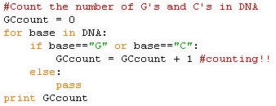
For Loop & Counting
Output:
How can we make this a function that returns GC count?

Slide 14


Strings are immutable
However, you can do something like this:
Output:
How could we loop through and change every “T” to “U”?

Slide 15
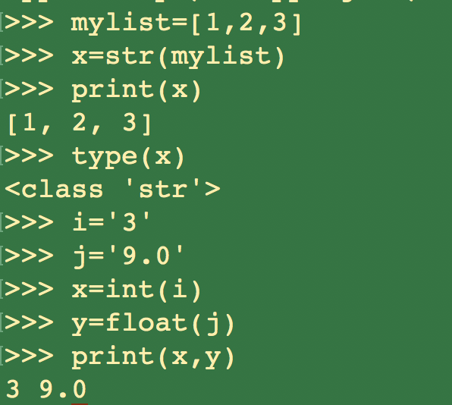

Slide 16
File Opening/Closing
Universal File reading:
fin=open(“tmp.txt”,”U”)
Writing to file:
output=“Don’t be silly\n”
fout=open(“outfile.txt”,”w”)
fout.write(output)
fout.close()

Slide 17
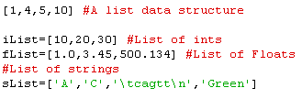
List Data Structure
The Python equivalent of an array but VERY flexible.

Slide 18
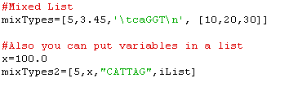
Lists can hold ANYTHING!
List within a list.
How might you make a 2 dimensional matrix with lists?
(Lists, within a list).
Let’s try 3 rows & 3 columns of 0’s.

Slide 19


Indexing and Slicing
What will this output be?
Output? ____
Output? ____
Output? ____

Slide 20


Lists are mutable

Slide 21
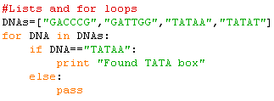
Iterate through lists
Output? ___
How could we use GetGC to calculate and print GC content of each DNA?

Slide 22

Appending to Lists

Slide 23


The range function
Output:

Slide 24


Dictionary Data Type
Organizes data by a string “key” rather than an integer element.
Brackets denote dictionary
Output:
Assign variable amino_acid
To be amino acid for “TTT”
Key Value

Slide 25


Weird Behavior?
Output:

Slide 26
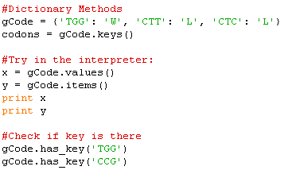
Dictionary Methods
#What does this return?
Write the following loop:
For every codon in gCode, print the amino acid.

