Slide 1
Python Library
A valuable source of functions
Python3 Library: https://docs.python.org/3/library/index.html
Re module:
https://docs.python.org/3/library/re.html
How to write a regular expression
How search, match, findall

Slide 2
Python Library
The random module: https://docs.python.org/3/library/random.html
Random module:
random.randrange(start, stop[, step])
random.randint(a, b)
random.choice(seq)
random.shuffle(x[, random])

Slide 3
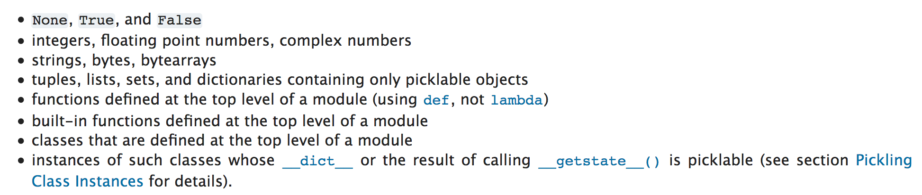
Python Library
Pickle: https://docs.python.org/3/library/pickle.html
What does pickle do?
Pickle methods
pickle.dump(obj, file, protocol=None, *, fix_imports=True)
pickle.load(file, *, fix_imports=True, encoding="ASCII", errors="strict")
Also ”dumps” and “loads”

Slide 4
Python Library
Urllib: https://docs.python.org/3/library/urllib.request.html#module-urllib.request
urllib.request.urlopen(url, data=None, [timeout, ]*, cafile=None, capath=None, cadefault=False, context=None) urllib.request.urlopen(url, data=None, [timeout, ]*, cafile=None, capath=None, cadefault=False, context=None)

Slide 5
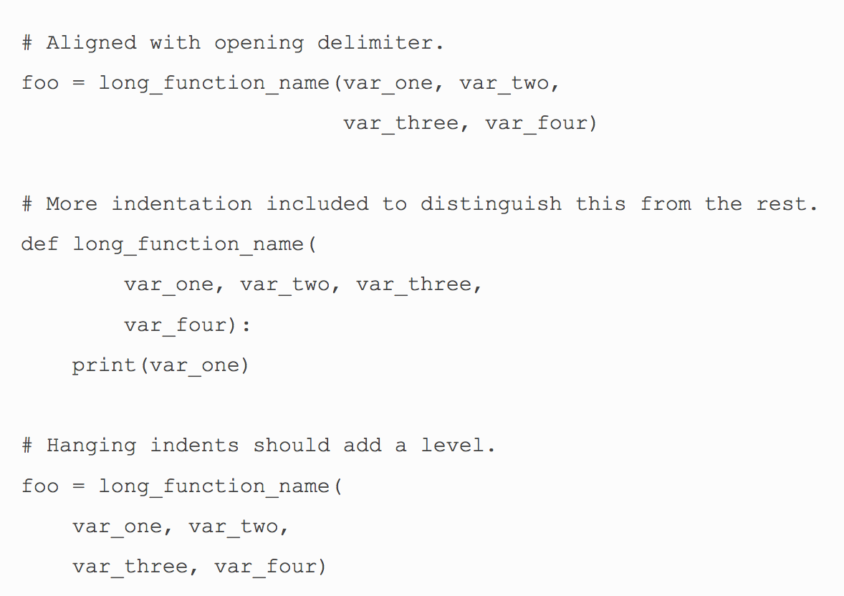
PEP8 Python coding standards
https://www.python.org/dev/peps/pep-0008/#a-foolish-consistency-is-the-hobgoblin-of-little-minds

Slide 6
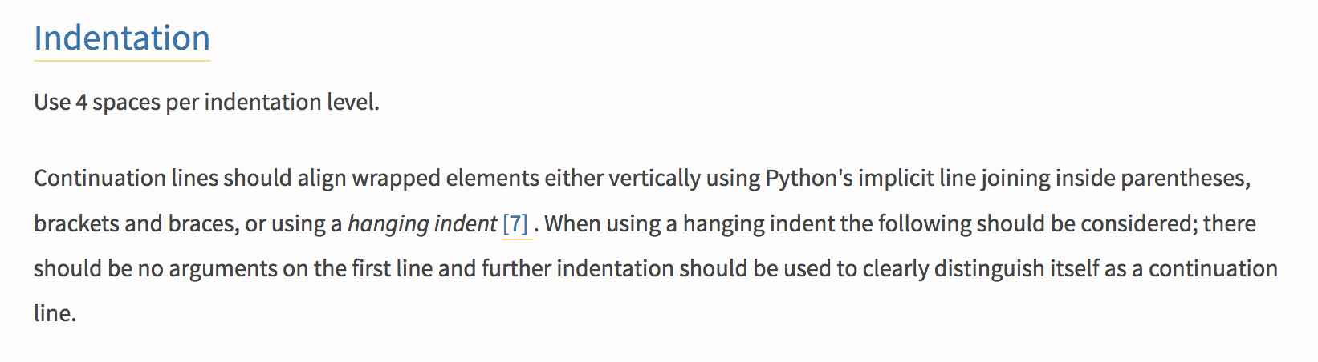
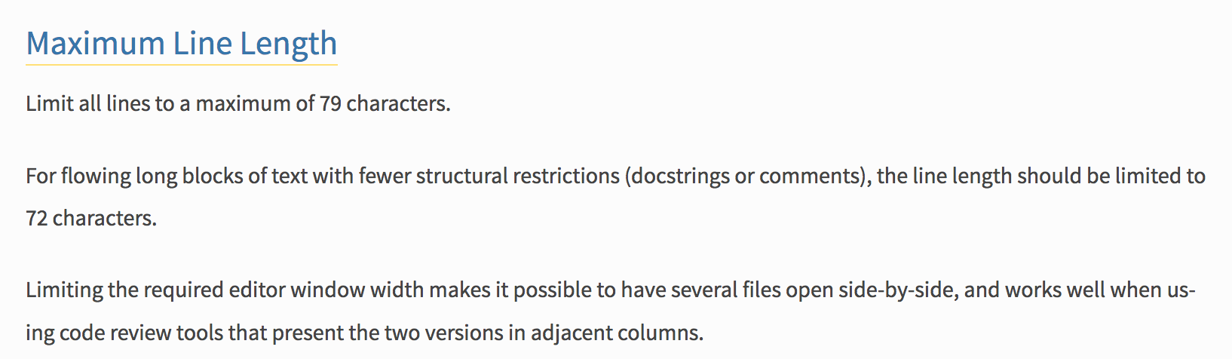
PEP8 continued

Slide 7
