Slide 1
For Loops
Computers: Never get bored
Do the same thing over and over and ….
For loops: Means of iteration
Simple, Stupid, Safe
For loops: (1) Start at the beginning; (2) Go one at a time; (3) Until the end.
Examples: Make & call random phone numbers; Search every 10 bases with a weight matrix.

Slide 2
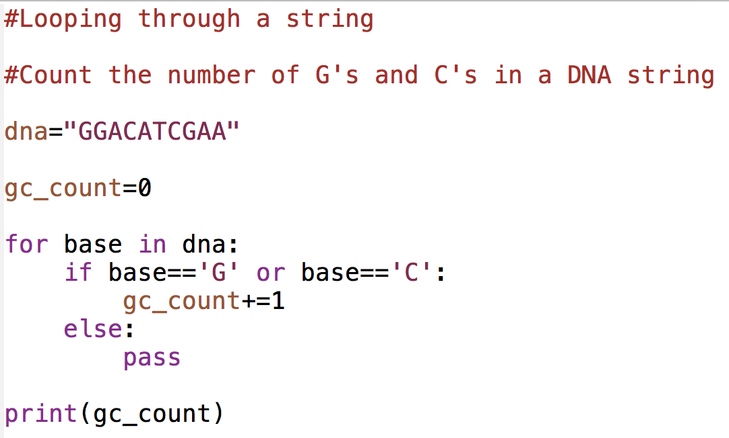
For Loop & Counting

Slide 3
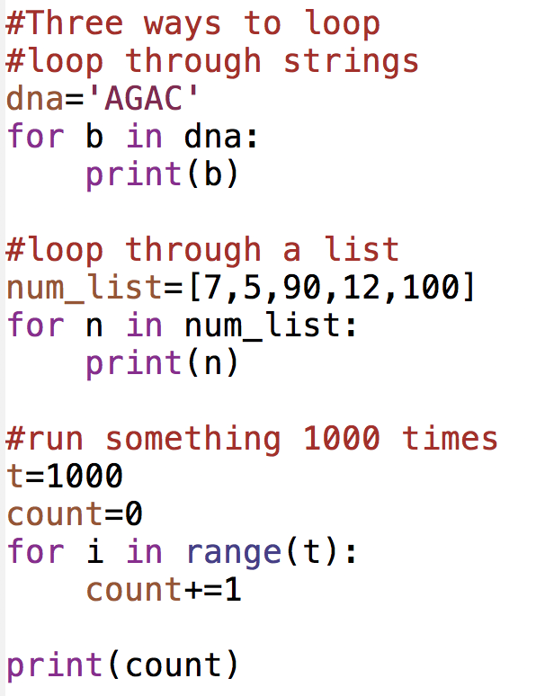
How do for loops work?
(1) Start at the beginning; (2) Go one at a time; (3) Until the end.

Slide 4
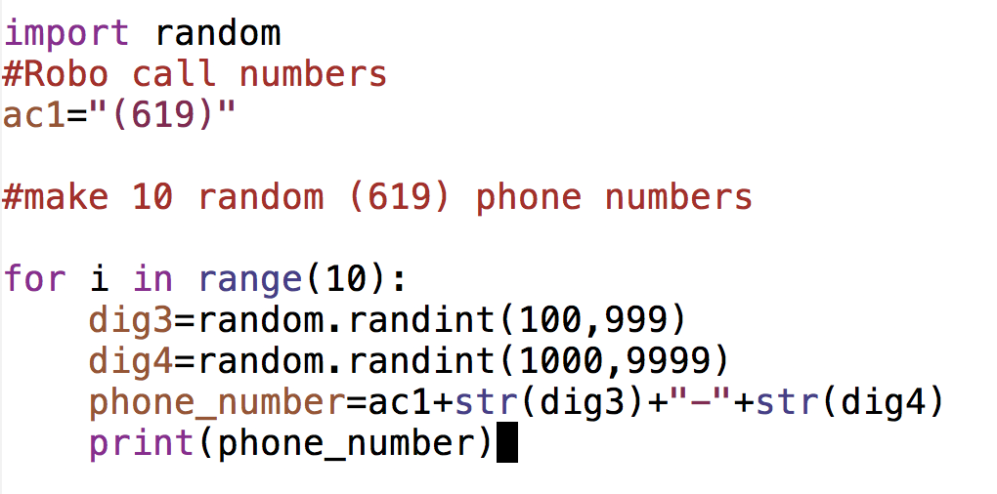
Robocall For loop

Slide 5
Working with strings
String in Python are objects
Objects are abstract programming concepts that combine data and methods (function).
Example:
pet=‘rover’ #pet is an object. The data is ‘rover’
pet=pet.upper() # this is a method working on the data
print(pet)

Slide 6
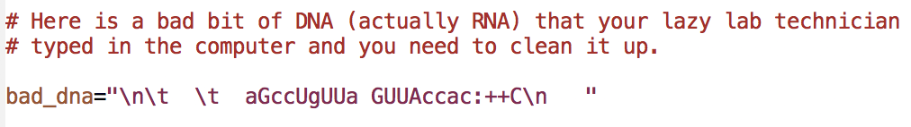
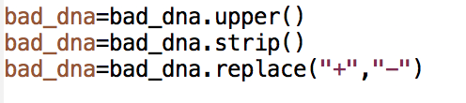
Cleaning up strings

Slide 7
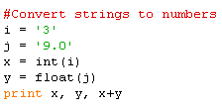
Convert from strings
#Convert anything to a string:
mylist=[5,6,7,8]
output=str(mylist)
x=9
output=str(x)

