Slide 1
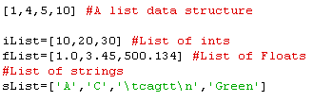
List Data Structure
The Python equivalent of an array but VERY flexible.

Slide 2
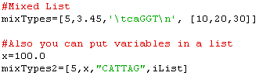
Lists can hold ANYTHING!
List within a list.
How might you make a 2 dimensional matrix with lists?
(Lists, within a list).
Let’s try 3 rows & 3 columns of 0’s.

Slide 3


Indexing and Slicing
What will this output be?
(
)
Output? ____
(
)
Output? ____
(
)
(
)
Output? ____

Slide 4


Lists are mutable
(
)

Slide 5
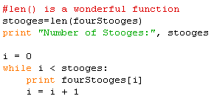
List Length
(
)
Write a while loop to iterate through the fourStooges list and print out the name of each stooge.

Slide 6

List Length
What do you think x is after these two statements?
How would you access the second element within the third element of mixTypes?

Slide 7
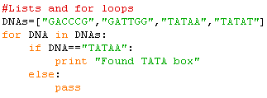
Iterate through lists
(
)
Output? ___
How could we use GetGC to calculate and print GC content of each DNA?

Slide 8

Appending to Lists
(
)

Slide 9


The range function
(
)
Output:
range(1,5) which is actually

Slide 10


List Deletion/Addition

Slide 11

if x not in list…
This is one sweet bit of useful code:
Asking if something is not in a list is very useful.

