Slide 1


Dictionary Data Type
Organizes data by a string “key” rather than an integer element.
Brackets denote dictionary
Output:
Assign variable amino_acid
To be amino acid for “TTT”
Key Value

Slide 2


Weird Behavior?
Output:

Slide 3
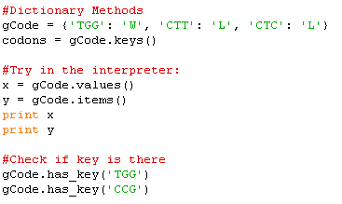
Dictionary Methods
#What does this return?
Write the following loop:
For every codon in gCode, print the amino acid.

