Slide 1
UNIX Tools Lecture 1
Dr. Scott Kelley

Slide 2
What will we cover?
UNIX history
Open source operating system
Advantages of UNIX
Operating system overview
UNIX utilities

Slide 3


Our Heroes
Ken Thompson
Wrote first Unix Assembly language on PDP-7
Dennis Ritchie
Created C programming lang and worked on Unix

Slide 4
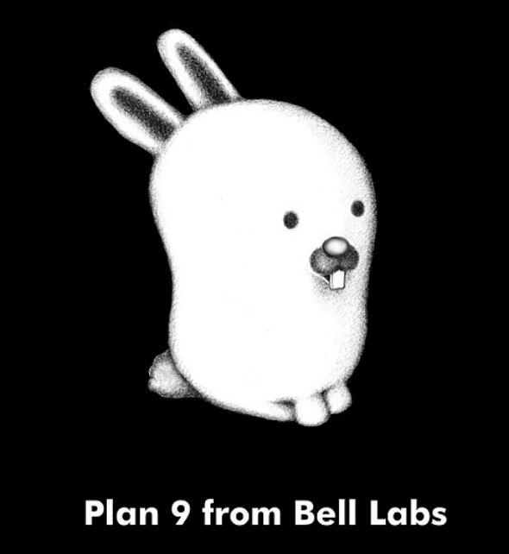


Slide 5
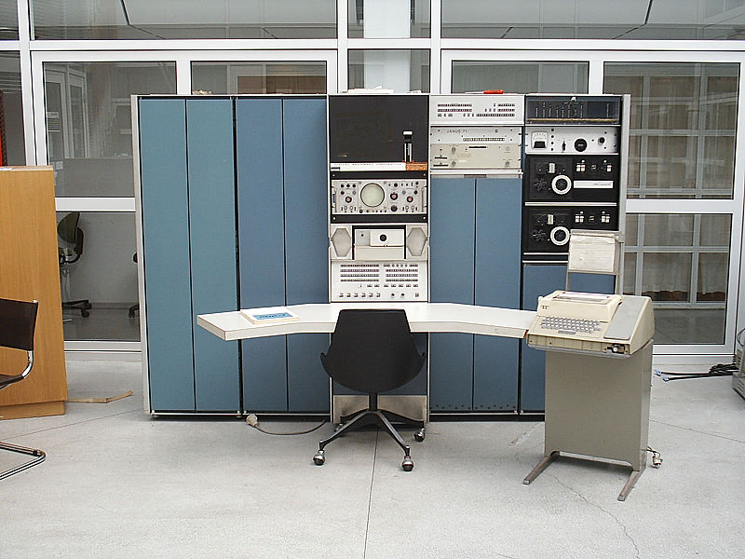
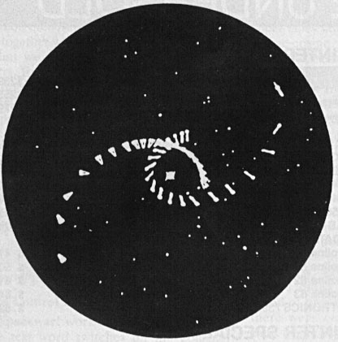
Video Games Spark Innovation
PDP-7 “Mini-computer”: The ORIGINAL Personal computer 1965
Space Travel: Ken Thompson (Bell Labs)
Notes:
Operating systems needed because without them there is inefficient use of resources.
CTSS (compatible time sharing system) was one of the first OSes, and MULTICs was to be a second generation OS.
MULTICS: Multi User file system from MIT/GE/Bell Labs, on expensive GE-645.
Introduced hierarchical file system
MULTICS died, but Thompson/Ritchie still wanted to play Space Pilot.
In order to do so, they decided to create a simplified version that would work on a PDP-7 that was laying around.
This led to a stripped down version of MULTICS called UNICS.

Slide 6
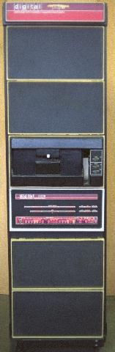
In the Beginning
UNICS: 1969 – PDP-7 minicomputer
PDP-7 goes away, rewritten on PDP-11 to “help patent lawyers”
V1: 1971
V3: 1973 (pipes, C language)
V6: 1976 (rewritten in C, base for BSD)
V7: 1979 (Licensed, portable)
PDP-11
Notes:
PDP7: 72K, 18 Bit, 120 made. The OS that came with it was terrible.
PDP11: 1970, $10K, 16 bit, 600K+ made
C: Also a 3rd generation system: BCPL (Basic Combined Programming Language) (similar to fortran) -> B (simplified) -> C (cleaned up, more powerful)
Up until V7 (not including), classroom use was allowed.

Slide 7
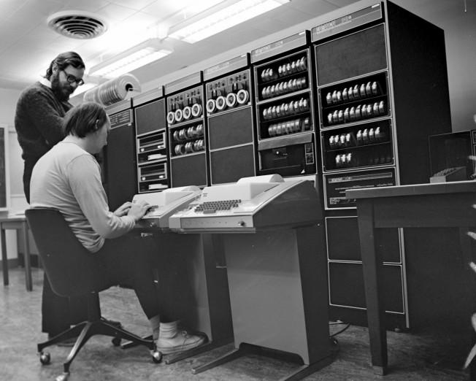

Slide 8





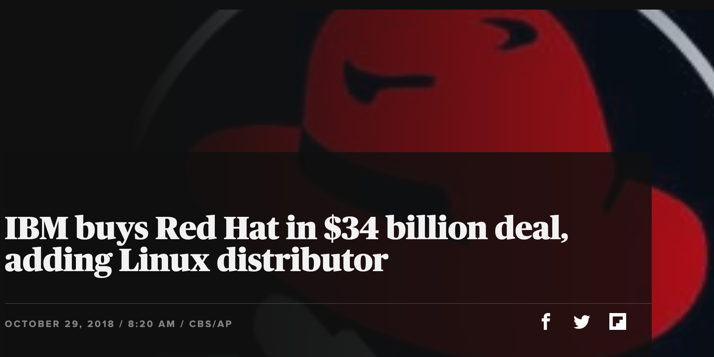
Commercial Success
AIX
SunOS, Solaris
Ultrix, Digital Unix
HP-UX
Irix
UnixWare -> Novell -> SCO -> Caldera ->SCO
Xenix: -> SCO
Red Hat -> IBM
Notes:
Early eighties: lots of commercial spinoffs.
XENIX: Port for microcomputers by microsoft, but inadequate. Sold to SCO after switch to QDOS (quick and dirty)
SUN: Bill Joy’s startup launched in 1982
SCO: One of the first (1978)
UnixWare: AT&T’s.

Slide 9

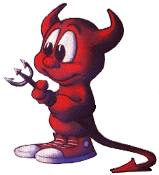
Send in the Clones
Linux
  Written in 1991 by Linus Torvalds
  Most popular UNIX variant
  Free with GNU license
BSD Lite
  FreeBSD (1993, focus on PCs)
  NetBSD (1993, focus on portability)
  OpenBSD (1996, focus on security)
  Free with BSD license
  Development less centralized
Notes:
GNU and BSD licenses have major differences.

Slide 10
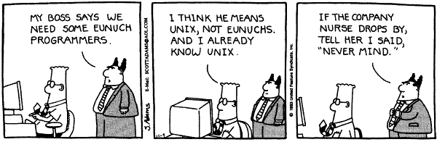
Popular Success!
Notes:
Cartoon from 1993

Slide 11

Darwin
Apple abandoned old Mac OS for UNIX
  Purchased NeXT in December 1996
  Unveiled in 2000
  Based on 4.4BSD-Lite
  Aqua UI written over Darwin
  Open Source

Slide 12
Why did UNIX succeed?
Technical strengths!
Research, not commercial
PDP-11 was popular with an unusable OS
AT&T’s legal concerns
  Not allowed to enter computer business but needed to write software to help with switches
  Licensed cheaply or free
Notes:
Breakup: 1983

Slide 13

The Open Source Movement
Has fueled much growth in UNIX
  Keeps up with pace of change
  More users, developers
    More platforms, better
    performance, better code
Many vendors switching to Linux

Slide 14
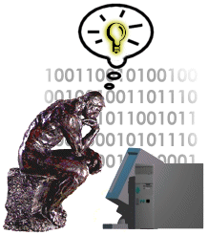
The UNIX Philosophy
Small is beautiful
  Easy to understand
  Easy to maintain
  More efficient
  Better for reuse
Make each program do one thing well
  More complex functionality by combining programs
  Make every program independent
Notes:
Core Idea: #1
#2 is an example of #1

Slide 15
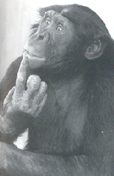
The UNIX Philosophy
..continued
Portability over efficiency
  Most efficient implementation is rarely portable
  Portability better for rapidly changing hardware
Use flat ASCII files
  Common, simple file format
  Example of portability over efficiency
Reusable code
  Good programmers write good code;
  great programmers borrow good code
Notes:
Example: Failure of ATARI 2600 move to ATARI 800 (hard (8K) so highly non portable)

Slide 16
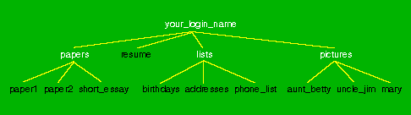
The UNIX Philosophy
..continued
Avoid captive interfaces
  The user of a program isn’t always human
  Look nice, but code is big and ugly
  Problems with scale
Silence is golden
  Only report if something is wrong
Think hierarchically

Slide 17
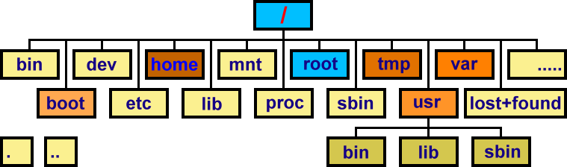
Typical Unix/Linux Structure
https://www.codepuppet.com/2012/06/08/directory-structure-in-linux/

Slide 18
The Operating System
The government of your computer
Kernel: Performs critical system functions and interacts with the hardware
Systems utilities: Programs and libraries that provide various functions through systems calls to the kernel

Slide 19
Kernel Basics
The kernel is …
  a program loaded into memory during the boot process, and always stays in physical memory.
  responsible for managing CPU and memory for processes, managing file systems, and interacting with devices.

Slide 20
UNIX Structural Layout
shell scripts
User Space
utilities
C programs
system calls
compilers
signal handler
Kernel
scheduler
device drivers
swapper
terminal
Devices
printer
disk
RAM

Slide 21
Kernel Subsystems
Process management
  Schedule processes to run on CPU
  Inter-process communication (IPC)
Memory management
  Virtual memory
  Paging and swapping
I/O system
  File system
  Device drivers
  Buffer cache

