Slide 1
BASH Scripting 101
Based on Ryan’s Tutorial at
https://ryanstutorials.net/bash-scripting-tutorial/

Slide 2
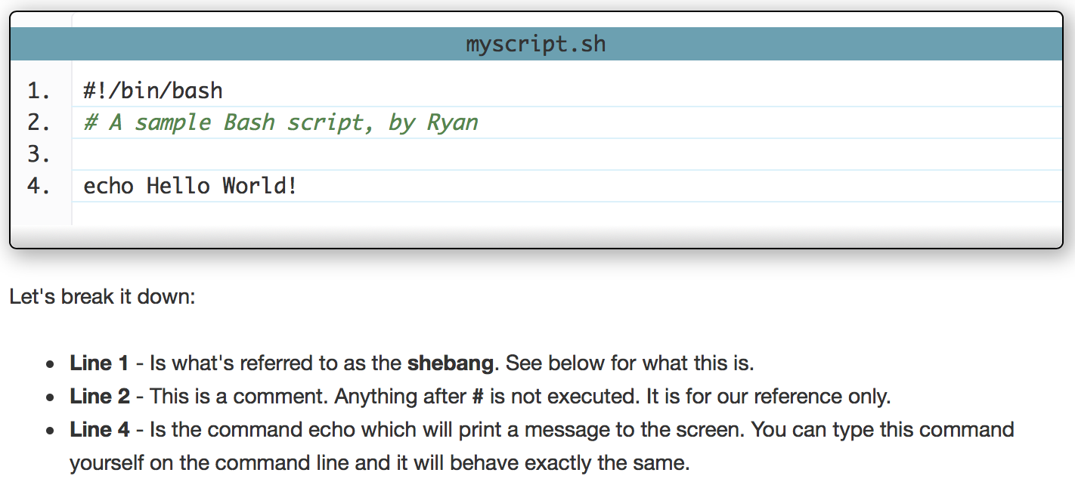
A simple bash script

Slide 3
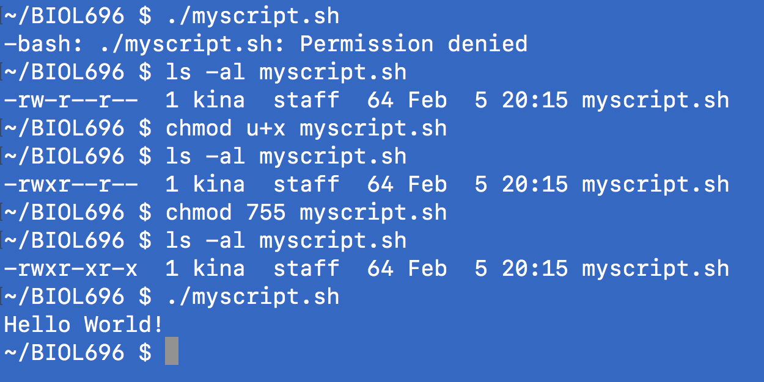
How to run a bash script

Slide 4
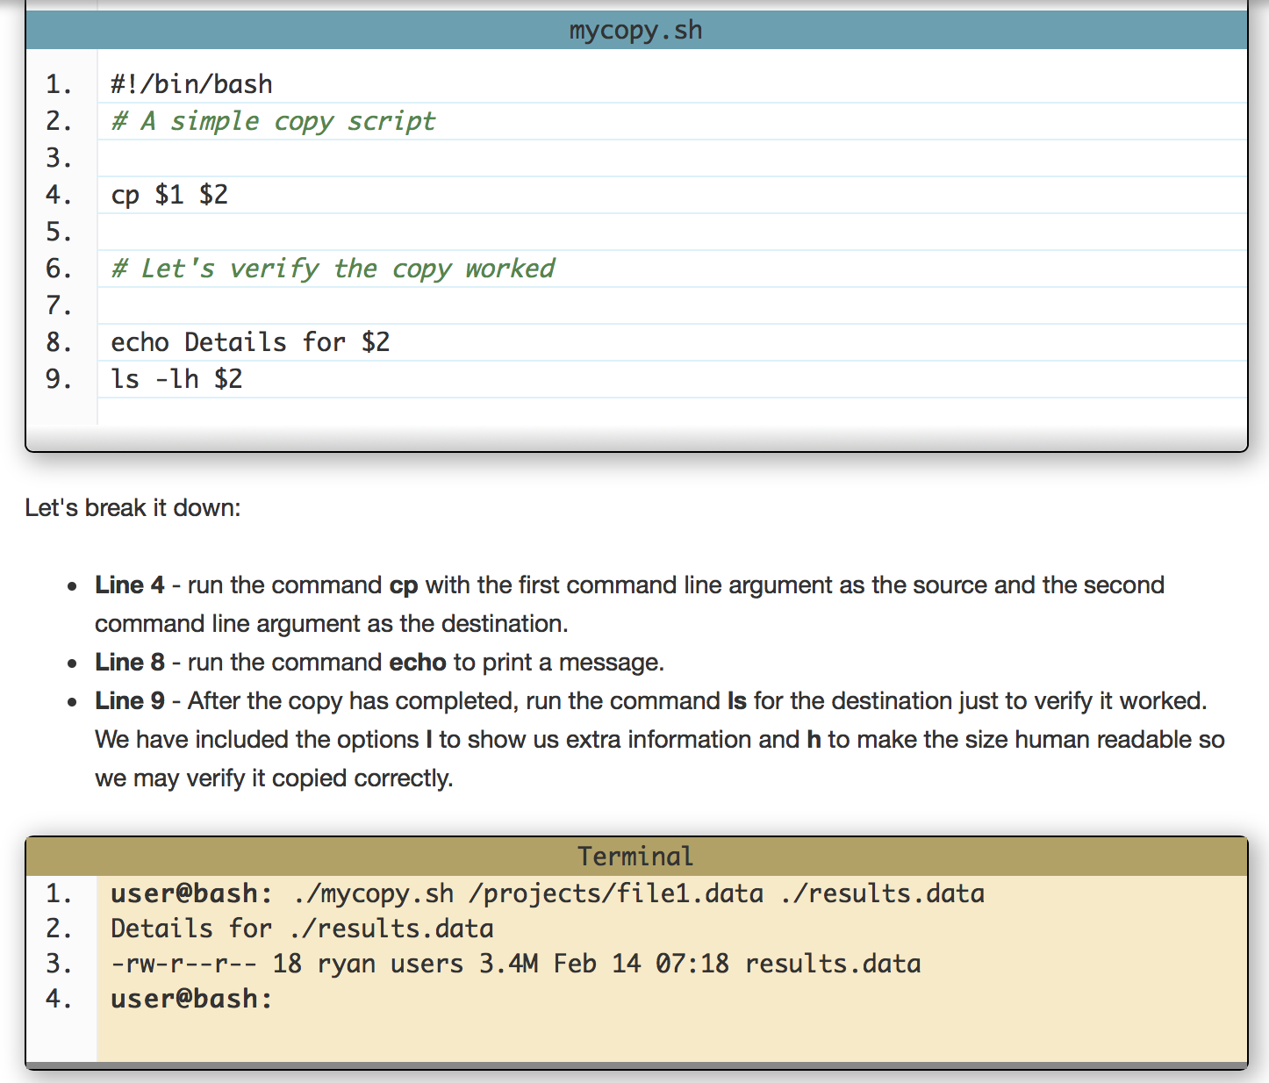

Slide 5
Other special variables
$0 - The name of the Bash script.
$1 - $9 - The first 9 arguments to the Bash script. (As mentioned above.)
$# - How many arguments were passed to the Bash script.
$@ - All the arguments supplied to the Bash script.
$? - The exit status of the most recently run process.
$$ - The process ID of the current script.
$USER - The username of the user running the script.
$HOSTNAME - The hostname of the machine the script is running on.
$SECONDS - The number of seconds since the script was started.
$RANDOM - Returns a different random number each time is it referred to.
$LINENO - Returns the current line number in the Bash script.

Slide 6
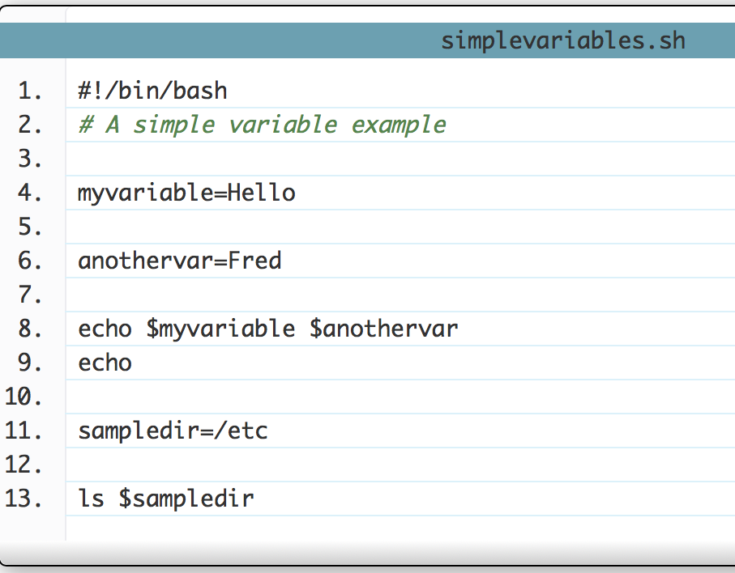
Setting our own variables
Setting the value of a variable. (When the variable is just one string quotes not needed.)
Checking the value of the variable (need $)

Slide 7
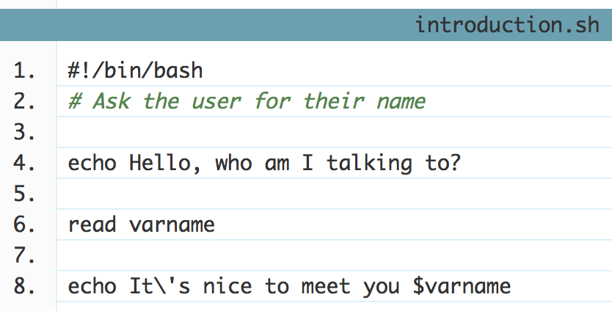
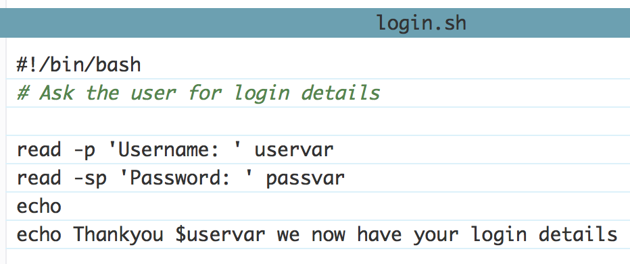
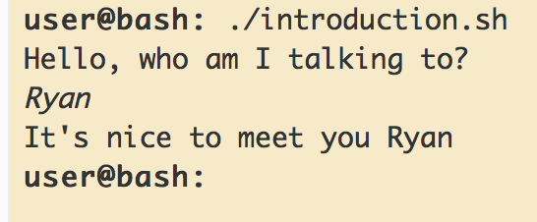
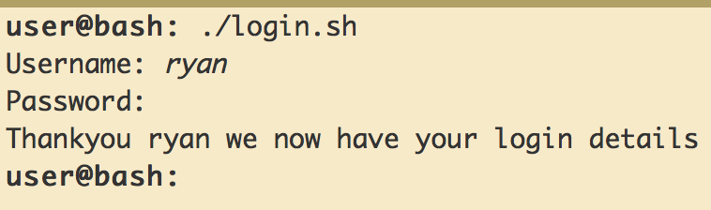
Ask user for input
When asking the user for input, we use a command called read

Slide 8
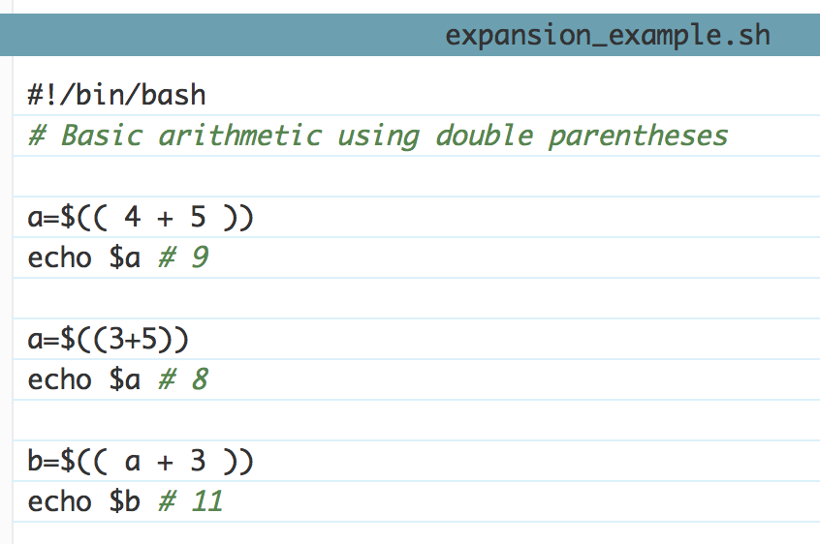
Arithmetic with double parentheses

Slide 9
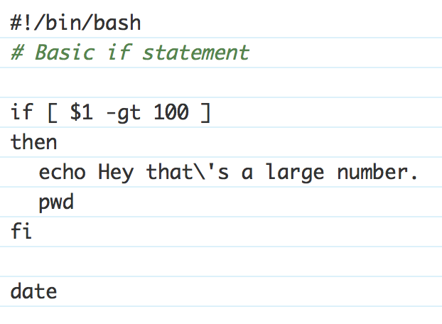
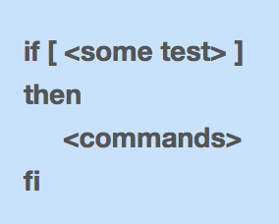
Basic if statements
Line 4 - Let's see if the first command line argument is greater than 100
Line 6 and 7 - Will only get run if the test on line 4 returns true.
Line 6 - The backslash ( \ ) in front of the single quote ( ' ) is needed as the single quote has a special meaning for bash and we don't want that special meaning.
Line 8 - fi signals the end of the if statement. All commands after this will be run as normal.
Line 10 - Because this command is outside the if statement it will be run regardless of the outcome of the if statement.

Slide 10
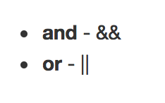
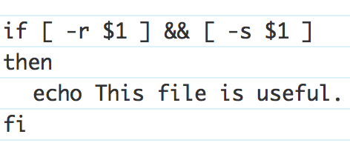
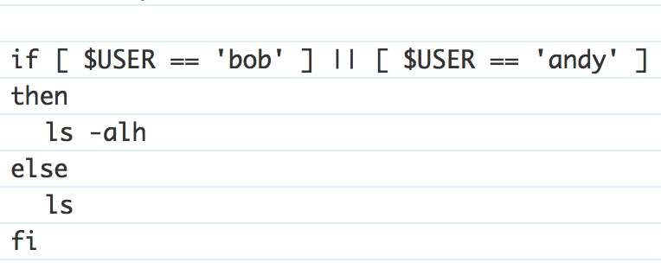
Bash Operators
Operator | Description
! EXPRESSION | The EXPRESSION is false.
-n STRING | The length of STRING is greater than zero.
-z STRING | The lengh of STRING is zero (ie it is empty).
STRING1 = STRING2 | STRING1 is equal to STRING2
STRING1 != STRING2 | STRING1 is not equal to STRING2
INTEGER1 -eq INTEGER2 | INTEGER1 is numerically equal to INTEGER2
INTEGER1 -gt INTEGER2 | INTEGER1 is numerically greater than INTEGER2
INTEGER1 -lt INTEGER2 | INTEGER1 is numerically less than INTEGER2
-d FILE | FILE exists and is a directory.
-e FILE | FILE exists.
-r FILE | FILE exists and the read permission is granted.
-s FILE | FILE exists and it's size is greater than zero (ie. it is not empty).
-w FILE | FILE exists and the write permission is granted.
-x FILE | FILE exists and the execute permission is granted.
Using && (and)
Using || (or)

Slide 11
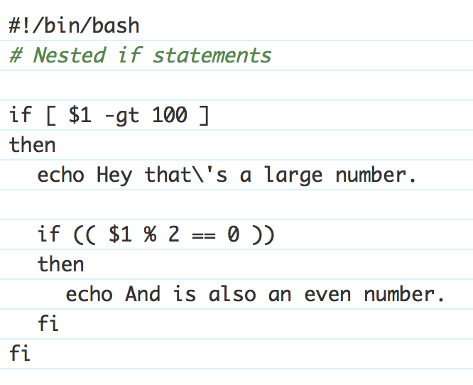
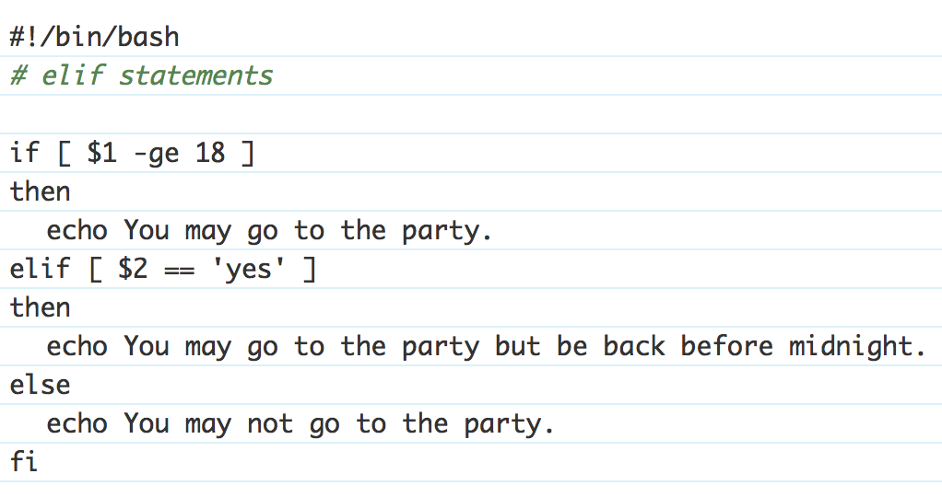
Nested if & if/elif statements

Slide 12
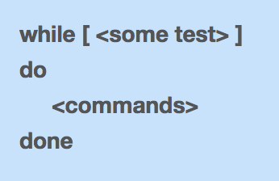
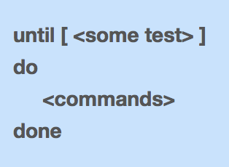
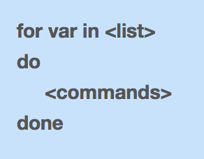
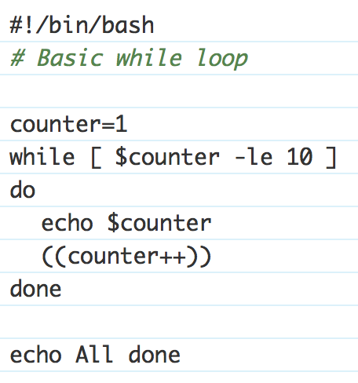
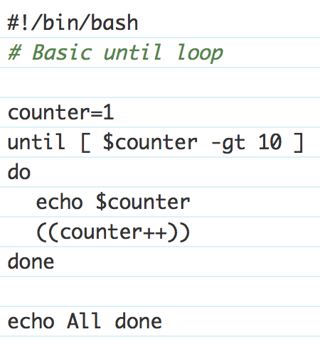
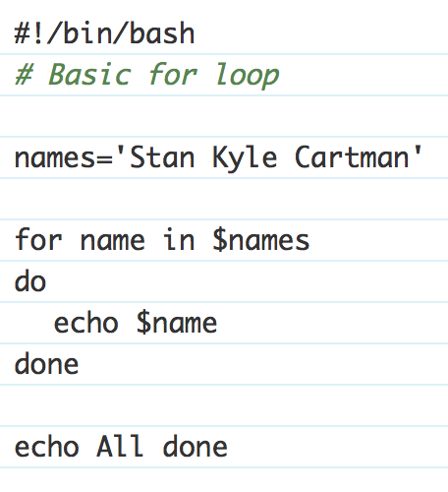
Loops: while, until and for

Slide 13
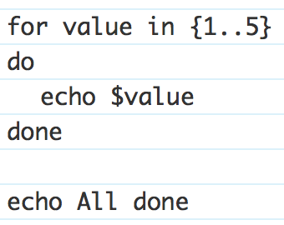
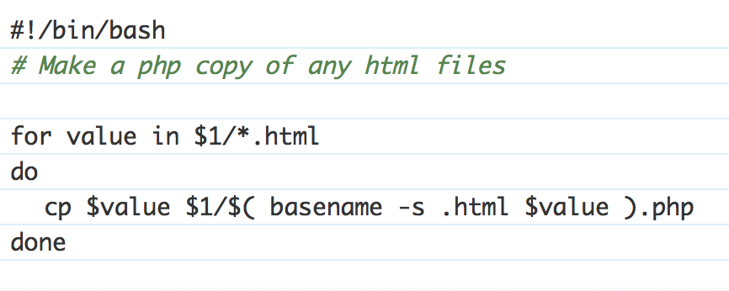
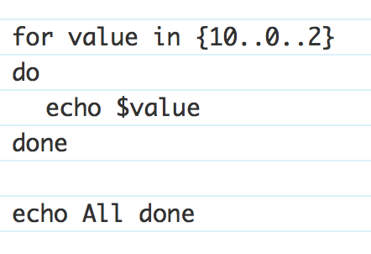
More with for
RANGE OF NUMBERS:
COOL WAY TO GO THROUGH FILES:
STEPS:

Slide 14
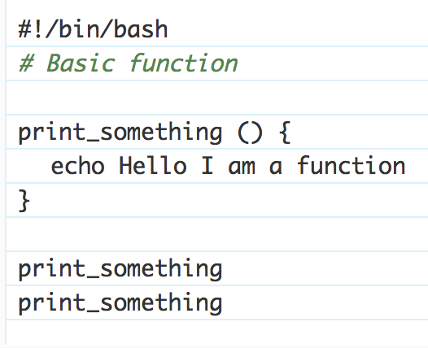
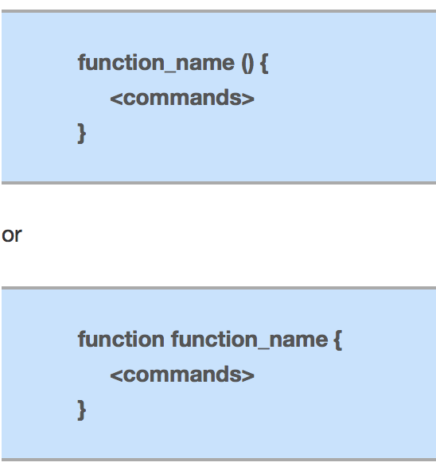
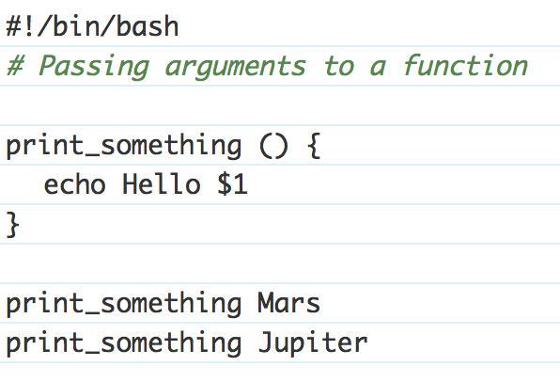
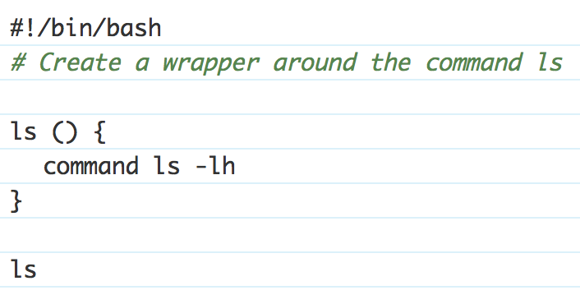
Functions
Overriding commands:

