Slide 1
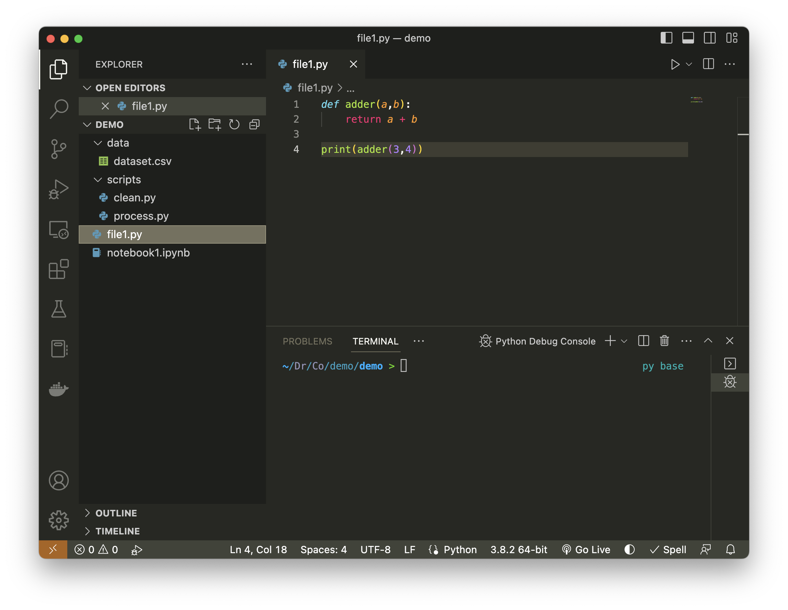
Activity Bar
Side Bar
Editor
Terminal
Status Bar

Slide 2
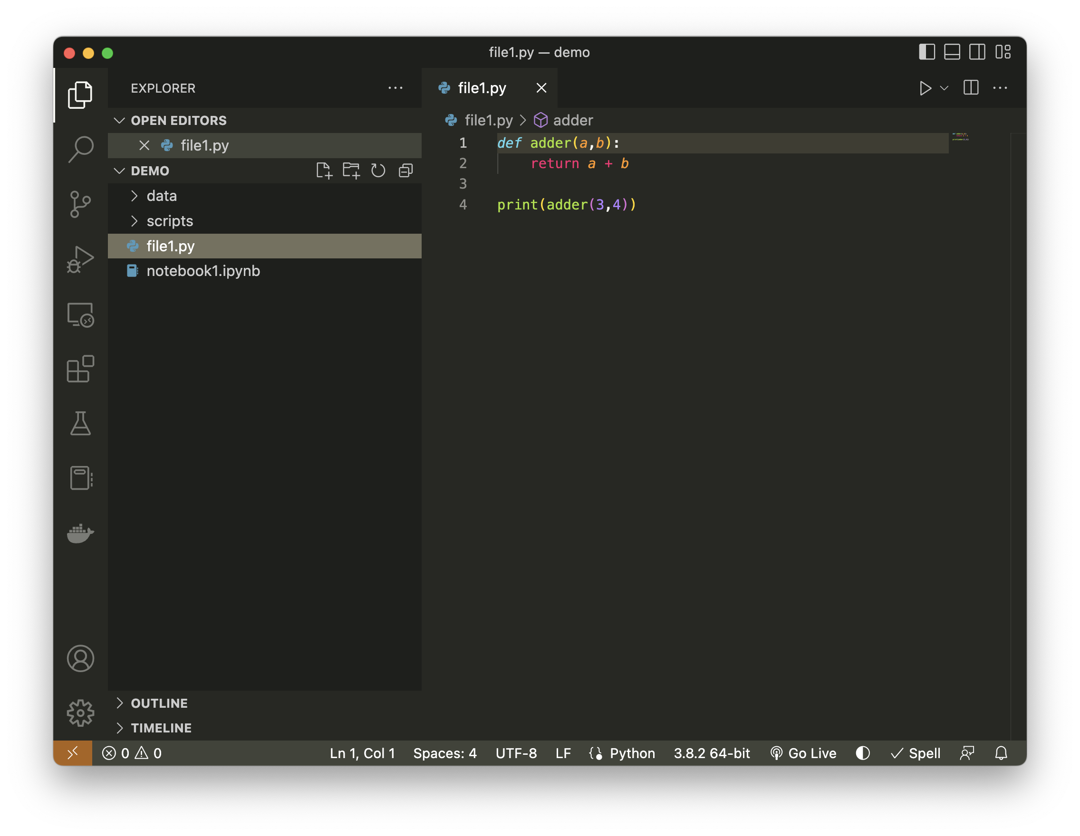
Run current file
Layout controls
File explorer
Split editor pane
Search
Git version control
Debugging tools
User accounts
Manage settings
Python environment

Slide 3
Run current file
Layout controls
File explorer
Split editor pane
Search
Git version control
Debugging tools
Open new
terminal
Terminal
User accounts
Manage settings
Python environment selector

