Slide 1
LEAD & MEAD
LING 573 Text Summarization D2
Claude Zhang
Julia McAnallen
Genevieve Peaslee
Zoe Winkworth

Slide 2
Baseline Systems
 | Lead Sentence | MEAD System
Content Selection | First sentence of each doc | MEAD
Information Ordering | chronological | MEAD score
Content Realization | Add until next sentence exceeds 100 words | Add until next sentence exceeds 100 words

Slide 3
Lead
Content Selection
First sentence of every document
Information Ordering
Chronologically by date and article id
Content Realization
Add complete sentences only, until limit. (exclude sentences > 100)

Slide 4
MEAD
Content Selection
Centroid score
Sentence position
First sentence overlap
Redundancy penalty
Information Ordering
Ordered by MEAD score (recalculated with redundancy penalty)
Content Realization (no change)

Slide 5
MEAD Content selection
C = Centroid score - Σ_{i}C_{w,I} With threshold value applied to words in centroid
P = Position score - ((n-i+1)/n) (original equation: ((n-i+1)/n)*C_{max} )
F = First-sentence overlap - cosine similarity with first sentence
C + P + F: Above scores are summed, applying optional weights (w_{c} , w_{p} , w_{f})
R: Redundancy applied - 2 * # overlapping wds/(# wds in sentence pair)
Next step: C + P + F - R

Slide 6
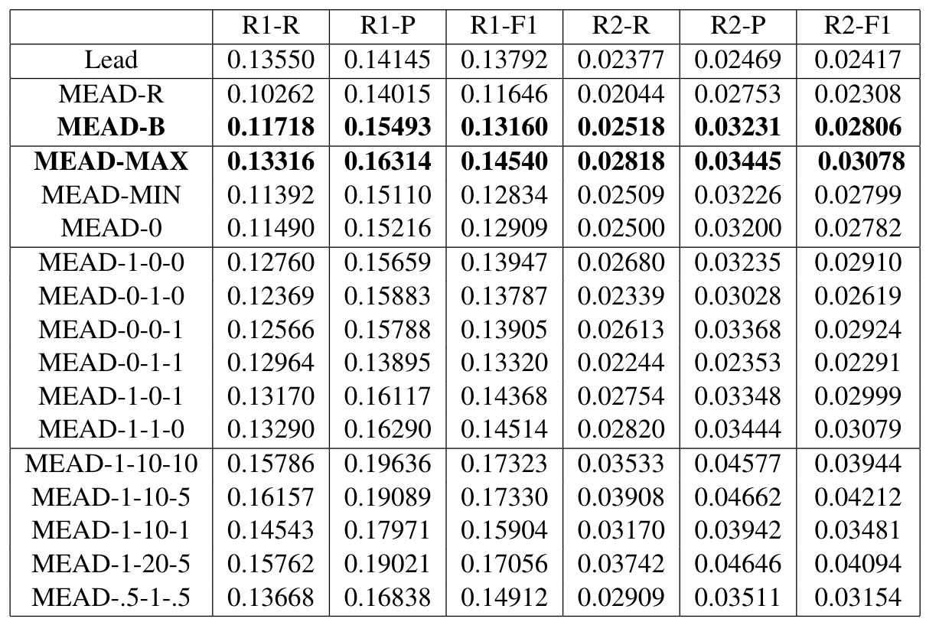
Results
Key
R - Reuters corpus
B - Brown corpus
Max/Min/0 - threshold values for words in centroid (default is Mean)
1-0-0, 0-1-0 etc. - weight values for:
w_{c} (centroid)
w_{p} (position)
w_{f} (first sentence overlap)

Slide 7
Sample Outputs
1 ROUGE-1 Eval D1046-A.M.100.H.2 R:0.15354 P:0.16250 F:0.15789
1 ROUGE-2 Eval D1046-A.M.100.H.2 R:0.00800 P:0.00847 F:0.00823
peers/devtest/D1046-A.M.100.H.1
In a report prepared for the meeting in Jakarta, the World Bank said recent economic reforms by Jakarta have "boosted Indonesia's economic resilience and positioned it better to absorb massive shocks, such as the natural disaster in Aceh and North Sumatra." Indonesia's death toll stands at almost 115,000, with thousands more still missing and hundreds of thousands left homeless after entire towns and villages were swept away or reduced to rubble by the quake and waves.
Uzbekistan on Monday sent a plane with 35 metric tons (39 short tons) of humanitarian aid to tsunami-hit Indonesia, the Foreign Ministry said.
The Ilyushin-76 cargo plane headed for Medan, the main city on Indonesia's Sumatra island, one of the areas hardest hit by the Dec. 26 tsunami, the ministry said in a statement.
A second plane with an additional 16 metric tons (18 short tons) of aid was to depart Monday evening.
The aid includes medicines, tents, food, two off-road vehicles, a motor boat, field kitchens, drinking water and helicopter parts.

Slide 8
Issues
D1016-A.M.100.C.2
HONG KONG, January 23 (Xinhua) -- Following are Hang Seng Index (key indicator of Hong Kong's blue chips), Hang Seng China Enterprises Index and the turnover on the Hong Kong Stock Exchange today (Thursday):
Index: Thursday Wednesday Change
Hang Seng Index (HSI) 13,610 13,692 -82
HSI Sectors:
Finance 14,545 14,534 +11
Turnover (Million HK Dollars):
HSI 8,285 11,158 -2,873
(Million US Dollars) 1,062 1,439 -377

Slide 9
Analysis
Average length of sentences is 20~30 words
Only 2~4 sentences in the summarization

Slide 10
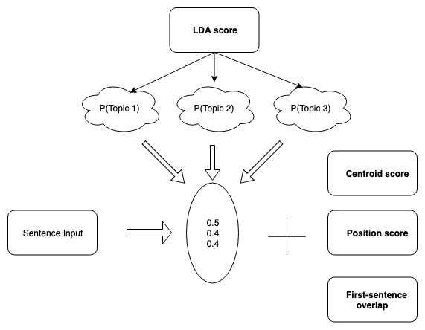
Next Steps
More Pre-processing (NER, lemmatization)
Content selection: MEALDA
Explore additional outside corpora
Improve information ordering strategy
Content realization: eliminate unwanted sentences and clauses, e.g. leading location information, multi-line lists

Slide 11
Thank you

Slide 12
Sample Outputs
1 ROUGE-1 Eval D1021-A.M.100.D.1 R:0.19492 P:0.19492 F:0.19492
1 ROUGE-2 Eval D1021-A.M.100.D.1 R:0.04310 P:0.04310 F:0.04310
peers/devtest/D1021-A.M.100.D.1
Lafave was charged in 2004 with two counts of lewd and lascivious battery and one count of lewd and lascivious exhibition after she allegedly had sex with the student in a sport utility vehicle while another teenager drove. Lafave was sentenced in Hillsborough County, where Tampa is located, to three years of house arrest and seven years probation after pleading guilty Nov. 22 to two counts of lewd and lascivious battery for having sex with the boy in a classroom and her home.
A hitch has developed in a plea deal agreed to by a former teacher who pleaded guilty to having sex with a 14-year-old student, a spokesman for the prosecutor said.
The agreement was meant to resolve charges against Debra Lafave, 25, in two counties.
But the judge in one of the counties has balked, Ric Ridgeway, a spokesman for the State Attorney's Office, said Thursday.
Lafave was sentenced to three years of house arrest and seven years probation after pleading guilty last month in Hillsborough County to two counts of lewd and lascivious battery.

Slide 13
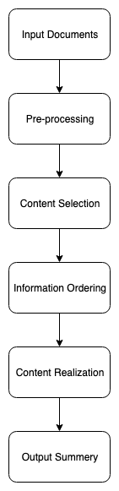
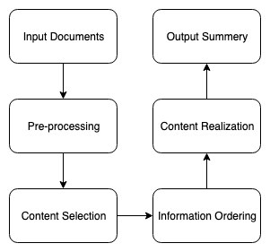
System architecture
Lead Sentence
MEAD System

Slide 14
Information Ordering

Slide 15
Content Realization

Slide 16
d2
../doc/D2_presentation.{pdf|pptx|etc}: Your presentation may be prepared in any computer-projectable format, including HTML, PDF, PPT, and Word. Your presentation should take about 10 minutes to cover your main content, including:
System architecture
Content selection
Information Ordering
Content Realization
Issues and successes
Related reading which influenced your approach
Your presentation should be deposited in your doc directory, but it is not due until the actual presentation time. You may continue working on it after the main deliverable is due.

Slide 17
Pre-processing
Tokenization
Remove stop words, punctuations
WordMap

