Slide 1
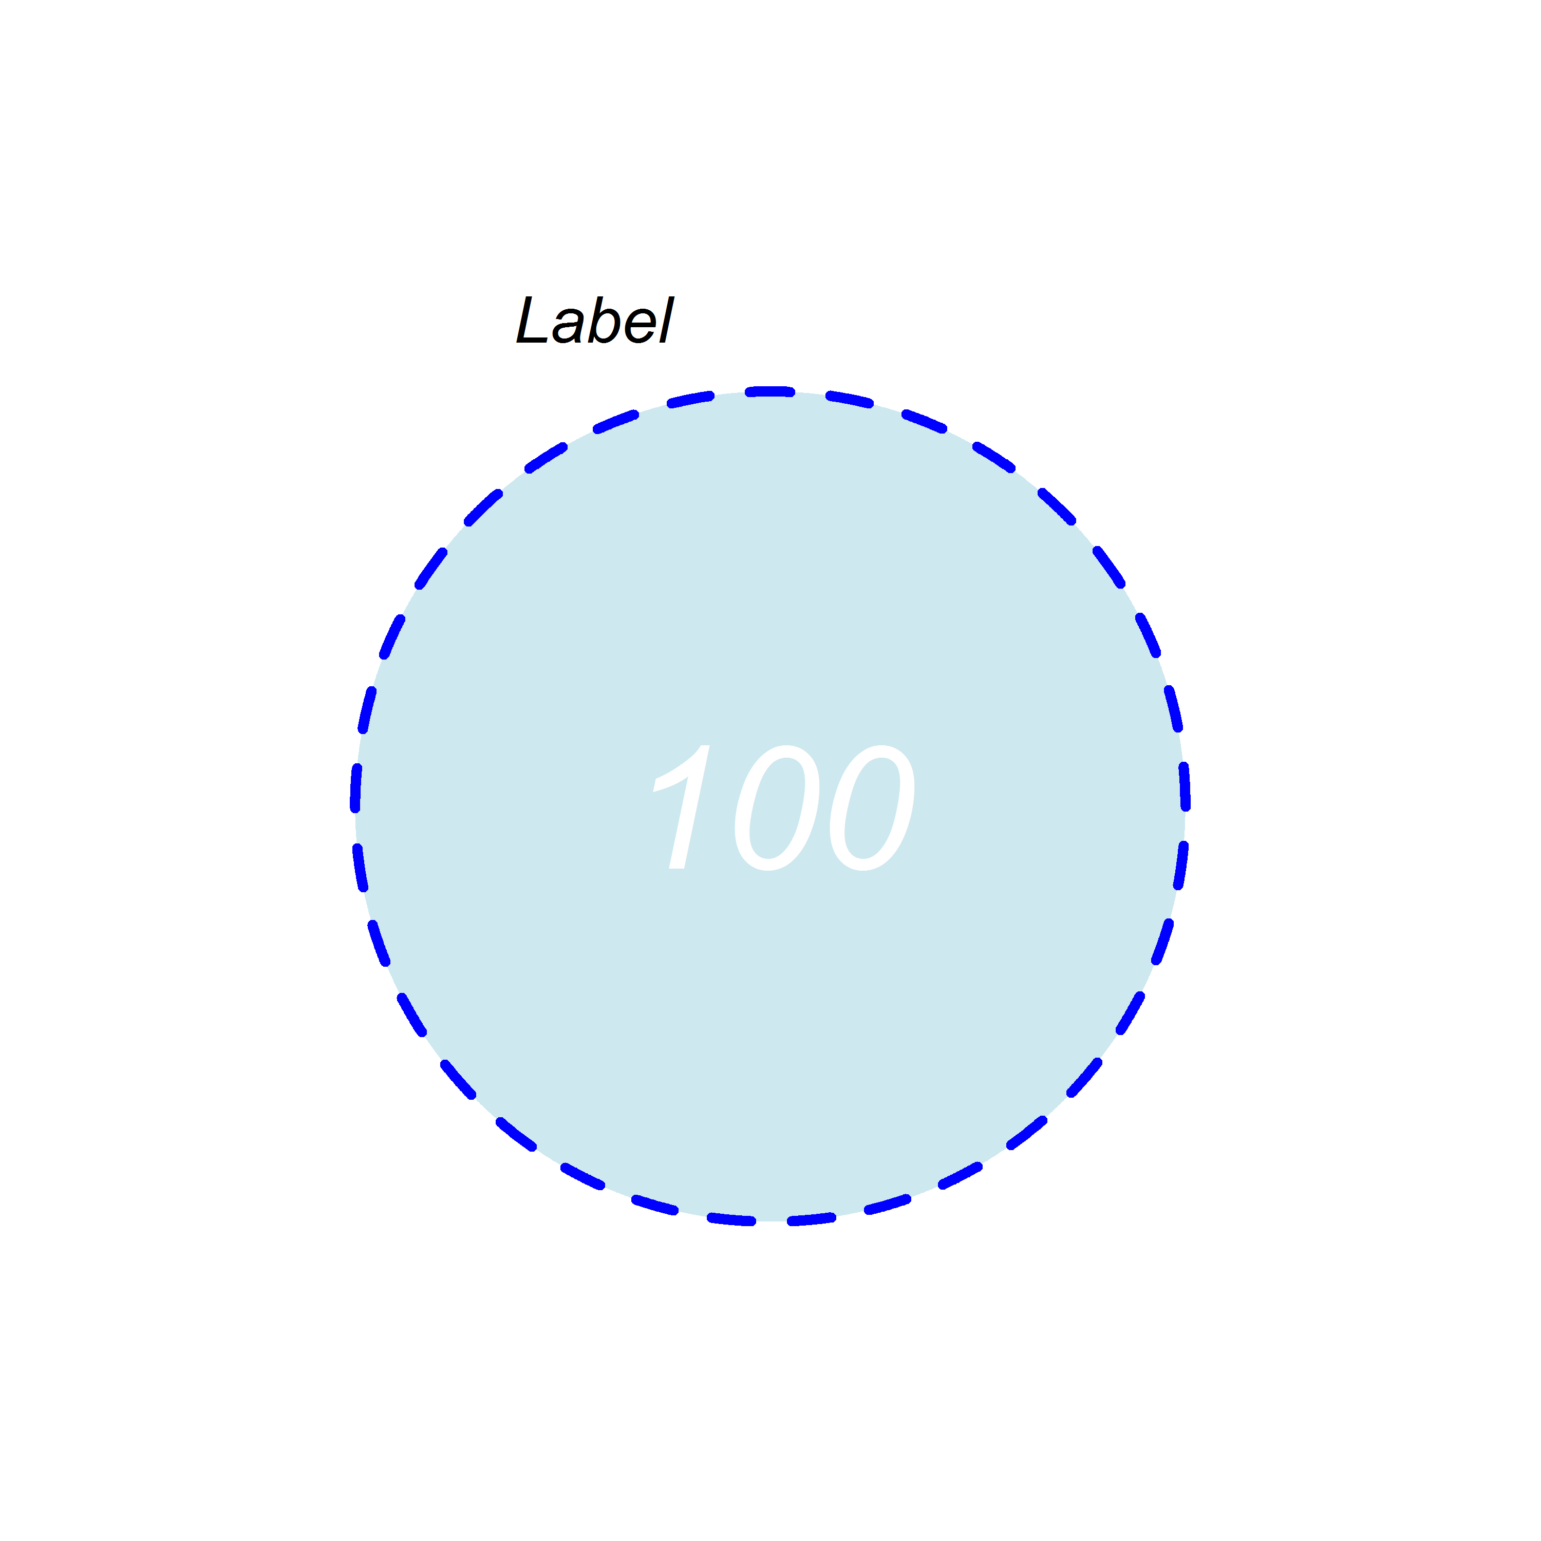
cat.pos = -20
cat.dist = 0.05
cat.cex = 1.5
cat.col = "black"
cat.fontface = "italic"
cat.fontfamily = "arial"
cat.default.pos = "outer“
cat.just = list(c(0.5, 0.5))
margin = 0.15
col = "blue"
lwd = 4
lty = "dashed"
label.col = "white"
cex = 4
fontface = "italic"
fontfamily = "arial"
fill = "light blue"
alpha = 0.6
Notes:
General parameters

Slide 2
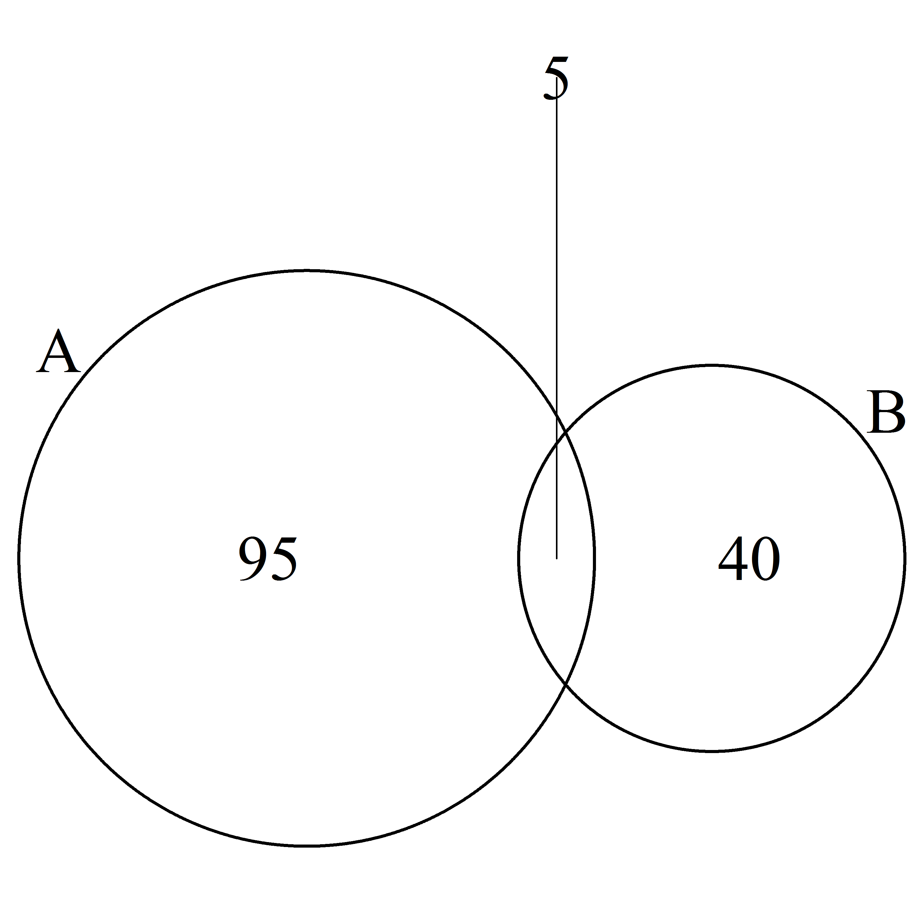
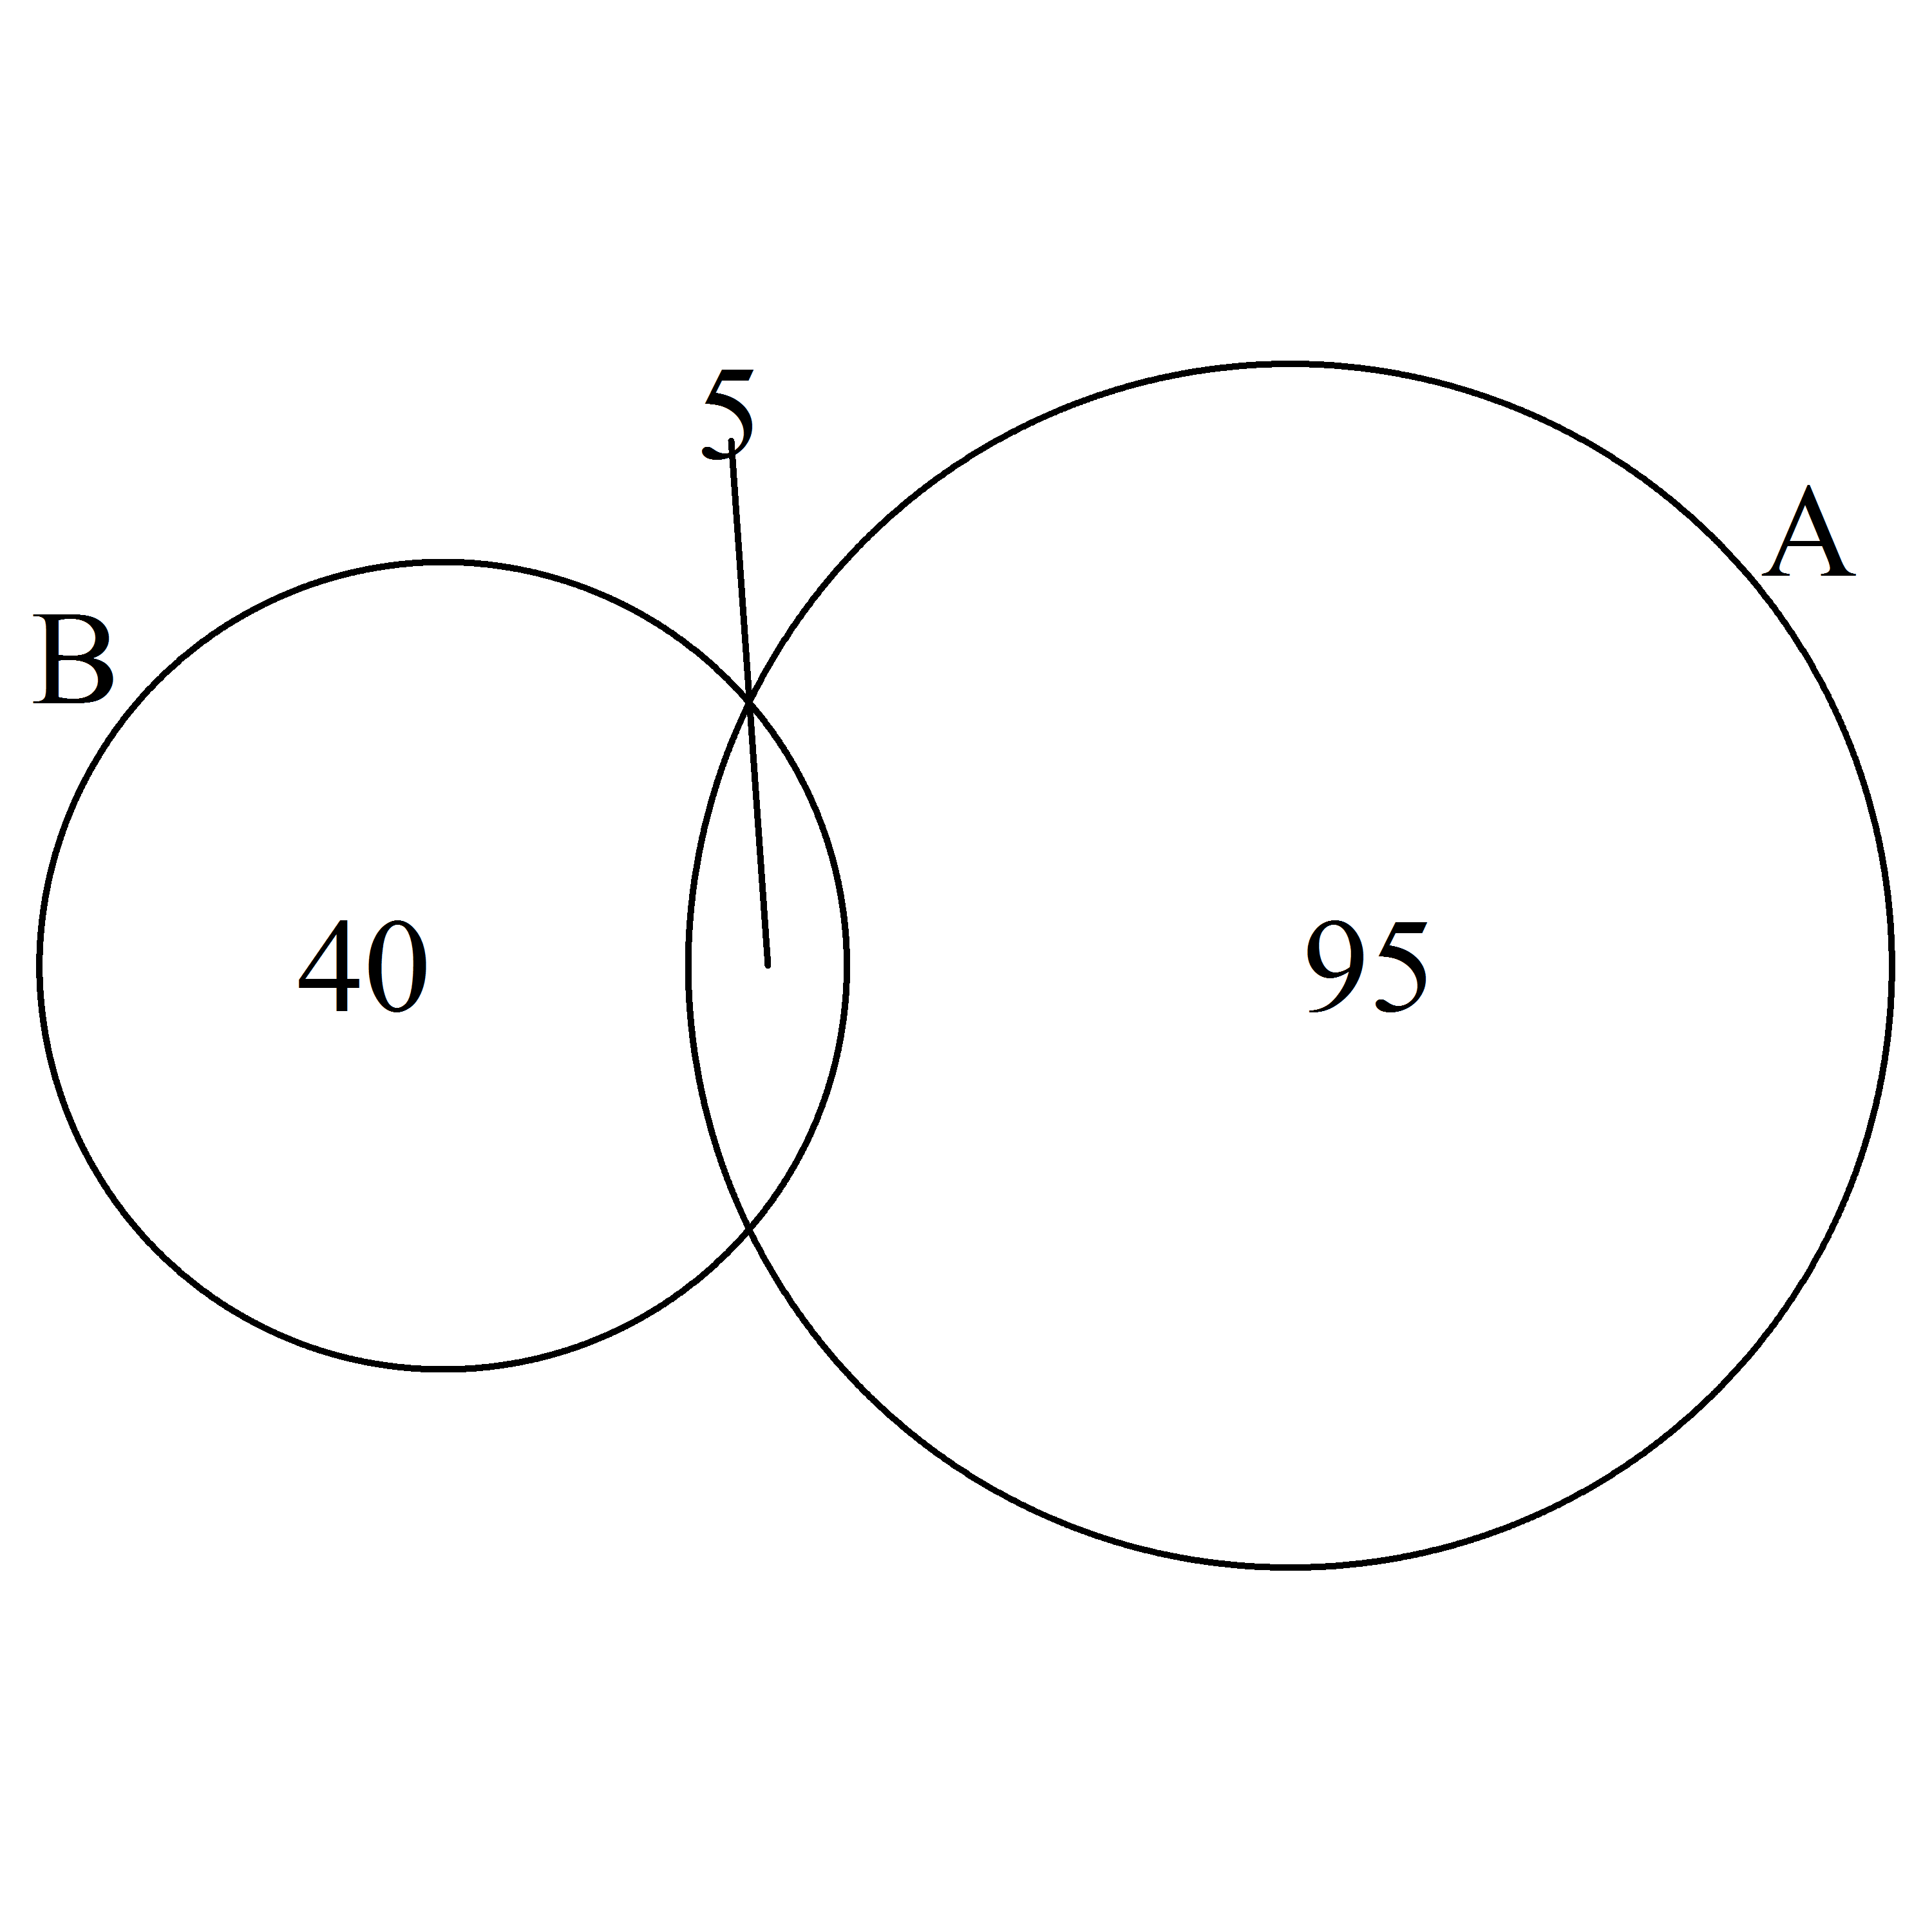
ext.text = TRUE
ext.line.lwd = 1
ext.dist = 0
ext.l = 1
ext.pos = 0
ext.text = TRUE
ext.line.lwd = 2
ext.dist = -0.15
ext.l = 0.95
ext.pos = -4
scaled = TRUE
inverted = FALSE
scaled = TRUE
inverted =TRUE
Notes:
Two-set specific parameters

Slide 3
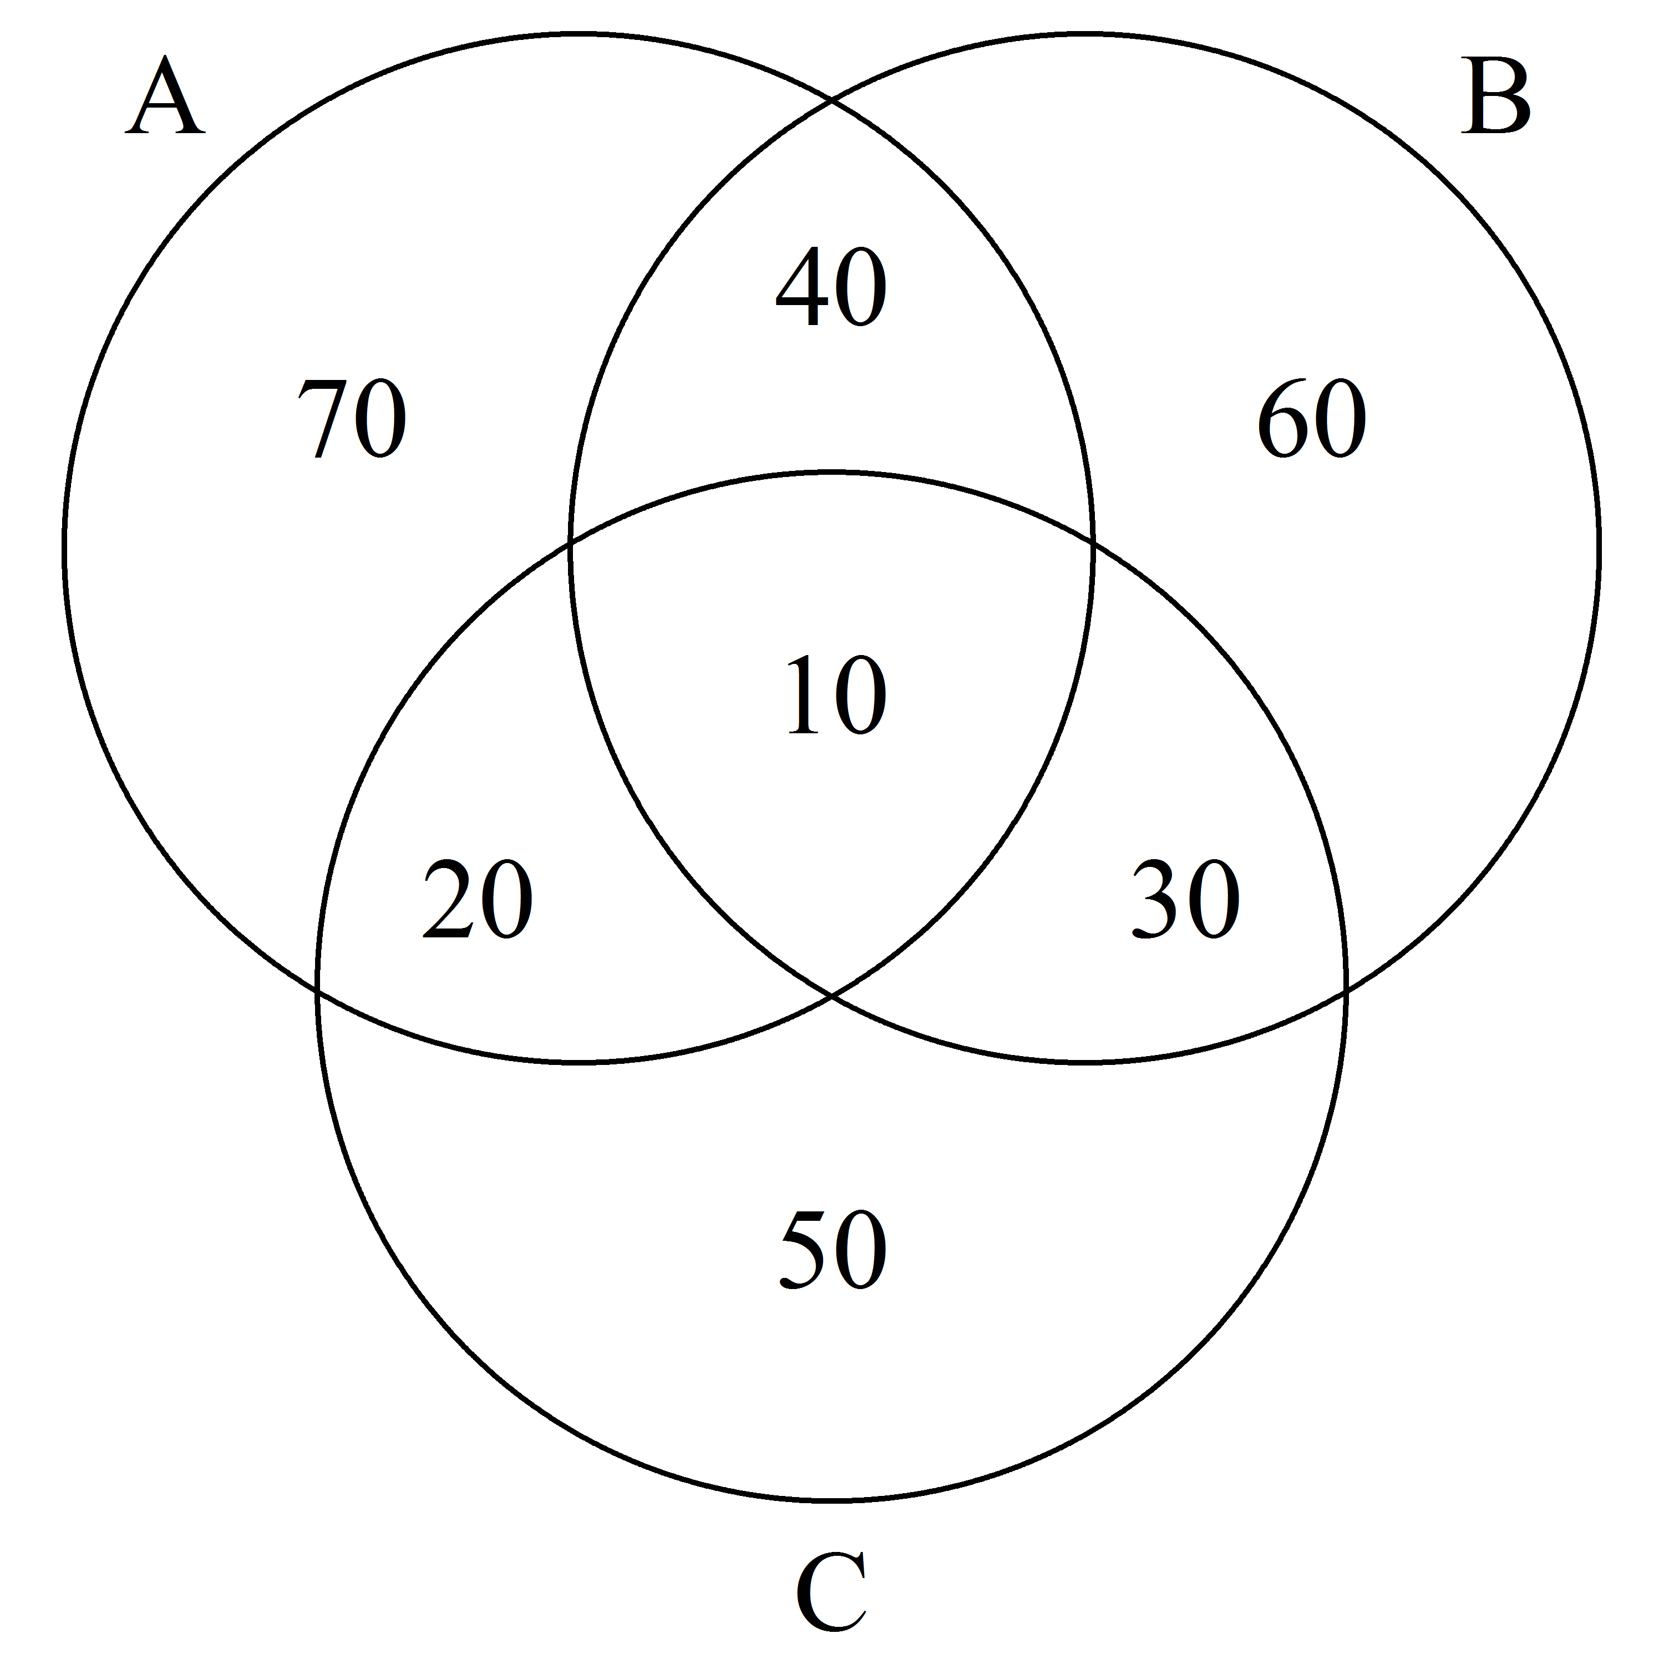
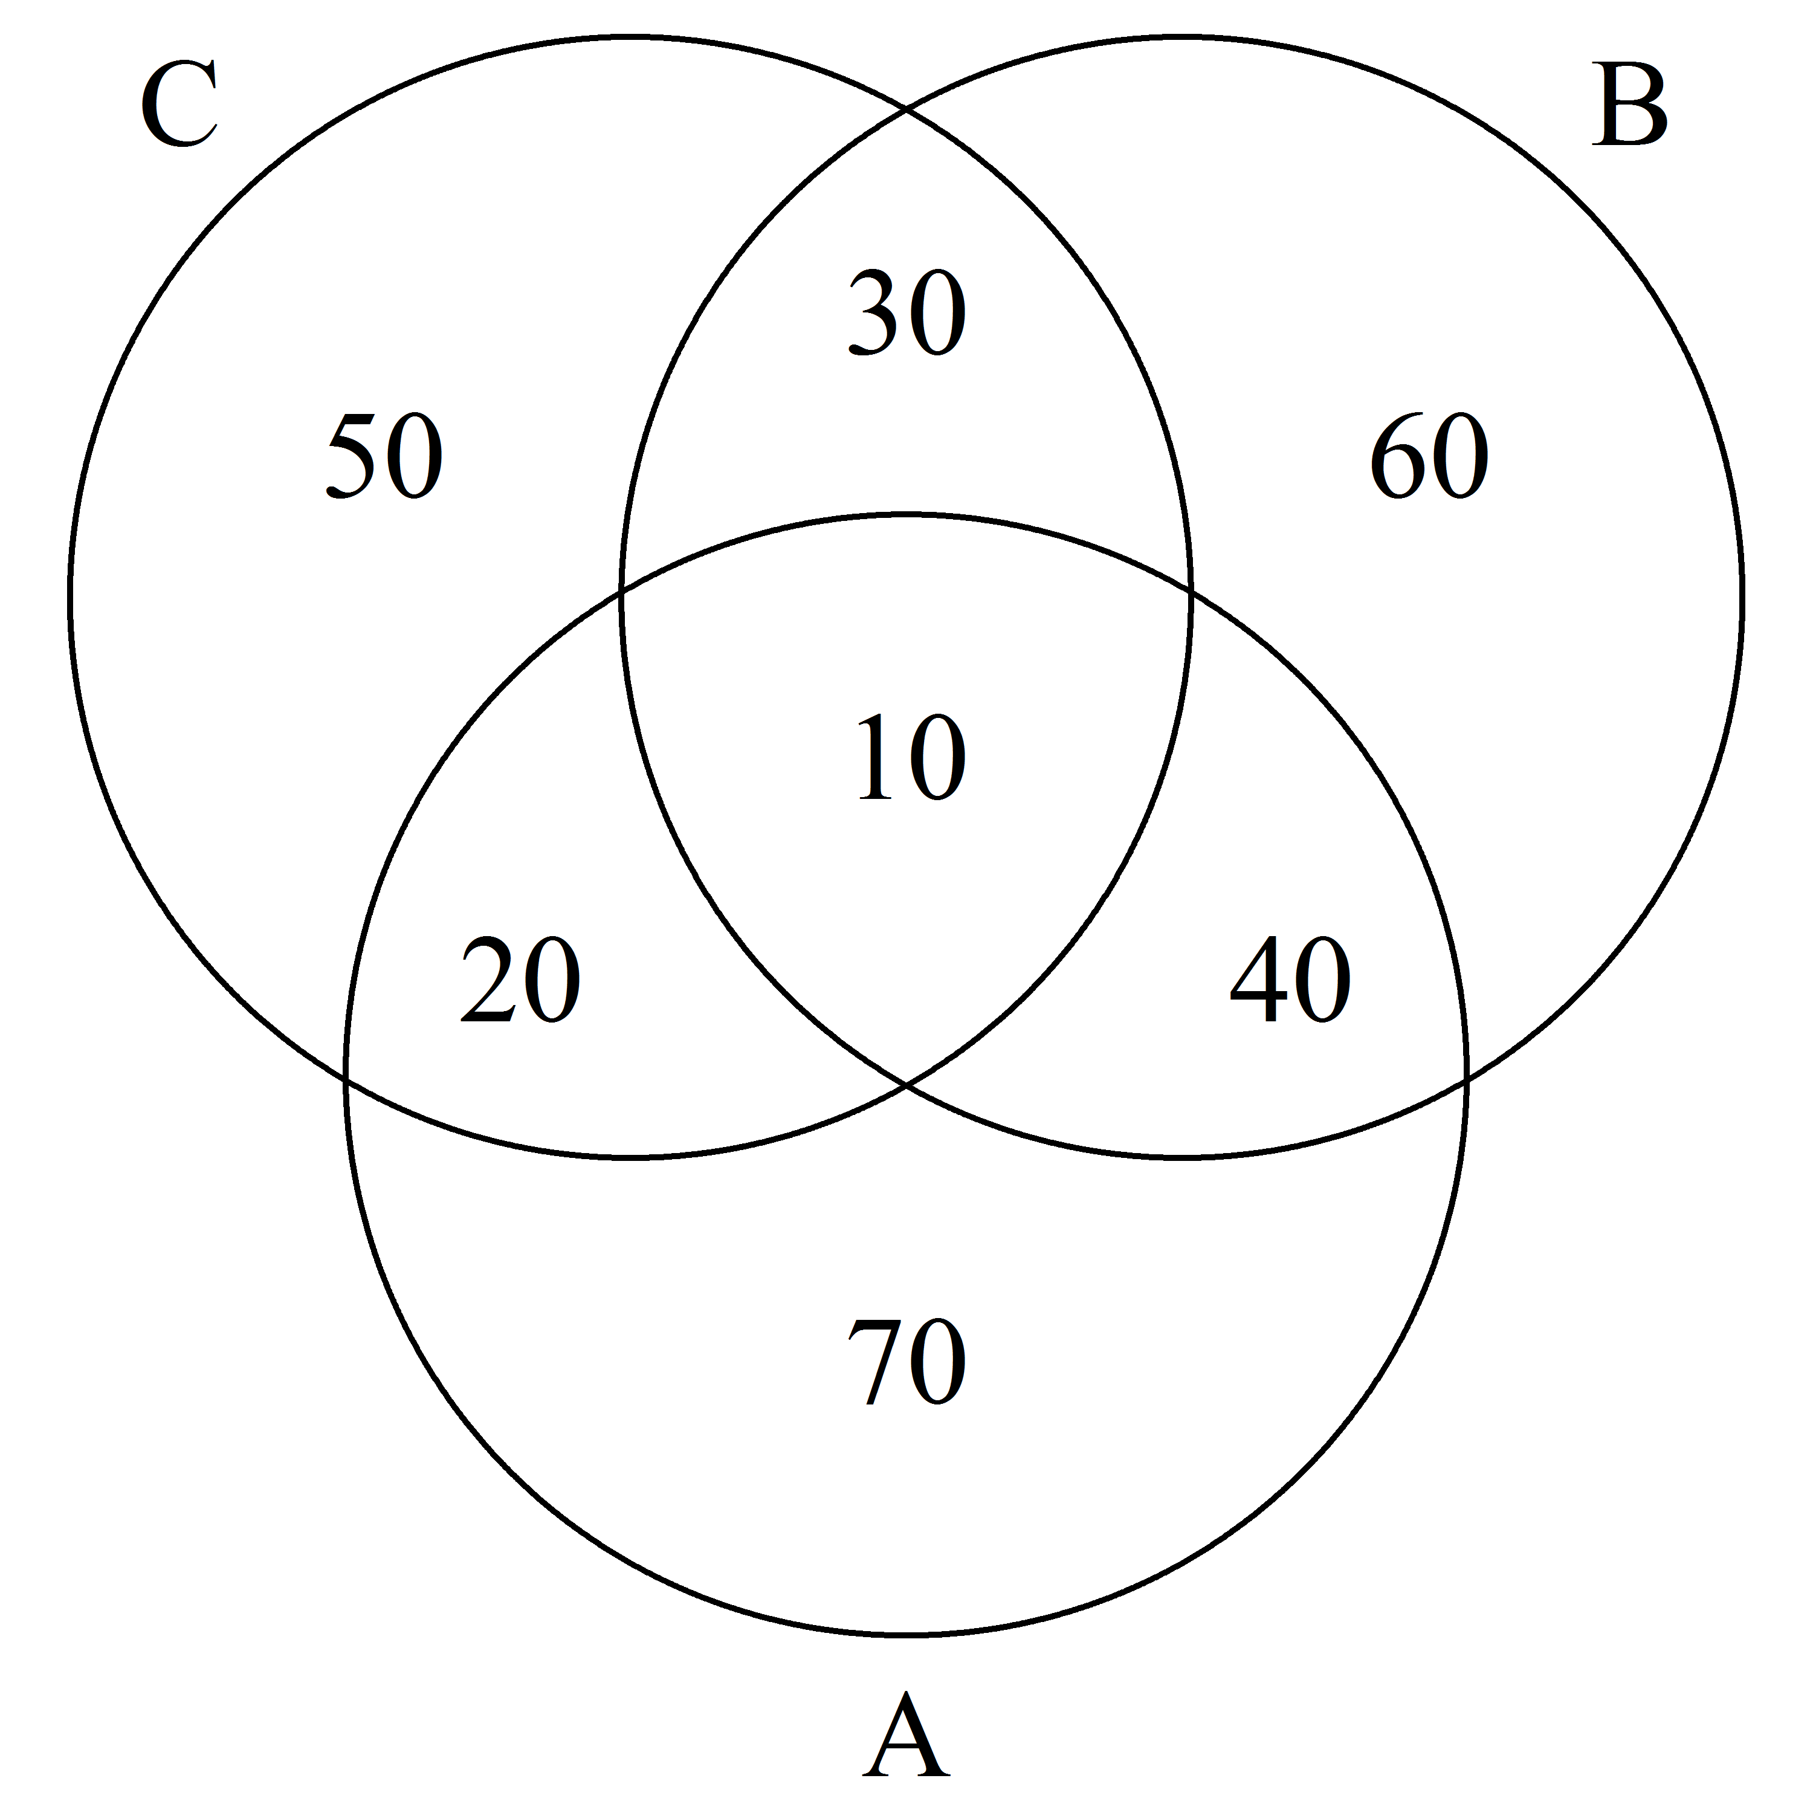
rotation = 2
reverse = TRUE
rotation = 1
reverse = FALSE
Notes:
Three-set rotations/reversions

Slide 4
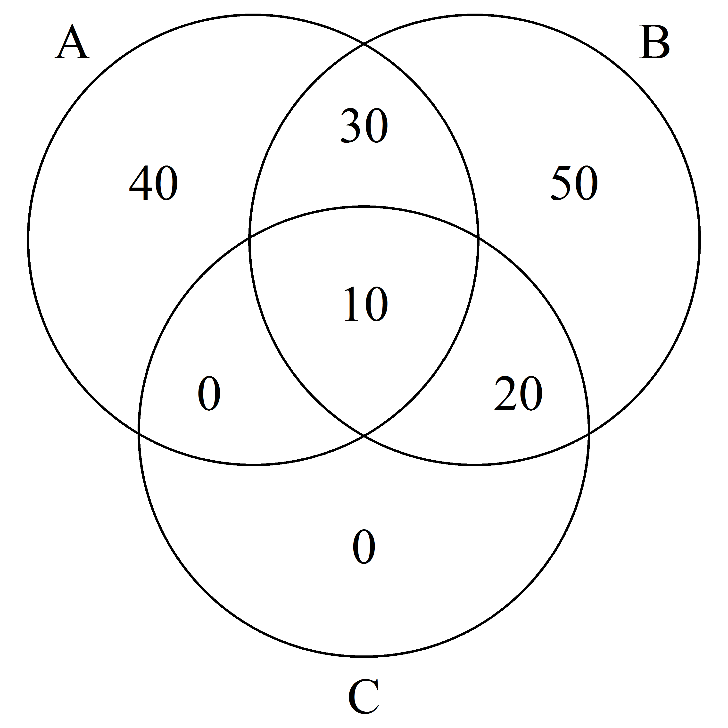
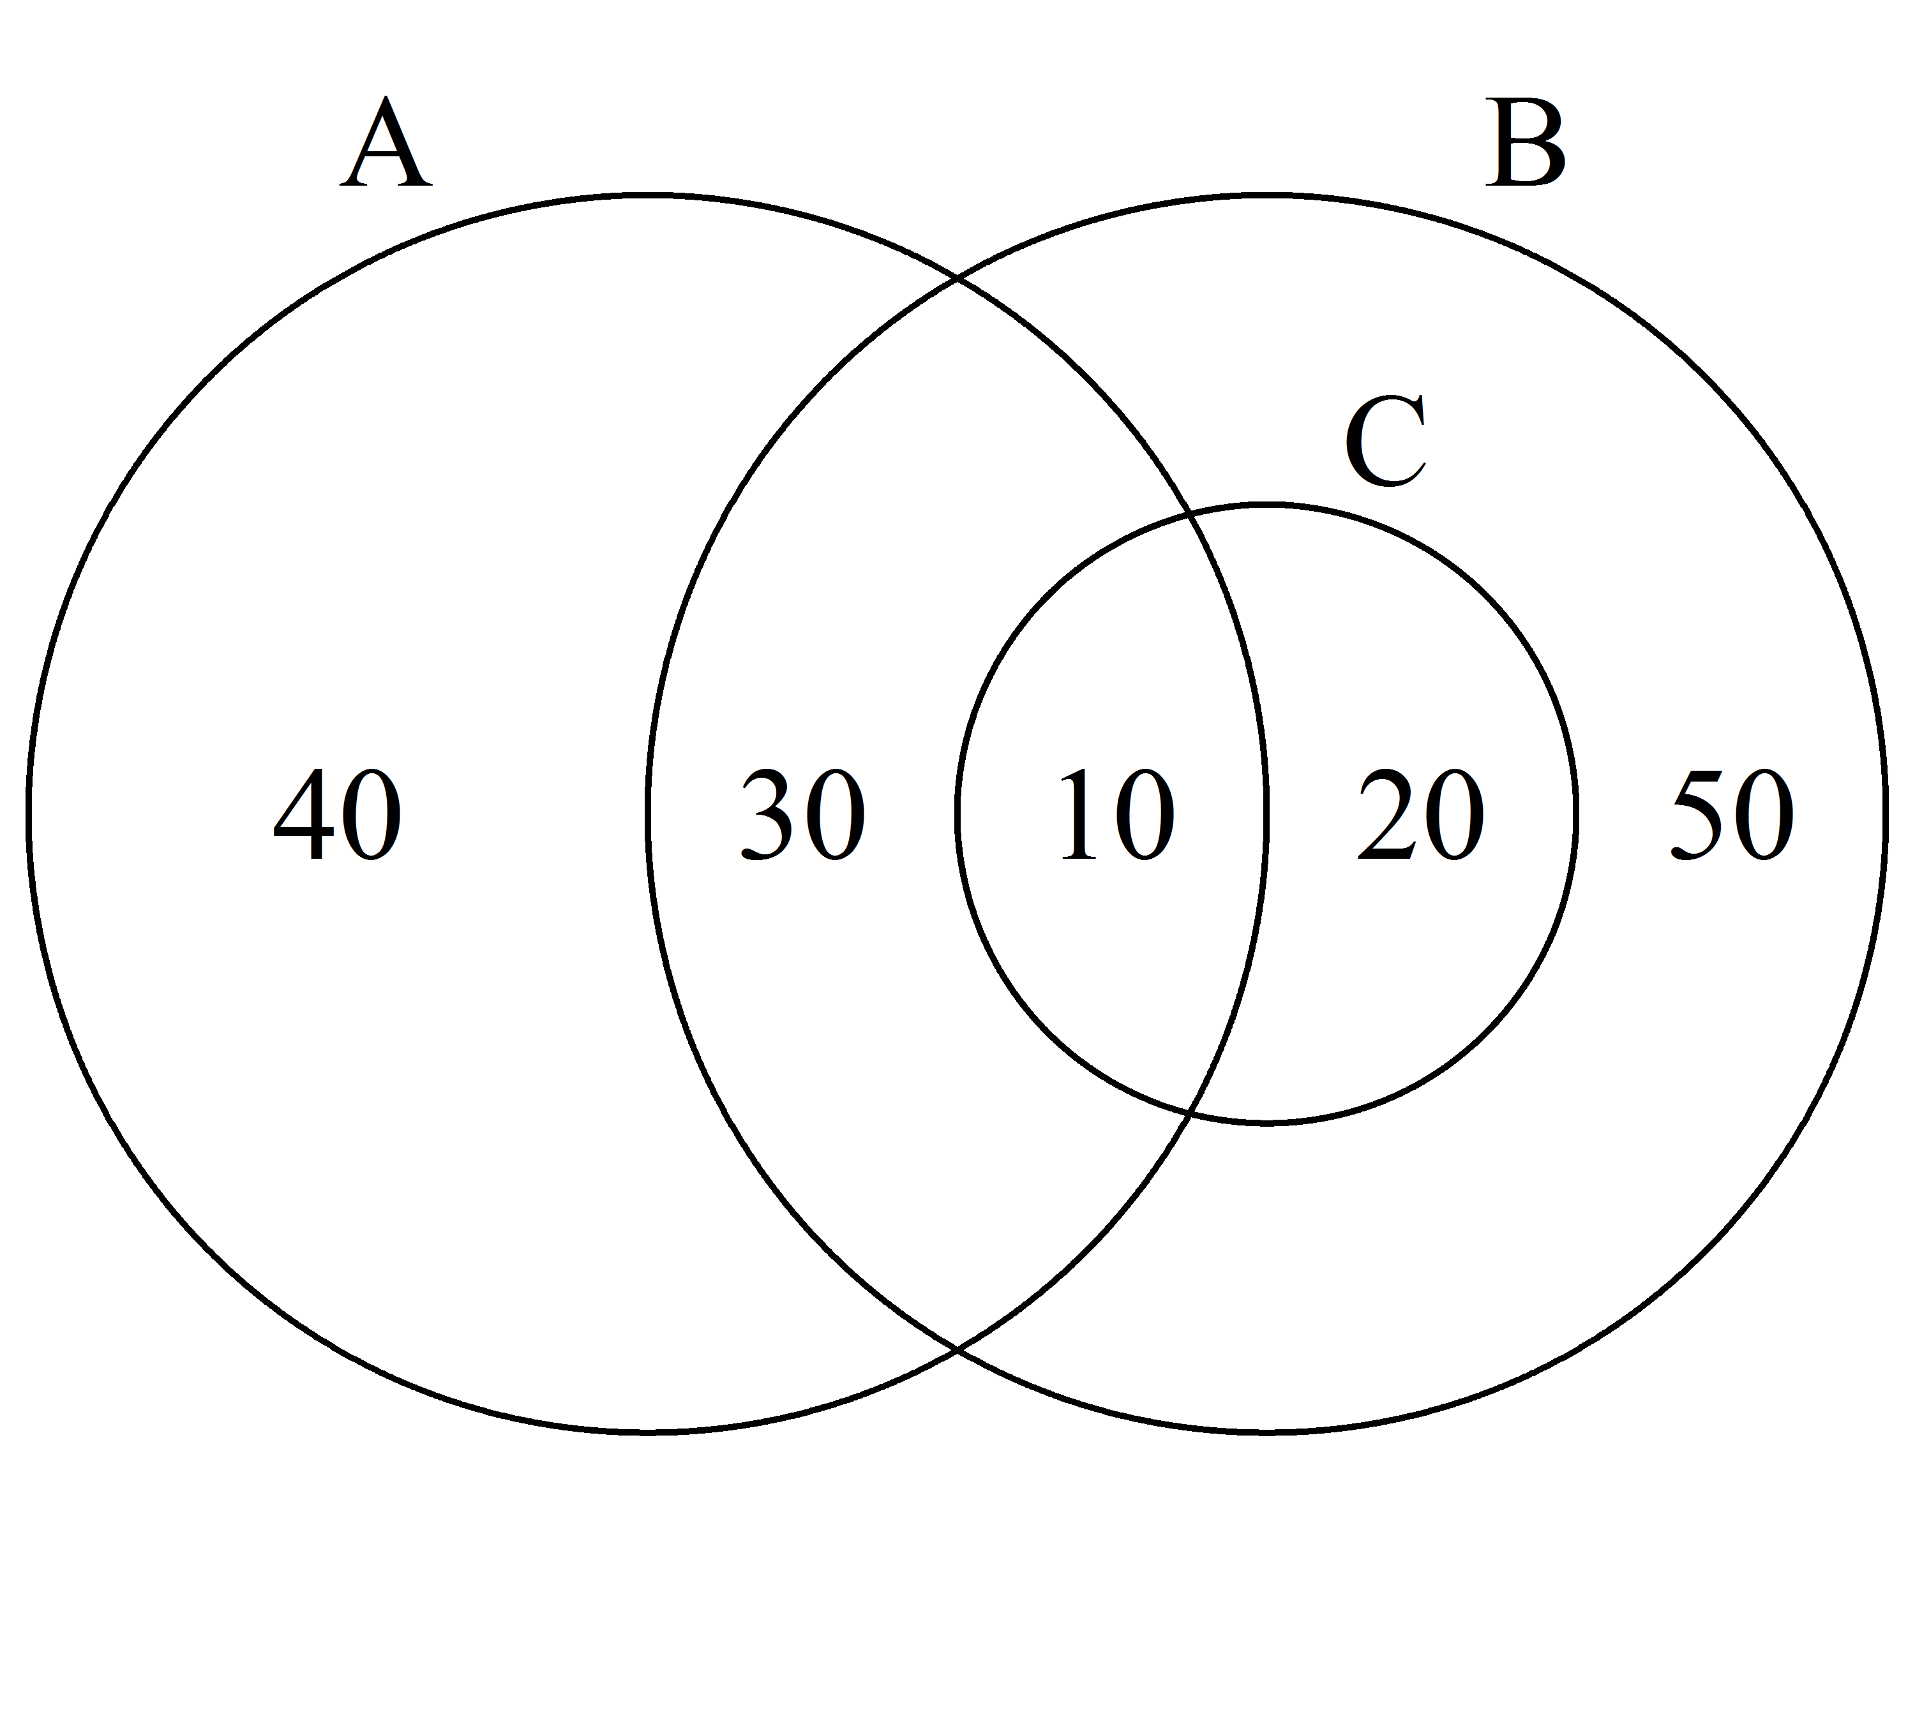
euler.d = FALSE
euler.d = TRUE
Notes:
Enable Euler diagrams

Slide 5
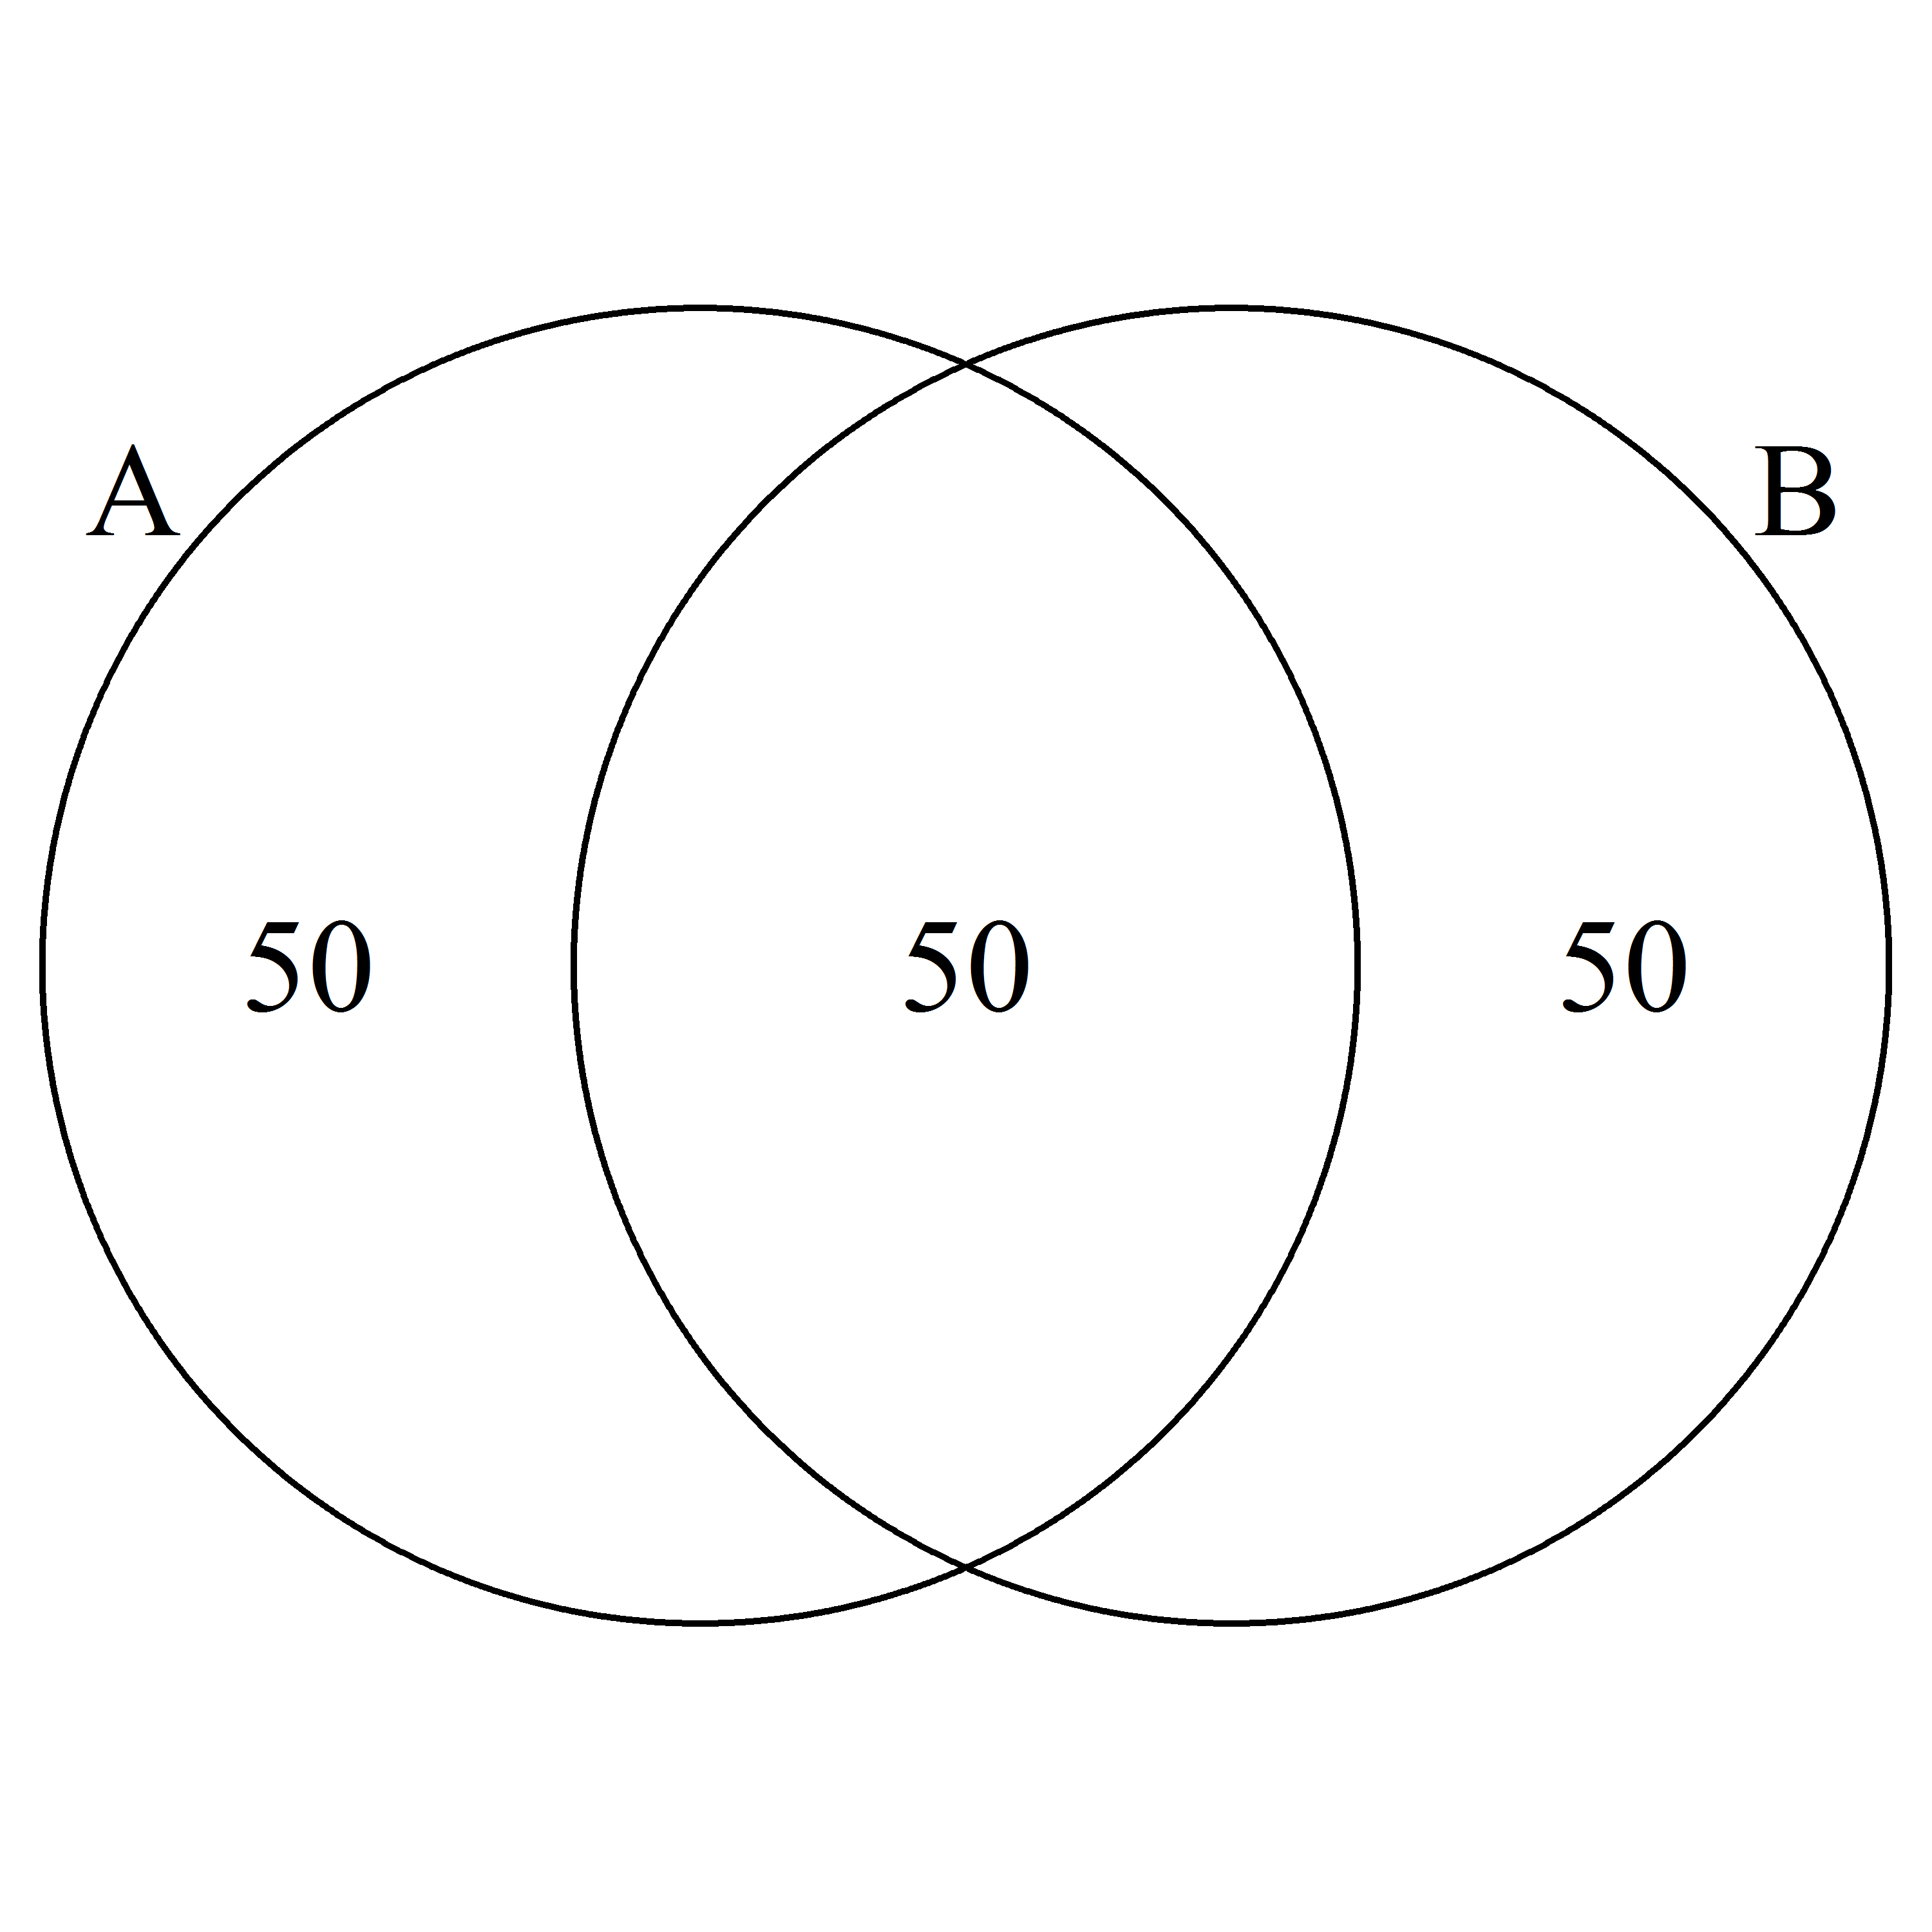
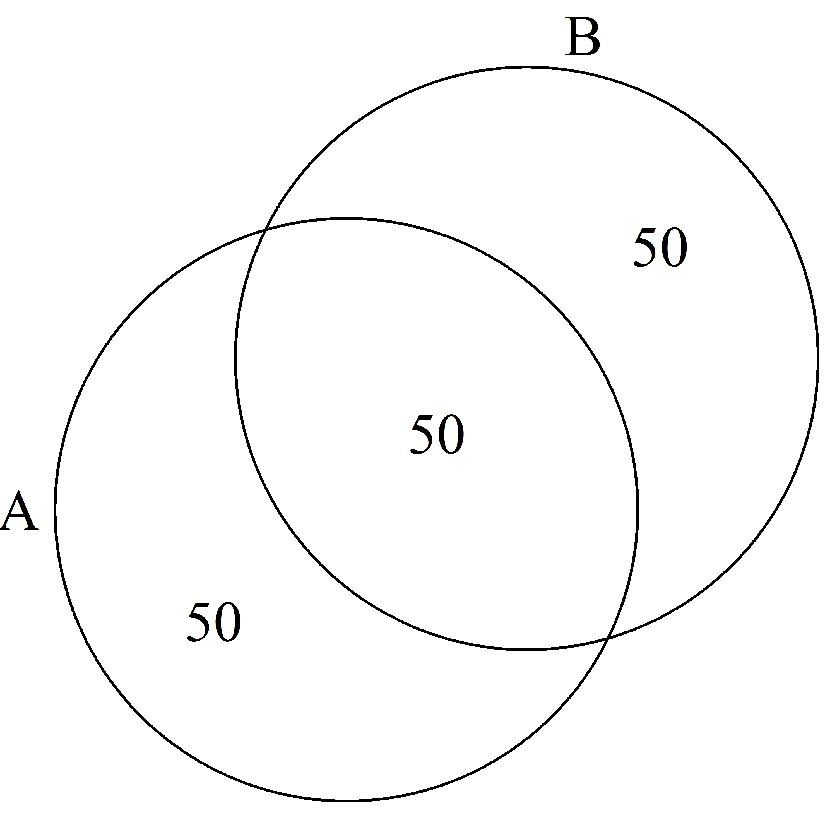
rotation = 40
rotation = 0
Notes:
Rotation

Slide 6
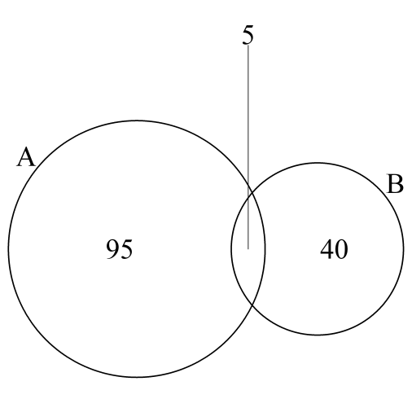
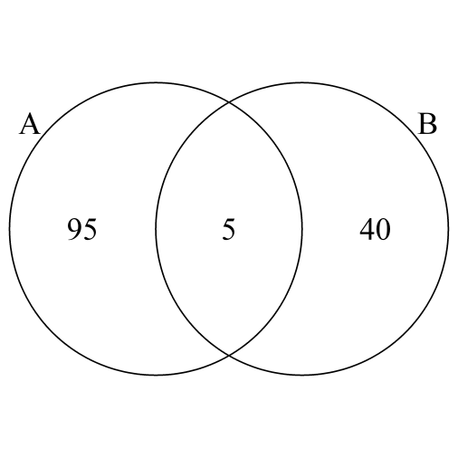
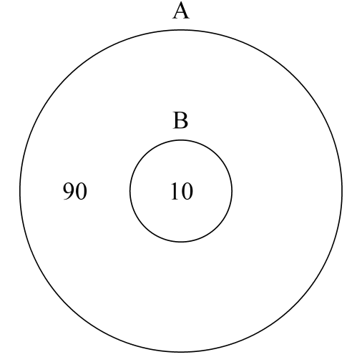
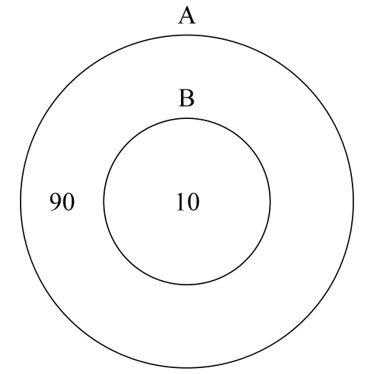
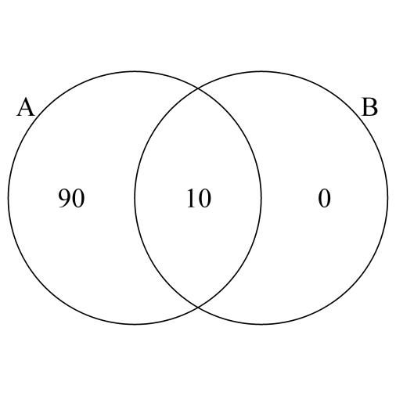
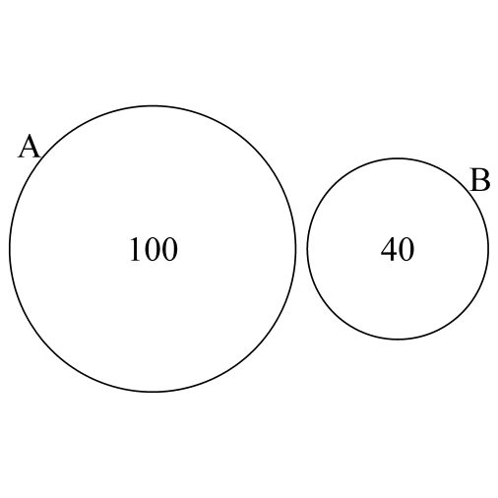
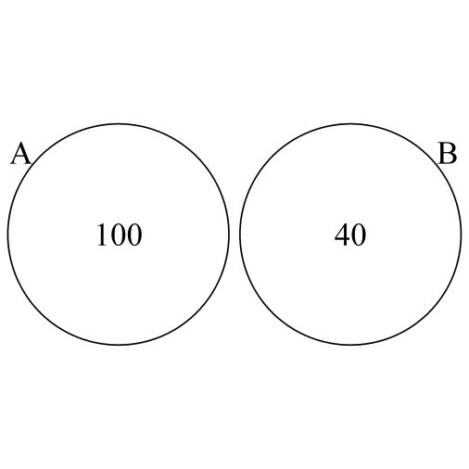
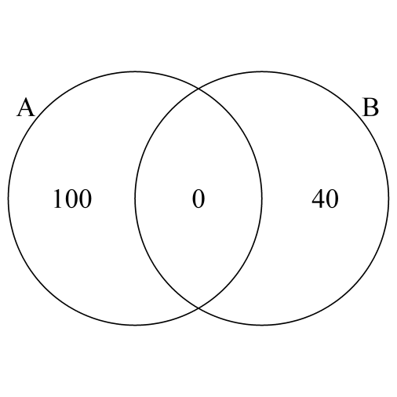
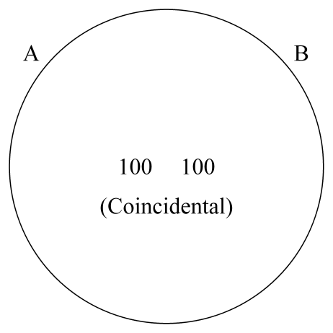
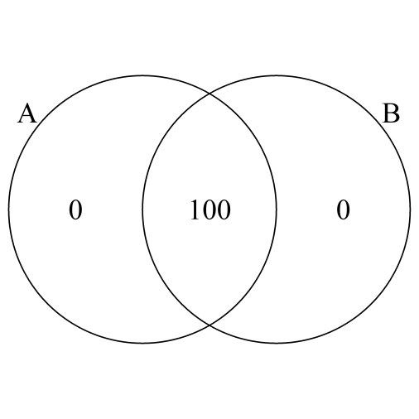
euler.d = TRUE & scaled = TRUE
euler.d = TRUE & scaled = FALSE
euler.d = FALSE & scaled = FALSE
Notes:
Usage and relation between the “euler.d” and “scaled” arguments (also applicable to certain three-set cases)

