Slide 1
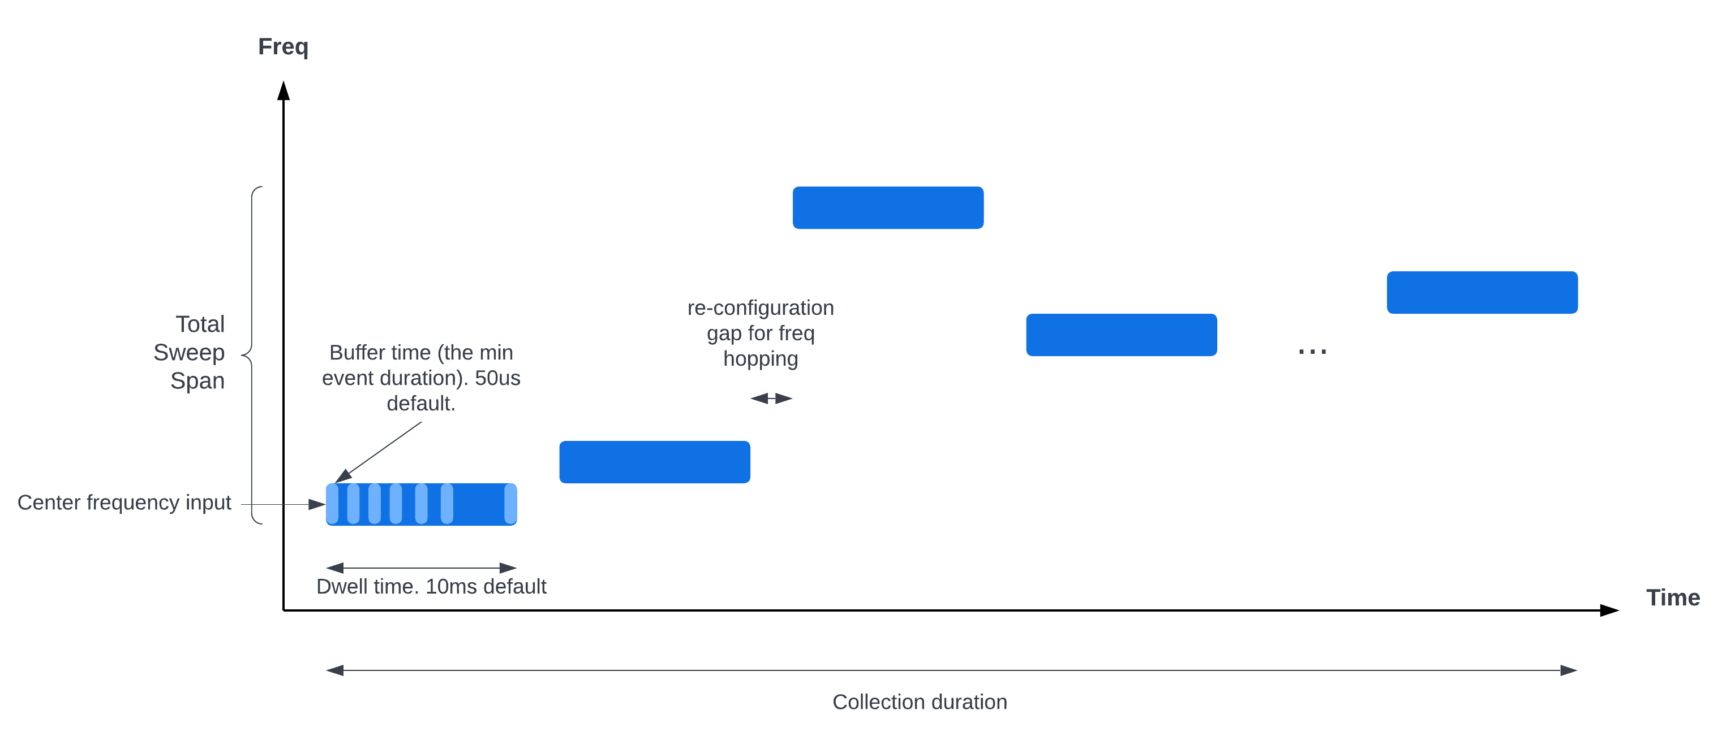
Activity Capture on Frequency Band
Frequency is randomly hopping in the range set from user.
Notes:
Minor edits. Stretch “outside” and “other voluntary” for non-binding WG activities with openness and fairness.

Slide 2
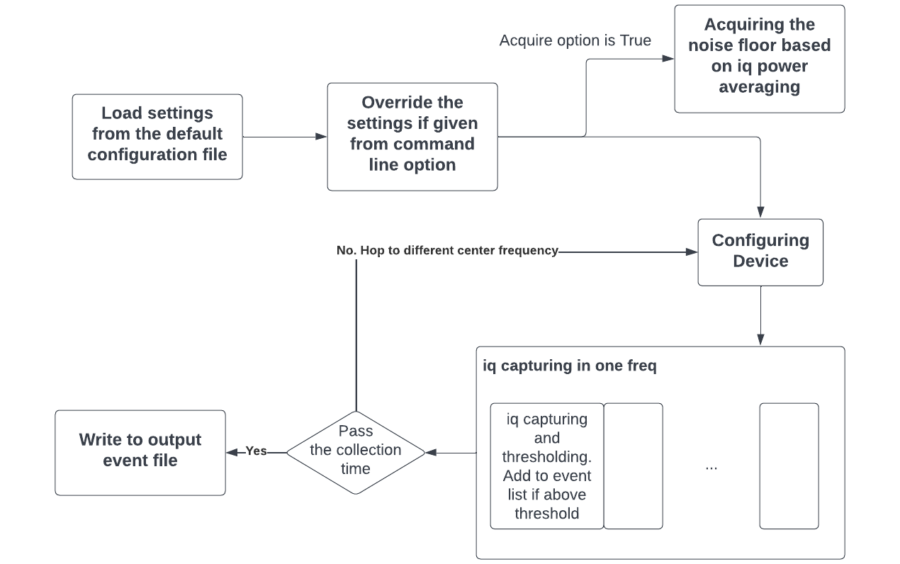
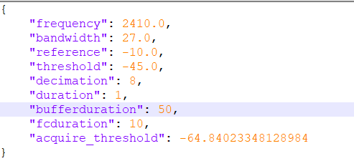
Design Flow
Notes:
Minor edits. Stretch “outside” and “other voluntary” for non-binding WG activities with openness and fairness.

Slide 3
Input Options (1)
options:
-h, --help show this help message and exit
-o output_filename, --output output_filename
Set the output file name. Default name will be py-out-<current time>
--conf configuration_file
Configuration file for the argparse
-f <center_freq>, --frequency <center_freq>
Start Center frequency (MHz) of the sweep measurement. Default to 2410.0 MHz
-b <Sweep_bandwidth>, --bandwidth <Sweep_bandwidth>
Total Sweep Bandwidth (MHz) of the measurement. The real sweeping bandwidth may be different based on the filter_bandwidth. Default mode is no sweeping
-fb <filter_bandwidth>, --filter_bandwidth <filter_bandwidth>
Bandwidth (MHz) of the iq capturing on specific center frequency. For BB60C different max bandwidth for different sample rate is specified in the bandwidth limitation table
-ref <reference_level>, --reference <reference_level>
Reference level (dBm) for the device. Default to -20dBm and should not set too low to prevent damaging the device.
--meta
Output all the configuration parameters in the Metadata-<output_filename> file.
Notes:
Minor edits. Stretch “outside” and “other voluntary” for non-binding WG activities with openness and fairness.

Slide 4
Input Options (2)
-th <Threshold>, --threshold <Threshold>
Threshold value (dBm) for the post processing. Only output the event having power larger than the
threshold. Default to -45dBm.
-d <Fs_decimation>, --decimation <Fs_decimation>
Decimation value for sampling frequency(can only be power of 2). The Sample frequency = 40/(decimation) Ms. Default to 8.
-t <Collection_duration>, --duration <Collection_duration>
Collection duration (min). Default to ?? min.
-bt <Buffer_duration>, --bufferduration <Buffer_duration>
The collection time to buffer for each measurement acquisition (us). Default to 50us.
-ft <Fc_dwelltime>, --fcduration <Fc_dwelltime>
The dwell time for the capturing staying in one frequency (ms). Default to 10ms.
--acquire [<acquire_time> ...]
The acquire time for the threshold for the noise floor(s). Default to 5s. If --acquire option is
called, it will capture and average the IQ data in <acquire_time> and then set the acquire_threshold in default_conf.json file
-r, --reset If the -r/--reset option is called. It will reset the default configuration after this execution. Currently
the only reset variable is the acquire_threshold in default_conf.json file
Notes:
Minor edits. Stretch “outside” and “other voluntary” for non-binding WG activities with openness and fairness.

Slide 5
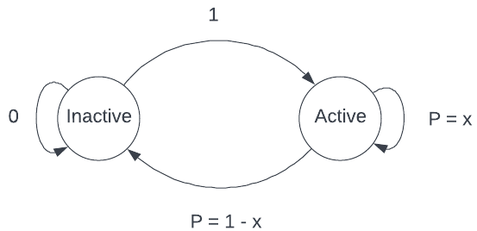
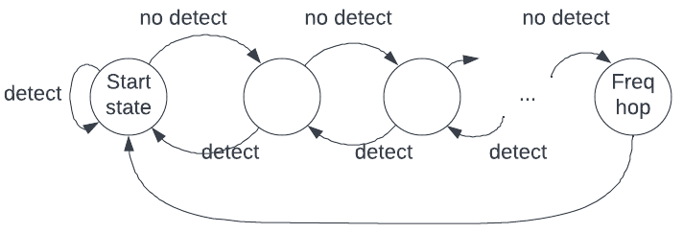
Undecided Items
Other capturing options :
Store and write out configuration file for future use.
N dBm higher than the acquired average power should be used for threshold.
Notes:
Minor edits. Stretch “outside” and “other voluntary” for non-binding WG activities with openness and fairness.

Slide 6
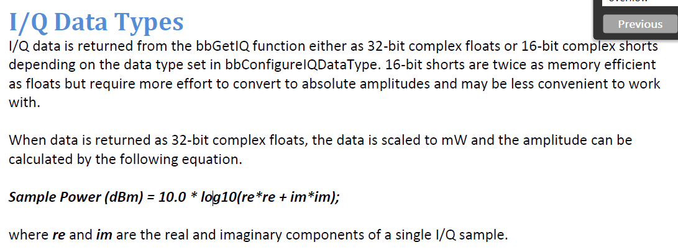
Appendix (1)

Slide 7
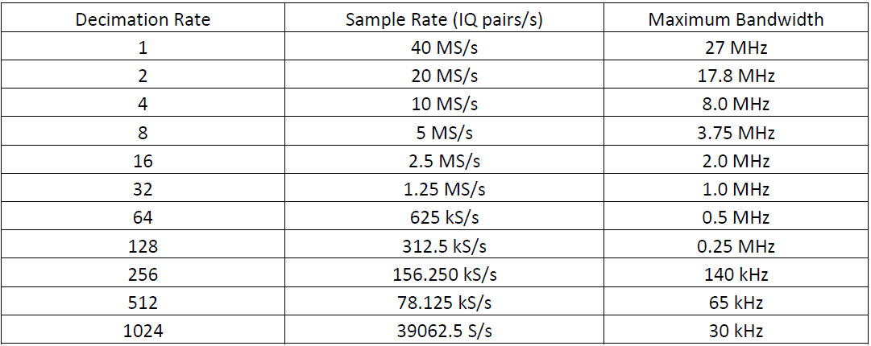
Appendix (2)

