Slide 1
《技术传播学》第四讲 ：有效说明书与用户手册 Technical Communication Episode 4 Effective Instructions and User Manuals
Learning objectives:
Learn how to start drafting instructions and user manuals
Learn to resolve the issues in drafting effective instructions and manuals

Slide 2
Part I Preparations for drafting instructions
Task 1:Discuss the following statement. Do you agree with it or not? Give your reasons. (Refer to pages 428-433 of the recommended book on process descriptions)
Instructions are process descriptions written to help readers perform a specific task — for instance, installing a water heater in a house.

Slide 3
Suggested clues for consideration(1)
Effective instructions are based on writing good descriptions.
Readers of a process description want to understand the process.
Readers of instructions want a step-by-step guide to help them perform the process.

Slide 4
Suggested clues for consideration(2)
Descriptions of processes(过程) are closely connected with descriptions of
1) Objects(部件与环境): parts or overall physical condition. Examples: an automobile tire, a volcano, etc.
2) Mechanisms(运行机制): the designed functioning of objects. Example: a car, a cell-phone, etc.

Slide 5
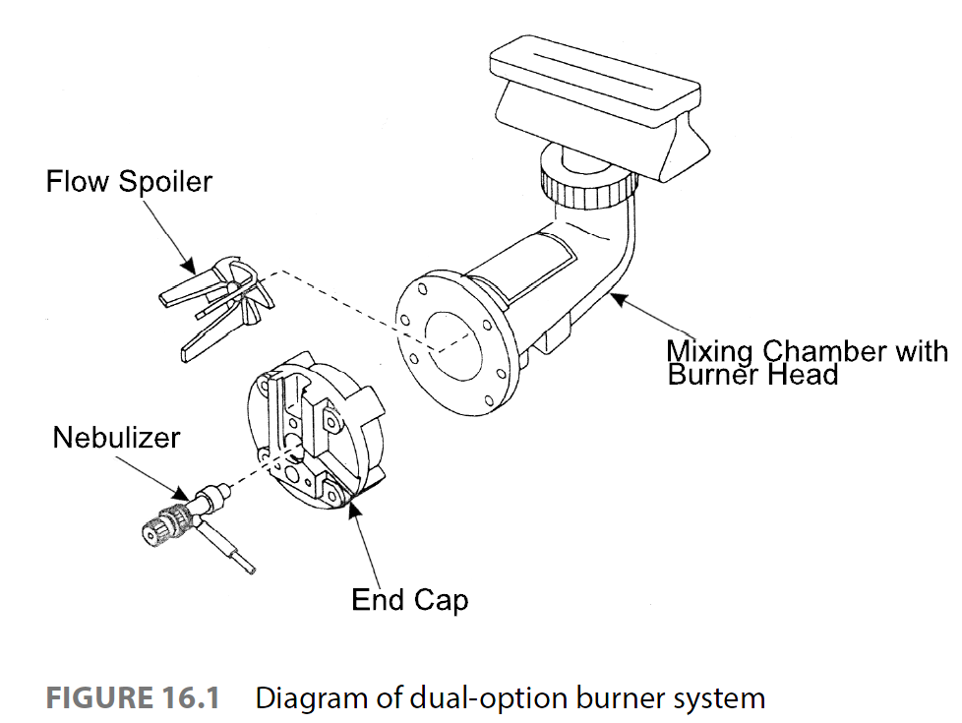
Object Description

Slide 6
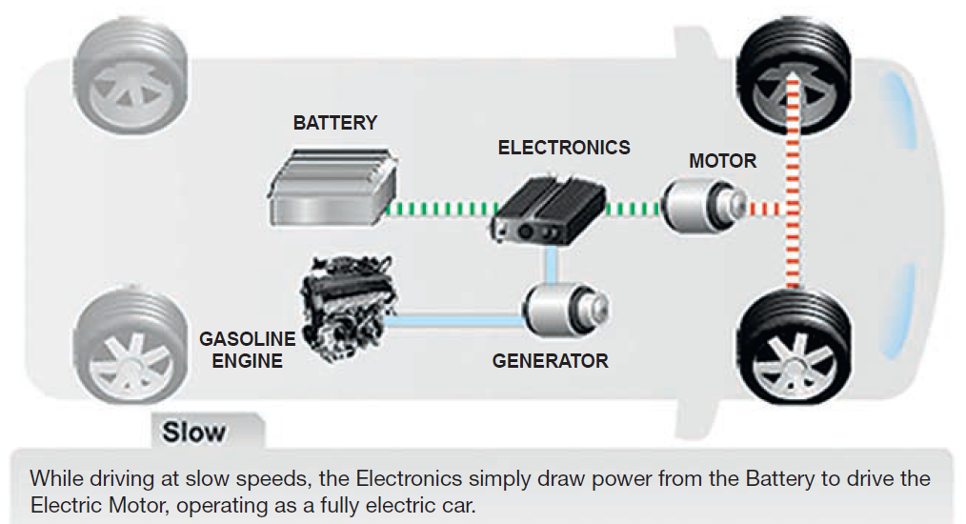
Description of Drivetrain Mechanism for a hybrid vehicle (混动汽车动力系统作用的描述)

Slide 7
Task 2: How do we construct clear, attractive page designs for instructions?
Task operation: Look at the two pictures on the next page and decide which is the better design. Give your reasons for the choice.

Slide 8

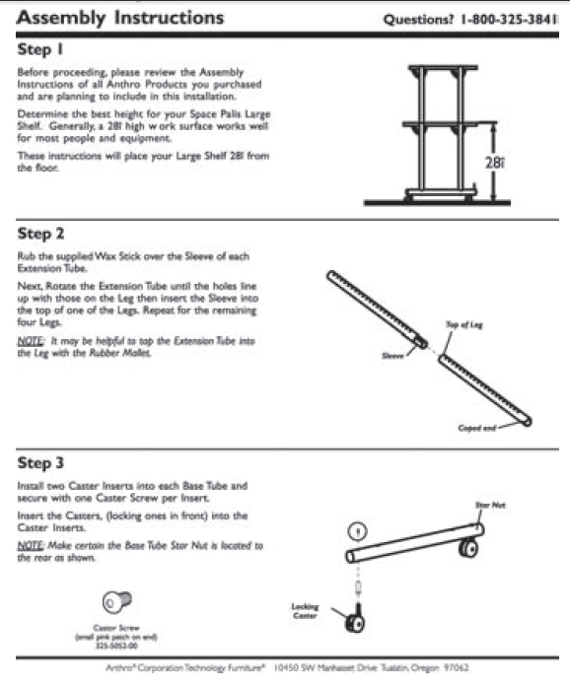

Slide 9
Cluttered design (disorganized)
This page is cluttered, containing far too much information. In addition, the page is not chunked effectively. As a result, the reader’s eyes don’t know where to focus. Would you look forward to using these instructions to assemble a cabinet?

Slide 10
Attractive Design
This page is well designed, containing an appropriate amount of information presented in a simple two-column format. Notice the effective use of white space and the horizontal rules separating the steps.

Slide 11
Guidelines for Designing Clear, Attractive Pages
Create an open, airy design. Do not squeeze too much information onto the page. Build in space for wide margins and effective line spacing, use large type, and chunk the information effectively.
Clearly relate the graphics to the text. In the step-by-step portion of a set of instructions, you will want to present graphics to accompany every step or almost every step. Create a design that makes it clear which graphics go with each text passage. One easy way to do this is to use a table, with the graphics in one column and the text in the other. A horizontal rule or extra line spacing separates the text and graphics for one step from the text and graphics for the next step.

Slide 12
Part II Planning for safety: Ethics Note
Question of group discussion:
Can you think of some key words for the safety concerns in designing instructions or user manuals? If yes, explain their significance.

Slide 13
Key word 1: responsibility
If the subject you are writing about involves safety risks, your most important responsibility is to do everything you can to ensure your readers’ safety.

Slide 14
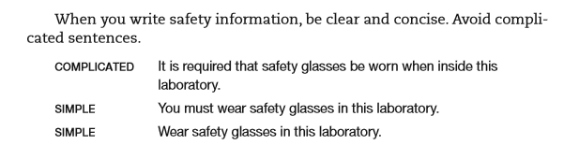
Example

Slide 15
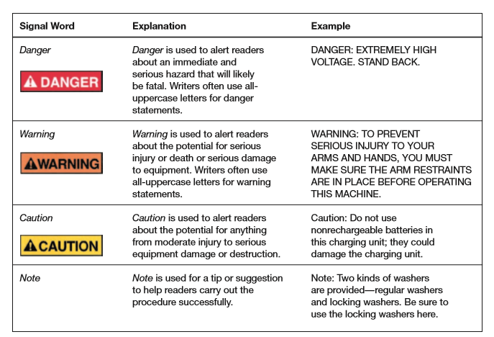
Key word 2: SIGNALS

Slide 16
Key word 3: LOCATION
What is the best location for the safety information?
This question has no easy answer because you cannot control how your audience reads your document.
Be conservative: put safety information wherever you think the reader is likely to see it, and don’t be afraid to repeat yourself. A reasonable amount of repetition — such as including the same safety comment at the top of each page — is effective.

Slide 17
Part III Drafting effective instructions
What are the four elements of a set of instructions?
A title
A general introduction
Step-by-step instructions
A Conclusion

Slide 18
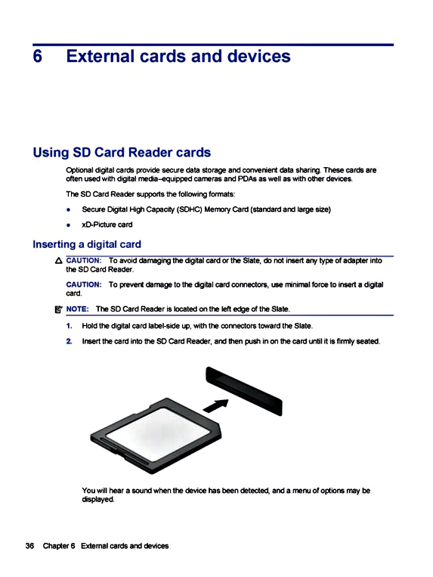
A sample page of a set of instructions in a user’s manual

Slide 19
Drafting Titles
A good title for instructions is simple and clear. Two forms are common:
• How-to. This is the simplest: “How to Install the J112 Shock Absorber.”
• Gerund. The gerund form is the -ing form of the verb: “Installing the J112 Shock Absorber.”

Slide 20
Drafting Introductions for Instructions
The general introduction provides the preliminary information that readers will need to follow the instructions safely and easily.
The drafting involves basic consideration on six aspects:
Personnel qualified or certified to perform the task.
Rationale (reasons) for tasks, such as changing radiator antifreeze in a car.
Time selection for tasks such as rotating tires or planting crops.
Safety measures.
Items of tools, material and equipment.
The duration of the task.

Slide 21
Drafting Step-by-Step Instructions
The heart of a set of instructions is the step-by-step information.
Tips for effective drafting:
Organize the steps chronologically
Number your steps
Use highlighting techniques
Limit the information within each step
Include graphics
Use short words, short sentences and short paragraphs
Begin your steps with verbs.

Slide 22
Task: Revising overloaded steps in the instructions
Overloaded Steps
Start the engine and run it to idling speed while opening the radiator cap and inserting the measuring gauge until the red ball within the glass tube floats either to the acceptable green range or to the dangerous red line.

Slide 23
Revision plan
Start the engine.
Run the engine to idling speed
Open the radiator cap.
Insert the measuring gauge.
Determine whether the red ball within the glass tube floats to the acceptable green range or up to the dangerous red line.

Slide 24
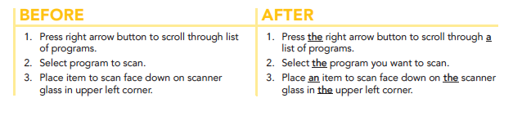
More Tips for Instructional steps
Do not omit articles

Slide 25
Drafting Conclusions
Instructions often conclude by stating that the reader has now completed the task or by describing what the reader should do next.
Example:
Now that you have replaced the glass and applied the glazing compound, let it sit for at least five days so that the glazing can cure. Then, prime and paint the window.

Slide 26
Some conclusions end with maintenance tips or a troubleshooting guide.
A troubleshooting guide, usually presented as a table, identifies common problems and explains how to solve them.

Slide 27
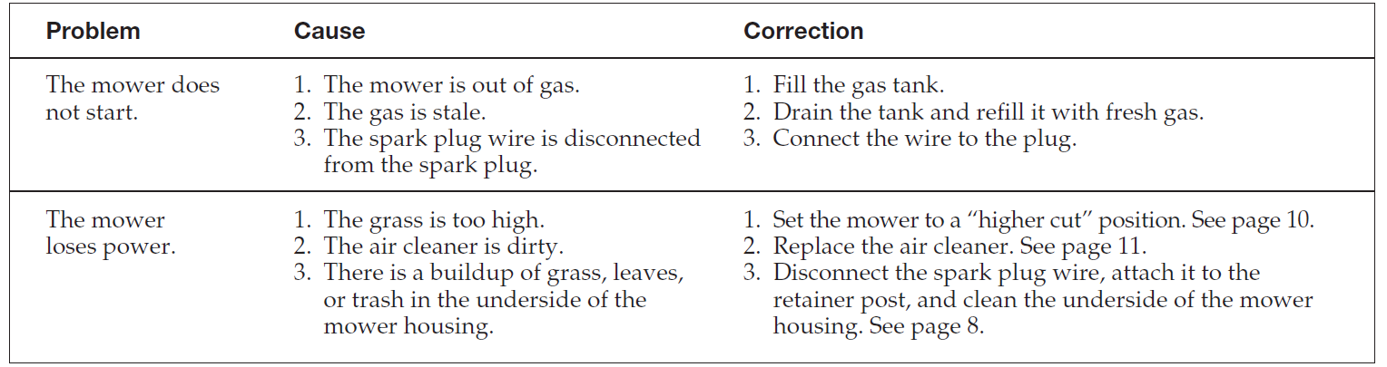
Sample of a troubleshooting guide

Slide 28
Part IV Effective User Manuals
There is no absolute distinction between a set of instructions and a user manual.
Yet, compared with a user manual, a set of instructions is typically shorter (usually 1-20 pages) and limited in its subject. For example, a set of instructions might discuss how to use an battery charger, whereas a manual might discuss how to use a laptop computer.

Slide 29
Part IV Effective User Manuals
A manual has typically a title page.
The main difference between the two is that a manual has more elaborate front matter and back matter.

Slide 30
Front matter
The introduction, sometimes called a preface, often contains an overview of the contents, frequently in the form of a table, which explains the main contents of each section and chapter. It also contains a conventions section, which explains the typography of the manual. For instance, italics are used for the titles of books, boldface for keyboard keys, and so forth. It also might include a where to get help section, referring readers to other sources of information, such as the company’s Web site and customer-support center. And it might contain a section listing the trademarks of the company’s own products and those of other companies

Slide 31
Back matter
Manuals typically include a set of specifications of the device or system, a list of relevant government safety regulations and industry standards that the device or system supports, tips on maintenance and servicing the device, a copyright page listing bibliographic information about the manual, and an index. Many manuals also include glossaries.

Slide 32
Questions for review
Are the instructions designed effectively, with adequate white space and a clear relationship between the graphics and the accompanying text?
Do the instructions have a clear title?
Does the introduction to the set of instructions state the purpose of the task? Does it describe safety measures or other concerns that readers should understand? Does it list necessary tools and materials?
Are the step-by-step instructions numbered? Are they simple and direct?
Are appropriate graphics included?
Does the conclusion include any necessary follow-up advice? Or if appropriate, a troubleshooting guide?

