Slide 1
人工智慧與資訊安全
人工智慧與資訊安全期中平時報告Matplotlib
Data Visualization
資料視覺化技術
Matplotlib
Data Visualization
資料視覺化技術
報告者:林耕鴻 A072E182
指導教授:偉大的恩師 龍大大

Slide 2
Agenda
Data Visualization資料視覺化
資料視覺化 套件
資料視覺化 實戰

Slide 3
[1].Data Visualization資料視覺化
[2].資料視覺化の套件
[3].Google Colab上的範利
[4].MATPLOTLIB
[5].MATPLOTLIB範例學習[1]單一圖形
matplotlib.pyplot的許多範例
plot():折線圖(Line chart):matplotlib.pyplot.plot
bar():長條圖|柱狀圖(Bar Chart):matplotlib.pyplot.bar
hist():直方圖(histogram):matplotlib.pyplot.hist
boxplot():箱形圖 (Box plot):matplotlib.pyplot.boxplot
scatter():散佈圖 (Scatter plot): matplotlib.pyplot.scatter
圓餅圖
[6].MATPLOTLIB範例學習[2]多圖形並陳

Slide 4
Data Visualization
資料視覺化

Slide 5
Data Visualization
資料視覺化
藉助於圖形化手段，
清晰有效地傳達與溝通訊息
https://zh.wikipedia.org/wiki/資料視覺化

Slide 6
Data Visualization
資料視覺化の有許多套件
請挑選你熟悉的….深入學習
Data Visualization
資料視覺化
藉助於圖形化手段，
清晰有效地傳達與溝通訊息
Matplotlib(本課程使用)
Seaborn
Ggplot
Bokeh
Pyga
Plotly

Slide 7
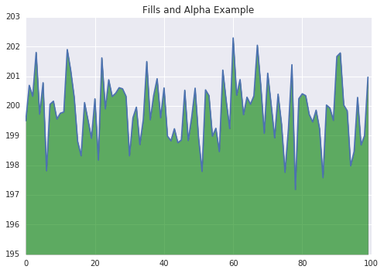
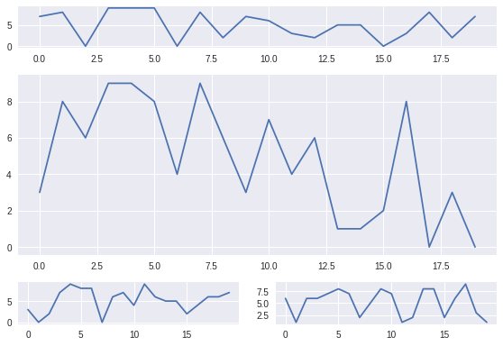
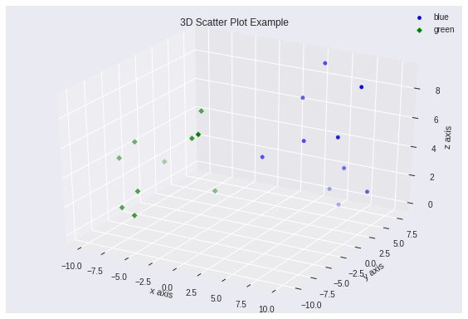
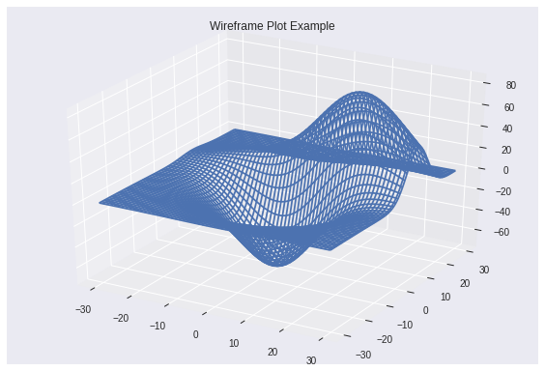
Charting in Colaboratory
Google Colab有許多範利可以提供你自我學習
https://colab.research.google.com/notebooks/charts.ipynb

Slide 8
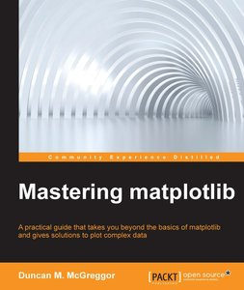
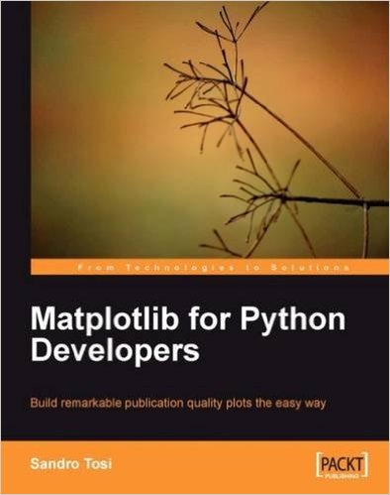
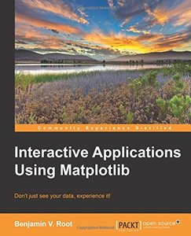


Slide 9
學習的最好參考: https://matplotlib.org/
User‘s Guide https://matplotlib.org/users/index.html

Slide 10
Data Visualization
資料視覺化の案例學習

Slide 11
github
mydeargreatteacher
uTaipei2019
1_2_Matplotlib範例學習快速入門.ipynb

Slide 12
Line Plots折線圖:基本統計圖形
import matplotlib.pyplot as plt
x = [1, 2, 3, 4, 5, 6, 7, 8, 9]
y1 = [1, 3, 5, 3, 1, 3, 5, 3, 1]
y2 = [2, 4, 6, 4, 2, 4, 6, 4, 2]
plt.plot(x, y1, label="line L")
plt.plot(x, y2, label="line H")
plt.plot()
plt.xlabel("x axis")
plt.ylabel("y axis")
plt.title("Line Graph Example")
plt.legend()
plt.show()

Slide 13
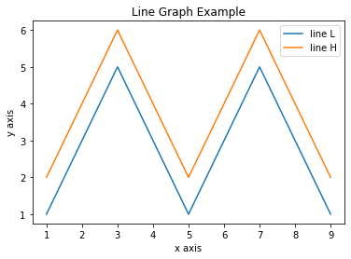

Slide 14
[隨堂小測驗]Line Plots折線圖:基本統計圖形 顏色改成紅色 線條改成虛線
import matplotlib.pyplot as plt
x = [1, 2, 3, 4, 5, 6, 7, 8, 9]
y1 = [1, 3, 5, 3, 1, 3, 5, 3, 1]
y2 = [2, 4, 6, 4, 2, 4, 6, 4, 2]
plt.plot(x, y2, label="line H")
plt.plot(x, y1,'r--',label="line L")
plt.plot()
plt.xlabel("x axis")
plt.ylabel("y axis")
plt.title("Line Graph Example")
plt.legend()
plt.show()

Slide 15
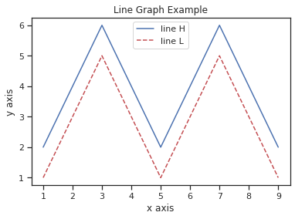

Slide 16
plot():折線圖範例2:看看底下產生的數學公式
import numpy as np
import matplotlib.pyplot as plt
t = np.arange(0.0, 2.0, 0.01)
s = np.sin(2*np.pi*t)
plt.plot(t, s)
plt.title(r'$\alpha_i > \beta_i$', fontsize=20)
plt.text(1, -0.6, r'$\sum_{i=0}^\infty x_i$', fontsize=20)
plt.text(0.6, 0.6, r'$\mathcal{A}\mathrm{sin}(2 \omega t)$',
fontsize=20)
plt.xlabel('time (s)')
plt.ylabel('volts (mV)')
plt.show()

Slide 17
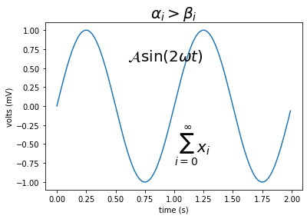

Slide 18
圓餅圖(Pie Chart)範例學習
#設定label：
labels = 'A','B','C','D','E','F'
#設定每個區塊的大小：
size = [33,52,12,17,62,48]
# 使用plt.pie()畫圓餅圖
plt.pie(size , labels = labels,autopct='%1.1f%%')
# autopct='%1.1f%%'是用來顯示百分比。
#為了要讓圓餅圖比例相等加上：
plt.axis('equal')
# 最後的顯示
plt.show()

Slide 19
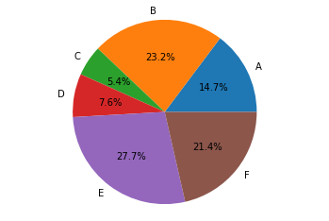

Slide 20
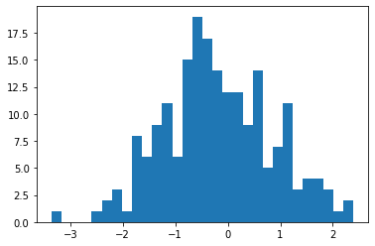
直方圖
import matplotlib.pyplot as plt
from numpy.random import normal,rand
x = normal(size=200)
plt.hist(x,bins=30)
plt.show()

Slide 21
長條圖範例一
from matplotlib import pyplot as plt
x = [5,8,10]
y = [12,16,6]
x2 = [6,9,11]
y2 = [6,15,7]
plt.bar(x, y, align = 'center')
plt.bar(x2, y2, color = 'g', align = 'center')
plt.title('Bar graph')
plt.ylabel('Y axis')
plt.xlabel('X axis')
plt.show()

Slide 22
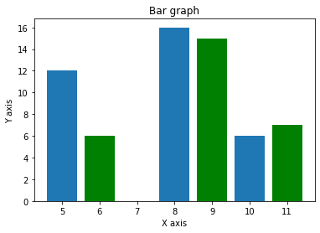

Slide 23
長條圖範例二
%matplotlib inline
import numpy as np
from matplotlib import pyplot as plt
plt.figure(figsize=(9,6))
n = 8
X = np.arange(n)+1 #X是1,2,3,4,5,6,7,8,柱的個數
#uniform均勻分佈的亂數，normal是正態分佈的亂數，0.5-1均勻分佈的數，一共有n個
Y1 = np.random.uniform(0.5,1.0,n)
Y2 = np.random.uniform(0.5,1.0,n)
plt.bar(X, Y1, alpha=0.9, width = 0.35, facecolor = 'lightskyblue', edgecolor = 'white', label='one',
lw=1)
plt.bar(X+0.35, Y2, alpha=0.9, width = 0.35, facecolor = 'yellowgreen', edgecolor = 'white', label=
'second', lw=1)
plt.legend(loc="upper left") # label的位置在左上，沒有這句會找不到label去哪了

Slide 24
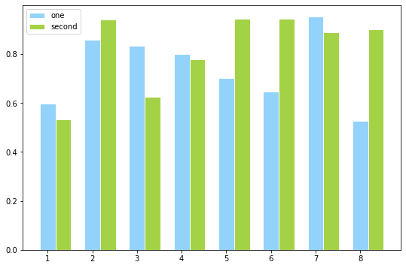

Slide 25
boxplot箱形圖 (Box plot)範例
import numpy as np
import matplotlib.pyplot as plt
# Fixing random state for reproducibility
np.random.seed(19680801)
# fake up some data
spread = np.random.rand(50) * 100
center = np.ones(25) * 50
flier_high = np.random.rand(10) * 100 + 100
flier_low = np.random.rand(10) * -100
data = np.concatenate((spread, center, flier_high, flier_low))
fig1, ax1 = plt.subplots()
ax1.set_title('Basic Plot')
ax1.boxplot(data)

Slide 26
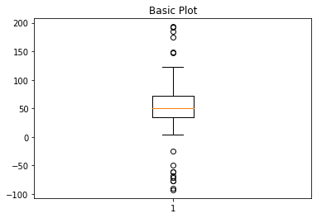

Slide 27
plot():折線圖
import numpy as np
import pylab as pl
# 產生資料
x = np.arange(0.0, 2.0*np.pi, 0.01)
y = np.sin(x)
#畫圖
pl.plot(x,y)
pl.xlabel('x')
pl.ylabel('y')
pl.title('sin')
pl.show()

Slide 28
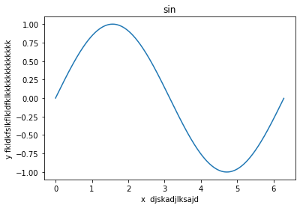

Slide 29
散佈圖 (Scatter plot)
import numpy as np
import pylab as pl
# 產生資料
x = np.arange(0, 2.0*np.pi, 0.2)
y = np.exp(x)*np.cos(x)
#畫圖
pl.scatter(x,y)
pl.show()

Slide 30
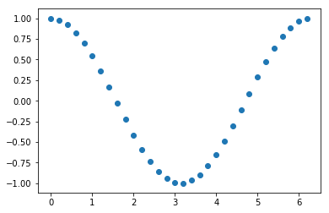

Slide 31
散佈圖 (Scatter plot)
import matplotlib.pylab as pl
import numpy as np
# 產生資料
x = np.random.random(100)
y = np.random.random(100)
#畫圖
#pl.scatter(x,y,s=x*500,c=u'r',marker=u'*')
pl.scatter(x,y,s=x*500,c=u'b',marker=u'p')
pl.show()

Slide 32
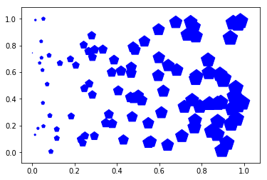

Slide 33
matplotlib.pyplot.legend的用處
import numpy as np
import pylab as pl
# 產生資料
x = np.arange(0.0, 2.0*np.pi, 0.01)
y = np.sin(x)
z = np.cos(x)
#畫圖
pl.plot(x, y, label='sin()')
pl.plot(x, z, label='cos()')
pl.xlabel('x')
pl.ylabel('y')
pl.title('sin-cos')
pl.legend(loc='center')
#pl.legend(loc='upper right')
#pl.legend(loc='upper right')
#pl.legend()
pl.show()

Slide 34
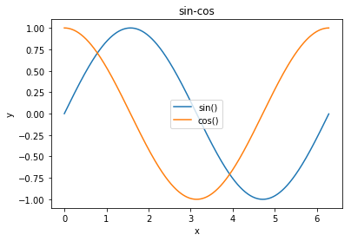

Slide 35
範例練習:帶有數學公式的圖形
import numpy as np
import matplotlib.pyplot as plt
# 產生資料
x = np.linspace(0, 2*np.pi, 500)
y = np.sin(x)
#z = np.cos(x*x)
z = np.cos(x*x*x)
#畫圖
plt.figure(figsize=(8,5))
#標籤前後加上$，代表以內嵌的LaTex引擎顯示為公式
plt.plot(x,y,label='$sin(x)$',color='red',linewidth=5) #紅色，2個像素寬
plt.plot(x,z,'b--',label='$cos(x^2)$') #b::藍色，--::虛線
plt.xlabel('Time(s)')
plt.ylabel('Volt')
plt.title('Sin and Cos figure using pyplot')
plt.ylim(-1.2,1.2)
plt.legend()
plt.show()

Slide 36
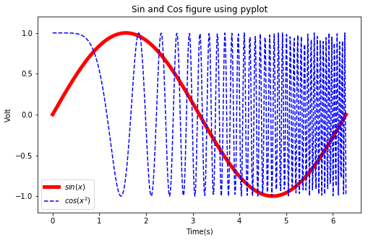

Slide 37
subplot範例練習2:多圖合併
import numpy as np
import matplotlib.pyplot as plt
# 產生資料
x= np.linspace(0, 2*np.pi, 500)
y1 = np.sin(x)
y2 = np.cos(x)
y3 = np.sin(x*x)
#畫圖
plt.figure(1) #建立圖形
#create three axes
ax1 = plt.subplot(2,2,1) #第一列第一行圖形
ax2 = plt.subplot(2,2,2) #第一列第二行圖形
ax3 = plt.subplot(2,1,2) #第二列
##設定第一張圖
plt.sca(ax1) #選擇ax1
plt.plot(x,y1,color='red') #繪製紅色曲線
plt.ylim(-1.2,1.2) #限制y坐標軸範圍
##設定第二張圖
plt.sca(ax2) #選擇ax2
plt.plot(x,y2,'b--') #繪製藍色曲線
plt.ylim(-1.2,1.2)
##設定第三張圖
plt.sca(ax3) #選擇ax3
plt.plot(x,y3,'g--')
plt.ylim(-1.2,1.2)
##多圖並呈
plt.show()

Slide 38
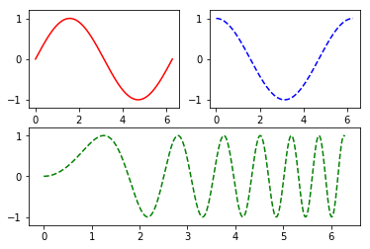

Slide 39
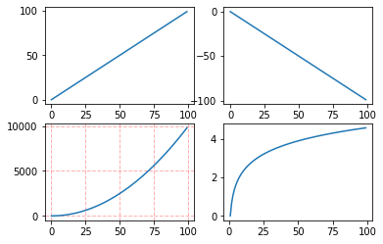
subplot範例練習1:多圖合併
import numpy as np
import matplotlib.pyplot as plt
x = np.arange(0, 100)
plt.subplot(221)
plt.plot(x, x)
#作圖2
plt.subplot(222)
plt.plot(x, -x)
#作圖3
plt.subplot(223)
plt.plot(x, x ** 2)
plt.grid(color='r', linestyle='--', linewidth=1,alpha=0.3)
#作圖4
plt.subplot(224)
plt.plot(x, np.log(x))
plt.show()

Slide 40
圖中圖的技術add_axes()
import matplotlib.pyplot as plt
#新建figure
fig = plt.figure()
# 定義資料
x = [1, 2, 3, 4, 5, 6, 7]
y = [1, 3, 4, 2, 5, 8, 6]
#新建區域ax1
#figure的百分比,從figure 10%的位置開始繪製, 寬高是figure的80%
left, bottom, width, height = 0.1, 0.1, 0.8, 0.8
# 獲得繪製的控制代碼
ax1 = fig.add_axes([left, bottom, width, height])
ax1.plot(x, y, 'r')
ax1.set_title('area1')
#新增區域ax2,巢狀在ax1內
left, bottom, width, height = 0.2, 0.6, 0.25, 0.25
# 獲得繪製的控制代碼
ax2 = fig.add_axes([left, bottom, width, height])
ax2.plot(x,y, 'b')
ax2.set_title('area2')
plt.show()

Slide 41
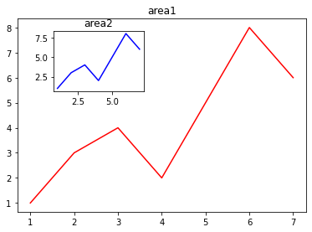

Slide 42
3D圖形畫製範例練習:
import numpy as np
import matplotlib.pyplot as plt
import mpl_toolkits.mplot3d
# 產生資料
x,y = np.mgrid[-2:2:20j, -2:2:20j]
z = 50 * np.sin(x+y) #測試資料
#畫圖
ax = plt.subplot(111, projection='3d') #三維圖形
ax.plot_surface(x,y,z,rstride=2, cstride=1, cmap=plt.cm.Blues_r)
ax.set_xlabel('X') #設定坐標軸標籤
ax.set_ylabel('Y')
ax.set_zlabel('Z')
plt.show()

Slide 43
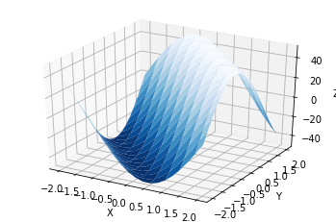

Slide 44
延伸閱讀: seaborn
import seaborn as sns
sns.set(style="ticks")
# Load the example dataset for Anscombe's quartet
df = sns.load_dataset("anscombe")
# Show the results of a linear regression within each dataset
sns.lmplot(x="x", y="y", col="dataset", hue="dataset", data=df,
col_wrap=2, ci=None, palette="muted", height=4,
scatter_kws={"s": 50, "alpha": 1});

Slide 45
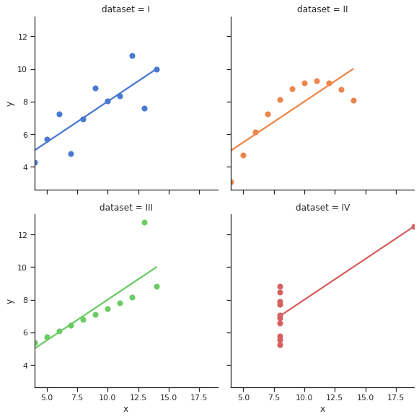

Slide 46
延伸閱讀: altair
import altair as alt
from vega_datasets import data
cars = data.cars()
alt.Chart(cars).mark_point().encode(
x='Horsepower',
y='Miles_per_Gallon',
color='Origin',
).interactive()

Slide 47
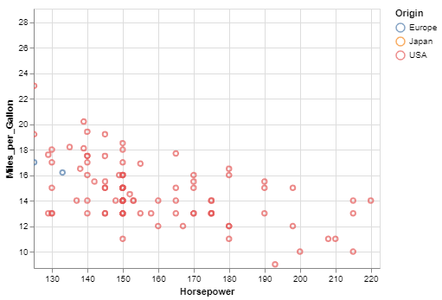

Slide 48
延伸閱讀:書bokeh
import numpy as np
from bokeh.plotting import figure, show
from bokeh.io import output_notebook
N = 4000
x = np.random.random(size=N) * 100
y = np.random.random(size=N) * 100
radii = np.random.random(size=N) * 1.5
colors = ["#%02x%02x%02x" % (r, g, 150) for r, g in zip(np.floor(50+2*x)
.astype(int), np.floor(30+2*y).astype(int))]
output_notebook()
p = figure()
p.circle(x, y, radius=radii, fill_color=colors, fill_alpha=0.6, line_color=None)
show(p)

Slide 49
延伸學習
Data Visualization
資料視覺化の各種套件
作業

Slide 50
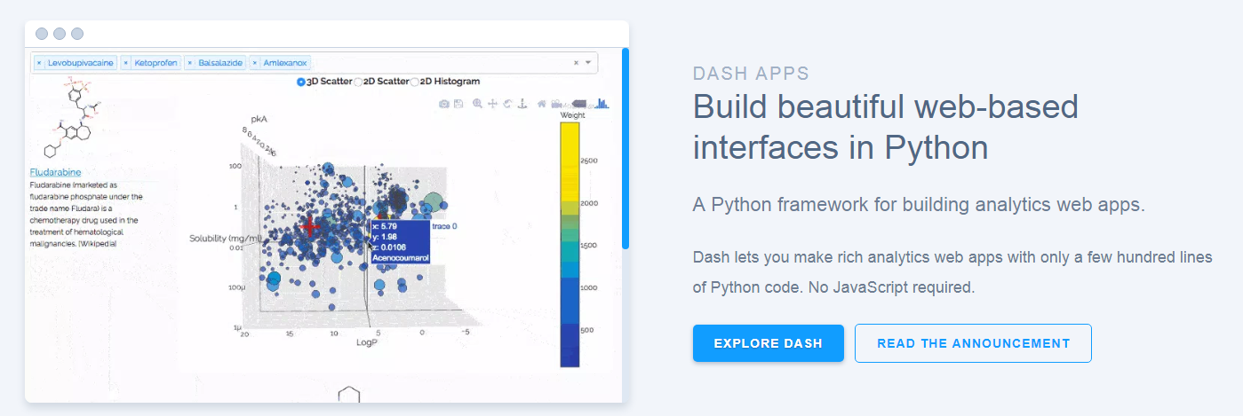
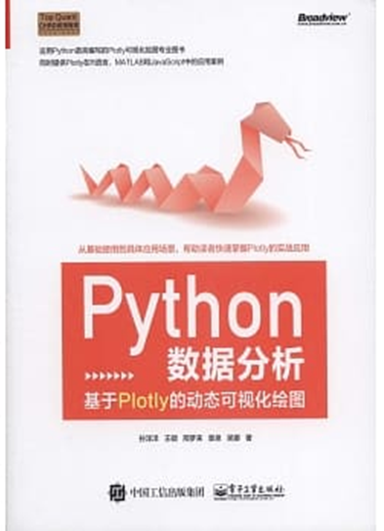
到官方網址https://plot.ly/看看互動式資料視覺化成果
延伸閱讀:推薦的教科書
Python數據分析：基於Plotly的動態可視化繪圖
作者： 孫洋洋, 王碩, 邢夢來, 袁泉, 吳娜
電子工業出版社
https://github.com/sunshe35/PythonPlotlyCodes

Slide 51
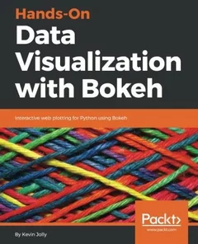
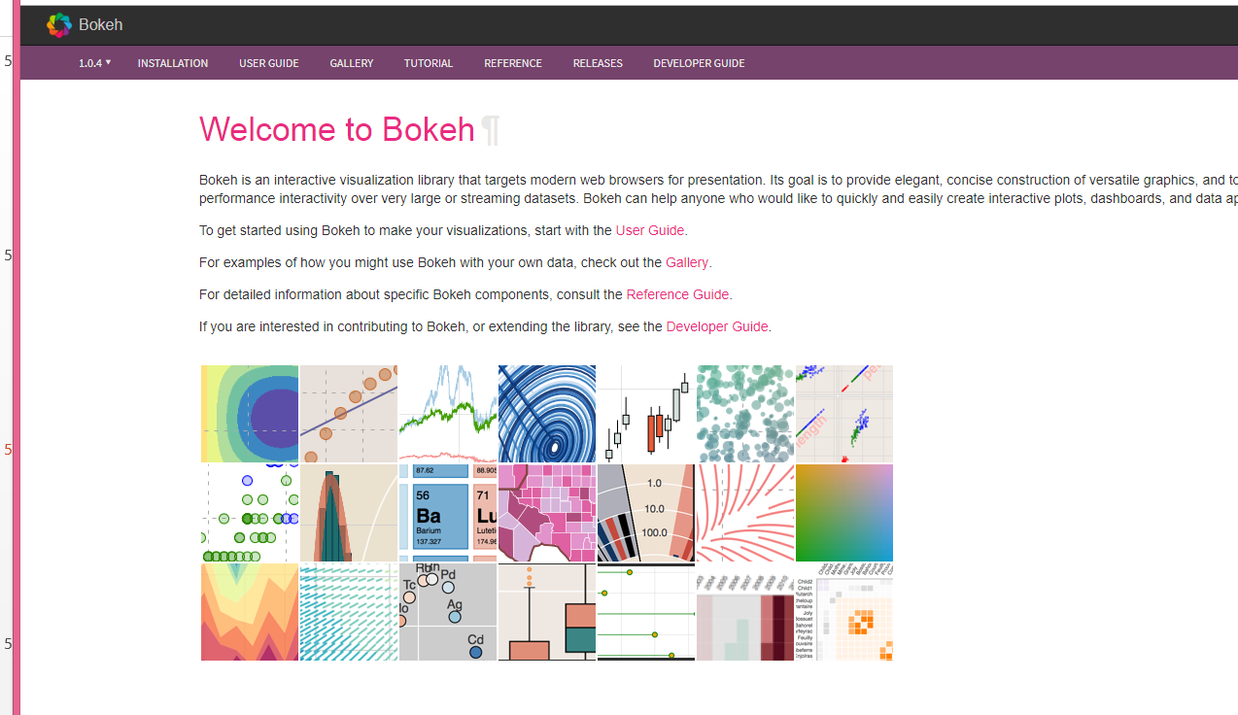
到官方網址https://bokeh.pydata.org/en/latest/
看看互動式資料視覺化成果
!pip install bokeh

Slide 52
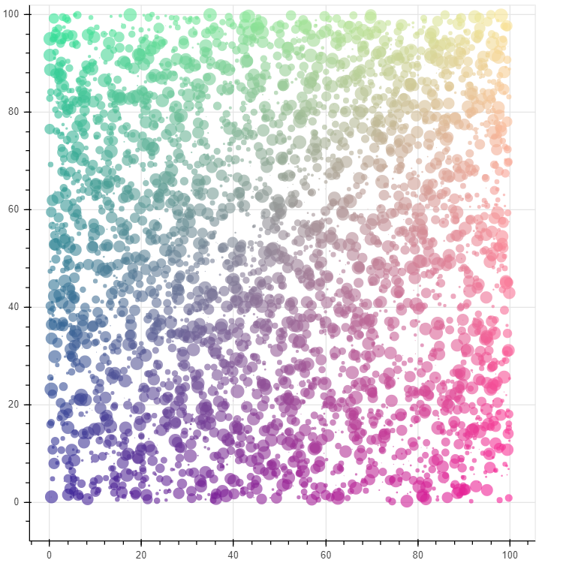
import numpy as np
from bokeh.plotting import figure, show
from bokeh.io import output_notebook
N = 4000
x = np.random.random(size=N) * 100
y = np.random.random(size=N) * 100
radii = np.random.random(size=N) * 1.5
colors = ["#%02x%02x%02x" % (r, g, 150) for r, g in zip(np.floor(50+2*x).astype(int), np.floor(30+2*y).astype(int))]
output_notebook()
p = figure()
p.circle(x, y, radius=radii, fill_color=colors, fill_alpha=0.6, line_color=None)
show(p)
https://colab.research.google.com/notebooks/charts.ipynb

Slide 53
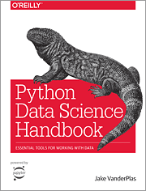
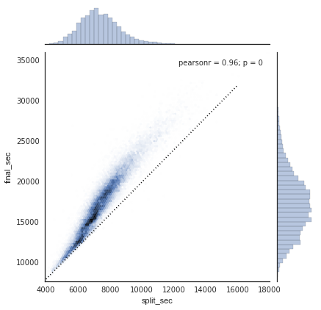
在Google Colab學習seaborn
!pip install seaborn==0.9.0
範例學習1:
https://colab.research.google.com/github/jakevdp/PythonDataScienceHandbook/blob/master/notebooks/04.14-Visualization-With-Seaborn.ipynb
範例學習2:
https://colab.research.google.com/drive/1o6MijFkNHiTPeS8Y5n59j2cH4-Mf2wX3

Slide 54
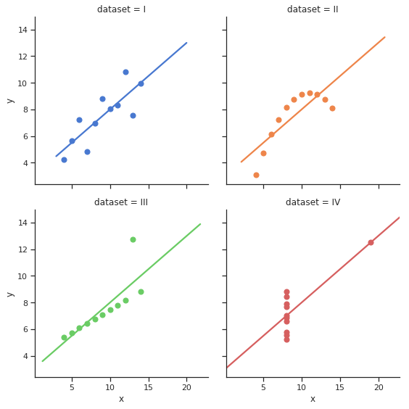
import seaborn as sns
sns.set(style="ticks")
# Load the example dataset for Anscombe's quartet
df = sns.load_dataset("anscombe")
# Show the results of a linear regression within each dataset
sns.lmplot(x="x", y="y", col="dataset", hue="dataset", data=df,
col_wrap=2, ci=None, palette="muted", height=4,
scatter_kws={"s": 50, "alpha": 1});
https://www.data-insights.cn/?p=179

Slide 55
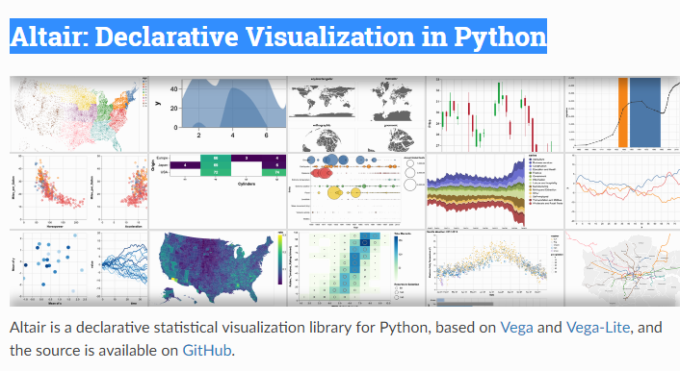
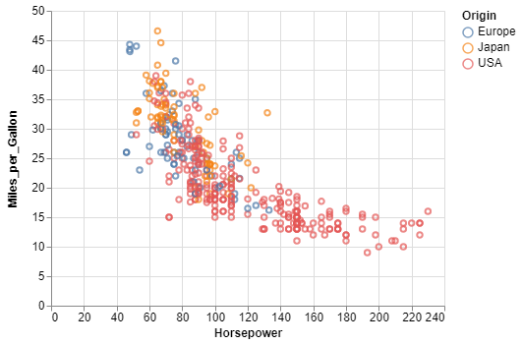
Altair: Declarative Visualization in Python
到官方網址https://altair-viz.github.io/
看看資料視覺化成果
import altair as alt
from vega_datasets import data
cars = data.cars()
alt.Chart(cars).mark_point().encode(
x='Horsepower',
y='Miles_per_Gallon',
color='Origin',
).interactive()

Slide 56
更多實戰演練
作業

Slide 57
PathPatch object
import matplotlib.path as mpath
import matplotlib.patches as mpatches
import matplotlib.pyplot as plt
fig, ax = plt.subplots()
Path = mpath.Path
path_data = [
(Path.MOVETO, (1.58, -2.57)),
(Path.CURVE4, (0.35, -1.1)),
(Path.CURVE4, (-1.75, 2.0)),
(Path.CURVE4, (0.375, 2.0)),
(Path.LINETO, (0.85, 1.15)),
(Path.CURVE4, (2.2, 3.2)),
(Path.CURVE4, (3, 0.05)),
(Path.CURVE4, (2.0, -0.5)),
(Path.CLOSEPOLY, (1.58, -2.57)),
]
codes, verts = zip(*path_data)
path = mpath.Path(verts, codes)
patch = mpatches.PathPatch(path, facecolor='r', alpha=0.5)
ax.add_patch(patch)
# plot control points and connecting lines
x, y = zip(*path.vertices)
line, = ax.plot(x, y, 'go-')
ax.grid()
ax.axis('equal')
plt.show()

Slide 59
Streamplot
import numpy as np
import matplotlib.pyplot as plt
import matplotlib.gridspec as gridspec
w = 3
Y, X = np.mgrid[-w:w:100j, -w:w:100j]
U = -1 - X**2 + Y
V = 1 + X - Y**2
speed = np.sqrt(U**2 + V**2)
fig = plt.figure(figsize=(7, 9))
gs = gridspec.GridSpec(nrows=3, ncols=2, height_ratios=[1, 1, 2])
# Varying density along a streamline
ax0 = fig.add_subplot(gs[0, 0])
ax0.streamplot(X, Y, U, V, density=[0.5, 1])
ax0.set_title('Varying Density')

Slide 60
# Varying color along a streamline
ax1 = fig.add_subplot(gs[0, 1])
strm = ax1.streamplot(X, Y, U, V, color=U, linewidth=2, cmap='autumn')
fig.colorbar(strm.lines)
ax1.set_title('Varying Color')
# Varying line width along a streamline
ax2 = fig.add_subplot(gs[1, 0])
lw = 5*speed / speed.max()
ax2.streamplot(X, Y, U, V, density=0.6, color='k', linewidth=lw)
ax2.set_title('Varying Line Width')
# Controlling the starting points of the streamlines
seed_points = np.array([[-2, -1, 0, 1, 2, -1], [-2, -1, 0, 1, 2, 2]])
ax3 = fig.add_subplot(gs[1, 1])
strm = ax3.streamplot(X, Y, U, V, color=U, linewidth=2,
cmap='autumn', start_points=seed_points.T)
fig.colorbar(strm.lines)
ax3.set_title('Controlling Starting Points')

Slide 61
# Displaying the starting points with blue symbols.
ax3.plot(seed_points[0], seed_points[1], 'bo')
ax3.set(xlim=(-w, w), ylim=(-w, w))
# Create a mask
mask = np.zeros(U.shape, dtype=bool)
mask[40:60, 40:60] = True
U[:20, :20] = np.nan
U = np.ma.array(U, mask=mask)
ax4 = fig.add_subplot(gs[2:, :])
ax4.streamplot(X, Y, U, V, color='r')
ax4.set_title('Streamplot with Masking')
ax4.imshow(~mask, extent=(-w, w, -w, w), alpha=0.5, cmap='gray', aspect='auto')
ax4.set_aspect('equal')
plt.tight_layout()
plt.show()

Slide 62
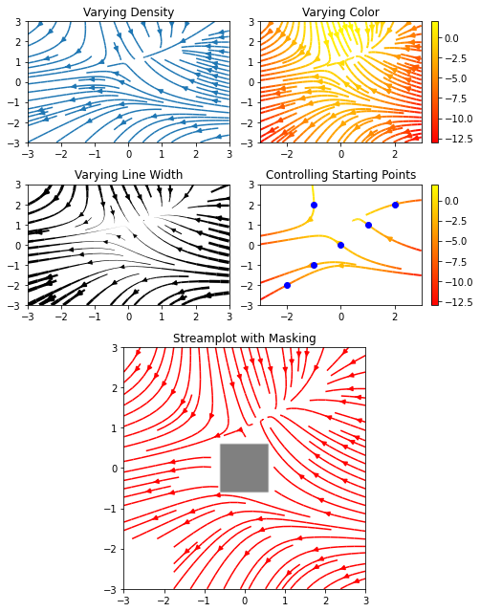

Slide 63
Ellipse Demo
import matplotlib.pyplot as plt
import numpy as np
from matplotlib.patches import Ellipse
# Fixing random state for reproducibility
np.random.seed(19680801)
NUM = 250
ells = [Ellipse(xy=np.random.rand(2) * 10,
width=np.random.rand(), height=np.random.rand(),
angle=np.random.rand() * 360)
for i in range(NUM)]

Slide 64
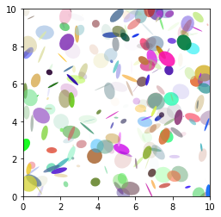
fig, ax = plt.subplots(subplot_kw={'aspect': 'equal'})
for e in ells:
ax.add_artist(e)
e.set_clip_box(ax.bbox)
e.set_alpha(np.random.rand())
e.set_facecolor(np.random.rand(3))
ax.set_xlim(0, 10)
ax.set_ylim(0, 10)
plt.show()

Slide 65
Percentiles as horizontal bar chart
import numpy as np
import matplotlib
import matplotlib.pyplot as plt
from matplotlib.ticker import MaxNLocator
from collections import namedtuple
np.random.seed(42)
Student = namedtuple('Student', ['name', 'grade', 'gender'])
Score = namedtuple('Score', ['score', 'percentile'])
# GLOBAL CONSTANTS
test_names = ['Pacer Test', 'Flexed Arm\n Hang', 'Mile Run', 'Agility',
'Push Ups']
test_units = dict(zip(test_names, ['laps', 'sec', 'min:sec', 'sec', '']))

Slide 66
def attach_ordinal(num):
"""Convert an integer to an ordinal string, e.g. 2 -> '2nd'."""
suffixes = {str(i): v
for i, v in enumerate(['th', 'st', 'nd', 'rd', 'th',
'th', 'th', 'th', 'th', 'th'])}
v = str(num)
# special case early teens
if v in {'11', '12', '13'}:
return v + 'th'
return v + suffixes[v[-1]]
def format_score(score, test):
"""
Create score labels for the right y-axis as the test name followed by the
measurement unit (if any), split over two lines.
"""
unit = test_units[test]
if unit:
return f'{score}\n{unit}'
else: # If no unit, don't include a newline, so that label stays centered.
return score

Slide 67
def format_ycursor(y):
y = int(y)
if y < 0 or y >= len(test_names):
return ''
else:
return test_names[y]
def plot_student_results(student, scores, cohort_size):
fig, ax1 = plt.subplots(figsize=(9, 7)) # Create the figure
fig.subplots_adjust(left=0.115, right=0.88)
fig.canvas.set_window_title('Eldorado K-8 Fitness Chart')
pos = np.arange(len(test_names))
rects = ax1.barh(pos, [scores[k].percentile for k in test_names],
align='center',
height=0.5,
tick_label=test_names)

Slide 68
ax1.set_title(student.name)
ax1.set_xlim([0, 100])
ax1.xaxis.set_major_locator(MaxNLocator(11))
ax1.xaxis.grid(True, linestyle='--', which='major',
color='grey', alpha=.25)
# Plot a solid vertical gridline to highlight the median position
ax1.axvline(50, color='grey', alpha=0.25)
# Set the right-hand Y-axis ticks and labels
ax2 = ax1.twinx()
# Set the tick locations
ax2.set_yticks(pos)
# Set equal limits on both yaxis so that the ticks line up
ax2.set_ylim(ax1.get_ylim())

Slide 69
# Set the tick labels
ax2.set_yticklabels([format_score(scores[k].score, k) for k in test_names])
ax2.set_ylabel('Test Scores')
xlabel = ('Percentile Ranking Across {grade} Grade {gender}s\n'
'Cohort Size: {cohort_size}')
ax1.set_xlabel(xlabel.format(grade=attach_ordinal(student.grade),
gender=student.gender.title(),
cohort_size=cohort_size))
rect_labels = []
# Lastly, write in the ranking inside each bar to aid in interpretation
for rect in rects:
# Rectangle widths are already integer-valued but are floating
# type, so it helps to remove the trailing decimal point and 0 by
# converting width to int type
width = int(rect.get_width())

Slide 70
rank_str = attach_ordinal(width)
# The bars aren't wide enough to print the ranking inside
if width < 40:
# Shift the text to the right side of the right edge
xloc = 5
# Black against white background
clr = 'black'
align = 'left'
else:
# Shift the text to the left side of the right edge
xloc = -5
# White on magenta
clr = 'white'
align = 'right'
# Center the text vertically in the bar
yloc = rect.get_y() + rect.get_height() / 2
label = ax1.annotate(
rank_str, xy=(width, yloc), xytext=(xloc, 0),
textcoords="offset points",
horizontalalignment=align, verticalalignment='center',
color=clr, weight='bold', clip_on=True)
rect_labels.append(label)

Slide 71
# Make the interactive mouse over give the bar title
ax2.fmt_ydata = format_ycursor
# Return all of the artists created
return {'fig': fig,
'ax': ax1,
'ax_right': ax2,
'bars': rects,
'perc_labels': rect_labels}
student = Student('Johnny Doe', 2, 'boy')
scores = dict(zip(
test_names,
(Score(v, p) for v, p in
zip(['7', '48', '12:52', '17', '14'],
np.round(np.random.uniform(0, 100, len(test_names)), 0)))))
cohort_size = 62 # The number of other 2nd grade boys
arts = plot_student_results(student, scores, cohort_size)
plt.show()

Slide 72
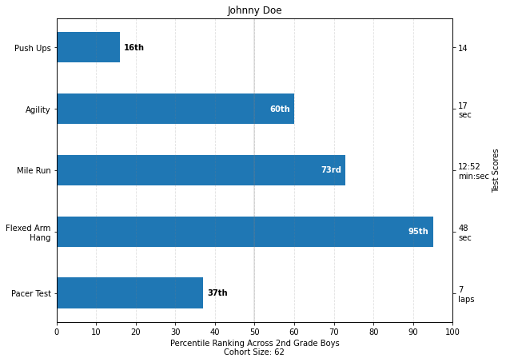

Slide 73
Table Demo
import numpy as np
import matplotlib.pyplot as plt
data = [[ 66386, 174296, 75131, 577908, 32015],
[ 58230, 381139, 78045, 99308, 160454],
[ 89135, 80552, 152558, 497981, 603535],
[ 78415, 81858, 150656, 193263, 69638],
[139361, 331509, 343164, 781380, 52269]]
columns = ('Freeze', 'Wind', 'Flood', 'Quake', 'Hail')
rows = ['%d year' % x for x in (100, 50, 20, 10, 5)]
values = np.arange(0, 2500, 500)
value_increment = 1000
# Get some pastel shades for the colors
colors = plt.cm.BuPu(np.linspace(0, 0.5, len(rows)))
n_rows = len(data)

Slide 74
index = np.arange(len(columns)) + 0.3
bar_width = 0.4
# Initialize the vertical-offset for the stacked bar chart.
y_offset = np.zeros(len(columns))
# Plot bars and create text labels for the table
cell_text = []
for row in range(n_rows):
plt.bar(index, data[row], bar_width, bottom=y_offset, color=colors[row])
y_offset = y_offset + data[row]
cell_text.append(['%1.1f' % (x / 1000.0) for x in y_offset])
# Reverse colors and text labels to display the last value at the top.
colors = colors[::-1]
cell_text.reverse()
# Add a table at the bottom of the axes
the_table = plt.table(cellText=cell_text,
rowLabels=rows,
rowColours=colors,
colLabels=columns,
loc='bottom')

Slide 75
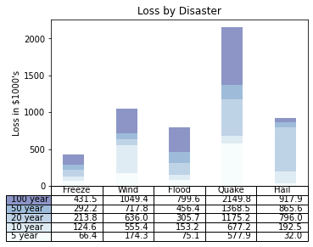
# Adjust layout to make room for the table:
plt.subplots_adjust(left=0.2, bottom=0.2)
plt.ylabel("Loss in ${0}'s".format(value_increment))
plt.yticks(values * value_increment, ['%d' % val for val in values])
plt.xticks([])
plt.title('Loss by Disaster')
plt.show()

Slide 76
Slider Demo
import numpy as np
import matplotlib.pyplot as plt
from matplotlib.widgets import Slider, Button, RadioButtons
fig, ax = plt.subplots()
plt.subplots_adjust(left=0.25, bottom=0.25)
t = np.arange(0.0, 1.0, 0.001)
a0 = 5
f0 = 3
delta_f = 5.0
s = a0 * np.sin(2 * np.pi * f0 * t)
l, = plt.plot(t, s, lw=2)
ax.margins(x=0)
axcolor = 'lightgoldenrodyellow'
axfreq = plt.axes([0.25, 0.1, 0.65, 0.03], facecolor=axcolor)
axamp = plt.axes([0.25, 0.15, 0.65, 0.03], facecolor=axcolor)

Slide 77
sfreq = Slider(axfreq, 'Freq', 0.1, 30.0, valinit=f0, valstep=delta_f)
samp = Slider(axamp, 'Amp', 0.1, 10.0, valinit=a0)
def update(val):
amp = samp.val
freq = sfreq.val
l.set_ydata(amp*np.sin(2*np.pi*freq*t))
fig.canvas.draw_idle()
sfreq.on_changed(update)
samp.on_changed(update)
resetax = plt.axes([0.8, 0.025, 0.1, 0.04])
button = Button(resetax, 'Reset', color=axcolor, hovercolor='0.975')
def reset(event):
sfreq.reset()
samp.reset()
button.on_clicked(reset)

Slide 78
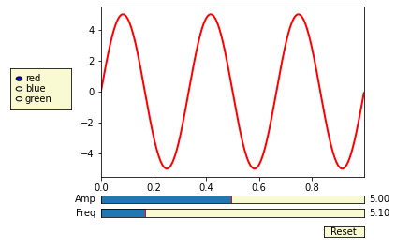
rax = plt.axes([0.025, 0.5, 0.15, 0.15], facecolor=axcolor)
radio = RadioButtons(rax, ('red', 'blue', 'green'), active=0)
def colorfunc(label):
l.set_color(label)
fig.canvas.draw_idle()
radio.on_clicked(colorfunc)
# Initialize plot with correct initial active value
colorfunc(radio.value_selected)
plt.show()

Slide 79
Polar Demo
import numpy as np
import matplotlib.pyplot as plt
r = np.arange(0, 2, 0.01)
theta = 2 * np.pi * r
fig, ax = plt.subplots(subplot_kw={'projection': 'polar'})
ax.plot(theta, r)
ax.set_rmax(2)
ax.set_rticks([0.5, 1, 1.5, 2]) # Less radial ticks
ax.set_rlabel_position(-22.5) # Move radial labels away from plotted line
ax.grid(True)
ax.set_title("A line plot on a polar axis", va='bottom')
plt.show()

Slide 80
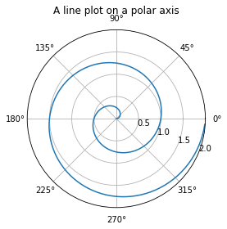

Slide 81
Legend using pre-defined labels
import numpy as np
import matplotlib.pyplot as plt
# Make some fake data.
a = b = np.arange(0, 3, .02)
c = np.exp(a)
d = c[::-1]
# Create plots with pre-defined labels.
fig, ax = plt.subplots()
ax.plot(a, c, 'k--', label='Model length')
ax.plot(a, d, 'k:', label='Data length')
ax.plot(a, c + d, 'k', label='Total message length')
legend = ax.legend(loc='upper center', shadow=True, fontsize='x-large')
# Put a nicer background color on the legend.
legend.get_frame().set_facecolor('C0')
plt.show()

Slide 82
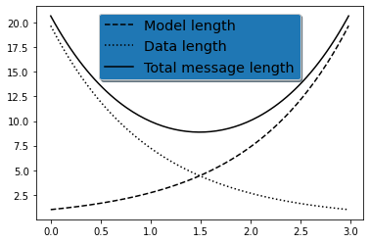

Slide 83
Mathtext Examples
import matplotlib.pyplot as plt
import subprocess
import sys
import re
# Selection of features following "Writing mathematical expressions" tutorial
mathtext_titles = {
0: "Header demo",
1: "Subscripts and superscripts",
2: "Fractions, binomials and stacked numbers",
3: "Radicals",
4: "Fonts",
5: "Accents",
6: "Greek, Hebrew",
7: "Delimiters, functions and Symbols"}
n_lines = len(mathtext_titles)

Slide 84
# Randomly picked examples
mathext_demos = {
0: r"$W^{3\beta}_{\delta_1 \rho_1 \sigma_2} = "
r"U^{3\beta}_{\delta_1 \rho_1} + \frac{1}{8 \pi 2} "
r"\int^{\alpha_2}_{\alpha_2} d \alpha^\prime_2 \left[\frac{ "
r"U^{2\beta}_{\delta_1 \rho_1} - \alpha^\prime_2U^{1\beta}_"
r"{\rho_1 \sigma_2} }{U^{0\beta}_{\rho_1 \sigma_2}}\right]$",
1: r"$\alpha_i > \beta_i,\ "
r"\alpha_{i+1}^j = {\rm sin}(2\pi f_j t_i) e^{-5 t_i/\tau},\ "
r"\ldots$",
2: r"$\frac{3}{4},\ \binom{3}{4},\ \genfrac{}{}{0}{}{3}{4},\ "
r"\left(\frac{5 - \frac{1}{x}}{4}\right),\ \ldots$",
3: r"$\sqrt{2},\ \sqrt[3]{x},\ \ldots$",
4: r"$\mathrm{Roman}\ , \ \mathit{Italic}\ , \ \mathtt{Typewriter} \ "
r"\mathrm{or}\ \mathcal{CALLIGRAPHY}$",
5: r"$\acute a,\ \bar a,\ \breve a,\ \dot a,\ \ddot a, \ \grave a, \ "
r"\hat a,\ \tilde a,\ \vec a,\ \widehat{xyz},\ \widetilde{xyz},\ "
r"\ldots$",

Slide 85
6: r"$\alpha,\ \beta,\ \chi,\ \delta,\ \lambda,\ \mu,\ "
r"\Delta,\ \Gamma,\ \Omega,\ \Phi,\ \Pi,\ \Upsilon,\ \nabla,\ "
r"\aleph,\ \beth,\ \daleth,\ \gimel,\ \ldots$",
7: r"$\coprod,\ \int,\ \oint,\ \prod,\ \sum,\ "
r"\log,\ \sin,\ \approx,\ \oplus,\ \star,\ \varpropto,\ "
r"\infty,\ \partial,\ \Re,\ \leftrightsquigarrow, \ \ldots$"}
def doall():
# Colors used in Matplotlib online documentation.
mpl_blue_rvb = (191. / 255., 209. / 256., 212. / 255.)
mpl_orange_rvb = (202. / 255., 121. / 256., 0. / 255.)
mpl_grey_rvb = (51. / 255., 51. / 255., 51. / 255.)
# Creating figure and axis.
plt.figure(figsize=(6, 7))
plt.axes([0.01, 0.01, 0.98, 0.90], facecolor="white", frameon=True)
plt.gca().set_xlim(0., 1.)
plt.gca().set_ylim(0., 1.)
plt.gca().set_title("Matplotlib's math rendering engine",
color=mpl_grey_rvb, fontsize=14, weight='bold')
plt.gca().set_xticklabels("", visible=False)
plt.gca().set_yticklabels("", visible=False)

Slide 86
# Gap between lines in axes coords
line_axesfrac = 1 / n_lines
# Plotting header demonstration formula
full_demo = mathext_demos[0]
plt.annotate(full_demo,
xy=(0.5, 1. - 0.59 * line_axesfrac),
color=mpl_orange_rvb, ha='center', fontsize=20)
# Plotting features demonstration formulae
for i_line in range(1, n_lines):
baseline = 1 - i_line * line_axesfrac
baseline_next = baseline - line_axesfrac
title = mathtext_titles[i_line] + ":"
fill_color = ['white', mpl_blue_rvb][i_line % 2]
plt.fill_between([0., 1.], [baseline, baseline],
[baseline_next, baseline_next],
color=fill_color, alpha=0.5)
plt.annotate(title,
xy=(0.07, baseline - 0.3 * line_axesfrac),
color=mpl_grey_rvb, weight='bold')
demo = mathext_demos[i_line]

Slide 87
plt.annotate(demo,
xy=(0.05, baseline - 0.75 * line_axesfrac),
color=mpl_grey_rvb, fontsize=16)
for i in range(n_lines):
s = mathext_demos[i]
print(i, s)
plt.show()
if '--latex' in sys.argv:
# Run: python mathtext_examples.py --latex
# Need amsmath and amssymb packages.
fd = open("mathtext_examples.ltx", "w")
fd.write("\\documentclass{article}\n")
fd.write("\\usepackage{amsmath, amssymb}\n")
fd.write("\\begin{document}\n")
fd.write("\\begin{enumerate}\n")
for i in range(n_lines):
s = mathext_demos[i]
s = re.sub(r"(?<!\\)\$", "$$", s)
fd.write("\\item %s\n" % s)
fd.write("\\end{enumerate}\n")
fd.write("\\end{document}\n")
fd.close()
subprocess.call(["pdflatex", "mathtext_examples.ltx"])
else:
doall()

Slide 88
