Slide 1
Project Overview
Project Name: Beauty Glow
Goal: Use sales data to identify key growth opportunities and optimize business performance.

Slide 2
Business Questions
- Which product categories are most profitable?
- What days or times drive the most sales?
- Are Instagram promotions generating revenue increases?

Slide 3
Key Findings - Product Performance
- Top Category: Skincare ($65,333 revenue).
- Top Product: Vitamin C Serum (845 units, $9,960).
- Least Performing Product: Brow Pencil (503 units, $5,030).

Slide 4
Key Findings - Sales Timing
- Best Sales Days:
- Wednesdays: $20,293
- Saturdays: $19,474
- Lowest Skincare Sales: Thursdays ($7,161).
- Face Masks on Thursdays: 6 units, $108 revenue.

Slide 5
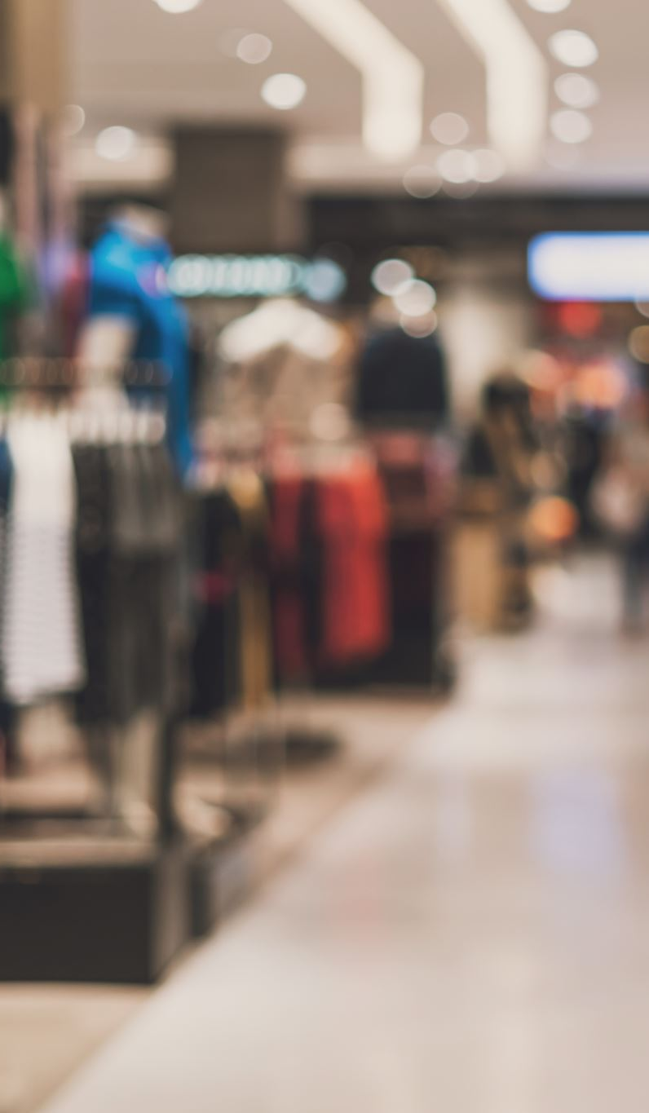
Key Findings - Sales Channel
- In-store Revenue: $58,479.
- Instagram Revenue: $38,685.
- Without Promotions: $64,241.
- With Promotions: $32,923.

Slide 6
Key Findings - Customer Behavior
- Total Customers: 1,737.
Top Spenders:
- Cust8697: $216 (mostly skincare).
- Cust6490: $208 (skincare and makeup).
- Cust2907: $205 (mainly Wednesdays).

Slide 7
Recommendations
- Focus on Skincare, especially Vitamin C Serum.
01
- Leverage Wednesdays and Saturdays with exclusive offers.
02
- Shift from broad to targeted promotions.
03
- Invest in Instagram content, influencers, and IG shopping.
04
- Bundle slow-moving products (e.g. Brow Pencil).
05
- Launch VIP program for top customers.
06

Slide 8
Next Steps
Implement
- Implement targeted promotional campaigns.
Build
- Build customer loyalty programs.
Monitor and evaluate
- Monitor and evaluate promo performance monthly.
Scale
- Scale Instagram marketing efforts.

