Slide 1

Foundations of Machine Learning DSA 5105 • Lecture 4
Soufiane Hayou
Department of Mathematics

Slide 2
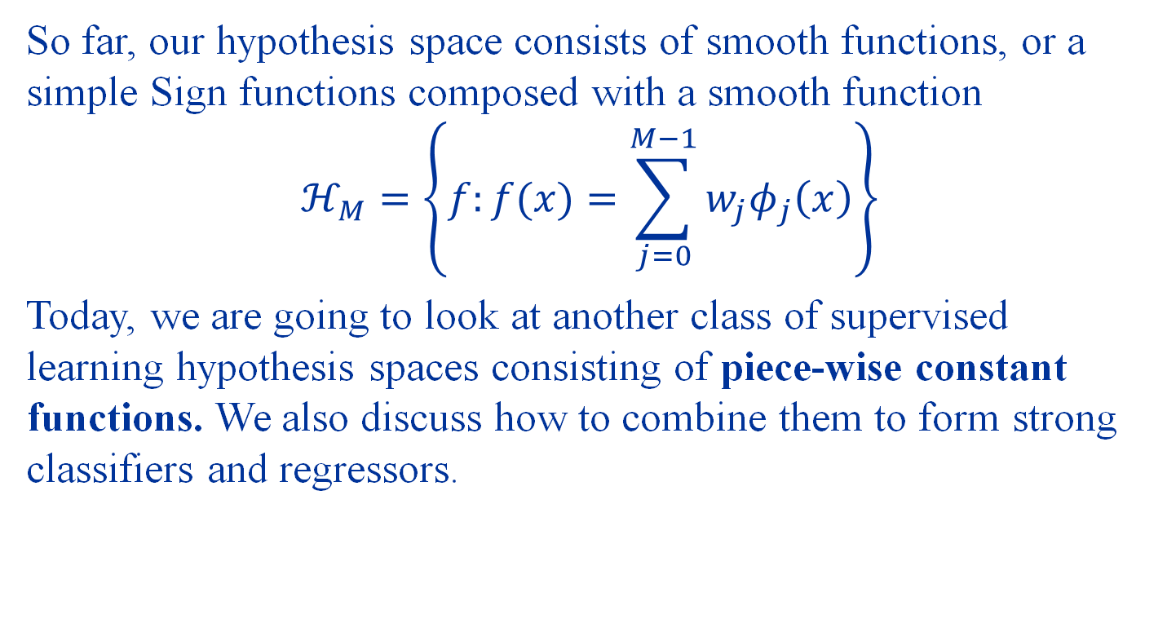
Last time
So far, our hypothesis space consists of smooth functions, or a simple Sign functions composed with a smooth function
$$ℋ_{M}=\left\{f:f(x)=\sum_{j=0}^{M−1}{w_{j}φ_{j}\left(x\right)}\right\}$$
Today, we are going to look at another class of supervised learning hypothesis spaces consisting of piece-wise constant functions. We also discuss how to combine them to form strong classifiers and regressors.

Slide 3
Decision Trees

Slide 4
Should I go to DSA5105?
Is it a Saturday afternoon?
No
Yes
Do DSA5105 homework/project
Go out with friends instead?
Have friends
No friends
Do they wanna learn ML?
Go to DSA5105
Yes
No
Go to DSA5105
Change friends

Slide 5
Decision Tree Basics
Root Node
Branches
Leaf Node
Internal Node
Depth = 3
Branches
Internal Node
Leaf Node
Branches
Leaf Node
Leaf Node

Slide 6
Decision Trees
Decision trees are very simple and useful ways to build models.
Key ideas
Stratify the input space into distinct, non-overlapping regions
Assign a chosen, constant prediction to each region

Slide 7
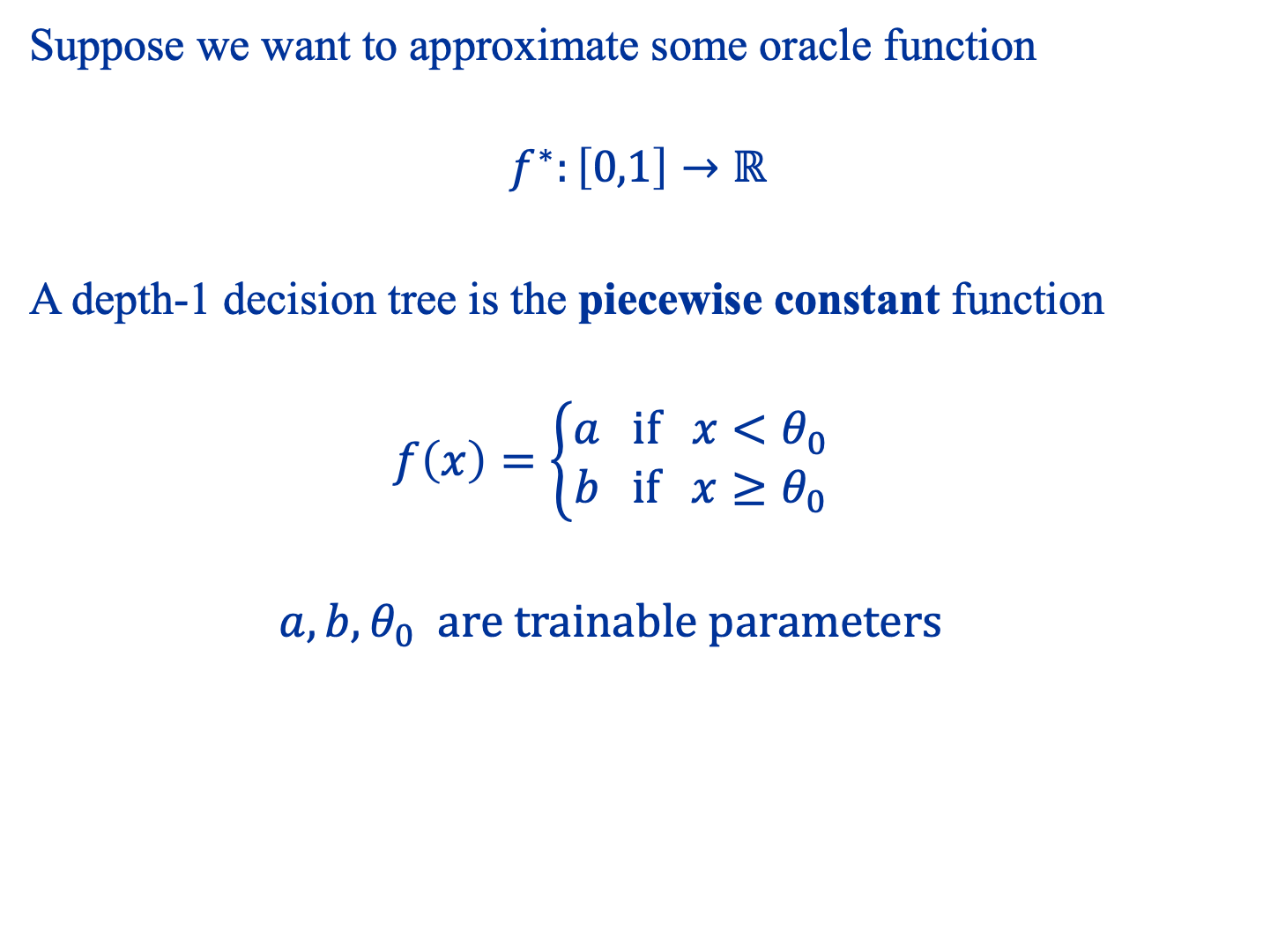
A One-Dimensional Example
Suppose we want to approximate some oracle function
$$f^{∗}:\left[0,1\right]→ℝ$$
A depth-1 decision tree is the piecewise constant function
$$f\left(x\right)=\left\{\begin{aligned}a if x<θ_{0} \\ b if x≥θ_{0}\end{aligned}\right.$$
$$a,b,θ_{0} are trainable parameters$$

Slide 8
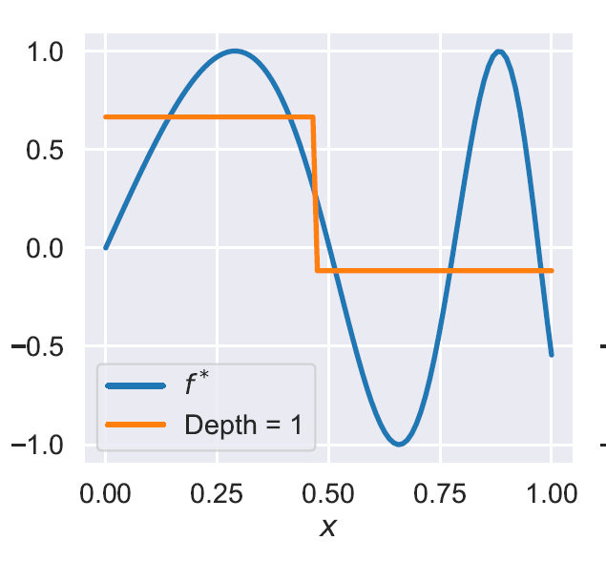

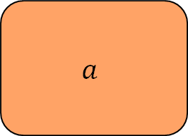
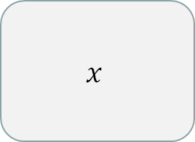



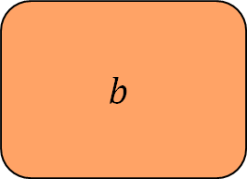

This corresponds to the following decision tree
$$x=θ_{0}$$
$$x$$
$$a$$
$$x≤θ_{0}$$
$$x>θ_{0}$$
$$b$$
$$a$$
$$b$$

Slide 9
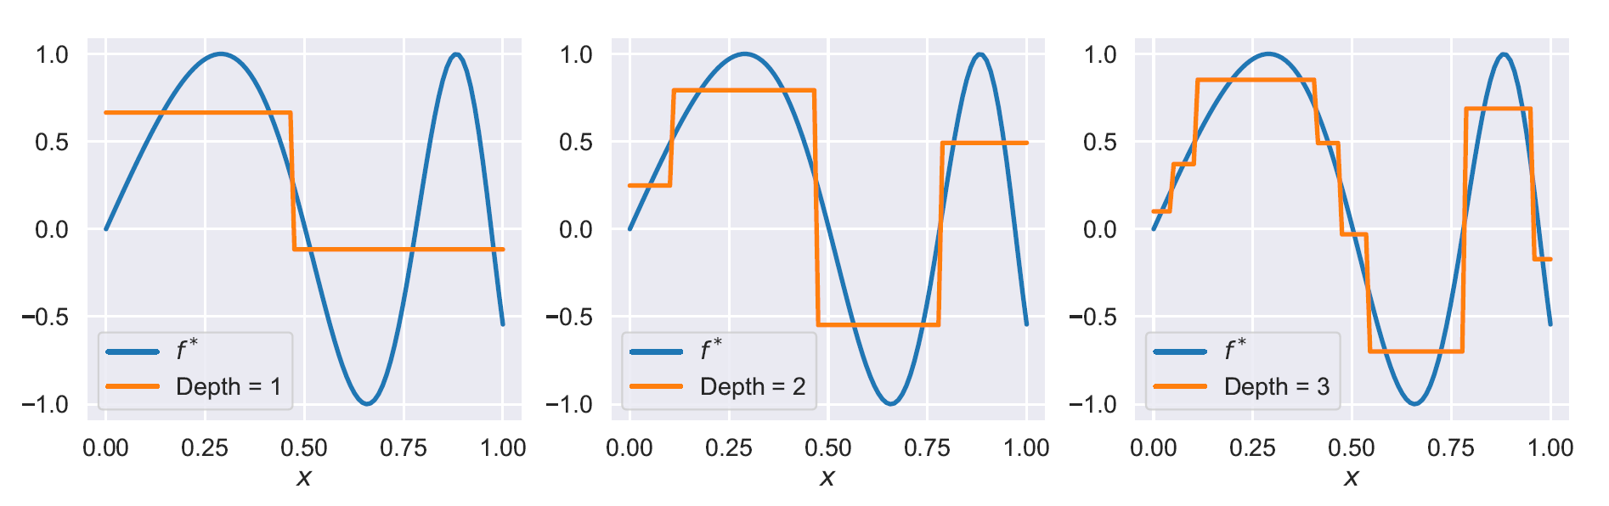
We can also further split the input space to form deeper trees

Slide 10
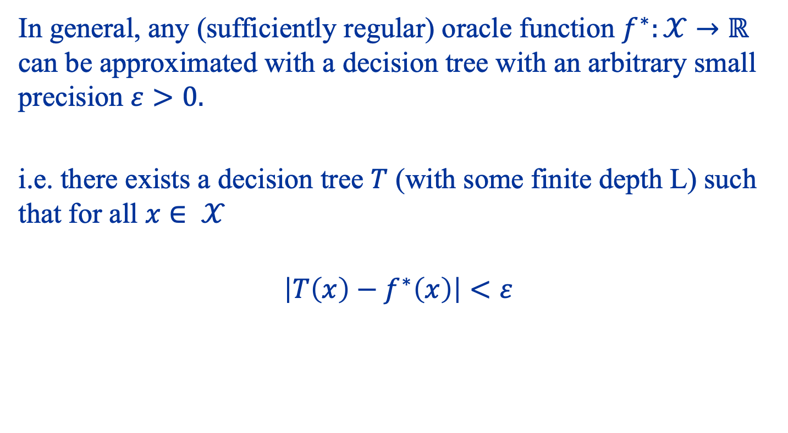
Universal approximation theorem
In general, any (sufficiently regular) oracle function $f^{∗}:𝒳→ℝ$ can be approximated with a decision tree with an arbitrary small precision $ε>0.$
i.e. there exists a decision tree $T$ (with some finite depth L) such that for all $x∈ 𝒳$
$$\left|T\left(x\right)−f^{∗}\left(x\right)\right|<ε$$

Slide 11
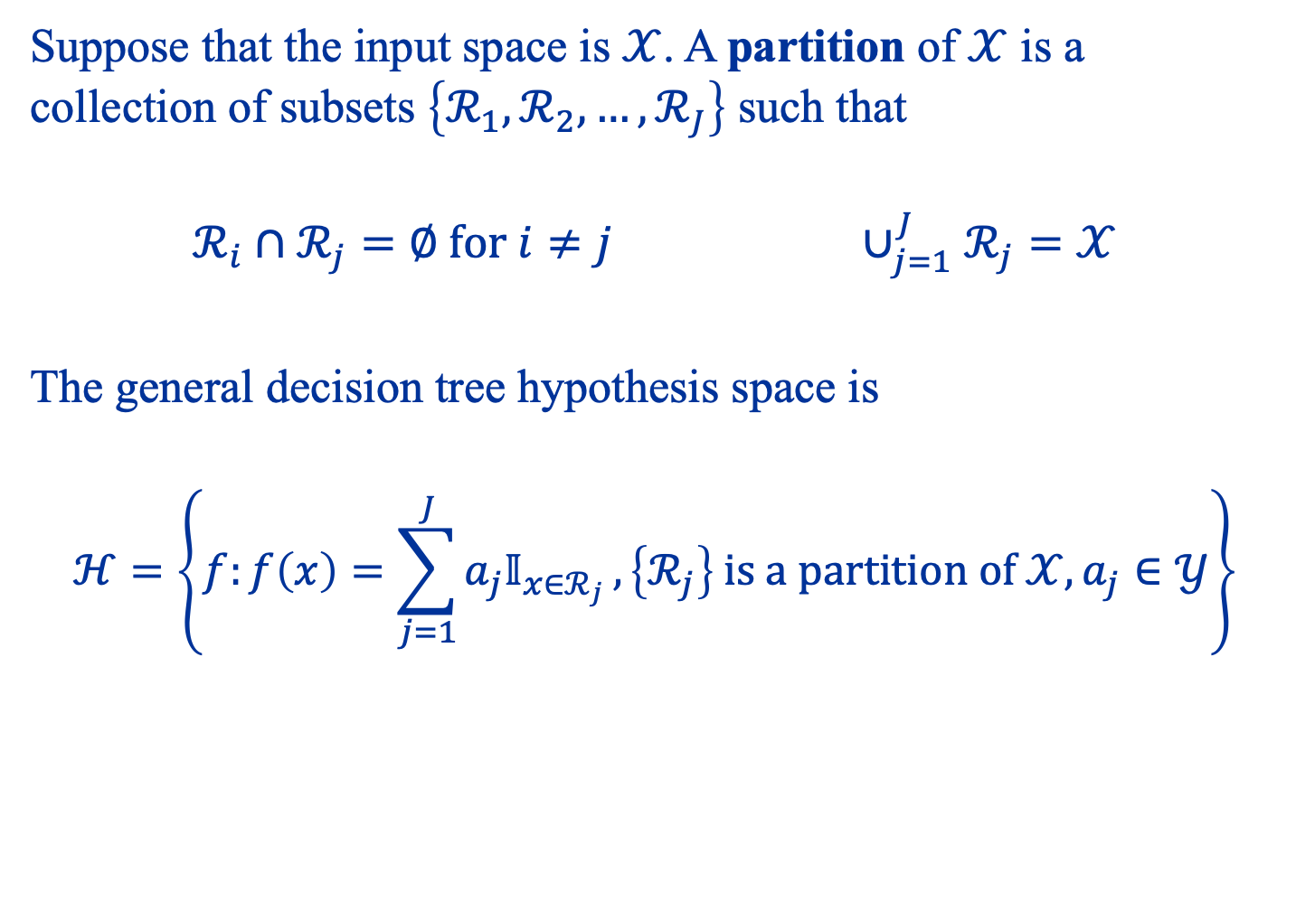
Classification and Regression Trees
Suppose that the input space is $𝒳$. A partition of $𝒳$ is a collection of subsets $\left\{ℛ_{1},ℛ_{2},…,ℛ_{J}\right\}$ such that
$$ℛ_{i}∩ℛ_{j}=∅ for i≠j ∪_{j=1}^{J}ℛ_{j}=𝒳$$
The general decision tree hypothesis space is
$$ℋ=\left\{f:f\left(x\right)=\sum_{j=1}^{J}{a_{j}𝕀_{x∈ℛ_{j}}},\left\{ℛ_{j}\right\} is a partition of 𝒳,a_{j}∈𝒴\right\}$$

Slide 12

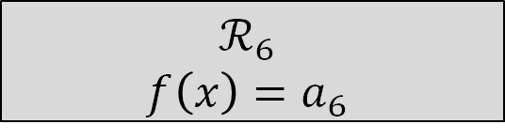

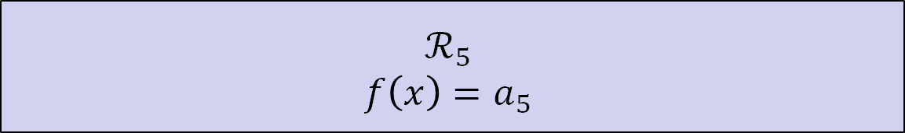


In theory, we can consider very general partitions, but in practice it is convenient to restrict to high-dimensional rectangles
$$ℛ_{1}$$
$$f\left(x\right)=a_{1}$$
$$ℛ_{2}$$
$$f\left(x\right)=a_{2}$$
$$ℛ_{3}$$
$$f\left(x\right)=a_{3}$$
$$ℛ_{4}$$
$$f\left(x\right)=a_{4}$$
$$ℛ_{6}$$
$$f\left(x\right)=a_{6}$$
$$ℛ_{5}$$
$$f\left(x\right)=a_{5}$$

Slide 13
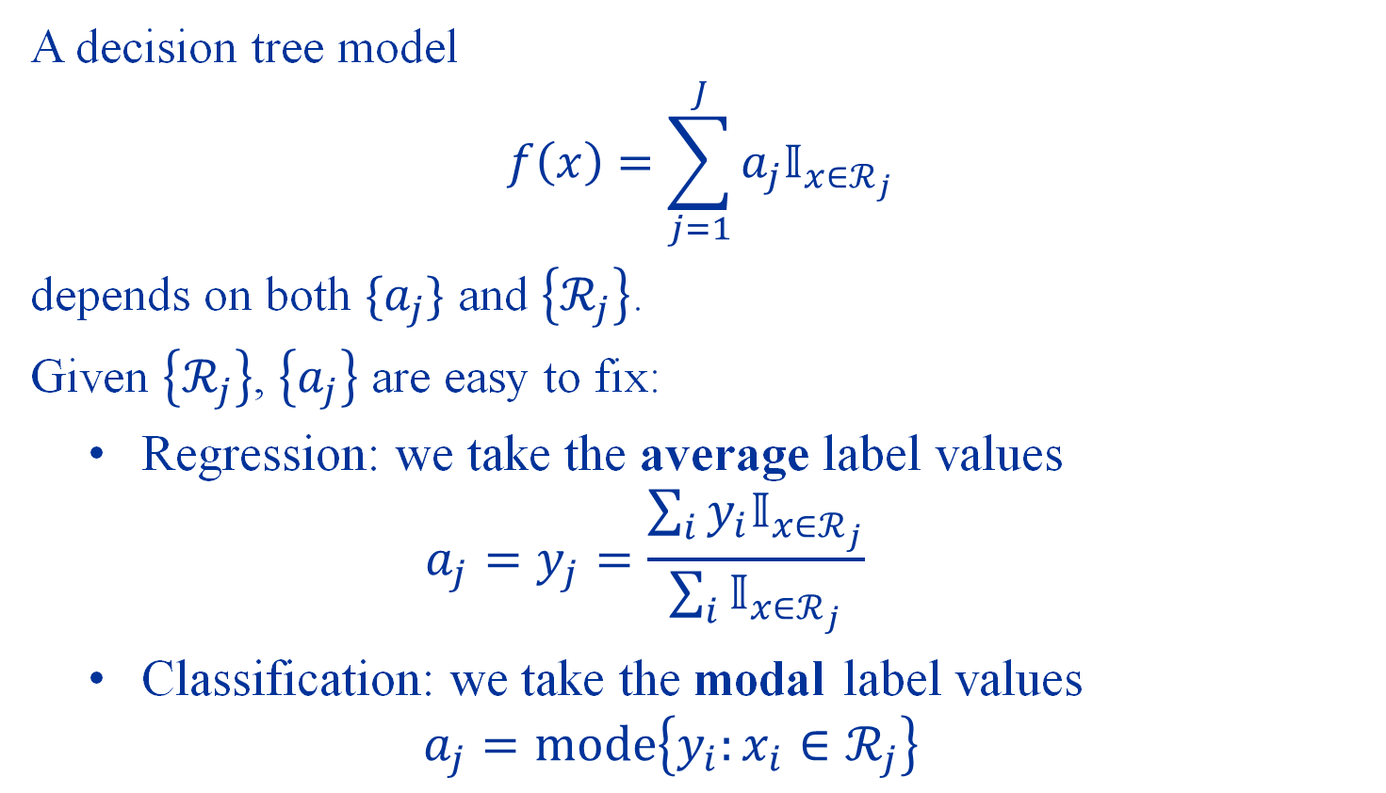
Learning Decision Trees
A decision tree model
$$f\left(x\right)=\sum_{j=1}^{J}{a_{j}𝕀_{x∈ℛ_{j}}}$$
depends on both $\{a_{j}\}$ and $\left\{ℛ_{j}\right\}$.
Given $\left\{ℛ_{j}\right\}$, $\left\{a_{j}\right\}$ are easy to fix:
Regression: we take the average label values $a_{j}=y_{j}=\frac{\sum_{i}{y_{i}𝕀_{x∈ℛ_{j}}}}{\sum_{i}{𝕀_{x∈ℛ_{j}}}}$
Classification: we take the modal label values $a_{j}=mode\left\{y_{i}:x_{i}∈ℛ_{j}\right\}$

Slide 14
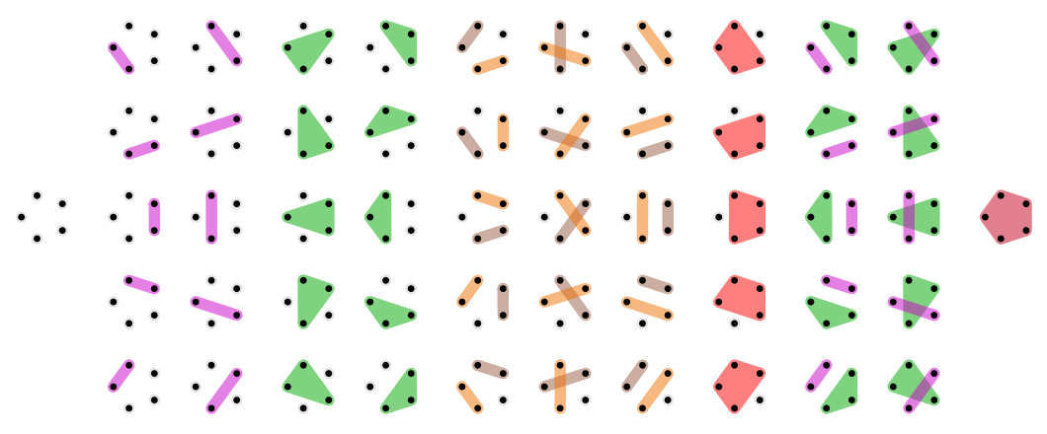
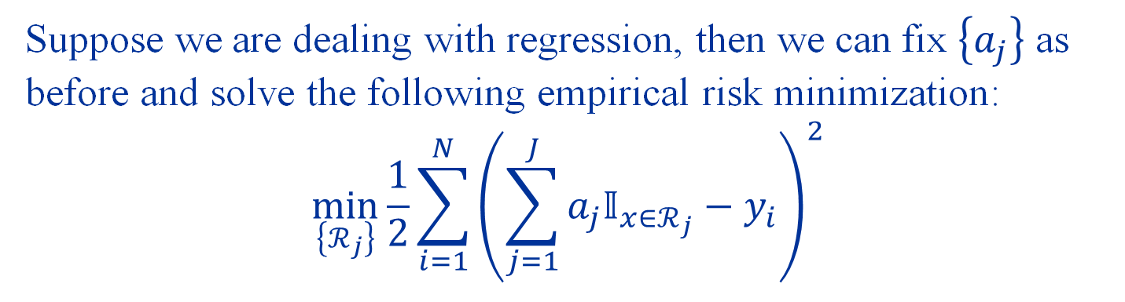
Suppose we are dealing with regression, then we can fix $\left\{a_{j}\right\}$ as before and solve the following empirical risk minimization:
$$\min_{\left\{ℛ_{j}\right\}}{\frac{1}{2}\sum_{i=1}^{N}{{\left(\sum_{j=1}^{J}{a_{j}𝕀_{x∈ℛ_{j}}}−y_{i}\right)}^{2}}}$$
Even restricting to rectangular partitions, this is very hard to solve!
Figure source: https://en.wikipedia.org/wiki/Bell_number

Slide 15
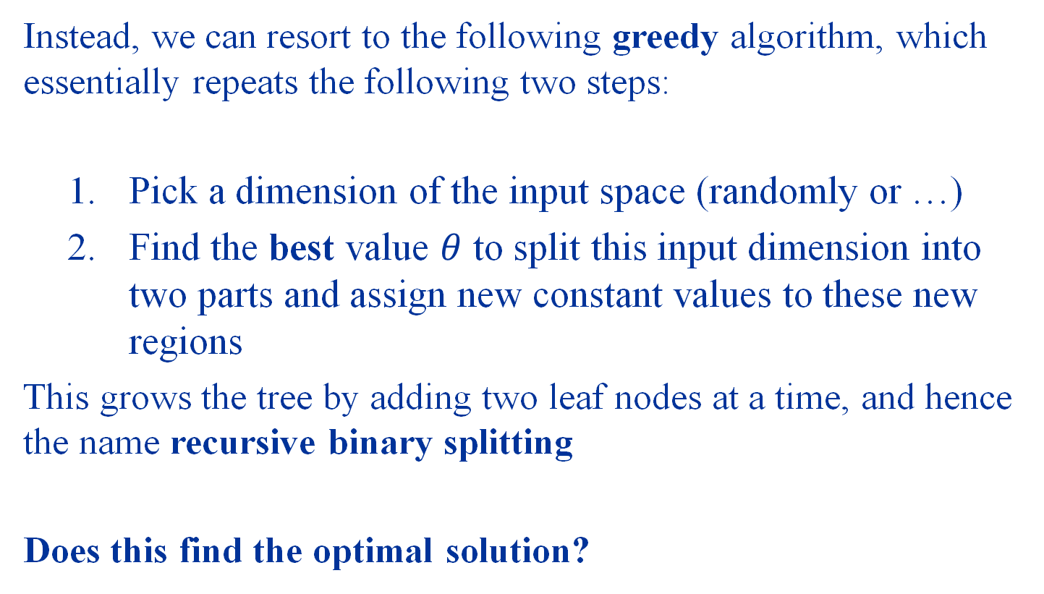
Recursive Binary Splitting
Instead, we can resort to the following greedy algorithm, which essentially repeats the following two steps:
Pick a dimension of the input space (randomly or …)
Find the best value $θ$ to split this input dimension into two parts and assign new constant values to these new regions
This grows the tree by adding two leaf nodes at a time, and hence the name recursive binary splitting
Does this find the optimal solution?

Slide 16
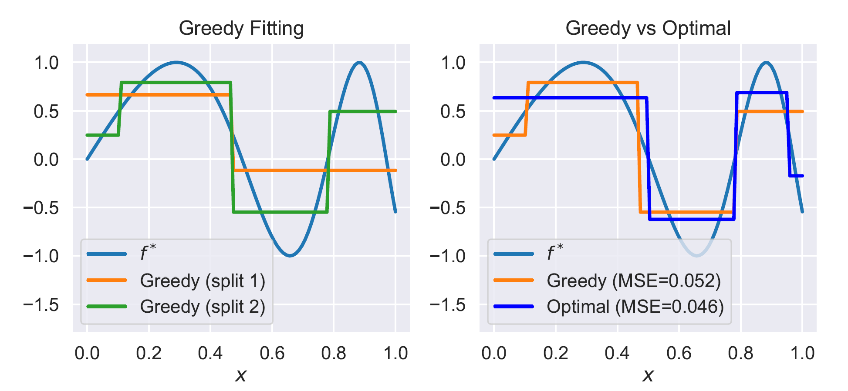
Greedy vs Optimal Solution

Slide 17
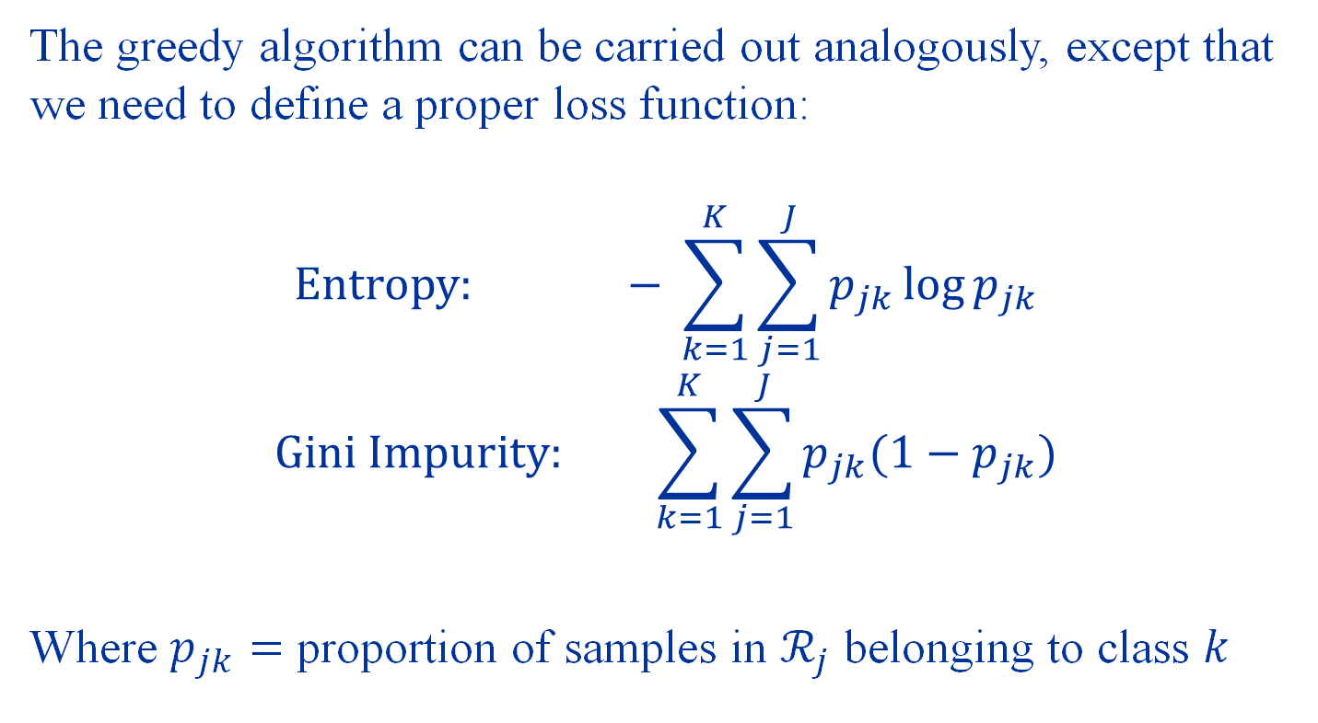
Decision Trees for Classification
The greedy algorithm can be carried out analogously, except that we need to define a proper loss function:
$$Entropy: − \sum_{k=1}^{K}{\sum_{j=1}^{J}{p_{jk}\log{p_{jk}}}}$$
$$Gini Impurity: \sum_{k=1}^{K}{\sum_{j=1}^{J}{p_{jk}(1−p_{jk})}}$$
Where $p_{jk}=$ proportion of samples in $ℛ_{j}$ belonging to class $k$

Slide 18
Advantages and Disadvantages
Advantages:
Can readily visualize and understand predictions
Implicit feature selection via analyzing contribution of splits to reduction of error/impurity
Robust to data types, supervised learning tasks and nonlinear relationships
Disadvantages:
Greedy algorithms may find sub-optimal solutions
Sensitive to data variation and balancing
Prone to overfitting

Slide 19
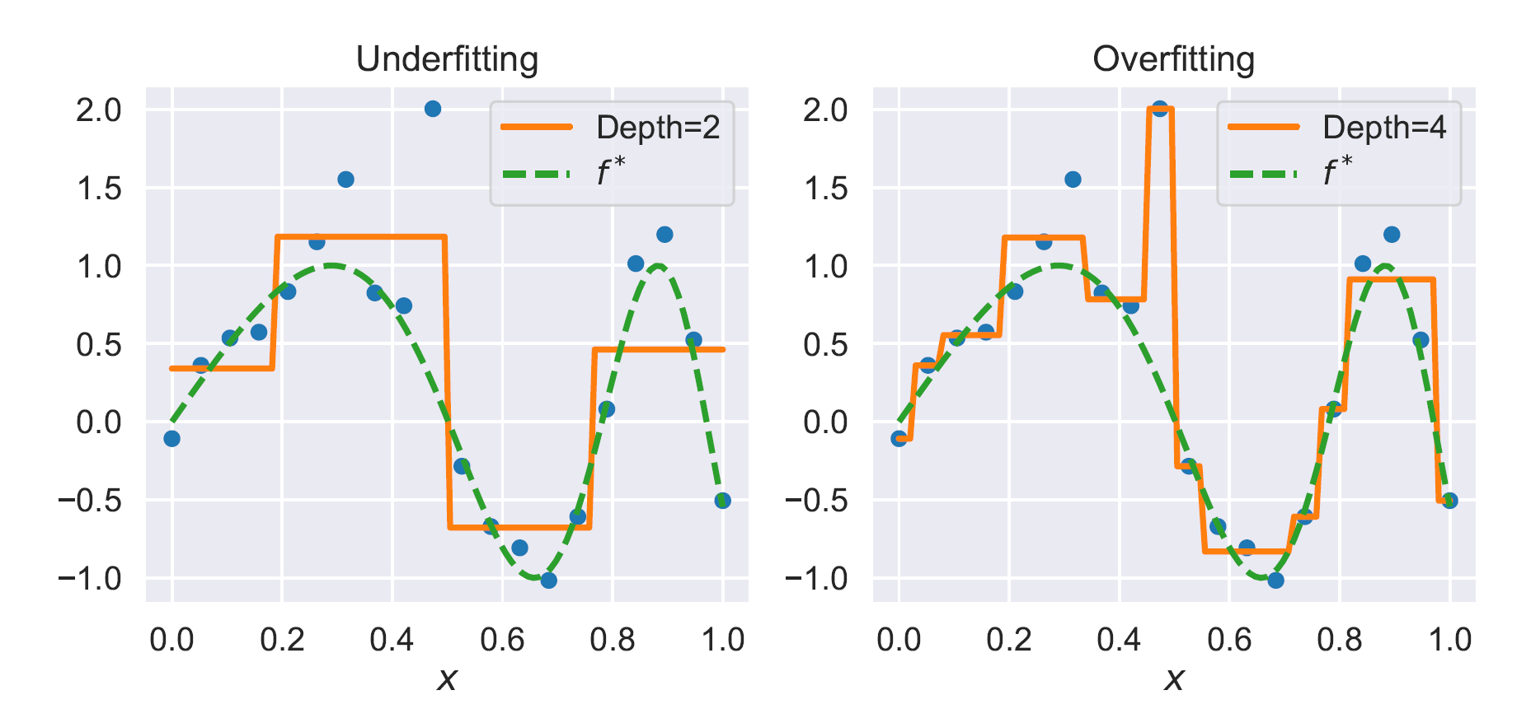
Overfitting
The biggest draw back of decision trees is overfitting

Slide 20
Model Ensembling

Slide 21
Ensemble Methods
An effective way to reduce overfitting and increase approximation power is to combine models. This is called model ensembling.
We will now introduce two classes of such methods
Bagging
Boosting

Slide 22
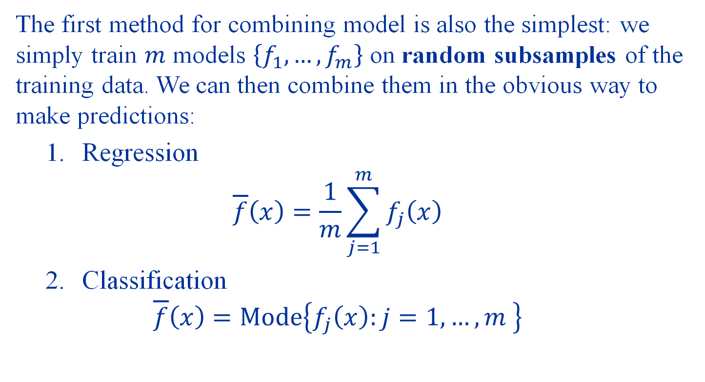
Bootstrap Aggregating (Bagging)
The first method for combining model is also the simplest: we simply train $m$ models $\left\{f_{1},…,f_{m}\right\}$ on random subsamples of the training data. We can then combine them in the obvious way to make predictions:
Regression $\overline{f}\left(x\right)=\frac{1}{m}\sum_{j=1}^{m}{f_{j}\left(x\right)}$
Classification $\overline{f}\left(x\right)=Mode\left\{f_{j}\left(x\right):j=1,…,m \right\}$

Slide 23
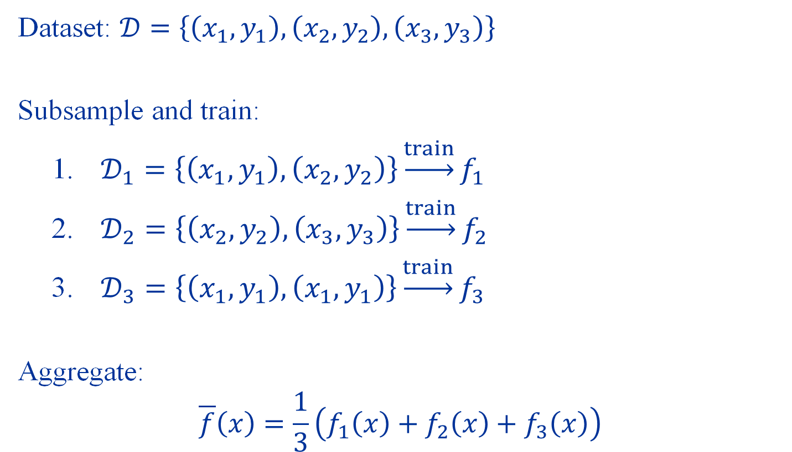
Example
Dataset: $𝒟=\left\{\left(x_{1},y_{1}\right),\left(x_{2},y_{2}\right),\left(x_{3},y_{3}\right)\right\}$
Subsample and train:
$𝒟_{1}=\left\{\left(x_{1},y_{1}\right),\left(x_{2},y_{2}\right)\right\}\underset{→}{train}f_{1}$
$𝒟_{2}=\left\{\left(x_{2},y_{2}\right),\left(x_{3},y_{3}\right)\right\}\underset{→}{train}f_{2}$
$𝒟_{3}=\left\{\left(x_{1},y_{1}\right),\left(x_{1},y_{1}\right)\right\}\underset{→}{train}f_{3}$
Aggregate:
$$\overline{f}\left(x\right)=\frac{1}{3}\left(f_{1}\left(x\right)+f_{2}\left(x\right)+f_{3}\left(x\right)\right)$$

Slide 24
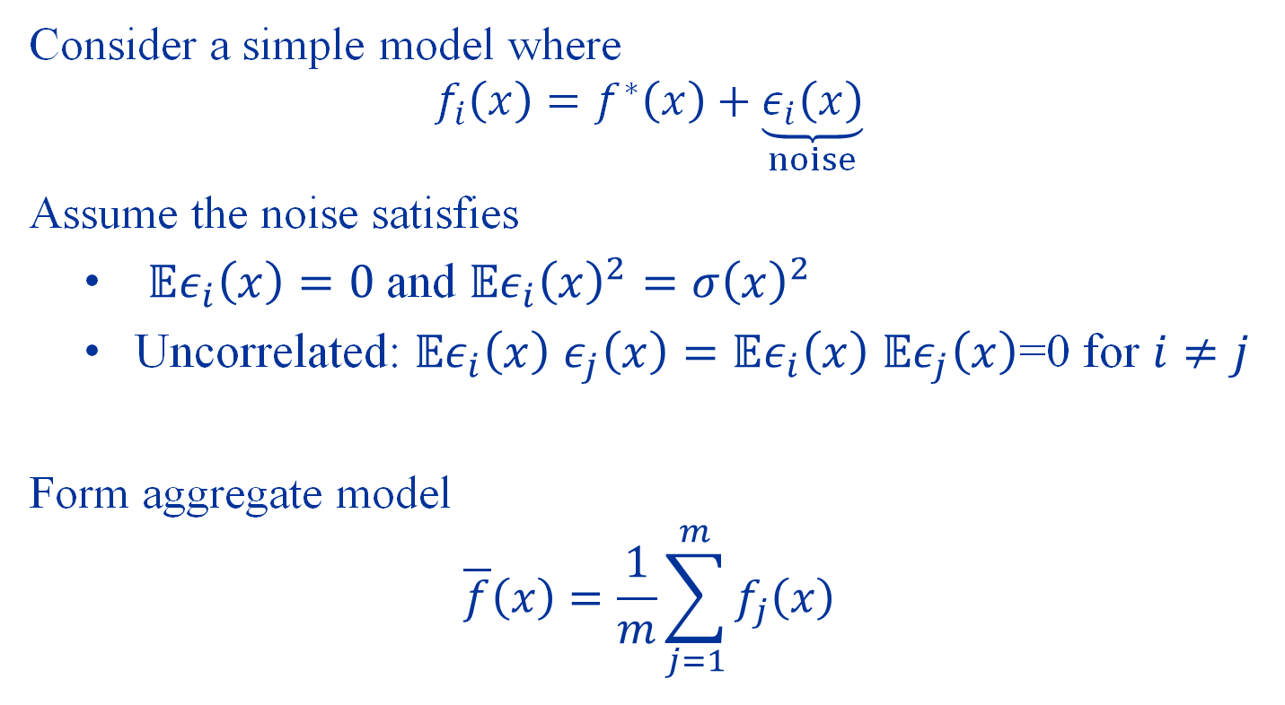
What does bagging do?
Consider a simple model where
$$f_{i}\left(x\right)=f^{∗}\left(x\right)+\underset{noise}{\underbrace{ε_{i}\left(x\right)}}$$
Assume the noise satisfies
$𝔼ε_{i}\left(x\right)=0$ and $𝔼ε_{i}{\left(x\right)}^{2}={σ\left(x\right)}^{2}$
Uncorrelated: $𝔼ε_{i}\left(x\right)$ $ε_{j}\left(x\right)=𝔼ε_{i}\left(x\right)$ $𝔼ε_{j}\left(x\right)$=0 for $i≠j$
Form aggregate model
$$\overline{f}\left(x\right)=\frac{1}{m}\sum_{j=1}^{m}{f_{j}\left(x\right)}$$

Slide 25
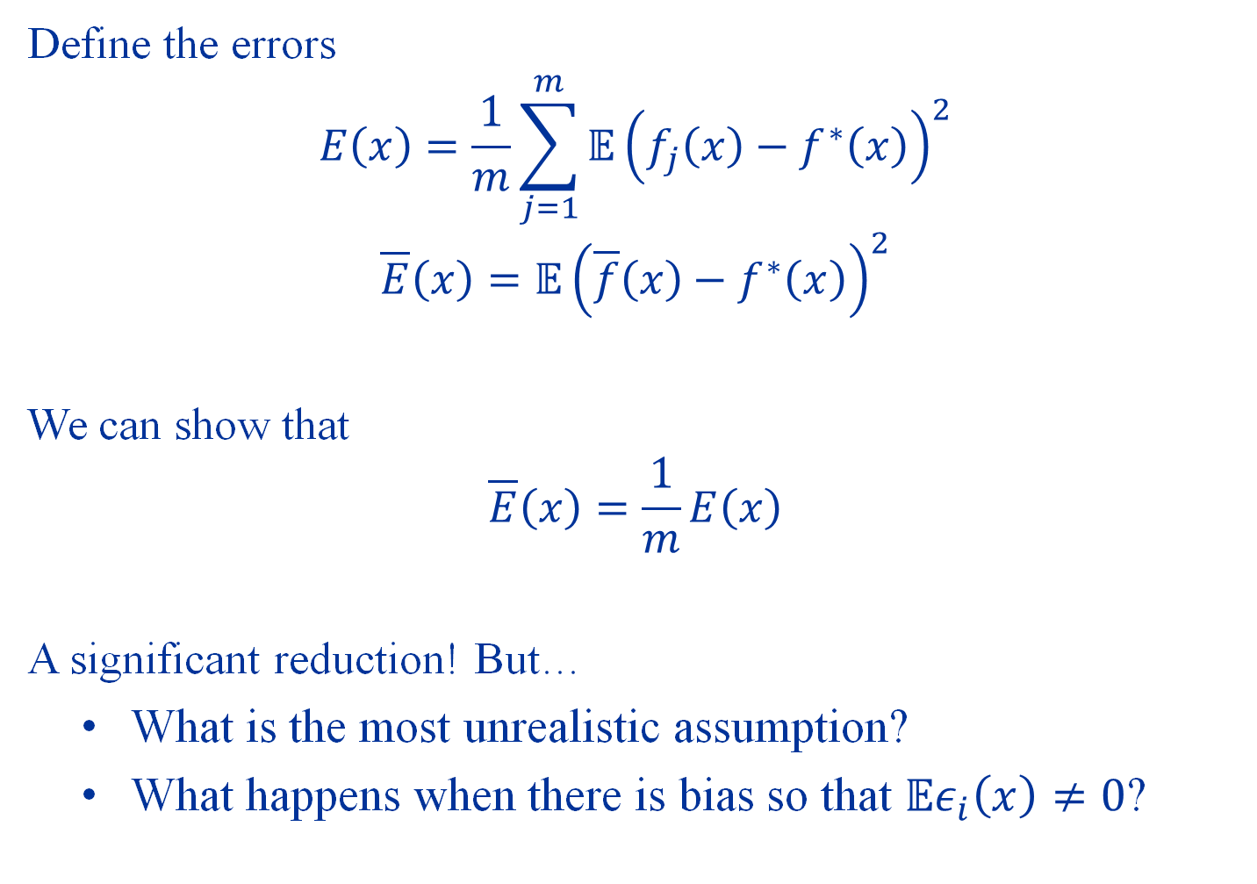
Define the errors
$$E\left(x\right)=\frac{1}{m}\sum_{j=1}^{m}{𝔼{\left(f_{j}\left(x\right)−f^{∗}\left(x\right)\right)}^{2}}$$
$$\overline{E}\left(x\right)=𝔼{\left(\overline{f}\left(x\right)−f^{∗}\left(x\right)\right)}^{2}$$
We can show that
$$\overline{E}\left(x\right)=\frac{1}{m}E\left(x\right)$$
A significant reduction! But…
What is the most unrealistic assumption?
What happens when there is bias so that $𝔼ε_{i}\left(x\right)≠0$?

Slide 26


Bias and Variance
Variance
Bias / Approximation Error
$$f^{∗}$$
Bagging
$$\hat{f}$$
?

Slide 27
Boosting
Unlike bagging whose purpose is to reduce variance, boosting aims to reduce bias.
It answers an important question in the positive:
Can weak learners be combined to form a strong learner?
We will introduce the simplest setting of the Adaptive Boosting or AdaBoost algorithm

Slide 28
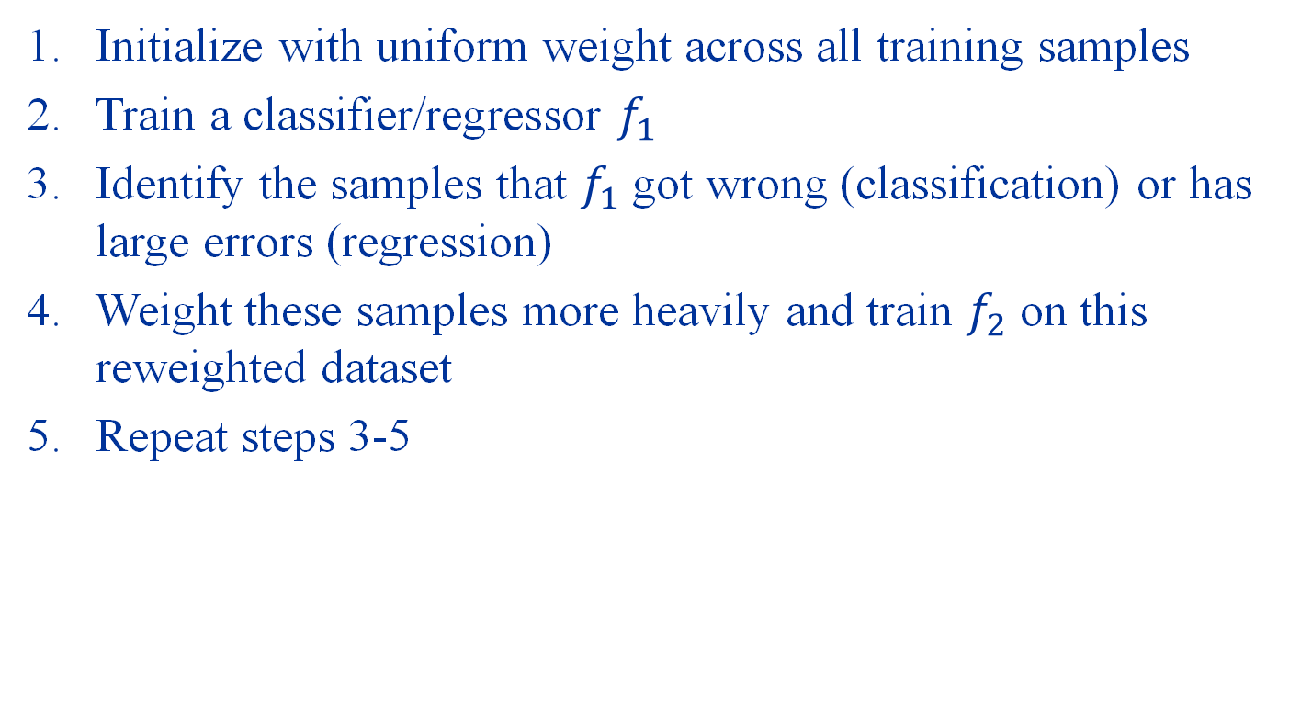
Key Ideas of AdaBoost
Initialize with uniform weight across all training samples
Train a classifier/regressor $f_{1}$
Identify the samples that $f_{1}$ got wrong (classification) or has large errors (regression)
Weight these samples more heavily and train $f_{2}$ on this reweighted dataset
Repeat steps 3-5

Slide 29
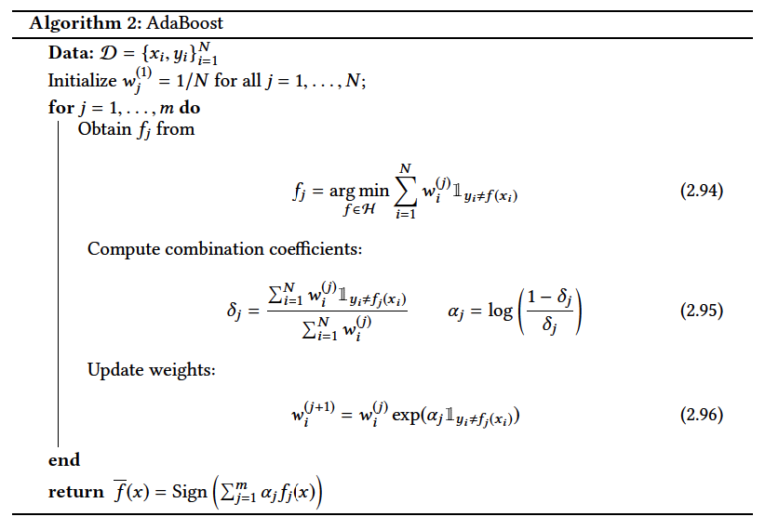

Slide 30
Bagging reduces variance Boosting reduces bias

Slide 31
Cross Validation
Recall: test data is the ultimate test of our model performance
But, should we rely on test data for model selection?

Slide 32
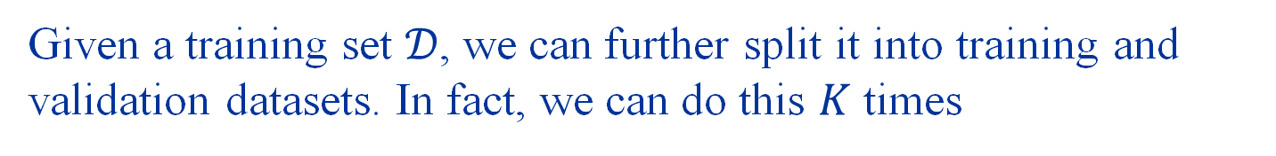
Given a training set $𝒟$, we can further split it into training and validation datasets. In fact, we can do this $K$ times
K-Fold Cross-Validation
Validation
Training
Training
Training
Score
Training
Validation
Training
Training
Score
Average Score
Training
Training
Validation
Training
Score
Training
Training
Training
Validation
Score

Slide 33
Summary
Decision trees
Piece-wise constant predictors
Learn by greedy algorithms
Model Ensembling
Bagging: reduce variance
Boosting: reduce bias
Tune models using cross validation

Slide 34
Project
Due 19th November (end of reading week)
Project Instructions on Canvas

Slide 35
Demo: Decision Trees with Ensembling

