Slide 1

Foundations of Machine Learning DSA 5105 • Lecture 5
Soufiane Hayou
Department of Mathematics

Slide 2
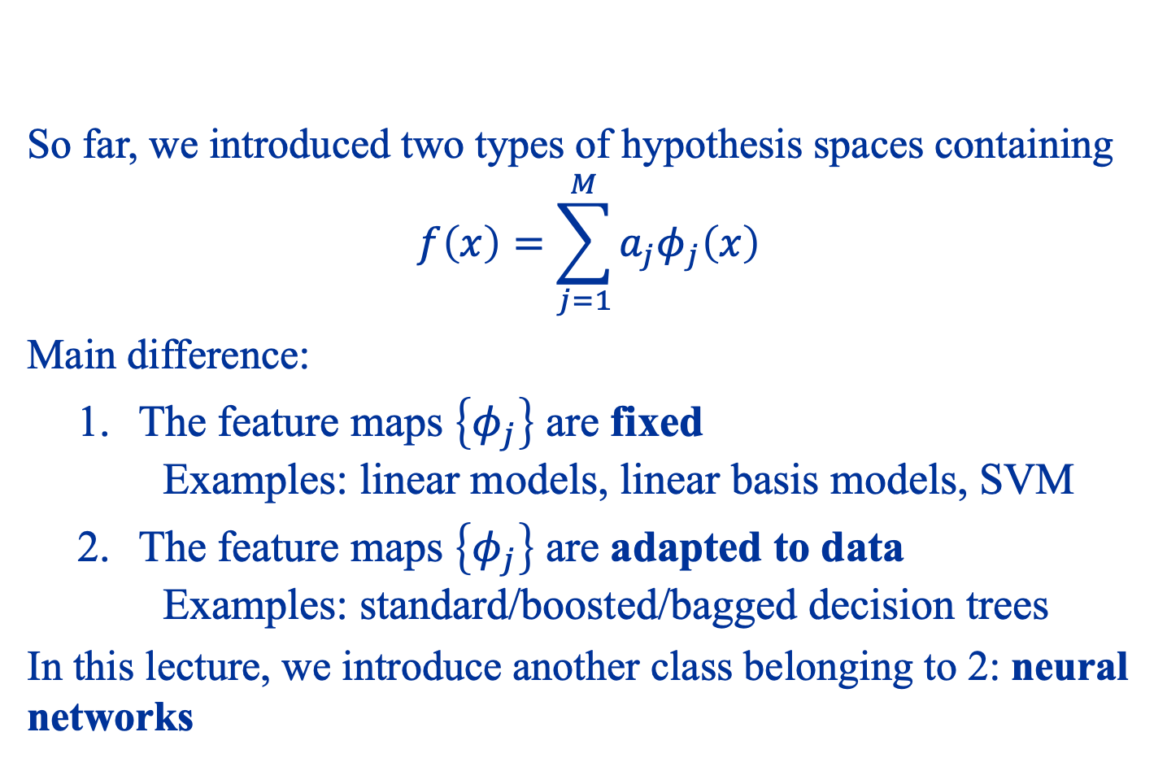
What we’ve seen so far
So far, we introduced two types of hypothesis spaces containing
$$f\left(x\right)=\sum_{j=1}^{M}{a_{j}φ_{j}\left(x\right)}$$
Main difference:
The feature maps $\left\{φ_{j}\right\}$ are fixed Examples: linear models, linear basis models, SVM
The feature maps $\left\{φ_{j}\right\}$ are adapted to data Examples: standard/boosted/bagged decision trees
In this lecture, we introduce another class belonging to 2: neural networks

Slide 3
Shallow Neural Networks

Slide 4
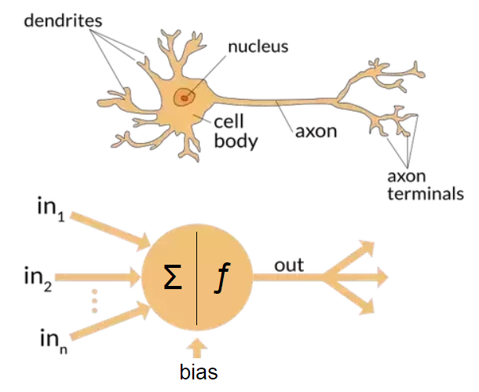
History
Neural networks originated from an attempt to model collective interaction of neurons
https://towardsdatascience.com/the-differences-between-artificial-and-biological-neural-networks-a8b46db828b7

Slide 5
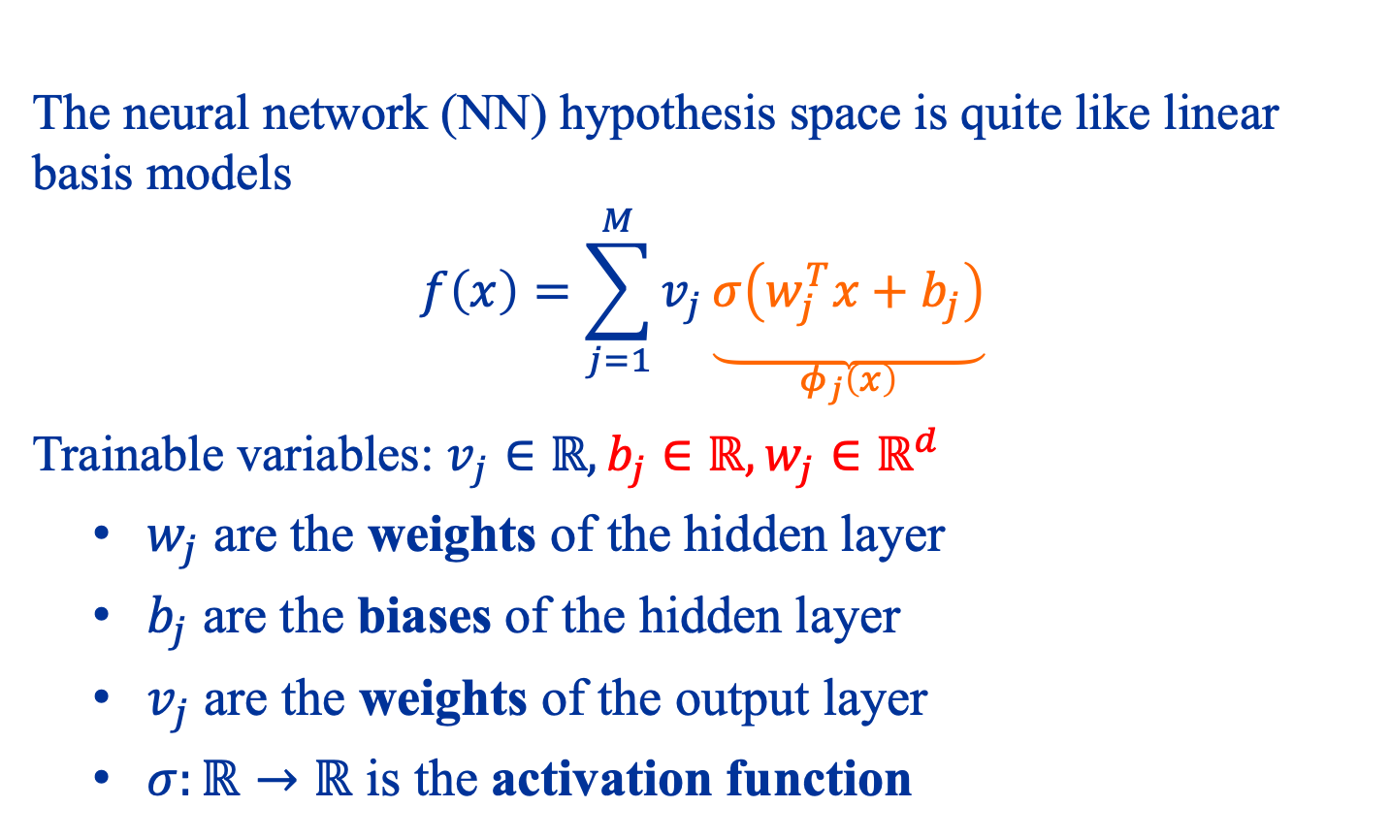
Neural Networks for Regression
The neural network (NN) hypothesis space is quite like linear basis models
$$f\left(x\right)=\sum_{j=1}^{M}{v_{j}\underset{\begin{aligned} \\ φ_{j}\left(x\right)\end{aligned}}{\underbrace{σ\left(w_{j}^{T}x+b_{j}\right)}}}$$
Trainable variables: $v_{j}∈ℝ,b_{j}∈ℝ,w_{j}∈ℝ^{d}$
$w_{j}$ are the weights of the hidden layer
$b_{j}$ are the biases of the hidden layer
$v_{j}$ are the weights of the output layer
$σ:ℝ→ℝ$ is the activation function

Slide 6
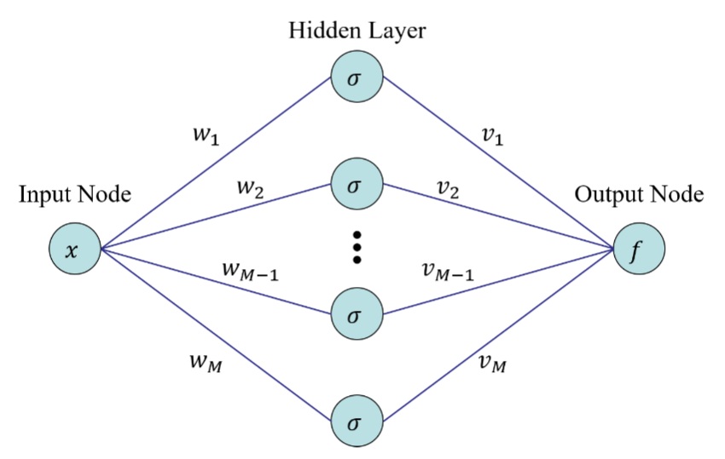

Slide 7
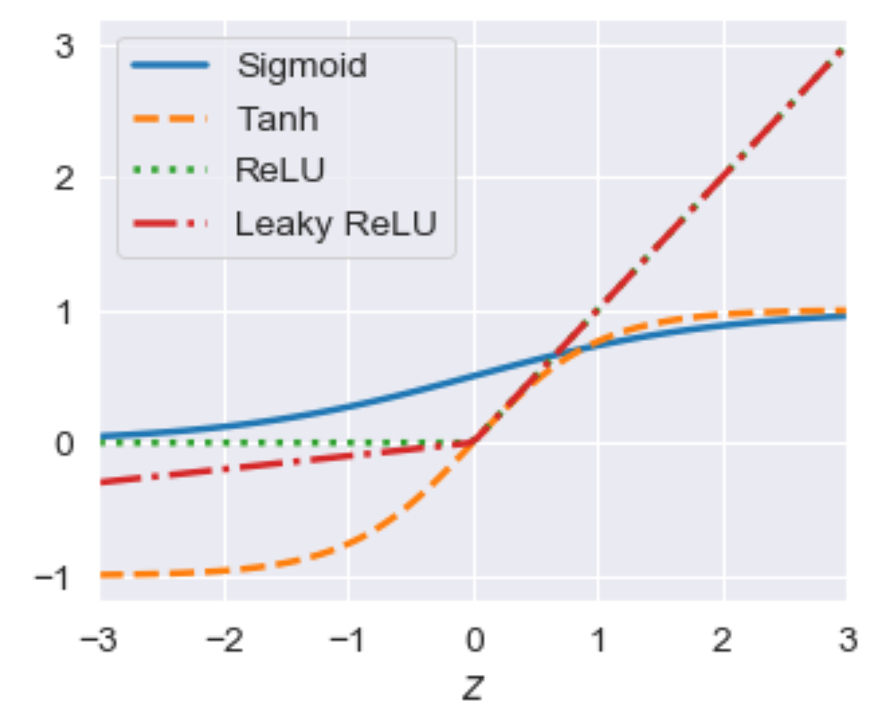
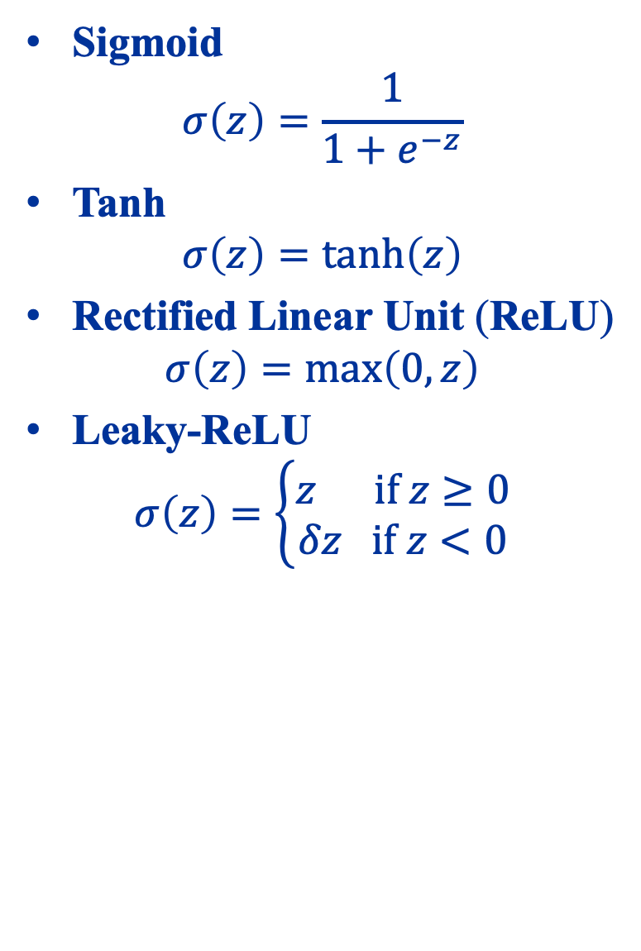
Activation Functions
Sigmoid $σ\left(z\right)=\frac{1}{1+e^{−z}}$
Tanh $σ\left(z\right)=\tanh\left(z\right)$
Rectified Linear Unit (ReLU) $σ\left(z\right)=\max\left(0,z\right)$
Leaky-ReLU $σ\left(z\right)=\left\{\begin{aligned}z if z≥0 \\ δz if z<0\end{aligned}\right.$

Slide 8
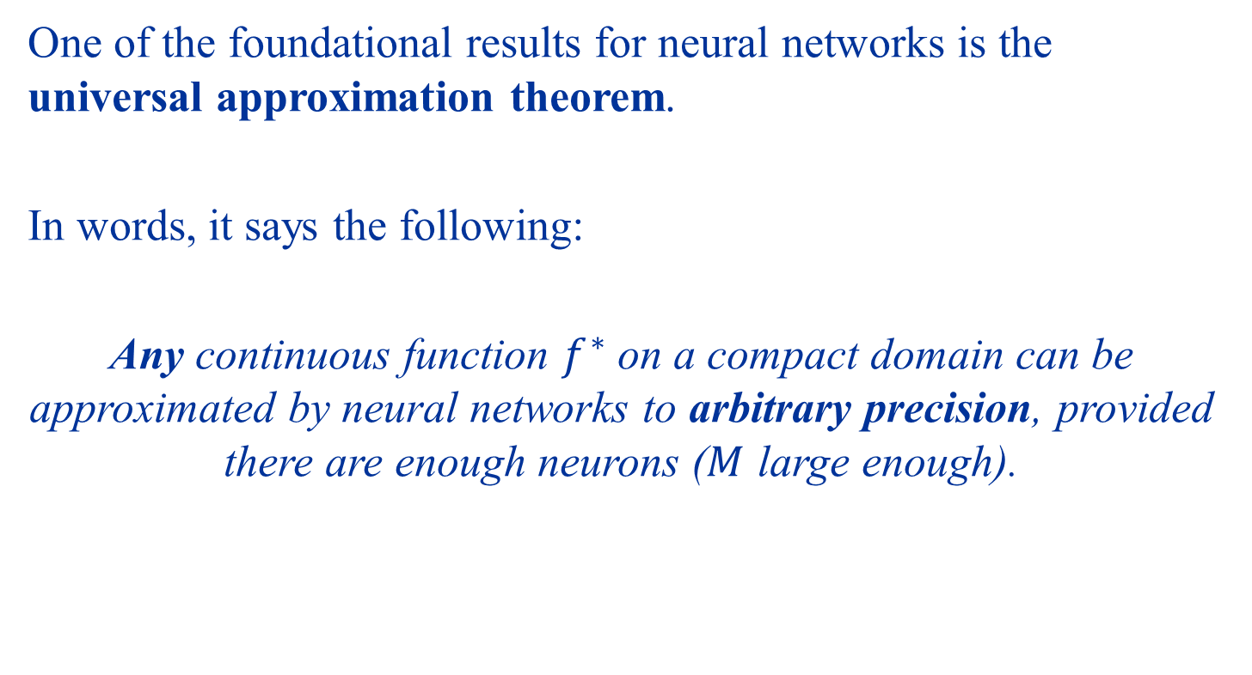
Universal Approximation Theorem
One of the foundational results for neural networks is the universal approximation theorem.
In words, it says the following:
Any continuous function $f^{∗}$ on a compact domain can be approximated by neural networks to arbitrary precision, provided there are enough neurons ($M$ large enough).

Slide 9


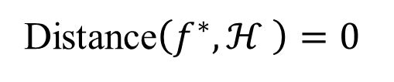

Neural networks hypothesis space of arbitrarily large width has zero approximation error!
Distance$\left(f^{∗},ℋ \right)=0$
$$f^{∗}$$
$$𝓗$$
$$\tilde{f}$$

Slide 10
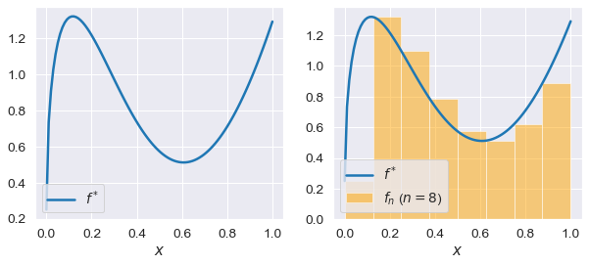

“Proof” in a Special Case
Let us consider a 1D continuous function on the unit interval
$$f^{∗}:\left[0,1\right]→ℝ$$

Slide 11
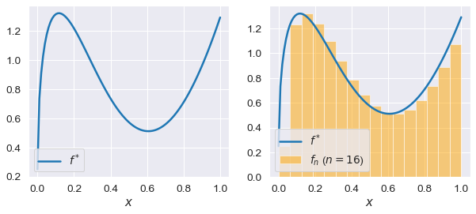
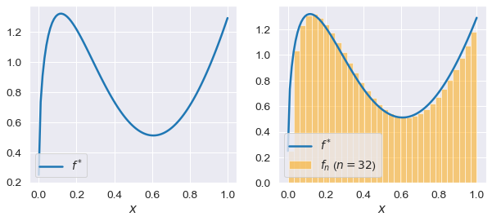
Step 1: Approximate by a step functions

Slide 12
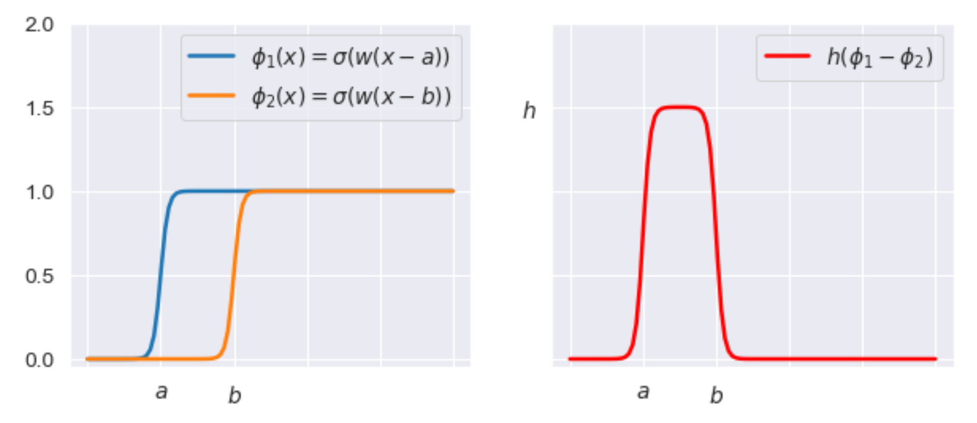
Step 2: Use two sigmoids to make a step

Slide 13
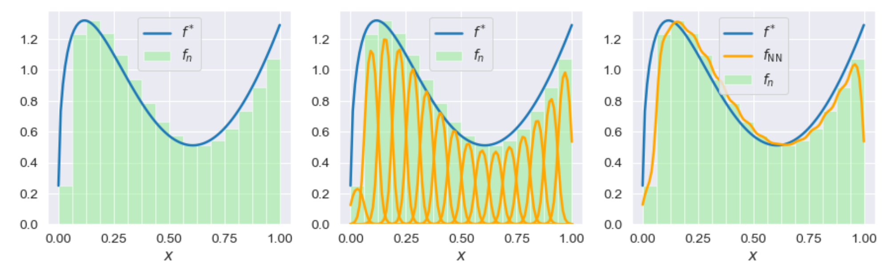
Step 3: Sum the resulting function

Slide 14
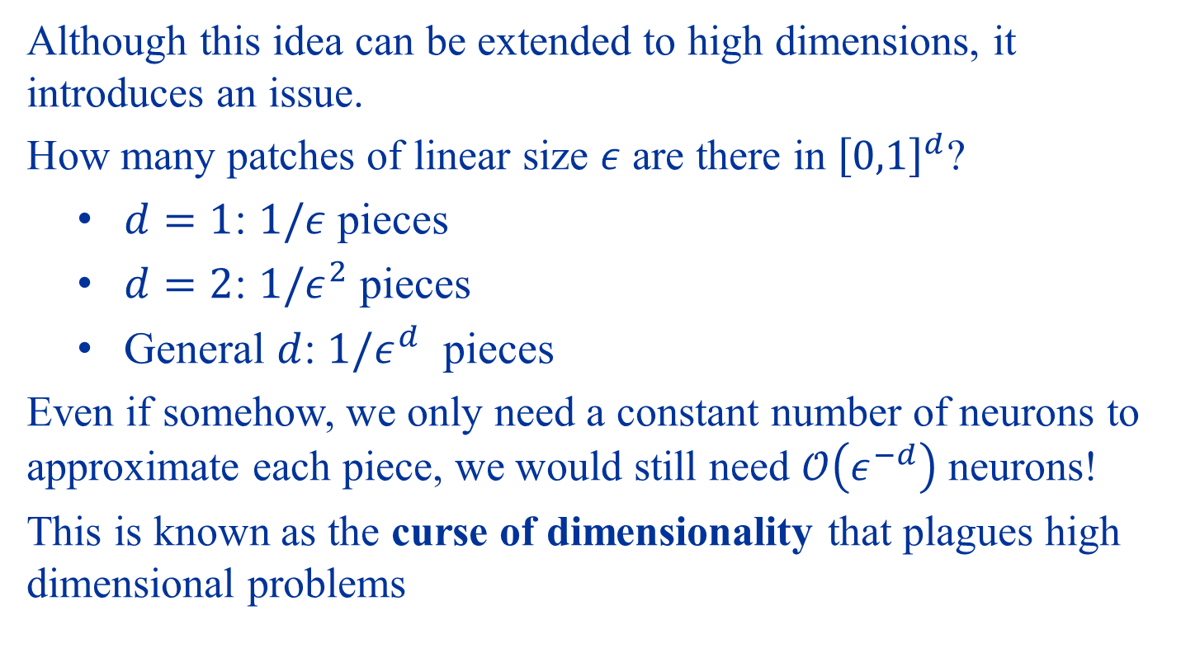
Curse of Dimensionality
Although this idea can be extended to high dimensions, it introduces an issue.
How many patches of linear size $ε$ are there in ${\left[0,1\right]}^{d}$?
$d=1$: $1/ε$ pieces
$d=2$: $1/ε^{2}$ pieces
General $d$: $1/ε^{d}$ pieces
Even if somehow, we only need a constant number of neurons to approximate each piece, we would still need $𝒪\left(ε^{−d}\right)$ neurons!
This is known as the curse of dimensionality that plagues high dimensional problems

Slide 15
Do neural networks suffer from the curse of dimensionality?

Slide 16
Linear and Nonlinear Approximation

Slide 17
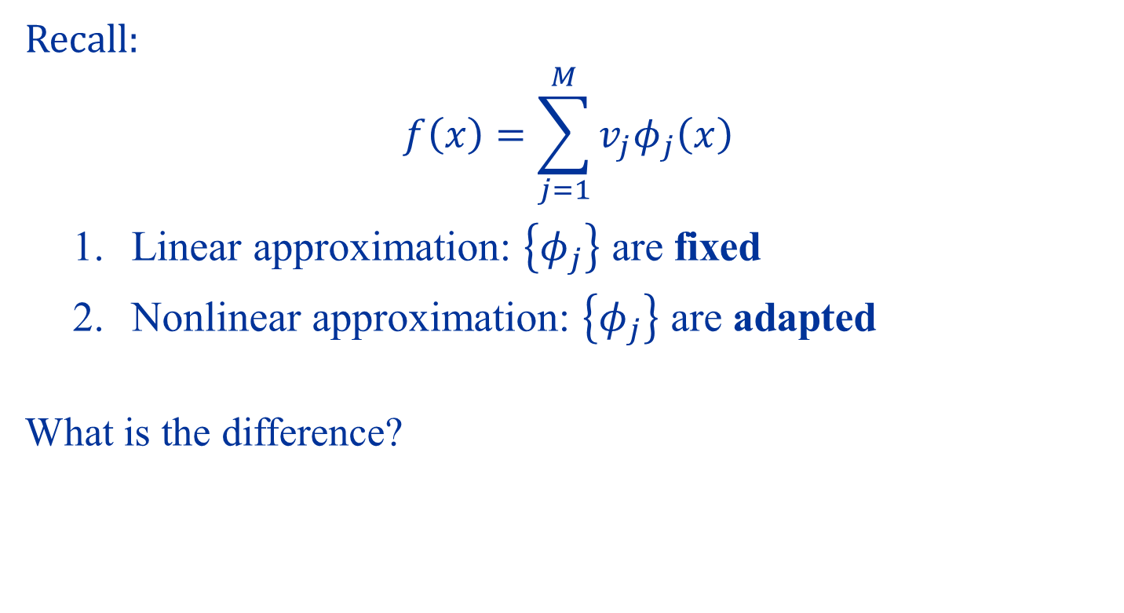
Linear vs Nonlinear Approximation
Recall:
$$f\left(x\right)=\sum_{j=1}^{M}{v_{j}φ_{j}\left(x\right)}$$
Linear approximation: $\left\{φ_{j}\right\}$ are fixed
Nonlinear approximation: $\left\{φ_{j}\right\}$ are adapted
What is the difference?

Slide 18



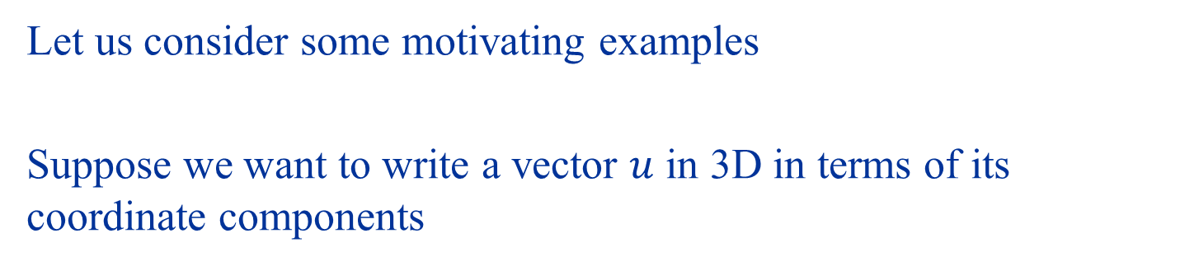





The significance of data-dependent feature maps
Let us consider some motivating examples
Suppose we want to write a vector $u$ in 3D in terms of its coordinate components
$$u_{3}$$
$$u$$
$$u_{2}$$
$$u=u_{1}e_{1}+u_{2}e_{2}+u_{3}e_{3}$$
$$e_{3}$$
$$e_{2}$$
$$e_{1}$$
$$u_{1}$$

Slide 19

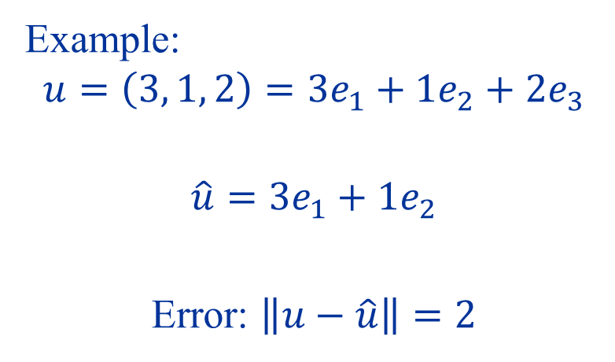









Suppose we can only use 2 coordinate axes, say $e_{1}$ and $e_{2}$
What is the best approximation $\hat{u}$ of $u$?
Example:
$$u=\left(3, 1, 2\right)=3e_{1}+1e_{2}+2e_{3}$$
$$\hat{u}=3e_{1}+1e_{2}$$
Error: $\left\|u−\hat{u}\right\|=2$
$$u$$
$$2$$
$$1$$
$$e_{3}$$
$$e_{2}$$
$$\hat{u}$$
$$e_{1}$$
$$3$$
What if we can pick which two bases to use after seeing $u$?
What if we can pick two bases from a much larger set?

Slide 20
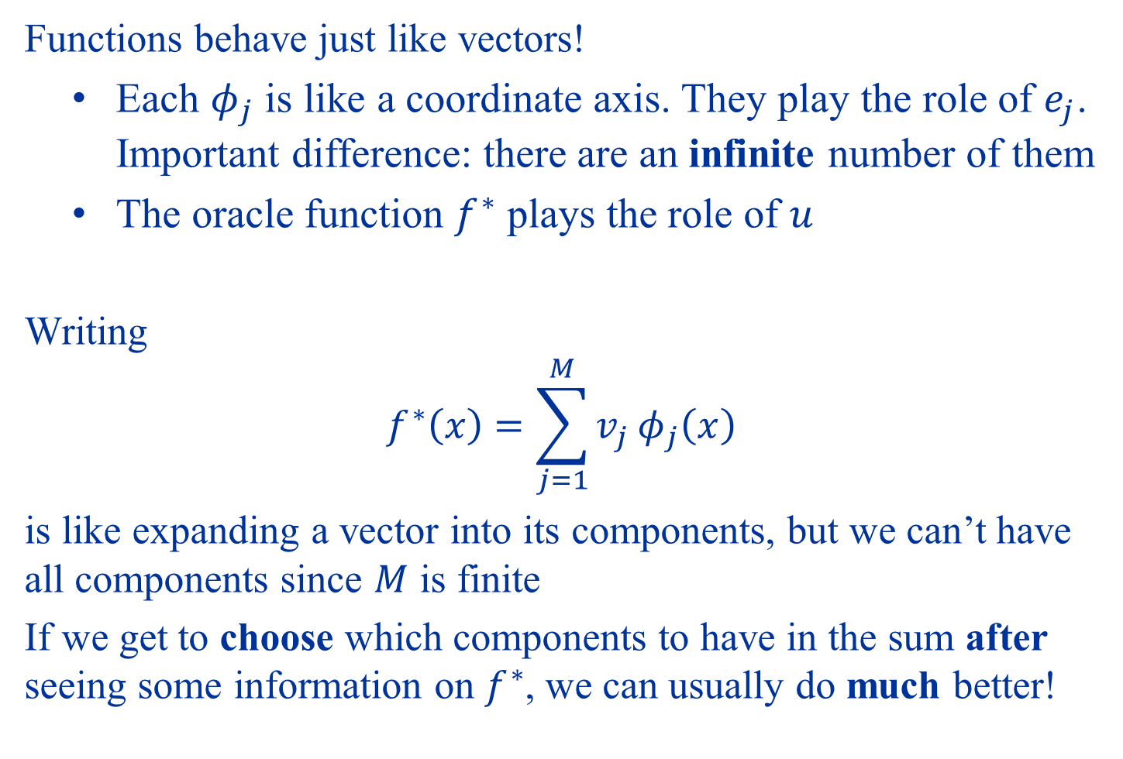
Functions behave just like vectors!
Each $φ_{j}$ is like a coordinate axis. They play the role of $e_{j}$. Important difference: there are an infinite number of them
The oracle function $f^{∗}$ plays the role of $u$
Writing
$$f^{∗}\left(x\right)=\sum_{j=1}^{M}{v_{j}}φ_{j}\left(x\right)$$
is like expanding a vector into its components, but we can’t have all components since $M$ is finite
If we get to choose which components to have in the sum after seeing some information on $f^{∗}$, we can usually do much better!

Slide 21
Linear Approximation Basis independent of data Nonlinear Approximation Basis depends on data

Slide 22
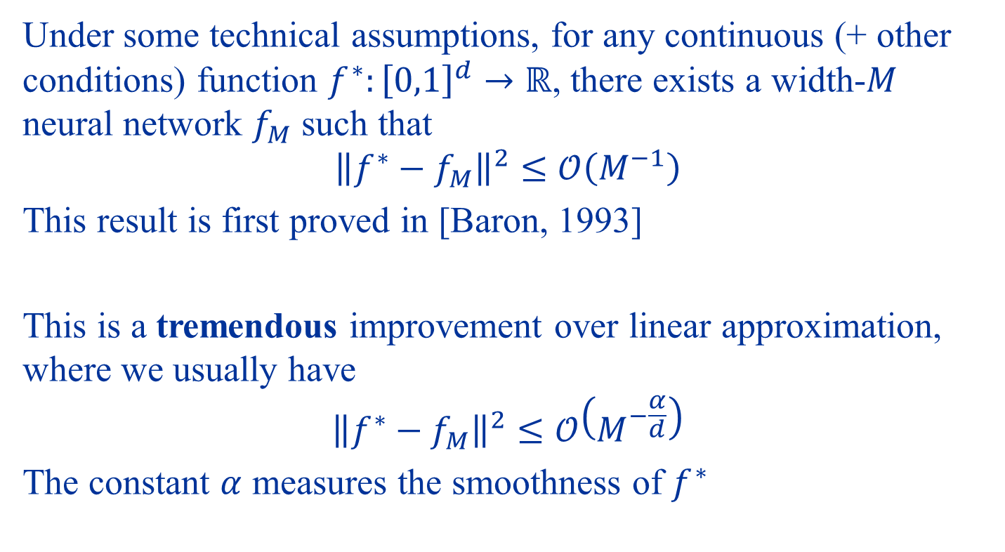
Overcoming the Curse of Dimensionality
Under some technical assumptions, for any continuous (+ other conditions) function $f^{∗}:{\left[0,1\right]}^{d}→ℝ$, there exists a width-$M$ neural network $f_{M}$ such that
$${\left\|f^{∗}−f_{M}\right\|}^{2}≤𝒪\left(M^{−1}\right)$$
This result is first proved in [Baron, 1993]
This is a tremendous improvement over linear approximation, where we usually have
$${\left\|f^{∗}−f_{M}\right\|}^{2}≤𝒪\left(M^{−\frac{α}{d}}\right)$$
The constant $α$ measures the smoothness of $f^{∗}$

Slide 23
Optimizing Neural Networks

Slide 24

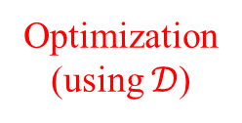
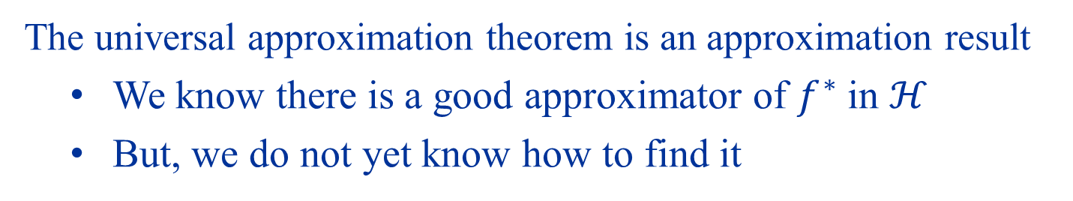



Optimization
The universal approximation theorem is an approximation result
We know there is a good approximator of $f^{∗}$ in $ℋ$
But, we do not yet know how to find it
$$𝓗$$
$$\tilde{f}≈f^{∗}$$
$$f_{0}$$
Optimization (using $𝒟$)
$$\hat{f}$$

Slide 25
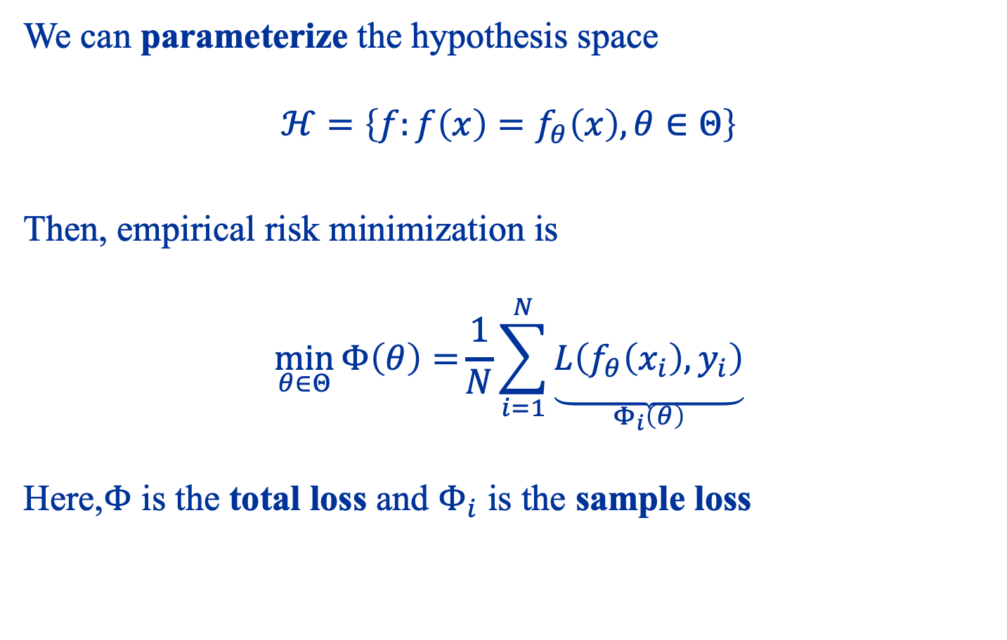
Empirical Risk Minimization for Neural Networks
We can parameterize the hypothesis space $$ℋ=\left\{f:f\left(x\right)=f_{θ}\left(x\right),θ∈Θ\right\}$$
Then, empirical risk minimization is $$\min_{θ∈Θ}{Φ\left(θ\right)=}\frac{1}{N}\sum_{i=1}^{N}{\underset{\begin{aligned} \\ Φ_{i}\left(θ\right)\end{aligned}}{\underbrace{L\left(f_{θ}\left(x_{i}\right),y_{i}\right)}}}$$ Here,$Φ$ is the total loss and $Φ_{i}$ is the sample loss

Slide 26
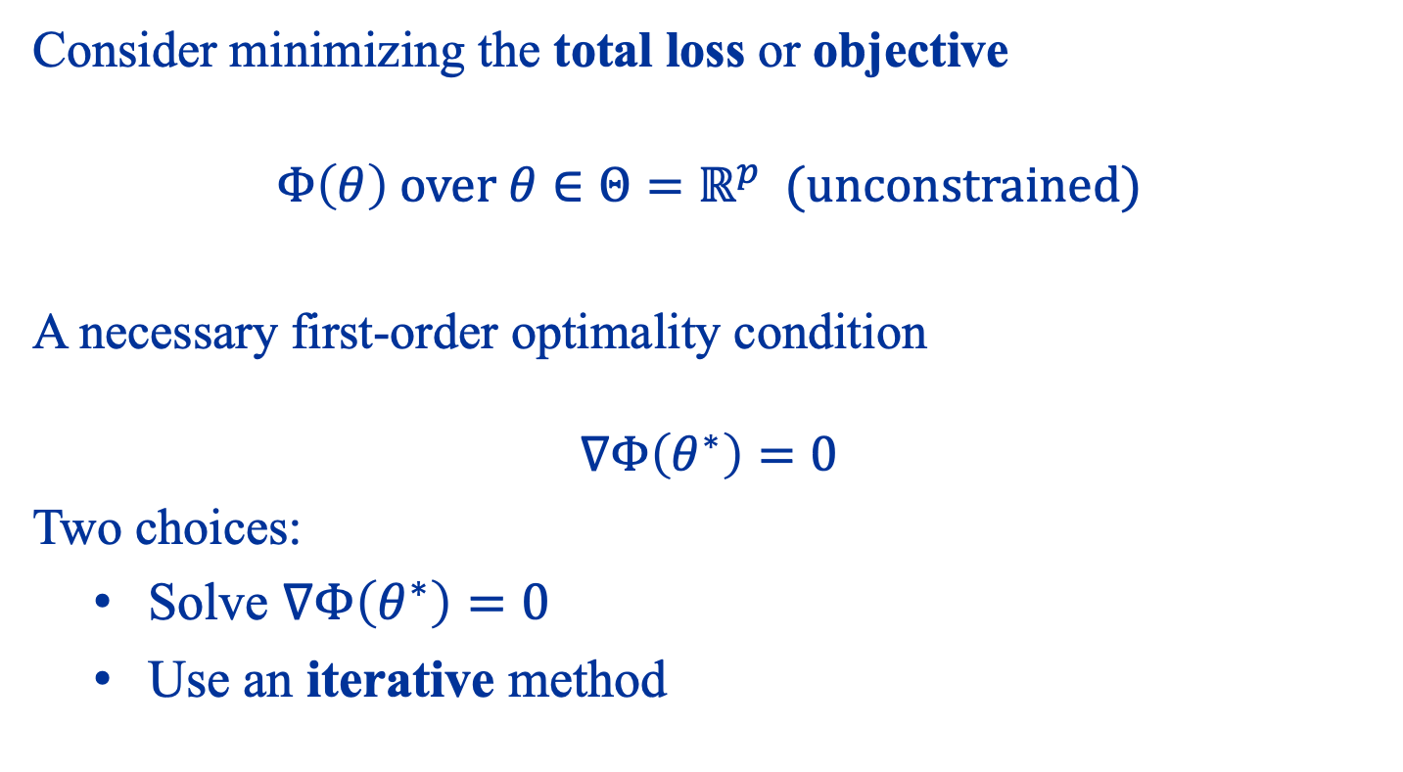
Gradient Descent
Consider minimizing the total loss or objective
$$Φ\left(θ\right) over θ∈Θ=ℝ^{p} (unconstrained)$$
A necessary first-order optimality condition $$∇Φ\left(θ^{∗}\right)=0$$
Two choices:
Solve $∇Φ\left(θ^{∗}\right)=0$
Use an iterative method

Slide 27
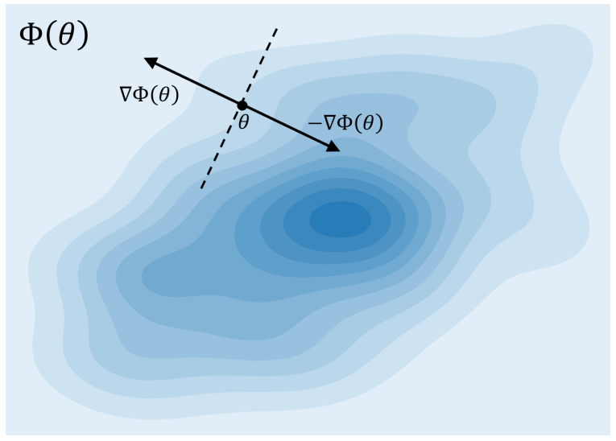

Slide 28
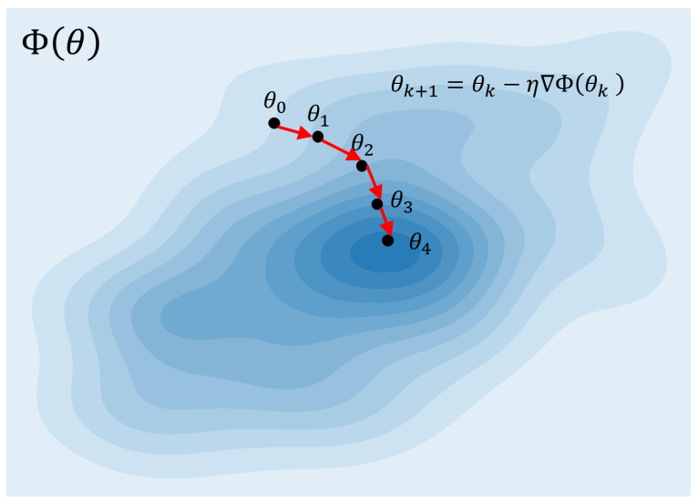

Slide 29
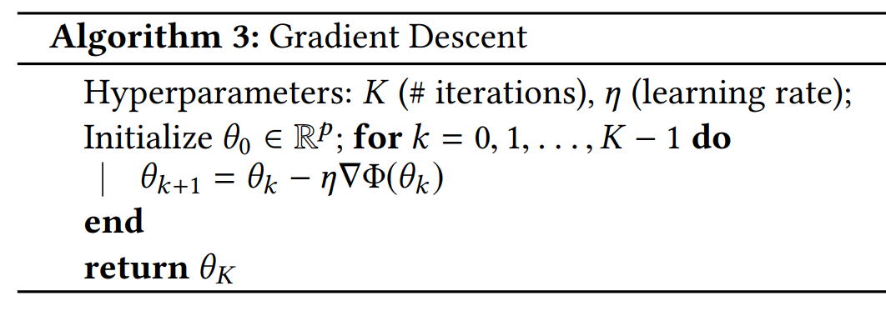

Slide 30

The Effect of Learning Rate
Look at the GD iteration
$$θ_{k+1}=θ_{k}−η∇Φ\left(θ_{k}\right)$$
When $η$ is too small, updates are slow
When $η$ is too large, the updates may become unstable

Slide 31

Example
One dimension $$Φ\left(θ\right)=\frac{1}{2}θ^{2} \\ ∇Φ\left(θ\right)=θ$$
GD iterates
$$θ_{k+1}=θ_{k}−ηθ_{k}=\left(1−η\right)θ_{k}$$
Solution
$$θ_{k}={\left(1−η\right)}^{k}θ_{0}$$

Slide 32
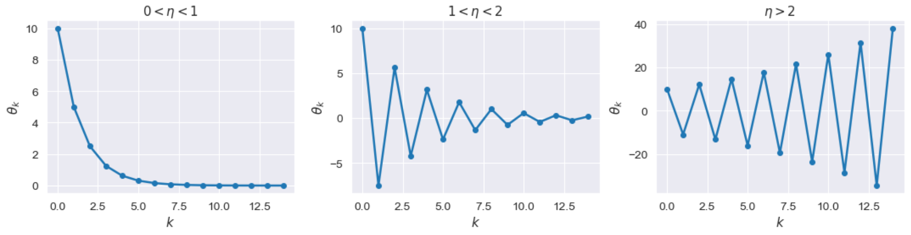

Slide 33
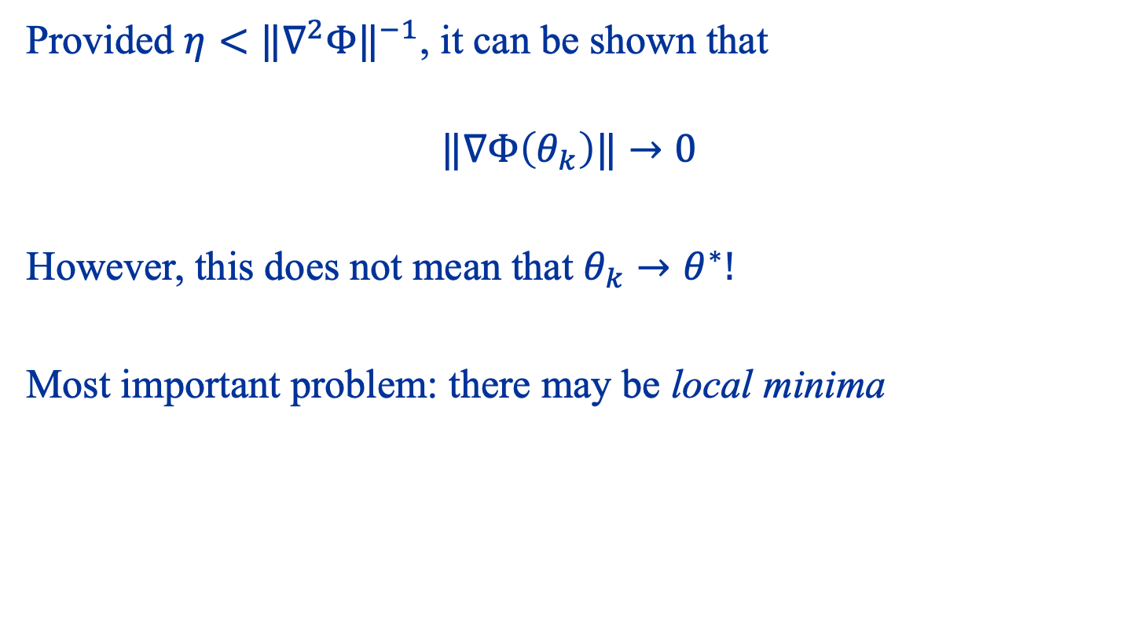
Convergence of GD
Provided $η<{‖∇^{2}Φ‖}^{−1}$, it can be shown that
$$‖∇Φ\left(θ_{k}\right)‖→0$$
However, this does not mean that $θ_{k}→θ^{∗}!$
Most important problem: there may be local minima

Slide 34
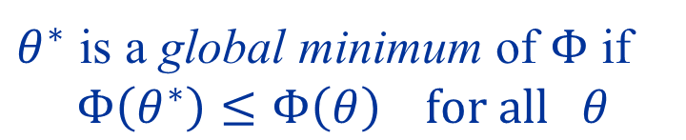
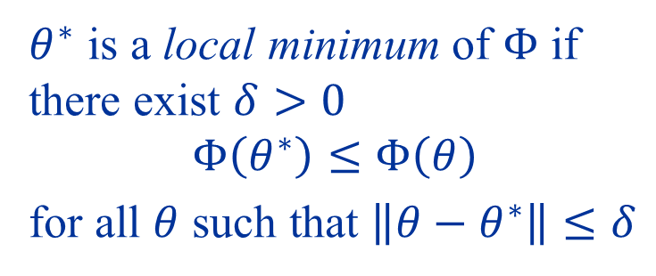

Local vs Global Minima
$θ^{∗}$ is a local minimum of $Φ$ if there exist $δ>0$
$$Φ\left(θ^{∗}\right)≤Φ\left(θ\right)$$
for all $θ$ such that $\left\|θ−θ^{∗}\right\|≤δ$
Local Min
Global Min
$θ^{∗}$ is a global minimum of $Φ$ if
$$Φ\left(θ^{∗}\right)≤Φ\left(θ\right) for all θ$$
$$δ$$
When does GD find a global minimum?

Slide 35
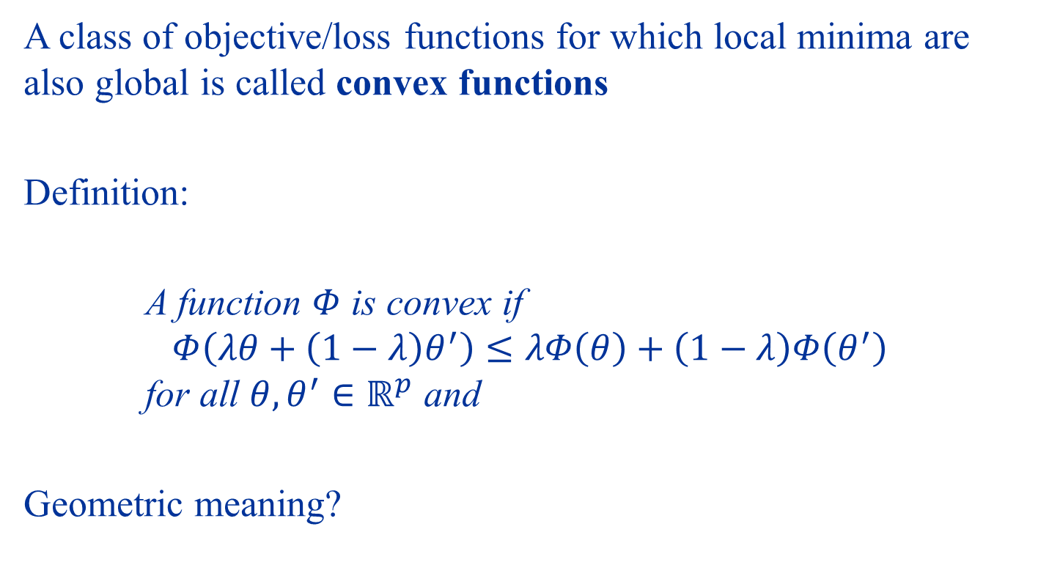
Convex Functions
A class of objective/loss functions for which local minima are also global is called convex functions
Definition:
A function $Φ$ is convex if $$Φ\left(λθ+\left(1−λ\right)θ^{′}\right)≤λΦ\left(θ\right)+\left(1−λ\right)Φ\left(θ^{′}\right)$$ for all $θ,θ^{′}∈ℝ^{p}$ and
Geometric meaning?

Slide 36
Examples
Convex:
Non-convex:

Slide 37

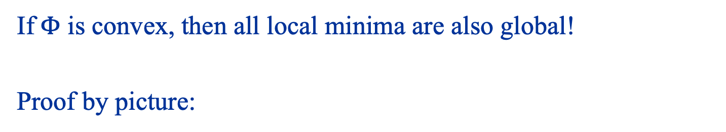
Important Property
If$Φ$ is convex, then all local minima are also global!
Proof by picture:
Local Min
$$δ$$

Slide 38
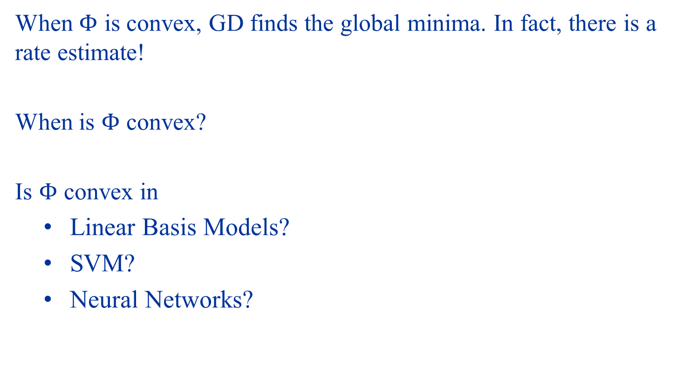
GD on Convex Functions
When $Φ$ is convex, GD finds the global minima. In fact, there is a rate estimate!
When is $Φ$ convex?
Is $Φ$ convex in
Linear Basis Models?
SVM?
Neural Networks?

Slide 39
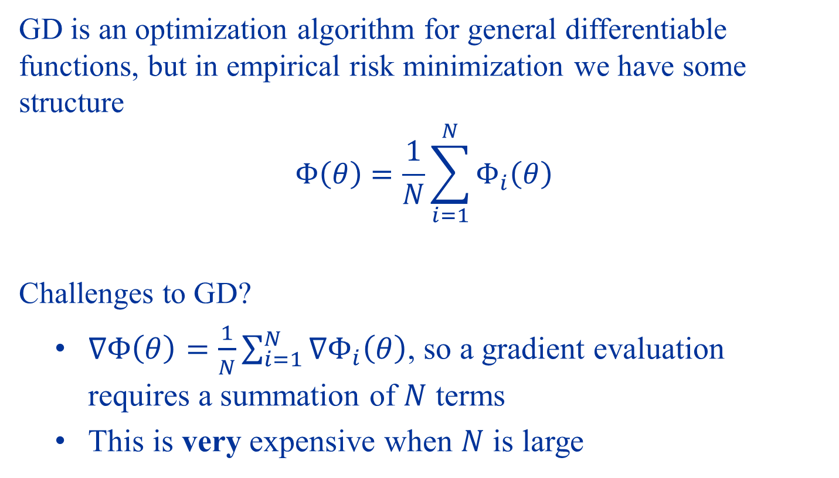
Stochastic Gradient Descent
GD is an optimization algorithm for general differentiable functions, but in empirical risk minimization we have some structure
$$Φ\left(θ\right)=\frac{1}{N}\sum_{i=1}^{N}{Φ_{i}\left(θ\right)}$$
Challenges to GD?
$∇Φ\left(θ\right)=\frac{1}{N}\sum_{i=1}^{N}{∇Φ_{i}\left(θ\right)}$, so a gradient evaluation requires a summation of $N$ terms
This is very expensive when $N$ is large

Slide 40
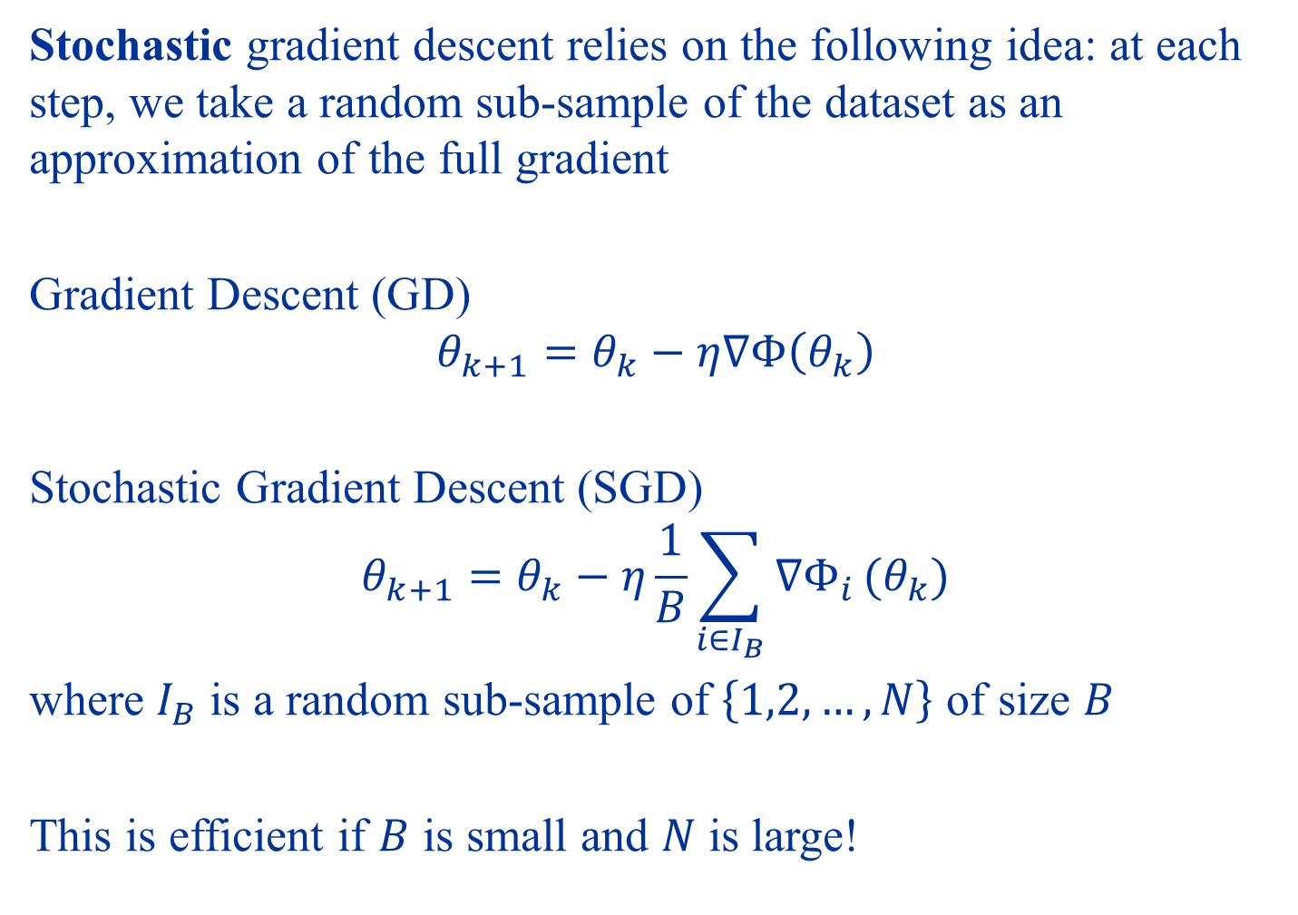
Stochastic gradient descent relies on the following idea: at each step, we take a random sub-sample of the dataset as an approximation of the full gradient
Gradient Descent (GD)
$$θ_{k+1}=θ_{k}−η∇Φ\left(θ_{k}\right)$$
Stochastic Gradient Descent (SGD)
$$θ_{k+1}=θ_{k}−η\frac{1}{B}\sum_{i∈I_{B}}{∇Φ_{i}}(θ_{k})$$
where $I_{B}$ is a random sub-sample of $\left\{1,2,…,N\right\}$ of size $B$
This is efficient if $B$ is small and $N$ is large!

Slide 41
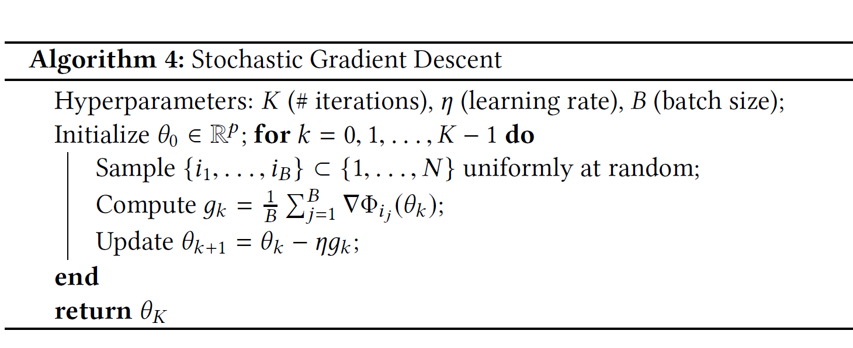

Slide 42
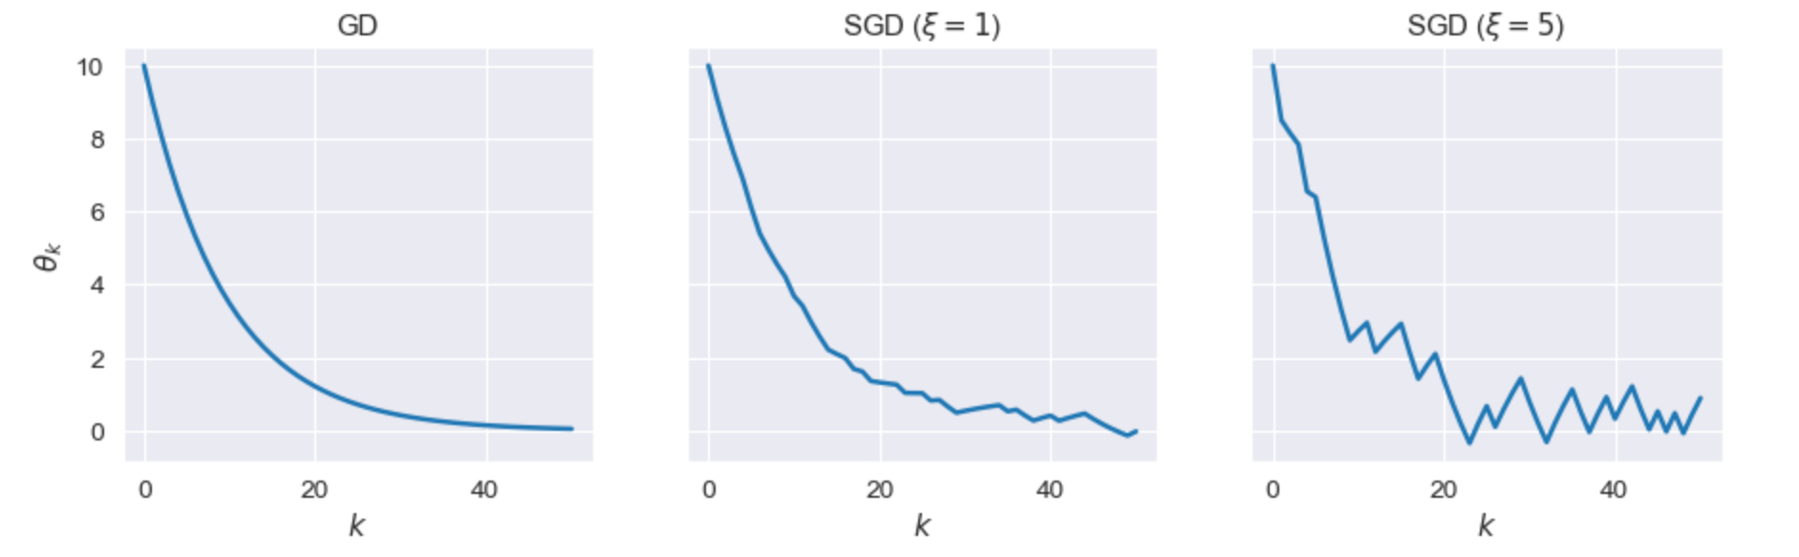
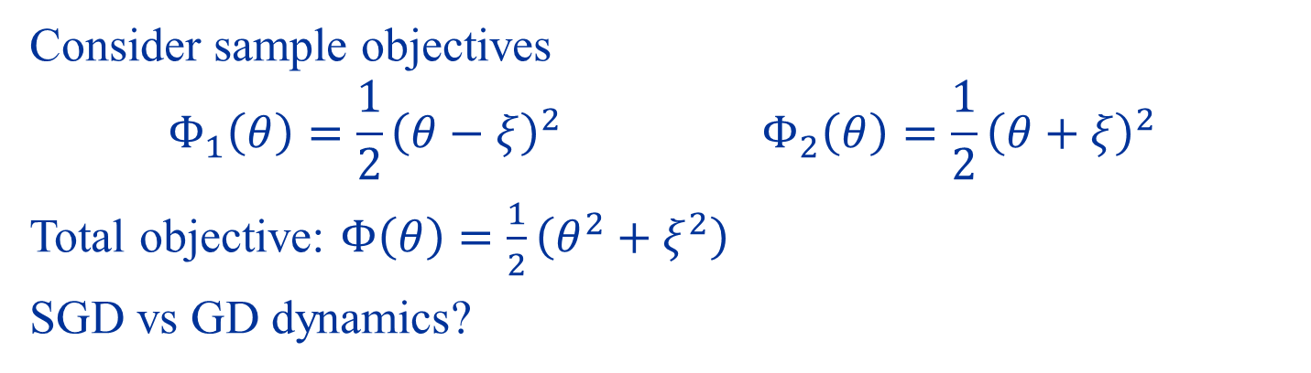
The Dynamics of SGD
Consider sample objectives
$$Φ_{1}\left(θ\right)=\frac{1}{2}{\left(θ−ξ\right)}^{2}{ Φ}_{2}\left(θ\right)=\frac{1}{2}{\left(θ+ξ\right)}^{2}$$
Total objective: $Φ\left(θ\right)=\frac{1}{2}\left(θ^{2}+ξ^{2}\right)$
SGD vs GD dynamics?

Slide 43
Deep Neural Networks

Slide 44
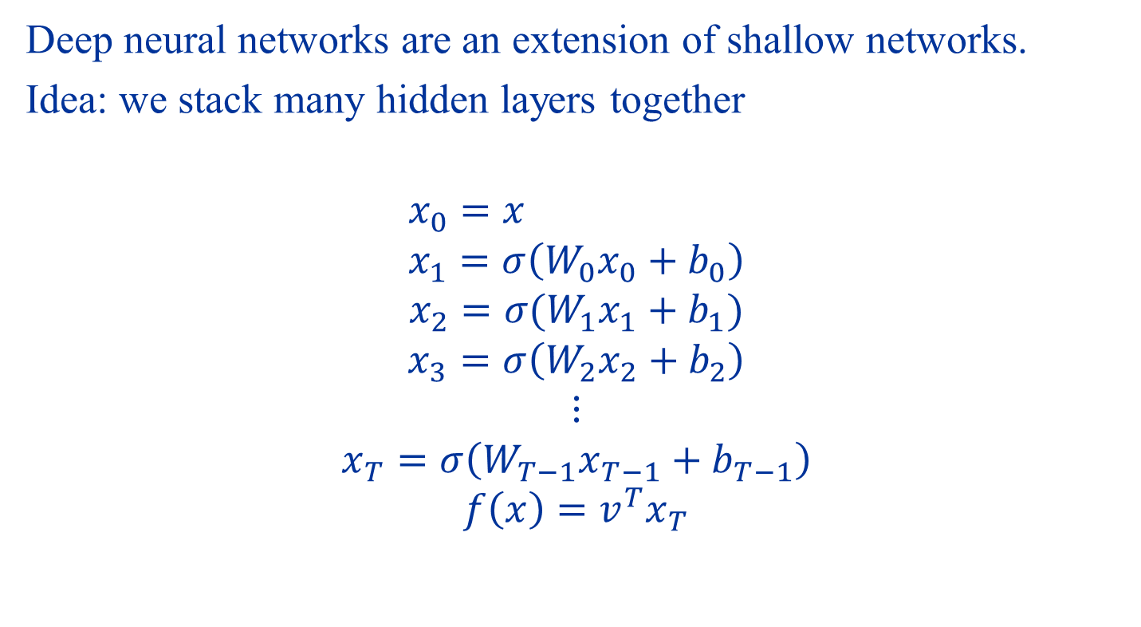
Deep Neural Networks
Deep neural networks are an extension of shallow networks.
Idea: we stack many hidden layers together
$$x_{0}=x \\ x_{1}=σ\left(W_{0}x_{0}+b_{0}\right)$$
$$x_{2}=σ(W_{1}x_{1}+b_{1})$$
$$x_{3}=σ\left(W_{2}x_{2}+b_{2}\right) \\ ⋮ \\ x_{T}=σ\left(W_{T−1}x_{T−1}+b_{T−1}\right) \\ f\left(x\right)=v^{T}x_{T}$$

Slide 45
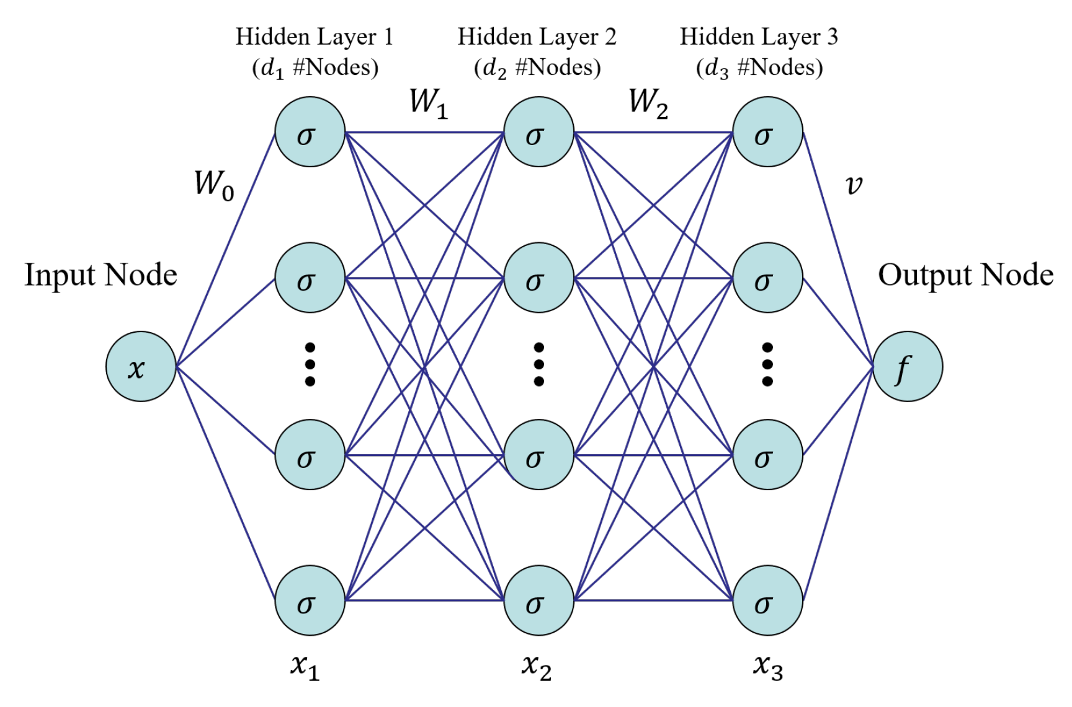

Slide 46
Optimizing Deep Neural Networks
Analogous to shallow NNs, deep NNs can also be optimized with (stochastic) gradient descent.
However, due to the repeated feed-forward structure we need an efficient algorithm to compute the gradients.
This is known as the back-propagation algorithm

Slide 47
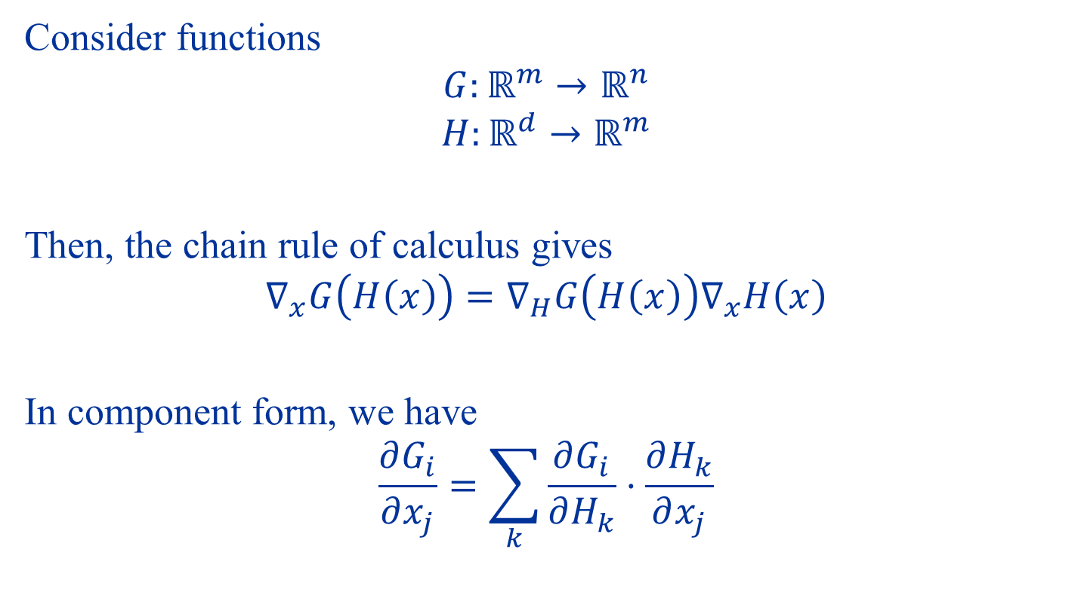
Review: Chain Rule
Consider functions
$$G:ℝ^{m}→ℝ^{n}$$
$$H:ℝ^{d}→ℝ^{m}$$
Then, the chain rule of calculus gives
$$∇_{x}G\left(H\left(x\right)\right)=∇_{H}G\left(H\left(x\right)\right)∇_{x}H\left(x\right)$$
In component form, we have
$$\frac{∂G_{i}}{∂x_{j}}=\sum_{k}{\frac{∂G_{i}}{∂H_{k}}⋅\frac{∂H_{k}}{∂x_{j}}}$$

Slide 48
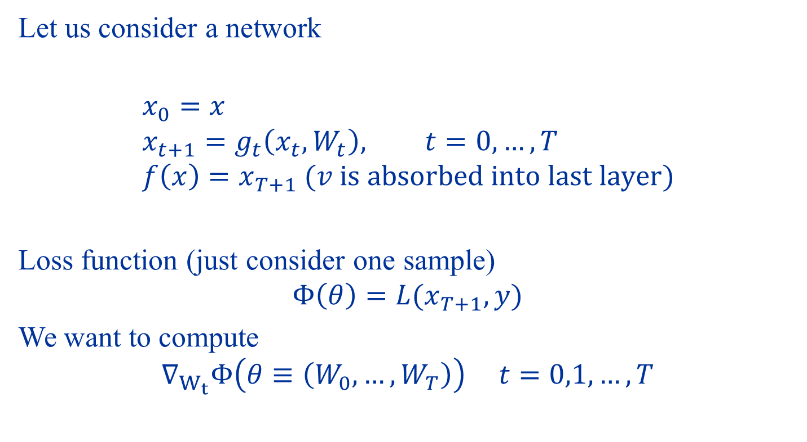
Back-Propagation
Let us consider a network
$$x_{0}=x \\ x_{t+1}=g_{t}\left(x_{t}, W_{t}\right), t=0,…,T \\ f\left(x\right)=x_{T+1} (v is absorbed into last layer)$$
Loss function (just consider one sample)
$$Φ\left(θ\right)=L(x_{T+1},y)$$
We want to compute
$$∇_{W_{t}}Φ\left(θ≡\left(W_{0},…,W_{T}\right)\right) t=0,1,…,T$$

Slide 49
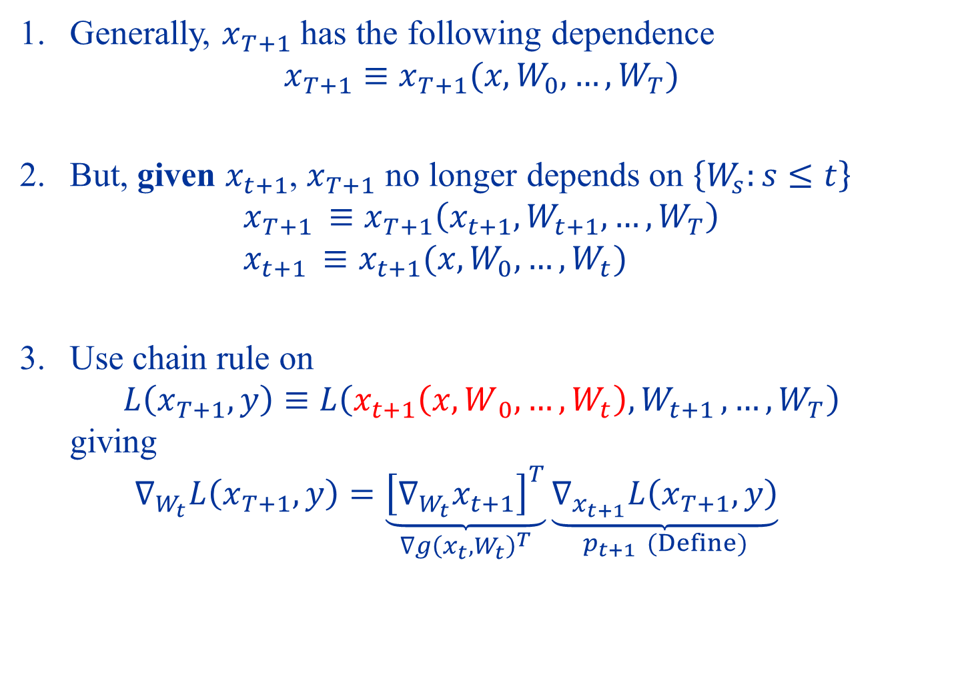
Generally, $x_{T+1}$ has the following dependence $x_{T+1}≡x_{T+1}(x,W_{0},…,W_{T})$
But, given $x_{t+1}$, $x_{T+1}$ no longer depends on $\left\{W_{s}:s≤t\right\}$ $x_{T+1 }≡x_{T+1}\left(x_{t+1},W_{t+1},…,W_{T}\right)$ $x_{t+1 }≡x_{t+1}(x,W_{0},…,W_{t})$
Use chain rule on $L\left(x_{T+1},y\right)≡L\left(x_{t+1}\left(x,W_{ 0},…,W_{t}\right),W_{t+1 },…,W_{T}\right)$ giving $∇_{W_{t}}L\left(x_{T+1},y\right)=\underset{∇g{\left(x_{t}, W_{t}\right)}^{T}}{\underbrace{{\left[∇_{W_{t}}x_{t+1}\right]}^{T}}}\underset{p_{t+1 } (Define)}{\underbrace{∇_{x_{t+1}}L\left(x_{T+1},y\right)}}$

Slide 50
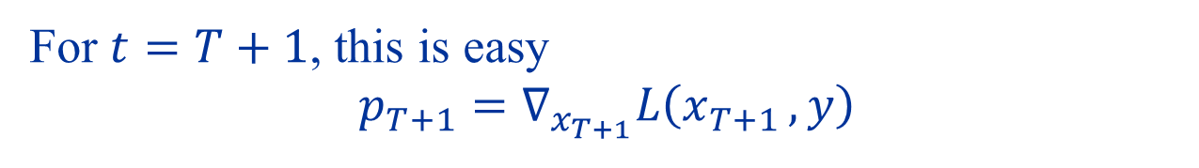
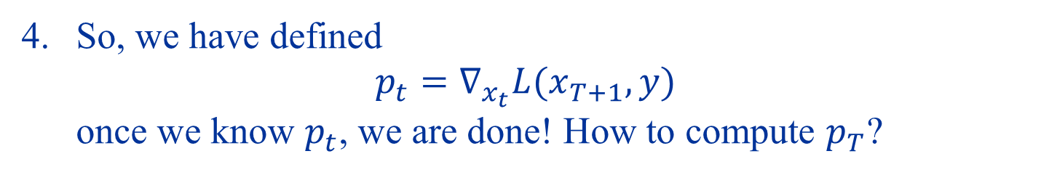
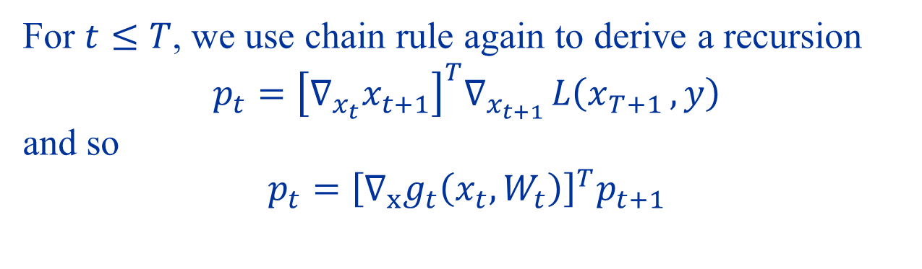
So, we have defined $p_{t}=∇_{x_{t}}L(x_{T+1},y)$ once we know $p_{t}$, we are done! How to compute $p_{T}$?
For $t=T+1$, this is easy $$p_{T+1}=∇_{x_{T+1}}L\left(x_{T+1 },y\right)$$
For $t≤T$, we use chain rule again to derive a recursion $$p_{t}={\left[∇_{x_{t}}x_{t+1}\right]}^{T}∇_{x_{t+1 }}L\left(x_{T+1 },y\right)$$ and so $$p_{t}={\left[∇_{x}g_{t}\left(x_{t},W_{t}\right)\right]}^{T}p_{t+1}$$

Slide 51
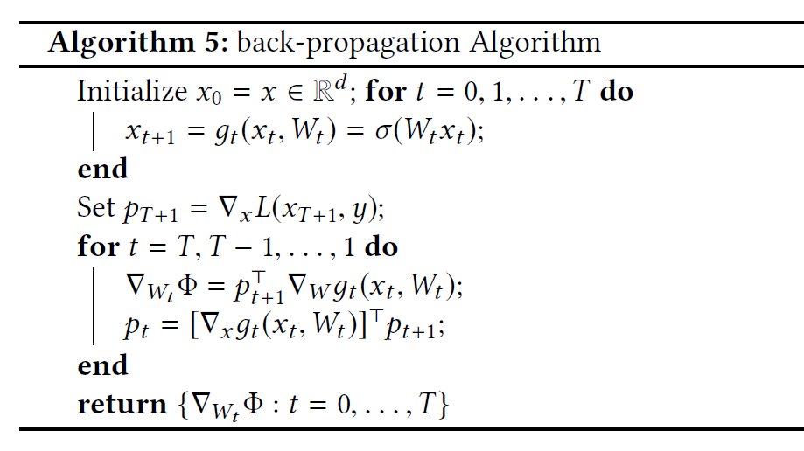

Slide 52
Summary
Approximation Properties of Neural Networks
Nonlinear approximation: adapted to data
Universal approximation property, overcomes curse of dimensionality
Optimizing Neural Networks
(Stochastic) Gradient Descent
For deep NNs, compute gradients using back-propagation

