Slide 1

Foundations of Machine Learning DSA 5105 • Lecture 7
Soufiane Hayou
Department of Mathematics

Slide 2
Limitation of FCNN The permutation invariance property loses spatial/temporal structure in the data!

Slide 3
Example: Convolutions in 2D
https://towardsdatascience.com/intuitively-understanding-convolutions-for-deep-learning-1f6f42faee1

Slide 4
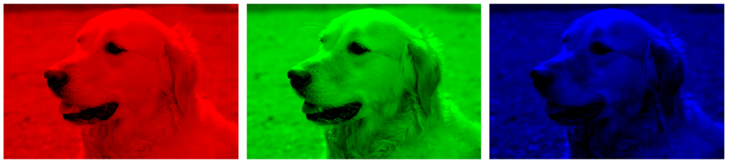
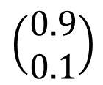


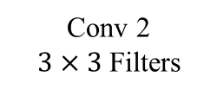
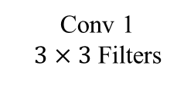
A Typical CNN Architecture
Conv 1
$3×3$ Filters
Conv 2
$3×3$ Filters
Flatten
FCNN
$$\left(\begin{matrix}0.9 \\ 0.1\end{matrix}\right)$$
Max Pool
$$2×2$$
Max Pool
$$2×2$$

Slide 5
What about text data?

Slide 6
Recurrent Neural Networks

Slide 7
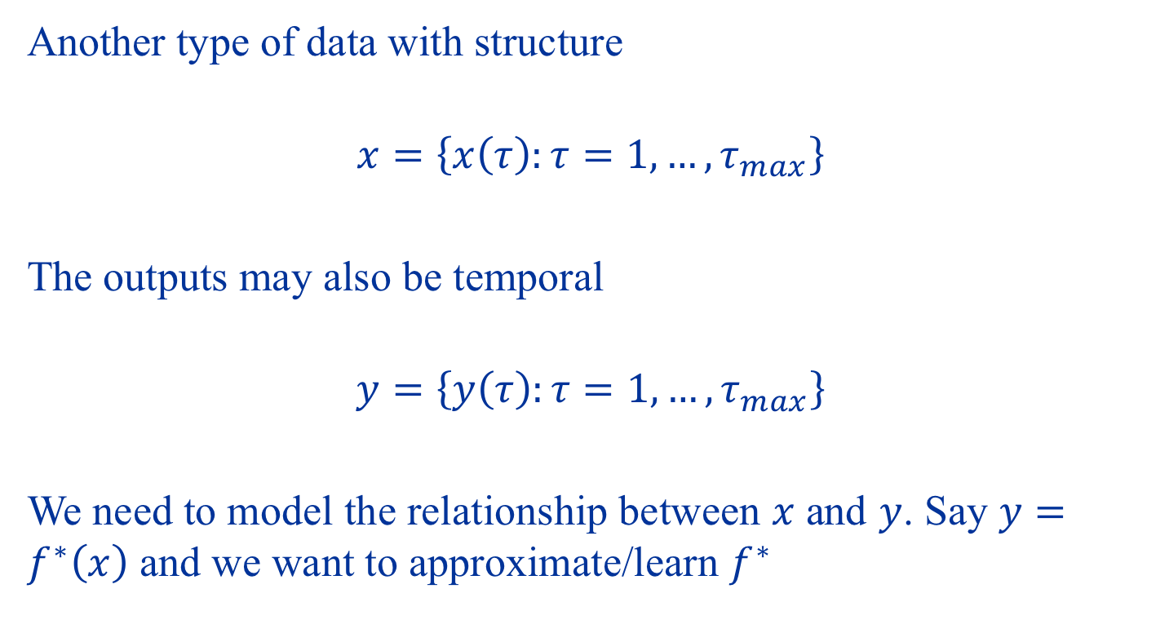
Time Series Data
Another type of data with structure
$$x=\left\{x\left(τ\right):τ=1,…,τ_{max}\right\}$$
The outputs may also be temporal
$$y=\left\{y\left(τ\right):τ=1,…,τ_{max}\right\}$$
We need to model the relationship between $x$ and $y$. Say $y=f^{∗}\left(x\right)$ and we want to approximate/learn $f^{∗}$

Slide 8
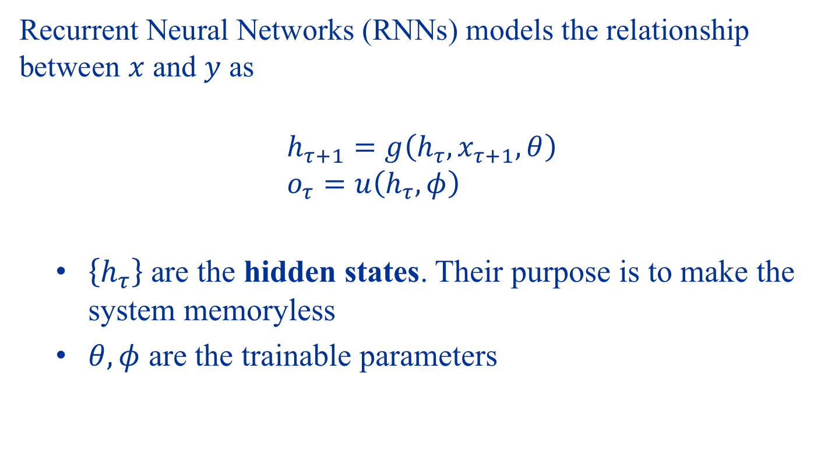
The Recurrent Architecture
Recurrent Neural Networks (RNNs) models the relationship between $x$ and $y$ as
$$h_{τ+1}=g\left(h_{τ},x_{τ+1},θ\right) \\ o_{τ}=u\left(h_{τ},φ\right)$$
$\left\{h_{τ}\right\}$ are the hidden states. Their purpose is to make the system memoryless
$θ,φ$ are the trainable parameters

Slide 9
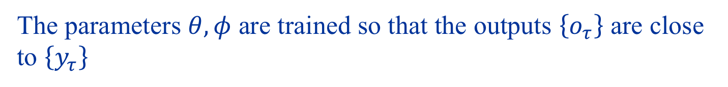
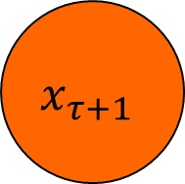

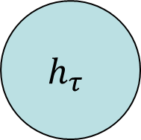

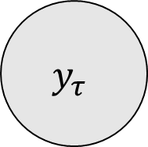
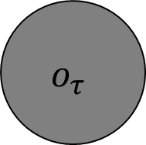
The Recurrent Architecture
$$h_{τ+1}=g\left(h_{τ},x_{τ+1},θ\right)$$
Minimize
$$x_{τ+1}$$
$$h_{τ}$$
$$o_{τ}$$
$$y_{τ}$$
$$o_{τ}=u\left(h_{τ},φ \right)$$
The parameters $θ,φ$ are trained so that the outputs $\left\{o_{τ}\right\}$ are close to $\left\{y_{τ}\right\}$

Slide 10
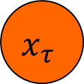

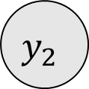


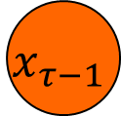
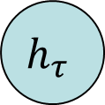
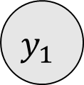


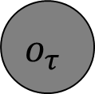
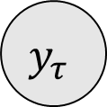
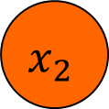
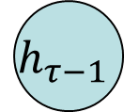

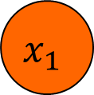
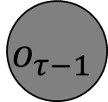

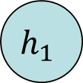
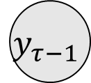
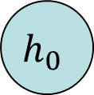
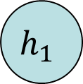
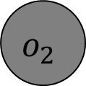

How to Optimize RNNs?
$$y_{1}$$
$$y_{2}$$
$$y_{τ−1}$$
$$y_{τ}$$
$$o_{1}$$
$$o_{2}$$
$$o_{τ−1}$$
$$o_{τ}$$
$$u\left(h_{0},φ \right)$$
$$u\left(h_{1},φ \right)$$
…
$$u\left(h_{τ−1},φ \right)$$
$$u\left(h_{τ},φ \right)$$
$$h_{0}$$
$$h_{1}$$
$$h_{1}$$
$$h_{τ−1}$$
$$h_{τ}$$
$$g(h_{0},x_{1},θ)$$
$$g(h_{1},x_{2},θ)$$
$$g(h_{τ−1},x_{τ},θ)$$
$$x_{1}$$
$$x_{2}$$
$$x_{τ−1}$$
$$x_{τ}$$

Slide 11
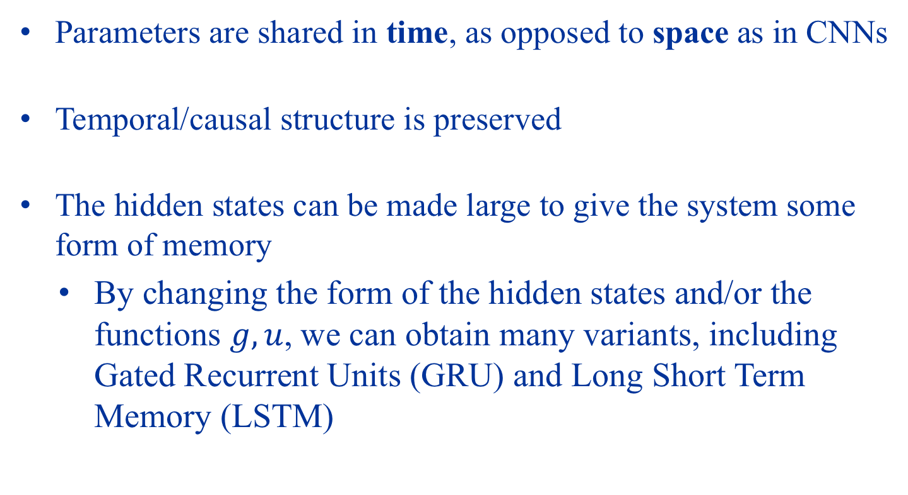
Important Observations
Parameters are shared in time, as opposed to space as in CNNs
Temporal/causal structure is preserved
The hidden states can be made large to give the system some form of memory
By changing the form of the hidden states and/or the functions $g,u$, we can obtain many variants, including Gated Recurrent Units (GRU) and Long Short Term Memory (LSTM)

Slide 12
Demo: RNNs for Text Generation

Slide 13
Summary
Convolution Neural Networks
Suitable for data with spatial structure (e.g. images)
Convolution and pooling builds equivariance, invariance
Recurrent Neural Networks
Suitable for data with temporal structure (e.g. text, time series)
They can build powerful models!

Slide 14
Project
Use at least one of Fully connected NN, CNN or RNN model in your project.
Due to availability of computing resources, I am not looking for high accuracy or good performance on large network structures. Rather, I am looking at correct usage, so try it on simple models if you like

