Slide 1

Principles of Machine Learning DSA 5105 • Lecture 9
Soufiane Hayou
Department of Mathematics

Slide 2
Last Time
We introduced dimensionality reduction tools
PCA
Autoencoder
Today, we will look at another class of methods for clustering, density estimation and related tasks

Slide 3
Clustering and the K-means Algorithm

Slide 4
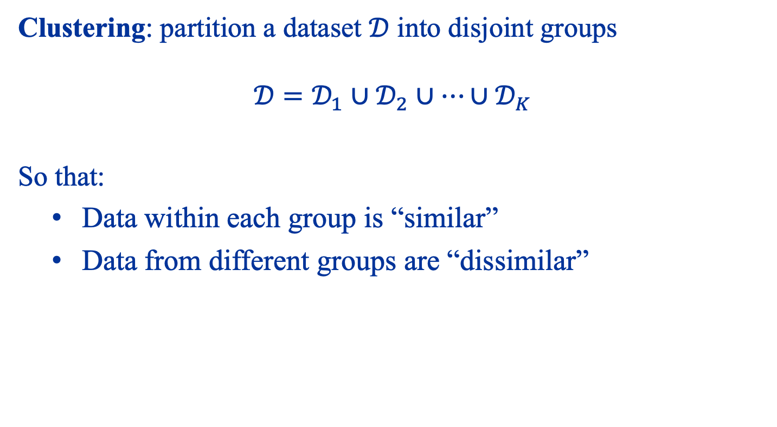
Clustering Data
Clustering: partition a dataset $𝒟$ into disjoint groups $$𝒟=𝒟_{1}∪𝒟_{2}∪…∪𝒟_{K}$$
So that:
Data within each group is “similar”
Data from different groups are “dissimilar”

Slide 5
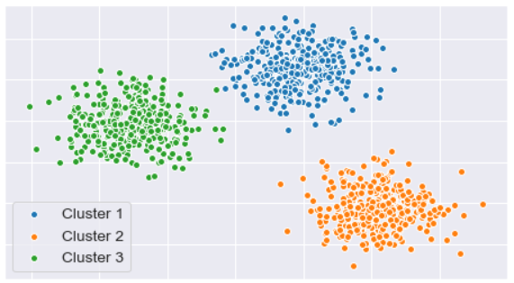
Clustering Data

Slide 6
Why Clustering?
There are many applications of clustering!
Information retrieval
Genetics
Market research
Social network analysis
Anomaly detection

Slide 7
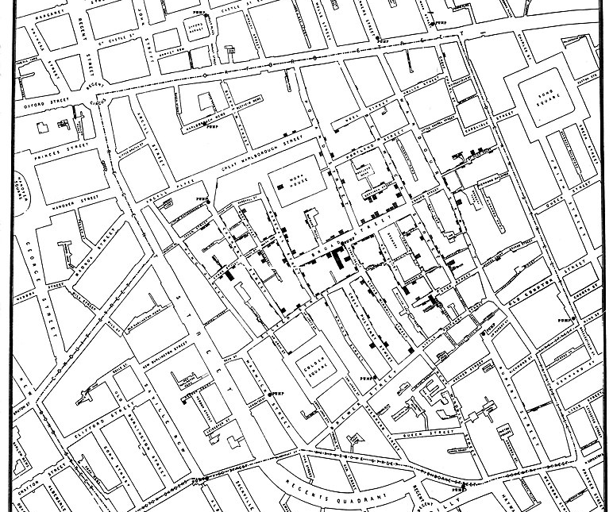

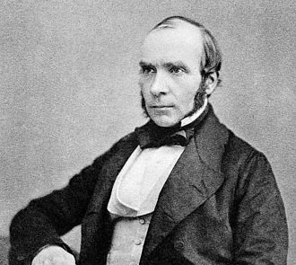
John Snow (1813-1858)
Widely regarded as the father of modern epidemiology
Predating the germ theory of disease, he was one of the first to propose a link between ingestion of contaminated water and the cholera outbreak of 1854 in Soho, London
He used a form of clustering to identify the source of the outbreak. How?
By observing that clusters are close to water sources!

Slide 8
K-means Clustering Algorithm
We will introduce the simplest form of clustering algorithm known as the K-means algorithm
Main idea:
Identify some representatives of each cluster
Assign each data point to a cluster by some rules

Slide 9




Cluster Representatives
Consider a dataset $𝒟={\left\{x_{i}\right\}}_{i=1}^{N}$ with $x_{i}∈ℝ^{d}$
To form $K$ clusters, we represent the “centers” of these clusters by $$z_{1},…,z_{K}∈ℝ^{d}$$
$$z_{1}$$
$$z_{3}$$
$$z_{2}$$

Slide 10
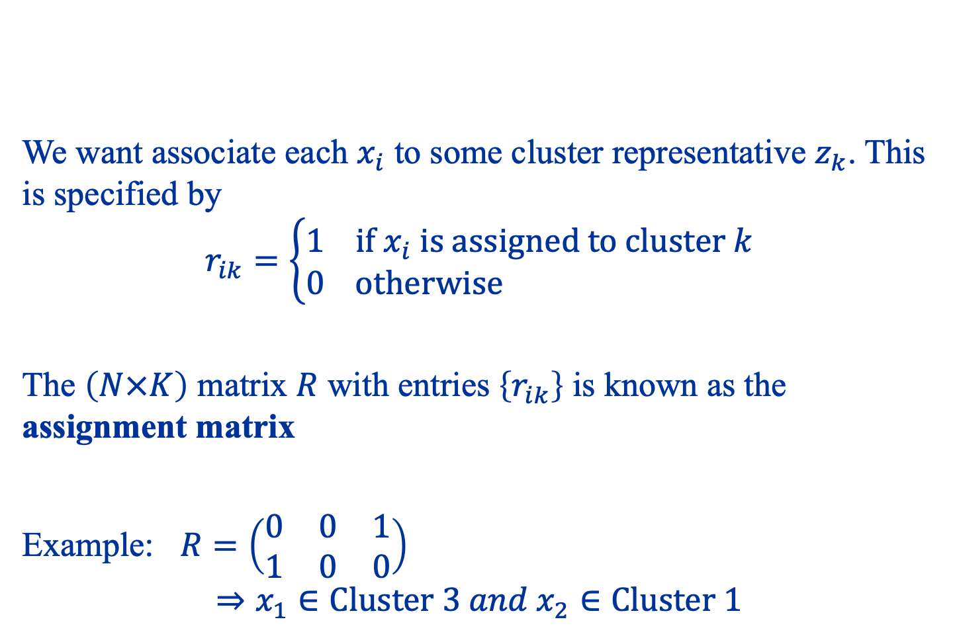
Assignment Matrix
We want associate each $x_{i}$ to some cluster representative $z_{k}$. This is specified by $$r_{ik}=\left\{\begin{aligned}1 if x_{i} is assigned to cluster k \\ 0 otherwise \end{aligned}\right.$$
The $\left(N×K\right)$ matrix $R$ with entries $\left\{r_{ik}\right\}$ is known as the assignment matrix
Example: $R=\left(\begin{matrix}0 & 0 & 1 \\ 1 & 0 & 0\end{matrix}\right)$
$$⇒x_{1}∈Cluster 3 and x_{2}∈Cluster 1$$

Slide 11
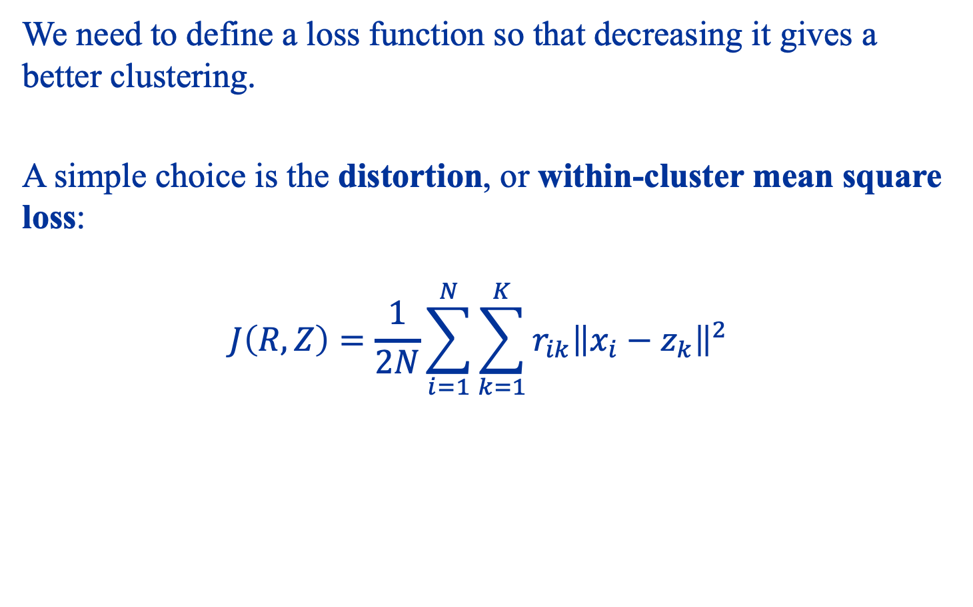
The Loss Function
We need to define a loss function so that decreasing it gives a better clustering.
A simple choice is the distortion, or within-cluster mean square loss: $$J\left(R,Z\right)=\frac{1}{2N}\sum_{i=1}^{N}{\sum_{k=1}^{K}{r_{ik}{\left\|x_{i}−z_{k}\right\|}^{2}}}$$

Slide 12
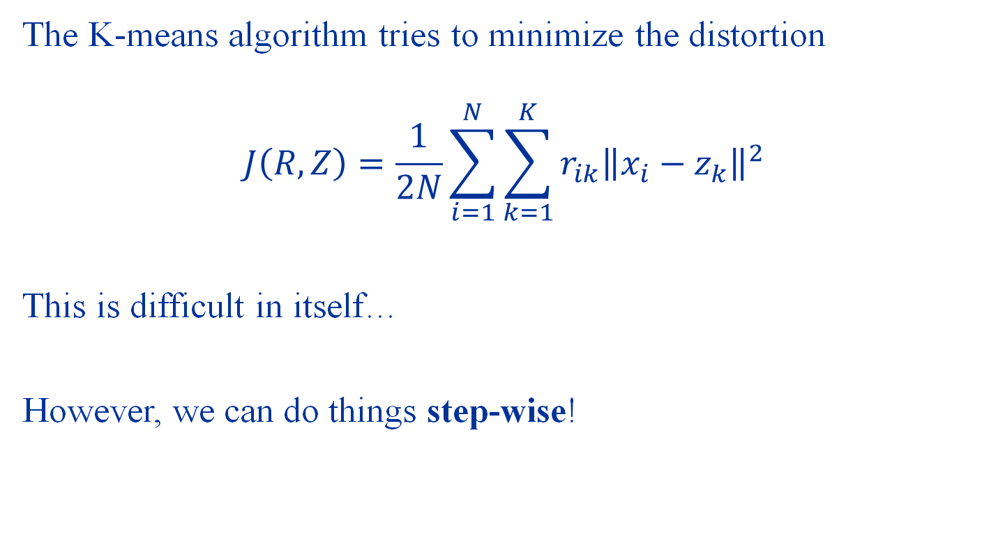
The K-means Algorithm
The K-means algorithm tries to minimize the distortion $$J\left(R,Z\right)=\frac{1}{2N}\sum_{i=1}^{N}{\sum_{k=1}^{K}{r_{ik}{\left\|x_{i}−z_{k}\right\|}^{2}}}$$
This is difficult in itself…
However, we can do things step-wise!

Slide 13
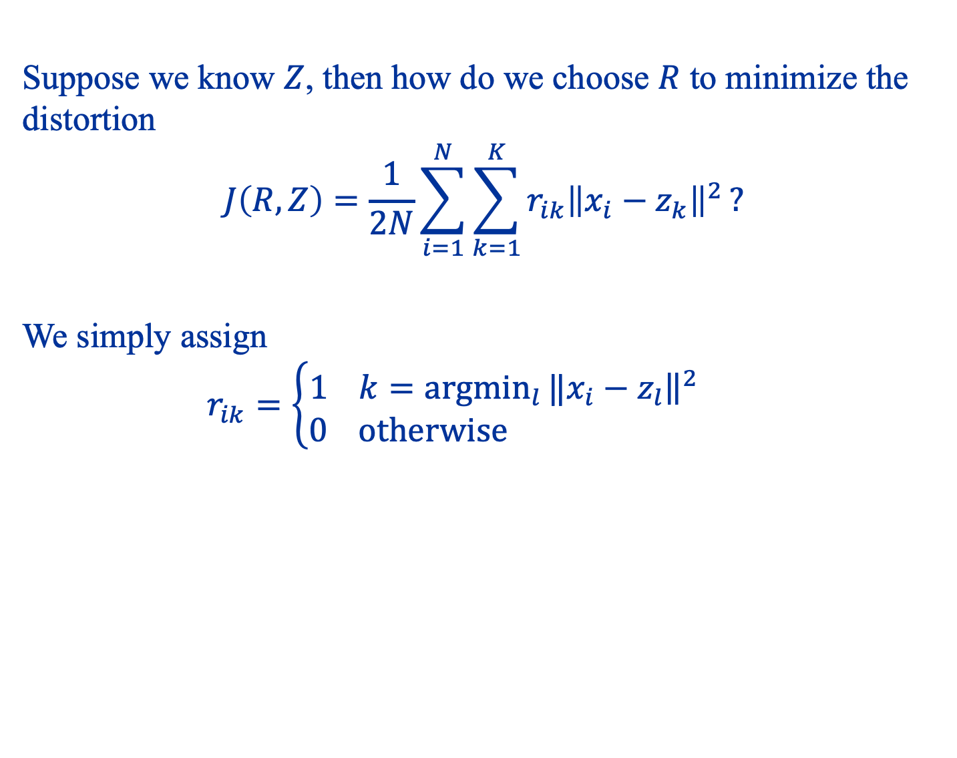
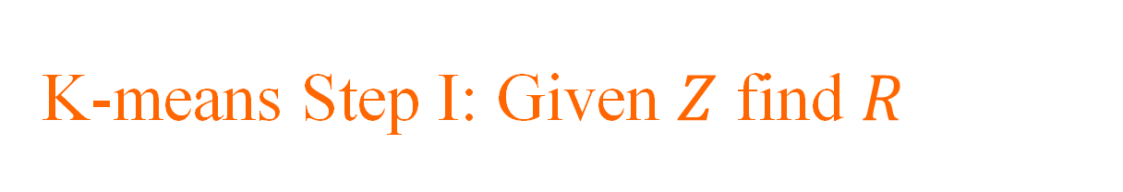
K-means Step I: Given $Z$ find $R$
Suppose we know $Z$, then how do we choose $R$ to minimize the distortion $$J\left(R,Z\right)=\frac{1}{2N}\sum_{i=1}^{N}{\sum_{k=1}^{K}{r_{ik}{\left\|x_{i}−z_{k}\right\|}^{2}}}?$$
We simply assign $$r_{ik}=\left\{\begin{aligned}1 k={argmin}_{l}{‖{\left.​x_{i}−z_{l}\right\|}^{2}} \\ 0 otherwise \end{aligned}\right.$$

Slide 14
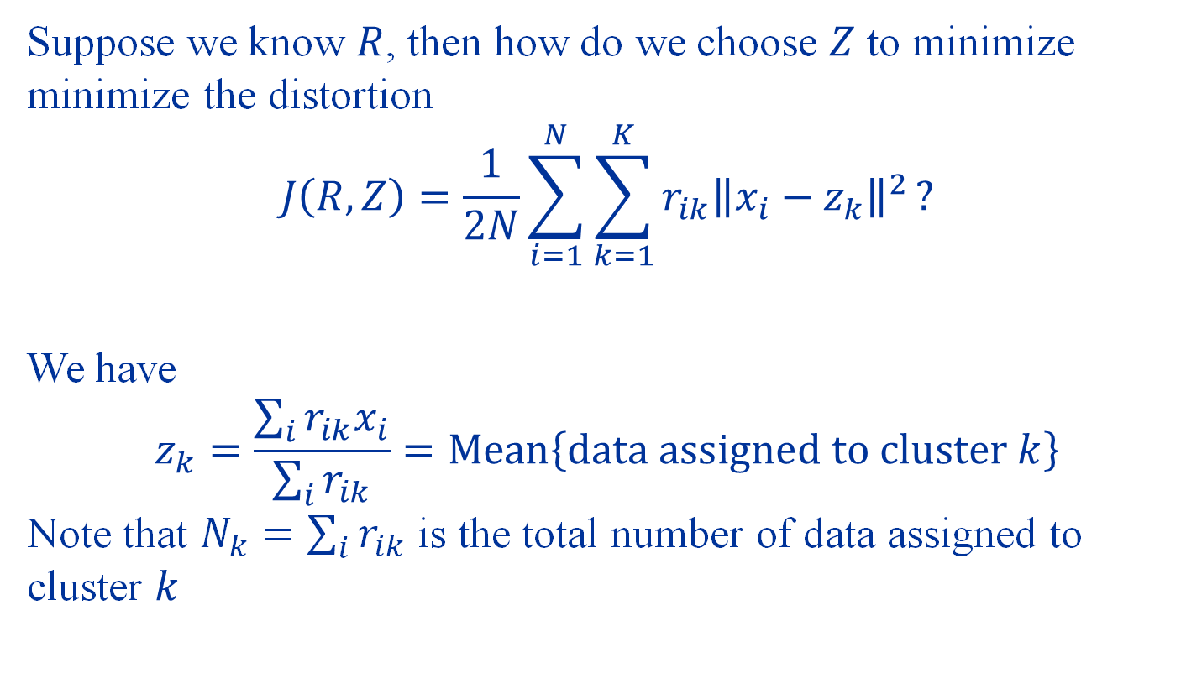
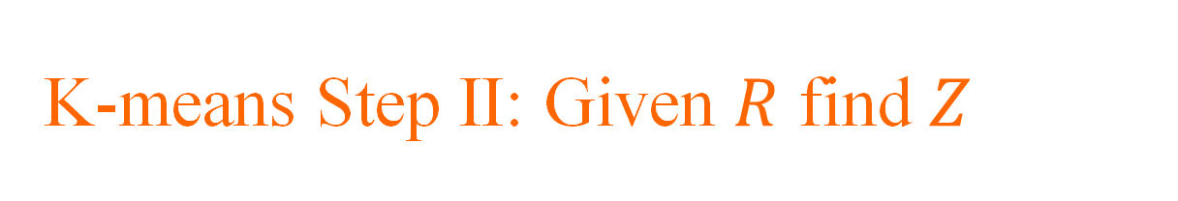
K-means Step II: Given $R$ find $Z$
Suppose we know $R$, then how do we choose $Z$ to minimize minimize the distortion $$J\left(R,Z\right)=\frac{1}{2N}\sum_{i=1}^{N}{\sum_{k=1}^{K}{r_{ik}{\left\|x_{i}−z_{k}\right\|}^{2}}}?$$
We have $$z_{k}=\frac{\sum_{i}{r_{ik}x_{i}}}{\sum_{i}{r_{ik}}}=Mean\left\{data assigned to cluster k\right\}$$ Note that $N_{k}=\sum_{i}{r_{ik}}$ is the total number of data assigned to cluster $k$

Slide 15
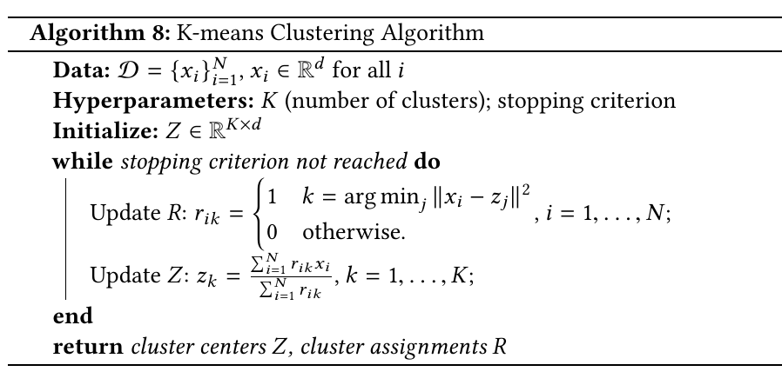
The K-means Algorithm

Slide 16
Visualizing K-means
https://towardsdatascience.com/introduction-to-image-segmentation-with-k-means-clustering-83fd0a9e2fc3

Slide 17
Does the algorithm converge?
Observe
The next clustering only depends on the current clustering If a clustering assignment changes, then loss must decrease
If loss decreases, there must be a new clustering assignment
There are only a finite number of clustering assignments
This shows that the K-means algorithm converges in a finite number of steps!

Slide 18
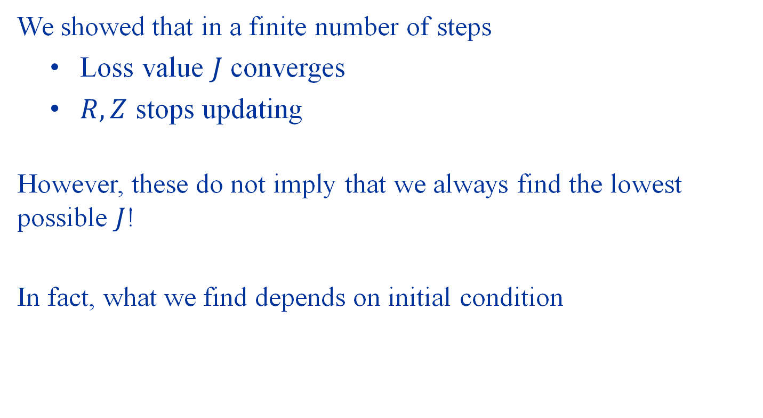
But…
We showed that in a finite number of steps
Loss value $J$ converges
$R,Z$ stops updating
However, these do not imply that we always find the lowest possible $J$!
In fact, what we find depends on initial condition

Slide 19
Example
$$𝒟=\left\{\left(2, 1\right),\left(2, −1\right),\left(−2,1\right),(−2,−1)\right\}$$

Slide 20
K-means cannot generally find a globally optimal clustering

Slide 21
Gaussian Mixture Models

Slide 22
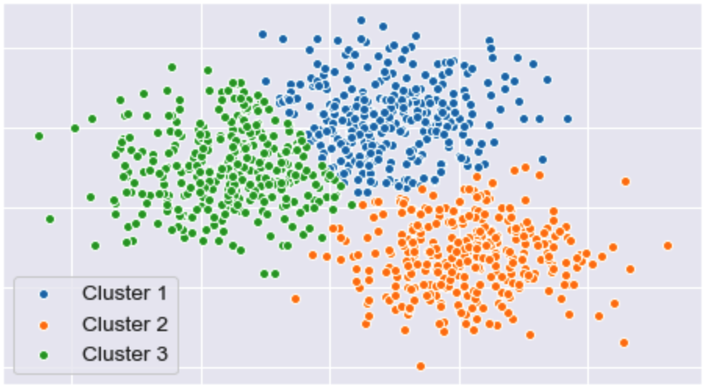
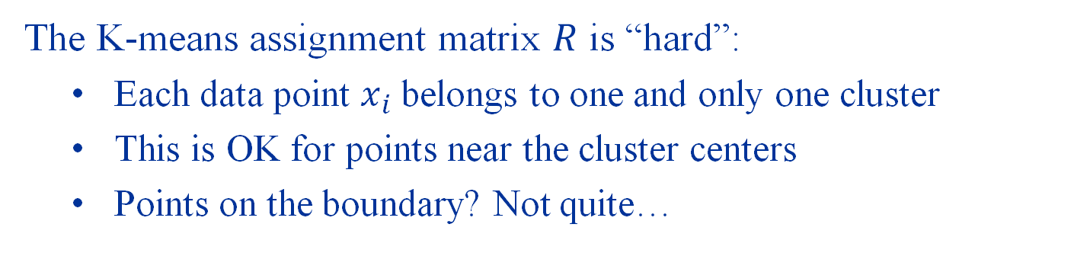
Some Shortcomings of K-means
The K-means assignment matrix $R$ is “hard”:
Each data point $x_{i}$ belongs to one and only one cluster
This is OK for points near the cluster centers
Points on the boundary? Not quite…

Slide 23
We want to assign points in a “soft” way! This is one motivation behind Gaussian Mixture Models

Slide 24
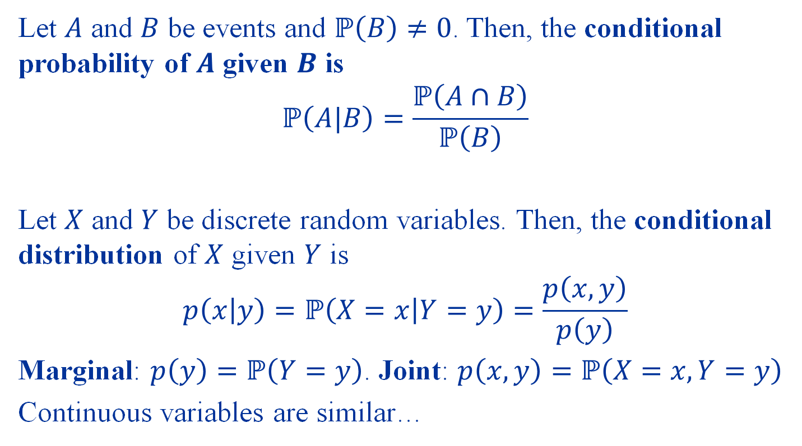
Review: Conditional Probability and Conditional Distribution
Let $A$ and $B$ be events and $ℙ\left(B\right)≠0$. Then, the conditional probability of $A$ given $B$ is
$$ℙ\left(A|B\right)=\frac{ℙ\left(A∩B\right)}{ℙ\left(B\right)}$$
Let $X$ and $Y$ be discrete random variables. Then, the conditional distribution of $X$ given $Y$ is $$p\left(x | y\right)=ℙ\left(X=x | Y=y\right)=\frac{p\left(x,y\right)}{p\left(y\right)}$$
Marginal: $p\left(y\right)=ℙ\left(Y=y\right)$. Joint: $p\left(x,y\right)=ℙ\left(X=x,Y=y\right)$
Continuous variables are similar…

Slide 25
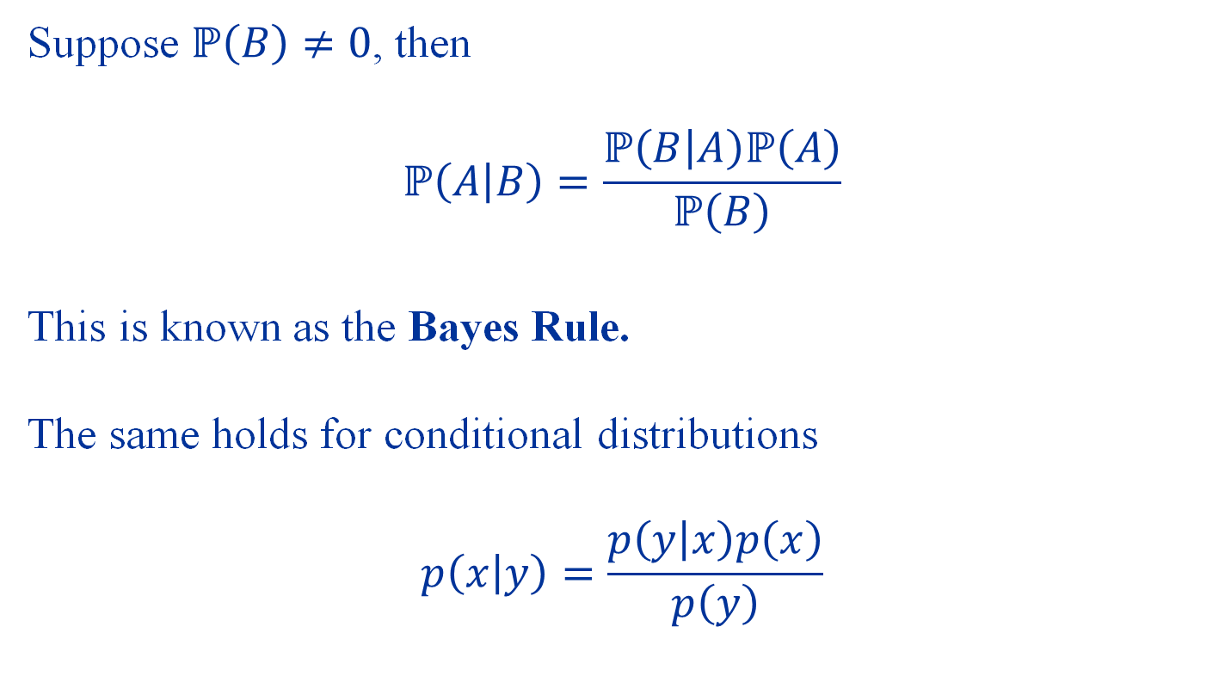
Bayes Rule
Suppose $ℙ\left(B\right)≠0$, then
$$ℙ\left(A | B\right)=\frac{ℙ\left(B | A\right)ℙ\left(A\right)}{ℙ\left(B\right)}$$
This is known as the Bayes Rule. The same holds for conditional distributions $$p\left(x | y\right)=\frac{p\left(y | x\right)p\left(x\right)}{p\left(y\right)}$$

Slide 26
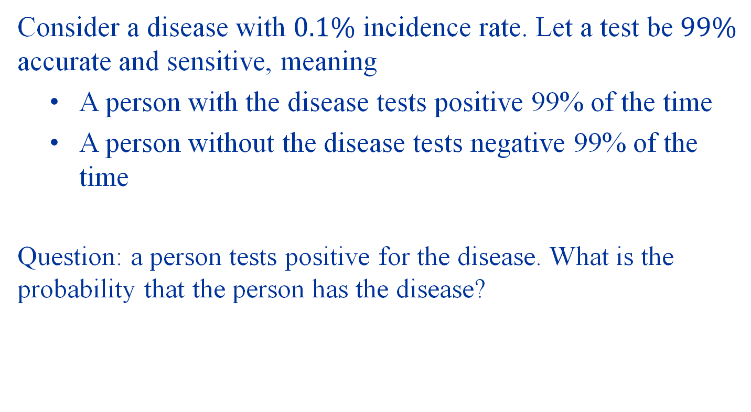
Example
Consider a disease with $0.1\%$ incidence rate. Let a test be $99\%$ accurate and sensitive, meaning
A person with the disease tests positive 99% of the time
A person without the disease tests negative 99% of the time
Question: a person tests positive for the disease. What is the probability that the person has the disease?

Slide 27
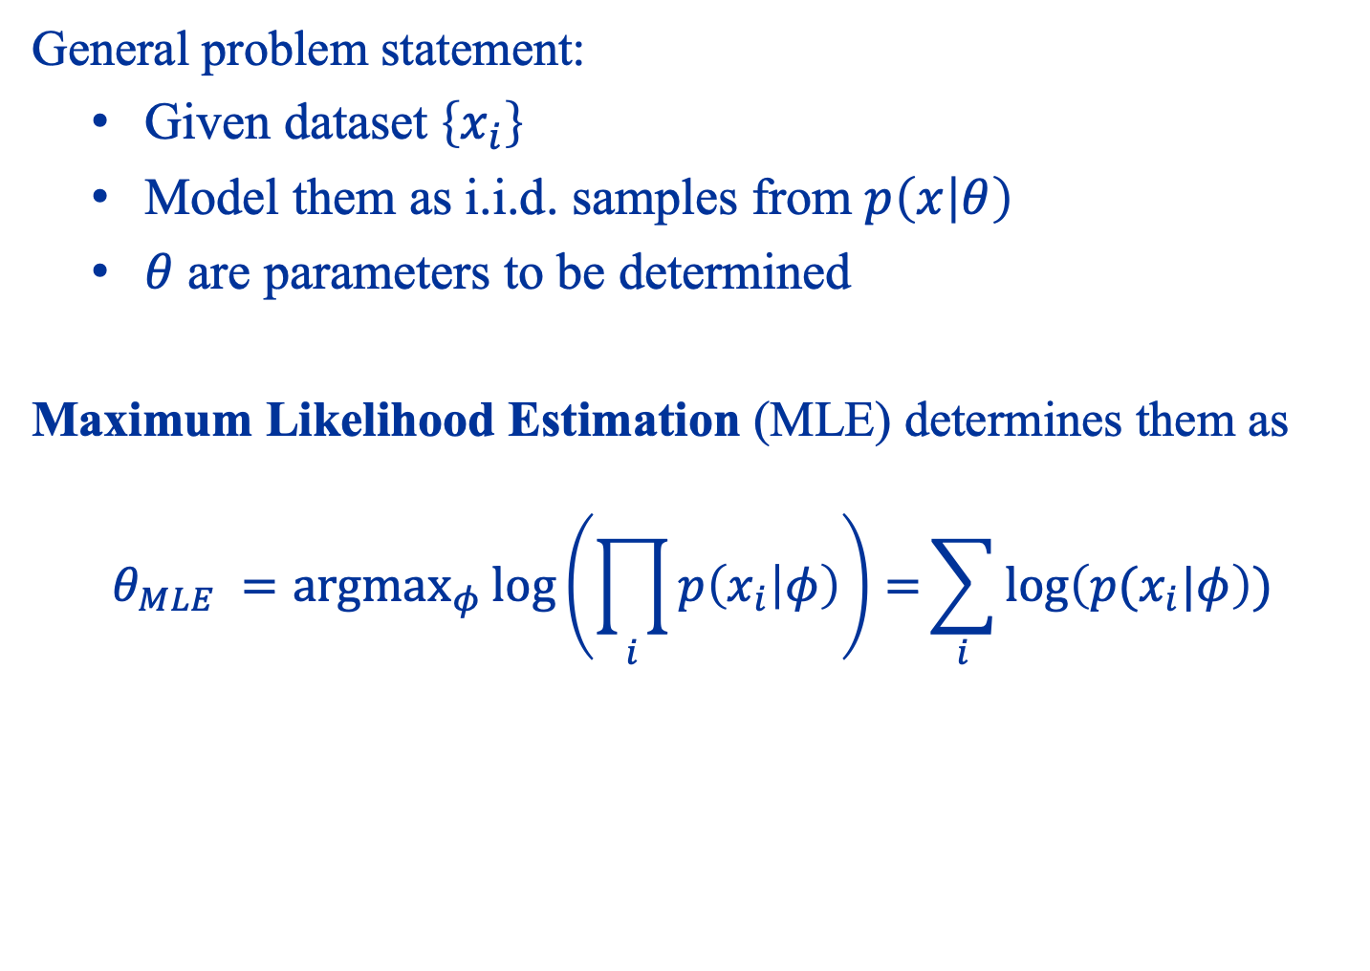
Maximum Likelihood Estimation
General problem statement:
Given dataset $\left\{x_{i}\right\}$
Model them as i.i.d. samples from $p\left(x | θ\right)$
$θ$ are parameters to be determined
Maximum Likelihood Estimation (MLE) determines them as $$θ_{MLE} ={argmax}_{φ}{\log\left(\prod_{i}{p\left(x_{i} | φ\right)}\right)=\sum_{i}{\log\left(p(x_{i}|φ\right))}}$$

Slide 28

Example
Let ${\left\{x_{i}\right\}}_{i=1}^{N}$ be a dataset in 1D. We model them as i.i.d. samples from a Gaussian distribution with unknown mean $z$ and unknown variance $σ^{2}$.
How do we determine $z$ and $σ^{2}$ from the data?

Slide 29
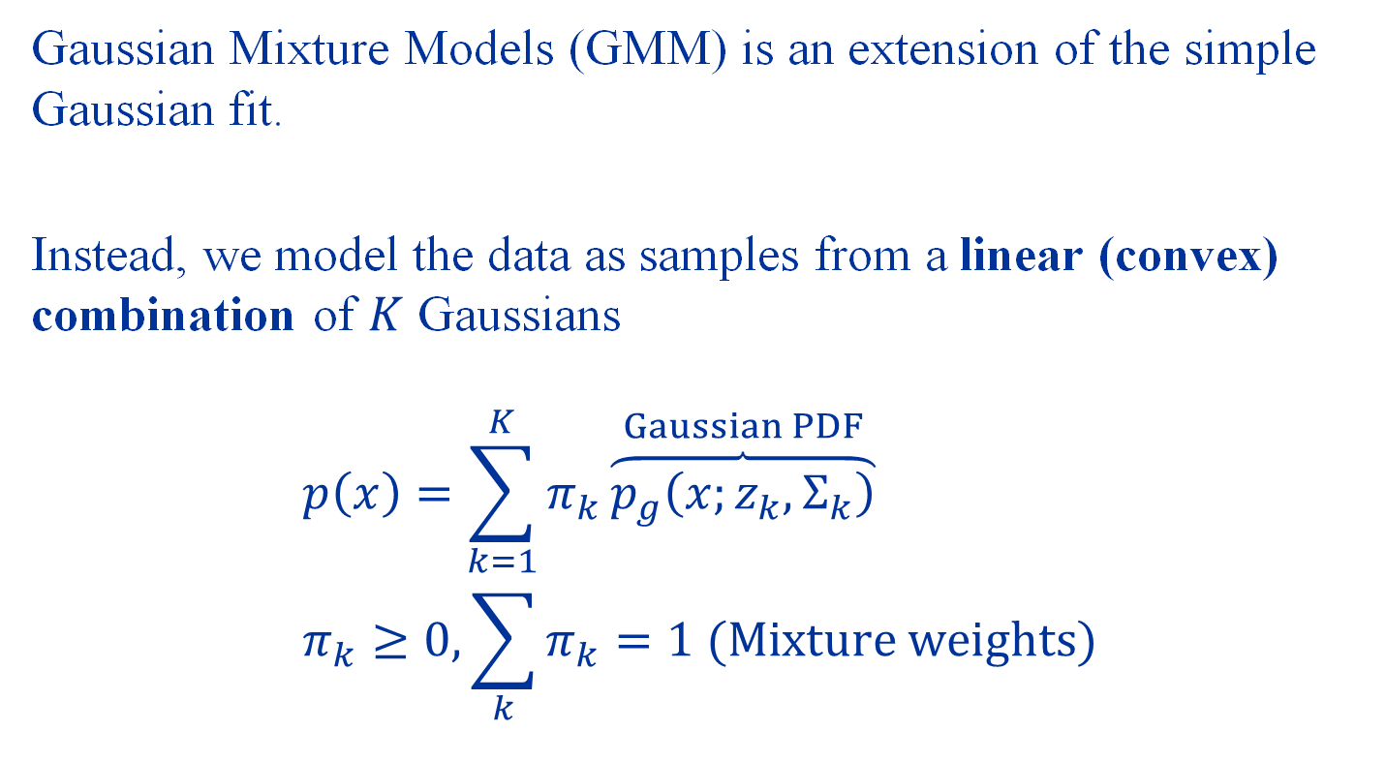
Gaussian Mixture Models
Gaussian Mixture Models (GMM) is an extension of the simple Gaussian fit.
Instead, we model the data as samples from a linear (convex) combination of $K$ Gaussians
$$p\left(x\right)=\sum_{k=1}^{K}{π_{k}}\overset{Gaussian PDF}{\overbrace{p_{g}\left(x;z_{k},Σ_{k}\right)}} \\ π_{k}≥0, \sum_{k}{π_{k}}=1 (Mixture weights)$$

Slide 30
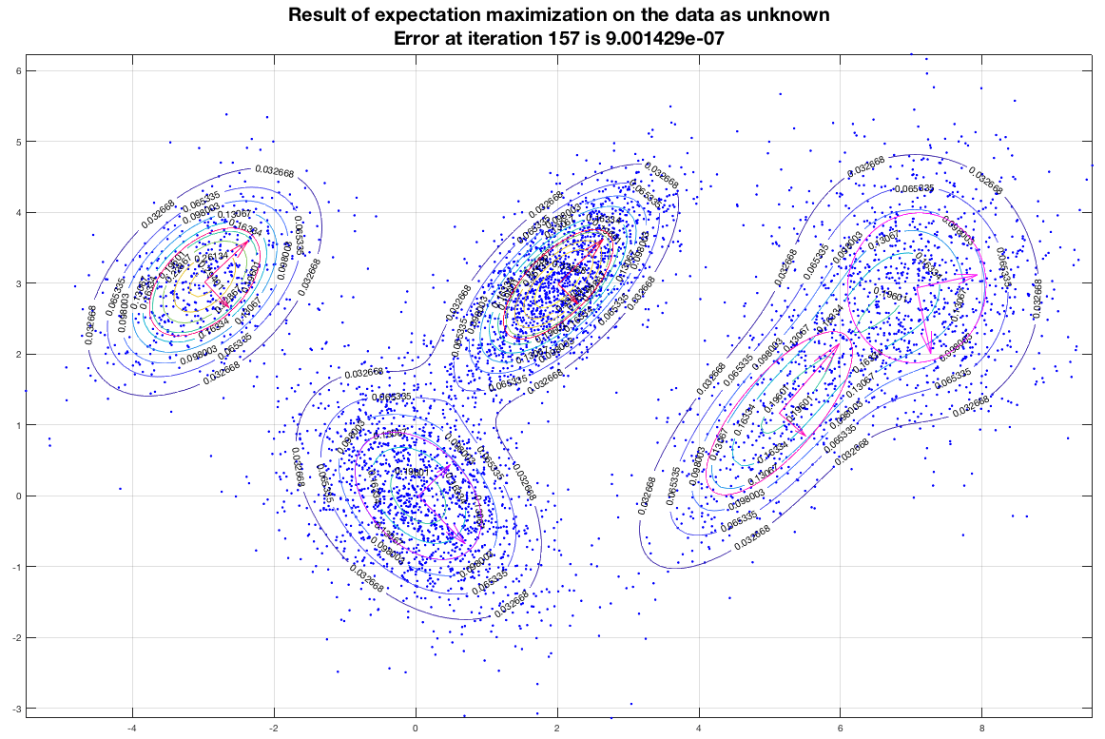
Example of a Gaussian Mixture Distribution

Slide 31
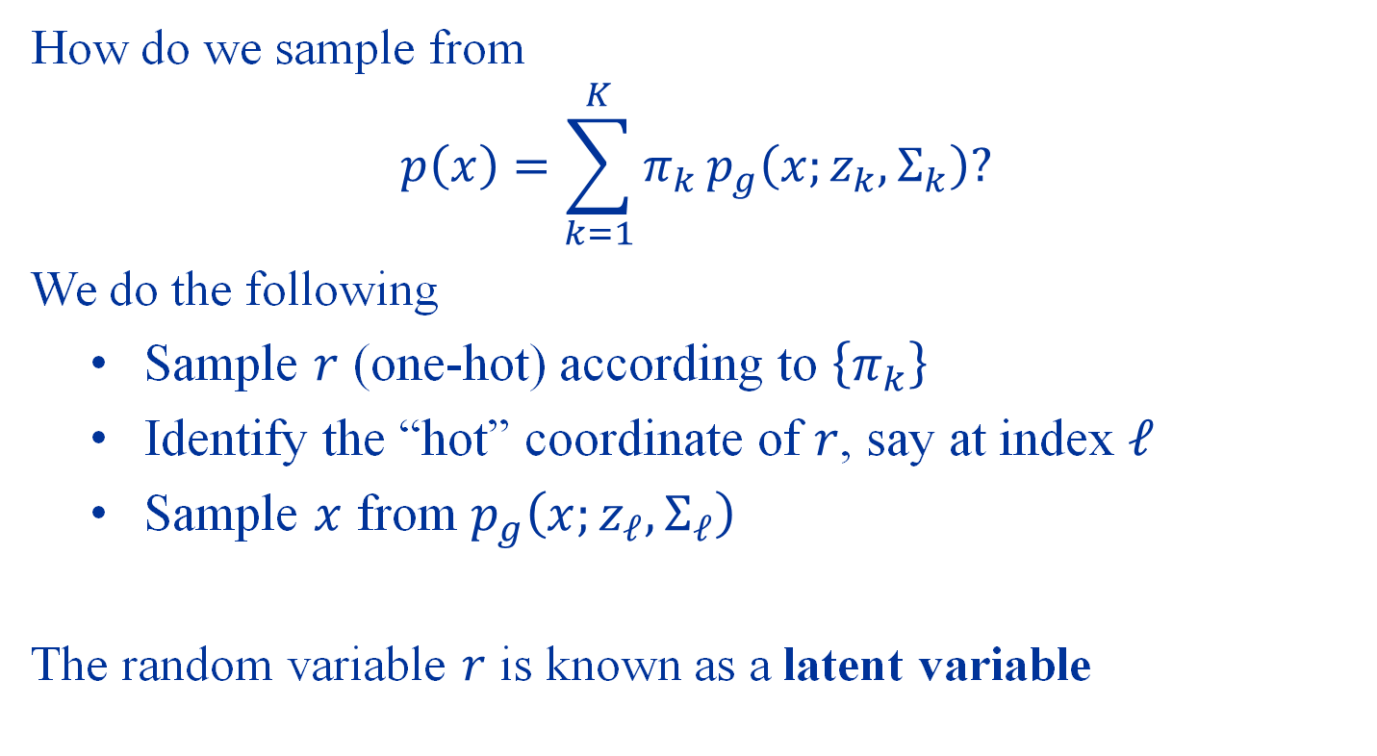
Gaussian Mixture Represented via Latent Variables
How do we sample from
$$p\left(x\right)=\sum_{k=1}^{K}{π_{k}}p_{g}\left(x;z_{k},Σ_{k}\right)?$$
We do the following
Sample $r$ (one-hot) according to $\left\{π_{k}\right\}$
Identify the “hot” coordinate of $r$, say at index $ℓ$
Sample $x$ from $p_{g}\left(x;z_{ℓ},Σ_{ℓ}\right)$
The random variable $r$ is known as a latent variable

Slide 32
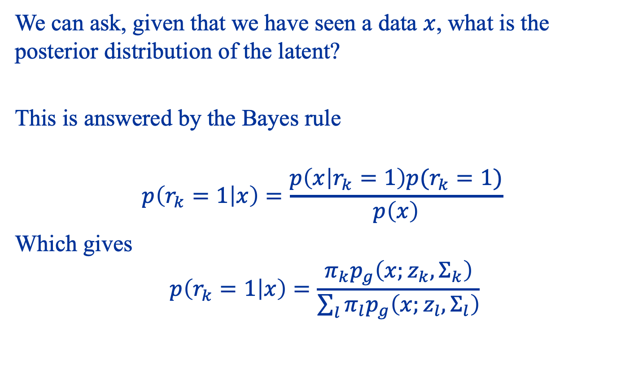

The Posterior Distribution of $r$
We can ask, given that we have seen a data $x$, what is the posterior distribution of the latent?
This is answered by the Bayes rule
$$p\left(r_{k}=1 | x\right)=\frac{p\left(x | r_{k}=1\right)p(r_{k}=1)}{p\left(x\right)}$$
Which gives $$p\left(r_{k}=1 | x\right)=\frac{π_{k}p_{g}\left(x;z_{k},Σ_{k}\right)}{\sum_{l}{π_{l}p_{g}\left(x;z_{l},Σ_{l}\right)}}$$

Slide 33
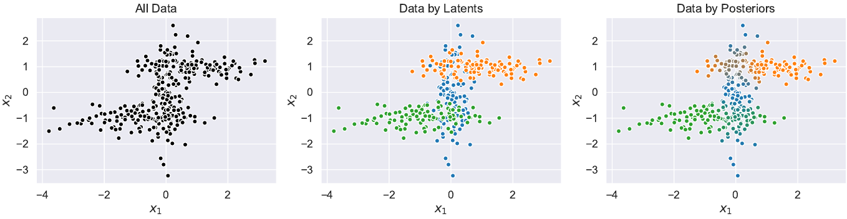
Posterior as “Responsibility”

Slide 34
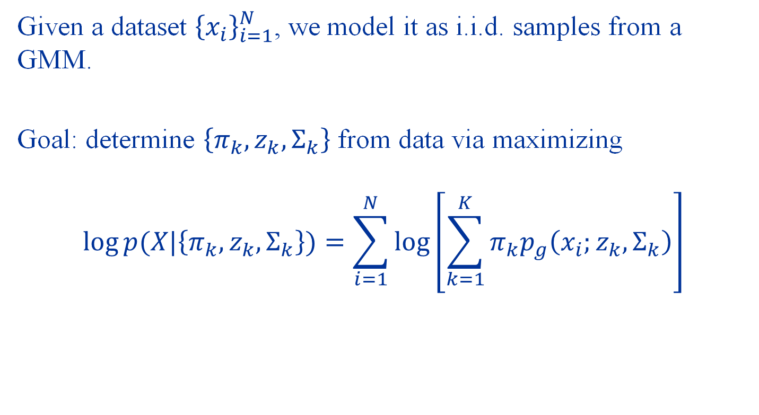
Maximum Likelihood for GMM
Given a dataset ${\left\{x_{i}\right\}}_{i=1}^{N}$, we model it as i.i.d. samples from a GMM.
Goal: determine $\left\{π_{k},z_{k},Σ_{k}\right\}$ from data via maximizing $$\log{p(X|\left\{π_{k},z_{k},Σ_{k}\right\}})=\sum_{i=1}^{N}{\log\left[\sum_{k=1}^{K}{π_{k}p_{g}\left(x_{i};z_{k},Σ_{k}\right)}\right]}$$

Slide 35
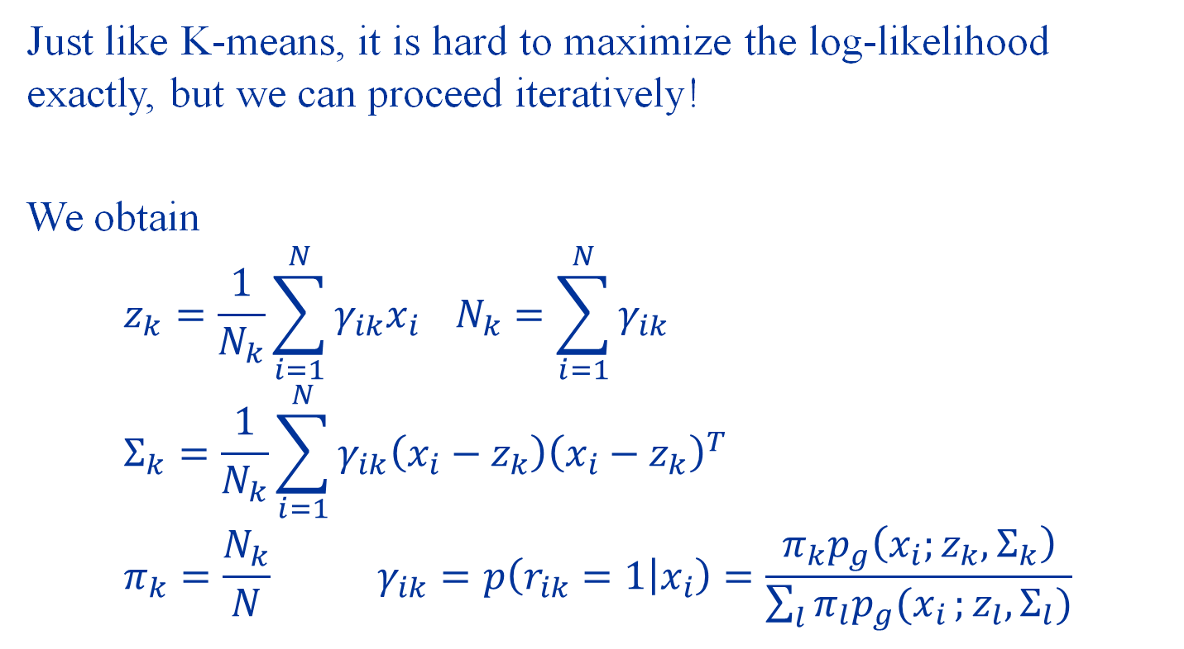
MLE for GMM
Just like K-means, it is hard to maximize the log-likelihood exactly, but we can proceed iteratively!
We obtain $$z_{k}=\frac{1}{N_{k}}\sum_{i=1}^{N}{γ_{ik}x_{i}} N_{k}=\sum_{i=1}^{N}{γ_{ik}} \\ Σ_{k}=\frac{1}{N_{k}}\sum_{i=1}^{N}{γ_{ik}\left(x_{i}−z_{k}\right){\left(x_{i}−z_{k}\right)}^{T}} \\ π_{k}=\frac{N_{k}}{N} γ_{ik}=p\left(r_{ik}=1 | x_{i}\right)=\frac{π_{k}p_{g}\left(x_{i};z_{k},Σ_{k}\right)}{\sum_{l}{π_{l}p_{g}(x_{i}};z_{l},Σ_{l})}$$

Slide 36
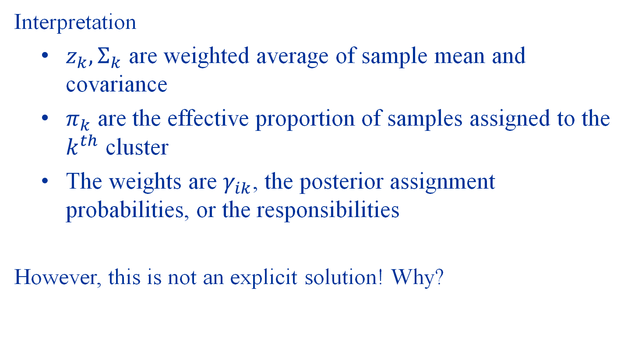
MLE for GMM
Interpretation
$z_{k},Σ_{k}$ are weighted average of sample mean and covariance
$π_{k}$ are the effective proportion of samples assigned to the $k^{th}$ cluster
The weights are $γ_{ik}$, the posterior assignment probabilities, or the responsibilities
However, this is not an explicit solution! Why?

Slide 37
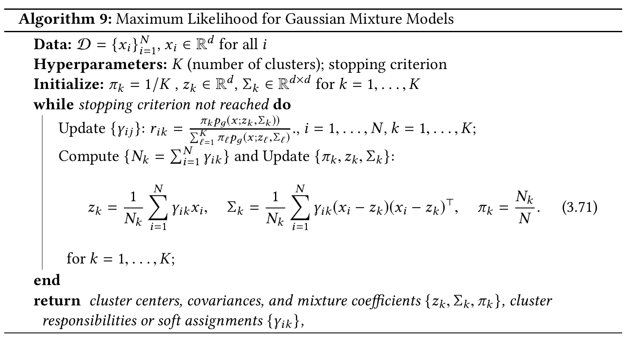
The MLE Algorithm for GMM

Slide 38

GMM vs K-means
Consider a simplified GMM so that $Σ_{k}=εI_{d}$
Then, $$γ_{ik}=\frac{π_{k}\exp\left(−\frac{1}{2ε}‖{\left.x_{i}−z_{k}​\right\|}^{2}\right)}{\sum_{l}{π_{l}\exp\left(−\frac{1}{2ε}‖{\left.x_{i}−z_{l}​\right\|}^{2}\right)}}$$
What happens when $ε→0$?

Slide 39
Summary
K-means algorithm: iteratively update center and assignments
GMM: a soft version of K-means where we iteratively update mean and covariance of Gaussians and soft assignments

Slide 40
Demo: K-means and GMM

