Slide 1

Principles of Machine Learning DSA 5105 • Lecture 2-3
Soufiane Hayou
Department of Mathematics

Slide 2
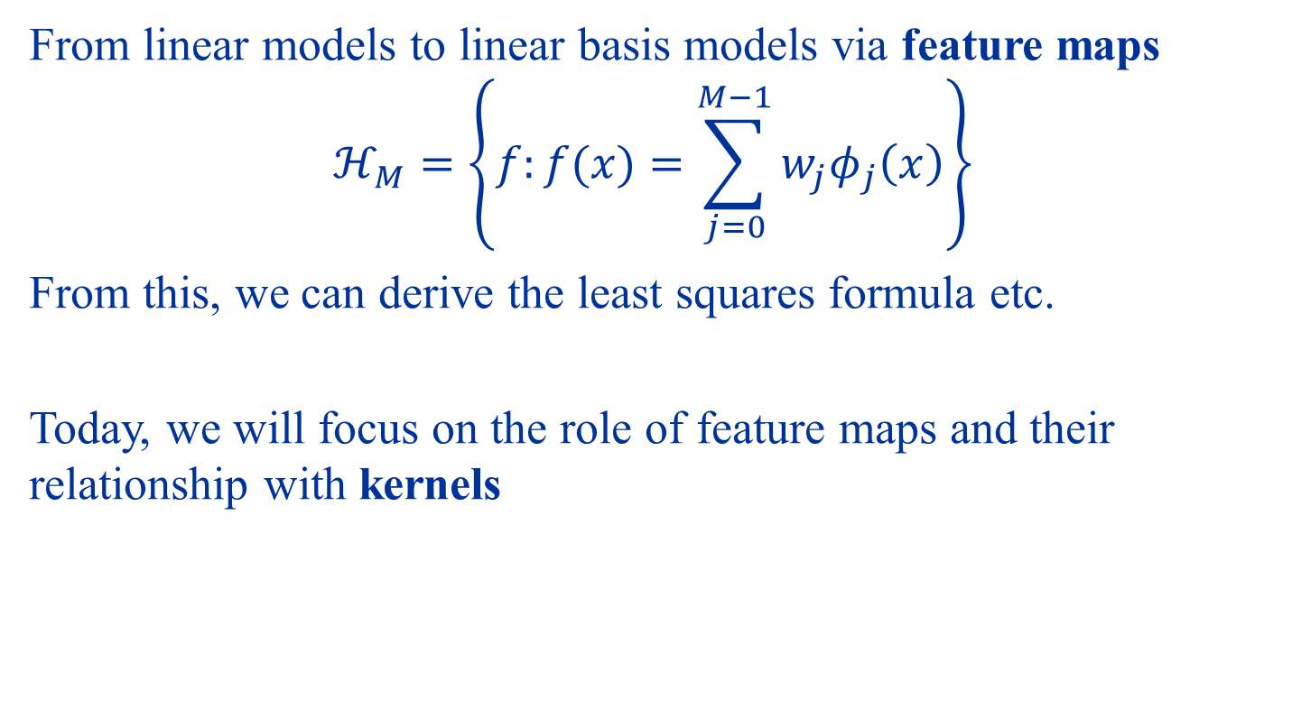
Last time
From linear models to linear basis models via feature maps
$$ℋ_{M}=\left\{f:f(x)=\sum_{j=0}^{M−1}{w_{j}φ_{j}\left(x\right)}\right\}$$
From this, we can derive the least squares formula etc.
Today, we will focus on the role of feature maps and their relationship with kernels

Slide 3
Interpreting Feature Maps

Slide 4
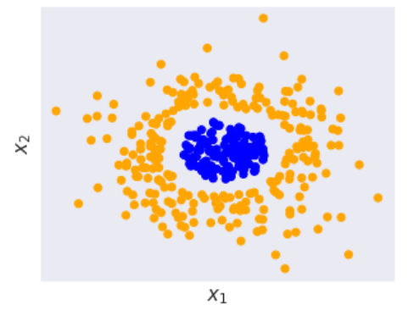
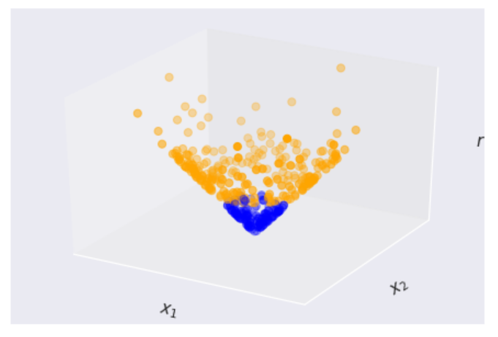





What do feature maps do really?
$$\left(x_{1},x_{2}\right)↦\left(φ_{1}\left(x\right),φ_{2}\left(x\right),φ_{3}\left(x\right),…\right)$$
$$φ_{1}\left(x\right)=x_{1},φ_{2}\left(x\right)=x_{2},φ_{3}\left(x\right)=‖x‖$$
$$φ_{3}$$
$$φ_{1}$$
$$φ_{2}$$

Slide 5



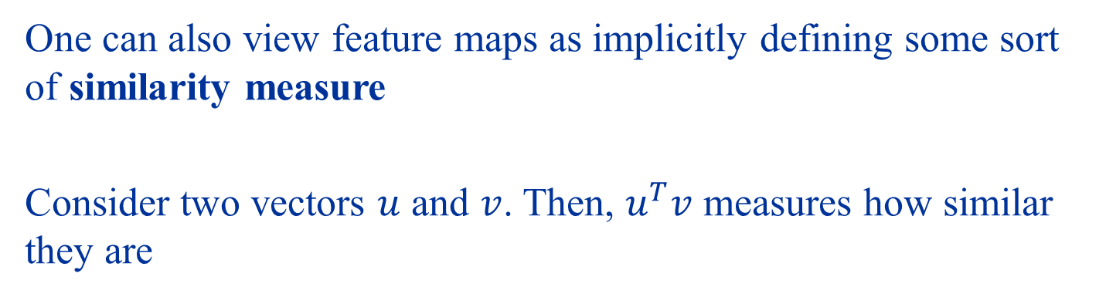




Another view of feature maps
One can also view feature maps as implicitly defining some sort of similarity measure
Consider two vectors $u$ and $v$. Then, $u^{T}v$ measures how similar they are
$$u$$
$$v$$
$$u$$
$$v$$
$$u$$
$$v$$
Increasing $u^{T}v$
Increasing similarity

Slide 6



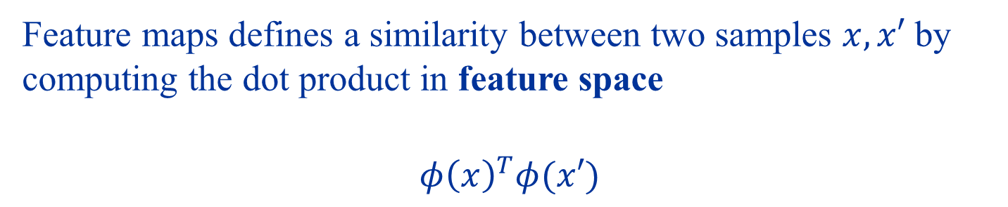



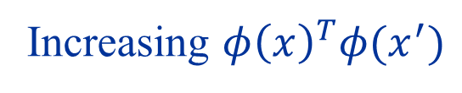
Feature maps defines a similarity between two samples $x,x′$ by computing the dot product in feature space
$$φ{\left(x\right)}^{T}φ(x′)$$
$$φ\left(x\right)$$
$$φ\left(x^{′}\right)$$
$$φ\left(x\right)$$
$$φ\left(x^{′}\right)$$
$$φ\left(x\right)$$
$$φ\left(x^{′}\right)$$
Increasing $φ{\left(x\right)}^{T}φ(x^{′})$
Increasing similarity in feature space

Slide 7
Least Squares Revisited

Slide 8
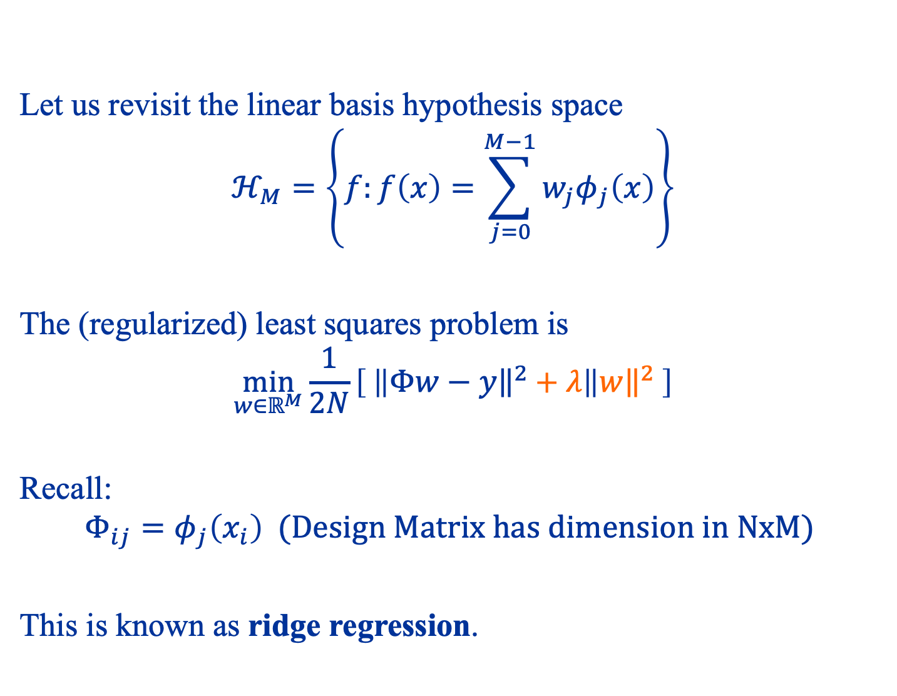
Let us revisit the linear basis hypothesis space
$$ℋ_{M}=\left\{f:f\left(x\right)=\sum_{j=0}^{M−1}{w_{j}φ_{j}\left(x\right)}\right\}$$
The (regularized) least squares problem is
$$\min_{w∈ℝ^{M}}{\frac{1}{2N}}\left[ \left\|{\left.​Φw−y\right\|}^{2}+λ\right\|{\left.​w\right\|}^{2} \right]$$
Recall:
$$Φ_{ij}=φ_{j}\left(x_{i}\right) (Design Matrix has dimension in NxM)$$
This is known as ridge regression.

Slide 9
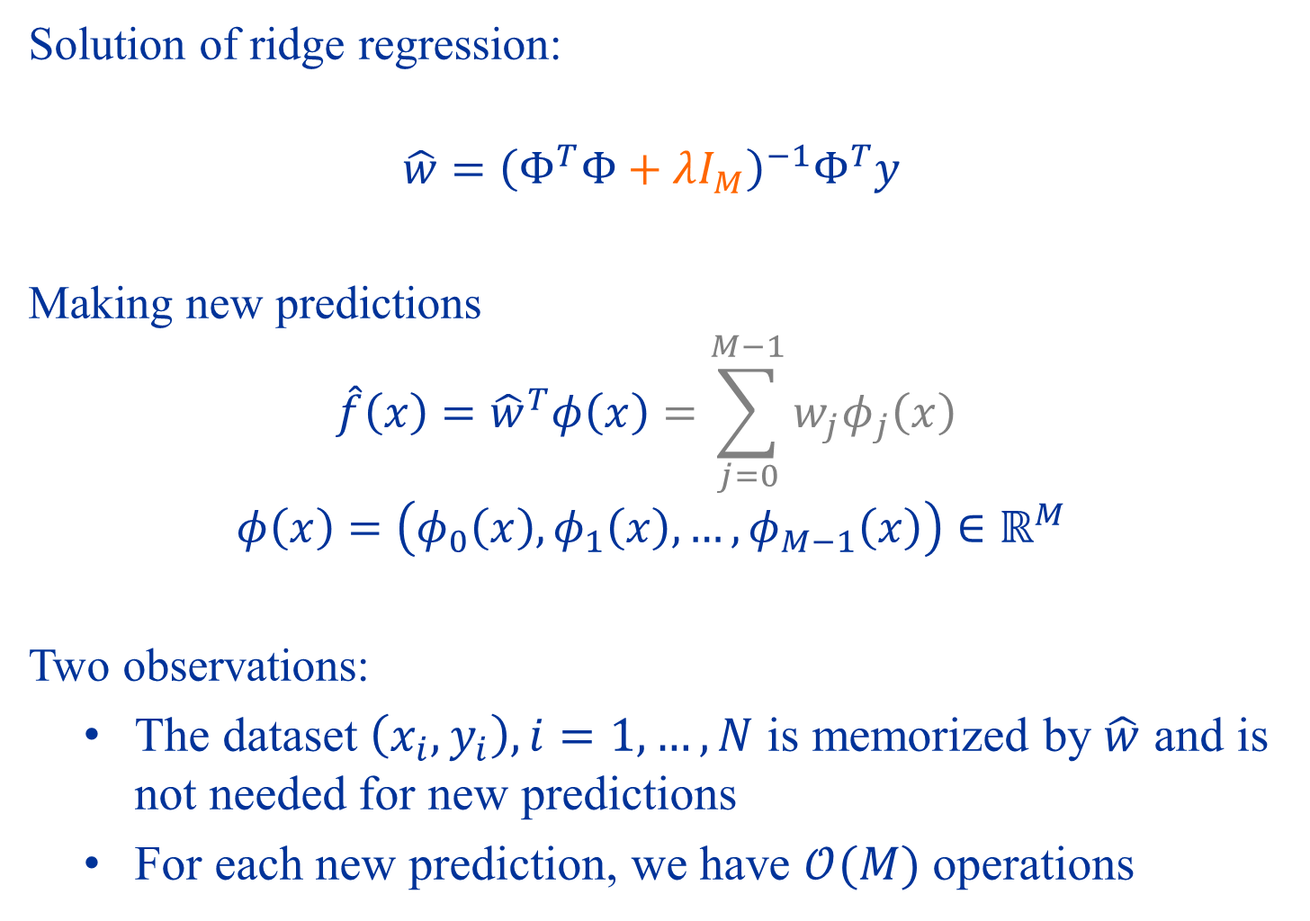
Solution of ridge regression:
$$\hat{w}={\left(Φ^{T}Φ+λI_{M}\right)}^{−1}Φ^{T}y$$
Making new predictions
$$\hat{f}\left(x\right)={\hat{w}}^{T}φ\left(x\right)=\sum_{j=0}^{M−1}{w_{j}φ_{j}\left(x\right)}$$
$$φ\left(x\right)=\left(φ_{0}\left(x\right), φ_{1}\left(x\right),…,φ_{M−1}\left(x\right)\right)∈ℝ^{M}$$
Two observations:
The dataset $\left(x_{i},y_{i}\right),i=1,…,N$ is memorized by $\hat{w}$ and is not needed for new predictions
For each new prediction, we have $𝒪(M)$ operations

Slide 10
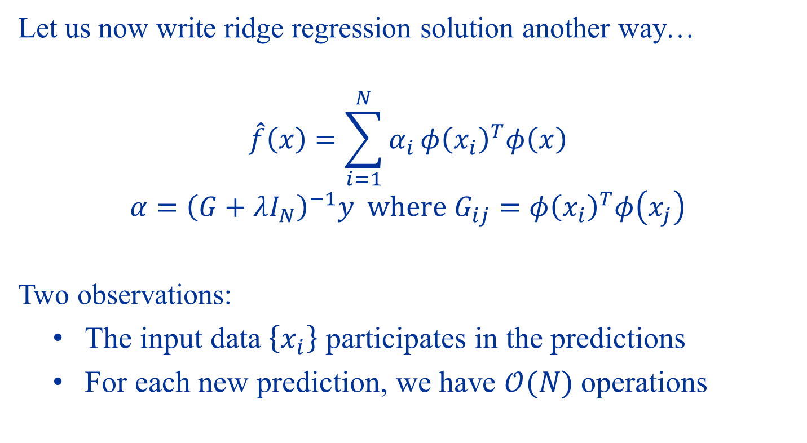
Reformulation of Ridge Regression
Let us now write ridge regression solution another way…
$$\hat{f}\left(x\right)=\sum_{i=1}^{N}{α_{i}}φ{\left(x_{i}\right)}^{T}φ\left(x\right)$$
$$α={\left(G+λI_{N}\right)}^{−1}y where G_{ij}=φ{\left(x_{i}\right)}^{T}φ\left(x_{j}\right)$$
Two observations:
The input data $\left\{x_{i}\right\}$ participates in the predictions
For each new prediction, we have $𝒪(N)$ operations
Gram matrix

Slide 11
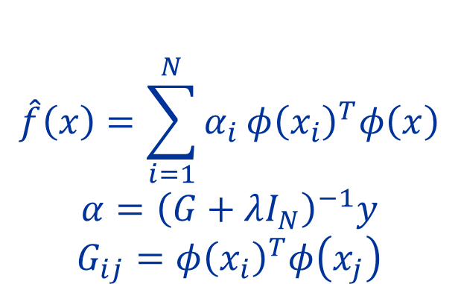
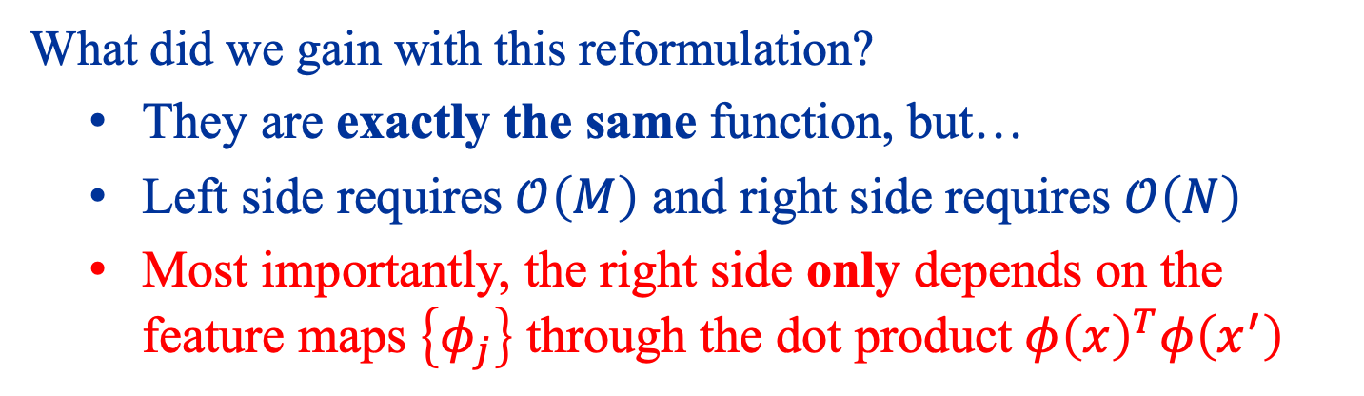

Original Solution
Reformulated Solution
$$\hat{f}\left(x\right)=\sum_{j=0}^{M−1}{{\hat{w}}_{j}^{T}}φ_{j}\left(x\right)$$
$$\hat{w}={\left(Φ^{T}Φ+λI_{M}\right)}^{−1}Φ^{T}y$$
$$\hat{f}\left(x\right)=\sum_{i=1}^{N}{α_{i}}φ{\left(x_{i}\right)}^{T}φ\left(x\right)$$
$$α={\left(G+λI_{N}\right)}^{−1}y$$
$$G_{ij}=φ{\left(x_{i}\right)}^{T}φ\left(x_{j}\right)$$
What did we gain with this reformulation?
They are exactly the same function, but…
Left side requires $𝒪\left(M\right)$ and right side requires $𝒪\left(N\right)$
Most importantly, the right side only depends on the feature maps $\left\{φ_{j}\right\}$ through the dot product $φ{\left(x\right)}^{T}φ\left(x^{′}\right)$

Slide 12
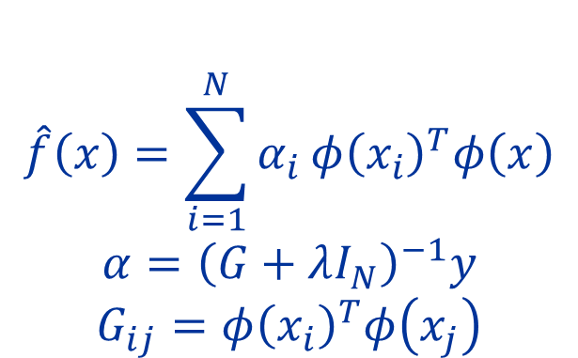
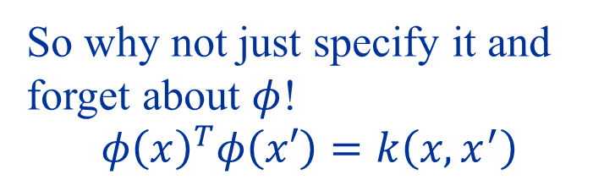

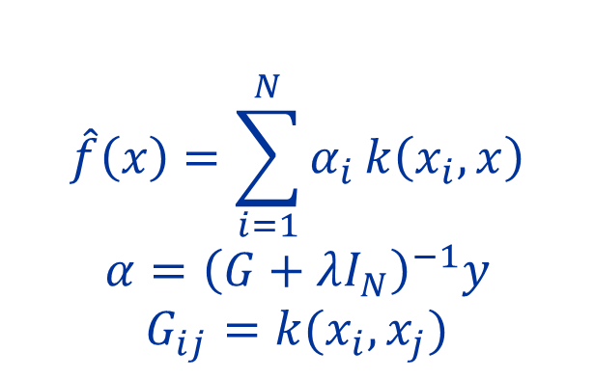
Reformulated Solution
$$\hat{f}\left(x\right)=\sum_{i=1}^{N}{α_{i}}φ{\left(x_{i}\right)}^{T}φ\left(x\right)$$
$$α={\left(G+λI_{N}\right)}^{−1}y$$
$$G_{ij}=φ{\left(x_{i}\right)}^{T}φ\left(x_{j}\right)$$
So why not just specify it and forget about $φ$!
$$φ{\left(x\right)}^{T}φ\left(x′\right)=k\left(x,x^{′}\right)$$
Only need “similarity” measure
$${φ\left(x\right)}^{T}φ\left(x′\right)$$
Kernel Ridge Regression
$$\hat{f}\left(x\right)=\sum_{i=1}^{N}{α_{i}}k\left(x_{i},x\right)$$
$$α={\left(G+λI_{N}\right)}^{−1}y$$
$$G_{ij}=k(x_{i},x_{j})$$
Kernel

Slide 13
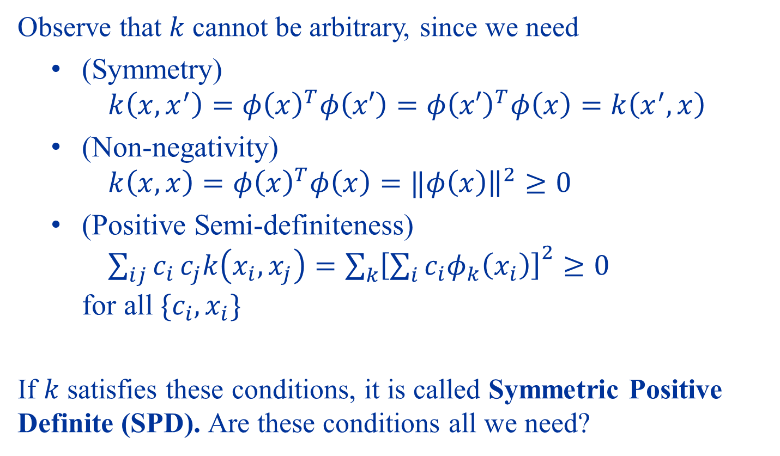

Can we choose any $k$ we want?
Observe that $k$ cannot be arbitrary, since we need
(Symmetry) $k\left(x,x^{′}\right)={φ\left(x\right)}^{T}φ\left(x′\right)={φ\left(x′\right)}^{T}φ\left(x\right)=k\left(x^{′},x\right)$
(Non-negativity) $k\left(x,x\right)=φ{\left(x\right)}^{T}φ\left(x\right)=‖{φ\left(x\right)\left.​\right\|}^{2}≥0$
(Positive Semi-definiteness) $\sum_{ij}{c_{i}}c_{j}k\left(x_{i},x_{j}\right)={\sum_{k}{\left[\sum_{i}{c_{i}φ_{k}\left(x_{i}\right)}\right]}}^{2}≥0$ for all $\{c_{i},x_{i}\}$
If $k$ satisfies these conditions, it is called Symmetric Positive Definite (SPD). Are these conditions all we need?

Slide 14
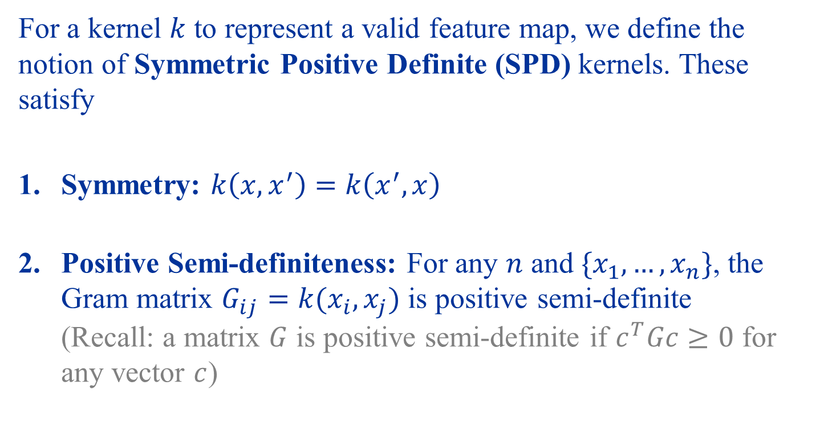
Symmetric Positive Definite Kernels
For a kernel $k$ to represent a valid feature map, we define the notion of Symmetric Positive Definite (SPD) kernels. These satisfy
Symmetry: $k\left(x,x^{′}\right)=k\left(x^{′},x\right)$
Positive Semi-definiteness: For any $n$ and $\{x_{1},…, x_{n}\}$, the Gram matrix $G_{ij}=k(x_{i},x_{j})$ is positive semi-definite (Recall: a matrix $G$ is positive semi-definite if $c^{T}Gc≥0$ for any vector $c$)

Slide 15
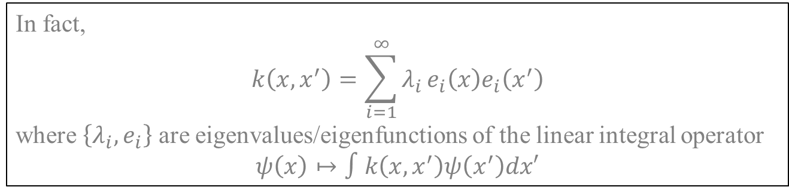
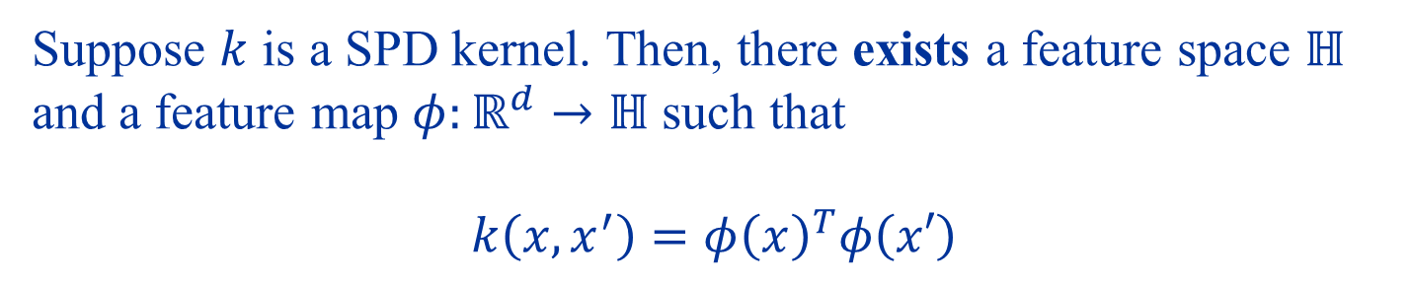
Mercer’s Theorem (1909)
Suppose $k$ is a SPD kernel. Then, there exists a feature space $ℍ$ and a feature map $φ:ℝ^{d}→ℍ$ such that
$$k\left(x,x^{′}\right)=φ{\left(x\right)}^{T}φ\left(x′\right)$$
In fact,
$$k\left(x,x^{′}\right)=\sum_{i=1}^{∞}{λ_{i}}e_{i}\left(x\right)e_{i}\left(x^{′}\right)$$ where $\left\{λ_{i},e_{i}\right\}$ are eigenvalues/eigenfunctions of the linear integral operator
$$ψ\left(x\right)↦∫k\left(x,x^{′}\right)ψ\left(x^{′}\right)dx′$$

Slide 16
Feature map SPD kernel and SPD kernel Feature map

Slide 17
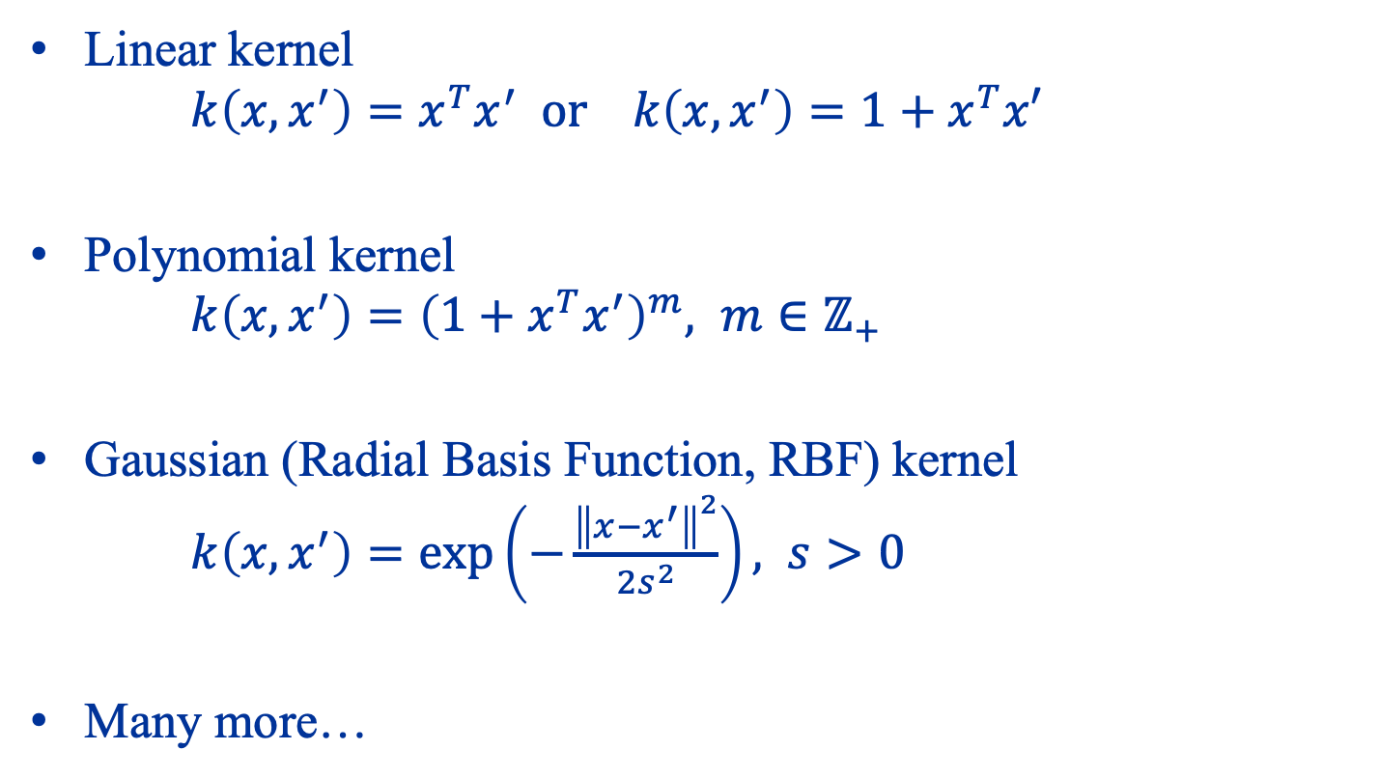
Examples of SPD kernels
Linear kernel $k\left(x,x^{′}\right)=x^{T}x^{′} or k\left(x,x^{′}\right)=1+x^{T}x′$
Polynomial kernel $k\left(x,x^{′}\right)={\left(1+x^{T}x^{′}\right)}^{m}, m∈ℤ_{+}$
Gaussian (Radial Basis Function, RBF) kernel $k\left(x,x^{′}\right)=\exp\left(−\frac{{\left\|x−x^{′}\right\|}^{2}}{2s^{2}}\right), s>0$
Many more…

Slide 18
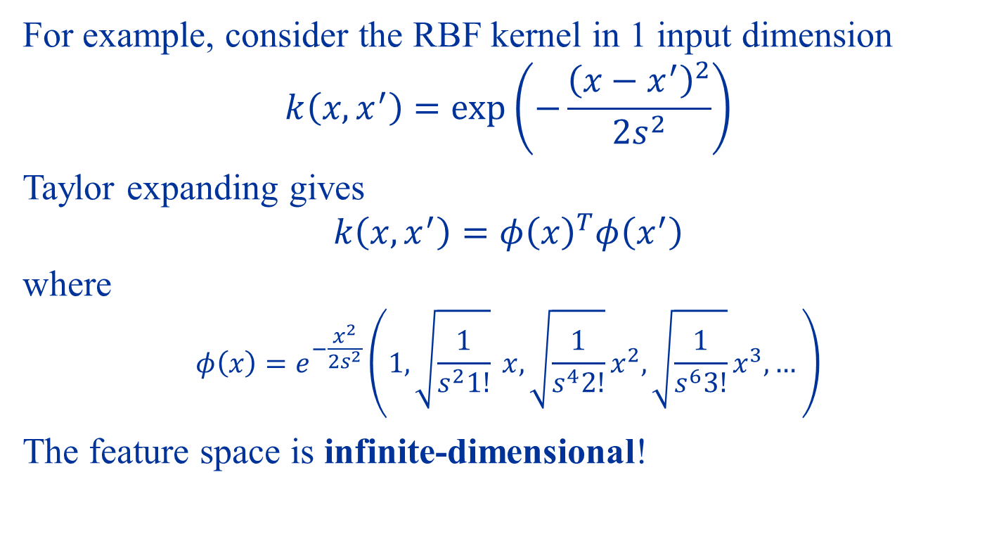
Flexibility of using kernels
For example, consider the RBF kernel in 1 input dimension
$$k\left(x,x^{′}\right)=\exp\left(−\frac{{\left(x−x^{′}\right)}^{2}}{2s^{2}}\right)$$
Taylor expanding gives
$$k\left(x,x^{′}\right)=φ{\left(x\right)}^{T}φ\left(x^{′}\right)$$
where
$$φ\left(x\right)=e^{−\frac{x^{2}}{2s^{2}}}\left(1,\sqrt{\frac{1}{s^{2}1!}} x,\sqrt{\frac{1}{s^{4}2!}}x^{2},\sqrt{\frac{1}{s^{6}3!}}x^{3},…\right)$$
The feature space is infinite-dimensional!

Slide 19
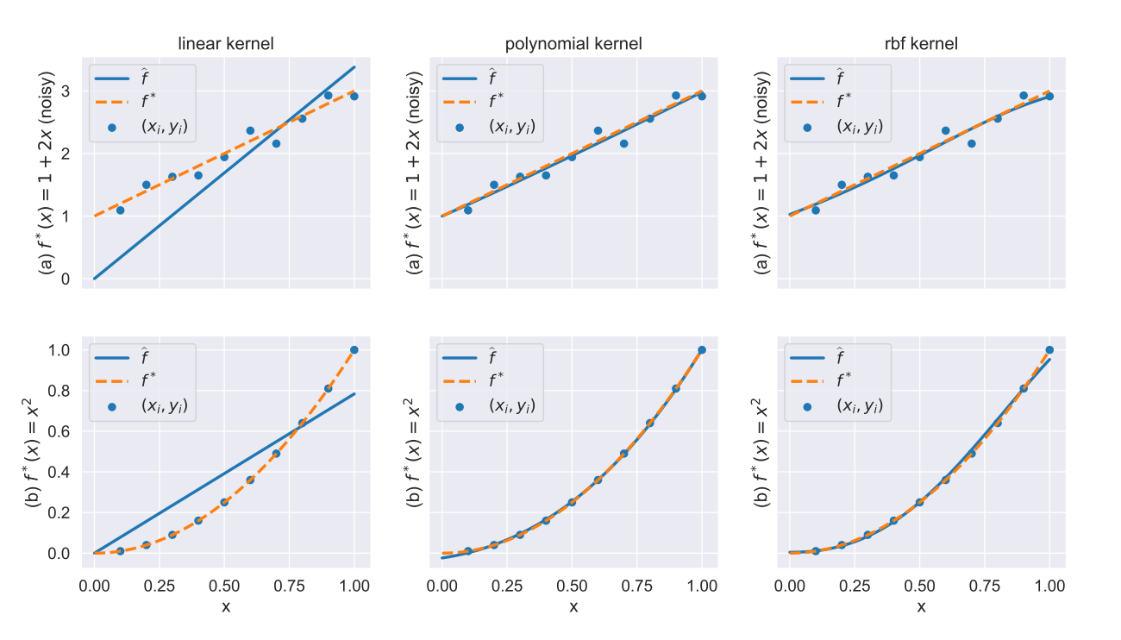
Kernel ridge regression with different types of kernels

Slide 20
Key Idea of Kernel Methods
Express solution in terms of similarity (dot product)
1
Replace feature maps with kernels
2

Slide 21
Support Vector Machines

Slide 22
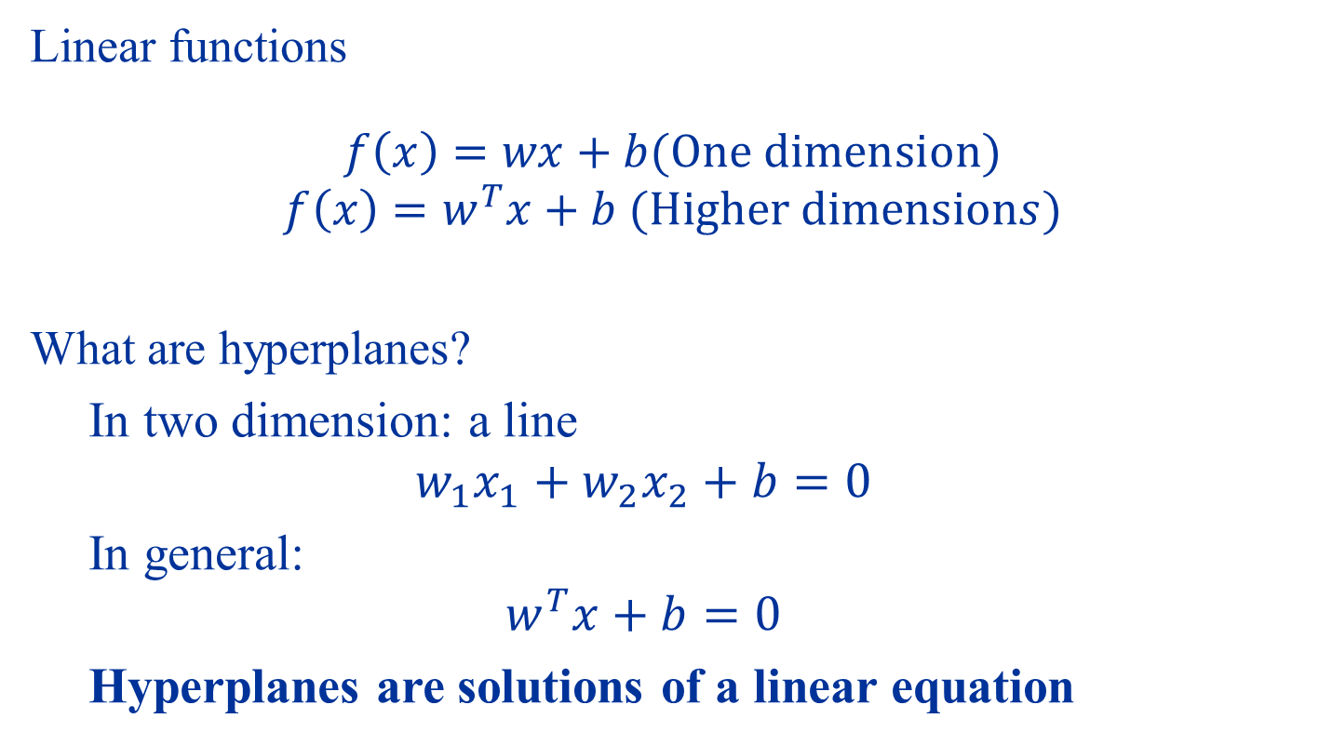
Linear (Affine) Functions and Hyperplanes
Linear functions
$$f\left(x\right)=wx+b(One dimension)$$
$$f\left(x\right)=w^{T}x+b (Higher dimensions)$$
What are hyperplanes?
In two dimension: a line
$$w_{1}x_{1}+w_{2}x_{2}+b=0$$
In general:
$$w^{T}x+b=0$$
Hyperplanes are solutions of a linear equation

Slide 23
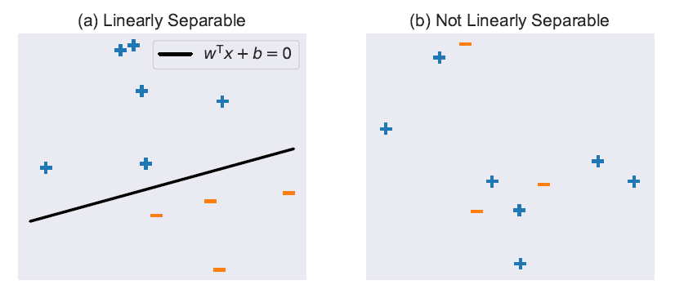
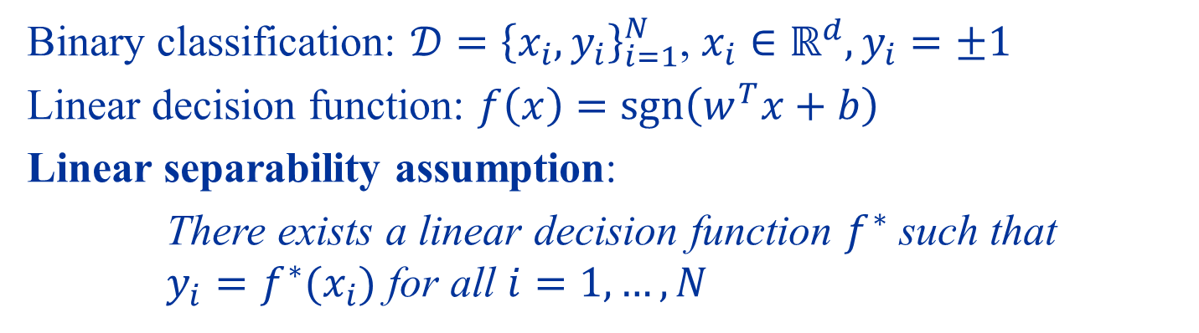
Classification using linear functions
Binary classification: $𝒟={\left\{x_{i},y_{i}\right\}}_{i=1}^{N}$, $x_{i}∈ℝ^{d},y_{i}=±1$
Linear decision function: $f\left(x\right)=\operatorname{sgn}\left(w^{T}x+b\right)$
Linear separability assumption:
There exists a linear decision function $f^{∗}$ such that $y_{i}=f^{∗}(x_{i})$ for all $i=1,…,N$

Slide 24
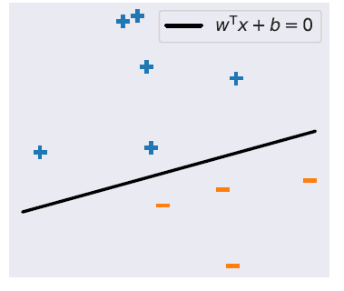

Margin
Margin
There can be many possible decision functions!

Slide 25
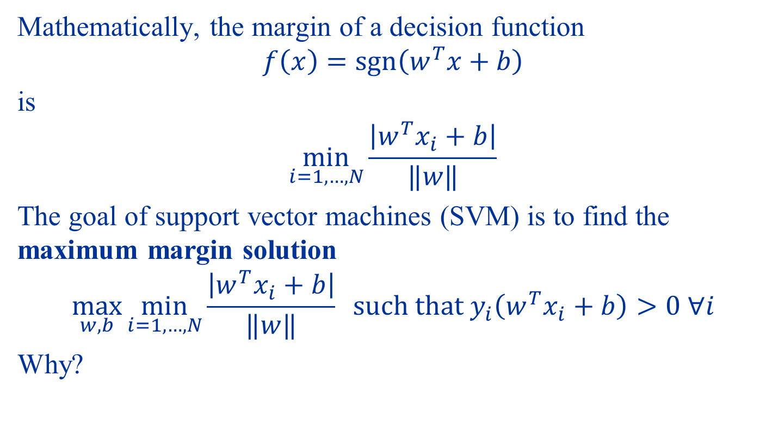
Maximum Margin Solution
Mathematically, the margin of a decision function
$$f\left(x\right)=\operatorname{sgn}\left(w^{T}x+b\right)$$
is
$$\min_{i=1,…,N}{\frac{\left|w^{T}x_{i}+b\right|}{‖w‖}}$$
The goal of support vector machines (SVM) is to find the maximum margin solution
$$\max_{w,b}{\min_{i=1,…,N}{\frac{\left|w^{T}x_{i}+b\right|}{‖w‖}}} such that y_{i}\left(w^{T}x_{i}+b\right)>0 ∀i$$
Why?

Slide 26
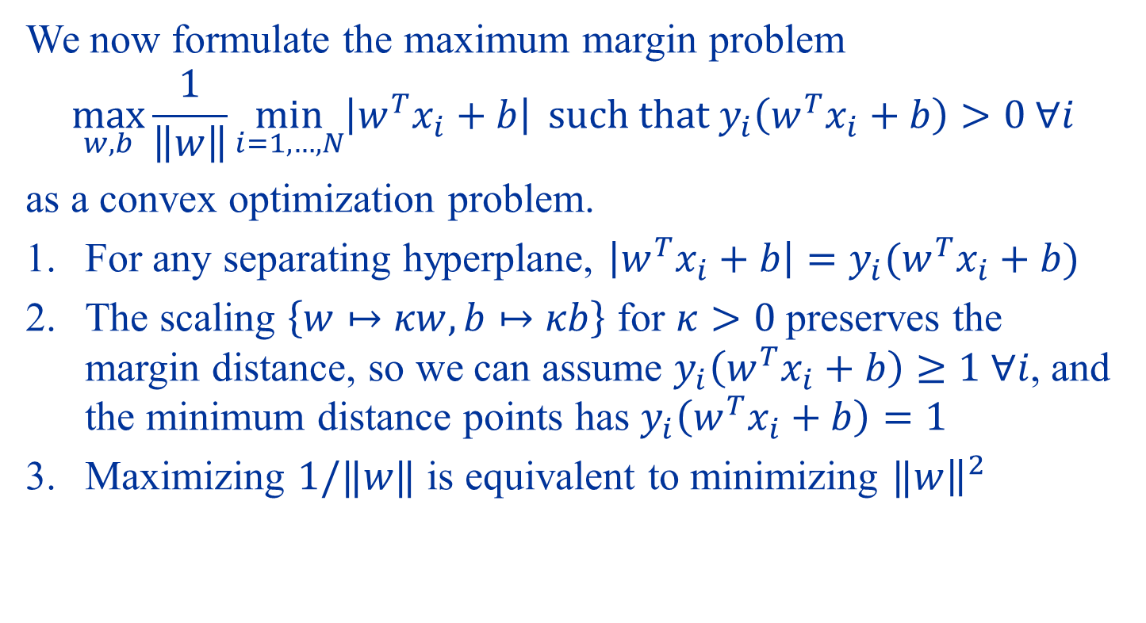
Convex Optimization Formulation
We now formulate the maximum margin problem
$$\max_{w,b}{\frac{1}{\left\|w\right\|}\min_{i=1,…,N}\left|w^{T}x_{i}+b\right|} such that y_{i}\left(w^{T}x_{i}+b\right)>0 ∀i$$
as a convex optimization problem.
For any separating hyperplane, $\left|w^{T}x_{i}+b\right|=y_{i}(w^{T}x_{i}+b)$
The scaling $\left\{w↦κw,b↦κb\right\}$ for $κ>0$ preserves the margin distance, so we can assume $y_{i}\left(w^{T}x_{i}+b\right)≥1 ∀i$, and the minimum distance points has $y_{i}\left(w^{T}x_{i}+b\right)=1$
Maximizing $1/‖w‖$ is equivalent to minimizing $‖{\left.​w\right\|}^{2}$

Slide 27

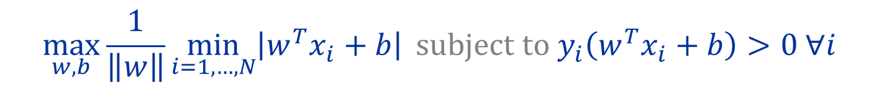
$$\max_{w,b}{\frac{1}{\left\|w\right\|}\min_{i=1,…,N}\left|w^{T}x_{i}+b\right|} subject to y_{i}\left(w^{T}x_{i}+b\right)>0 ∀i$$
Reformulated as a constrained convex optimization problem
$$\min_{w,b}{\frac{1}{2}{\left\|w\right\|}^{2}} subject to y_{i}\left(w^{T}x_{i}+b\right)≥1 ∀i$$

Slide 28
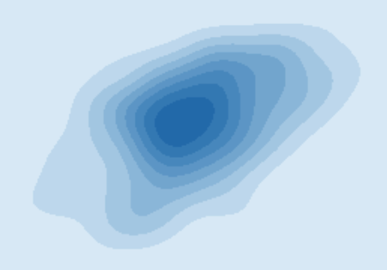










The Method of Lagrange Multipliers
Minimizing a function $F\left(z\right)$ can be found by $∇F\left(z\right)=0$. What if there are constraints?
First example:
$$\min{F\left(z\right)} subject to z^{T}a=0$$
$$F(z)$$
$$F(z)$$
$$∇F(\hat{z})$$
$$\hat{z}$$
$$∇F$$
$$a$$
$$a$$
$$z^{T}a=0$$
$$z^{T}a=0$$

Slide 29


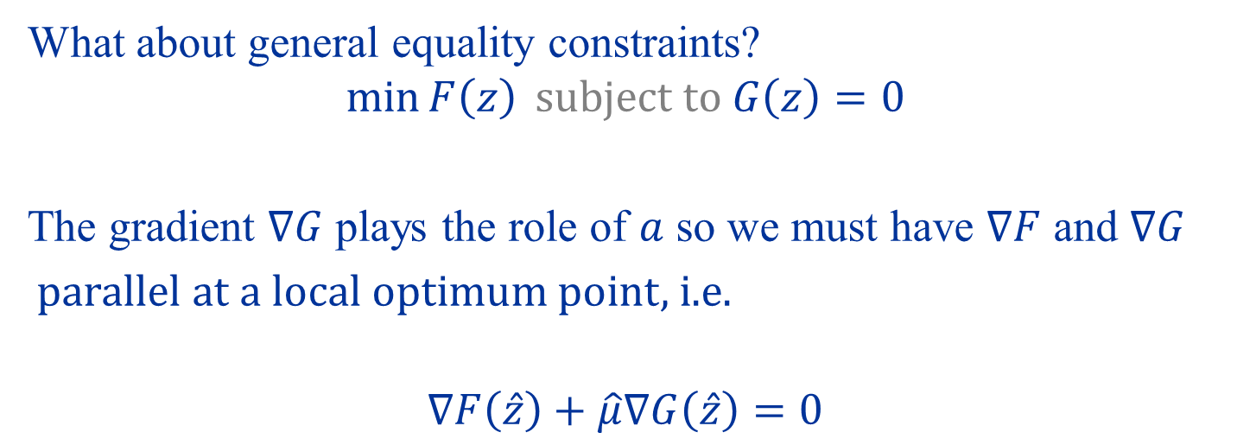



What about general equality constraints?
$$\min{F\left(z\right)} subject to G\left(z\right)=0$$
The gradient $∇G$ plays the role of $a$ so we must have $∇F$ and $∇G$
parallel at a local optimum point, i.e.
$$∇F\left(\hat{z}\right)+\hat{μ}∇G\left(\hat{z}\right)=0$$
$$F(z)$$
$$\hat{z}$$
$$∇F(\hat{z})$$
$$∇G(\hat{z})$$
$$G\left(z\right)=0$$

Slide 30

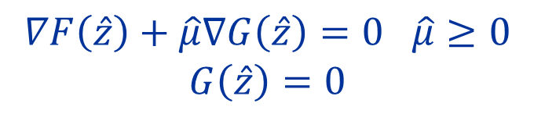









What about general inequality constraints?
$$\min{F\left(z\right)} subject to G\left(z\right)≤0$$
Constraint Inactive
Constraint Active
$$F(z)$$
$$F(z)$$
$$\hat{z}$$
$$∇F(\hat{z})$$
$$\hat{z}$$
$$∇G(\hat{z})$$
$$G\left(z\right)≤0$$
$$G\left(z\right)≤0$$
$$∇F\left(\hat{z}\right)=0 G\left(\hat{z}\right)<0$$
$$∇F\left(\hat{z}\right)+\hat{μ}∇G\left(\hat{z}\right)=0 \hat{μ}≥0$$
$$G\left(\hat{z}\right)=0$$

Slide 31
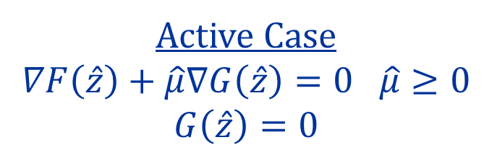
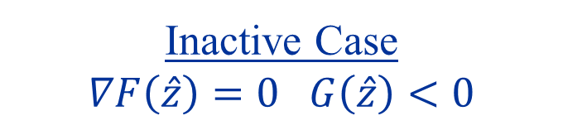
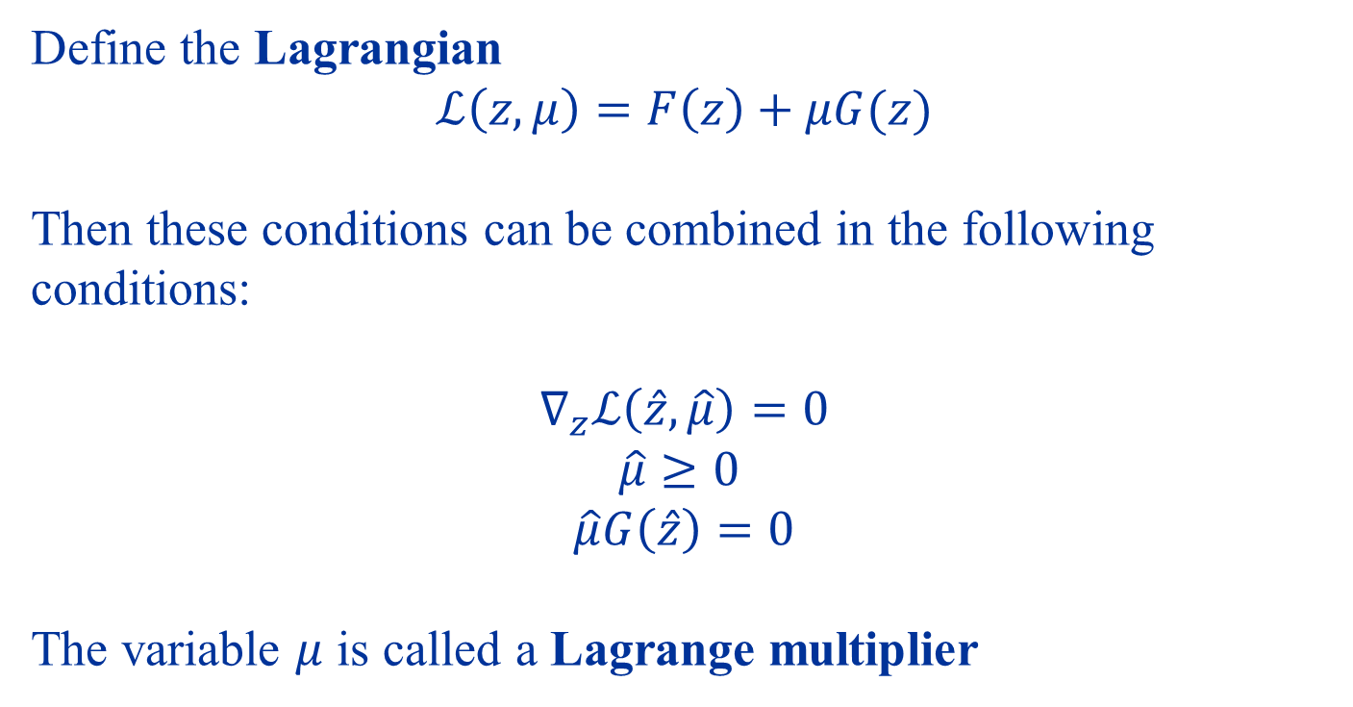
Inactive Case
$$∇F\left(\hat{z}\right)=0 G\left(\hat{z}\right)<0$$
Active Case
$$∇F\left(\hat{z}\right)+\hat{μ}∇G\left(\hat{z}\right)=0 \hat{μ}≥0$$
$$G\left(\hat{z}\right)=0$$
Define the Lagrangian
$$ℒ\left(z,μ\right)=F\left(z\right)+μG(z)$$
Then these conditions can be combined in the following conditions:
$$∇_{z}ℒ\left(\hat{z},\hat{μ}\right)=0$$
$$\hat{μ}≥0$$
$$\hat{μ}G\left(\hat{z}\right)=0$$
The variable $μ$ is called a Lagrange multiplier

Slide 32
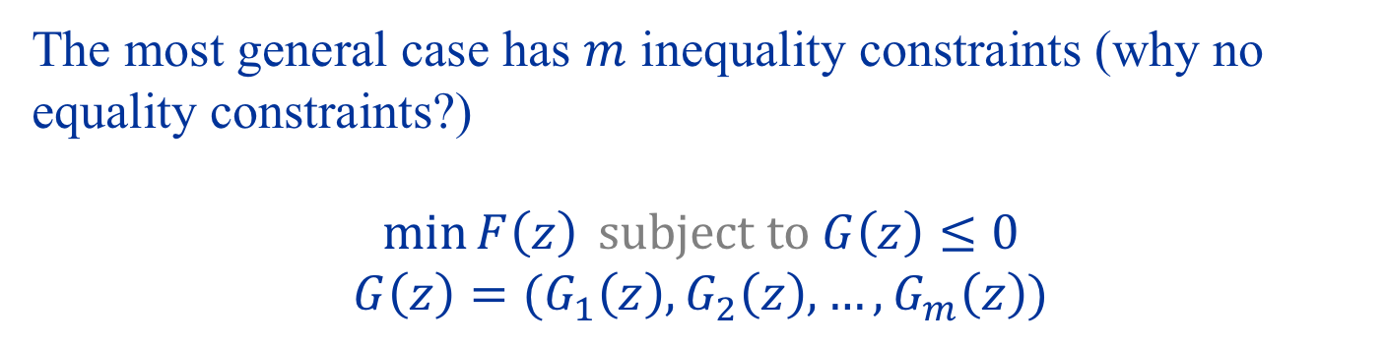
The most general case has $m$ inequality constraints (why no equality constraints?)
$$\min{F\left(z\right)} subject to G\left(z\right)≤0$$
$$G\left(z\right)=(G_{1}\left(z\right),G_{2}\left(z\right),…,G_{m}\left(z\right))$$

Slide 33
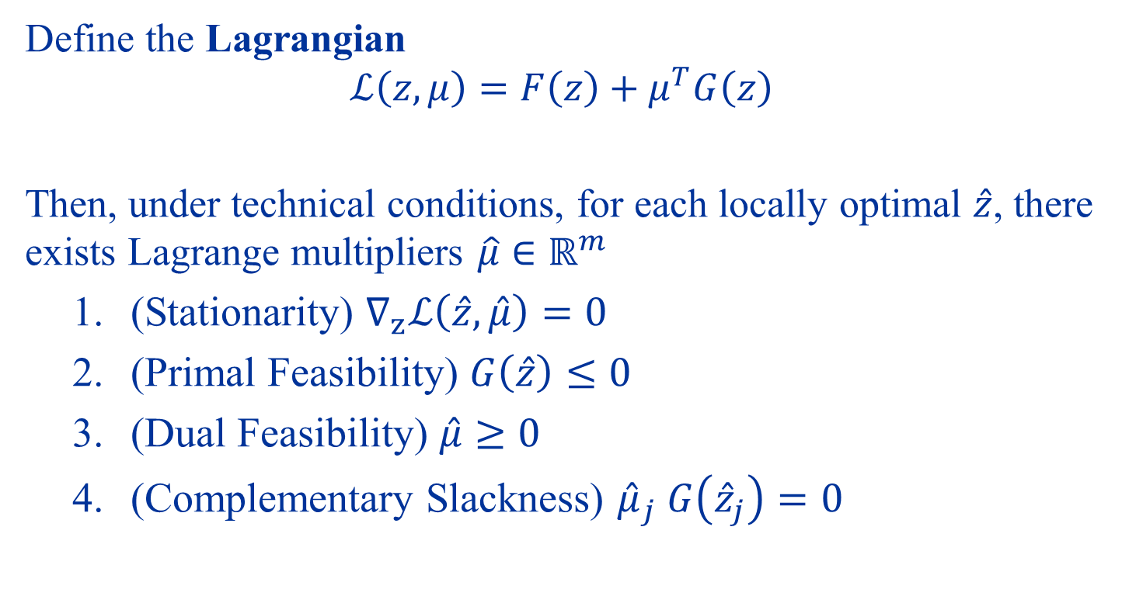
Karush-Kuhn-Tucker (KKT) Conditions
Define the Lagrangian
$$ℒ\left(z,μ\right)=F\left(z\right)+μ^{T}G\left(z\right)$$
Then, under technical conditions, for each locally optimal $\hat{z}$, there exists Lagrange multipliers $\hat{μ}∈ℝ^{m}$
(Stationarity) $∇_{z}ℒ\left(\hat{z},\hat{μ}\right)=0$
(Primal Feasibility) $G\left(\hat{z}\right)≤0$
(Dual Feasibility) $\hat{μ}≥0$
(Complementary Slackness) ${\hat{μ}}_{j} G\left({\hat{z}}_{j}\right)=0$

Slide 34
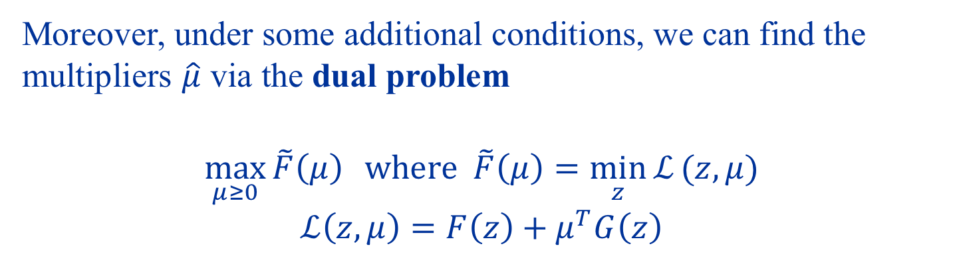
Dual Problem
Moreover, under some additional conditions, we can find the multipliers $\hat{μ}$ via the dual problem
$$\max_{μ≥0}{\tilde{F}\left(μ\right)} where \tilde{F}\left(μ\right)=\min_{z}{ℒ}(z,μ)$$
$$ℒ\left(z,μ\right)=F\left(z\right)+μ^{T}G\left(z\right)$$
Choice (Primal)
Price (Dual)

Slide 35


Back to the SVM…
$$\min_{w,b}{\frac{1}{2}{\left\|w\right\|}^{2}} subject to y_{i}\left(w^{T}x_{i}+b\right)≥1 ∀i$$
We apply KKT conditions with
$$z=\left(w,b\right)$$
$$F\left(z\right)=\frac{1}{2}{\left\|w\right\|}^{2}$$
$$G_{i}\left(z\right)=1−y_{i}\left(w^{T}x_{i}+b\right)$$

Slide 36
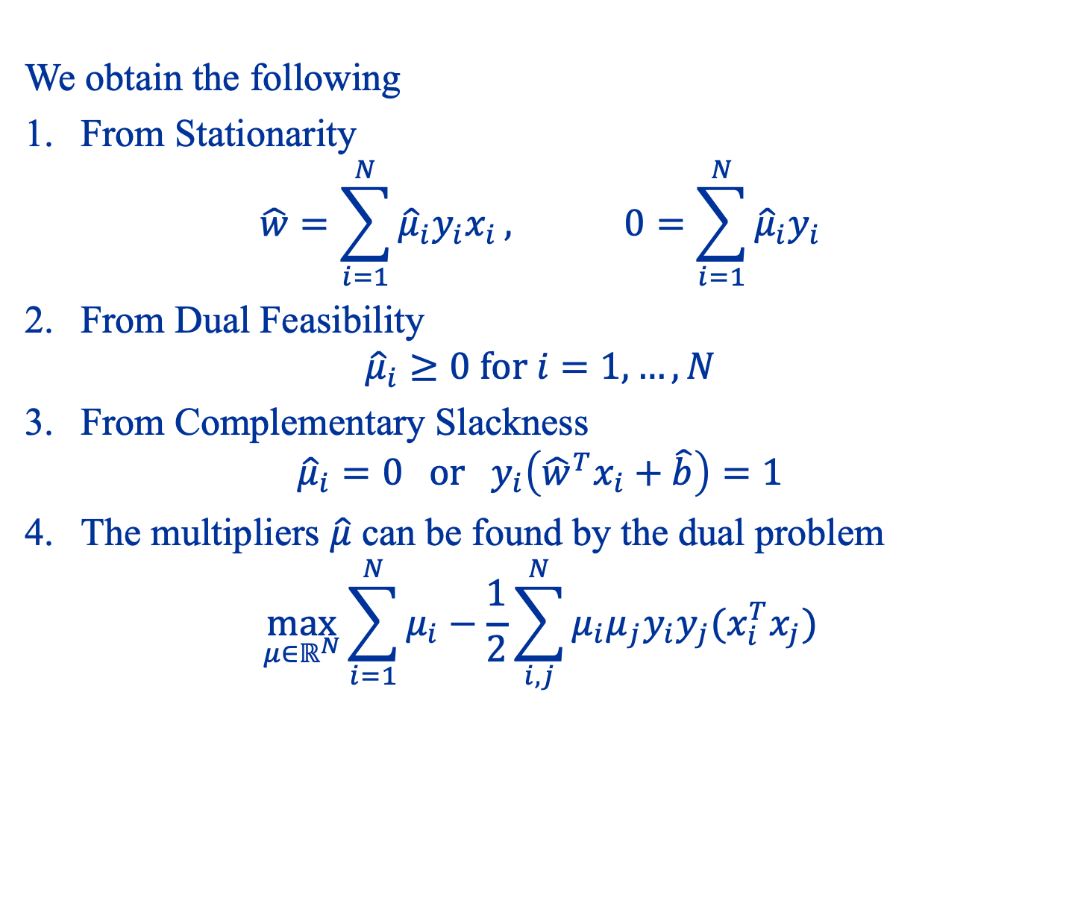
We obtain the following
From Stationarity $\hat{w}=\sum_{i=1}^{N}{{\hat{μ}}_{i}y_{i}x_{i}}, 0=\sum_{i=1}^{N}{{\hat{μ}}_{i}y_{i}}$
From Dual Feasibility ${\hat{μ}}_{i}≥0 for i=1,…,N$
From Complementary Slackness ${\hat{μ}}_{i}=0 or y_{i}\left({\hat{w}}^{T}x_{i}+\hat{b}\right)=1$
The multipliers $\hat{μ}$ can be found by the dual problem $\max_{μ∈ℝ^{N}}{\sum_{i=1}^{N}{μ_{i}}−\frac{1}{2}\sum_{i,j}^{N}{μ_{i}μ_{j}y_{i}y_{j}(x_{i}^{T}x_{j})}}$

Slide 37
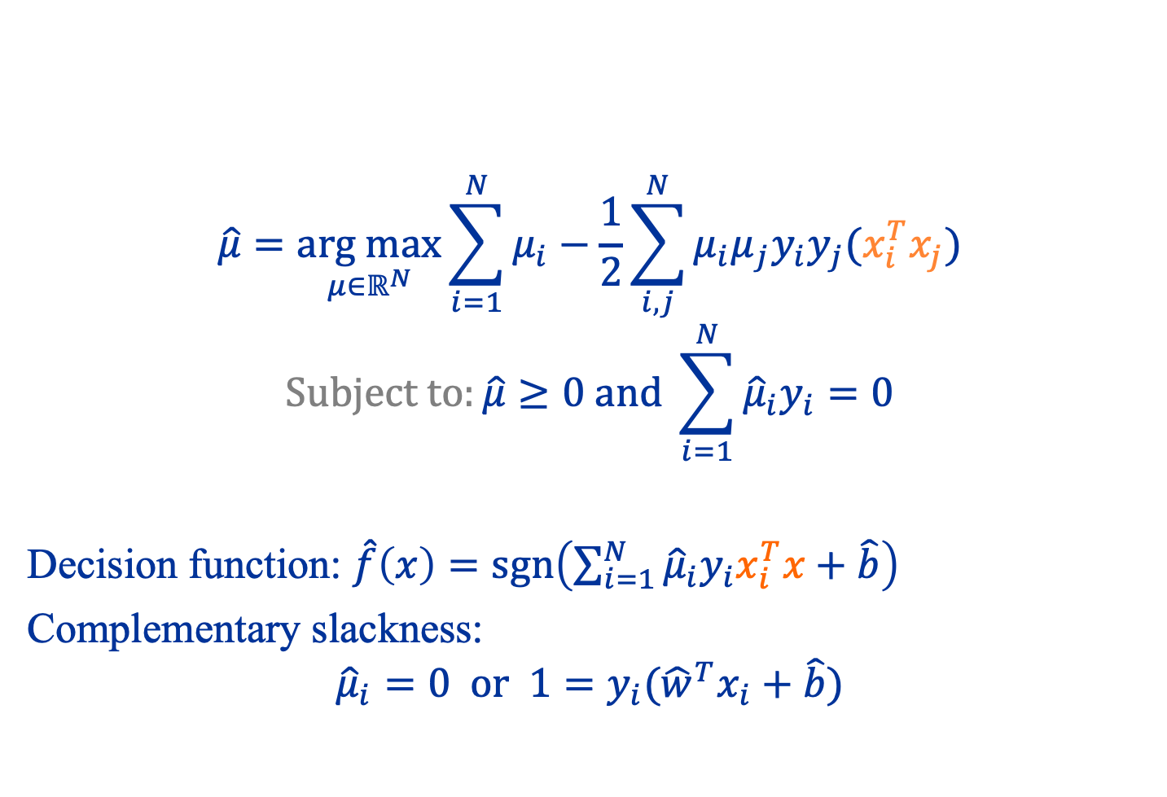
Dual Formulation of SVM
$$\hat{μ}=\underset{μ∈ℝ^{N}}{arg max}{\sum_{i=1}^{N}{μ_{i}}−\frac{1}{2}\sum_{i,j}^{N}{μ_{i}μ_{j}y_{i}y_{j}(x_{i}^{T}x_{j})}}$$
$$Subject to:\hat{μ}≥0 and \sum_{i=1}^{N}{{\hat{μ}}_{i}y_{i}}=0$$
Decision function: $\hat{f}\left(x\right)=\operatorname{sgn}\left(\sum_{i=1}^{N}{{\hat{μ}}_{i}y_{i}x_{i}^{T}x+\hat{b}}\right)$
Complementary slackness:
$${\hat{μ}}_{i}=0 or 1=y_{i}({\hat{w}}^{T}x_{i}+\hat{b})$$

Slide 38
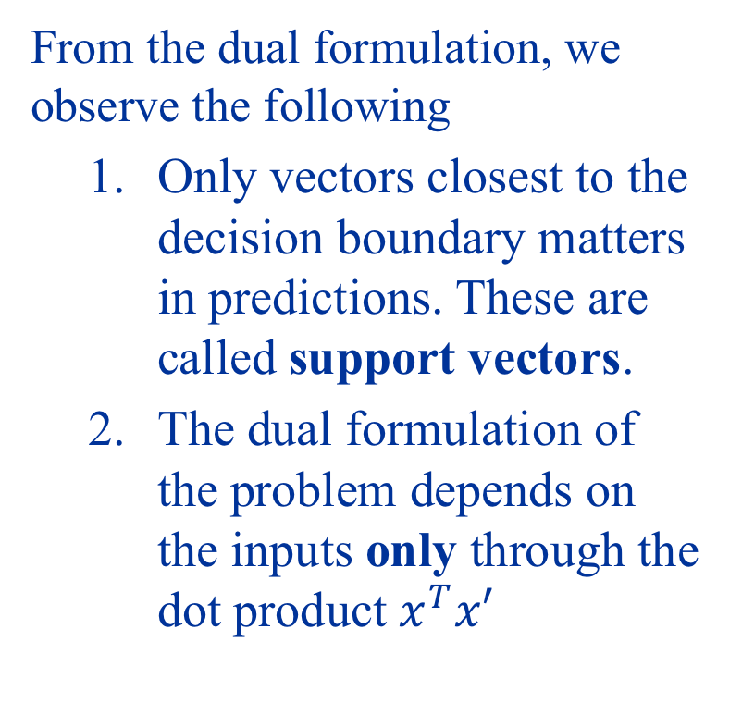
Crucial Observations
From the dual formulation, we observe the following
Only vectors closest to the decision boundary matters in predictions. These are called support vectors.
The dual formulation of the problem depends on the inputs only through the dot product $x^{T}x′$
support vectors

Slide 39
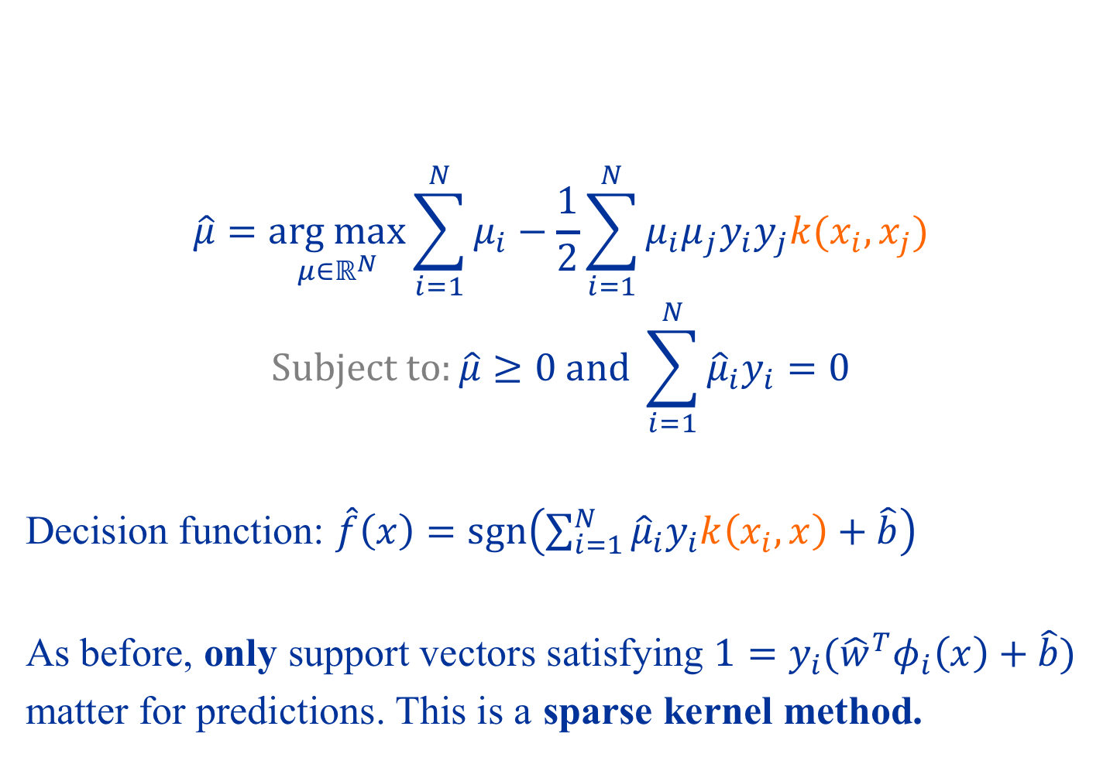
Kernel Support Vector Machines
$$\hat{μ}=\underset{μ∈ℝ^{N}}{arg max}{\sum_{i=1}^{N}{μ_{i}}−\frac{1}{2}\sum_{i=1}^{N}{μ_{i}μ_{j}y_{i}y_{j}k(x_{i},x_{j})}}$$
$$Subject to:\hat{μ}≥0 and \sum_{i=1}^{N}{{\hat{μ}}_{i}y_{i}}=0$$
Decision function: $\hat{f}\left(x\right)=\operatorname{sgn}\left(\sum_{i=1}^{N}{{\hat{μ}}_{i}y_{i}k\left(x_{i},x\right)+\hat{b}}\right)$
As before, only support vectors satisfying $1=y_{i}({\hat{w}}^{T}φ_{i}\left(x\right)+\hat{b})$
matter for predictions. This is a sparse kernel method.

Slide 40
Summary
The essence of kernel methods
Write solution only in terms of dot products (this usually involves going to a “dual” formulation)
Go nonlinear by using kernels to replace dot products
Support vector machines
Maximum margins solution
Example of sparse kernel method: only some points (support vectors) are used for prediction

Slide 41
Consultations
TAs:
Jiang Haotian
Chen Yurui
You can contact them for any questions or consultations.

Slide 42
HW1 and Mid-Term test
HW1: You can find the 1st homework on Canvas (“Assignements”)
Mid-term:
Date: Sat 1st Oct, 2022 (2 hours)
Mode: Online

