Slide 1



IT5006 FUNDAMENTALS OF DATA ANALYTICS · GROUP 10 · FINAL PRESENTATION
Predicting delivery performance
and satisfaction risk
Two prediction moments on the Olist Brazilian marketplace — from nine tables to a deployed application
Pan Pinyou · Li Yudan · Zhu Gengyu
National University of Singapore · November 2026
Live app team10-it5006-olist.streamlit.app Code github.com/gengyuzccc-cell/Team10_IT5006_Ecommerce_Analytics_AY2627Sem1
Notes:
[0:00–0:20] Good evening. We are Group 10. Our project asks two questions of the Olist marketplace data, at two different moments in an order's life, and turns the answers into decisions that two teams can act on — and we have deployed the result as a live application that you can open right now.

Slide 2



One number drove the whole project
A late delivery is the strongest single driver of a bad review in 99,091 Olist orders (2017–2018)
One decision chain: Problem 1's output is Problem 2's most important input.
1–2 STAR REVIEW RATE
9.2%
54.0%
on time
delivered late
5.9× more likely, and monotone in how late the parcel is. Review score correlates −0.33 with lead time and ~0 with price or basket size: the delivery, not the purchase, drives the rating.
Checkout
Delivery
Review
PROBLEM 1 · AT CHECKOUT
PROBLEM 2 · AT DELIVERY
How long will this order take, and will it miss its promise?
Will this delivered order draw a 1–2 star review?
77% of reviews are 4–5 stars; the minority is what we predict. Lead time itself halves across the window, so every model also has to survive drift.
Regression on lead time + a late flag · Operations: re-quote, pre-warn, expedite
Classification · Customer experience: reach out before the review is written
Notes:
[0:20–1:05] The data is Olist, a Brazilian marketplace: 99,441 orders in nine relational tables. One finding from our exploratory phase stood above everything else. If a parcel arrives on time, about nine per cent of customers leave a one- or two-star review. If it arrives late, fifty-four per cent do. That is a six-fold increase, and it grows with every day of delay. So we framed two problems at two moments. At checkout, before anything ships: how long will this take and will it miss the promised date — that is for operations. At delivery, before the review is written: will this customer leave a bad review — that is for customer experience. They form one chain: the order flagged at checkout is the one that arrives late, and the one that arrives late is the one worth calling.

Slide 3



Nine tables, one row per order — and two traps inside them
Chronological, customer-disjoint split; leakage defined per prediction moment
Join inflation
ONE JOB PER PERIOD
Items, payments and reviews are one-to-many. A naive merge turns 99,441 orders into 118,437 rows (+19%) and biases every average. We aggregate each child table first, then join, and assert the grain.
Train
Validation
Test
Train Jan 2017 – Apr 2018 · 73,008 orders · fit, tune with expanding-window CV
Validation May – Jun 2018 · 13,156 · choose models, thresholds, calibration
customer_id is not a person
Test Jul – Aug 2018 · 12,927 · scored once, replayed by the app
99,441 customer_id values map to 96,096 people. Group on the wrong key and there are no repeat buyers; on the right one, 2,997 are — and 227 straddle the split, so we remove them.
WHAT ONE FORBIDDEN COLUMN IS WORTH
0.589 → 1.000
Leakage, one rule per moment
At checkout nothing about fulfilment exists; at delivery the delivery outcome is history. assert_no_leakage(features, regime) runs before any fit.
ROC-AUC of the late-delivery model after adding the realised delivery time. That is not a result; it is the target restated — and it is why the guard is a test, not a convention.
Notes:
[1:05–2:00] Nine tables, one row per order. Two things in this dataset bite anyone who is not careful. Three tables are one-to-many against orders, so a naive join inflates the data by nineteen per cent and quietly reweights every average. And customer_id is regenerated per order — it is not a person. We split the data by time, with each period doing exactly one job: fit on the past, choose and calibrate on a two-month validation window, and score the July–August 2018 test window once, for models already chosen. And we define leakage per prediction moment: delivery dates are forbidden at checkout and allowed at delivery. One forbidden column takes ROC-AUC from 0.59 to a perfect 1.0 — so the guard is an assertion that runs before any model is fitted.

Slide 4
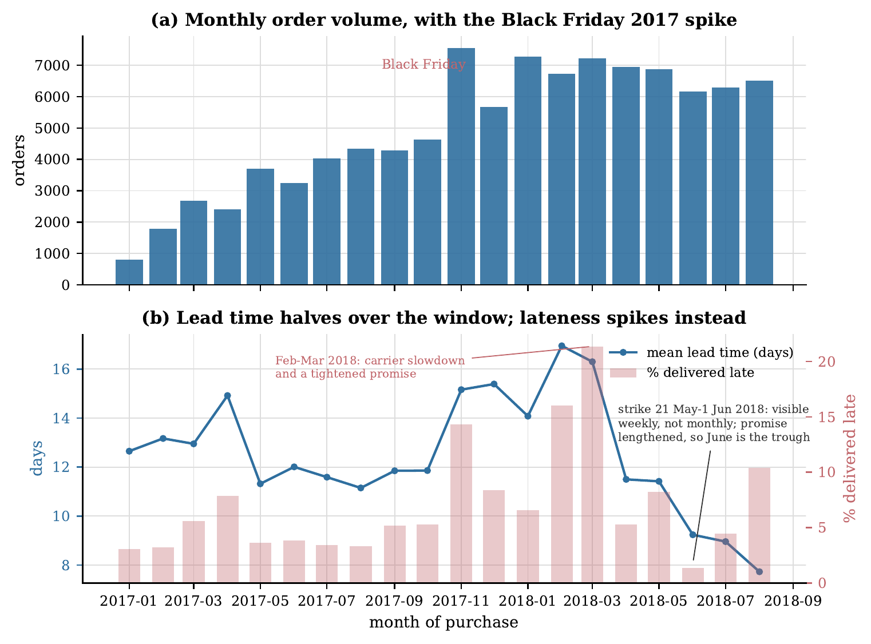
What the data told us: drift, volatility and shocks
Three facts from the exploratory analysis that shaped every modelling decision
LEAD TIME DRIFTS
16.9 → 7.7 days
mean lead time, Feb → Aug 2018. Under a level shift R² goes negative; MAE leads, and models must be refitted on a rolling basis.
LATENESS IS VOLATILE, NOT TRENDING
1.4% – 21.4%
monthly late rate. Black Friday 14.3%; Feb–Mar 2018 a carrier-side slowdown (transit 8.7 → 13.2 d) while the promise was tightened.
THE MAY 2018 TRUCKERS' STRIKE
Only weekly
Monthly orders (a) and mean lead time against the late rate (b), Jan 2017 – Aug 2018
invisible in monthly data: orders in transit were 16.0% late, then the promise jumped from 19.5 to 36.8 days and June became the quietest month.
Notes:
[2:00–2:55] Three facts shaped everything. First, drift: Olist got much faster during the window — mean lead time fell from seventeen days to under eight. A model trained on the slower past is off-level on the present, so R-squared goes negative even for a useful model, we lead with mean absolute error, and we plan for monthly refits. Second, lateness does not trend, it spikes — from one per cent to twenty-one per cent month to month. Our Phase 1 report blamed the May 2018 truckers' strike; the evaluators asked us to look again, and the real peak is a February–March carrier slowdown that coincided with Olist tightening its promise. Third, the strike is real but only visible at weekly resolution, because Olist responded by stretching the promised window to thirty-seven days. None of these shocks is a property of an order, which puts a ceiling on any late classifier — and we said so before modelling.

Slide 5



Three families as ladders — complexity has to earn its place
The same three families serve the regression and both classifiers; every rung is compared with the one below it
A · LINEAR
B · TREE-BASED
C · ENSEMBLE
rung 2 · HistGradientBoosting
rung 1 · Ridge / ℓ2 logistic
rung 1 · RandomForest
rung 1 · Stacking (A + B)
rung 0 · LinearRegression / LogisticRegression
rung 0 · DecisionTree
rung 0 · Voting (A + B)
Every model is a scikit-learn Pipeline (imputation, one-hot with rare levels pooled, scaling for the linear family only). Search: RandomizedSearchCV, 30 draws, scored by five expanding-window folds. Seed 42 everywhere.
Time is respected
Select by rank, not by score
Metrics match the action
TimeSeriesSplit ×5 for tuning; shuffled k-fold shown only as a contrast exhibit
Windows differ in difficulty more than models do, so candidates are ranked within each of the 3 most recent windows
PR-AUC against its floor for choosing; Precision@K for the team's day; calibrated probabilities for the cost layer
Notes:
[2:55–3:50] The brief allows two or three model families; we use three, and we run each as a ladder, starting from the simplest variant. Plain least squares before Ridge; one tree before a forest before gradient boosting; and an ensemble built only from the winners of the first two. That way 'the complexity was worth it' is a finding, not an assumption. Three design rules. Time is respected: hyperparameters are tuned with expanding-window cross-validation. Models are selected by rank across the three most recent out-of-sample windows, because the windows differ in difficulty far more than the models do. And the metrics match the action: PR-AUC against its no-skill floor to choose a model, precision at K for what a team's day actually looks like, and calibrated probabilities for the cost layer.

Slide 6
Problem 1 — lead time, and a late flag that needs no model of its own
Held-out test window, July–August 2018; every candidate scored once
Test MAE in days, lower is better
MEAN ABSOLUTE ERROR
3.90 days
41% below a constant fitted on the past, 60% below the platform's own promised date (9.79 d)
THE LATE FLAG: DERIVED VS DIRECT
2.89× vs 1.24×
lift over the no-skill PR floor. Thresholding the regression against the promise beats every classifier trained on the binary label (ROC-AUC 0.782 vs 0.584)
WHY THE BLEND WINS
A tree cannot predict outside the targets it was fitted on, and test-window lead times are shorter than anything common in training. The linear member extrapolates the level; averaging (1:2) lets one member cover the other's exact failure. Ridge does not beat plain least squares — regularisation bought nothing here.
Notes:
[3:50–4:50] Problem 1, the regression. The deployed model is a voting blend of a linear model and gradient-boosted trees, with mean absolute error of three point nine days — forty-one per cent better than a constant, and sixty per cent better than the date Olist itself shows the customer, because a promise is a commercial decision, padded, not a forecast. Inside the tree family every rung paid off; inside the linear family it did not — Ridge is worse than plain least squares, and we say so. The blend wins for a specific reason: trees cannot extrapolate a falling level, the linear member can, and averaging covers that exact failure. For the late flag we did not need a second model at all: comparing the regression's forecast with the promised date gives two point nine times the no-skill floor, against one point two for the best classifier trained directly on the binary label.

Slide 7
Problem 2 — low-review risk at delivery
Every candidate on the held-out window, with the fold-to-fold spread the Phase 2 evaluation asked for
Test PR-AUC, higher is better · no-skill floor 0.110
ROC-AUC
PR-AUC LIFT
0.749
3.75×
balanced accuracy 0.681
0.414 vs a 0.110 floor; 0.415 on 12,617 unseen customers
FOLD-TO-FOLD VARIATION
±0.09 spread across the five folds, < 0.001 between the best three trees. The windows differ far more than the models — so we rank within windows. Deployed: the StackingClassifier the pre-registered rule chose (mean rank 1.67 vs 2.00); the single boosted model is a statistical tie.
CLASS WEIGHTING: THE ABLATION PHASE 1 PROMISED
Weighting the loss: PR-AUC 0.415 → 0.411 (no gain), Brier 0.078 → 0.133, mean predicted risk 0.12 → 0.34 against an actual 0.11. It inflates every customer's risk threefold. We fit on the true prior and tune the threshold on validation instead (0.19).
Notes:
[4:50–5:55] Problem 2, the review model. ROC-AUC of 0.75 and PR-AUC of 0.41 — three and three-quarter times the no-skill floor, on a target where always predicting 'satisfied' scores eighty-nine per cent accuracy and catches nothing. It scores the same on customers it has never seen. The Phase 2 evaluators asked us to show the fold-to-fold variation, and it is instructive: the spread across folds is about plus or minus 0.09, while the best three tree models are within a thousandth of each other. Cross-validation cannot separate them — which is exactly why we rank within windows. What is deployed is the stacking classifier that our pre-registered rule chose; the single boosted model is a tie, and we say so in one place, consistently, with a test that checks it. And the ablation we promised in Phase 1: weighting the loss for imbalance buys no discrimination and triples every predicted risk, so we move the threshold instead.

Slide 8
Evaluate the way the team works: the top of a ranked list
A team contacts the K riskiest deliveries it can reach in a day — so Precision@K and Recall@K describe its day
Review-risk list on the test window: precision and recall of the top K% of deliveries
TOP 5% OF DELIVERIES (≈10 CONTACTS A DAY)
0.678 · 0.307
two contacts in three reach a would-be 1–2 star reviewer, covering 31% of them; cut per day, 0.572
BREAK-EVEN PRECISION (R$5 CONTACT : R$40 REVIEW)
0.125
cleared at every capacity up to half of all deliveries — capacity, not the threshold, is what binds
THE LATE FLAG NEVER PAYS FOR AN EXPEDITE
0.29 < 0.30
its precision peaks at 0.27–0.29 and falls with volume; a R$12 expedite needs 0.30. Informative (ROC-AUC 0.78), and still not worth paying to act on — re-quote and pre-warn instead
Notes:
[5:55–6:50] PR-AUC is the right number for choosing a model, but nobody acts on a whole ranking. A customer-experience team contacts the K riskiest deliveries it can reach in a day, so the number that describes its day is the precision of that top K. At five per cent of deliveries — about ten contacts a day — two in three contacts reach a customer who really would have left a one- or two-star review, covering thirty-one per cent of them. Under an illustrative five-reais contact and forty-reais review, break-even precision is 0.125, and the list clears it at every capacity we tried: the constraint is the team's capacity, not the model's threshold. The late flag tells the opposite story: it never reaches the 0.30 that a twelve-reais expedite would need. A genuinely informative model that is still not worth paying to act on — so operations gets the free levers, not the expensive one.

Slide 9
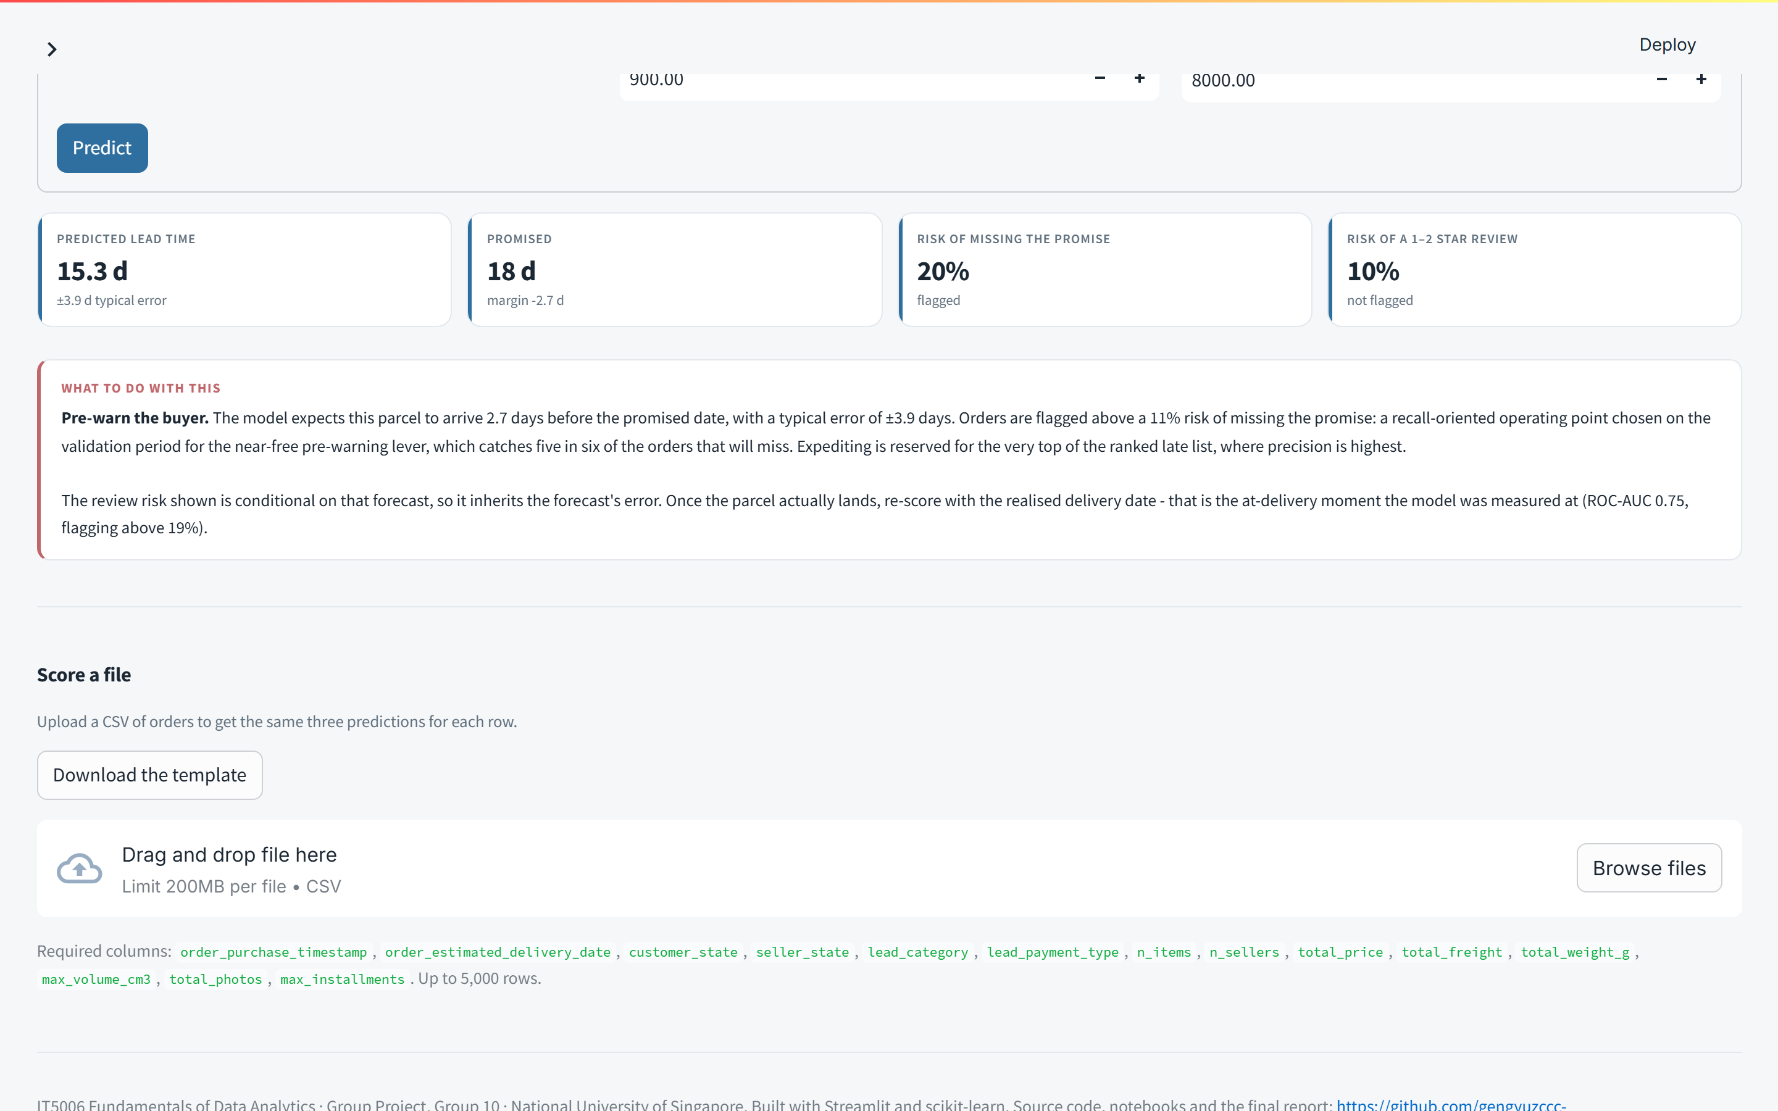



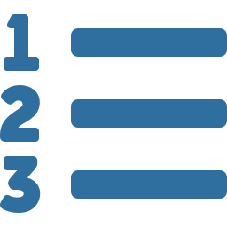
Deployed: team10-it5006-olist.streamlit.app
Streamlit Community Cloud · Python 3.12 · scores single orders and CSV files, returns a ranked triage list
Eight tabs
five exploratory views with filters, Predict, Replay a day, Model card
One feature pipeline
a form or CSV row runs through the same src/features.py builders the models were fitted on — nothing is reimplemented
Small and honest
three artifacts under 1 MB, loaded lazily; scikit-learn version pinned and checked; ten edge cases handled with specific messages
Triage list
upload a day's orders, enter the team's capacity K, get the top-K marked with the precision that K achieved on the held-out window
Notes:
[6:50–7:45] Everything is deployed. The application serves all three models: enter one order as it would look at checkout and you get the expected lead time, the risk of missing the promise against the tuned threshold, and the review risk. Upload a CSV and you get the same three predictions for every row, plus the triage list: enter your team's capacity and the top-K are marked, with the precision that capacity achieved on the held-out window shown beside them. Nothing in the app reimplements the feature engineering — a form submission runs through exactly the same code the models were trained on, which is the most common way a deployed model quietly stops matching its reported metrics. [Live demo if time allows: Predict tab, change the promised date, watch the late risk move.]

Slide 10
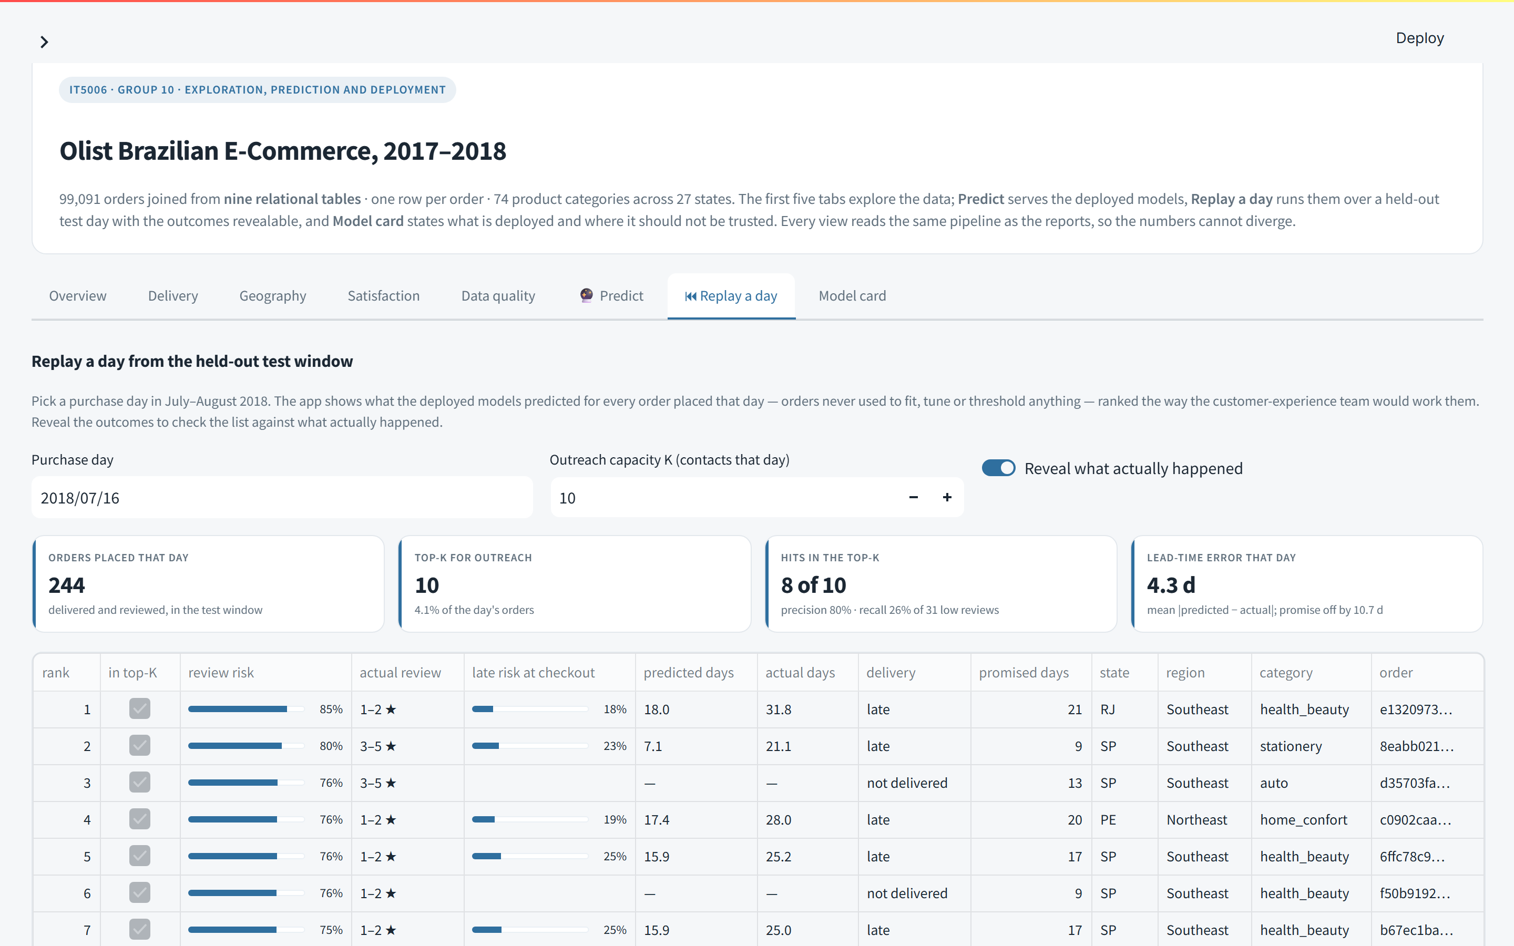
Replay any day of the held-out window — then reveal what happened
The brief's "held-out historical records simulating new orders", made inspectable
16 JULY 2018, CAPACITY 10
8 of 10
of the ten riskiest orders placed that day, eight really left a 1–2 star review; the panel beside it shows the same capacity on all 62 test days
MODEL CARD
What is deployed, read from the pickles: VotingRegressor (1A), the derived late flag (1B), StackingClassifier (2)
Every searched model's selected hyperparameters
The fold-to-fold table and chart for every candidate
Precision@K / Recall@K; where not to trust the models
A calculator for the outreach pilot
Notes:
[7:45–8:25] New in this phase is Replay a day. Because the data ends in 2018, the app predicts on held-out historical orders that stand in for new ones — so we made that literal. Pick any day in the July–August test window, pick a capacity, and the app ranks that day's orders exactly as the team would work them. Then flip the toggle and it reveals what actually happened. On the sixteenth of July, eight of the ten riskiest orders really did leave a one- or two-star review. The model card states exactly what is deployed, read from the artifacts themselves, with every hyperparameter, the fold-to-fold table, and where the models should not be trusted.

Slide 11

Recommendations: cheap levers at checkout, a ranked list at delivery
Each action with its trigger and its cost — and the experiment that would validate the business case
Who | Lever | Trigger | Cost
Operations, at checkout | Re-quote the promised date with the estimate | every order · MAE 3.90 d vs the promise's 9.79 | none
 | Pre-warn the buyer | late risk ≥ 0.11 · catches 5 in 6 of the orders that will miss | near zero
 | Expedite freight | only where precision > 0.30 — it never is · manual review of the top 1–2% only | R$12
 | Monitor sellers, routes, carrier | track-record features and the weekly late series as early warning | analyst time
Customer experience, at delivery | Contact before the review is written | the day's deliveries ranked by risk, worked top-down to capacity K | R$5
Platform | Refit monthly; monitor predicted vs realised lead time | the drift is the dominant risk to both models | —
PER 1,000 DELIVERED ORDERS
R$1,466
net benefit of the review-risk list at the cost optimum (flagging 15%); a 5% capacity still captures R$1,107
THE PILOT THAT TESTS THE ASSUMPTION
The reais figure assumes a contact prevents the review it reaches — nobody in this data was ever contacted
Randomise inside each day's top-K: contact half, leave half; compare the 1–2 star rate
Control rate is already known: 57% at ten a day. Break-even: avert 1 review in 5 (21.9%)
Six weeks at ten contacts a day detects a 1-in-4 effect (191 per arm, 80% power)
Primary outcome: the 1–2 star rate in each arm; secondary: the realised benefit per contact, which replaces the assumed R$40
Notes:
[8:25–9:25] What should each team do? Operations should re-quote every promise with the model's estimate and pre-warn buyers above an eleven per cent late risk — both nearly free, and the warning reaches five in six of the orders that will actually miss. It should not expedite on the flag; the precision is never there. Customer experience should work each day's deliveries from the top of the risk list to its capacity. Under our stated costs that policy is worth about fourteen hundred reais per thousand orders. But that figure rests on one assumption the data cannot test: that a call prevents the review. So our final recommendation is an experiment, not a rollout: randomise inside the daily top-K, contact half, leave half. The control rate is already known — fifty-seven per cent — break-even needs one averted review in five, and six weeks at ten contacts a day is enough to detect a one-in-four effect. The model card has the calculator.

Slide 12



Limitations — and what we learned about method
Stated before the numbers were, and carried into the deployment plan
A moving target
Shocks no order can see
A benefit that is assumed
A rating is not satisfaction
Lead time fell 5.3 days between training and test; the regression over-predicts everywhere, most in the North (+4.8 d). Refit monthly; recalibrate with it.
Black Friday, a carrier slowdown, a national strike — carrier capacity and promising policy, not order attributes. The late flag's ceiling is real.
The cost analysis values a contact at the review it prevents; the data contains no contacts. Pilot before scaling.
Reviews are self-selected and J-shaped; the quietly dissatisfied customer never appears. Triage scores, not entitlements — never to penalise a seller.
FOUR METHOD FINDINGS THAT TRAVEL BEYOND THIS DATASET
Cross-validation inside a drifting period reorders the candidates against the forward window, and its fold-to-fold spread is wider than the gaps between them — select by rank on recent windows, and report when even that fails (it did, once).
Weighting the loss for imbalance leaves ranking unchanged and inflates risk threefold — move the threshold instead.
Raw PR-AUC is not comparable across periods with different base rates; its lift over the floor is.
The most useful business results were negative: an informative flag that does not justify an expensive action, and a policy worth testing before it is worth anything.
Notes:
[9:25–9:50] The limitations were stated before the numbers were. The models are fitted on a moving target, so they need monthly refits. The biggest driver of lateness is shocks no order can see. The benefit of outreach is assumed until the pilot runs. And a rating is not satisfaction. Four method lessons travel further: select by rank on recent windows, because cross-validation under drift reorders models and its spread swamps the differences; move the threshold rather than weight the loss; compare PR-AUC by its lift over the floor, not raw; and value the negative results.

Slide 13


Thank you
Two prediction moments, one decision chain, a deployed application — and an experiment to run next.
Live application
https://team10-it5006-olist.streamlit.app
Repository, notebooks, report
https://github.com/gengyuzccc-cell/Team10_IT5006_Ecommerce_Analytics_AY2627Sem1
Questions?
Pan Pinyou · Li Yudan · Zhu Gengyu — Group 10, IT5006, National University of Singapore
Notes:
[9:50–10:00] Thank you. The app is live at the link, the repository holds every notebook, the tests and the final report, and we are happy to take questions.

