Slide 1

NEURULA
THE TENSORS
Nicolas Ayala^{PO, SM}
Anish Pahilajani
Kat Negrete
Mahesh Vegiraju
Alex Hutchins
APRIL 6, 2022

Slide 2

NEURULA
The embryonic stage where the architecture of the brain is first being developed

Slide 3
NEURULA
Machine learning can appear obscure and complicated, posing a barrier to people who are unfamiliar but interested.
However, designing working neural networks doesn’t have to be difficult.

Slide 4
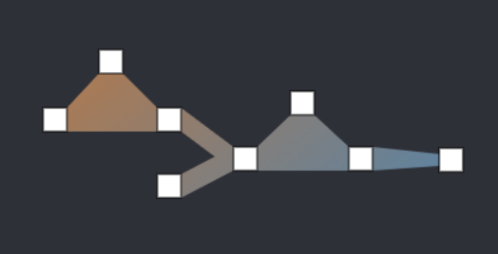
PROJECT SCOPE
A. A website in which you can drag and drop blocks allowing you to design neural networks in an intuitive fashion
B. Once you design a network, you can download auto-generated code that implements that network in tensorflow or pytorch.
C. You can save these networks and tweak them later after seeing how they fare in their task

Slide 5
RELEASE PLAN
Sprint 1
A. As someone interested in neural networks, I want a GUI for creating perceptron tensorflow networks, so that I can make them in an intuitive fashion.
B. As a user of the website, I want the GUI to allow for convolutional networks as well, so I can generate more types of networks.
A. As someone just learning about neural networks, I want it to tell me basic information about the network, such as number of parameters and number of layers, so I can have a better understanding of the network at a glance.
Spike
Becoming familiar with svelte, fastAPI
Infrastructure
Linking the frontend with the backend with fastAPI

Slide 6
RELEASE PLAN
Sprint 2
B. As a user of the website, I want to also generate pytorch networks, so that I can choose different implementations for the same network.
B. As a user of the website, I want to generate the code that optimizes the network as well, as I want an intuitive interface for the entire machine learning pipeline.
A. As a user of the website, I want operator blocks for abstractions of common architecture patterns, so I can create and visualize networks based off of these patterns easier.
A. As a user of the website, I want some pre-made networks available, so that I can build off of common network templates.
Spike
Learning network generation in pytorch

Slide 7
RELEASE PLAN
Sprint 3
C. As a user of the website, I want to be able to access my neural networks across multiple machines.
C. As a user of the website, I want to be able to save the graphical network, so I can leave the website and improve it later.
A. As a user of the website, I want the model I create to be run on a real dataset, so I can get a sense of the efficiency of my model
Spike
Learning how to use Heroku
Infrastructure
Set up the hosting service

Slide 8
RELEASE PLAN
Sprint 4
A. As a researcher, I want the model I create to be run on a real dataset, so I can get a sense of the efficiency of my model
C. As a user of the website, I want to be able to abstract my entire network into a block, so I can use it in later networks.
C. As someone learning about neural networks, I want a basic tutorial to guide me on creating a simple network, so that my first time using this can go smoothly

Slide 9
ARCHITECTURE
Single Page Front End GUI
API
Backend code generation and Data Base

Slide 10





TECHNOLOGIES
SVELTE
Front-end, open-source JavaScript framework for making interactive webpages.
JAVASCRIPT
Programming language that is one of the core technologies of the World Wide Web, alongside HTML and CSS.
FASTAPI
Web framework for developing RESTful APIs in Python.
PYTHON
High-level, general-purpose programming language.
HEROKU
Cloud application platform for hosting the website

Slide 11
CHALLENGES/ RISKS
We are unfamiliar with some of the technologies
Time needs to be allocated to learning/ becoming familiar with them
Some of the tasks may be harder to complete than as they appear
Due to the complex design, there will be lots of unforeseen road blocks
Not all of us have experience working in large groups or for big projects like this

Slide 12
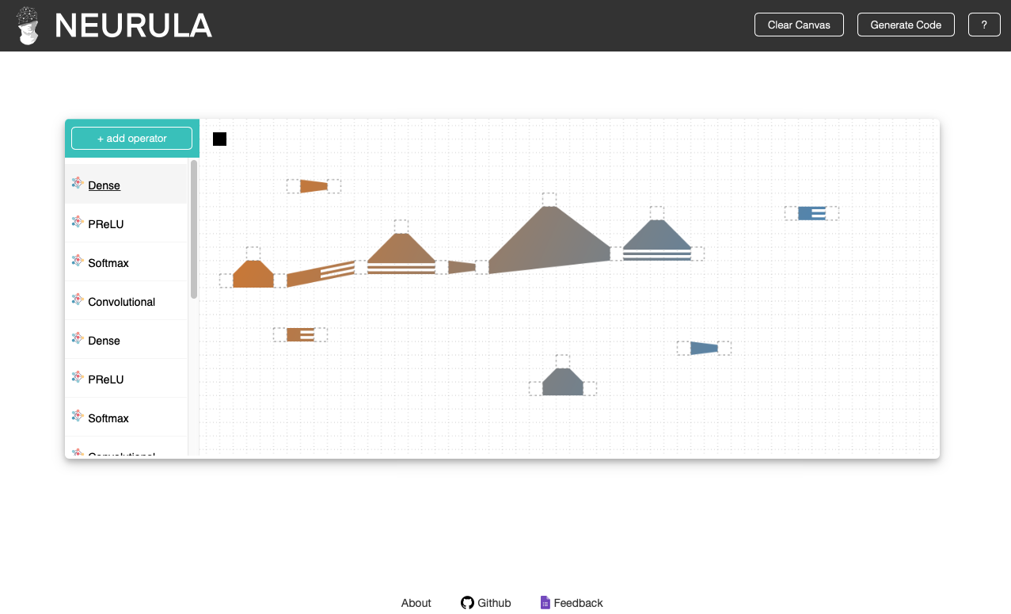
MINIMAL VIABLE PRODUCT
A. As a user of the website, I want a GUI for creating perceptron tensorflow networks, so that I can make them in an intuitive fashion.
B. As a user of the website, I want the GUI to allow for convolutional networks as well, so I can generate more types of networks.
B. As a user of the website, I want to also generate pytorch networks, so that I can choose different implementations for the same network.
C. As a user of the website, I want to be able to access my neural networks across multiple machines.
C. As a user of the website, I want to be able to save the graphical network, so I can leave the website and improve it later.

