Slide 1
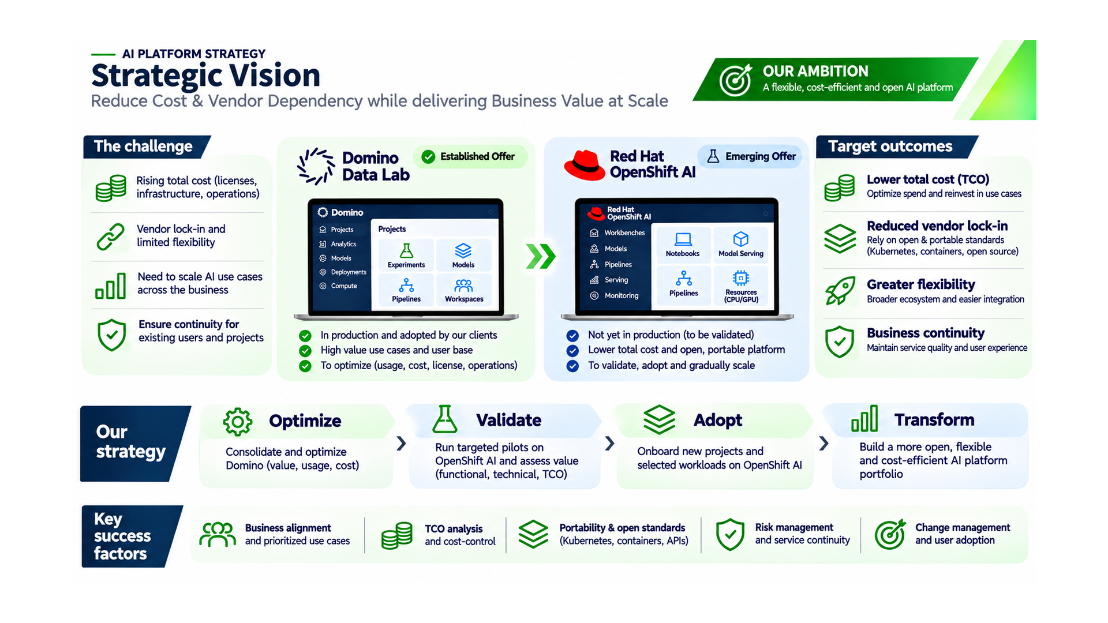

Slide 2
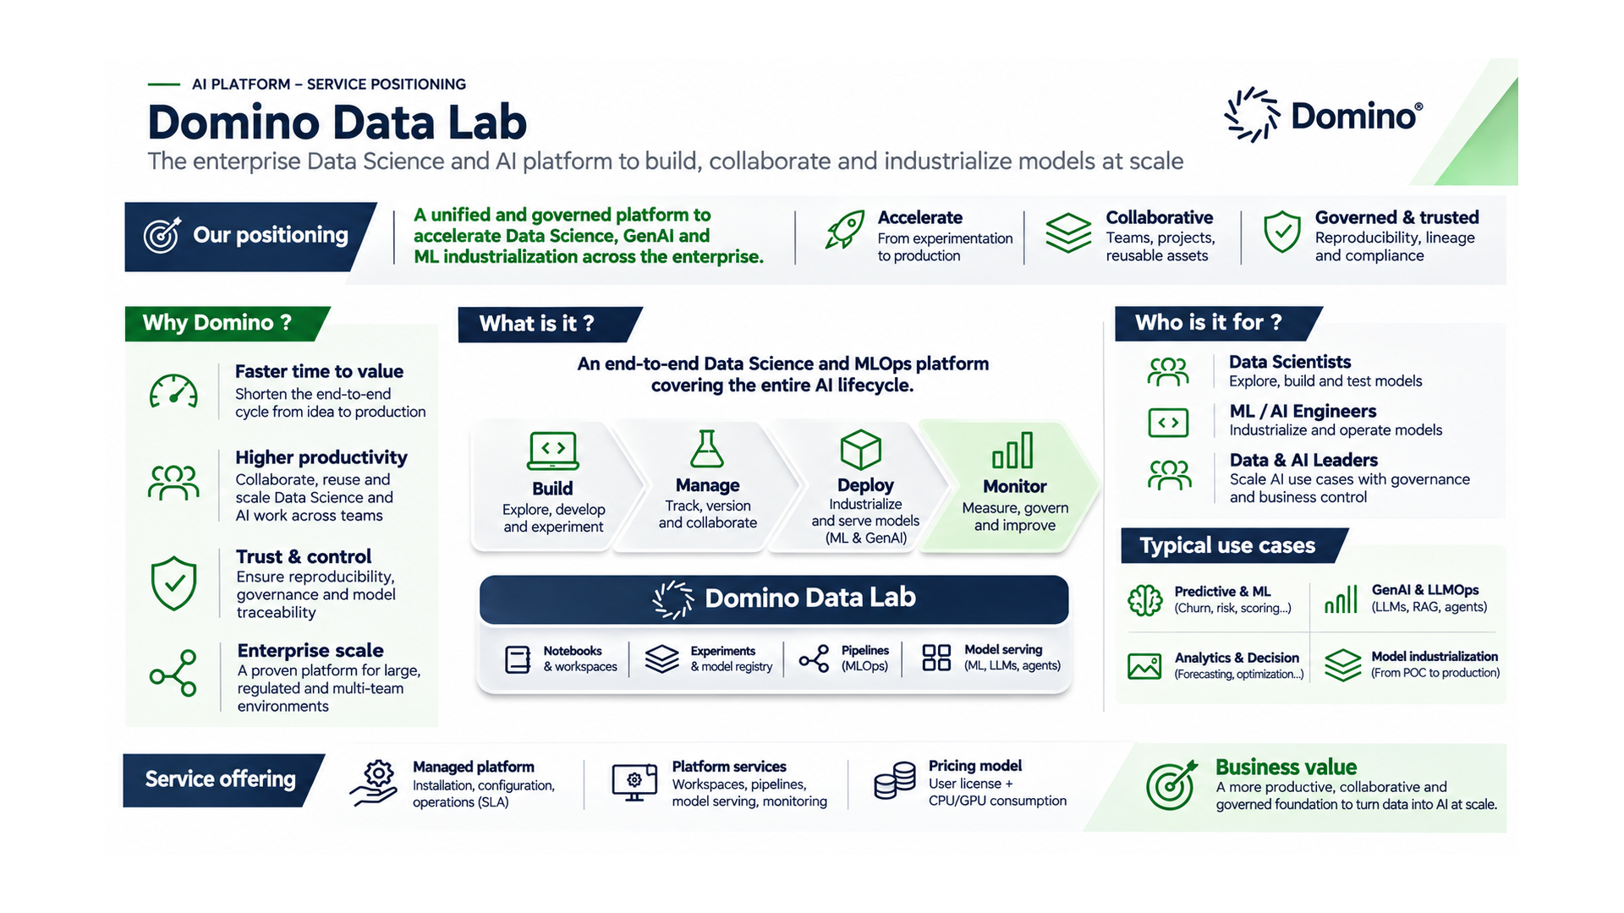

Slide 3
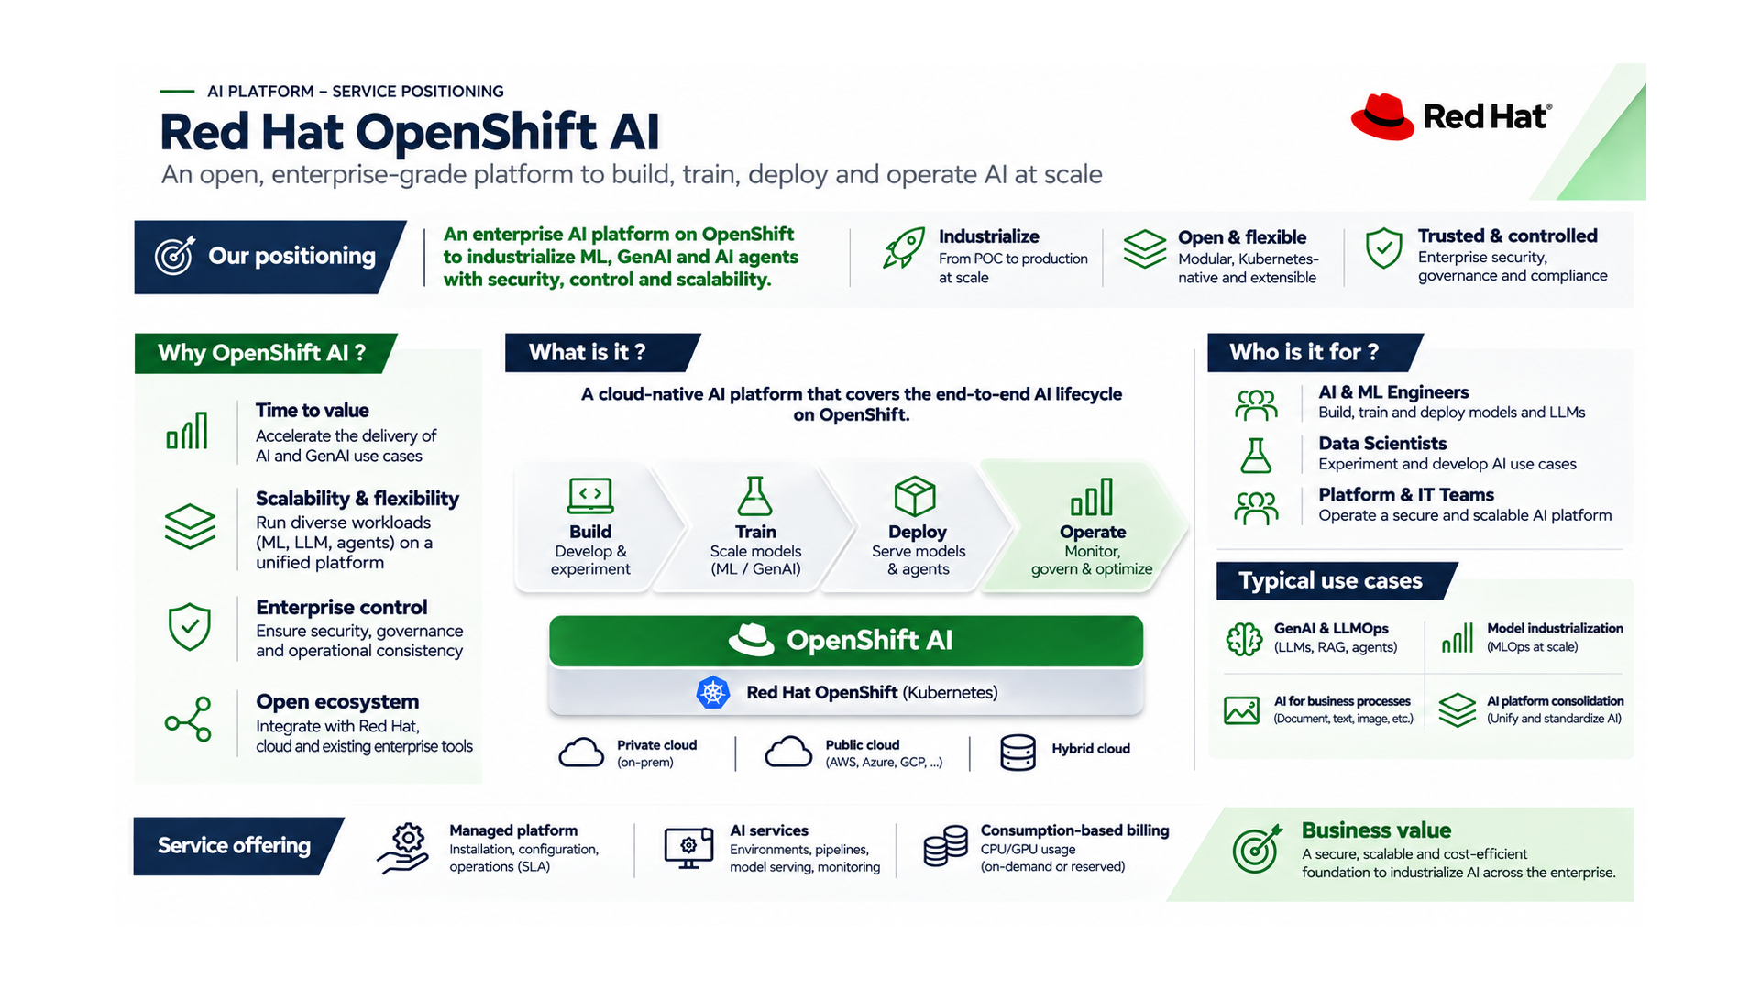

Slide 4
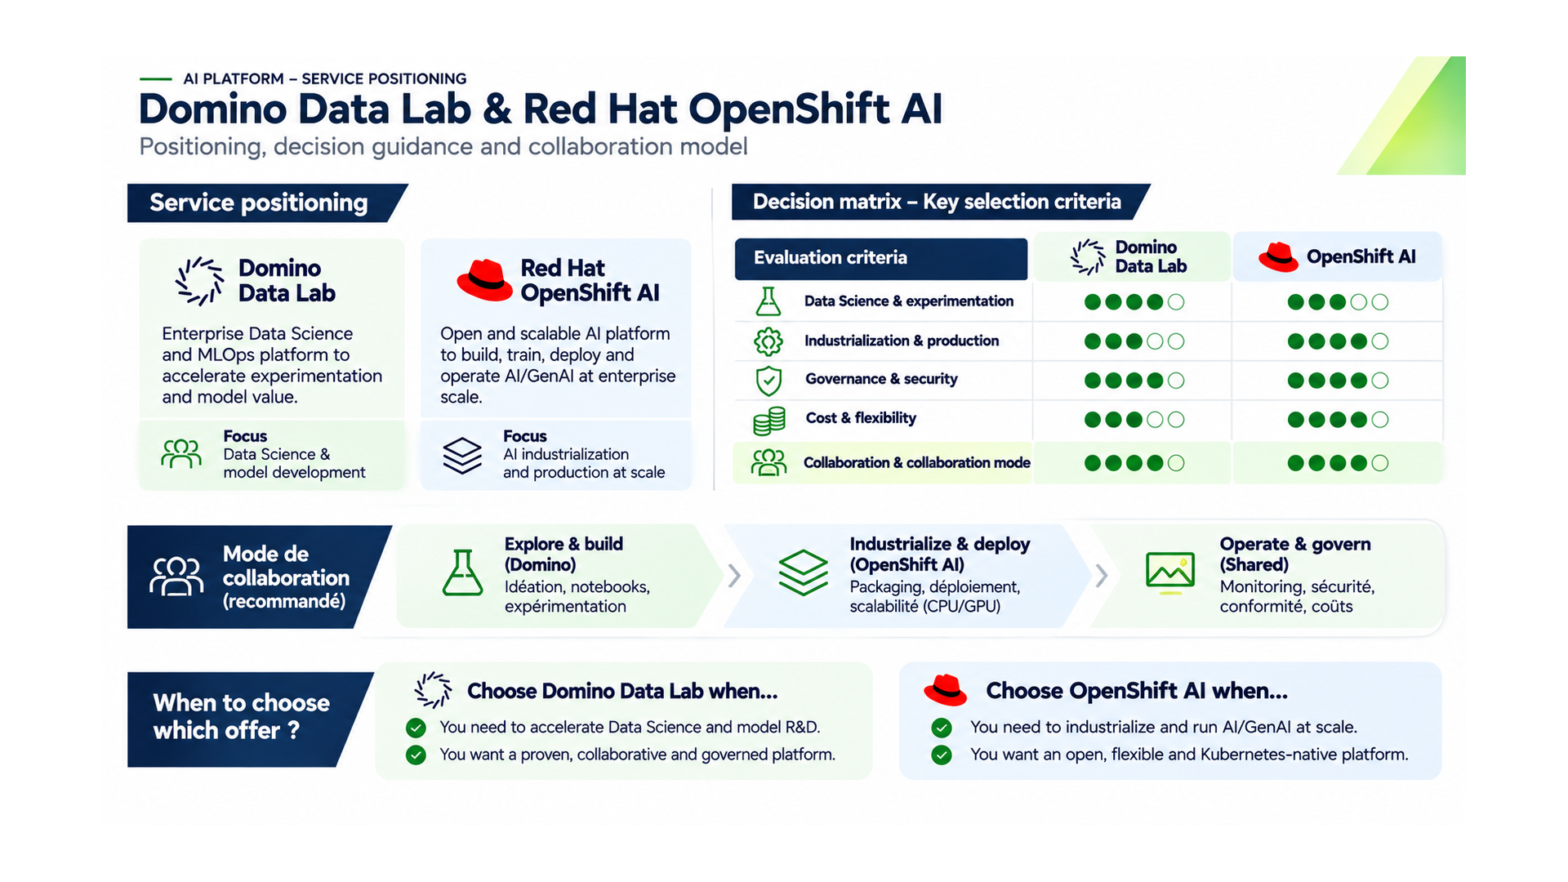

Slide 5
AI PLATFORM STRATEGY
05
Customer Segmentation — Retain, Target, Transition
Different approaches for established clients, new demand and potential migrations
RETAIN | Domino
TARGET | OpenShift AI
TRANSITION | Selective
Existing clients and business-critical workloads.
Maintain service quality, optimize licence and compute consumption, grow valuable use cases.
New projects requiring flexibility, AI engineering or a lower TCO.
Qualify customer needs, run targeted POCs and validate the operating model.
Eligible existing workloads only.
Compare migration cost, collaboration, portability, security and continuity before any change.
Customer principle: no forced migration; prove incremental value and protect user experience.

Slide 6
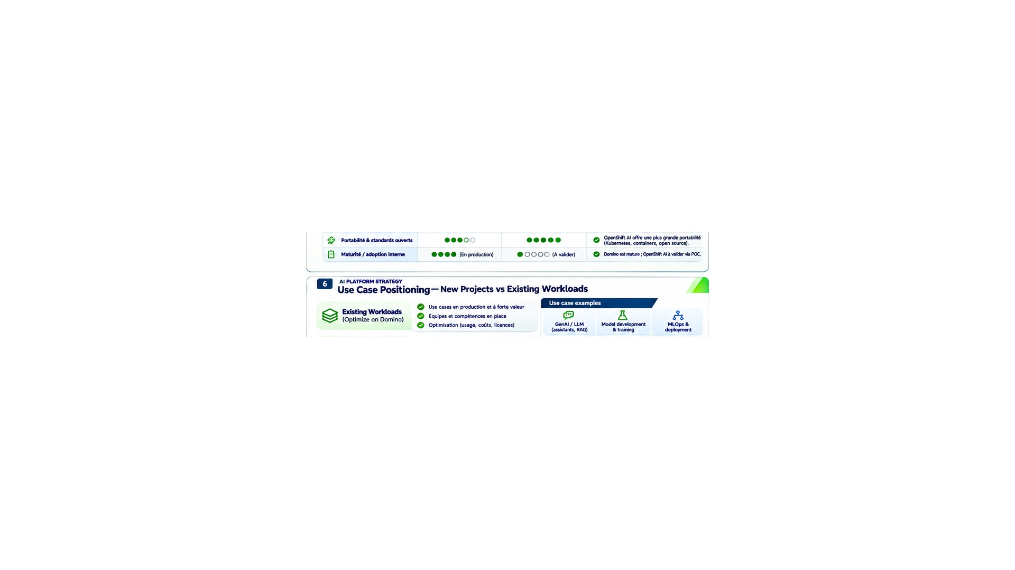

Slide 7
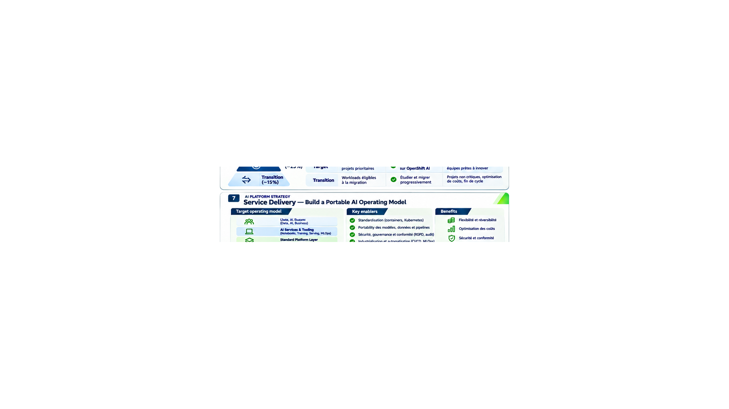

Slide 8
AI PLATFORM STRATEGY
08
Pricing & TCO — Demonstrate the Real Cost Advantage
OpenShift AI is expected to cost less; the full economic benefit still needs validation
DOMINO | Existing model
OPENSHIFT AI | Target model
Client billing: user licence + CPU/GPU usage.
Full cost: licences, compute, storage, platform operations, support and governance.
Client billing: CPU/GPU usage.
Full cost: Red Hat subscriptions where applicable, compute, storage, engineering, operations and support.
3-year TCO = subscriptions + infrastructure + operations + support + migration + productivity impact
Decision rule: confirm savings using comparable workloads, utilization and service levels.

Slide 9
AI PLATFORM STRATEGY
09
Portfolio Transformation — Optimize, Validate, Adopt, Transform
Reduce vendor dependency without compromising established services
01 OPTIMIZE
02 VALIDATE
03 ADOPT
04 TRANSFORM
Domino today
Contain cost, improve utilization and retain high-value teams.
OpenShift AI POCs
Test capabilities, collaboration, security, portability and TCO.
New projects first
Onboard suitable projects; establish support and service billing.
Portfolio over time
Consider selective migrations only with demonstrated benefits.
Strategic objective: lower total cost, more choice and measurable customer value.

Slide 10
AI PLATFORM STRATEGY
10
Roadmap & KPIs — Prove Value Before Scaling
A stage-gated plan with measurable criteria, not invented savings targets
Q1–Q2 | OPTIMIZE
Q3–Q4 | VALIDATE
Q5–Q6 | ADOPT
Q7–Q8 | TRANSFORM
Inventory Domino usage and cost; identify workload candidates.
Run OpenShift AI pilots; verify security, user experience and TCO.
Onboard first suitable customers; operate and measure support.
Scale proven use cases; review selective migrations.
KEY KPIs
3-year TCO • Active users • GPU utilization • Time-to-value • Satisfaction • Portable workloads
Go / No-Go: security + operational readiness + functional fit + verified economics.

