Slide 1
PySQL --DBMS HW1--
R00943104 許家豪

Slide 2

1989, Guido van Rossum
There is only one way to do it.

Slide 3
Python Cmd Module
CLI -> Args -> Interpreter -> Module
DB -> Relation -> Table -> Record

Slide 4
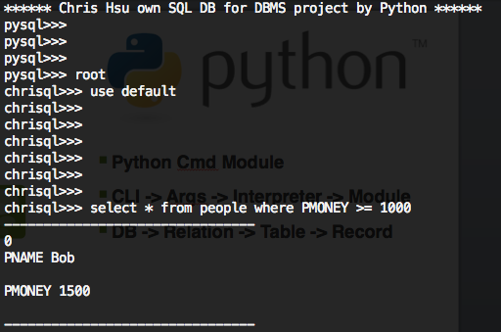
Python CmdModule --- self made CLI

Slide 5

help: show all commands
register: user login account
show: show all databases / tables
hist: see the history
use: choose DB
exit: exit PySQL
All with error message
Ex. Other command: ‘*** Unknown syntax: ’

Slide 6
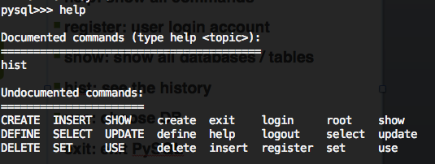
help: show all commands

Slide 7

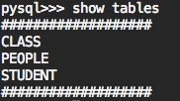
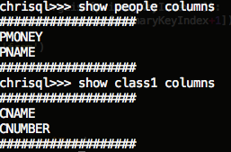

hist: see the history
show :show databases / tables / columns

Slide 8

register: sign up
Other Command: ‘Unknown syntax’

Slide 9
login & logout
define
set: must finish define first
create: table or DB
insert
select: multiple column, spaces, * , >= & <= are supported => need picture
delete
update
Upper and Lower case are all supported => need picture

Slide 10

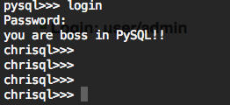

set: must finish define first
Login: user/admin

Slide 11
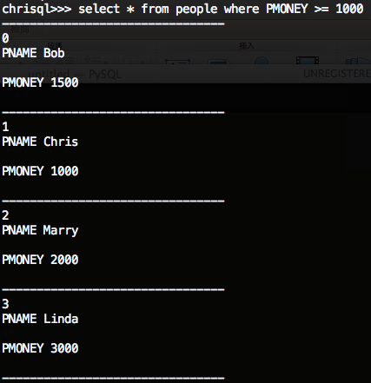
select: * , >= & <= are supported

Slide 12
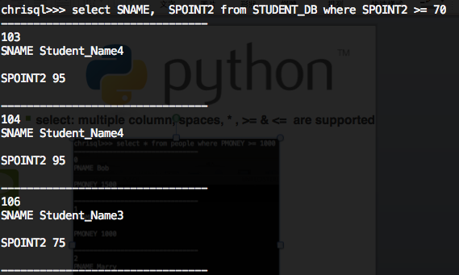
select: multiple column with random spaces are supported

Slide 13
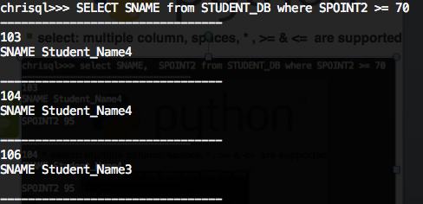
Upper and lower cases all supported

Slide 14
Future Work:
UI
Select Nest Construct
More debug info

