Slide 1



Yearly Sales
View in Power BI
Last data refresh:
8/23/2022 11:22:31 AM UTC
Downloaded at:
8/24/2022 3:26:15 PM UTC

Slide 2
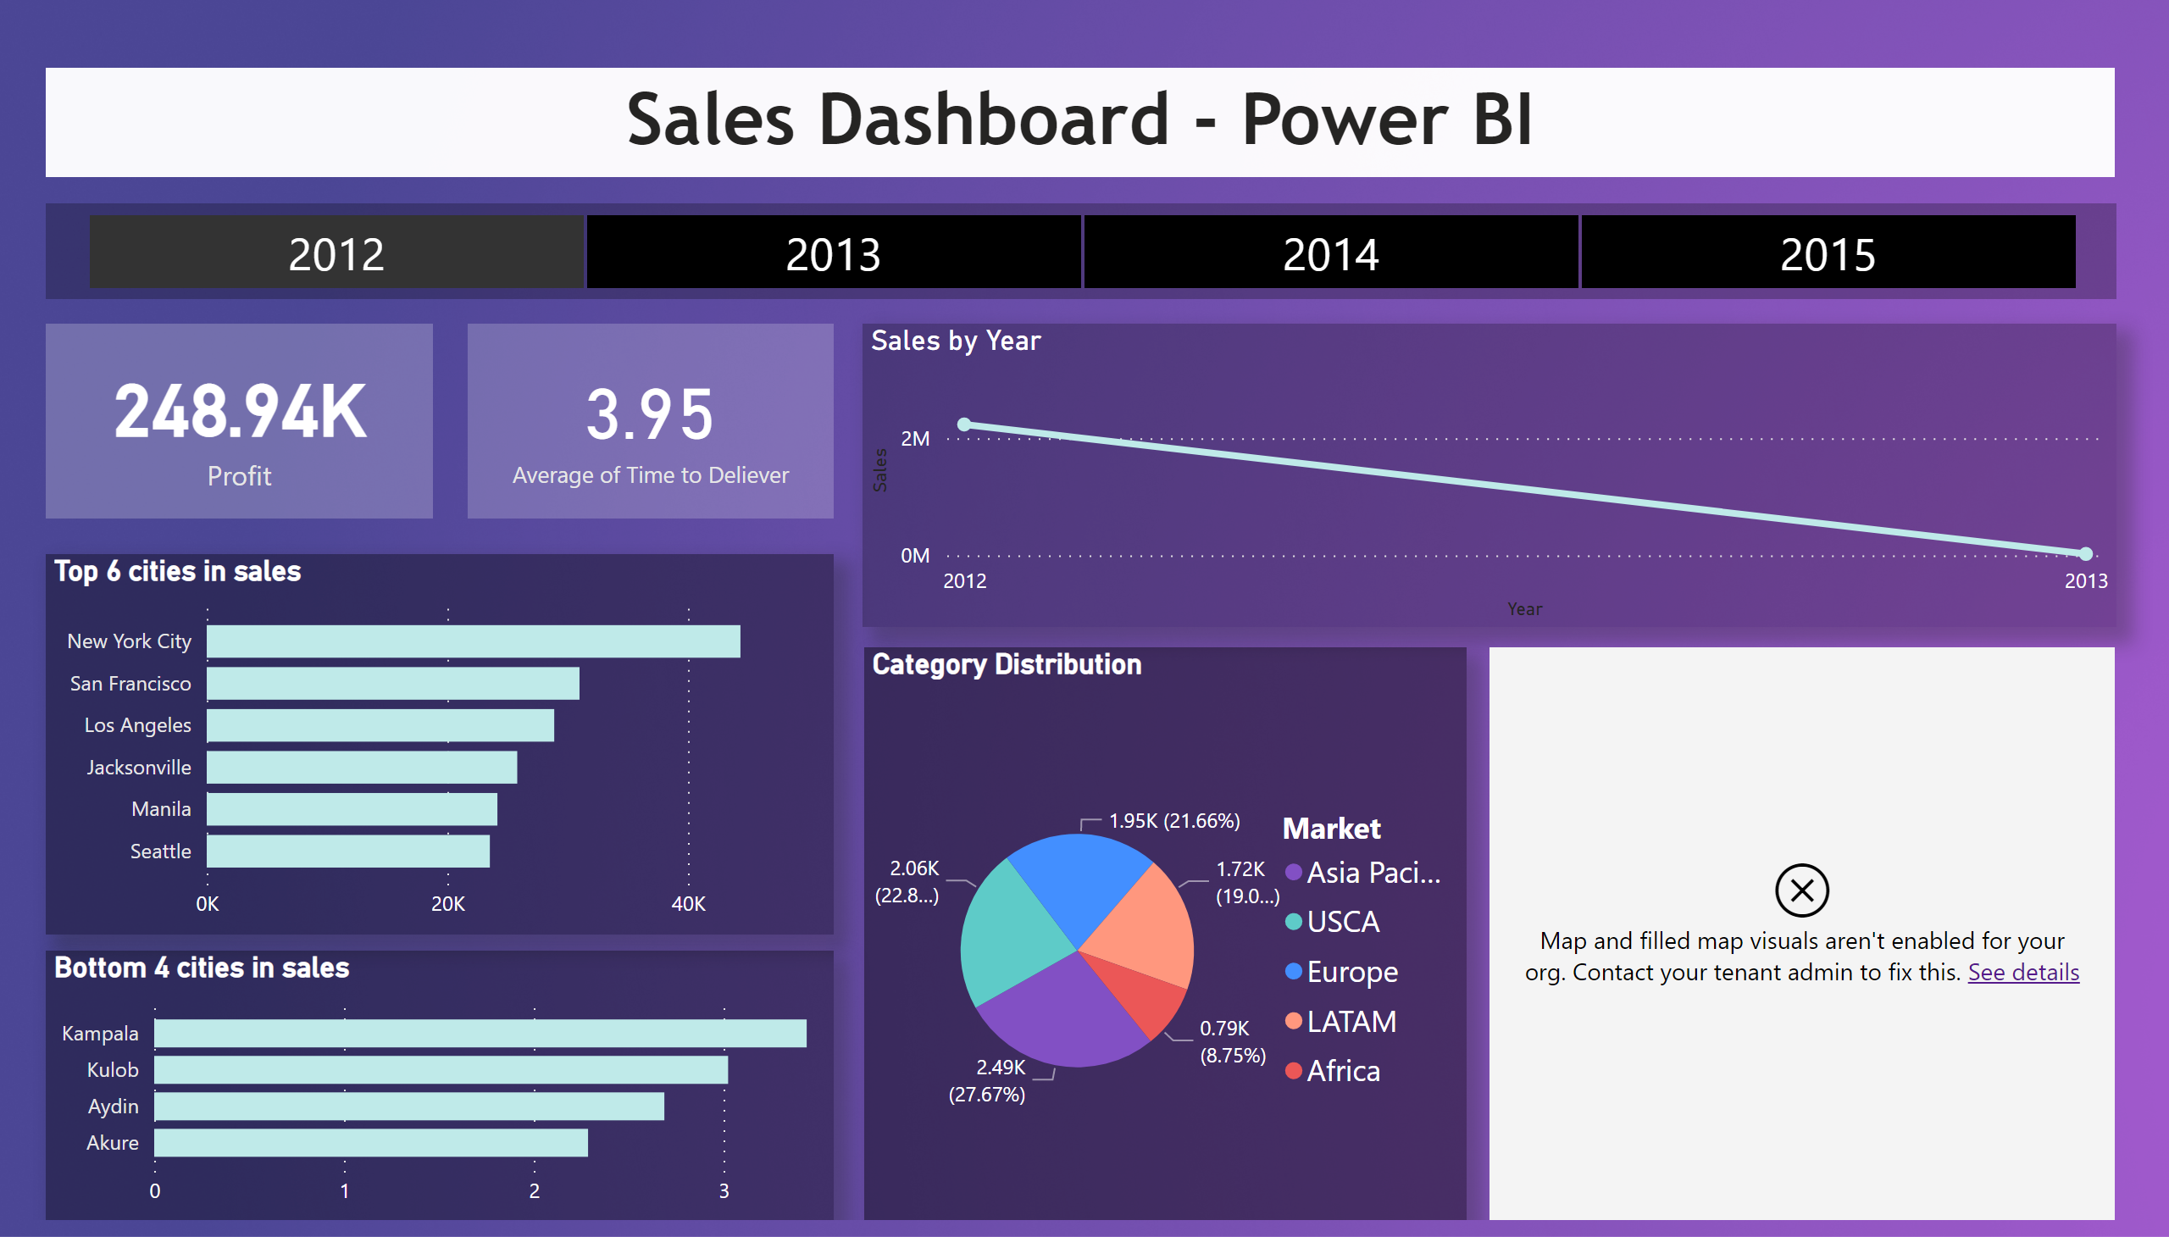
Page 1
Notes:
card
No alt text provided
Top 6 cities in sales
No alt text provided
lineChart
No alt text provided
card
No alt text provided
slicer
No alt text provided
textbox
No alt text provided
Category Distribution
No alt text provided
Bottom 4 cities in sales
No alt text provided
map
No alt text provided

