Slide 1
Opengl homework 3
caramelyo

Slide 2
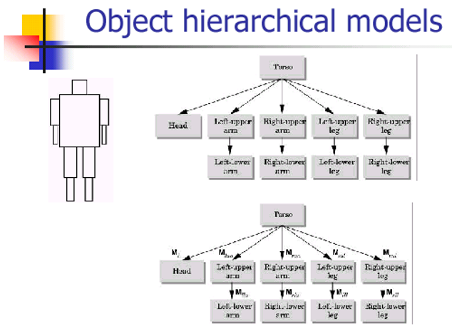
Homework 3
Object hierarchical models

Slide 3
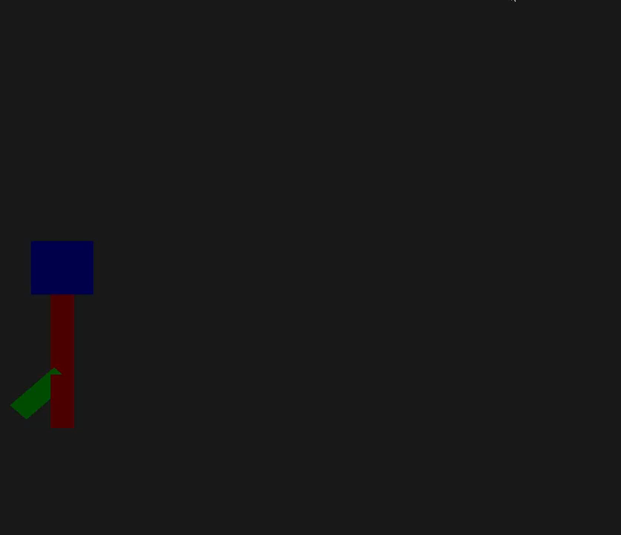
Homework 3

Slide 4

Homework 3
Key concept :
Record each transformation matrix of body part
Create the hierarchy of body
$Mf=Tallupper ∗Tself ∗Rallupper ∗Rself ∗Sallupper ∗Sself$

Slide 5

Homework 3

Slide 6

Homework 3
Hierarchy
Body
Left thigh
Left shank
Right shank
Right thigh

Slide 7
Homework 3
Body
Left thigh
Left shank
Right shank
Right thigh
Hierarchy
M == T * R * S

Slide 8
Homework 3
Body
Left thigh
Left shank
Right shank
Right thigh
Hierarchy
M == T * R * S
T_{upper} * T_{self} * R_{upper} * R_{self} * S_{upper} * S_{self}

Slide 9
Homework 3
Body
Left thigh
Left shank
Right shank
Right thigh
Hierarchy
M == T * R * S
T_{upper} * T_{self} * R_{upper} * R_{self} * S_{upper} * S_{self}

Slide 10
Homework 3
Body
Left thigh
Left shank
Right shank
Right thigh
Hierarchy
M == T * R * S
T_{upper} * T_{self} * R_{upper} * R_{self} * S_{upper} * S_{self}
T_{upper1} * T_{self} * R_{upper1} * R_{self} * S_{upper1} * S_{self}

Slide 11
Homework 3
Body
Left thigh
Left shank
Right shank
Right thigh
Hierarchy
M == T * R * S
T_{upper} * T_{self} * R_{upper} * R_{self} * S_{upper} * S_{self}
T_{upper1} * T_{self} * R_{upper1} * R_{self} * S_{upper1} * S_{self}

Slide 12
Homework 3
Requirements
Hierarchical model
At least three hierarchies
Ex : body – thigh – shank
Texture
Use texture (at least simple colors) on your model
Let user know the difference between parts of model
Body
Thigh
Shank

Slide 13
Homework 3
Requirements
User input
User has capability of controlling the model you created
Move forward and backward; turn left and right (by arrow keys)
Changeable view point(camera)
View point is changeable in position (at least two different positions)
It will be convenient for you to see your model turning around
They can be switched by ‘c’ key

Slide 14
Homework 3
Requirements summary
Hierarchical model
At least three hierarchies
Texture
Use texture (at least simple colors) on your model
User input
User has capability of controlling the model you created
Changeable view point(camera)
View point is changeable in position (at least two different positions)

Slide 15
Homework 3
Other requirements
Use OpenGL (like homework 1) (you can start homework 3 from homework 1)
Deadline : 2019 / 05 / 20 (Mon.)
A readme file to explain
Environment
How to use your program (how to compile … user input …)
How do you achieve the requirements (method …)
Something you want to tell TAs
Make sure that all files you hand in can be compiled in any computers
If your homework cannot be compiled in TA’s PC, then it is regarded that you don’t hand in homework
If you output your result as video, please upload your result to YouTube and append its link in readme file

Slide 16

Homework 3
Bonus
Let your model jump by space key with appropriate animation

Slide 17
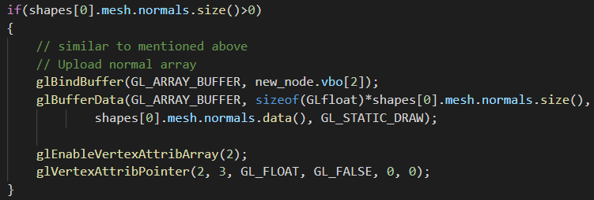
Homework 1
There are two information (positions and normals) that you need to send to shader in homework 1
So you need vbo[0] and vbo[1] only

Slide 18
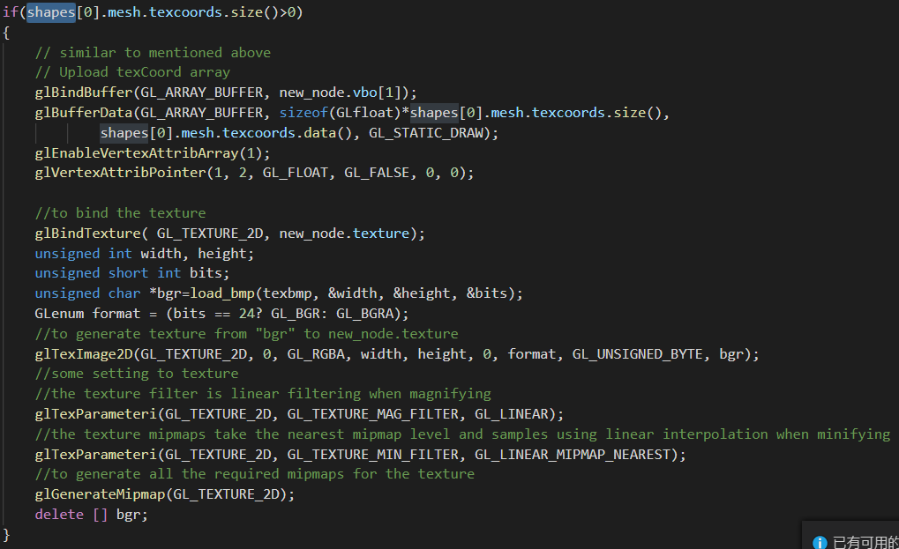
Homework 1
If your model has texture information, then you can send it to shader with VBO

Slide 19
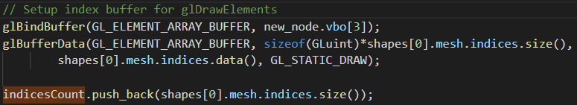
Homework 1
As mentioned above, your EBO should be bound to vbo[2]
The order of VBO is not fixed
It’s dependent on how you send VBOs to shader

Slide 20
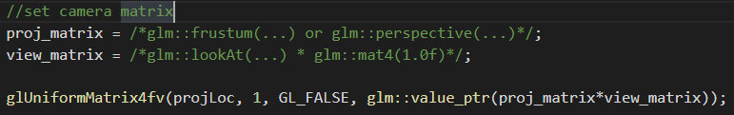
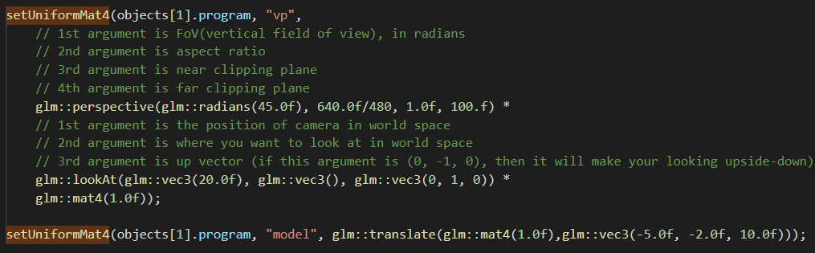
Homework 1
MVP setting
VP setting

Slide 21
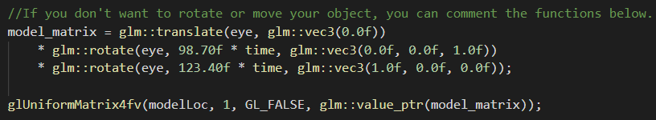
Homework 1
MVP setting
M setting

Slide 22
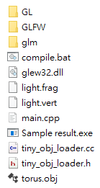
Homework 1
Environment setting
Lost dll files
Path problems
Use relative path rather than absolute path !!
There will be the obj file (read by your program) in release directory
That is, user can start your program by clicking the exe file in release directory rather than through visual studio
OS
Please mention it in the readme file !!
Compile(build) your code in release mode !!

Slide 23
Any questions?

