Slide 1
Encoder-Only Transormer
Volatility Forecasting
DS 207 Final Project · Team: Greed and Fear · Author: Ronald · March 27, 2026
train_transformer.py

Slide 2
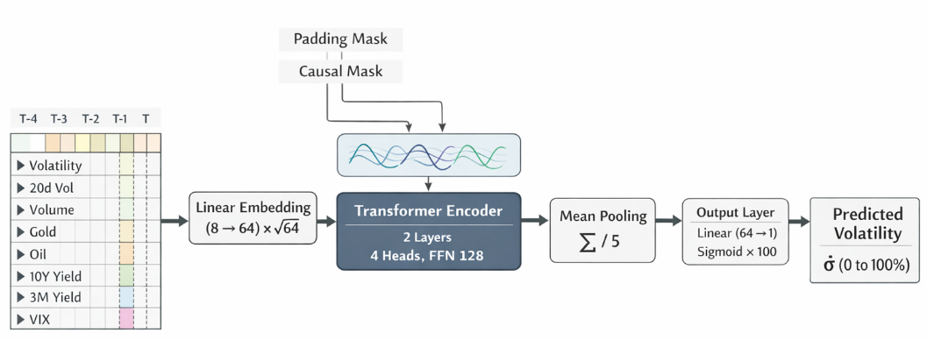
Model Architecture Overview (Encoder Only Transformer)
3 / 4
DS 207 · Team Greed and Fear · Elastic Net Volatility Forecasting · March 2026
Notes:
Coefficient interpretation for V1 and V2 (Elastic Net). [Sources] - elastic_net_vol_v1v2_vb_done_032726.ipynb (user-provided notebook) - elastic_net_vol_slides_wip_032726.pptx (user-provided deck)

Slide 3
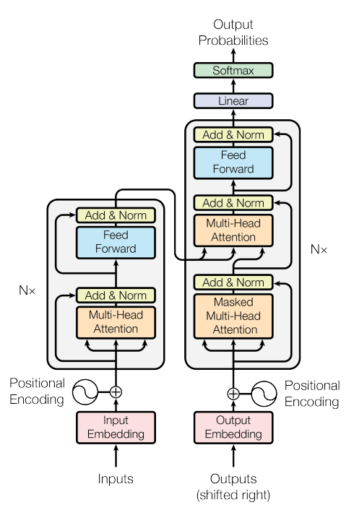
Model Architecture Overview (Encoder Only Transformer)
3 / 4
Decoder part replaced by Linear Layer for regression downstream task
DS 207 · Team Greed and Fear · Elastic Net Volatility Forecasting · March 2026
Notes:
Coefficient interpretation for V1 and V2 (Elastic Net). [Sources] - elastic_net_vol_v1v2_vb_done_032726.ipynb (user-provided notebook) - elastic_net_vol_slides_wip_032726.pptx (user-provided deck)

