Slide 1
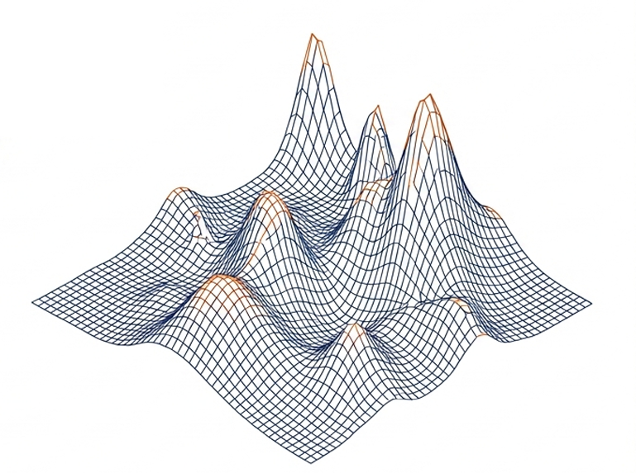
Forecasting Next-Week Realized Volatility for S&P 500 Sector and Industry ETFs
A TensorFlow-Based Approach Using FactSet Data and Subgroup Evaluation
COURSE: DATASCI 207 Final Project Proposal
TEAM: Vinit Bhatt, Siddharthen Sridhar, Ronald Ho, Diogo Viveiros
STATUS: Project Proposal

Slide 2
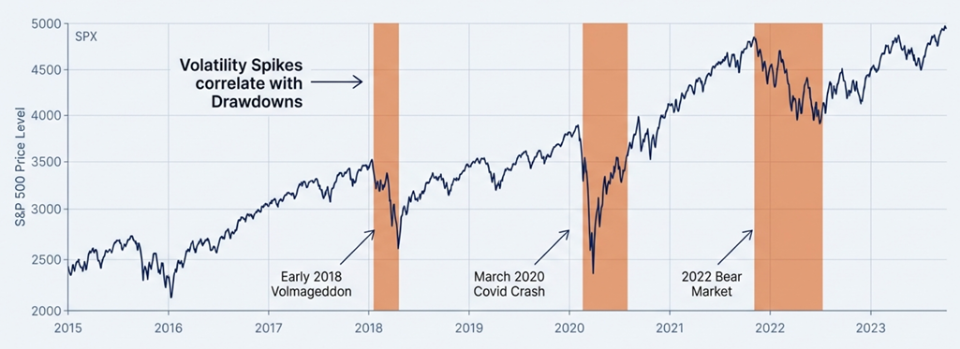
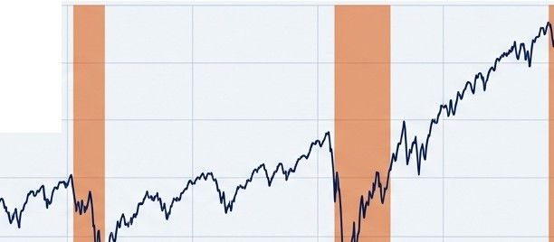
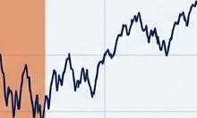
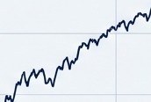




Motivation: Volatility is the Driver of Portfolio Risk and Drawdowns
5000
SPX
4500
Volatility Spikes
correlate with -->
Drawdowns
� 4000
(I)
_J
0)
u
·c 3500
Cl..
0
0
LI}
� 3000
(/)
2500
Early 2018 Volmageddon
March 2020 Covid Crash
2022 Bear Market
2000+---------.------r----------.-----..,..........-----r-------'----t-"'.... . ...-- _
2015 2016 2017 2018
The Problem
Short-horizon returns are often random noise, but volatility exhibits persistence and clustering. When volatility spikes, correlations converge to 1.0, and risk controls fail.
2019 2020 2021 2022 2023
The Opportunity
Unlike direction (up/down), volatility is a predictable target. Forecasting next-week volatility allows for pre-emptive position sizing and risk budgeting before the damage is done.

Slide 3
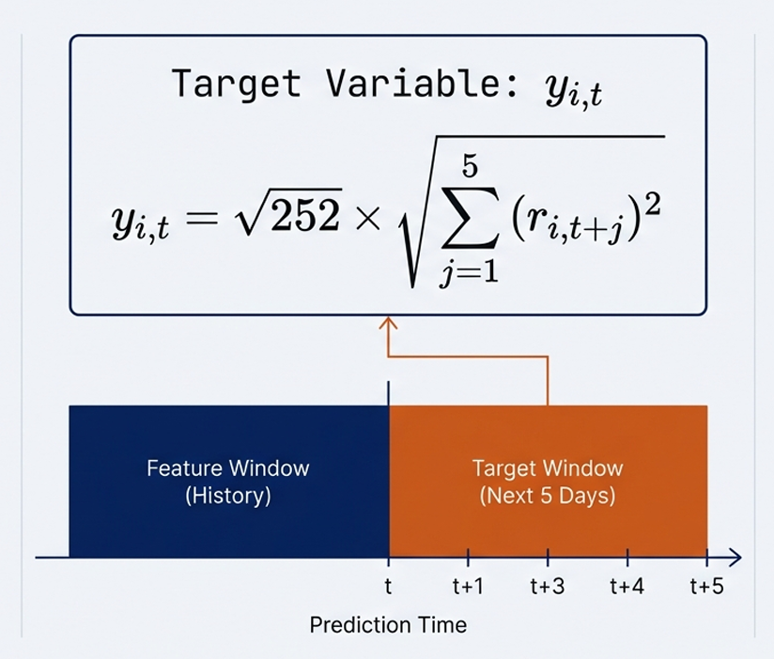
Problem Definition: The Math Behind the Prediction
The Target Key Constraints
Target Variable: Y·_{i}t ,
5
- Annualized Realized Volatility.
- No Look-Ahead Bias: Predictions at time t use only features available at or
before t.
Yi,t == 252 x
� ( ri,t+j)²
j=l
- Horizon: Next 5 Trading Days.
- Scope: Continuous regression problem (not binary classification).
- r represents Log Returns.
Feature Window
Target Window
(History)
(Next 5 Days)
t t+1
Prediction Time
t+3
t+4

Slide 4
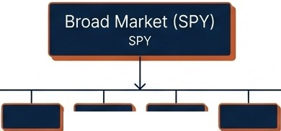








The Data Advantage: Professional-Grade Universe via FactSet
Data Source & Quality
Utilizing university access to FactSet, a professional investment platform ($20k/yr value). This ensures adjusted pricing accuracy compared to free data sources.
Timeline: Daily data from 2015-2025.
Core Fields: Adjusted Closing Price, Trading Volume.
The Universe
12 Sector ETFs
XLK, XLF, XLV, etc.
22 Selected Industry ETFs
SMH - Semiconductors, XBI - Biotech, KRE - Regional Banking, etc.
Universe Granularity allows for specific Subgroup Analysis (Sector vs. Industry).

Slide 5
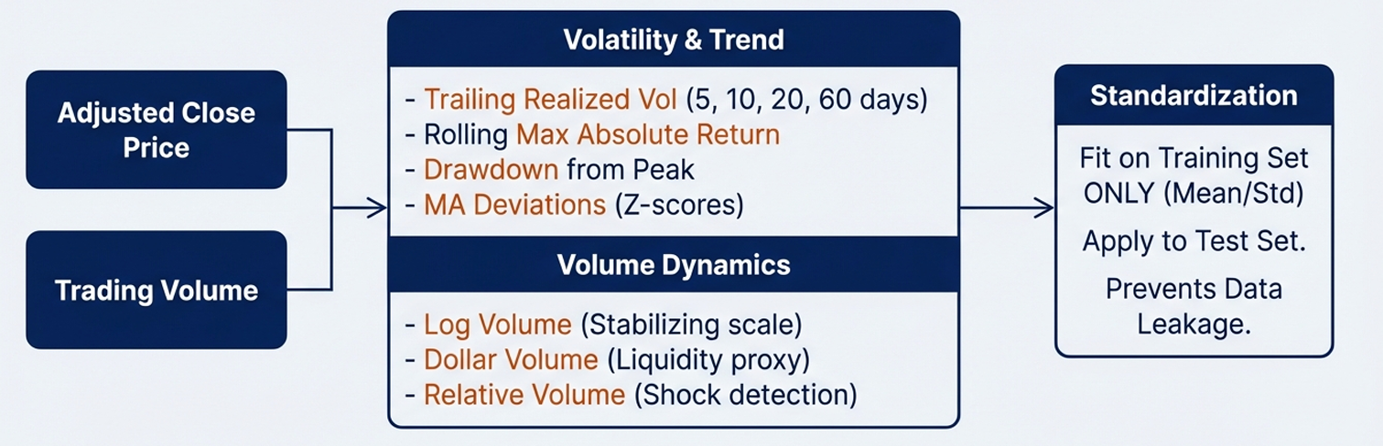


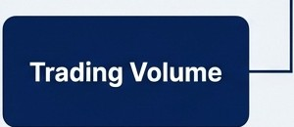
Feature Engineering: Extracting Signal from from Price and Volume
Raw Inputs Transformations Preprocessing
Volatility & Trend
Trailing Realized Vol (5, 10, 20, 60 days)
Rolling Max Absolute Return
Drawdown from Peak
1--3J>I - MA Deviations (Z-scores)
Adjusted Close
Price
Fit on Training Set
ONLY (Mean/Std)
Apply to Test Set.
Prevents Data Leakage.
Volume Dynamics
Log Volume (Stabilizing scale)
Dollar Volume (Liquidity proxy)
Relative Volume (Shock detection)
Rationale: Volume shocks often reflect information arrival that precedes price volatility.

Slide 6
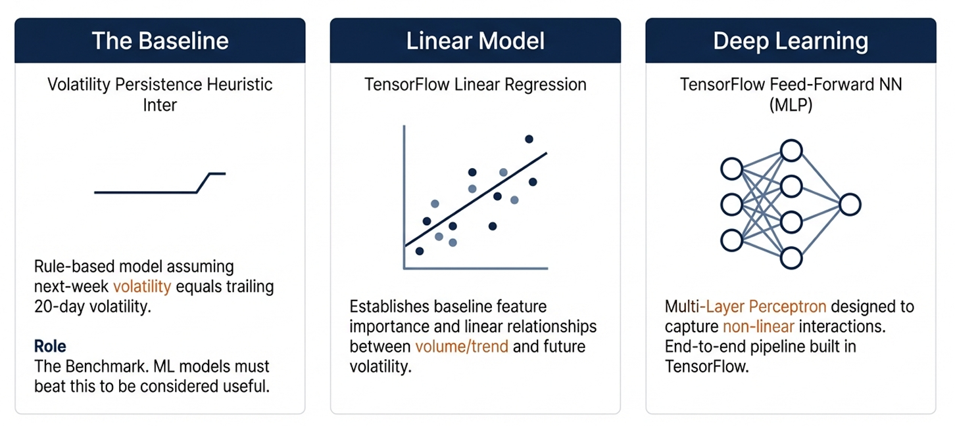

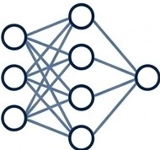

Modeling Strategy: From Heuristics to Neural Networks
Linear Model
Deep Learning
Volatility Persistence Heuristic Inter
TensorFlow Linear Regression
TensorFlow Feed-Forward NN (MLP)
•
r
Rule-based model assuming
next-week volatility equals trailing 20-day volatility.
Establishes baseline feature importance and linear relationships between volume/trend and future volatility.
Multi-Layer Perceptron designed to capture non-linear interactions.
End-to-end pipeline built in TensorFlow.
Role
The Benchmark. ML models must beat this to be considered useful.

Slide 7
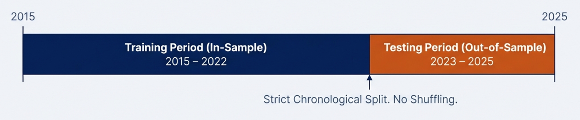
Evaluation Protocol: Realistic Time-Series Splitting
2015
2025
Training Period (In-Sample)
Testing Period (Out-of-Sample)
2015 - 2022
2023-2025
Strict Chronological Split. No Shuffling.
Primary Metrics:
MAE (Mean Absolute Error): Measures average magnitude of forecast error.
RMSE (Root Mean Square Error): Penalizes large outliers, critical for risk management contexts.
Error Analysis:
Visual inspection of Prediction vs. Actuals to identify failure modes during market shocks.
Isl\ NotebookLM

Slide 8
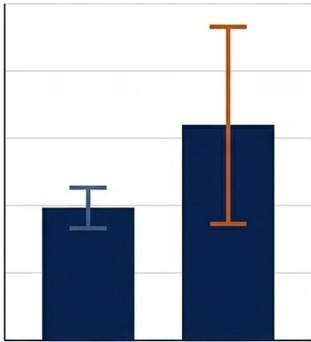
Subgroup Analysis: Sector vs. Industry Performance
The Hypothesis
Are broad Sectors (e.g., Technology) easier to forecast than specific Industries (e.g., Semiconductors)? This
analysis informs portfolio construction-placing higher confidence in models for stable subgroups.
Reporting Levels
Level 1: Global Metrics
- Overall MAE/RMSE across the entire SPY universe.
Level 2: Subgroup Metrics
- Aggregated performance for 12 Sector ETFs vs. 22 Industry ETFs.
Level 3: Idiosyncratic Analysis
- Identification of specific industries that are systematically harder or easier to forecast.
Sector Industry
Forecast Error Variance

Slide 9
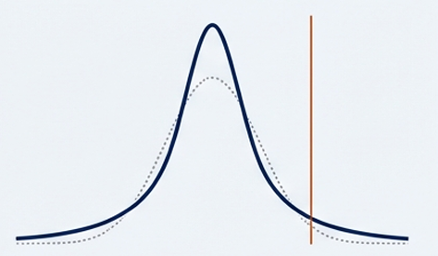
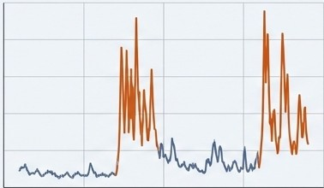



Planned Exploratory Data Analysis (EDA)
Distributions & Fat Tails
Volatility Clustering
Correlations & Regimes
..........
..'
.•
.••
.•
.•
......-.......
'•,
······-----··
Analyzing price/return distributions for non-normality.
Visualizing persistence: high volatility is followed by high
volatility.
Heatmaps showing how Sector correlations tighten during stress periods.
Data Integrity Checks
Missing data verification in FactSet pull.
Ticker mapping validation across 2015-2025.

Slide 10
Limitations and Risks
Overfitting
Neural networks may memorize noise in the training set (2015-2022) rather than learning generalizable patterns.
Black Swan Events
Models trained on 'normal' volatility regimes may fail to predict extreme outliers or unprecedented market shocks.
Non-Stationarity
Market structural changes (regime shifts) in the 2023-2025 test set may differ fundamentally from the training period dynamics.
Universe Bias
The selected ETF universe is a proxy for the economy but may not perfectly represent all market conditions.
Isl\ NotebookLM

Slide 11

Project Deliverables and Roadmap
The Deliverables
GitHub Repository: Full source code with reproducible notebooks.
Execution Plan
Team: Vinit S. Bhatt, Siddharthen Sridhar, Ronald Ho
Status: Data extraction (FactSet) and Proposal Drafting complete.
Notebook 1: Data Prep & EDA
Notebook 2: Feature Engineering
Notebook 3: Modeling & Evaluation
Reports: Milestone Report & Final Report
Presentation: In-class findings presentation
Data Extraction (Done)
EDA&
Features
Model Training
Final Analysis
I'S\ NotebookLM

Slide 12
Summary: From Prediction to Risk Management
THE PROBLEM
Volatility destroys value. We need to see it coming.
THE SOLUTION
A TensorFlow Neural Network pipeline trained on professional
FactSet data.
THE VISION
To build a 'risk radar' superior to historical averages, enabling safer portfolio construction.
Thank You. Questions?
Isl\ NotebookLM

