Slide 1
F12CIM-07
102545
林裕騏

Slide 2
Outline
內部課程
Web Design
YED 開門7件事
Item 2-3
Item 4-2-2
Item 5-5
Future Plan

Slide 3
內部課程
E-learning
F12CIM 內部課程
看其他人有沒有範例

Slide 4

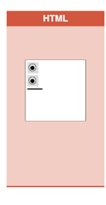
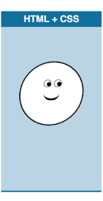
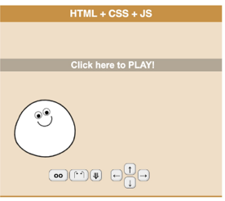


Web Design Language
Web page is composed of three parts: HTML、CSS and Javascript.
The backbone of the web page.
Basic elements, e.g. image、button etc..
Web Page
The behavior of the web page.
The most complex one.
The appearance of the web page.
Element style, e.g. font、color、position etc..

Slide 5
Web Design Tool
Devextreme
Bootsrap
Lodash
Jquery
Ajax

Slide 6
YED 開門7件事

Slide 7
未來規劃

