Slide 1
Machine learning
Predict cancer mortality rates for US counties.

Slide 2
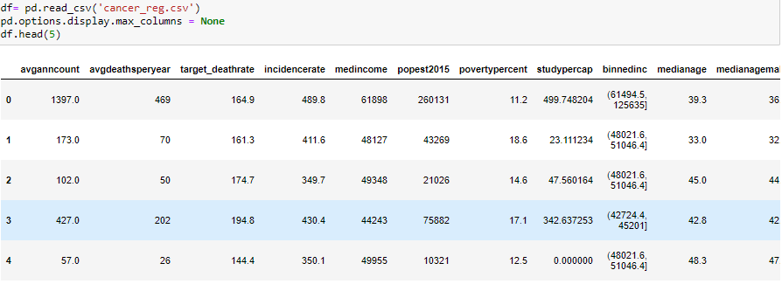
Introduction to data
These data were aggregated from a number of sources including the American Community Survey (census.gov), clinicaltrials.gov, and cancer.gov.
Task: Build a best possible regression model to predict "TARGET_deathRate"

Slide 3
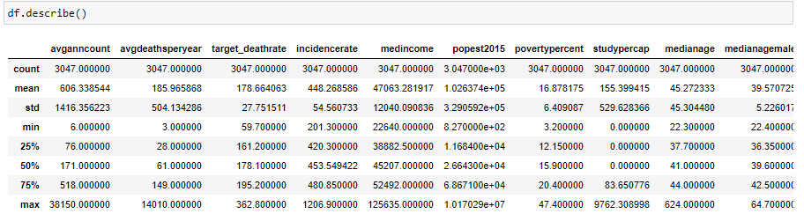
Introduction to data
The data has 33 columns of which there are 30 numerical variables , 2 categorical variables and the target variable ‘target_deathrate’.
The data has 3047 instances.

Slide 4
Data cleaning
As we can see from the above figure, the data contains outliers in most of the columns.
The data also has missing values which needs to be imputed.
I have deleted the column with 95% missing values since it is useless to impute.
I have two other columns which need to be imputed with 25% and 3% missing values which I have imputed with mean median and mode iteratively and found that mean gives the most accurate fit.
This solves the problem of missing values but we have highly correlated features.

Slide 5
Removing similar features and basic feature engineering
There are three features which are correlated.
[['avgdeathsperyear', 'popest2015', 'medianagefemale', 'pctpubliccoveragealone', 'pctmarriedhouseholds']
The best way to deal with them is delete the first two columns as they pretty much resemble the initial column avganncount.
The third column can be however replaced by the average of medianage male and medianagefemale.
Similar process is done for the columns ['pctprivatecoverage', 'pctprivatecoveragealone', 'pctempprivcoverage']
This takes us to the next step of dealing with categorical variables.

Slide 6
Dealing with categorical variables
There are two categorical variables.
Since the variable ‘binnedinc’ is a function of ‘medincome’ which is numerical, I removed the variable.
The next variable ‘geography’ has unique categories for is row which makes it pretty much useless for the model.
I removed the county and considered only the state which makes more sense.
Even after removing the county, we have over 50 categories for the column and so I categorized some of the states as other depending on the value counts.
I have used dummy variable to transform the variable so that it can be used for linear models.
This ends the hassle with categorical variables and we move on to deal with outliers.

Slide 7
Dealing with outliers
There are a lot of outliers in the data which may inform a lot about the data.
Using the z-score I have split the dataset into 2 sets one with 2558 rows and the other with 494 rows which are outliers.
I have analyzed the two datasets separately and found no meaning in the outliers dataset.
I finally discarded them in the code.

Slide 8
Normalizing data
Now we have a dataset that is clean without outliers but is not normalized.
As linear models cannot handle de-normalized data well. I have divided all numerical columns by 20% of the mean of the column so the total values will be in range of [-5, 5] and [0, 5] for positive variables.

Slide 9
Fitting the model
I have used the sklearn library to fit the model to the cleaned data.
I have used the following regressors:
Ordinary Least Squares
Lasso.
Ridge
SVR(poly)

Slide 10
Finding the best model
After fitting the data, I have predicted the r2 score for all the regressors used.
I found out that Ridge method of Linear model was performing better than the rest of the models.
I have decided to further tune this model to see if I could male the score a little bigger.
The final scores I got were updated in the next slide.

Slide 11
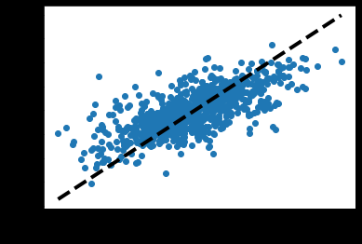

Slide 12
Scores
explained_variance_score: 0.5099170125604049
mean_squared_error: 294.4175988228492
mean_absolute_error: 12.971883945261894
max_error 80.71473721603823
r2_score: 0.5089729394501935

Slide 13
Thank you
Mani Kanth Prasanna Seelam (4555036)

