Slide 1
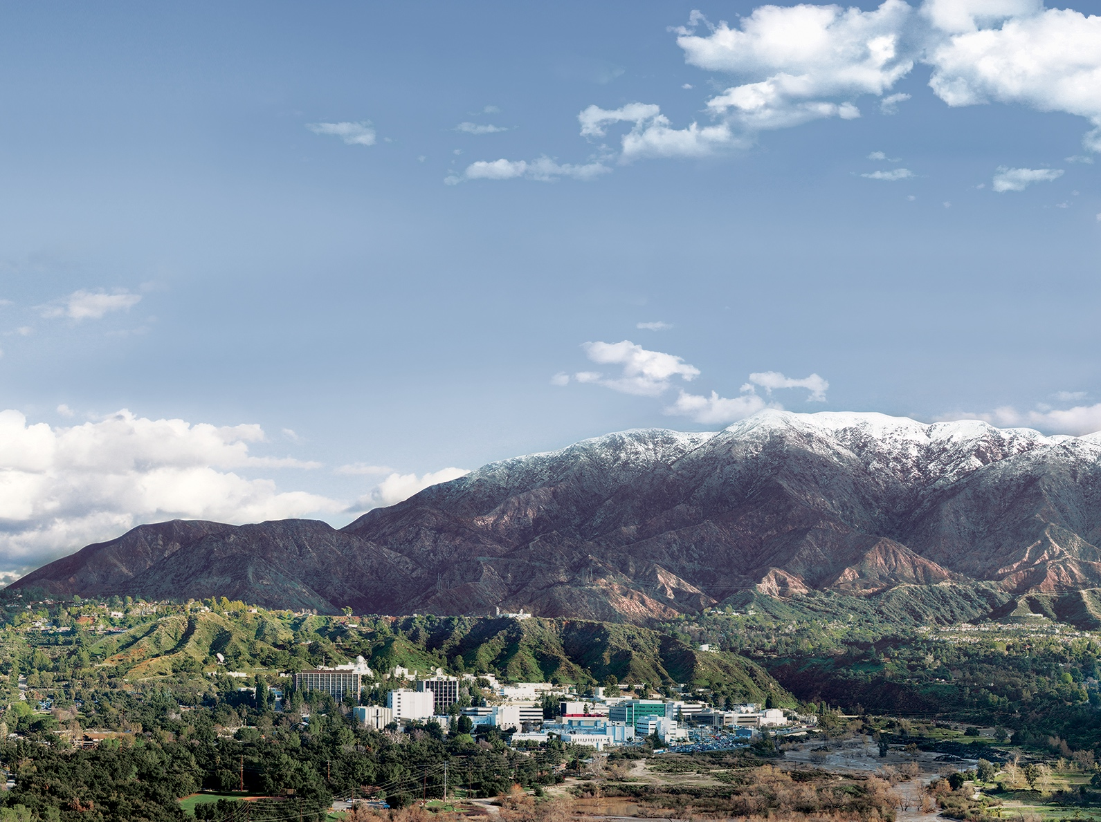
SAR Satellites including the NASA-ISRO SAR Mission
Eric J. Fielding
with NISAR slides from
Paul A. Rosen, NISAR Team
Jet Propulsion Laboratory
California Institute of Technology
2026 EarthScope InSAR Processing and Analysis (ISCE+)
online
August 6 , 2026
Copyright 2026 California Institute of Technology. Government sponsorship acknowledged.

Slide 2
Classic SAR satellites
Satellite | repeat cycle (days) | wave-length (cm)
European ERS-1/ERS-2 ‘92-’01(-2011) | 35 (1,3,183) | 6
Canadian Radarsat-1 1995-2013 | 24 | 6
European Envisat ‘03-Sep.’10(‘10-Apr.’12) | 35 (30) | 6
Japanese ALOS Jan. 2006–Apr. 2011 | 46 | 24
German TerraSAR-X ’07, TanDEM-X ‘10 | 11 | 3
Italian COSMO-SkyMed 4x launched ‘07-’10 | 16 (1,4,7,8) | 3
Canadian Radarsat-2 launched Dec. 2007 | 24 | 6
Notes:
Also Seasat, JERS-1 and SIR-C, but those are not used much

Slide 3
SAR satellites processing
satellite | Modes | ISCE2 processing support?
ERS-1/ERS-2 | 1 strip map | yes raw, SLC
RADARSAT-1 | 7 standard strip 5 fine strip ScanSAR | strip: maybe CEOS raw ScanSAR: no
Envisat | 7 standard strip (IM) ScanSAR (WS) | strip: yes raw, SLC ScanSAR: no
ALOS | strip FBS, FBD, POL ScanSAR | strip: yes raw, SLC ScanSAR: no
TerraSAR-X, PAZ | strip ScanSAR Spotlight | strip: SLC ScanSAR: no Spotlight: SLC
COSMO/SkyMed | strip, ScanSAR, Spotlight | strip: raw, SLC Spotlight: SLC
RADARSAT-2 | strip (4 types), ScanSAR, Spotlight | strip: SLC Spotlight: ?

Slide 4
other SAR spacecraft
Satellite | repeat cycle (days) | wave-length (cm)
US SeaSat 1978 (110 days) | 17/3 | 24
Japanese JERS-1 1992-1998 | 44 | 24
US Shuttle Imaging Radar–C (SIR-C) 1994 (2x 10-day flights) | 1 day, 6 months | 3, 6, 24

Slide 5
new SAR spacecraft
satellite (launch) | repeat cycle (days) | wave-length (cm)
Copernicus Sentinel-1 (A: Apr. 2014–June 2026, B: Apr. 2016–Dec. 2021, C: Dec. 2024, D: Nov. 2025) | 12(6) | 6
Japanese ALOS-2 (May 2014) | 14 | 24
Indian RISAT-1 (Apr. 2012–Sept. 2016) | 25 | 6
NASA-ISRO SAR (NISAR) mission (July 2025) | 12 | 12,24

Slide 6
New SAR satellites processing
Satellite | Modes | ISCE2 proc. | ISCE3 proc.
Sentinel-1A, B, C, D | stripmap TOPS | strip: SLC (raw extra work) TOPS: SLC (topsApp.py) | TOPS: SLC (COMPASS)
ALOS-2 (alos2App.py, alosStack) | strip (3 types) ScanSAR Spotlight | strip: SLC ScanSAR: full-aperture SLC Spotlight: SLC | Strip: SLC (testing)
RISAT-1 | stripmap ScanSAR | strip: SLC, raw extra work ScanSAR: no

Slide 7
More new SAR spacecraft
satellite (launch or planned) | repeat cycle (days) | wave-length (cm)
Argentina SAOCOM-1 (A: Oct. 2018, B: Aug. 2020) | 16(8) | 24
Japanese ALOS-4 (June 2024) | 14 | 24
Italian COSMO-SkyMed 2nd Gen. (1: Dec. 2019, 2: Jan. 2022, 3:, 4:) | N/A | 3
Canadian RADARSAT Constellation Mission 3x (Jun. 2019) | 4 | 6

Slide 8
More new SAR spacecraft
Satellite (launch or planned) | Repeat cycle (days) | Wavelength (cm)
South Korea KompSat-5 (2013-2022) | 16(8) | 3
Spanish PAZ (clone TerraSAR-X) (Feb. 2018) | 11 (4,7) | 3
Capella-1 through -n (2018–present) some InSAR-capable | ? | 3
ICEYE ~40 operational satellites now (in July 2026) some satellites have 1-day separation | 1 | 3
Umbra 24 satellites planned (first launched 2021), no InSAR yet | N/A | 3
Several other countries and companies have launched SAR and InSAR-capable satellites

Slide 9
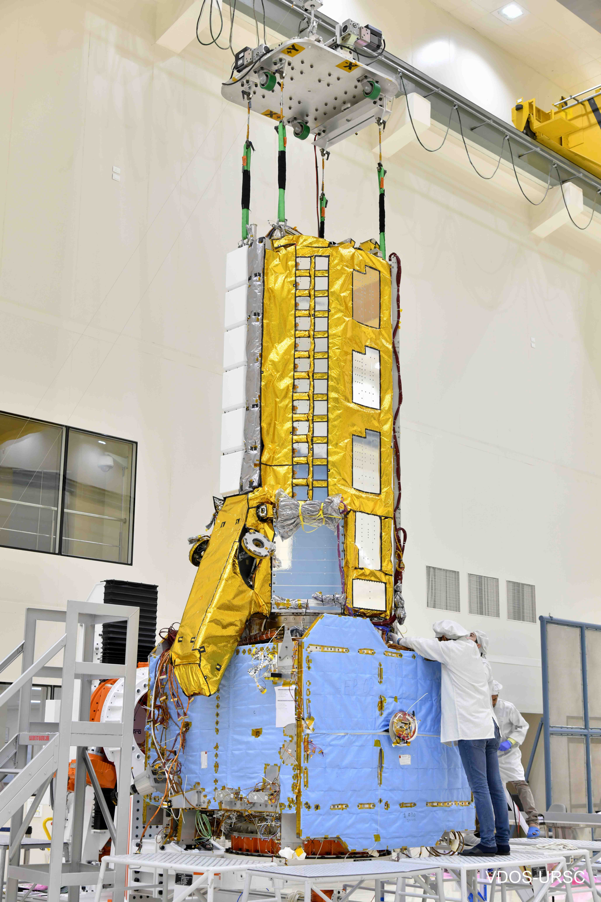
It is time to get ready
NISAR launched July 30, 2025!!
First light images ~2 months after launch
Science mode active ~3 months after launch
Full science operations December 2025
Global products to Level 2 are fully and openly available to the global community since July 2026
Broad scientific and applied uses
Cloud-based data, tools and services facilitate access and use
Data processed and stored in Amazon cloud (AWS)
For more information: https://science.nasa.gov/mission/nisar/
News updates: https://science.nasa.gov/blogs/nisar/

Slide 10
Open-Source Science for NISAR
Science products
ASF Vertex and EarthData searchable
NISAR HDF5 specification: https://science.nasa.gov/mission/nisar/data/
Open Source Software – SDS and data processing code available for download
InSAR Scientific Computing Environment, Enhanced Edition (ISCE3): https://github.com/isce-framework/isce3
Open Source Science algorithms for science products
Jupyter notebooks available for download: https://gitlab.com/nisar-science-algorithms
Open Source Training Opportunities
Jupyter notebooks in cloud training environments at Alaska Satellite Facility OpenScienceLab
ARSET and other courses: https://science.nasa.gov/mission/nisar/sar-education-resources/
Cloud computing resources for NASA subscribers

