Slide 1
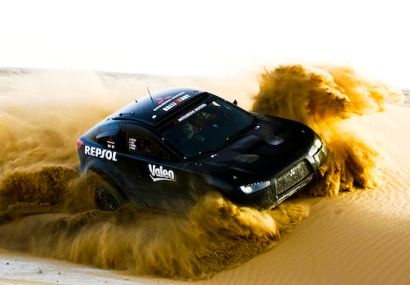
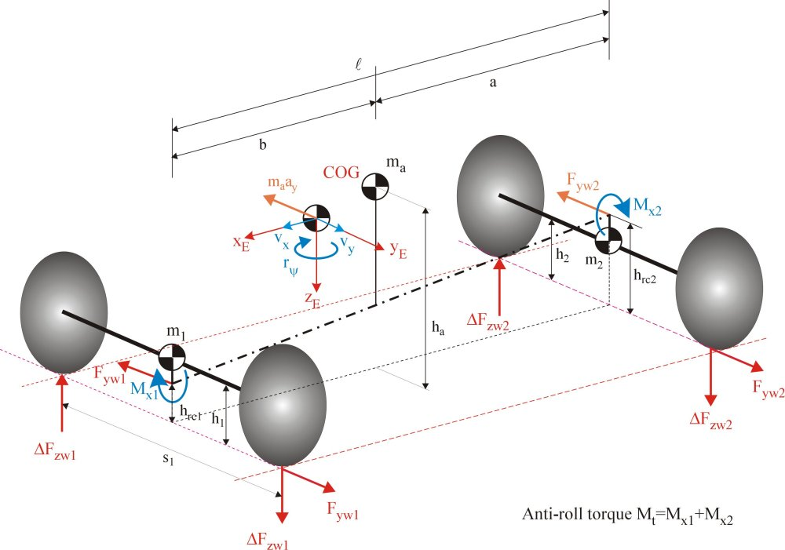
Optimizing the Control of Aggressive Braking Maneuvers for Wheeled Vehicles Via Analytical and Numerical Methods
Oktay Arslan, Jason Bentley, Matthew Bigelow, Aude Marzuoli
AE 6511 Optimal Guidance and Control Term Project
10 December 2010

Slide 2
Outline
Introduction
Vehicle Model and Optimal Control Problem
Analytical Results and Discussion
Numerical Results and Discussion
Conclusions and Recommendations

Slide 3
Introduction
Why are we here?

Slide 4
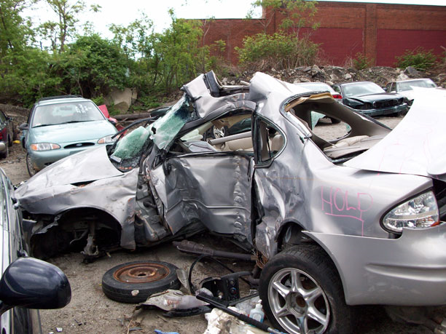
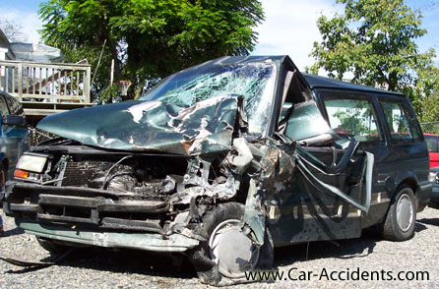
Vehicle Safety
6,420,000 auto accidents in U.S. in 2005
These cost over $230 billion
115 people die every day in U.S. from car crashes

Slide 5
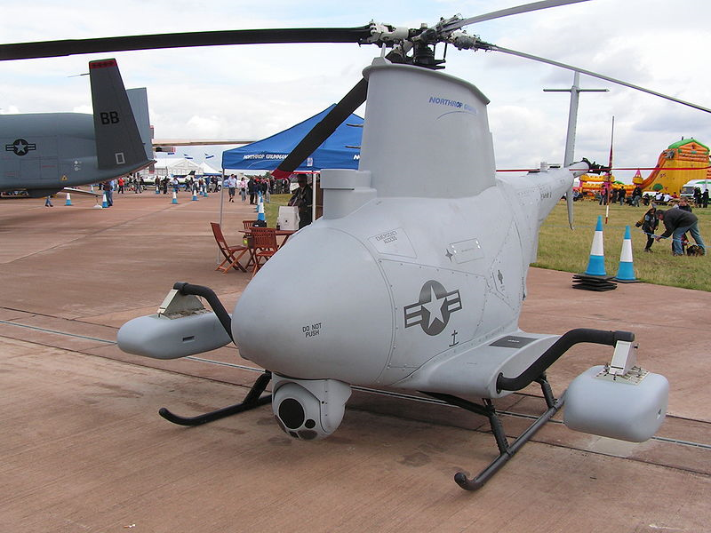
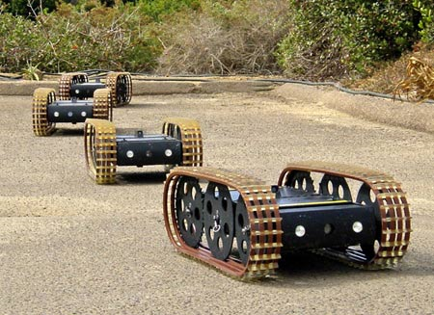
Unmanned Vehicles
Unmanned aerial vehicles (UAVs) are already in use
Some employ automated controls
Desired to have unmanned land vehicles as well

Slide 6
Modeling and Optimal Control
Nobody’s perfect.

Slide 7
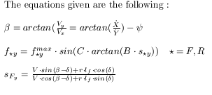
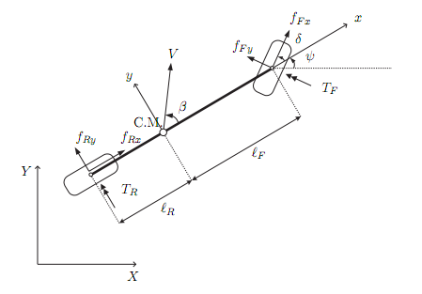
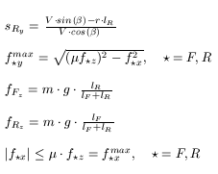
Vehicle Model

Slide 8
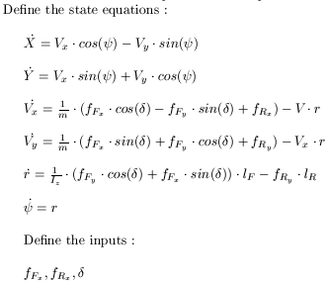
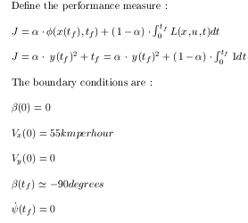
Optimal Control Problem Formulation

Slide 9

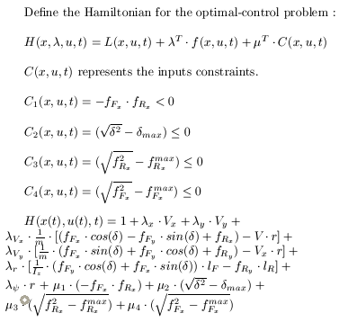
Optimal Control Problem for a Rear-Wheel Driven Vehicle

Slide 10

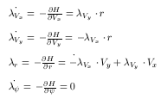
Optimal Control Problem : Necessary Conditions

Slide 11
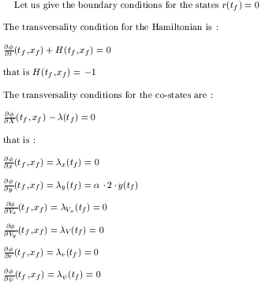
Optimal Control Problem : Transversality Conditions

Slide 12
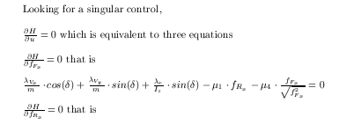
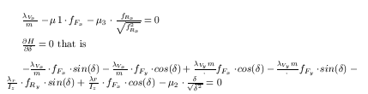
Optimal Control and Investigation for a Singular Control
In theory :

Slide 13
Analytical Results and Discussion
The wisest know that they know nothing.

Slide 14
Numerical Results and Discussion
When in doubt, ask your calculator.

Slide 15
Conclusions and Recommendations
Our survey says…

Slide 16
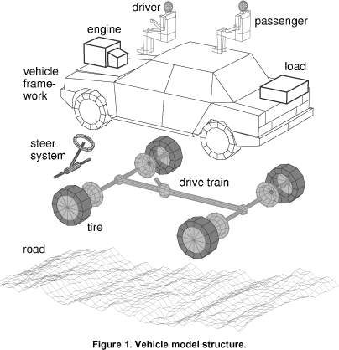
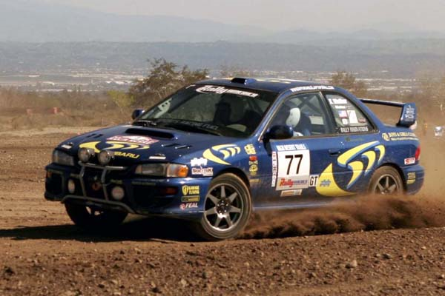
The End
Any Questions?

