Slide 1

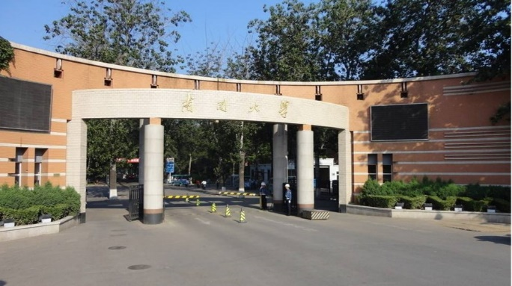
Part 2
Wave Optics
---- Maxwell’s Equations

Slide 2

Contents
Electromagnetic Theory of Light
Polarization and Fresnel's Equations
Interference
Diffraction
Anisotropic optics

Slide 3
Maxwell’s Equations

Slide 4
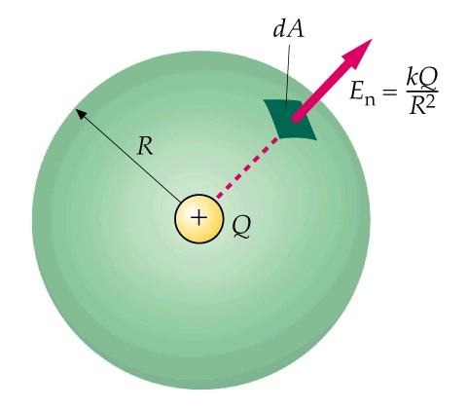
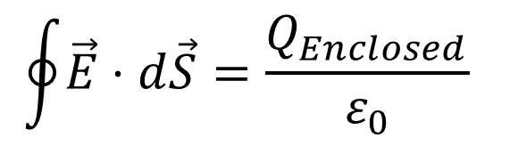
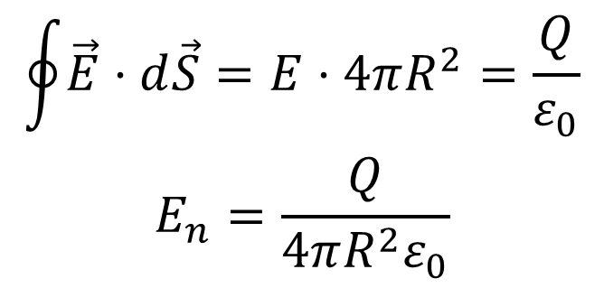
Gauss's Law
Relation between charges and electric field: The net electric flux through any closed surface is proportional to the charge enclosed by that surface.
$$\oint{\vec{E}⋅d\vec{S}}=\frac{Q_{Enclosed}}{ε_{0}}$$
dS
$$\begin{matrix}\oint{\vec{E}⋅d\vec{S}}=E⋅4πR^{2}=\frac{Q}{ε_{0}} \\ E_{n}=\frac{Q}{4πR^{2}ε_{0}}\end{matrix}$$

Slide 5
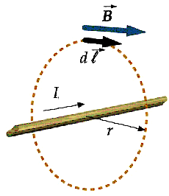
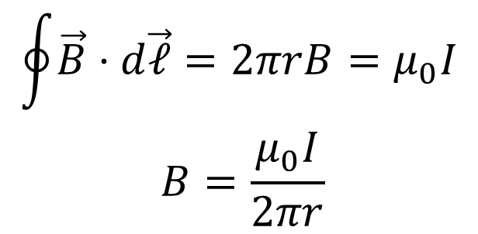
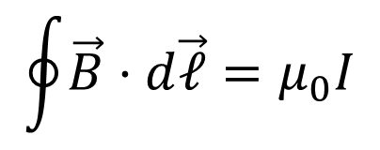
Ampere's Law:
Relation between charges and electric field:
$$\oint{\vec{B}⋅d\vec{𝓁}}=μ_{0}I$$
$$\begin{matrix}\oint{\vec{B}⋅d\vec{𝓁}}=2π\text{​}rB=μ_{0}I \\ B=\frac{μ_{0}I}{2π\text{​}r}\end{matrix}$$

Slide 6
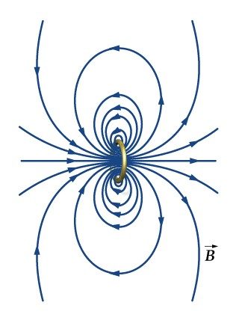
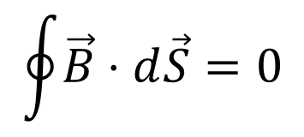
Gauss's Law for magnetism
The net flux of a B field through any closed surface is zero.
Isolated magnetic poles do not exist.
$$\oint{\vec{B}⋅d\vec{S}}=0$$

Slide 7
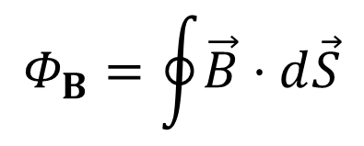
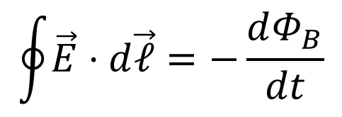
Faraday's Law
Changing magnetic flux induces E field.
E.g. electric motor, generator.
$$\oint{\vec{E}⋅d\vec{𝓁}}=−\frac{dΦ_{B}}{dt}$$
dS
B
B
Flux：
$$Φ_{B}=\oint{\vec{B}⋅d\vec{S}}$$

Slide 8
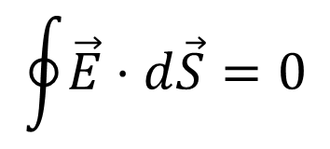
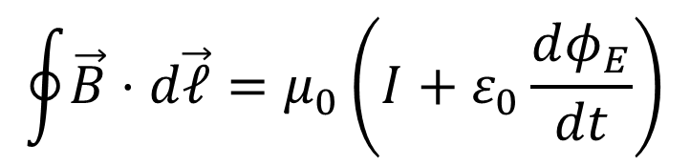
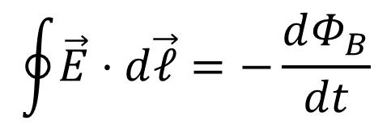
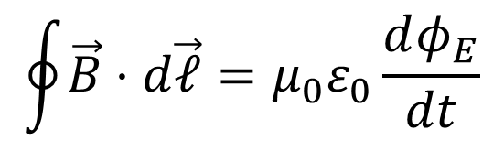
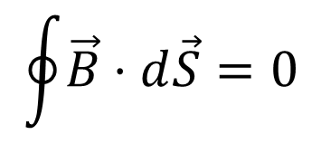
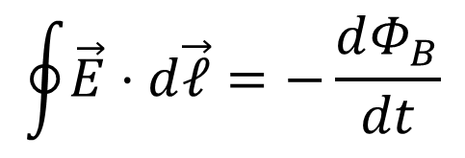
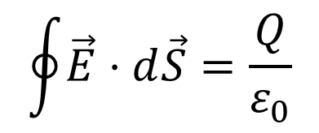
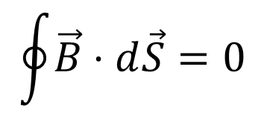
Maxwell’s Equations
$$\oint{\vec{E}⋅d\vec{S}}=\frac{Q}{ε_{0}}$$
$$\oint{\vec{E}⋅d\vec{𝓁}}=−\frac{dΦ_{B}}{dt}$$
$$\oint{\vec{B}⋅d\vec{S}}=0$$
$$\oint{\vec{B}⋅d\vec{𝓁}}=μ_{0}\left(I+ε_{0}\frac{dφ_{E}}{dt}\right)$$
In general cases, no currents or charges exit in media. So the equations become:
$$\oint{\vec{E}⋅d\vec{S}}=0$$
$$\oint{\vec{E}⋅d\vec{𝓁}}=−\frac{dΦ_{B}}{dt}$$
$$\oint{\vec{B}⋅d\vec{S}}=0$$
$$\oint{\vec{B}⋅d\vec{𝓁}}=μ_{0}ε_{0}\frac{dφ_{E}}{dt}$$

Slide 9

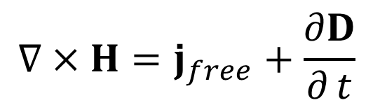
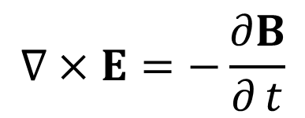

Differential Forms
Maxwell’s equations in differential forms are
$$∇⋅D=ρ_{free}$$
$$∇⋅B=0$$
$$∇×E=−\frac{∂B}{∂ t}$$
$$∇×H=j_{free}+\frac{∂D}{∂ t}$$

Slide 10
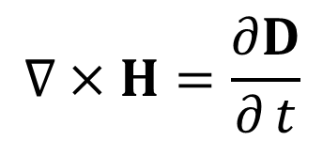

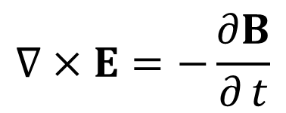
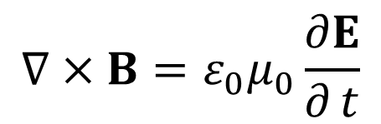


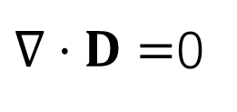

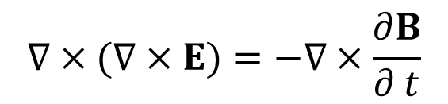

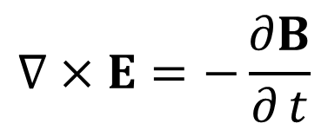
Differential Forms
In general $j_{free}=0,ρ_{free}=0,$ Maxwell’s equations becomes
$∇⋅D=$0
$$∇⋅E=0$$
In the vacuum
$$∇⋅B=0$$
$$∇⋅B=0$$
$$D=ε_{0}E$$
$$∇×E=−\frac{∂B}{∂ t}$$
$$∇×E=−\frac{∂B}{∂ t}$$
$$B=μ_{0}H$$
$$∇×H=\frac{∂D}{∂ t}$$
$$∇×B=ε_{0}μ_{0}\frac{∂E}{∂ t}$$
Taking rotation on both sides of the 3rd equation, we have
$$∇×(∇×E)=−∇×\frac{∂B}{∂ t}$$

Slide 11
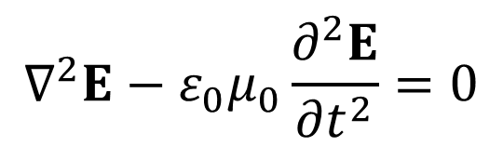
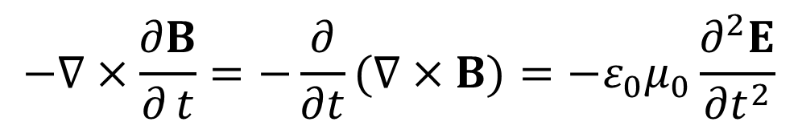
Differential Forms
Left side:
$$∇×(∇×E)=∇(∇⋅E)−∇^{2}E=−∇^{2}E$$
$$−∇×\frac{∂B}{∂ t}=−\frac{∂}{∂t}(∇×B)=−ε_{0}μ_{0}\frac{∂^{2}E}{∂t^{2}}$$
Right side:
Wave equation for the electric field:
$$∇^{2}E−ε_{0}μ_{0}\frac{∂^{2}E}{∂t^{2}}=0$$

Slide 12
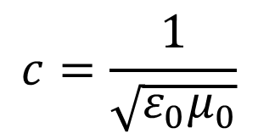
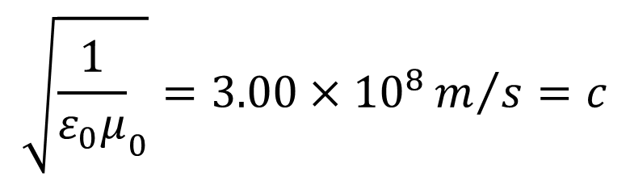
Propagation speed
The propagation velocity of the EM wave in the vacuum is
$$c=\frac{1}{\sqrt{ε_{0}μ_{0}}}$$
the velocity of light
in the vacuum
$$\sqrt{{\frac{1}{ε_{0}μ}}_{0}}=3.00×{10}^{8}m/s=c$$

Slide 13

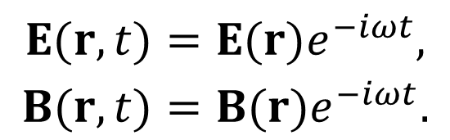


EM wave in the nonconductive medium
Assuming a EM fields in a media is harmonic with a frequency ω, we have
$$D=ε(ω)E$$
$$B=μ(ω)H$$
Then, the temporal variation of the EM wave is
$$,$$
$$\begin{matrix}E(r,t)=E(r)e^{−iωt}, \\ B(r,t)=B(r)e^{−iωt}.\end{matrix}$$
The actual quantities are
ReE and ReB.
The monochrome wave

Slide 14
Maxwell’s equations in the NC medium
Taking rotation on both sides of the 3rd equation, we obtain

Slide 15

Maxwell’s equations in the NC medium
$$∇^{2}E\left(r\right)+k^{2}E\left(r\right)=0, k^{2}=ω^{2}εμ.$$
Helmholtz equation
Similarly, we can obtain the equation for B
$$∇^{2}B(r)+k^{2}B(r)=0$$
Helmholtz equation---the differential equation of wave motion at definite frequency.

Slide 16


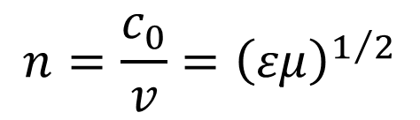
Speed in the media
Refractive index follows:
$$n=\frac{c_{0}}{v}$$
We get
$$n=\frac{c_{0}}{v}={\left(εμ\right)}^{1/2}$$
Normally optical media are not ferromagnetic, i.e. μ=1. So we have:
$$n=\sqrt{ε}$$

Slide 17
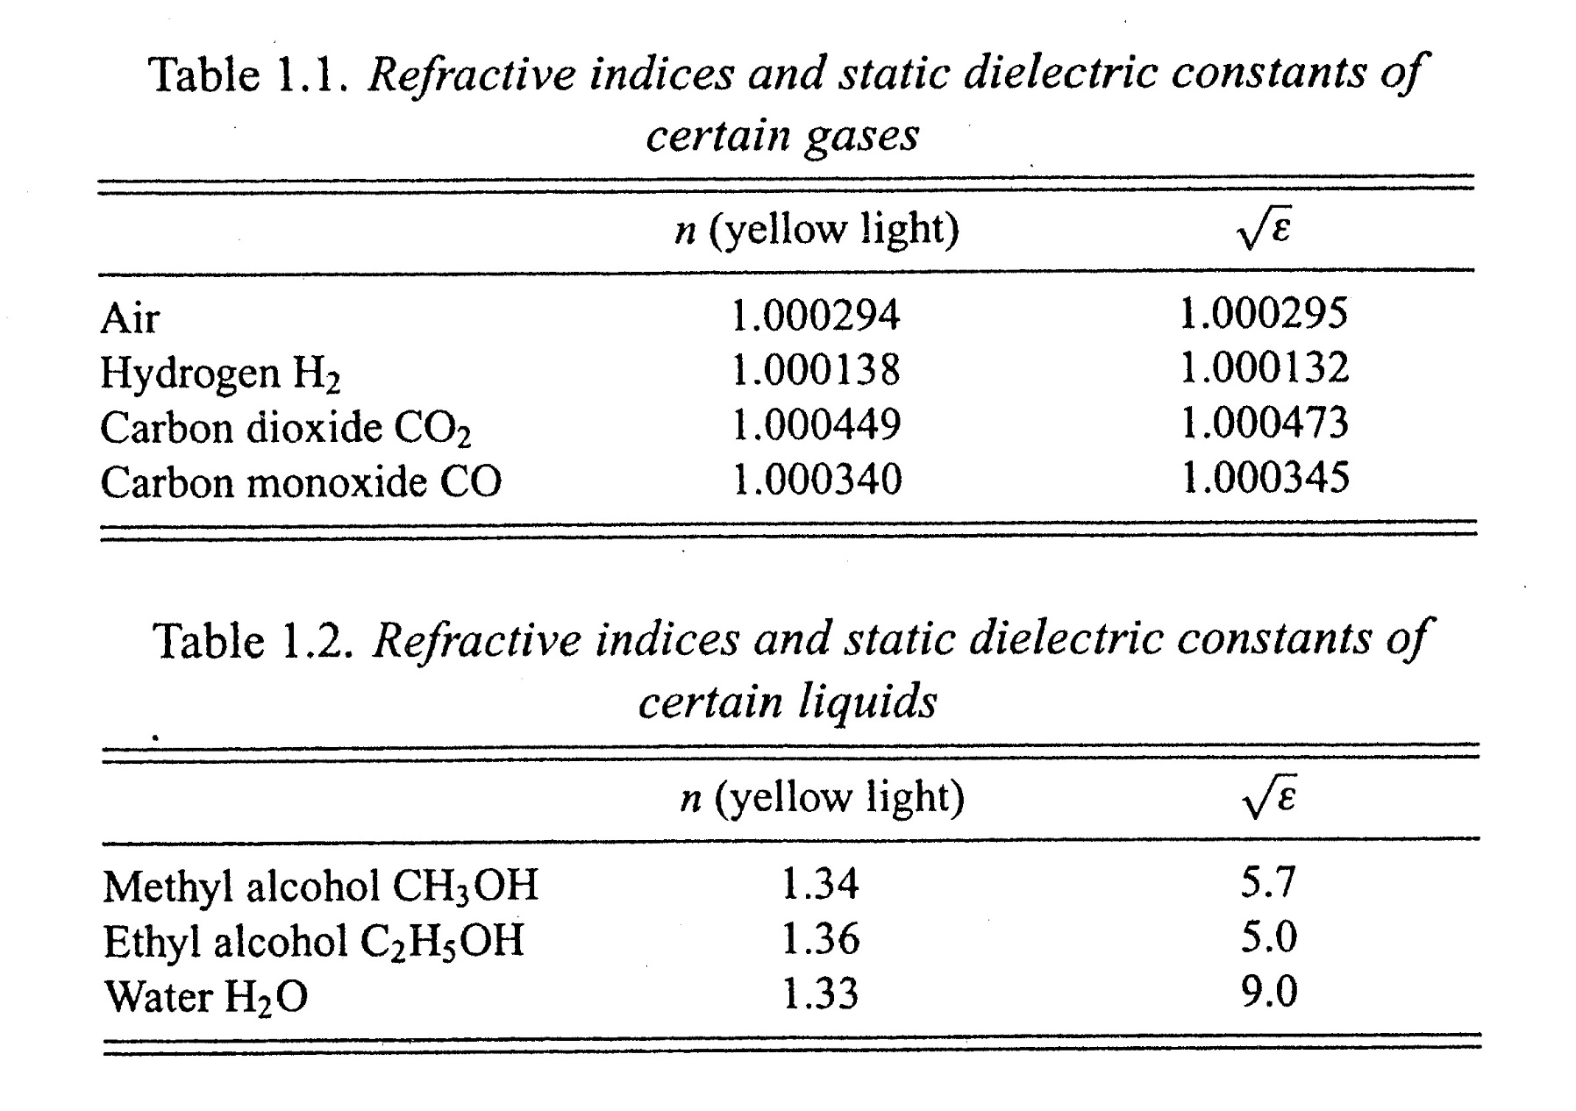

Notes:
静电场下的介电常数

Slide 18
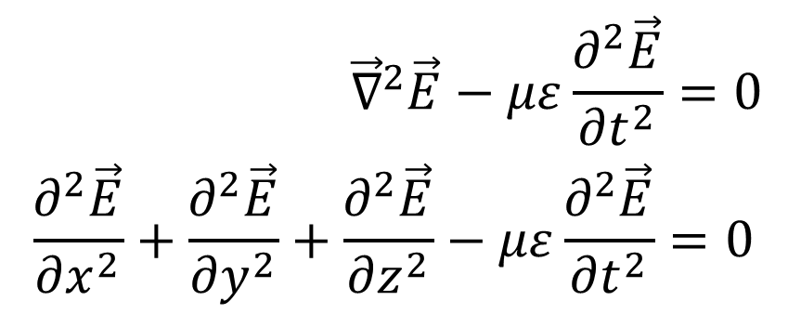
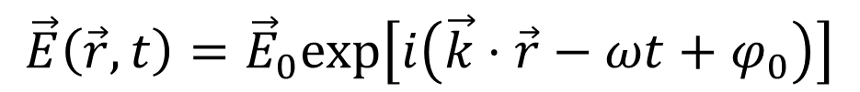
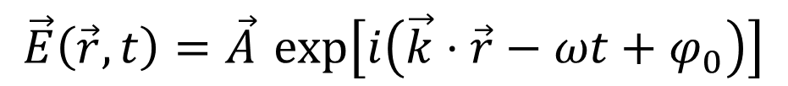
The 3D vector wave equation
$$\begin{matrix} {\vec{∇}}^{2}\vec{E}−με\frac{∂^{2}\vec{E}}{∂t^{2}}=0 \\ \frac{∂^{2}\vec{E}}{∂x^{2}}+\frac{∂^{2}\vec{E}}{∂y^{2}}+\frac{∂^{2}\vec{E}}{∂z^{2}}−με\frac{∂^{2}\vec{E}}{∂t^{2}}=0\end{matrix}$$
Note the vector symbol over the E.
which has the vector field solution:
This is really just three independent wave equations, one each for the x-, y-, and z-components of E.
$$\vec{E}\left(\vec{r},t\right)=\vec{A} exp\left[i\left(\vec{k}⋅\vec{r}−ωt+φ_{0}\right)\right]$$
$$\vec{E}\left(\vec{r},t\right)={\vec{E}}_{0}exp\left[i\left(\vec{k}⋅\vec{r}−ωt+φ_{0}\right)\right]$$

Slide 19
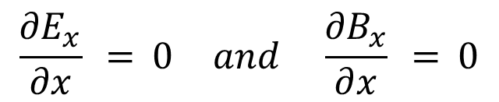
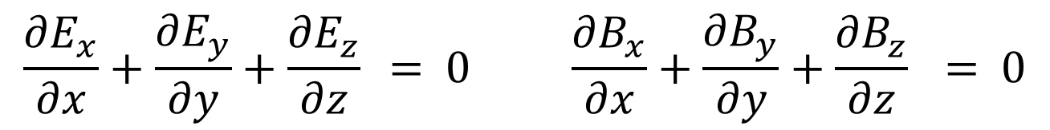

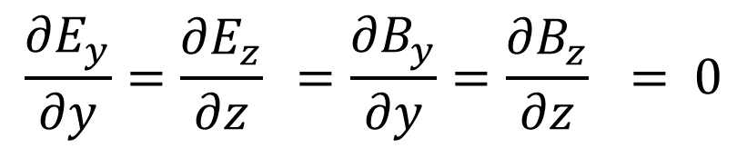
Can light be longitudinal field?
Suppose a beam propagates along the x-direction in isotropic medium. It’s a function of x and t (not y or z), so :
Generally we have
that is,
$$\frac{∂E_{y}}{∂y}=\frac{∂E_{z}}{∂z} =\frac{∂B_{y}}{∂y}=\frac{∂B_{z}}{∂z} = 0$$
$$\vec{∇}⋅\vec{E} = 0 and \vec{∇}⋅\vec{B} = 0$$
$$\frac{∂E_{x}}{∂x}+\frac{∂E_{y}}{∂y}+\frac{∂E_{z}}{∂z} = 0 \frac{∂B_{x}}{∂x}+\frac{∂B_{y}}{∂y}+\frac{∂B_{z}}{∂z} = 0$$
$$\frac{∂E_{x}}{∂x} = 0 and \frac{∂B_{x}}{∂x} = 0$$
Substituting the zero values, we have:
The longitudinal fields are at constant, and not waves.

Slide 20
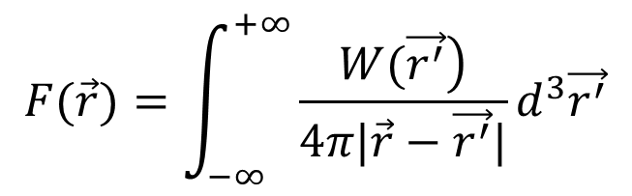
Is it correct “Light is longitudinal field”?
In fact, the statement is not always correct. 
Case 1: there is a interface between two infinite media, i.e. evanescent field in total internal reflection
Case 2: the medium is anisotropic.
Case 3: there is free charges inside the medium.
Here we concentrate on the case 3.
Let assume F(r) is a solution of vector Poisson equation:
$$\left.W(\vec{r})=−∇^{2}F(\vec{r})=∇×(∇×F(\vec{r}))−∇∇⋅F(\vec{r}\right)$$
We get that:
$$F(\vec{r})=\int_{−∞}^{+∞}{\frac{\left.W(\vec{r^{′}}\right)}{4π|\vec{r}−\vec{r^{′}}|}}d^{3}\vec{r^{′}}$$

Slide 21


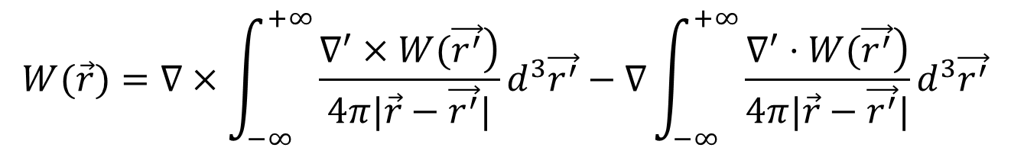
Is it correct “Light is longitudinal field”?
Considering W(r) is zero at infinity, we can prove that:
$$W(\vec{r})=∇×\int_{−∞}^{+∞}{\frac{\left.∇^{′}×W(\vec{r^{′}}\right)}{4π|\vec{r}−\vec{r^{′}}|}}d^{3}\vec{r^{′}}−∇\int_{−∞}^{+∞}{\frac{\left.∇^{′}⋅W(\vec{r^{′}}\right)}{4π|\vec{r}−\vec{r^{′}}|}}d^{3}\vec{r^{′}}$$
rotation-free part
W_{T}(r)
Divergence-free part
W_{L}(r)
In reciprocal (k) space, we can prove that:
$$\vec{k}⋅W_{T}(\vec{r})=0$$
and
$$\vec{k}×W_{L}(\vec{r})=0$$
It demonstrates that W_{T}(r) and W_{L}(r) are transverse and longitudinal field respective. When does W_{L}(r) exist?

Slide 22
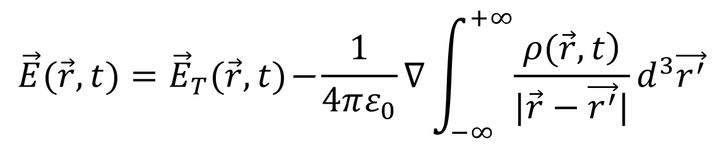
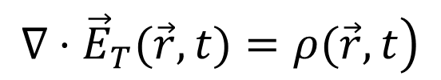
Is it correct “Light is longitudinal field”?
When there is free charge density ρ(r, t), we have
$$\left.∇⋅{\vec{E}}_{T}(\vec{r},t)=ρ(\vec{r},t\right)$$
The total electric field is:
$$\vec{E}(\vec{r},t)={\vec{E}}_{T}(\vec{r},t)\text{−}\frac{1}{4πε_{0}}∇\int_{−∞}^{+∞}{\frac{\left.ρ(\vec{r},t\right)}{|\vec{r}−\vec{r^{′}}|}}d^{3}\vec{r^{′}}$$
The electric field is not longer a transverse field when a charge density exists!!!
Because there is no magnetic monopoles, the magnetic field will qualify as a transverse field.

Slide 23
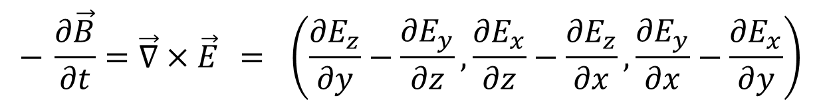


Direction of Magnetic field
Suppose the previous wave has its electric field along the y-direction [so E_{x} = E_{z}= 0, and E_{y} = E_{y}(x,t)]. Use:
$$− \frac{∂\vec{B}}{∂t}=\vec{∇}×\vec{E} = \left(\frac{∂E_{z}}{∂y}−\frac{∂E_{y}}{∂z},\frac{∂E_{x}}{∂z}−\frac{∂E_{z}}{∂x},\frac{∂E_{y}}{∂x}−\frac{∂E_{x}}{∂y}\right)$$
$$− \frac{∂\vec{B}}{∂t}=\left(0,0,\frac{∂E_{y}}{∂x}\right)$$
So:
In other words:
The magnetic field points in the z-direction.
$$−\frac{∂B_{z}}{∂t}=\frac{∂E_{y}}{∂x}$$

Slide 24
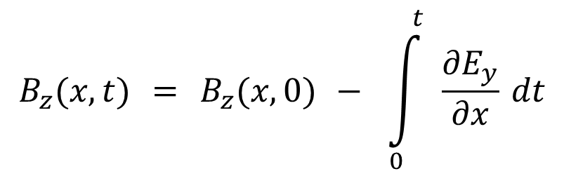
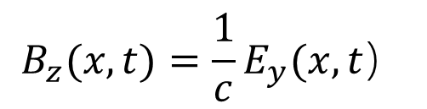



The strength of magnetic-field
$$−\frac{∂B_{z}}{∂t}=\frac{∂E_{y}}{∂x}$$
and
$$E_{y}\left(\vec{r},t\right)={\overset{̰}{E}}_{0}exp\left[i\left(kx−ω t\right)\right]$$
$$B_{z}(x,t) = B_{z}(x,0) − \int_{0}^{ t}{ \frac{∂E_{y}}{∂x}} dt$$
We can integrate:
Take B_{z}(x,0) = 0
Differentiating E_{y} with respect to x yields an ik, and integrating with respect to t yields a 1/-iw.
$$B_{z}(x,t)=−\frac{ik}{−iω}E_{0}exp\left[\left.i(kx−ωt\right)\right]$$
So:
But w / k = c:
$$B_{z}(x,t)=\frac{1}{c}E_{y}(x,t）$$

Slide 25


The electric and the magnetic field
The electric and magnetic fields are in phase.
t=t₀
The electric field, the magnetic field, and the k-vector are all perpendicular:
$$\vec{E}×\vec{B}∝\vec{k}$$

Slide 26






The Energy Density of Light Wave
$$\begin{matrix}U_{E}=\frac{1}{2}εE^{2} \\ \end{matrix}$$
The energy density of an electric field is:
The energy density of a magnetic field is:
Using B = E/c, and , which together imply that
we have:
Total energy density:
So the electrical and magnetic energy densities in light are equal.
$$\begin{matrix} \\ U_{B}=\frac{1}{2}\frac{1}{μ}B^{2}\end{matrix}$$
$$c=1/{\sqrt{εμ}}$$
$$B=E\sqrt{εμ}$$
$$U_{B}=\frac{1}{2}\frac{1}{μ}\left(E^{2}εμ\right)=\frac{1}{2}εE^{2}=U_{E}$$
$$U=U_{E}+U_{B}=εE^{2}$$

Slide 27






Why we neglect the magnetic field
$${\vec{F}}_{electrical}$$
$${\vec{F}}_{magnetic}$$
The force on a charge, q, is:
Taking the ratio of the
magnitudes of the two forces:
Since B = E/c:
where is the charge velocity
$$\vec{F} = q \vec{E} + q \vec{v}×\vec{B}$$
$$\frac{F_{magnetic}}{F_{electrical}} ≤ \frac{qvB}{qE}$$
$$\begin{matrix}|\vec{v}×\vec{B}|=vBsinθ \\ ≤vB\end{matrix}$$
$$\frac{F_{magnetic}}{F_{electrical}} ≤ \frac{v}{c}$$
So as long as a charge’s velocity is much less than the speed of light, we can neglect the light’s magnetic force compared to its electric force.

Slide 28

The Poynting Vector
The power per unit area in a beam.
U = Energy density
A
Justification (but not a proof):
Energy through area A in time Δt:
So the energy per unit time per unit area:
And the direction is reasonable.
$$\text{U}\text{V}\text{=}\text{UAc}Δ\text{t}$$
c Δt
$$\text{UV}\text{/(}\text{A}Δ\text{t}\text{)=}\text{UAc}Δ\text{t}\text{/(}\text{A}Δ\text{t}\text{)=}\text{Uc}\text{=}\text{c}εE^{2}=c^{2}ε\text{EB}$$

Slide 29




The Irradiance (often called the Intensity)
$$〈\left.\vec{S}(\vec{r},t\right)〉= \frac{1}{T}\int_{t−T/2}^{t+T/2}{\vec{S}(\vec{r},t′) dt′}$$
A light wave’s average power per unit area is the irradiance.
Substituting a light wave into the expression for the Poynting vector,
, yields:
The average of cos² is 1/2:
$$\vec{S} = c^{2} ε \vec{E} × \vec{B}$$
real amplitudes
$$\left.\vec{S}(\vec{r},t)=c^{2} ε {\vec{E}}_{0} × {\vec{B}}_{0} \cos^{2}(\vec{k}⋅\vec{r}−ω t−θ\right)$$
$$\begin{matrix}⇒ I(\vec{r},t) = 〈\left.\vec{S}(\vec{r},t\right)〉=\frac{c^{2} ε {\vec{E}}_{0}×{\vec{B}}_{0}}{2} \\ \end{matrix}$$

Slide 30





The Irradiance (continued)
Since the electric and magnetic fields are perpendicular and B₀ = E₀ / c,
$$I=\frac{1}{2} c^{2} ε {\vec{E}}_{0}×{\vec{B}}_{0}$$
becomes:
$$I=\frac{1}{2}cε {|E_{0}|}^{ 2}$$
where:
$${|{\vec{E}}_{0}|}^{2}=E_{0x}E_{0x}^{∗}+E_{0y}E_{0y}^{∗}+E_{0z}E_{0z}^{∗}$$
The formula only works when the wave is of the form:
$$\vec{E}\left(\vec{r},t\right)=Re{\vec{E}}_{0}exp\left[i\left(\vec{k}⋅\vec{r}−ω t\right)\right]$$
that is, when all the fields involved have the same
$$\vec{k}⋅\vec{r}−ω t$$

