Slide 1

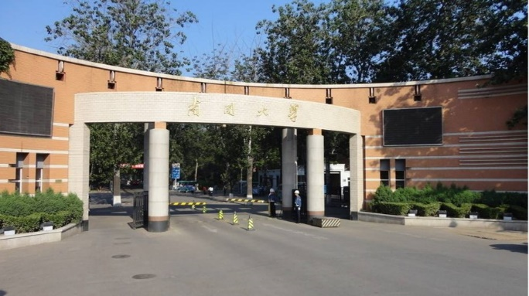
Part 2
Wave Optics
----Brief introduction of polarization

Slide 2

Contents
Electromagnetic Theory of Light
Polarization and Fresnel's Equations
Interference
Diffraction
Anisotropic optics

Slide 3
Certain physical phenomena are observed which are most easily explained by invoking the wave nature of light, rather than the particle nature. These topics are:
polarization
interference
diffraction

Slide 4
Polarization and Fresnel's Equations
Brief introduction of polarization
Fresnel's Equations for Reflection and Refraction

Slide 5
Brief introduction of polarization

Slide 6
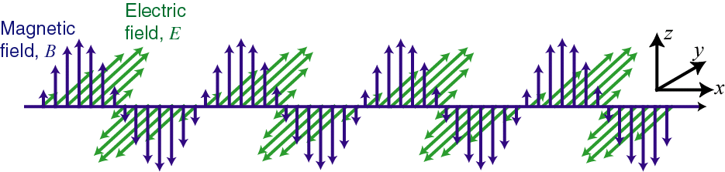

In the Lecture Previous
The electric field is along y-direction. k is along x direction
$$\vec{E}×\vec{B}∝\vec{k}$$
t=t₀

Slide 7
Polarization
Polarization, is an expression of the orientation of the lines of electric flux in an electromagnetic field (EM field). Polarization can be constant -- that is, existing in a particular orientation at all times, or it can rotate with each wave cycle.

Slide 8
Polarization
All vibration can be resolved into three components according to the three orthogonal coordination axes. In light vector map, only need x- and y-components. In optical waveband, because of the high frequency of light, oscillations along x- and y- axis must have the same frequency.
In the following discussion, without special emphasis, consider of the polarization is limited at a certain spatial location.

Slide 9
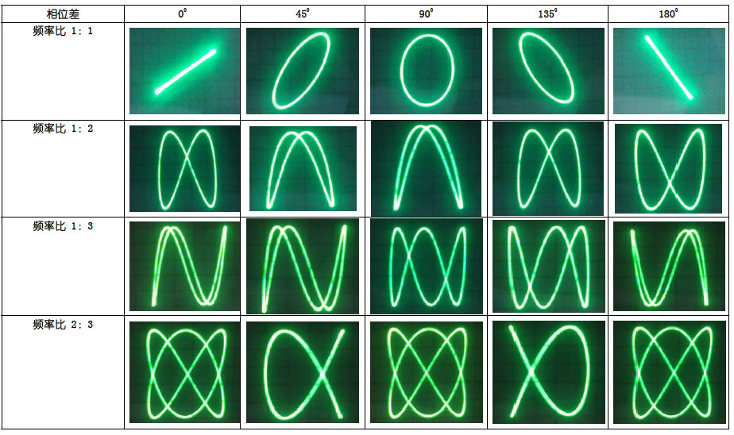
Composition of Vibration / Lissajous Figure

Slide 10
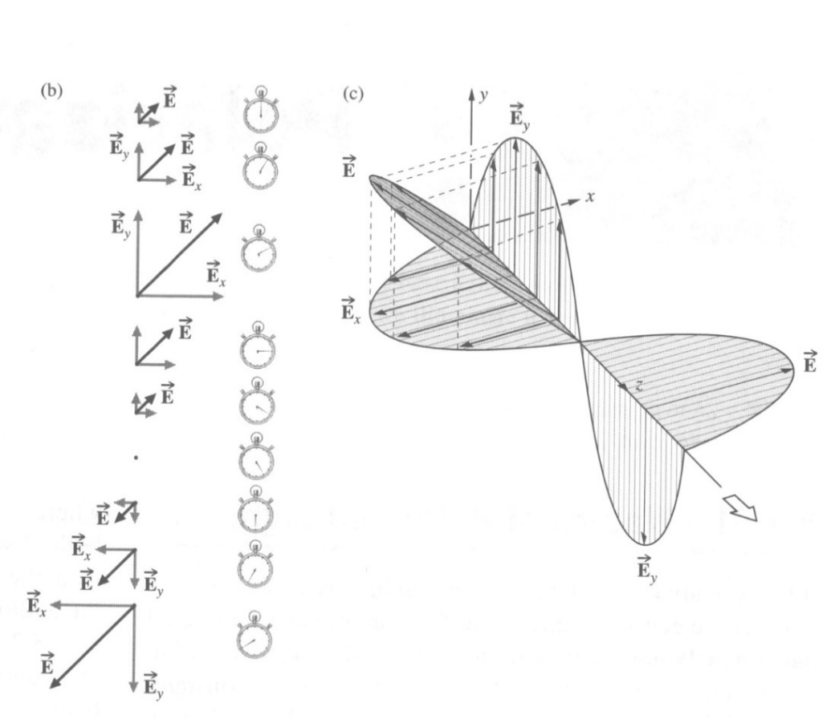


45° Linear Polarization
$$\left.E_{x}(z,t)=E_{0}exp[i(kz−ωt)\right]$$
$$\left.E_{y}(z,t)=E_{0}exp[i(kz−ωt)\right]$$
E always points to particular direction.
E₀, the complex amplitude, is the same for x- and y-component.
E₀ may be complex or real. So we normally do not write here ϕ₀.

Slide 11
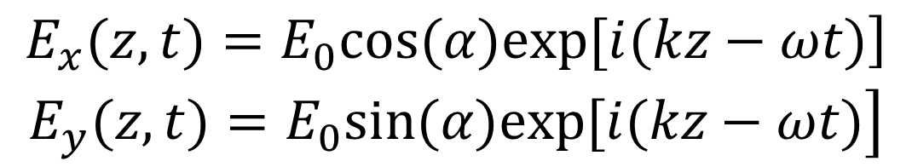
Linear Polarization with angular α
$$\begin{matrix}\left.E_{x}(z,t)=E_{0}cos(α)exp[i(kz−ωt)\right] \\ \left.E_{y}(z,t)=E_{0}sin(α)exp[i(kz−ωt)\right]\end{matrix}$$
E-field vibrates over time and space but keeps its direction.
The y-component is in phase with the x-component, but has different magnitude.
α is the crossing angle viewing toward the light source
y
α
x

Slide 12
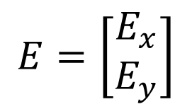
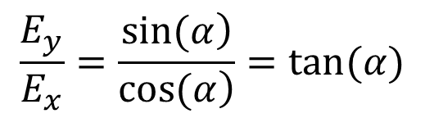
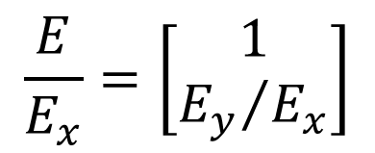
Jones Vector
A 2-dimensional vector containing the two complex x- and y-amplitudes:
$$E=\left[\begin{matrix}E_{x} \\ E_{y}\end{matrix}\right]$$
For many purposes, we only care about the relative values:
$$\frac{E}{E_{x}}=\left[\begin{matrix}1 \\ {E_{y}}/{E_{x}}\end{matrix}\right]$$
Arbitrary linear polarization:
0° linear (x) polarization: E_{y} /E_{x} = 0
90° linear (y) polarization: E_{y} /E_{x} = ¥
45° linear polarization: E_{y} /E_{x} = 1
$$\frac{E_{y}}{E_{x}}=\frac{\left.sin(α\right)}{\left.cos(α\right)}=tan(α)$$

Slide 13
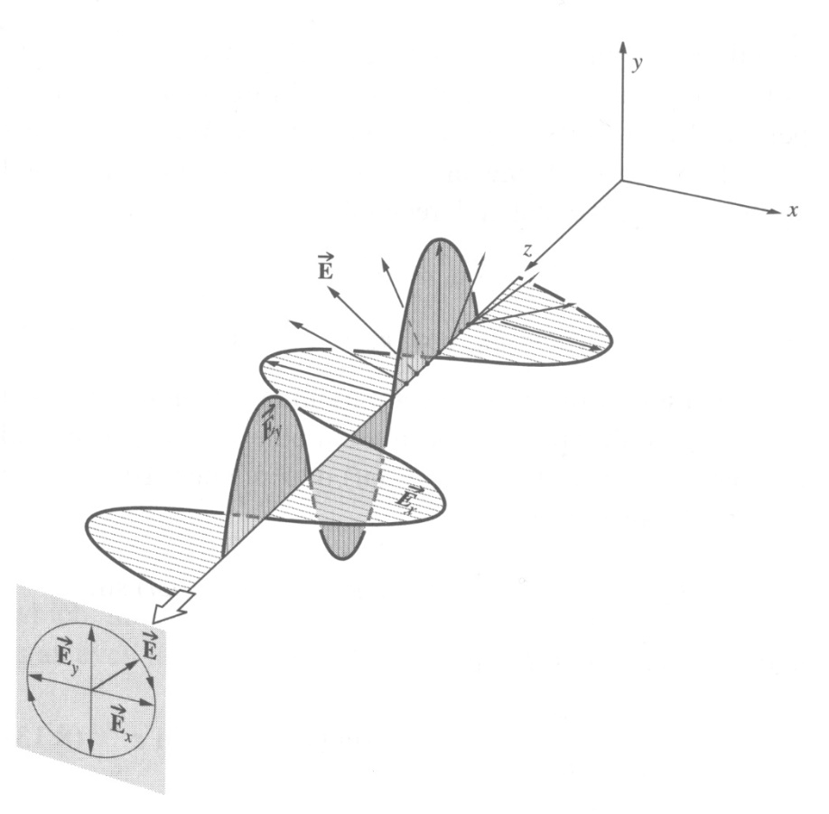
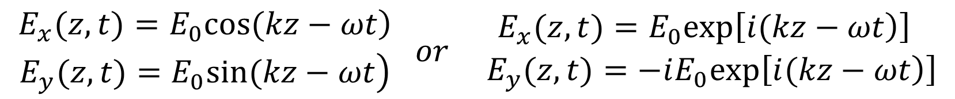
Left Circular (or Helical) Polarization
$$\begin{matrix}\left.E_{x}(z,t)=E_{0}cos(kz−ωt\right) \\ \left.E_{y}(z,t)=E_{0}sin(kz−ωt\right)\end{matrix} or \begin{matrix}E_{x}(z,t)=E_{0}exp\left[\left.i(kz−ωt\right)\right] \\ { E}_{y}(z,t)=−iE_{0}exp\left[\left.i(kz−ωt\right)\right]\end{matrix}$$
x- and y- components are always 90°out of phase.
The E-field rotates counterclockwise around the k-vector (looking back at the source).
E-field variation over time and space
kz-ωt = 0°

Slide 14
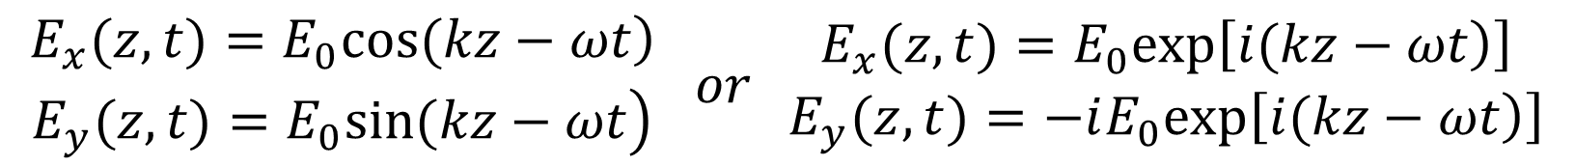
Right Circular (or Helical) Polarization
$$\begin{matrix}\left.E_{x}(z,t)=E_{0}cos(kz−ωt\right) \\ \left.E_{y}(z,t)=E_{0}sin(kz−ωt\right)\end{matrix} or \begin{matrix}E_{x}(z,t)=E_{0}exp\left[\left.i(kz−ωt\right)\right] \\ E_{y}(z,t)=−iE_{0}exp\left[\left.i(kz−ωt\right)\right]\end{matrix}$$
E-field variation over time and space
x- and y- components are always 90°out of phase, but in the other direction.
The E-field rotates clockwise around the k-vector (looking back at the source).
y
x
kz-ωt = 0°
kz-ωt = 90°

Slide 15
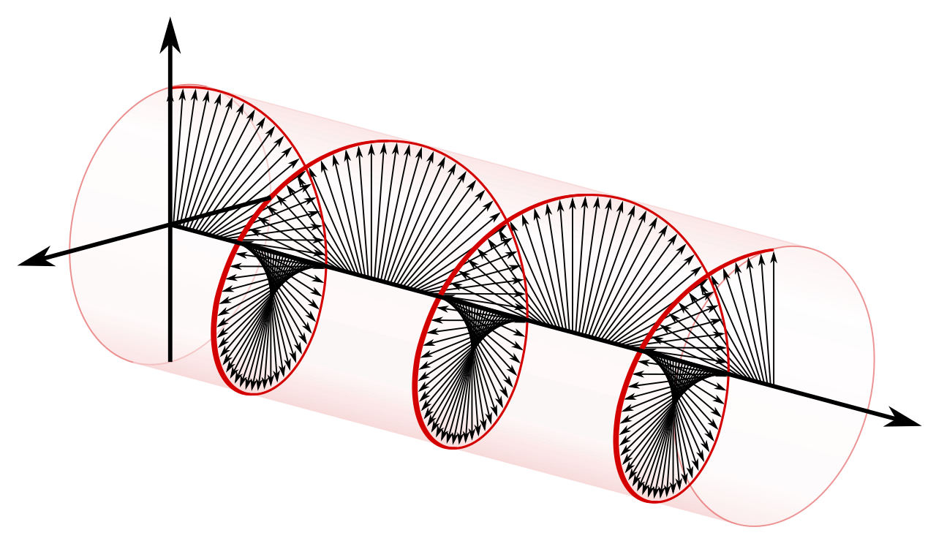


Left and Right Handness

Slide 16
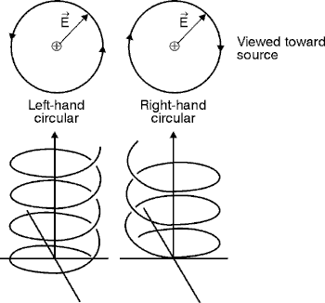
Left and Right Handedness
looking back at the source
Reflection changes the handedness (chirality)
Phase difference between x- and y- components decides the handness

Slide 17
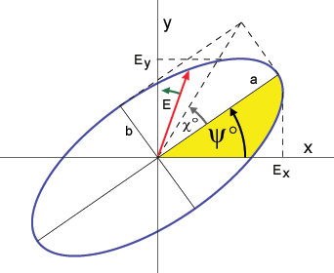


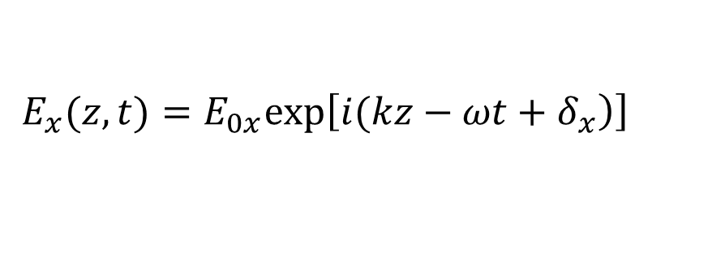

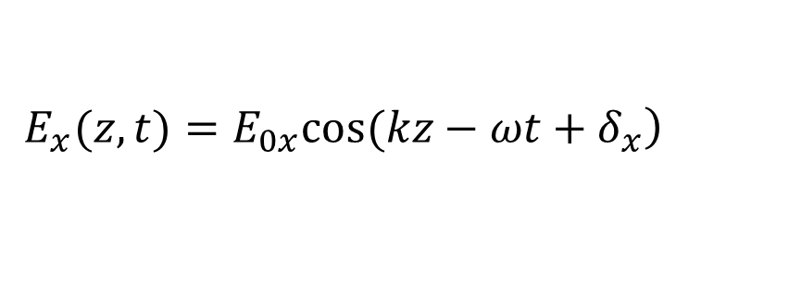
Elliptical Polarization
$$\left.E_{x}(z,t)=E_{0x}cos(kz−ωt+δ_{x}\right)$$
y
$$\left.E_{y}(z,t)=E_{0y}cos(kz−ωt+δ_{y}\right)$$
$$where{ E}_{0x}≠E_{0y}$$
x
or
$$E_{x}(z,t)=E_{0x}exp\left[\left.i(kz−ωt+δ_{x}\right)\right]$$
$$E_{y}(z,t)=E_{0y}exp\left[\left.i(kz−ωt+δ_{y}\right)\right]$$
E_{0x} and E_{0y} are complex amplitudes. The resulting E-field rotates clockwise or counter-clockwise around the k-vector (looking down the z-axis toward the origin).

Slide 18
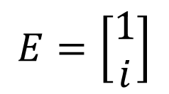
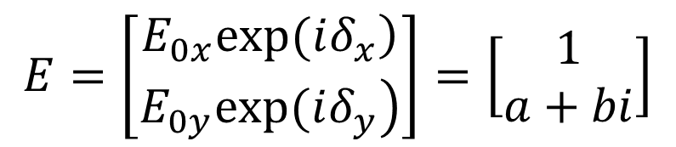
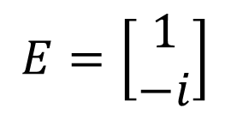
JV for Circular and Elliptical Polarizations
Circular polarization has an imaginary Jones vector y-component
$$E=\left[\begin{matrix}1 \\ i\end{matrix}\right]$$
$$E=\left[\begin{matrix}1 \\ −i\end{matrix}\right]$$
Right circular polarization
Left circular polarization
Elliptical polarization has both real and imaginary components:
$$E=\left[\begin{matrix}\left.E_{0x}exp(iδ_{x}\right) \\ \left.E_{0y}exp(iδ_{y}\right)\end{matrix}\right]=\left[\begin{matrix}1 \\ a+bi\end{matrix}\right]$$

Slide 19
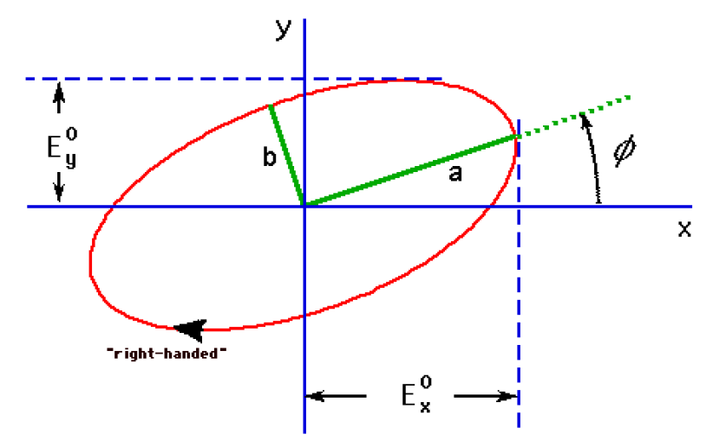


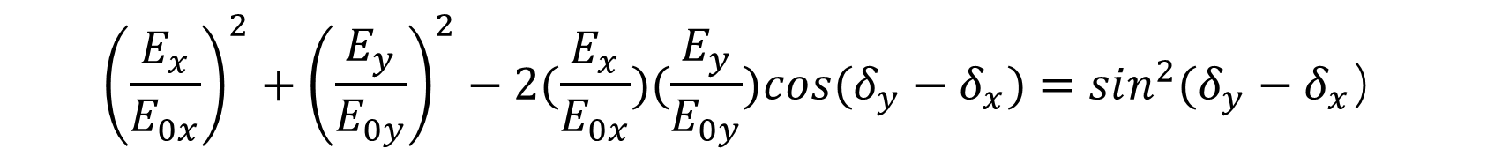
Electric field of elliptical polarization
The locus of time sequence of electric field of an elliptical polarization in a plane perpendicular to the propagation follows an ellipse:
$${\left(\frac{E_{x}}{E_{0x}}\right)}^{2}+{\left(\frac{E_{y}}{E_{0y}}\right)}^{2}−2(\frac{E_{x}}{E_{0x}})(\frac{E_{y}}{E_{0y}})cos(δ_{y}−δ_{x})=sin^{2}(δ_{y}−δ_{x}）$$
Right hand:
$$\begin{matrix} & 0<δ_{y}−δ_{x}<π\end{matrix}$$
Left hand:
$$−π<δ_{y}−δ_{x}<0$$

Slide 20
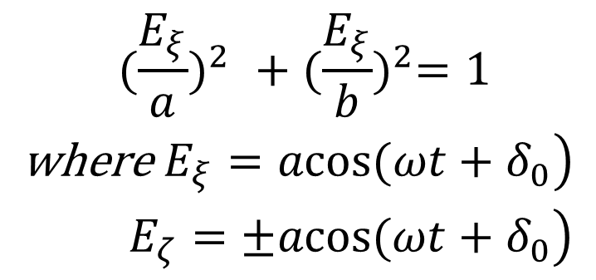
Electric field of elliptical polarization
A more convenient description is by transforming the previous equation to its principal axes form:
$$E_{x}=E_{ξ}cosφ−E_{ζ}sinφ \text{and} E_{y}=E_{ξ}cosφ+E_{ζ}sinφ$$
Then we have:
$$\begin{matrix} {(\frac{E_{ξ}}{a})}^{2} +{(\frac{E_{ξ}}{b})}^{2}=1 \\ \left.\text{where} E_{ξ}=acos(ωt+δ_{0}\right) \\ \left. E_{ζ}=±acos(ωt+δ_{0}\right)\end{matrix}$$
+ RHEP, -LHEP

Slide 21
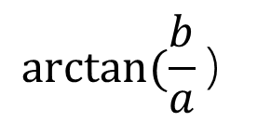
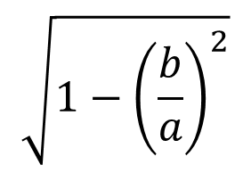

Electric field of elliptical polarization
$$\sqrt{1−{\left(\frac{b}{a}\right)}^{2}}$$
Ellipticity:
$$\frac{a}{b}$$
Ellipse's eccentricity:
Orientation angle: ϕ
Ellipticity angle:
$$arctan(\frac{b}{a}）$$

Slide 22


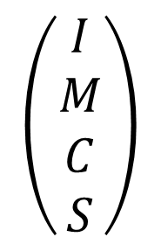
Stokes vector of parameter
$$\left(\begin{matrix}I \\ M \\ C \\ S\end{matrix}\right)$$
Stokes vector：
$$I=E_{0x}^{2}+E_{0y}^{2}$$
$$M=E_{0x}^{2}−E_{0y}^{2}$$
$$C=2E_{0x}E_{0y}cos(δ_{y}−δ_{x})=2E_{0x}E_{0y}cosδ_{y}$$
$$S=2E_{0x}E_{0y}sin(δ_{y}−δ_{x})=2E_{0x}E_{0y}sinδ_{y}$$

Slide 23

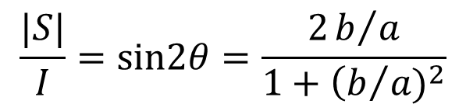
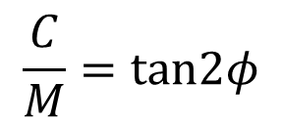
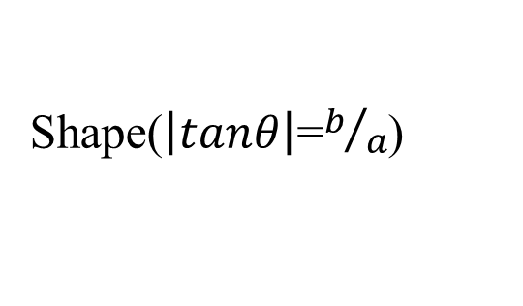
Stokes vector of parameter
These vector components give a complete geometric description of the vibrational ellipse:
I
Size(intensity)
$$\frac{C}{M}=tan2φ$$
Azimuth
$$\frac{|S|}{I}=sin2θ=\frac{2b/a}{1+{\left(b\right.}/{a)^{2}}}$$
Shape($\left|tanθ\right|$=$b/a$)
$$\text{Sign} \text{of} S$$
Handedness

Slide 24
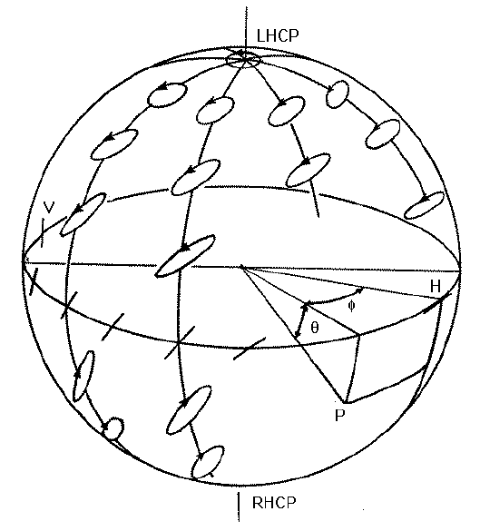






Poincaré sphere or representation
It can be proved that :
$$I^{2}=M^{2}\text{+}C^{2}\text{+}S^{2}$$
For a completely polarized field only three of parameters or vector components are independent. And we can obtain the coordinates of the Poincaré sphere or representation as:
$$2φ$$
$$2θ$$
$$M=Icos2θcos2φ$$
$$C=Icos2θsin2φ$$
$$S=Isin2θ$$

Slide 25
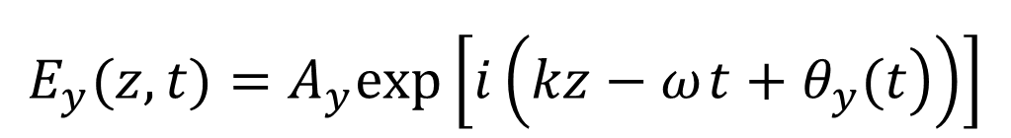
Natural Polarization
Lets consider the case:
$$E_{x}(z,t)=A_{x}exp\left[i\left(\left.kz−ω t+θ_{x}(t\right)\right)\right]$$
$$\begin{matrix} \\ E_{y}(z,t)=A_{y}exp\left[i\left(\left.kz−ω t+θ_{y}(t\right)\right)\right]\end{matrix}$$
where θ_{x}(t) and θ_{y}(t) are functions that vary temporally. If the variation time scale is slower than 1/ω, but too faster to be measurable, any single resultant polarization state is indiscernible. In this case, the light is of natural polarization, or randomly polarized.

Slide 26
Partial Polarization
More general case is that the electric field direction changes in a way that is neither totally regular nor totally irregular. It is called partial polarization. Normally we concern the partial polarization as the superposition of special amount of natural and polarized light.
A perfectly monochromatic plane wave is always polarized!!

Slide 27
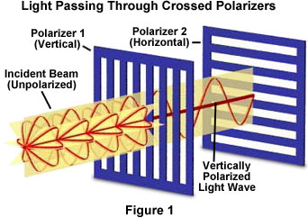
How to measure polarization
We use Polaroid or Polarizer to measure the polarization. Ideally saying, only the linear polarization component along certain direction can pass the polaroid.

