Slide 1

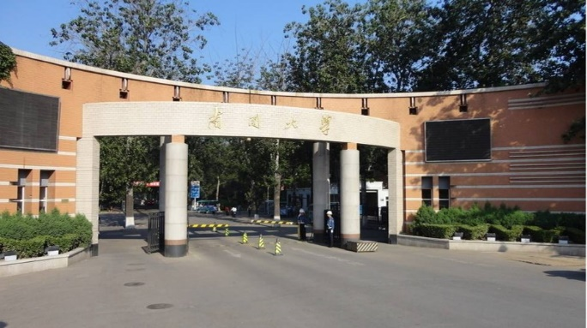
Part 2
Wave Optics
---- Fresnel's Equations 1

Slide 2

Contents
Electromagnetic Theory of Light
Polarization and Fresnel's Equations
Interference
Diffraction
Anisotropic optics

Slide 3
Fresnel's Equations for Reflection and Refraction

Slide 4
Incident Planes and the Polarizations
Perpendicular (“S”) polarization sticks out of or into the plane of incidence.
Incident medium
Plane of incidence (here the xy plane) is the plane that contains the incident and reflected k-vectors.
E_{i}
E_{r}
n_{i}
θ_{i}
θ_{r}
Interface
Plane of the interface (here the yz plane) (perpendicular to page)
y
θ_{t}
x
n_{t}
z
E_{t}
Parallel (“P”) polarization lies parallel to the plane of incidence.
Transmitting medium

Slide 5
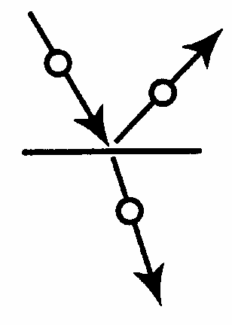
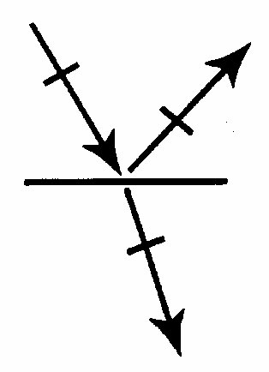
Shorthand notation for the polarizations
Perpendicular (S) polarization sticks up out of the plane of incidence. It is also called Transverse Electric (TE) polarization as the electric field is perpendicular to the incident plane
Parallel (“P”) polarization lies parallel to the plane of incidence. It is also called Transverse Magnetic (TM) polarization

Slide 6
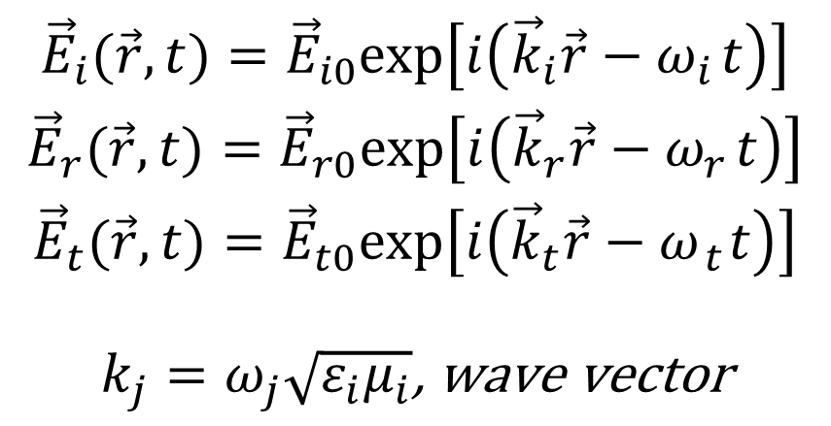
Reconsider GO laws using EM theory
Incident medium
EM wave equations for the three beams:
n_{i}
$$\begin{matrix}{\vec{E}}_{i}(\vec{r},t)={\vec{E}}_{i0}exp\left[i\left({\vec{k}}_{i}\vec{r}−ω_{i} t\right)\right] \\ {\vec{E}}_{r}(\vec{r},t)={\vec{E}}_{r0}exp\left[i\left({\vec{k}}_{r}\vec{r}−ω_{r} t\right)\right] \\ {\vec{E}}_{t}(\vec{r},t)={\vec{E}}_{t0}exp\left[i\left({\vec{k}}_{t}\vec{r}−ω _{t} t\right)\right] \\ \\ k_{j}=ω_{j}\sqrt{ε_{i}μ_{i}}\text{, }\text{wave} \text{vector}\end{matrix}$$
θ_{i}
θ_{r}
Interface
Plane of the interface (here the yz plane) (perpendicular to page)
y
θ_{t}
x
n_{t}
z
Transmitting medium

Slide 7
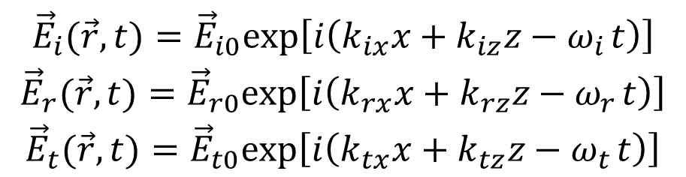
Reconsider GO laws using EM theory
Set the interface as the xoz-plane, i.e. y=0. At the interface waves can be written as
n_{i}
y
θ_{i}
θ_{r}
Interface
Plane of the interface (here the yz plane) (perpendicular to page)
z
x
$$\begin{matrix}{\vec{E}}_{i}(\vec{r},t)={\vec{E}}_{i0}exp\left[i\left(k_{ix}x+k_{iz}z−ω_{i} t\right)\right] \\ {\vec{E}}_{r}(\vec{r},t)={\vec{E}}_{r0}exp\left[i\left(k_{rx}x+k_{rz}z−ω_{r} t\right)\right] \\ {\vec{E}}_{t}(\vec{r},t)={\vec{E}}_{t0}exp\left[i\left(k_{tx}x+k_{tz}z−ω_{t} t\right)\right]\end{matrix}$$
θ_{t}
n_{t}

Slide 8
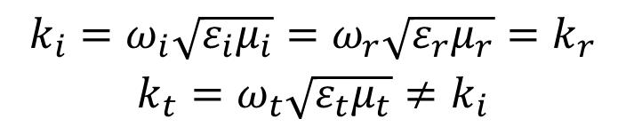
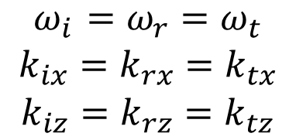
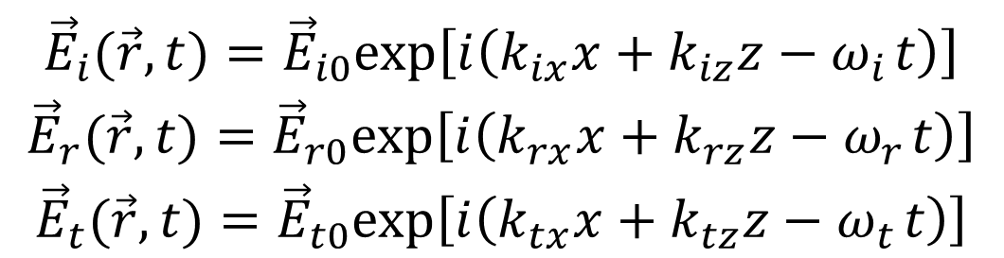
Reconsider GO laws using EM theory
$$\begin{matrix}{\vec{E}}_{i}(\vec{r},t)={\vec{E}}_{i0}exp\left[i\left(k_{ix}x+k_{iz}z−ω_{i} t\right)\right] \\ {\vec{E}}_{r}(\vec{r},t)={\vec{E}}_{r0}exp\left[i\left(k_{rx}x+k_{rz}z−ω_{r} t\right)\right] \\ {\vec{E}}_{t}(\vec{r},t)={\vec{E}}_{t0}exp\left[i\left(k_{tx}x+k_{tz}z−ω_{t} t\right)\right]\end{matrix}$$
Continue conditions are satisfied for all value of x, z and t.
$$\begin{matrix}ω_{i} =ω_{r}=ω_{t} \\ k_{ix}=k_{rx}=k_{tx} \\ k_{iz}=k_{rz}=k_{tz}\end{matrix}$$
$$\begin{matrix}k_{i}=ω_{i}\sqrt{ε_{i}μ_{i}}=ω_{r}\sqrt{ε_{r}μ_{r}}=k_{r} \\ k_{t}=ω_{t}\sqrt{ε_{t}μ_{t}}≠k_{i}\end{matrix}$$

Slide 9




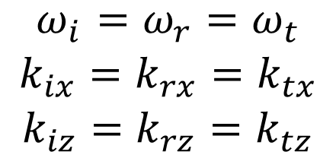
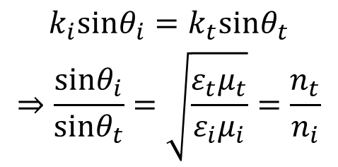

Reconsider GO laws using EM theory
$$\begin{matrix}ω_{i} =ω_{r}=ω_{t} \\ k_{ix}=k_{rx}=k_{tx} \\ k_{iz}=k_{rz}=k_{tz}\end{matrix}$$
n_{i}
y
θ_{i}
θ_{r}
Interface
Plane of the interface (here the yz plane) (perpendicular to page)
z
x
$$k_{rz}=k_{tz}=k_{iz}=0$$
θ_{t}
Coplanarity
n_{t}
$$k_{t}=ω_{t}\sqrt{ε_{t}μ_{t}}≠k_{i}$$
$$k_{i}=ω_{i}\sqrt{ε_{i}μ_{i}}=ω_{r}\sqrt{ε_{r}μ_{r}}=k_{r}$$
Without any loss of generality, we set the incident beam in xoy plane, i.e. take k_{iz}=0
$$k_{ix}=k_{i}sinθ_{i} k_{rx}=k_{r}sinθ_{r}$$
$$\begin{matrix}k_{i}sinθ_{i}=k_{t}sinθ_{t} \\ ⇒\frac{sinθ_{i}}{sinθ_{t}}=\sqrt{\frac{ε_{t}μ_{t}}{ε_{i}μ_{i}}}=\frac{n_{t}}{n_{i}}\end{matrix}$$
$$θ_{i}=θ_{r}$$
Reflection law
Snell’s relation

Slide 10
Fresnel Equations
Fresnel was the first to the fraction of a light wave reflected and transmitted by a flat interface between two media with different refractive indices.
It proceeds by considering the boundary conditions at the interface for the electric and magnetic fields of the light waves.
E_{r}
E_{i}
n_{i}
B_{i}
θ_{i}
θ_{r}
B_{r}
y
Interface
z
x
θ_{t}
E_{t}
n_{t}
B_{t}
We’ll do the perpendicular polarization first.

Slide 11
Boundary Condition for E at an Interface
y
The Tangential Electric Field ($\overset{⃑}{E}$) is Continuous
z
x
The total E-field in the incident plane is continuous.
Here, all E-fields are in the z-direction, which is in the plane of the interface (xz),
so:
E_{i}
E_{r}
n_{i}
B_{i}
θ_{i}
θ_{r}
B_{r}
Interface
θ_{t}
E_{t}
n_{t}
B_{t}
$$\left.E_{\text{i}}(x, y=0, z, t) +E_{\text{r}}(x, y=0, z, t)=E_{\text{t}}(x, y=0, z, t\right)$$

Slide 12

Boundary Condition for B at an Interface
y
The Tangential Magnetic Field ($\overset{⃑}{H}$) is Continuous
z
x
The total B-field in the incident plane is continuous.
Here, all B-fields are in the xy-plane, so we take the x-components at the boundary:
E_{i}
E_{r}
n_{i}
θ_{i}
B_{r}
θ_{i}
θ_{i}
θ_{r}
B_{i}
Interface
θ_{t}
E_{t}
n_{t}
B_{t}
$${\text{H}}_{\text{i}}\text{cos}\text{(}θ_{\text{i}}{\text{) + }\text{H}}_{\text{r}}\text{cos}\text{(}θ_{\text{r}}{\text{) = }\text{H}}_{\text{t}}\text{cos}\text{(}θ_{\text{t}}\text{)}$$
*It's really the tangential B/μ, but we're using μ = μ ₀

Slide 13
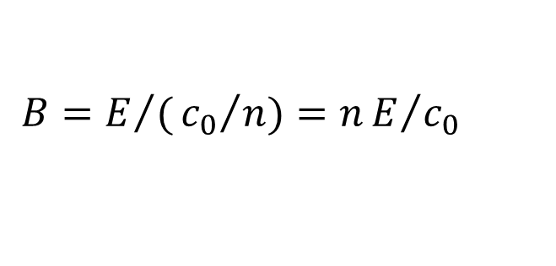

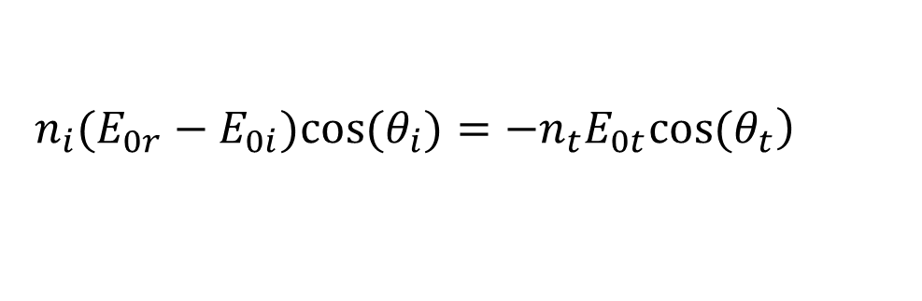


Reflection and Transmission for S-Polarized Light
Reducing the temporal items, we get the relation among the complex amplitudes :
$$E_{0i}+E_{0r}=E_{0t}$$
H=B/μ and take μ = μ _{0：}
$$\begin{matrix} \\ \left.−B_{0i}cos(θ_{i})+B_{0r}cos(θ_{r})=−B_{0t}cos(θ_{t}\right)\end{matrix}$$
Because
$$B=E/({c_{0}}/n)=nE/{c_{0}}$$
and
$${ θ}_{i}=θ_{r}$$
$$\left. n_{i}(E_{0r}−E_{0i})cos(θ_{i})=−n_{t}E_{0t}cos(θ_{t}\right)$$
Substituting for E_{0t} using
$$E_{0i}+E_{0r}=E_{0t}$$
$$\left.n_{i}(E_{0r}−E_{0i})cos(θ_{i})=−n_{t}(E_{0r}+E_{0i})cos(θ_{t}\right)$$

Slide 14
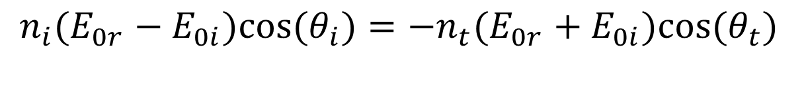
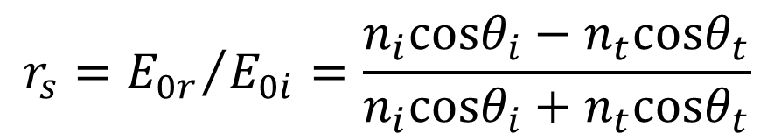
Reflection and Transmission for S-Polarized Light
We have：
$$\begin{matrix}n_{i}(E_{0r}−E_{0i})cos(θ_{i})=−n_{t}(E_{0r}+E_{0i})cos(θ_{t}) \\ \end{matrix}$$
$$\begin{matrix} \\ E_{0r}\left[\left.n_{i}cos(θ_{i})+n_{t}cos(θ_{t}\right)\right]=E_{0i}\left[\left.n_{i}cos(θ_{i})−n_{t}cos(θ_{t}\right)\right]\end{matrix}$$
Solve the equations we get the amplitude reflection coefficient
$$r_{s}={E_{0r}}/{E_{0i}}=\frac{n_{i}cosθ_{i}−n_{t}cosθ_{t}}{n_{i}cosθ_{i}+n_{t}cosθ_{t}}$$

Slide 15
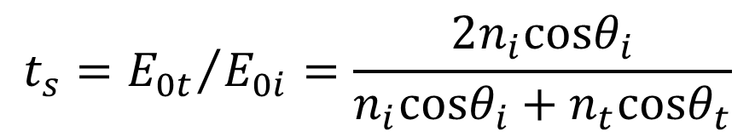
Reflection and Transmission for S-Polarized Light
Analogously, we have the amplitude transmission coefficient
$$t_{s}={E_{0t}}/{E_{0i}}=\frac{2n_{i}cosθ_{i}}{n_{i}cosθ_{i}+n_{t}cosθ_{t}}$$
These equations is the Fresnel Equations for S-polarized or perpendicularly polarized light

Slide 16
Fresnel Equations—Parallel electric field
This B-field points into the page.
y
E_{i}
B_{r}
B_{i}
E_{r}
z
x
θ_{i}
θ_{r}
n_{i}
Interface
Beam geometry
for light with its
electric field
parallel to the
plane of incidence
(i.e., in the page)
θ_{t}
E_{t}
n_{t}
B_{t}
Note that in a different notation for the reflected field is used in some books.

Slide 17

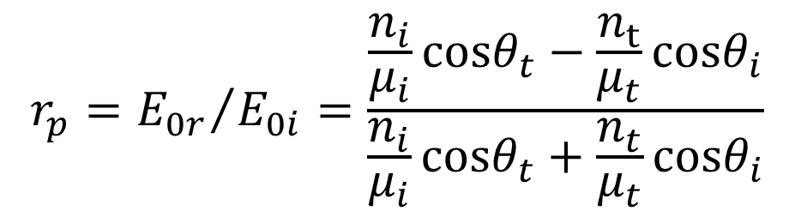
Reflection & Transmission Coefficients for P-Polarized Light
For parallel polarized light, H_{0i} - H_{0r} = H_{0t}
and E_{0i}cos(θ_{i}) + E_{0r}cos(θ_{r}) = E_{0t}cos(θ_{t})
Solving for E_{0r} / E_{0i} yields the reflection coefficient, r_{p}:
H=B/μ and
$$B=E/({c_{0}}/n)=nE/{c_{0}}$$
$$r_{p}={E_{0r}}/{E_{0i}}=\frac{\frac{n_{i}}{μ_{i}}cosθ_{t}−\frac{n_{t}}{μ_{t}}cosθ_{i}}{\frac{n_{i}}{μ_{i}}cosθ_{t}+\frac{n_{t}}{μ_{t}}cosθ_{i}}$$

Slide 18
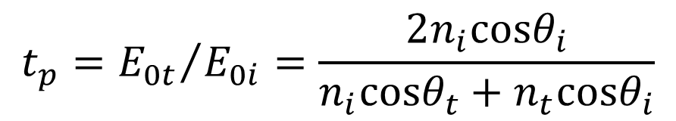
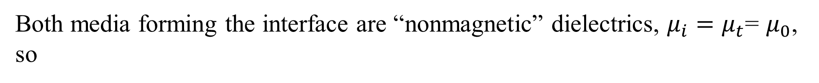
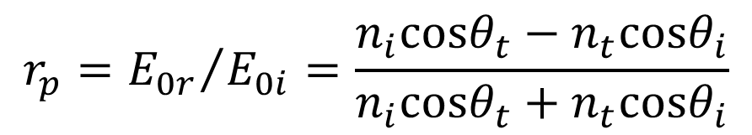
Reflection & Transmission Coefficients for P-Polarized Light
Both media forming the interface are “nonmagnetic” dielectrics, $μ_{i}=μ_{t}$= $μ_{0}$, so
$$r_{p}={E_{0r}}/{E_{0i}}=\frac{n_{i}cosθ_{t}−n_{t}cosθ_{i}}{n_{i}cosθ_{t}+n_{t}cosθ_{i}}$$
Analogously, the transmission coefficient, t_{p} = E_{0t} / E_{0i}, is
$$t_{p}={E_{0t}}/{E_{0i}}=\frac{2n_{i}cosθ_{i}}{n_{i}cosθ_{t}+n_{t}cosθ_{i}}$$
These equations are called the Fresnel Equations for parallel polarized light.

Slide 19
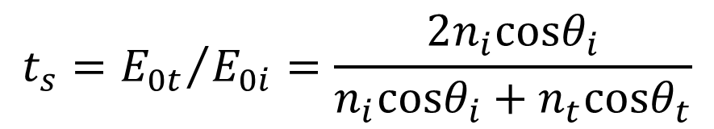
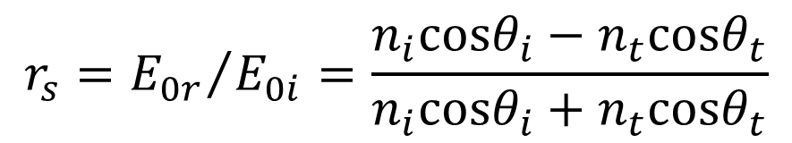
Fresnel equations
S-polarization:
$$r_{s}={E_{0r}}/{E_{0i}}=\frac{n_{i}cosθ_{i}−n_{t}cosθ_{t}}{n_{i}cosθ_{i}+n_{t}cosθ_{t}}$$
E_{i}
E_{r}
n_{i}
B_{i}
θ_{i}
θ_{r}
B_{r}
y
z
x
$$t_{s}={E_{0t}}/{E_{0i}}=\frac{2n_{i}cosθ_{i}}{n_{i}cosθ_{i}+n_{t}cosθ_{t}}$$
θ_{t}
E_{t}
n_{t}
B_{t}

Slide 20
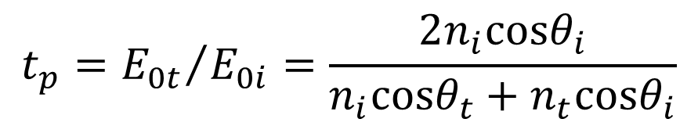
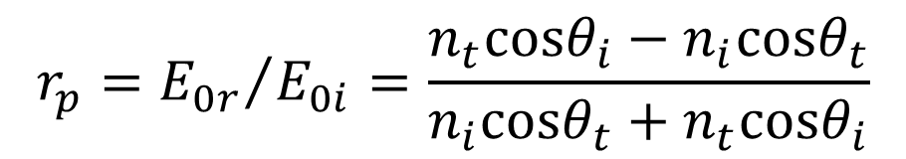
Fresnel equations
P-polarization:
$$r_{p}={E_{0r}}/{E_{0i}}=\frac{n_{t}cosθ_{i}−n_{i}cosθ_{t}}{n_{i}cosθ_{t}+n_{t}cosθ_{i}}$$
E_{i}
E_{r}
n_{i}
B_{i}
θ_{i}
θ_{r}
B_{r}
$$t_{p}={E_{0t}}/{E_{0i}}=\frac{2n_{i}cosθ_{i}}{n_{i}cosθ_{t}+n_{t}cosθ_{i}}$$
Interface
θ_{t}
E_{t}
n_{t}
B_{t}

Slide 21
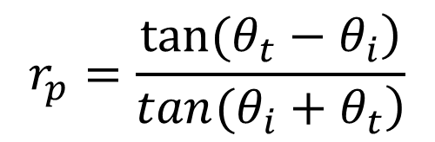
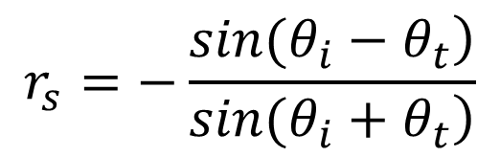
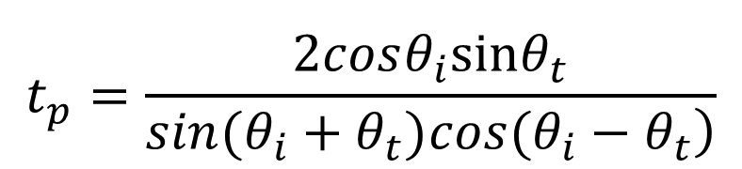
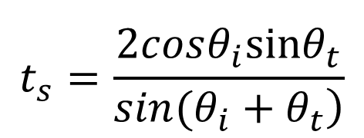
Fresnel equations
Other forms:
$$r_{s}=−\frac{\left.sin(θ_{i}−θ_{t}\right)}{\left.sin(θ_{i}+θ_{t}\right)}$$
$$r_{p}=\frac{\left.tan(θ_{t}−θ_{i}\right)}{\left.tan(θ_{i}+θ_{t}\right)}$$
$$\begin{matrix} \\ t_{s}=\frac{2cosθ_{i}sinθ_{t}}{\left.sin(θ_{i}+θ_{t}\right)}\end{matrix}$$
$$\begin{matrix} \\ t_{p}=\frac{2cosθ_{i}sinθ_{t}}{\left.sin(θ_{i}+θ_{t})cos(θ_{i}−θ_{t}\right)}\end{matrix}$$

Slide 22
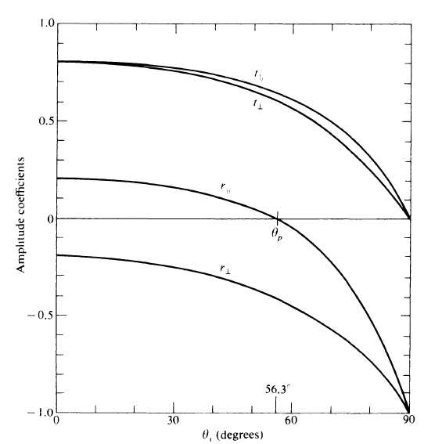
Reflection & Transmission Coefficients for an Air-to-Glass Interface
n_{air} ≈ 1 < n_{glass} ≈ 1.5
Phase may change with the incident angle.
Total reflection at grazing incident, i.e. θ=90º for both polarizations

Slide 23
Reflection & Transmission Coefficients for an Air-to-Glass Interface
n_{air} ≈ 1 < n_{glass} ≈ 1.5
Zero reflection for parallel polarization at “Brewster's angle” (56.3°for our sample).
Brewster’s angle
r_{p}=0!

Slide 24
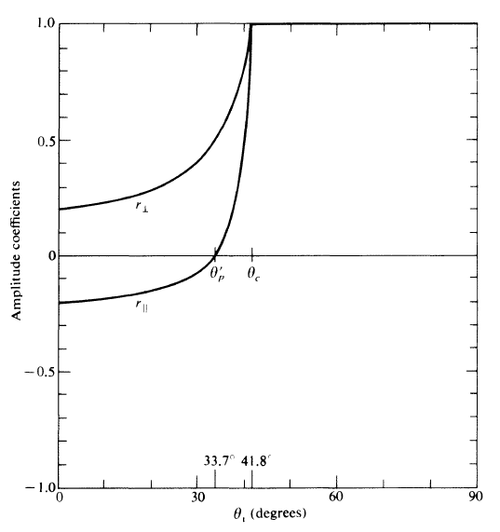
Reflection for a Glass-to-Air Interface
n_{glass} ≈ 1.5 > n_{air} ≈ 1.0
Critical
angle
Phase change still exist
Brewster’s angle still exist in p-polarization beam.
When θ_{i}> θ _{crit}, total internal reflection happens. Here
θ_{crit} = arcsin(n_{t} /n_{i})
Total internal reflection
Brewster’s angle

Slide 25
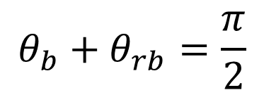
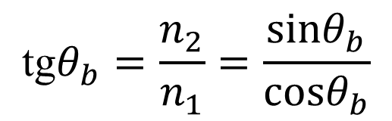
Brewster’s Law
At certain incident angle, r_{P}=0. The incident angle is Brewster’s angle which obey Brewster’s law:
$$\text{tg}θ_{b}=\frac{n_{2}}{n_{1}}=\frac{sinθ_{b}}{cosθ_{b}}$$
When incident angle is equal to the Brewster angle, the reflected is perpendicular to the refracted beam, i.e.
$$θ_{b}+θ_{rb}=\frac{π}{2}$$

Slide 26
Brewster’s Law
Samples:
Air-to-Glass with n₂=1.5
Air-to-water with n₂=1.33
When polarized light is incident onto the interface along θ_{b}, the reflected beam is s-polarized because r_{p}=0. But it does not mean the transmitted beam is p-polarized. Most energy of s-polarized beam transmits the interface. For example, at the air-to-glass interface, 85% of s-polarized beam goes into the glass when the incident angle is Brewster’s angle.

Slide 27
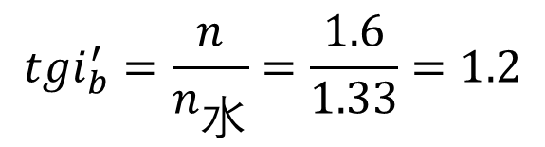
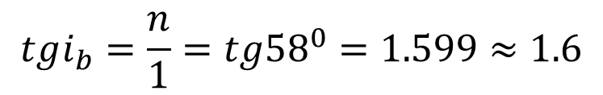

例题：已知某材料在空气中的布儒斯特角i_{b}=58º,求它的折射率？若将它放 在水中（水的折射率为 1.33），求布儒斯特角？该材料对水的相对 折射率是多少？
解：设该材料的折射率为 n ，空气的折射率为1，
$$tgi_{b}=\frac{n}{1}=tg{58}^{0}=1.599≈1.6$$
$$tgi_{b}^{′}=\frac{n}{n_{水}}=\frac{1.6}{1.33}=1.2$$
放在水中，则对应有
所以：
$$i_{b}^{′}={50.3}^{0}$$
该材料对水的相对折射率为1.2

Slide 28

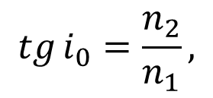

例题： 一束自然光以某一角射到平面玻璃板上，反射光恰为线偏振光，且 折射光的折射角为32⁰，求： (1) 自然光的入射角；(2) 玻璃的折射 率；(3) 经过玻璃片后透射光的偏振状态。
解：(1) 由布儒斯特定律，反射光为线偏振光时，反射光与折射光垂直,
i₀+ r=90⁰
$$i_{0}={90}^{∘}−r={58}^{∘}$$
(2) 由
$$tg i_{0}=\frac{n_{2}}{n_{1}},$$
n₁=1得
$$n_{2}=n_{1}tg i_{0}=tg{58}^{∘}=1.6$$
(3)
透射光为部分偏振光.

Slide 29
Get polarized light by reflection
Reflected and transmitted beams are all partial polarized.
In reflection direction S-polarized beam is dominant whereas in the transmission direction P-polarized beam dominates.
At Brewster’s angle, only S-polarized component exists in the reflected beam!!!

Slide 30
Get polarized light by reflection
By a pile-of-plates polarizer invented by Arago in 1812, the reflected beam can be totally s-polarized and the transmitted beam totally p-polarized.
Normally, these kinds of polarizer are made from glass for visible, silver chloride plates for infrared, and quartz or vycor for ultraviolet light.

Slide 31
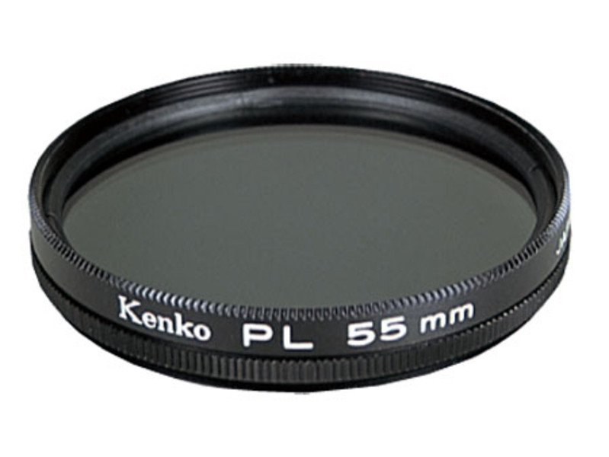
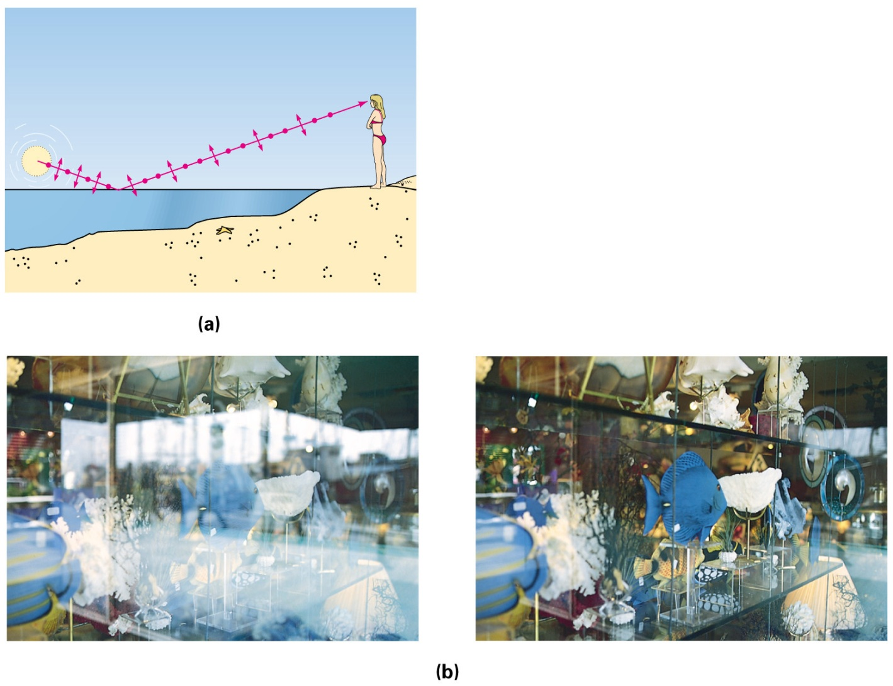
Example of Glare Reduction

Slide 32
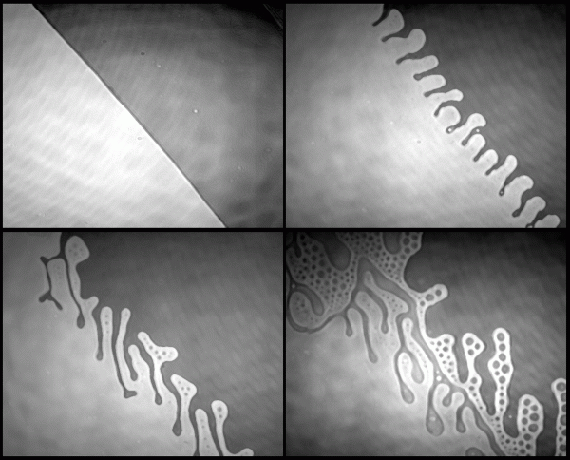
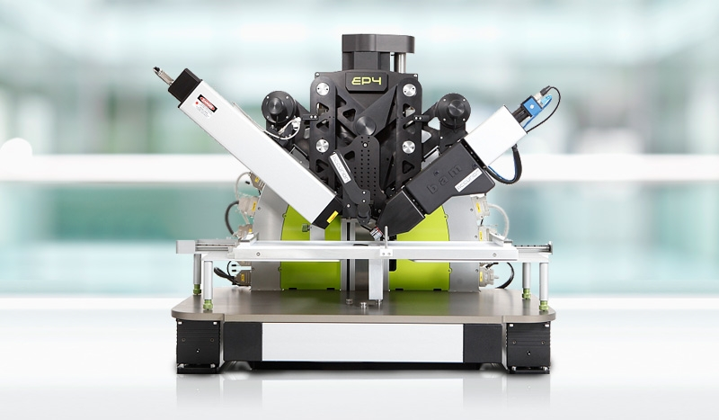
Brewster angle microscope

Slide 33
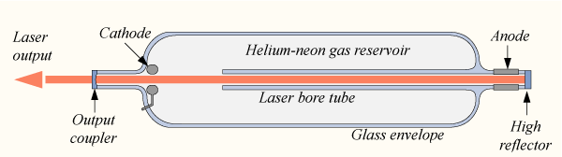
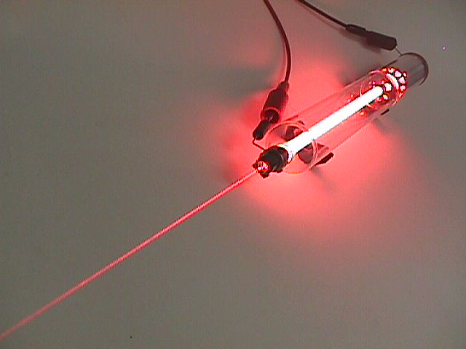
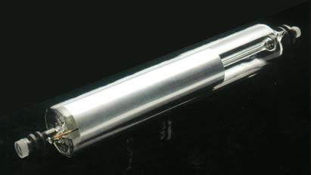
Application Samples
Linear polarization output from a Lasers use Brewster’s window with low loss.

Slide 34
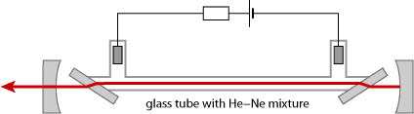
Application Samples
Linear polarization output from a Lasers use Brewster’s window with low loss.
P-polarized
component
S-polarized
component
S-polarized
component

Slide 35
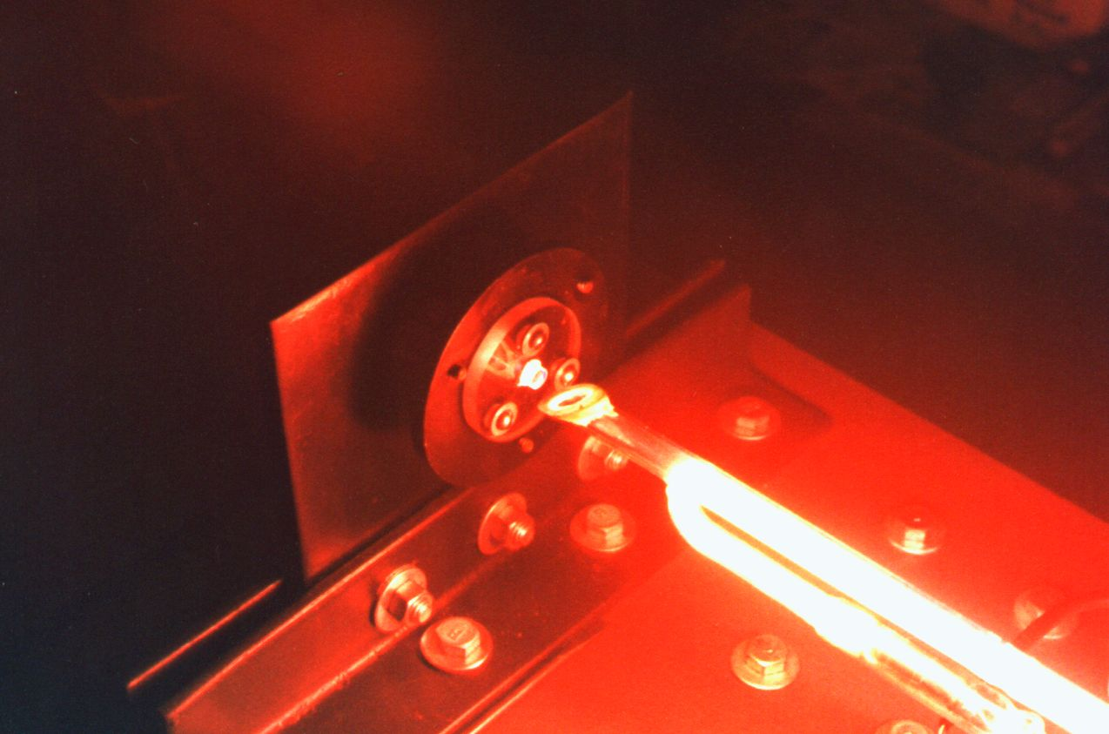
Application Samples
Linear polarization output from a Lasers use Brewster’s window with low loss.

