Slide 1

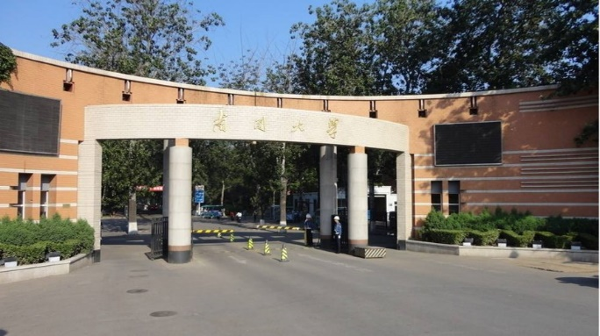
Part 2
Wave Optics
---- Fresnel's Equations 2

Slide 2

Contents
Electromagnetic Theory of Light
Polarization and Fresnel's Equations
Interference
Diffraction
Anisotropic optics

Slide 3
Fresnel's Equations for Reflection and Refraction

Slide 4

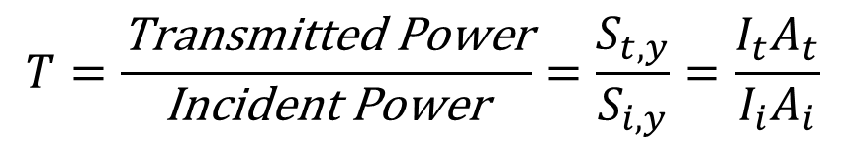

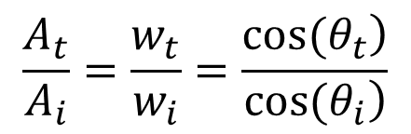
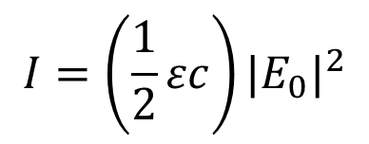
Transmittance (T)
$$I=\left(\frac{1}{2}εc\right){|E_{0}|}^{2}$$
$$T=\frac{\text{Transmitted} \text{Power}}{\text{Incident} \text{Power}}=\frac{S_{t,y}}{S_{i,y}}=\frac{I_{t}A_{t}}{I_{i}A_{i}}$$
A = Cross Section Area
$$c={c_{0}}/n$$
$$n=\sqrt{ε}$$
w_{i}
θ_{i}
If the beam has width w_{i}, the beam expands in one dimension on refraction.
y
n_{i}
n_{t}
x
w_{t}
θ_{t}
$$\frac{A_{t}}{A_{i}}=\frac{w_{t}}{w_{i}}=\frac{\left.cos(θ_{t}\right)}{\left.cos(θ_{i}\right)}$$

Slide 5
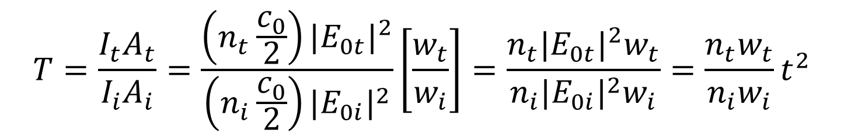
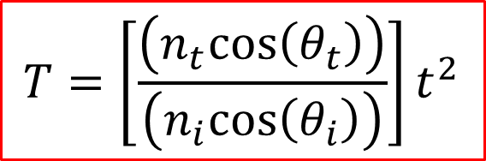
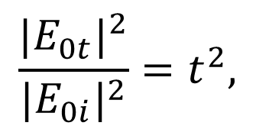
Transmittance (T)
$$T=\frac{I_{t}A_{t}}{I_{i}A_{i}}=\frac{\left(n_{t}\frac{c_{0}}{2}\right){|E_{0t}|}^{2}}{\left(n_{i}\frac{c_{0}}{2}\right){|E_{0i}|}^{2}}\left[\frac{w_{t}}{w_{i}}\right]=\frac{n_{t}{|E_{0t}|}^{2}w_{t}}{n_{i}{|E_{0i}|}^{2}w_{i}}=\frac{n_{t}w_{t}}{n_{i}w_{i}}t^{2}$$
since
$$\frac{{|E_{0t}|}^{2}}{{|E_{0i}|}^{2}}=t^{2},$$
$$T=\left[\frac{\left(n_{t}cos\left(θ_{t}\right)\right)}{\left(n_{i}cos\left(θ_{i}\right)\right)}\right]t^{2}$$
The Transmittance is also called the Transmissivity.

Slide 6

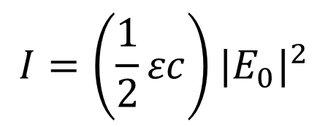
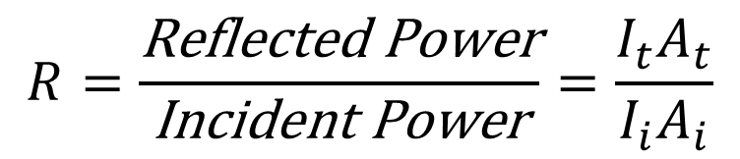
Reflectance (R)
$$I=\left(\frac{1}{2}εc\right){|E_{0}|}^{2}$$
$$R=\frac{\text{Reflected} \text{Power}}{\text{Incident} \text{Power}}=\frac{I_{t}A_{t}}{I_{i}A_{i}}$$
A = Cross Section Area
w_{i}
θ_{i}
θ_{r}
n_{i}
w_{i}
n_{t}
Because n_{i}=n_{r} and θ_{i}= θ_{r},
$$R=r^{2}$$
The Reflectance is also called the Reflectivity.

Slide 7
Reflectance and Transmittance for an Air-to-Glass Interface
S-polarization
P-polarization
1.0
.5
0
1.0
.5
0
T
T
R
R
0° 30° 60° 90°
0° 30° 60° 90°
Incidence angle, θ_{i}
Incidence angle, θ_{i}
R + T = 1

Slide 8
Reflectance and Transmittance for a Glass-to-Air Interface
Perpendicular polarization
Parallel polarization
1.0
.5
0
1.0
.5
0
R
R
T
T
0° 30° 60° 90°
0° 30° 60° 90°
Incidence angle, θ_{i}
Incidence angle, θ_{i}
R + T = 1

Slide 9
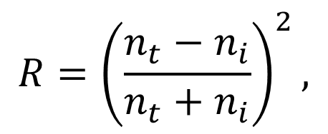
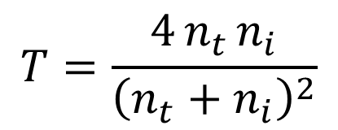
Reflection at normal incidence
$$R={\left(\frac{n_{t}−n_{i}}{n_{t}+n_{i}}\right)}^{2},$$
$$T=\frac{4 n_{t }n_{i}}{{\left(n_{t}+n_{i}\right)}^{2}}$$
When θ_{i} = 0,
For an air-glass interface (n_{i} = 1.0 and n_{t} = 1.5),
R = 4% and T = 96%
The reflection has big implications for photography lenses.
The values are the same, whichever direction the light travels, from air to glass or from glass to air.

Slide 10
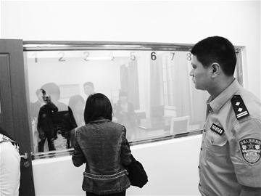
Please pay attention to incident intensity
One-way mirrors

Slide 11

Please pay attention to incident intensity
One-way mirrors
$$I_{t}=I_{incident}⋅T$$
High illumination
High reflection
Low illumination
Low reflection
Metal film
Quite thick
Glass

Slide 12
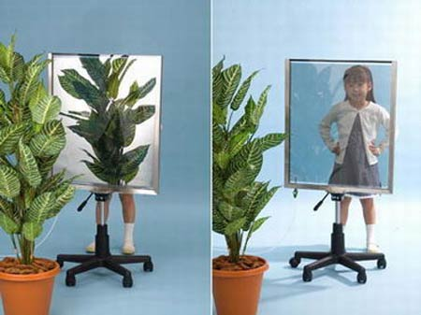
Please pay attention to incident intensity
One-way mirrors
Please pay attention to the difference in the illumination of
the plant and the girl in the two pictures

Slide 13
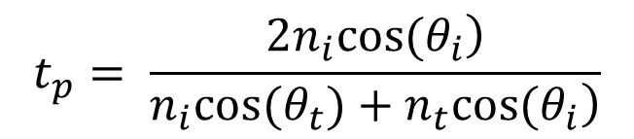
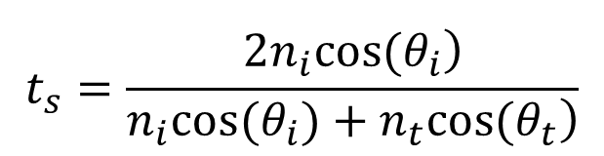
Phase Shift in Refraction
For S-polarized light:
E_{i}
E_{r}
n_{i}
$$\begin{matrix} \\ t_{s}=\frac{\left.2n_{i}cos(θ_{i}\right)}{\left.n_{i}cos(θ_{i})+n_{t}cos(θ_{t}\right)}\end{matrix}$$
B_{i}
θ_{i}
θ_{r}
B_{r}
Interface
θ_{t}
E_{t}
n_{t}
For P-polarized light:
B_{t}
$$t_{p}= \frac{\left.2n_{i}cos(θ_{i}\right)}{\left.n_{i}cos(θ_{t})+n_{t}cos(θ_{i}\right)}$$
E_{i}
B_{r}
n_{i}
B_{i}
θ_{i}
θ_{r}
E_{r}
t_{s} and t_{p} keep positive. So the refracted beam always be in phase with the incident beam.
Interface
θ_{t}
E_{t}
n_{t}
B_{t}

Slide 14
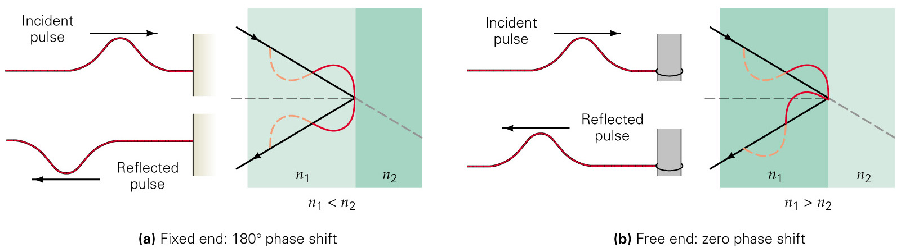
Reflection and Phase Shift
In mechanism, 180º phase shift is decided by the fixing condition of the end

Slide 15

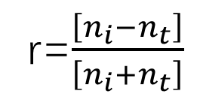
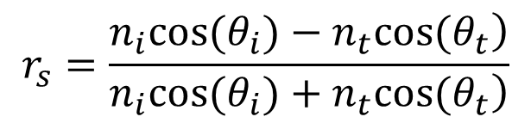
P.S. in Reflection at near normal incidence
For S-polarized light:
E_{i}
E_{r}
n_{i}
$$r_{s}=\frac{\left.n_{i}cos(θ_{i})−n_{t}cos(θ_{t}\right)}{\left.n_{i}cos(θ_{i})+n_{t}cos(θ_{t}\right)}$$
B_{i}
θ_{i}
θ_{r}
B_{r}
Interface
r=$\frac{\left[n_{i}−n_{t}\right]}{\left[n_{i}+n_{t}\right]}$
θ_{t}
When $θ_{i}=0$,
E_{t}
n_{t}
B_{t}
If n_{i}<n_{t} (air to glass), r_{s}<0. It means the reflected beam is 180⁰ out of phase compared to the incident beam.
Analogously, if n_{i} > n_{t} (glass to air), r_{s} > 0. Reflected beam is in phase with the incident beam.

Slide 16
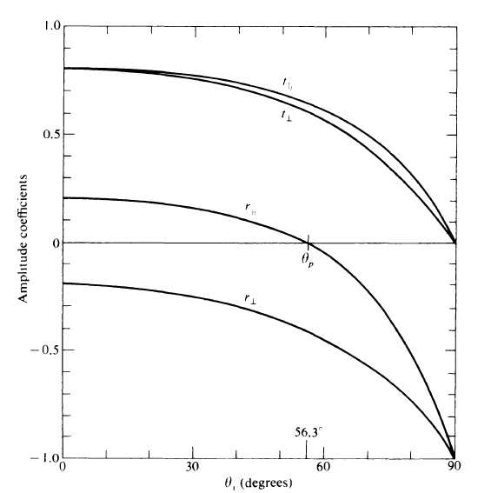
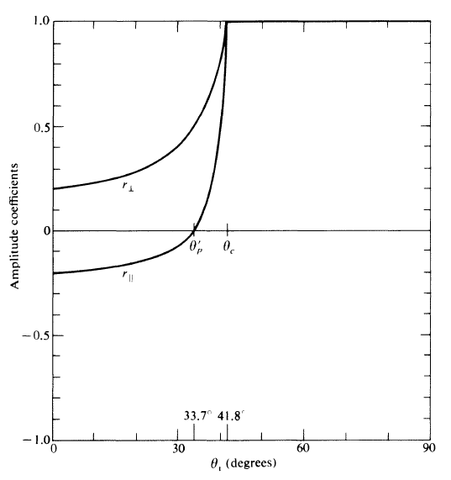
n_{i} < n_{t}
n_{i} > n_{t}

Slide 17
P.S. in Reflection at near normal incidence
E_{i}
E_{r}
n_{i}
B_{i}
θ_{i}
θ_{r}
B_{r}
Interface
θ_{t}
E_{t}
n_{t}
B_{t}
If n_{i}<n_{t} (air to glass), r_{p}>0. As the s-polarized beam, the reflected p-polarized beam has 0 phase shift relative to the incident beam.
Analogously, if n_{i} > n_{t} (glass to air), r_{p} <0. π phase shift happens.

Slide 18
n_{i} < n_{t}
n_{i} > n_{t}

Slide 19
π phase change in normal incidence
E_{i}
E_{r}
n_{i}
B_{i}
θ_{i}
θ_{r}
B_{r}
Interface
θ_{t}
E_{t}
n_{t}
B_{t}
S-polarization
E_{i}
E_{r}
n_{i}
B_{i}
θ_{i}
θ_{r}
B_{r}
Interface
θ_{t}
E_{t}
n_{t}
B_{t}
n_{i} < n_{t}
P-polarization

Slide 20
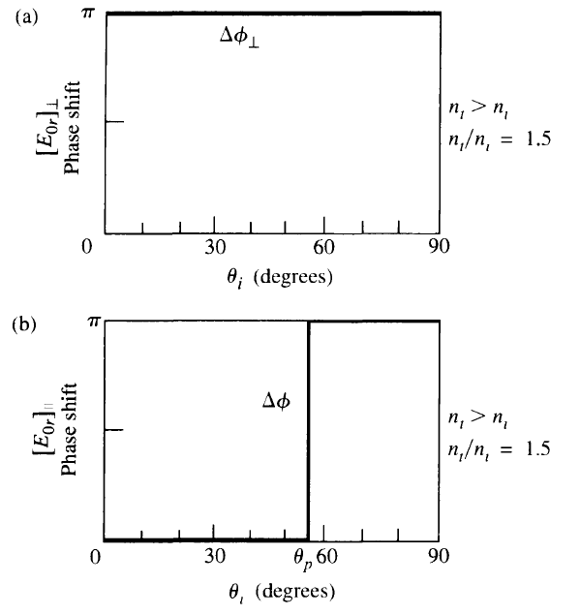
π phase change in normal incidence
E_{i}
E_{r}
n_{i}
B_{i}
θ_{i}
θ_{r}
B_{r}
Interface
θ_{t}
E_{t}
n_{t}
B_{t}
S-polarization
E_{i}
E_{r}
n_{i}
B_{i}
θ_{i}
θ_{r}
B_{r}
Interface
θ_{t}
E_{t}
n_{t}
B_{t}
n_{i} < n_{t}
P-polarization

Slide 21
π phase change in normal incidence
E_{i}
E_{r}
n_{i}
B_{i}
θ_{i}
θ_{r}
B_{r}
Interface
θ_{t}
E_{t}
n_{t}
B_{t}
S-polarization
E_{i}
E_{r}
n_{i}
B_{i}
θ_{i}
θ_{r}
B_{r}
Interface
θ_{t}
E_{t}
n_{t}
B_{t}
n_{t} < n_{i}
P-polarization

Slide 22
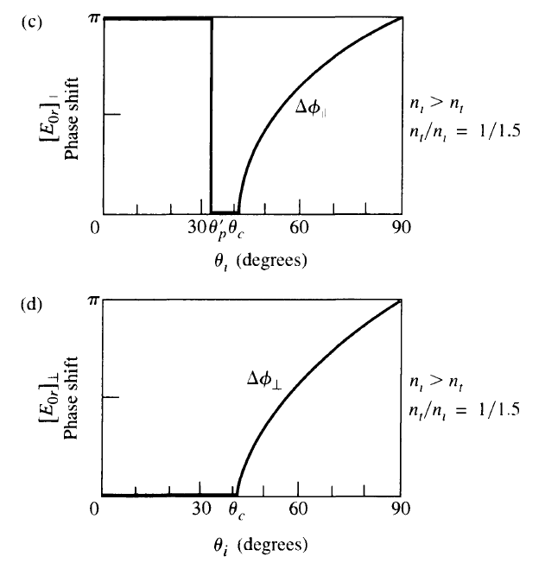
π phase change in normal incidence
E_{i}
E_{r}
n_{i}
B_{i}
θ_{i}
θ_{r}
B_{r}
Interface
θ_{t}
E_{t}
n_{t}
B_{t}
S-polarization
E_{i}
E_{r}
n_{i}
B_{i}
θ_{i}
θ_{r}
B_{r}
Interface
θ_{t}
E_{t}
n_{t}
B_{t}
n_{t} < n_{i}
P-polarization

Slide 23
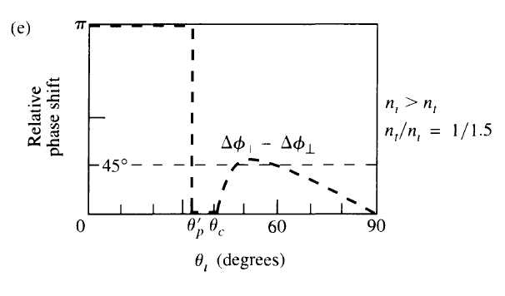
π phase change in normal incidence
E_{i}
E_{r}
n_{i}
B_{i}
θ_{i}
θ_{r}
B_{r}
Interface
θ_{t}
E_{t}
n_{t}
B_{t}
S-polarization
E_{i}
E_{r}
n_{i}
B_{i}
θ_{i}
θ_{r}
B_{r}
Interface
θ_{t}
n_{t} < n_{i}
E_{t}
n_{t}
B_{t}
P-polarization

Slide 24
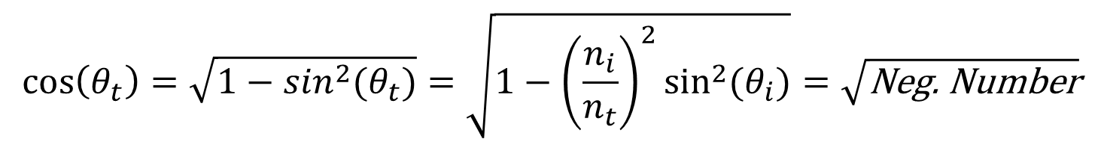
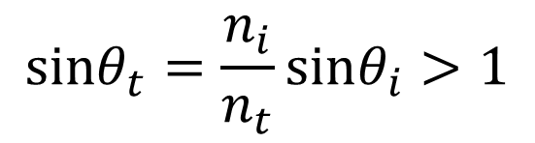
Total internal reflection
Concern the reflection of the p-polarizated beam when θ_{i}> θ_{crit} .
θ_{i}
n_{i}
$$sinθ_{t}=\frac{n_{i}}{n_{t}}sinθ_{i}>1$$
y
θ_{t}
n_{t}
x
Although sinθ_{t}>1, which means θ_{t} doesn’t exist, we still compute θ_{t} by Snell’s law. Then
$$\cos\left(θ_{t}\right)=\sqrt{1−\sin^{2}(θ_{t})}=\sqrt{1−{\left(\frac{n_{i}}{n_{t}}\right)}^{2}\sin^{2}(θ_{i})}=\sqrt{\text{Neg}\text{. }\text{Number}}$$
Then we have$r≡r_{⊥}r_{⊥}^{∗}=1,$which means that all power is reflected.

Slide 25
Total internal reflection
Concern p-polarizated beam
θ_{i}
n_{i}
y
θ_{t}
n_{t}
x

Slide 26
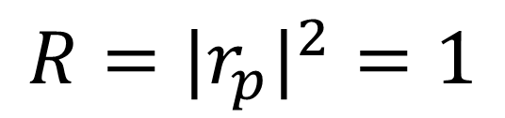
Total internal reflection
Three important conclusion:
θ_{i}
n_{i}
$$R={|r_{p}|}^{2}=1$$
y
θ_{t}
n_{t}
x
Entire energy is reflected back into the incident medium —— total internal reflection

Slide 27
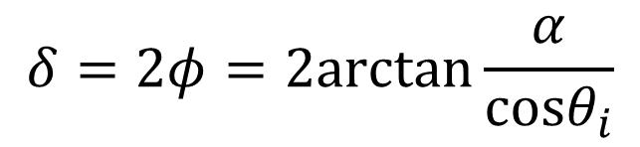
Total internal reflection
Three important conclusion:
θ_{i}
n_{i}
y
θ_{t}
n_{t}
x
Reflected beam has phase shift:
$$δ=2φ=2arctan\frac{α}{cosθ_{i}}$$

Slide 28

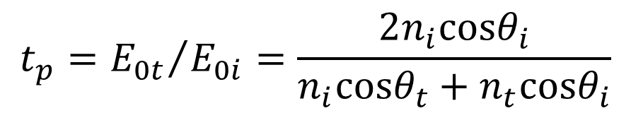
Total internal reflection
Three important conclusion:
θ_{i}
n_{i}
y
θ_{t}
$$t_{p}={E_{0t}}/{E_{0i}}=\frac{2n_{i}cosθ_{i}}{n_{i}cosθ_{t}+n_{t}cosθ_{i}}$$
n_{t}
x
It is obviously not equal to zero, which means in the transmitted medium EM field is not zero.

Slide 29

The Evanescent Wave
When total internal reflection happens, reflectivity is 1 and all incident energy is reflected. What is the transmitted wave when total internal reflection occurs?
θ_{i}
n_{i}
y
θ_{t}
n_{t}
x
Let’s assume the transmission and Snell relation is still meaningful. Then the x- and y-component of wave vector of the transmitted beam are given by:
$$\begin{matrix}{\text{k}}_{\text{tx}}= \text{k} \text{sin}θ_{\text{t}} & \end{matrix}{ \text{k}}_{\text{ty}}=−\text{k} \text{cos}θ_{\text{t}}$$

Slide 30
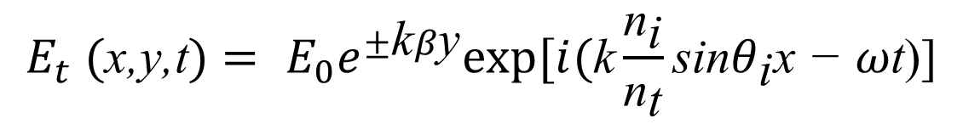
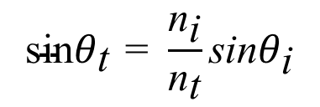
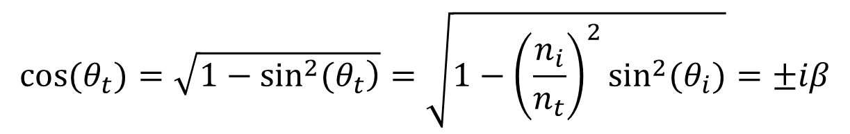
The Evanescent Wave
θ_{i}
n_{i}
Using Snell's Law, we can write:
$$\text{sin}θ_{\text{t}}\text{ = }\frac{{\text{n}}_{\text{i}}}{{\text{n}}_{\text{t}}}\text{sin}θ_{\text{i}}$$
y
θ_{t}
n_{t}
x
$$cos(θ_{t})=\sqrt{\left.1−\sin^{2}(θ_{t}\right)}=\sqrt{1−{\left(\frac{n_{i}}{n_{t}}\right)}^{2}\sin^{2}(θ_{i})}=±iβ$$
Then we have:
$$E_{t} \text{(}\text{x}\text{,}\text{y}\text{,}\text{t})= E_{0}e^{±\text{k}β\text{y}}exp[i(\text{k}\frac{{\text{n}}_{\text{i}}}{{\text{n}}_{\text{t}}}\text{sin}θ_{\text{i}}\text{x}\text{ − }ω\text{t}\text{)]}$$

Slide 31
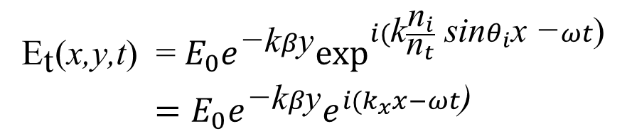
The Evanescent Wave
Reverse the direction of y-axis and rewrite the field equation, we have:
θ_{i}
n_{i}
y
θ_{t}
n_{t}
x
$$\begin{matrix}{\text{E}}_{\text{t}}\text{(}\text{x}\text{,}\text{y}\text{,}\text{t}\text{) }\text{=} E_{0}e^{\text{−}\text{k}β\text{y}}\exp^{i(\text{k}\frac{{\text{n}}_{i}}{{\text{n}}_{t}} \text{sin}θ_{i}\text{x}\text{ −}ωt\text{)}} \\ =E_{0}e^{\text{−}\text{k}β\text{y}}e^{i(k_{x}x−ωt\text{)}}\end{matrix}$$
x
y
The transmitted wave, called evanescent wave decays exponentially in the transverse direction and propagate along the interface. 1/β is called the depth of penetration.

Slide 32
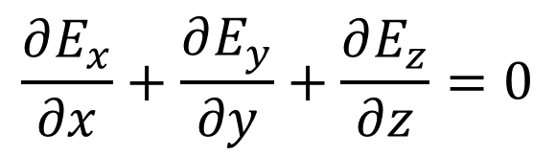

The longitudinal components of the evanescent wave
Concern the function of the evanescent wave:
θ_{i}
n_{i}
θ_{t}
n_{t}
$$E(r,t)={\vec{E}}_{0}e^{−k_{y}^{′}y}⋅e^{\left.i(k_{x}x−ω⋅t\right)}$$
x
y
Here the complex amplitude ${\overset{⃑}{E}}_{0}$ has three components:$E_{x0},$ $E_{y0},$and $E_{z0}.$
According to Maxwell equations, $•\overset{⃑}{E} = 0$，i.e.
$$\frac{∂E_{x}}{∂x}+\frac{∂E_{y}}{∂y}+\frac{∂E_{z}}{∂z}=0$$

Slide 33
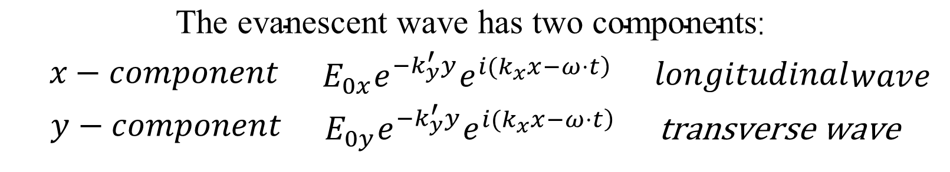
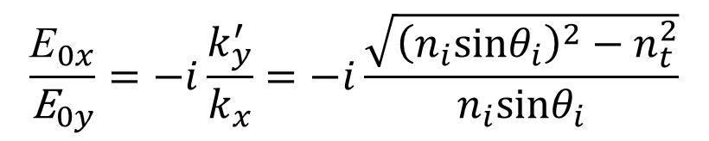

The longitudinal components of the evanescent wave
So we have:
$$(ik_{x}{\text{E}}_{0x}−k_{y}^{′}E_{0y})e^{−k_{y}^{′} y}⋅e^{\left.i(k_{x}x−ω⋅t\right)}=0$$
$$ik_{x}E_{0x}−k_{y}^{′}E_{0y}=0$$
$$\frac{{\text{E}}_{0x}}{{\text{E}}_{0y}}=−i\frac{k_{y}^{′}}{k_{x}}=−i\frac{\sqrt{{\left(n_{i}sinθ_{i}\right)}^{2}−n_{t}^{2}}}{n_{i}sinθ_{i}}$$
i.e.
$$\begin{matrix}\text{The} \text{evanescent} \text{wave} \text{has} \text{two} \text{components}\text{: } \\ \begin{matrix} x−component & \end{matrix}E_{0x}e^{−k_{y}^{′}y}e^{\left.i(k_{x}x−ω⋅t\right)}\begin{matrix} & longitudinal\end{matrix}wave \\ \begin{matrix}y−component & \end{matrix}E_{0y}e^{−k_{y}^{′}y}e^{\left.i(k_{x}x−ω⋅t\right)}\begin{matrix} & \text{transverse} \text{wave}\end{matrix}\end{matrix}$$

Slide 34
Frustrated Total Internal Reflection
When another surface approaches the interface, total internal reflection can be “frustrated.”
n=1
n
n
The surface distance when frustrated total internal reflection happens is decided by the depth of penetration.

Slide 35
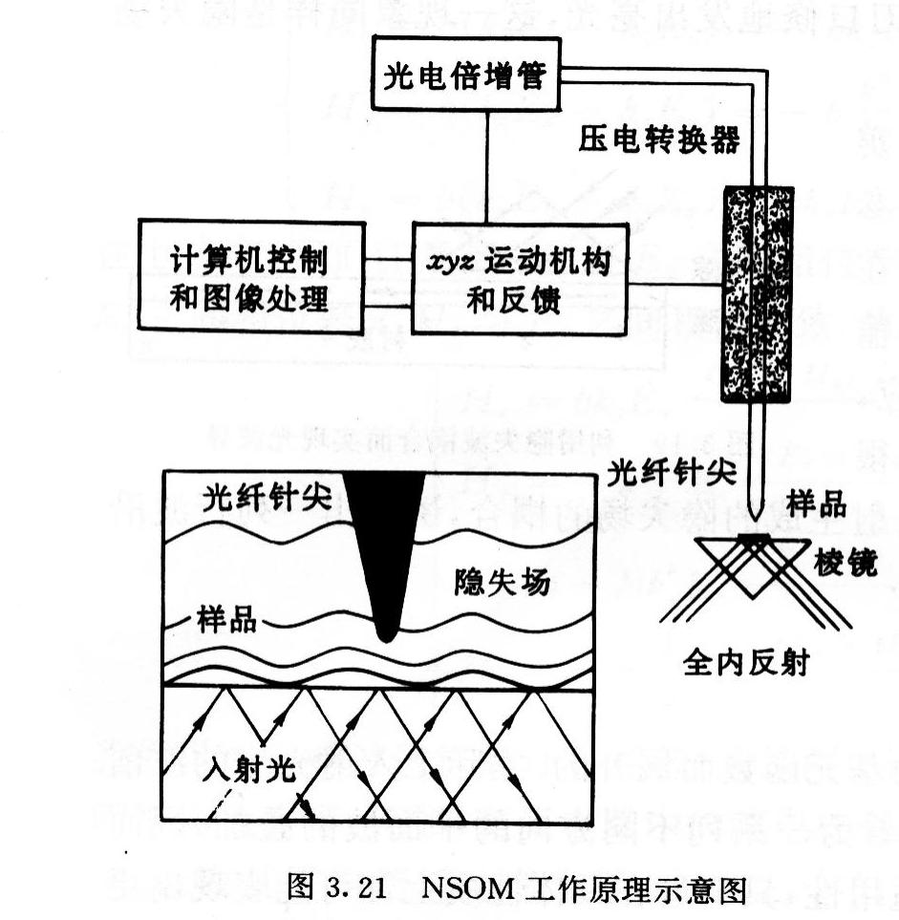
Scanning near-field microscope (SNOM)
By using a fiber tip with aperture of several tens nanometers and the precise position controlling system, we can check the distribution of the evanescent wave from a surface. The evanescent wave is decided by the surface profile. So, we can measure the surface height.

Slide 36

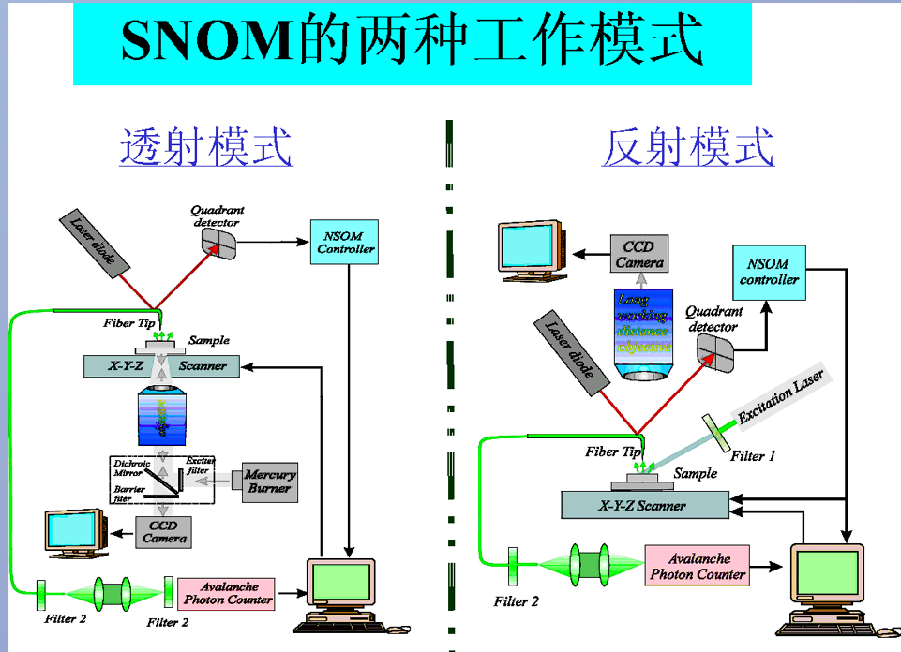
Working mode

Slide 37
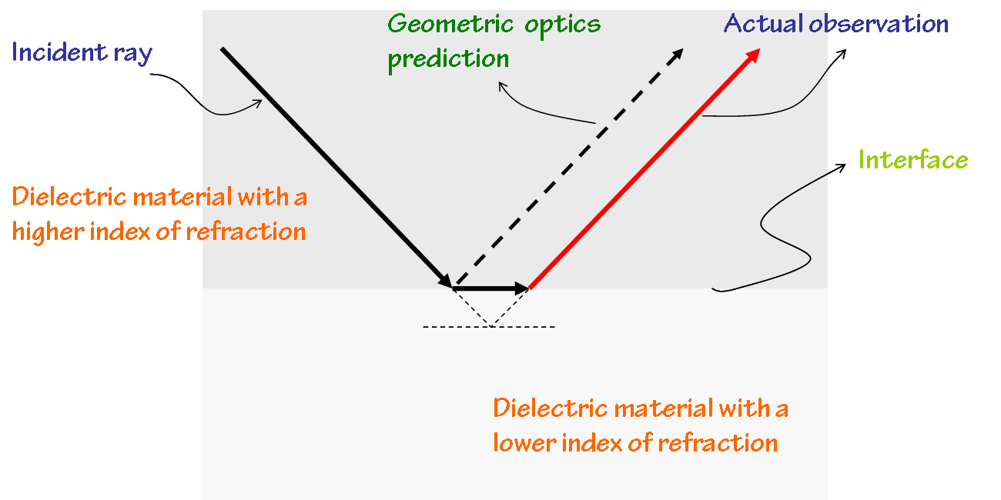
Goos–Hänchen Shift

