Slide 1
実験条件
Beam profiler
Pinhole
Biconvex lens
Table Experimental conditions
P.B.S
Laser
Objective
lens
Y
X
Mirror
Stage
direction
Z
Fig. Schema of confocal method

Slide 2
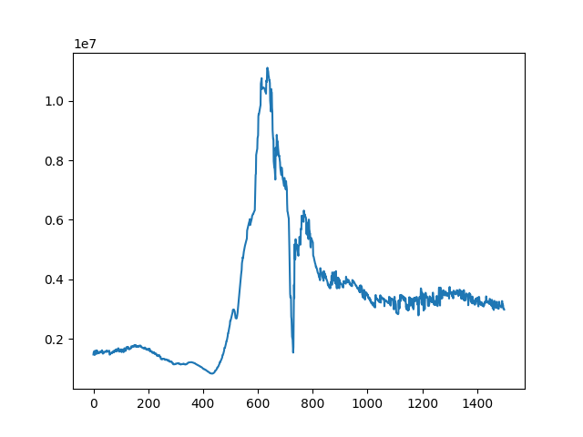
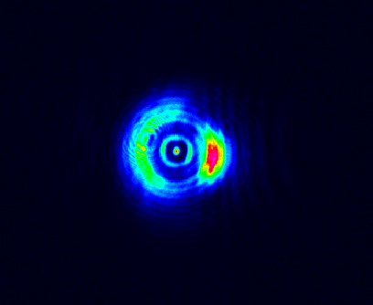
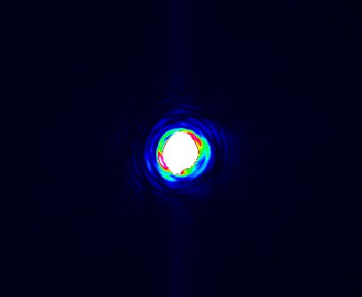
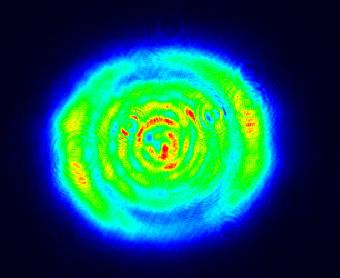
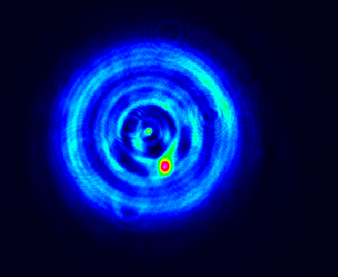
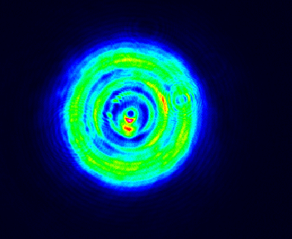
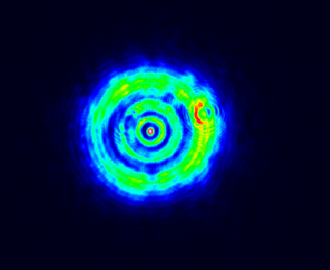
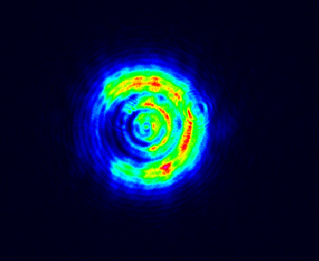
実験結果
Luminance
Z-axis moving amount
Fig.1 I-Z curve (Mirror)
Table Output images

