Slide 1
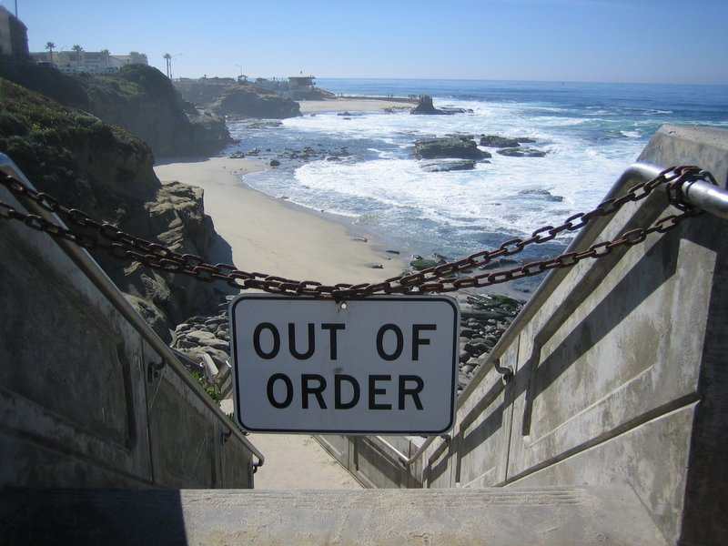
Hal Daumé III
Microsoft Research University of Maryland
me@hal3.name @haldaume3 he/him/his
image credit:
Lyndon Wong

Slide 2
We’ve all probably seen figures like this…
(this one in particular is thanks to Kyunghyun Cho)
Notes:
Left-to-right monotonic structure
Efficient learning: a series of text classification
Separation between learning and inference
Search is still an issue in principle, but works well in practice.
Better search algorithms can improve the quality of generation.
THIS STUFF WORKS

Slide 3
New Tasks
New Models
Notes:
Given that these neural autoregressive models work, what is left to do?

Slide 4
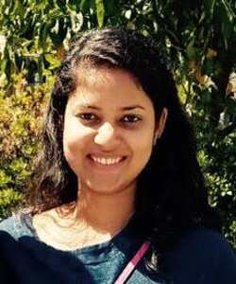
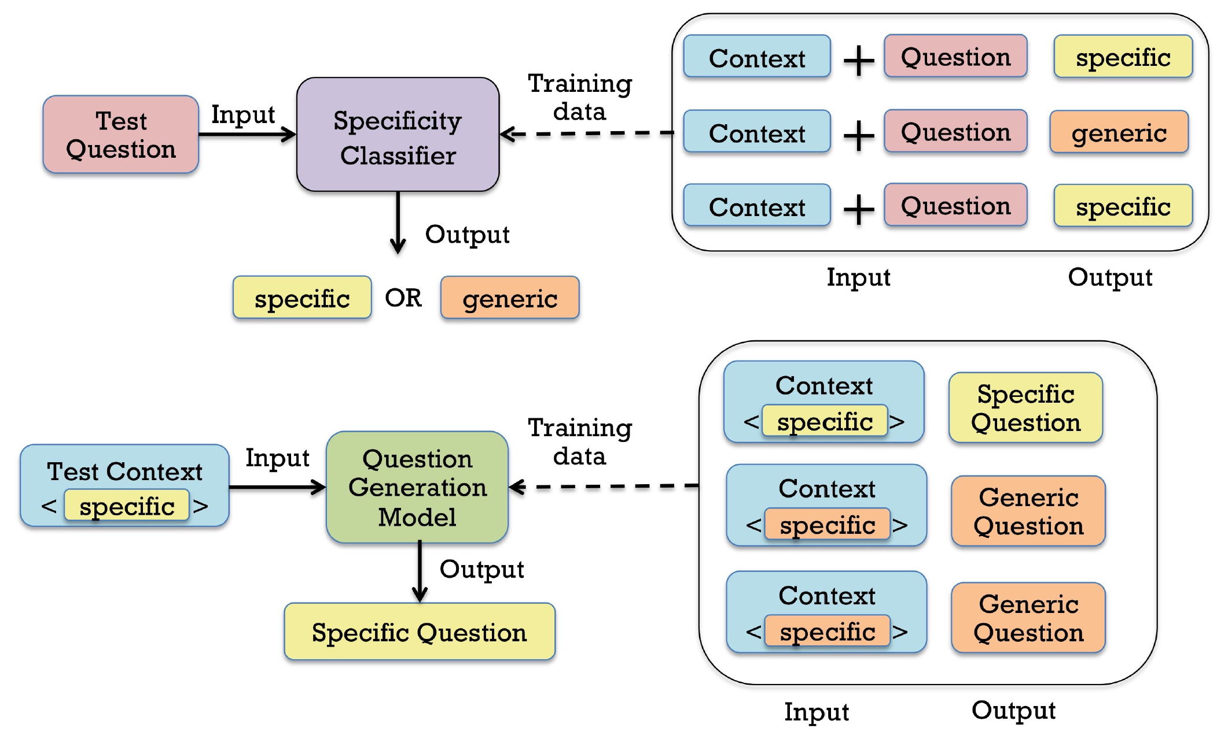
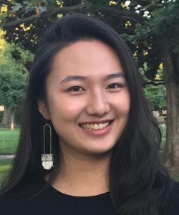
New Tasks
Sudha Rao
Upcoming presentation at Widening NLP Workshop at ACL’19
Trista Cao

Slide 5
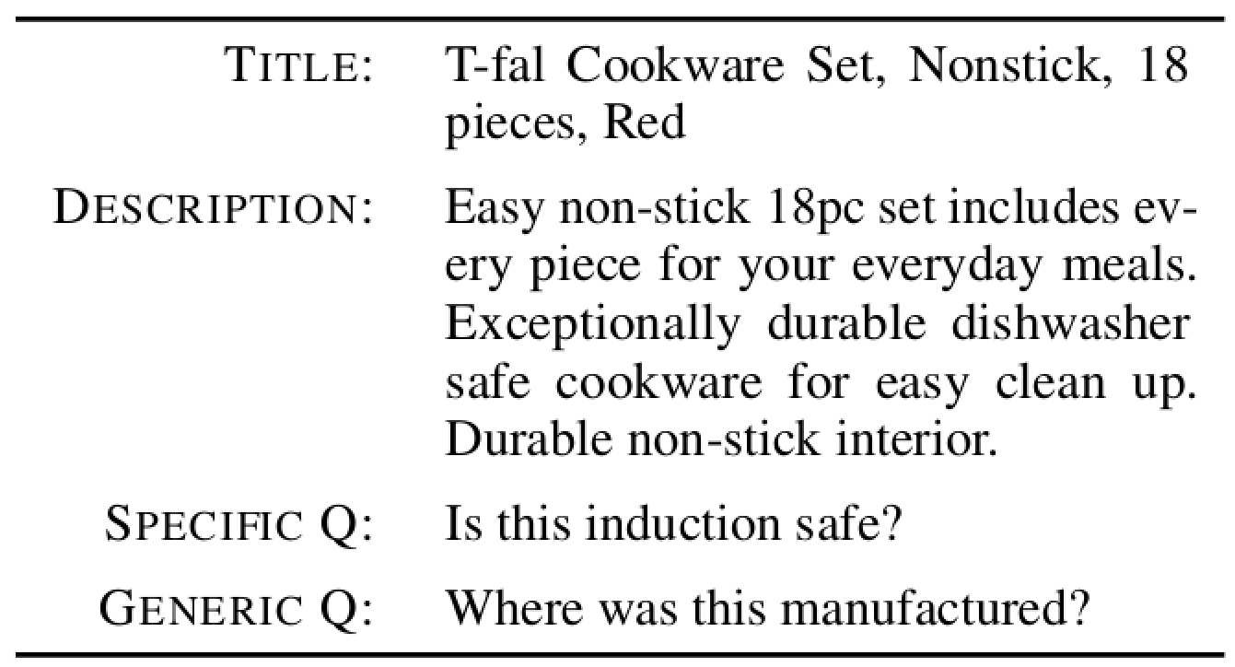
New Tasks
Rao
Cao
[Louis & Nenkova, IJCNLP’11, Gao, Zhong, Pretiuc-Pietro & Li, AAAI’19]

Slide 6
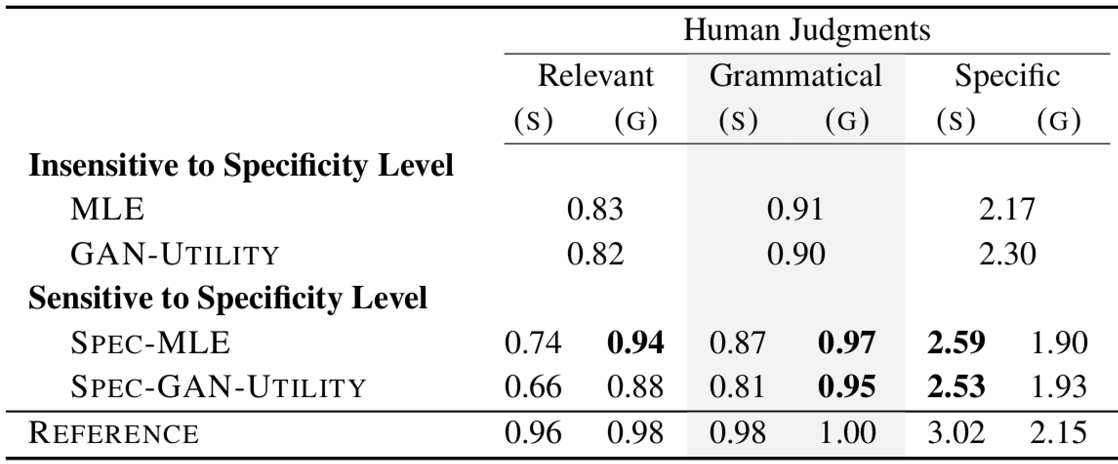
New Tasks
Rao
Cao

Slide 7
New Tasks
New Models
Notes:
Given that these neural autoregressive models work, what is left to do?

Slide 8
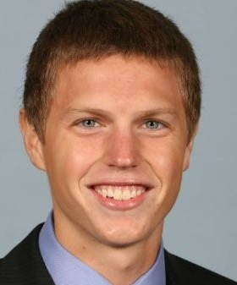
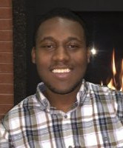
New Models
.
you
.
i
study
i
<stop>
Sean Welleck
<stop>
wish
could
lol
<stop>
a
<stop>
<stop>
<stop>
<stop>
<stop>
<stop>
work
lot
<stop>
<stop>
<stop>
<stop>
Also featuring Kyunghyun Cho (not pictured); to appear at ICML 2019 next week
Kianté Brantley

Slide 9
Linearizing the hierarchical prediction
Welleck
Brantley
+ Kyunghyun Cho, ICML’19
.
you
.
i
study
???
i
<stop>
<stop>
wish
???
lol
<stop>
a
could
<stop>
<stop>
???
work
lot
<stop>
<stop>
<stop>
<stop>
<stop>
<stop>
<stop>
<stop>

Slide 10
Imitation learning w/ equivocating expert
Welleck
Brantley
+ Kyunghyun Cho, ICML’19
.
you
i wish you could study lol .
<stop>
.
i
study
???
i
<stop>
<stop>
wish
???
lol
<stop>
a
could
<stop>
<stop>
???
work
lot
<stop>
<stop>
<stop>
<stop>
<stop>
<stop>
Target: i wish you could study lol .
<stop>
<stop>

Slide 11
Imitation learning w/ equivocating expert
Welleck
Brantley
+ Kyunghyun Cho, ICML’19
.
you
i wish you could study lol .
<stop>
.
i
study
i
<stop>
<stop>
wish
???
lol
<stop>
a
could
<stop>
<stop>
???
work
lot
<stop>
<stop>
<stop>
<stop>
<stop>
<stop>
Target: i wish you could study lol .
<stop>
<stop>

Slide 12
Imitation learning w/ equivocating expert
Welleck
Brantley
+ Kyunghyun Cho, ICML’19
.
you
i wish you could study lol .
<stop>
.
i
could
i
<stop>
<stop>
wish
???
lol
<stop>
a
could
<stop>
<stop>
???
work
lot
<stop>
<stop>
<stop>
<stop>
<stop>
<stop>
Target: i wish you could study lol .
<stop>
<stop>

Slide 13
Quicksort-esque expert policy
{the, on, mat, ., sat, cat, the}
on
Welleck
Brantley
+ Kyunghyun Cho, ICML’19
The cat sat on the mat .
{The, sat, cat}
{mat, ., the}
sat
mat
{The, cat}
{<stop>}
{the}
{.}
cat
<stop>
the
.
{The}
{<stop>}
{<stop>}
{<stop>}
{<stop>}
{<stop>}
The
<stop>
<stop>
<stop>
<stop>
<stop>
{<stop>}
{<stop>}
<stop>
<stop>

Slide 14
Model structure on top of quicksort
Welleck
Brantley
{the, on, mat, ., sat, cat, the}
+ Kyunghyun Cho, ICML’19
The cat sat on the mat .
on
{The, sat, cat}
{mat, ., the}
sat
Valid items
on
sat
Loss
mat
the
.

Slide 15
Formalizing the expert policy
Welleck
Brantley
where
+ Kyunghyun Cho, ICML’19
{The, sat, cat}
sat
Valid items
on
sat
Loss
mat
the
.

Slide 16
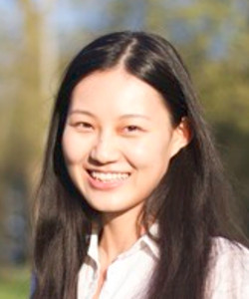
Distributing mass across equivocations
Welleck
Brantley
Uniform Oracle
Coaching Oracle [He et al., 2012]
Annealed Coaching Oracle
+ Kyunghyun Cho, ICML’19
Valid items
mat
the
.

Slide 17
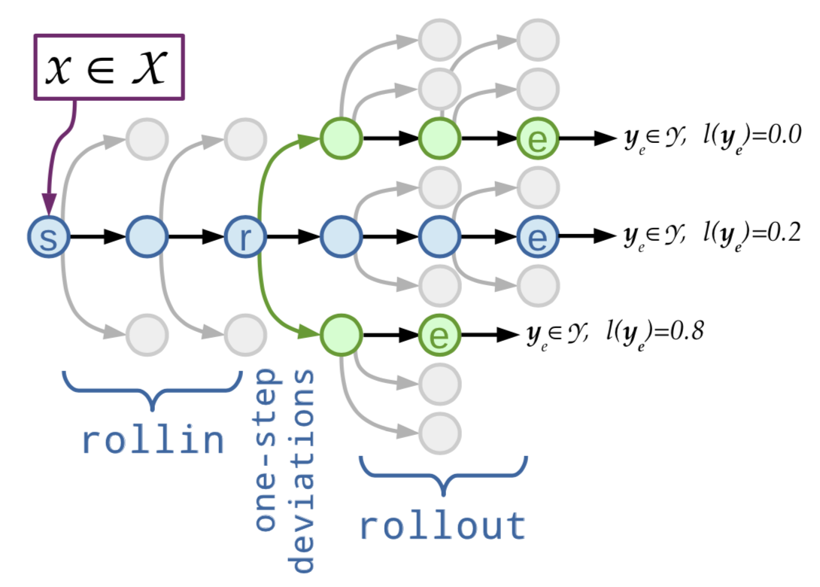
Training via imitation learning
This is a special case of imitation learning with an optimal oracle
Extensively studied and used in NLP [Goldberg&Nivre, 2012; Vlachos&Clark, 2014 and many more]
Extensively studied and used in robotics and control [Ross et al., 2011; and many more recent work from Abeel and Levine et al.]
Learning-to-search* for non-monotonic sequential generation
Roll-in by a oracle/learned policy
Roll-out by an oracle policy
Easy to swap roll-in and roll-out policies
Welleck
Brantley
+ Kyunghyun Cho, ICML’19

Slide 18
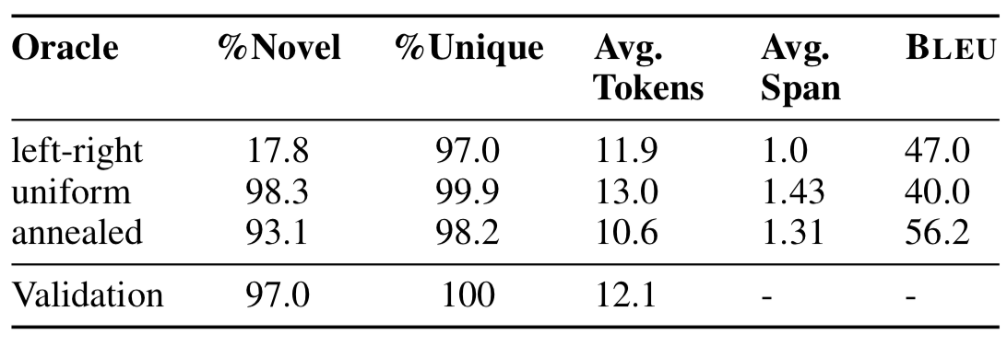
Results on unconditional generation
Welleck
Brantley
Implicit probabilistic model: sampling 👍 normalized probability 👎
Difficult to analyze quantitatively, but we tried:
All the models were trained on utterances from a dialogue data [ConvAI PersonaChat]
+ Kyunghyun Cho, ICML’19

Slide 19
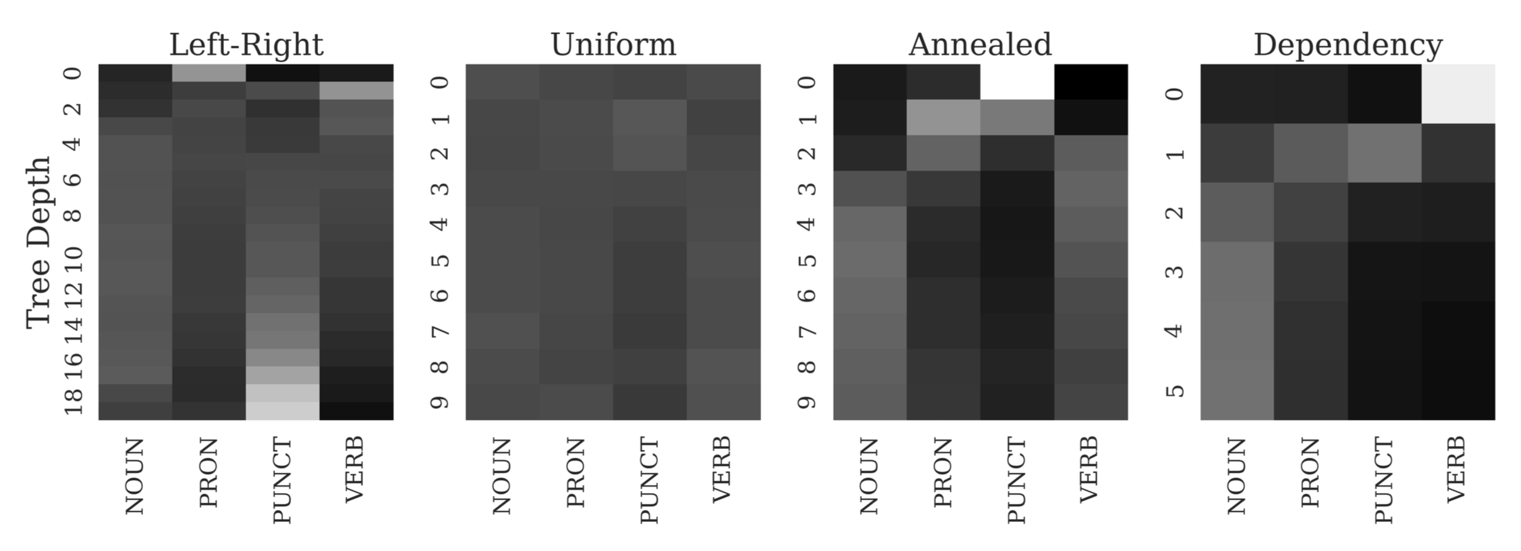
Results on unconditional generation
Welleck
Brantley
Implicit probabilistic model: sampling 👍 normalized probability 👎
We can also do a bit of more analysis:
+ Kyunghyun Cho, ICML’19

Slide 20
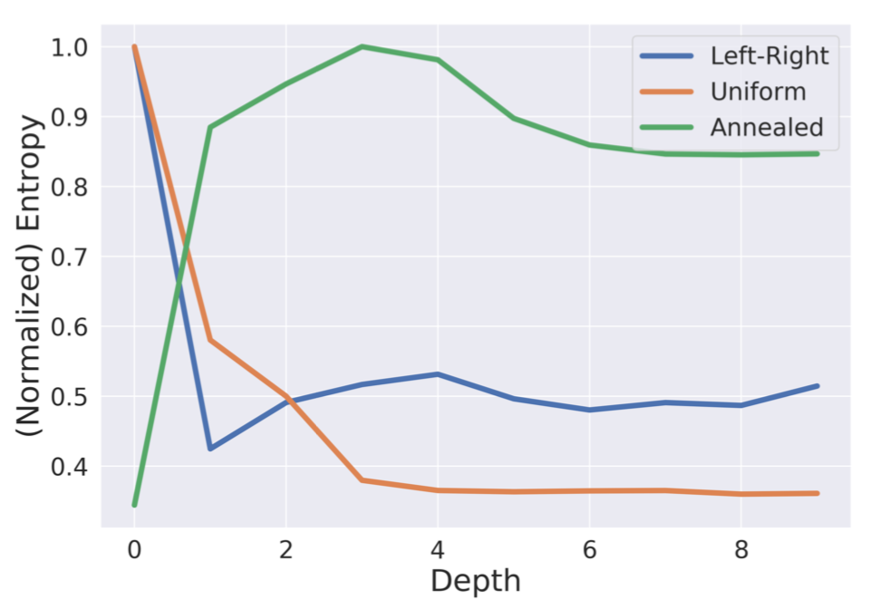
Results on unconditional generation
Welleck
Brantley
Implicit probabilistic model: sampling 👍 normalized probability 👎
We can also do a bit of more analysis:
+ Kyunghyun Cho, ICML’19

Slide 21
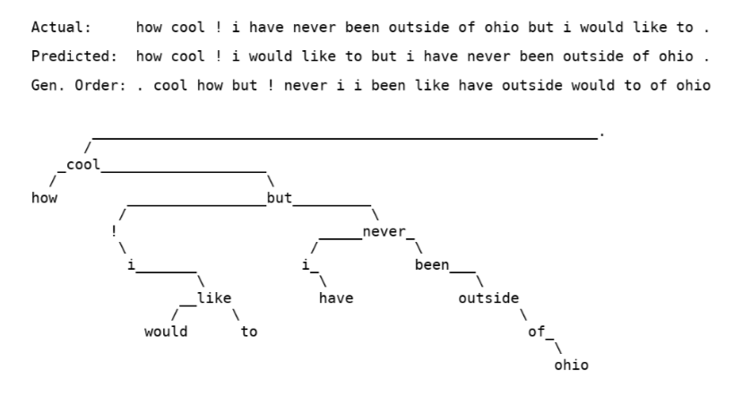
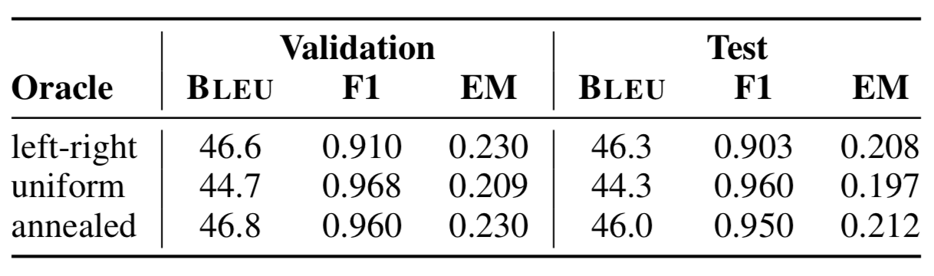
Word descrambling
Welleck
Brantley
+ Kyunghyun Cho, ICML’19

Slide 22
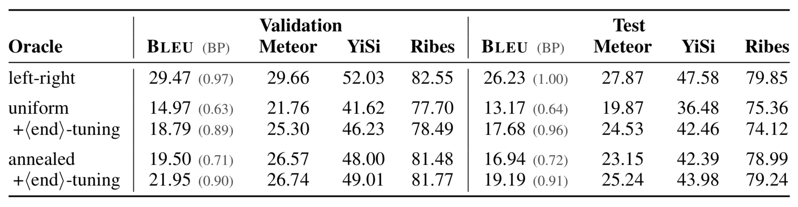
Machine translation
Welleck
Brantley
+ Kyunghyun Cho, ICML’19
Lags behind left-to-right, monotonic generation in MT:
Though, how much it lags depends on how you measure the quality

Slide 23
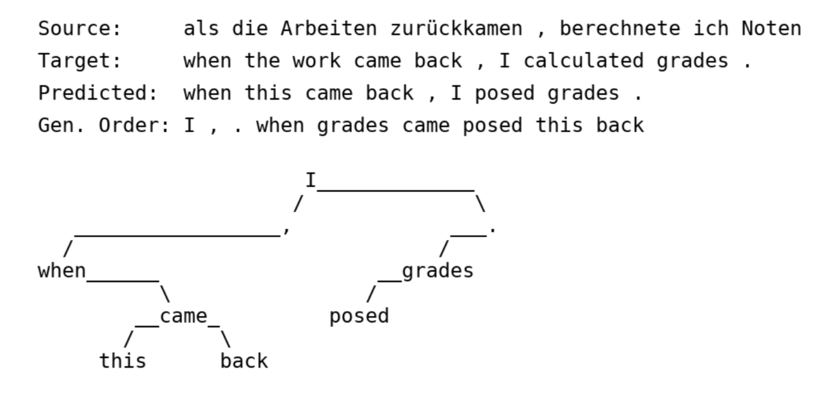
Machine translation
Welleck
Brantley
+ Kyunghyun Cho, ICML’19

Slide 24
Summary and discussion
Rao
Cao
Welleck
Brantley
Lots of fun stuff to do moving to new tasks, models
Promising results in non-monotonic generation
But still haven’t “cracked” it
Should we improve modeling/representations?
Should we improve training algorithms?
Some contemp work: [Gu et al., arxiv’19; Stern et al., arxiv’19]
Code at https://github.com/wellecks/nonmonotonic_text
Thanks! Questions?

