Slide 1
ServiceNow Tutorial Start
What/Why ServiceNow:
https://www.youtube.com/watch?v=StF3bXCbtJ8
Also a Udemy Online Course: $11.00 typically
https://www.udemy.com/servicenow-201-development

Slide 2
I have a semi-basic Tutorial (more complex than Hello World) but
At the same time, way less complex than a real world scenario.
It’s stored on the public Internet GitHub Site.
Use the following slide for more information on how to
Access, Download, and Install the Tutorial Project to Your
Developer Service Now Instance.
You will most likely need to create your own GitHub User Account. It’s FREE (but all of your stuff is public visible).
Use this GitHUB URL to access the Tutorial:
https://github.com/genmoltekit/RADT-ServiceNow-Tutorial.git
Note: The URL must be used within the ServiceNow Studio interface. Otherwise it can’t be downloaded/installed easily.

Slide 3
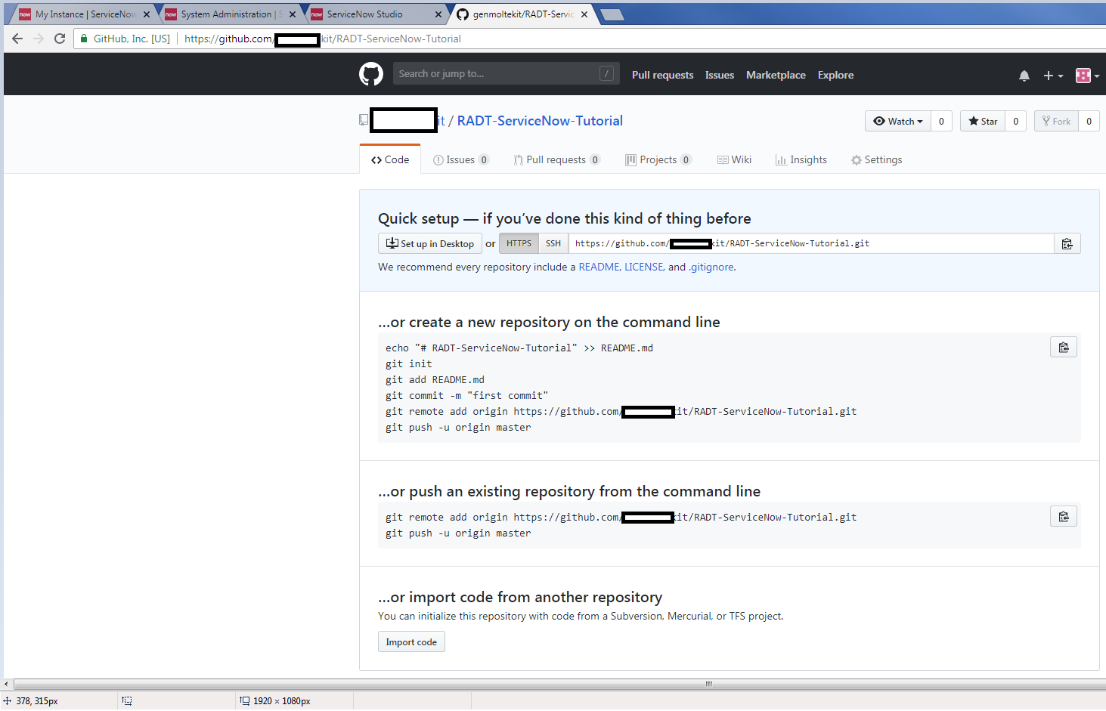
Create a public GitHub Project…..

Slide 4
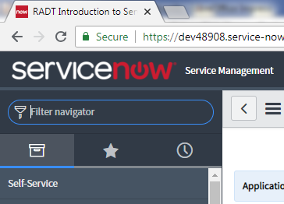
Now we want to access the ServiceNow “Studio”.
Thats essentially the Developer IDE that allows creation/editing of all the various Objects/Components of the entire Service Now project.
From within the “Studio” you can create Tables, Scripts, Workflows, customizable User Interface Forms (to collect Data that is stored in the corresponding Table) etc etc…
To find the Studio..
You just search for it in main ServiceNow interface of your Developer Instance.

Slide 5
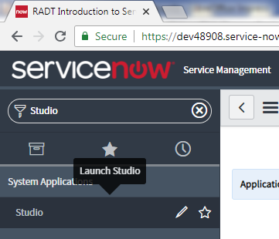
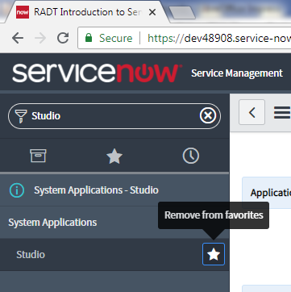
Clicking the hollow/outlined star will setup a ‘Favorites Link’ so that you can quickly access it later.

Slide 6
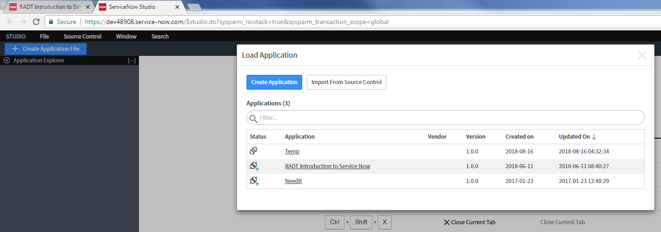
Clicking that “Studio” link opens up another window (or Tab) in the Browser.
This is where you can choose to open one of the existing Applications.
If the list is empty, then you need to either create one or Import it from GitHub.

Slide 7
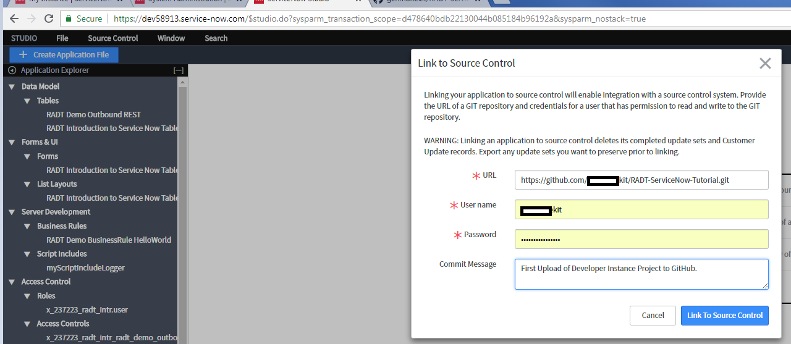
From the Studio View of ServiceNow… click on “Source Control”
Then click on the white popup dialog that is displayed here.
Enter in the URL for my GitHub Tutorial.
Enter in YOUR Github Username and Password.
Then click the Blue button “Link to Source Control” to start the process.
NOTE: you might have to create an empty project FIRST on your Developer Instance before you can download and install one from GitHub. (it’s a bug).

Slide 8
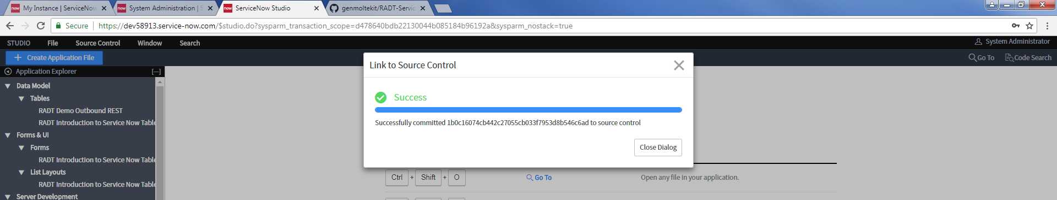

Slide 9

Click on the link to “RADT Introduction to Service Now”
To get started on exploring the components of the App.

Slide 10
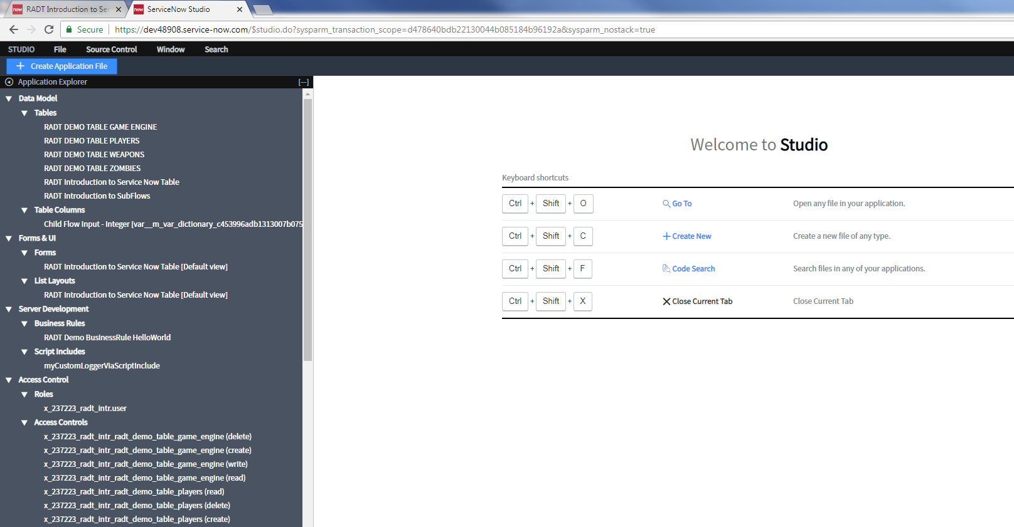
This is your standard Studio display when opening a project
Clicking on the entries in the left-hand side list
Will open and edit that component. You can expand/collapse the tree view as desired.

Slide 11
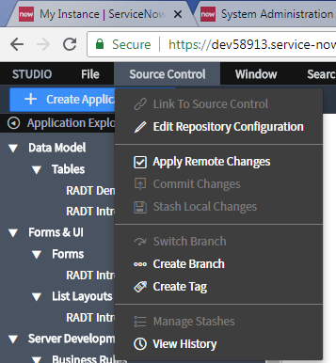
If your Project is originated from GitHub..
Or if you have created a new project and then linked it to GitHub, you will see additional options
Available under the “Source Control” menu

Slide 12
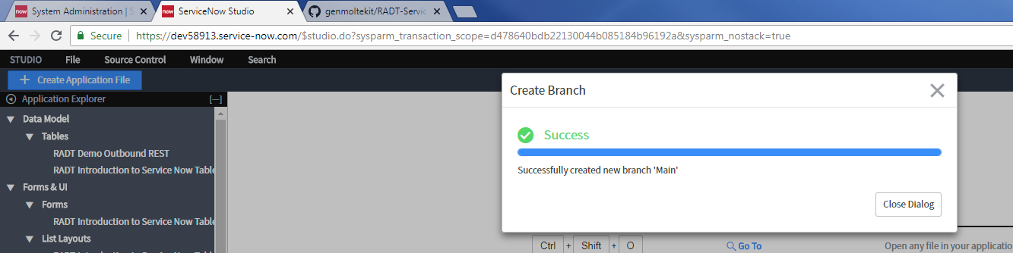

Create Branch to GitHub Linked Project
Then switch to the Branch
In order to start using the Tutorial.. You need to create a branch via the service now interface options under the “Source Control” menu.
The “Branch” essentially gives you Read/Write privs to the Project.
This is necessary to make changes which can kickstart the Workflows…
All changes to this Branch are local to your Developer Instance.
You can pick
Any name for
Your branch that you wish.

Slide 13
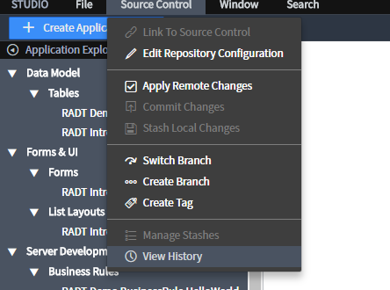
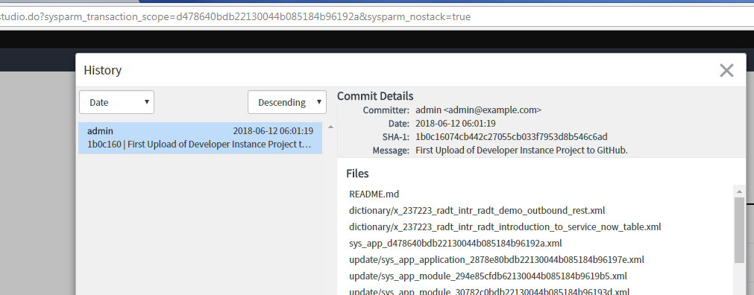
This just illustrates how you can verify the most relevant information (and Changes) to the current Branch on your Dev Instance.

Slide 14
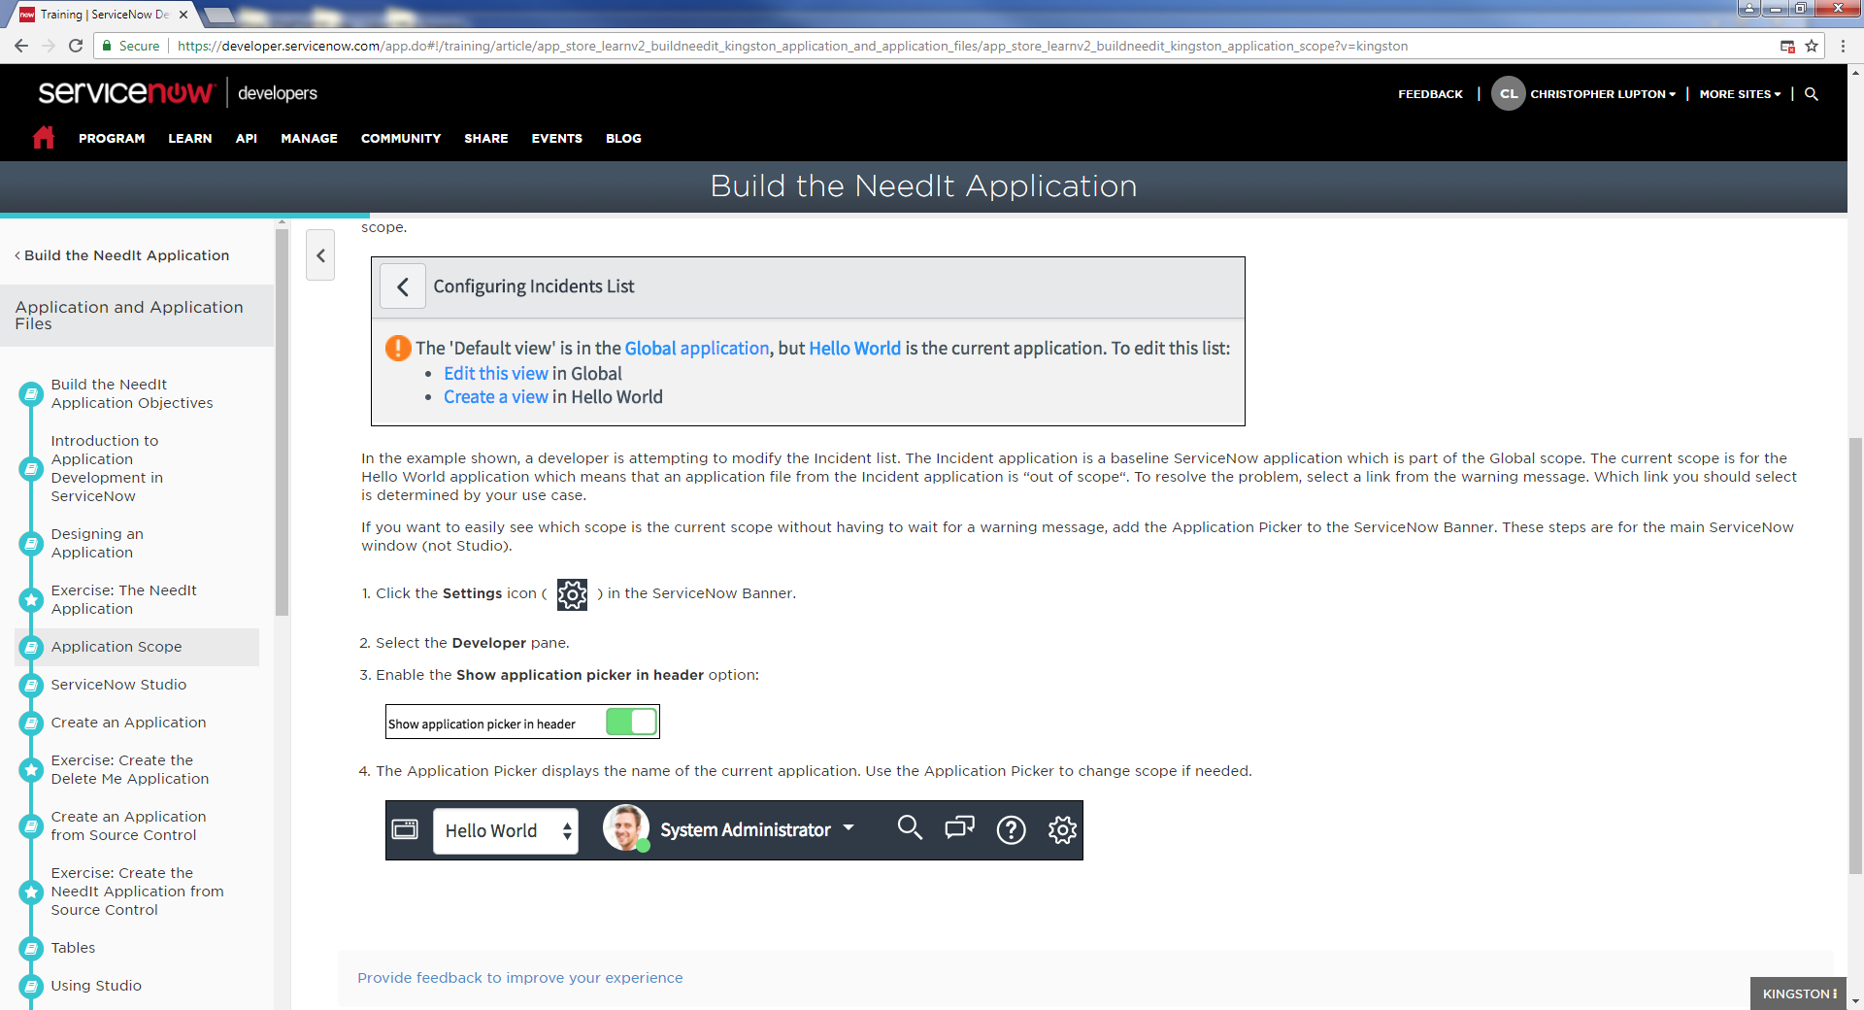
Application Scope is automatically set with a globally unique ID.
Every application on every instance of every Service Now Instance.
Developers can use the Scope to determine visibility/interactivity of various
Components from one Application to another….

Slide 15
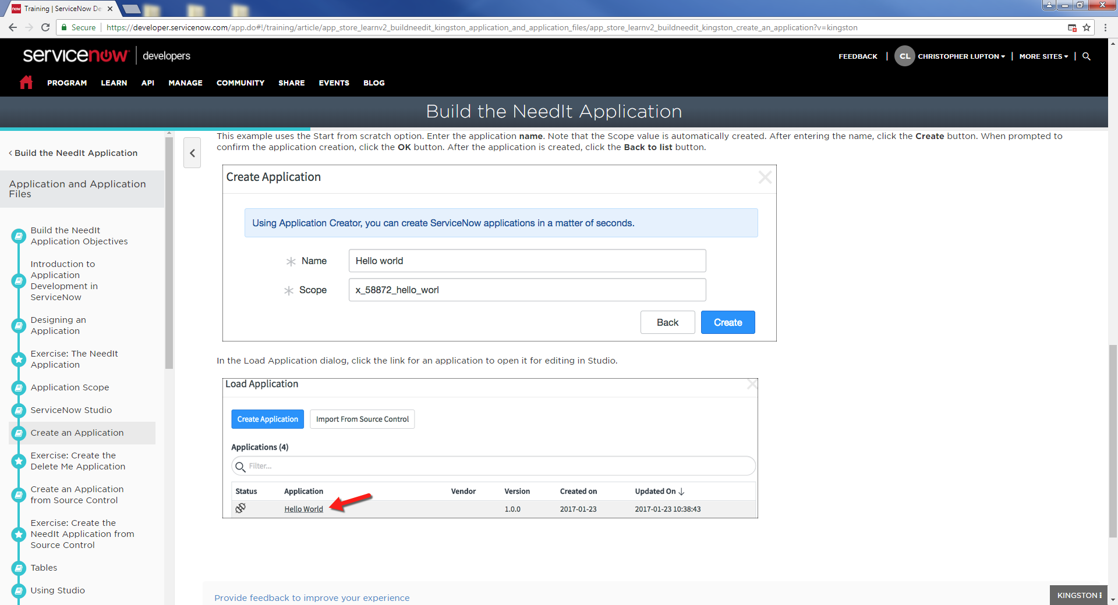
Example of how ServiceNow builds the Scope name

Slide 16
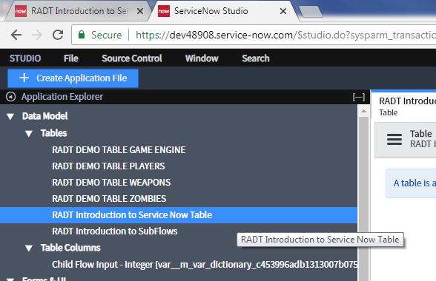
Let’s get started...
Open up the tree section with the label named: “Tables”
Then click the entry “RADT Introduction to Service Now Table”

Slide 17
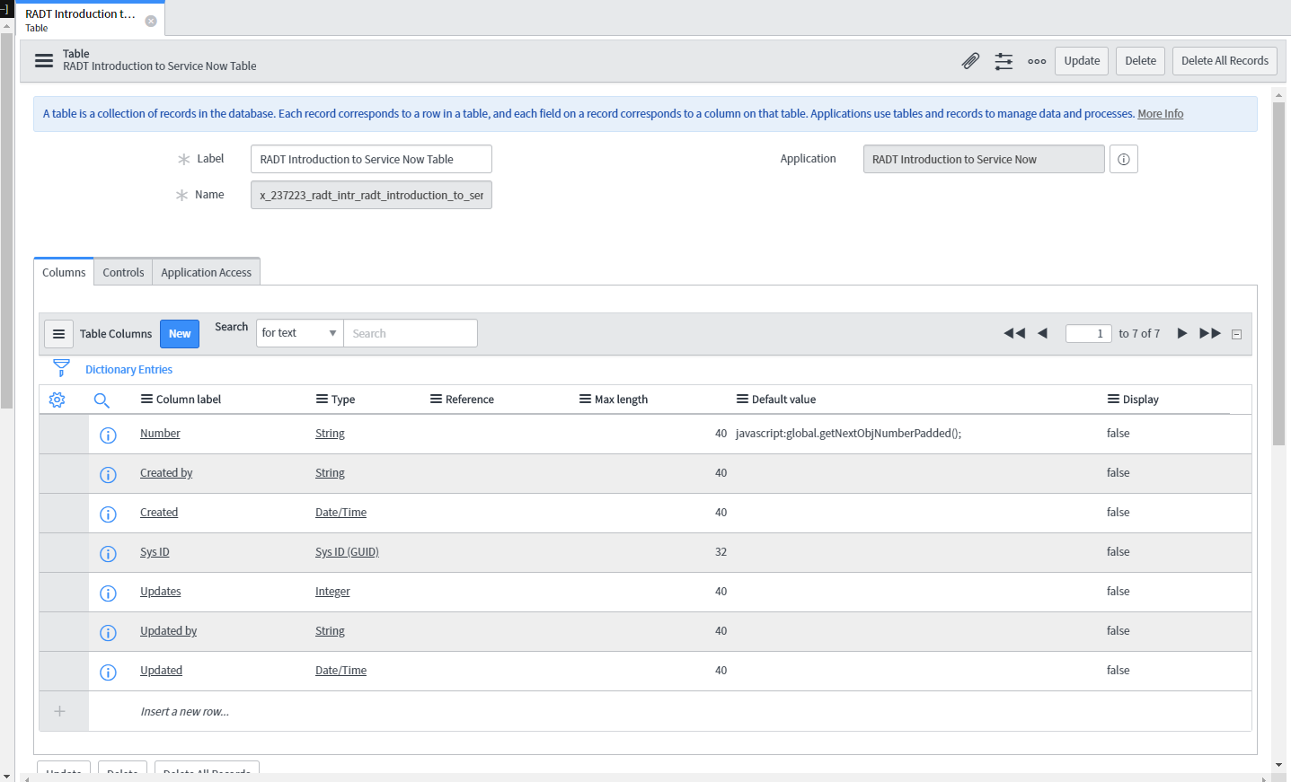
Now you will see the Edit View of the selected Table…
From here you can add / modify any of the columns of the Table.
As fields are created.. the corresponding Data Entry Form will be updated automatically.

Slide 18
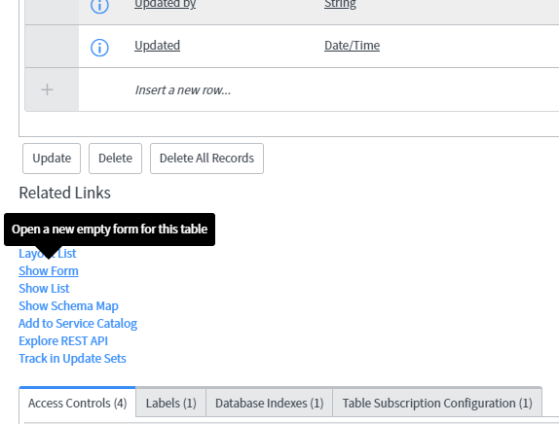
For a quick start to see what this project does.. lets go ahead and create a new Record and save it into the Table.
To do this.. we have to switch from the Edit view to the Data Entry View of the Table.
Look at the “Related Links” Section and click the blue “Show Form” link.

Slide 19
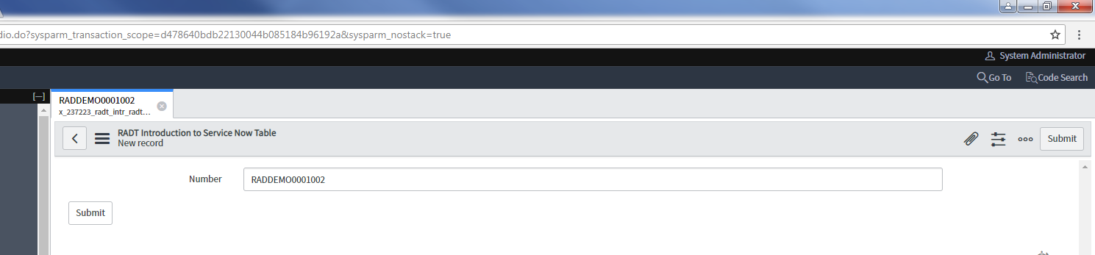
Now for simplicity sake, the Form is only going to show fields that are unique to the custom Table that has already been created for you. There is only one field added.. all other fields were inherited from a standard ServiceNow Table when it was created.
The Table was also preconfigured to provide a uniqueID for each Record.
You can modify this value.. or leave it as it is..
Clicking “Submit” will save the Record and kick start the WorkFlow that is preconfigured to look for changes to records in this Table.

Slide 20
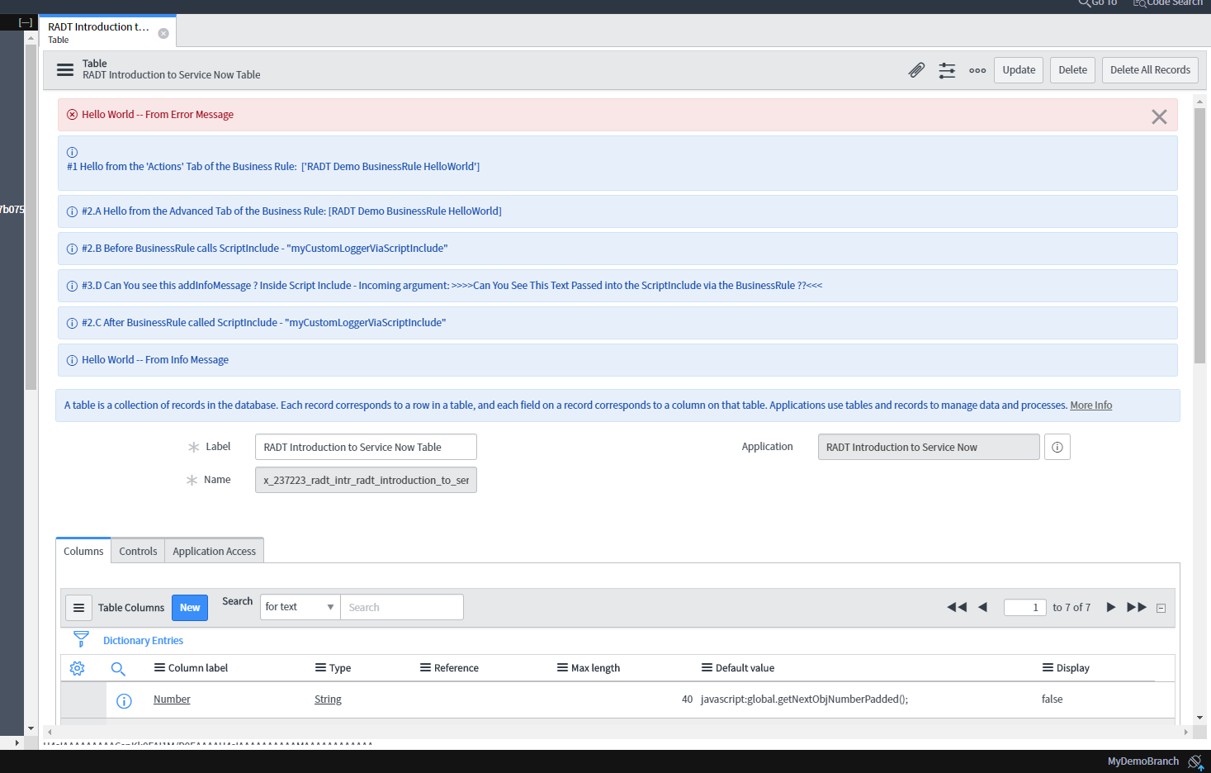
The tutorial includes several debug statements within the workflow …
This is why the Red and Blue messages are displayed at the top of the
Design View of the Table once the Record was submitted and saved into Table.
Note: we did NOT have an actual error.
I created a log message of type “error” so that you can see what one looks like.

Slide 21
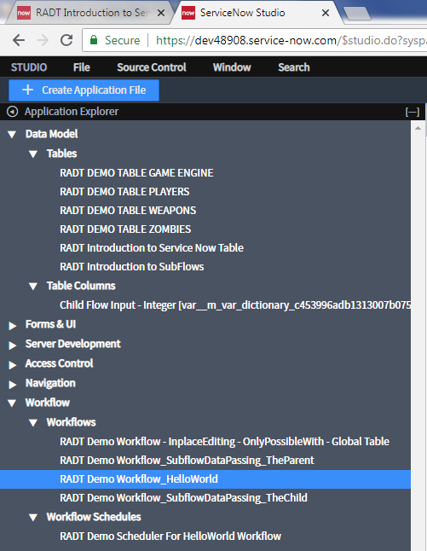
To see where the code exists for creating these Debug Messages.. we need to view the WorkFlow that is associated with this Table. A Table can have many workflows associated with it.. but each Workflow can only be associated with one Table.

Slide 22
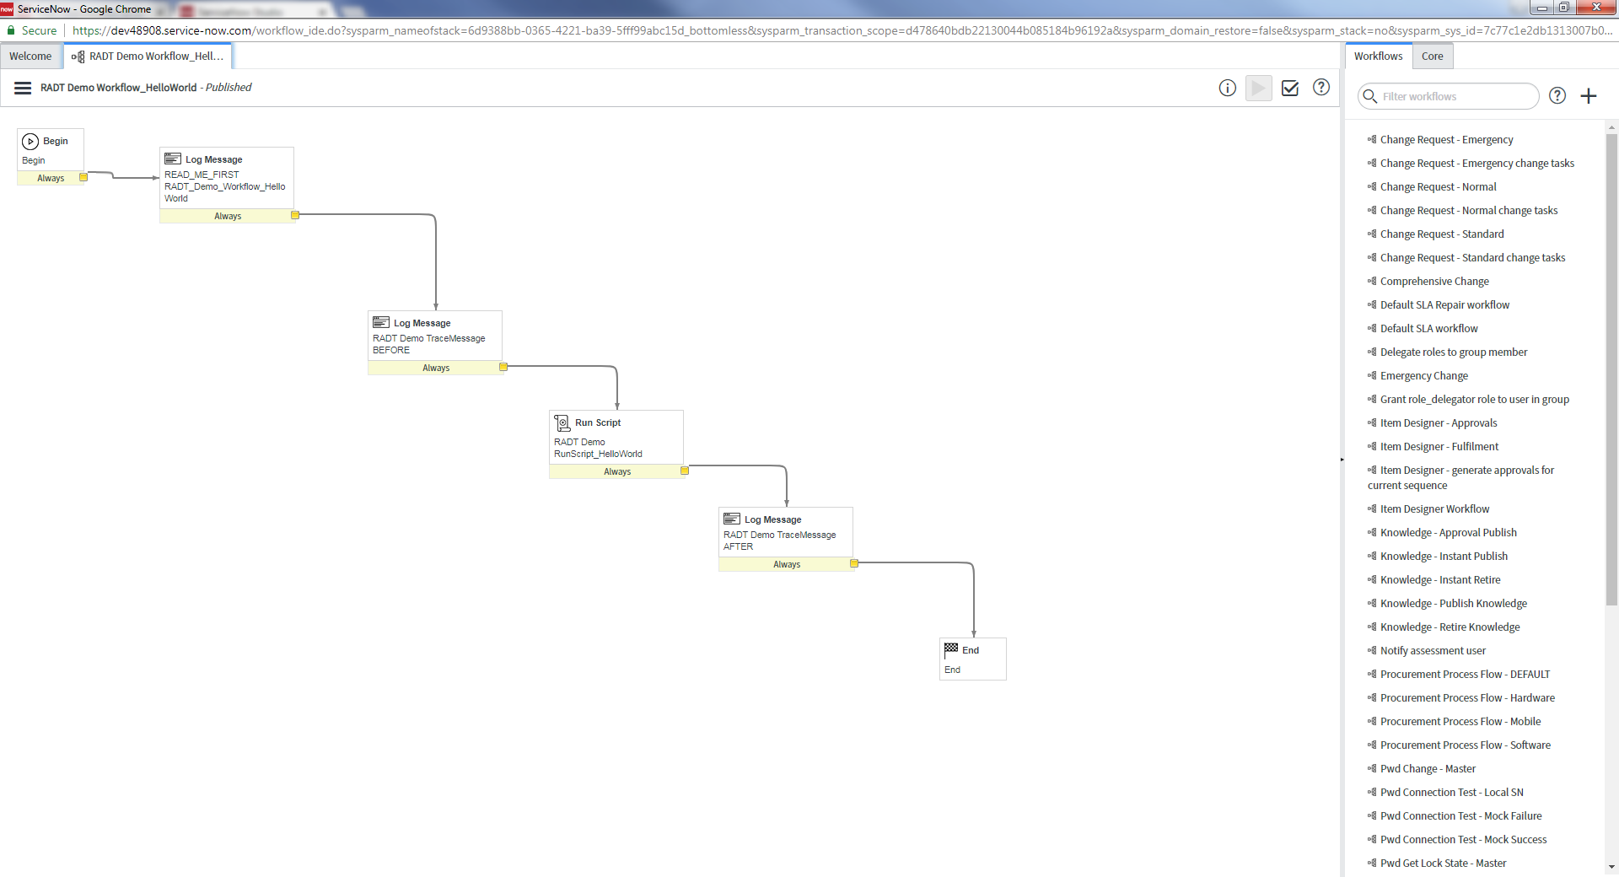
Clicking the Entry for “RADT Demo Workflow_HelloWorld” will open a new window
Which shows the visual representation of all the steps and control logic ….
This particular workflow isnt doing much other than generating the Log Message (blue and red) that you saw on the previous slides.

Slide 23
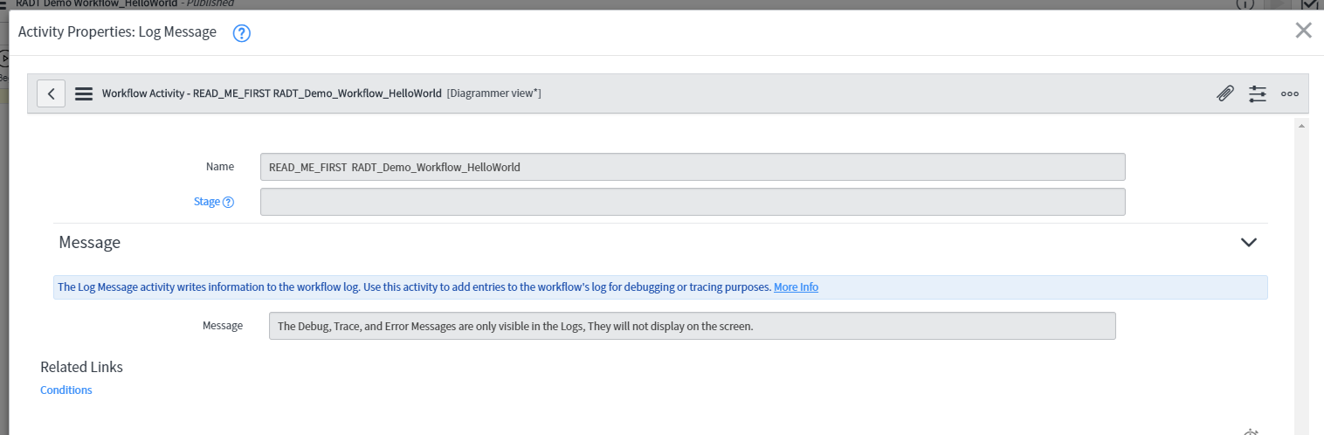
Double Clicking one of the Widgets on the Workflow takes you to Edit Mode for that Widget.

Slide 24
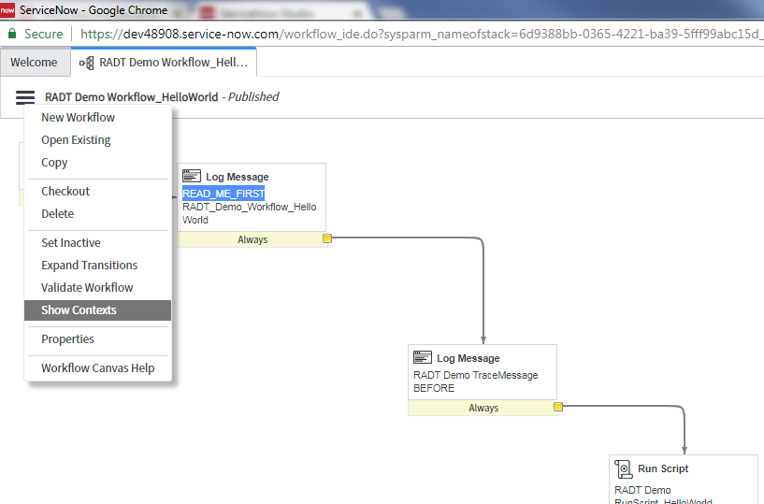
From the main workflow view, you can see a visual trace of the route the workflow used to get to it’s termination widget “End”. This can be helpful if you have a complex workflow with many conditional paths that will not all be executed.

Slide 25
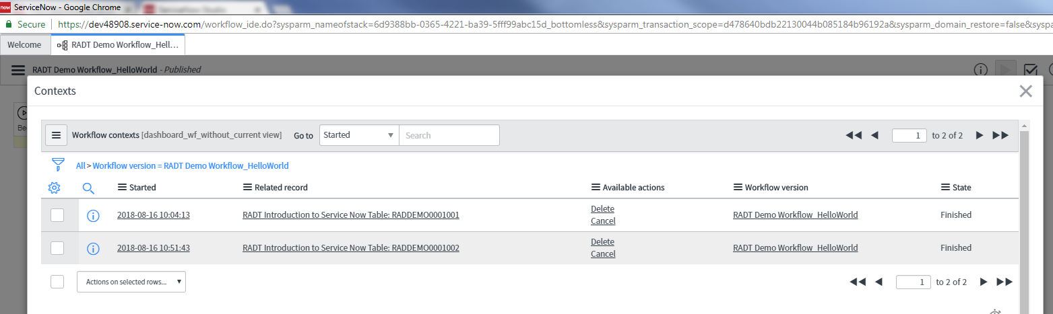
A record of every execution of a workflow is stored within ServiceNow….
If you have a business rule that executes in the background, or have thousands of Users interacting with Forms that modify the Table that is associated with this workflow.. you could potentially have thousands of separate context records.
Each record represents the current state of that workflow for that User/Row etc.
Picking one of these Entries and clicking on it will reveal the visual trace path of the workflow.
If the “State” column is not “Finished”.. then the workflow is still running. The more workflows that are running, the more resources that are used in memory etc. etc.
You can use this form to terminate any workflow instances (called ‘Contexts’).

Slide 26
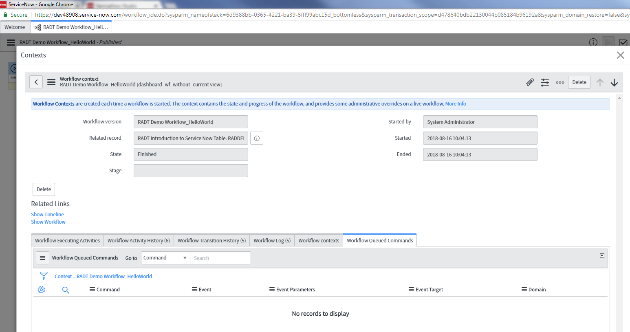
Click the “show Workflow” link to see the visual trace of the path used for this instance of the Workflow.

Slide 27
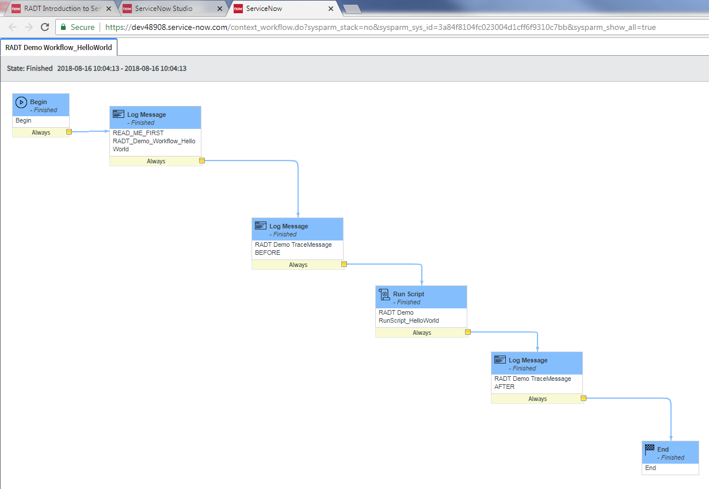
Now in this scenario, we only have
A single path of execution..
So there is nothing really interesting to see here.. but other workflows with multiple paths would only highlight blue for the path taken.

Slide 28
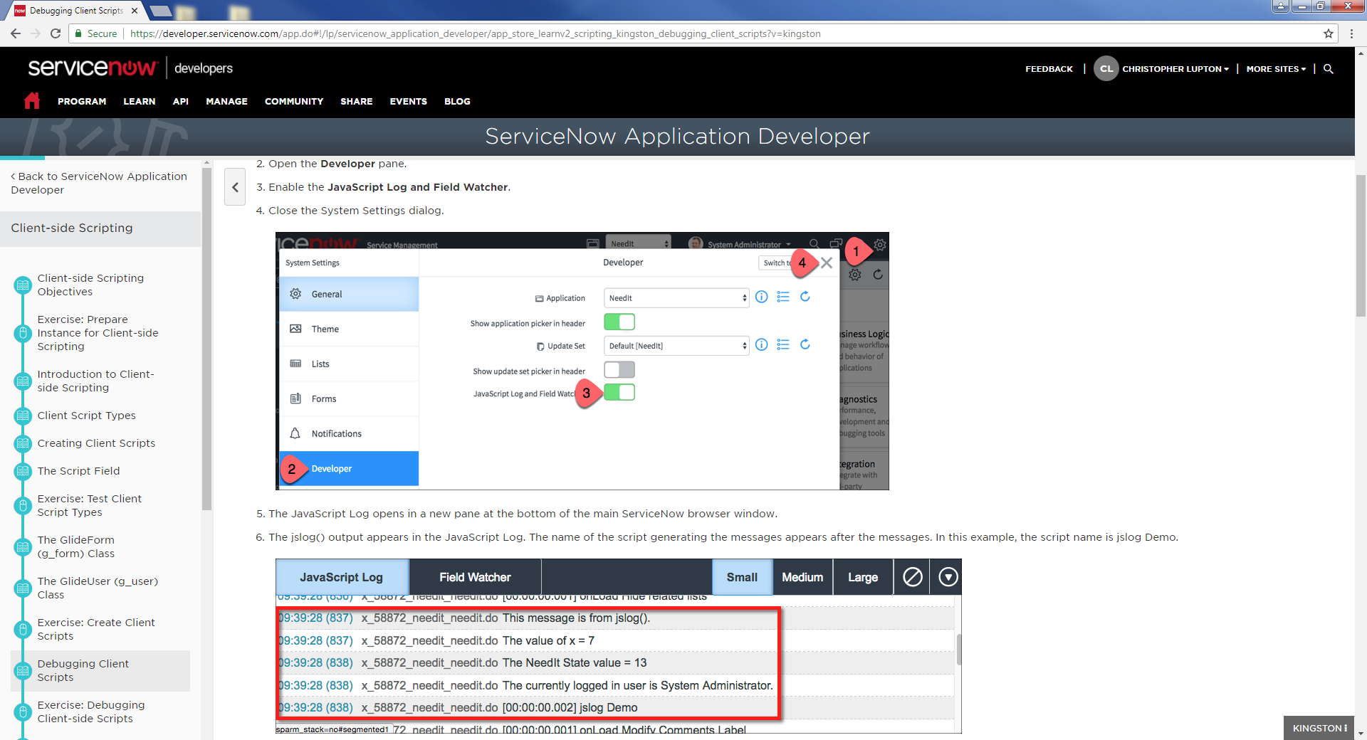
How to view the Javascript Logs, Field Watcher (other Debug Tips)

Slide 29
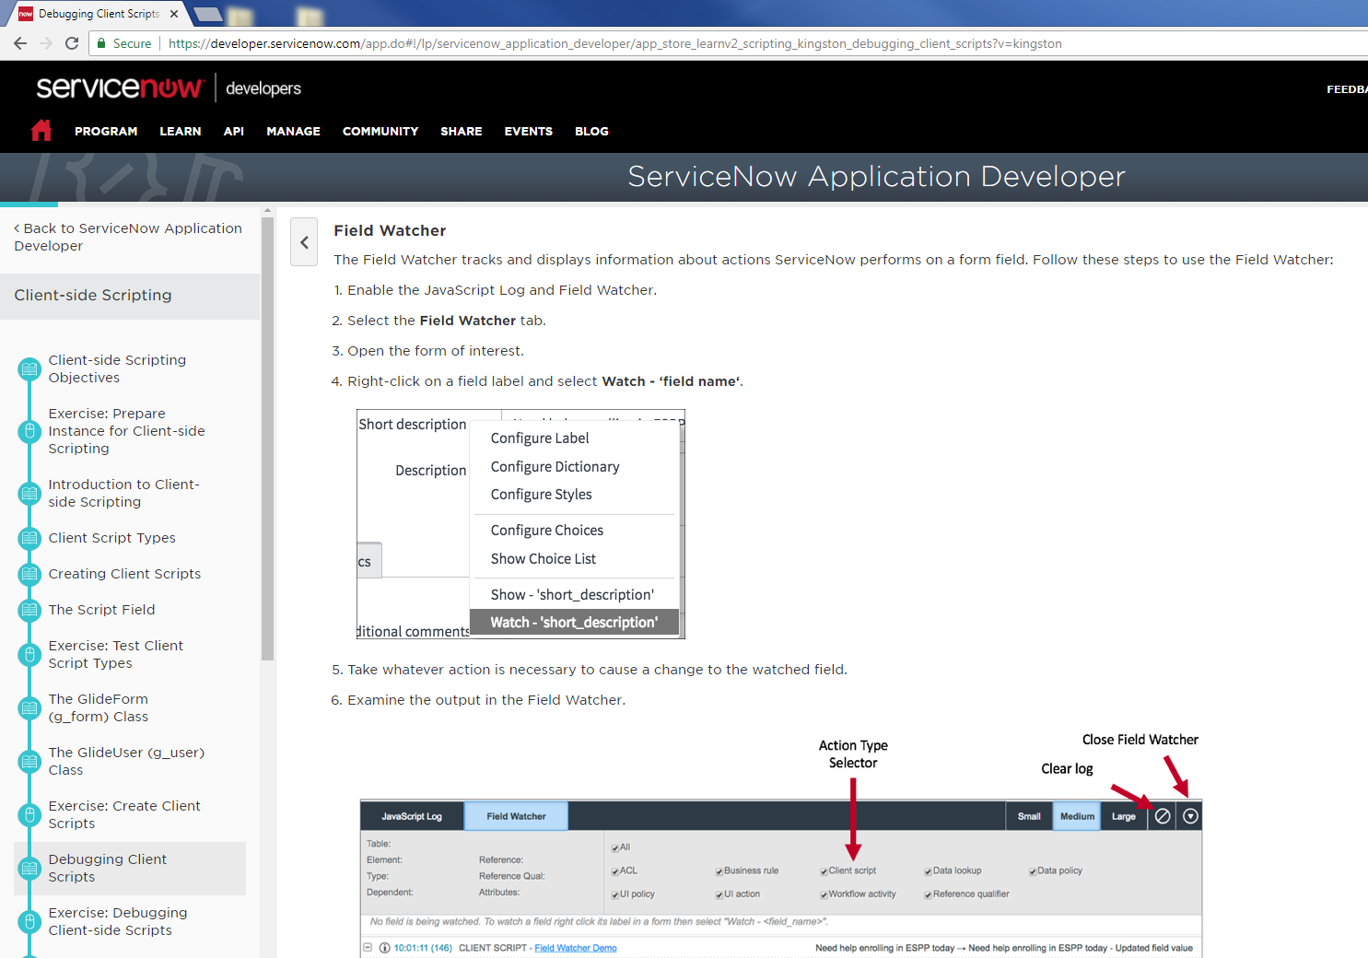
Field Watcher for debugging actions on Forms

Slide 30
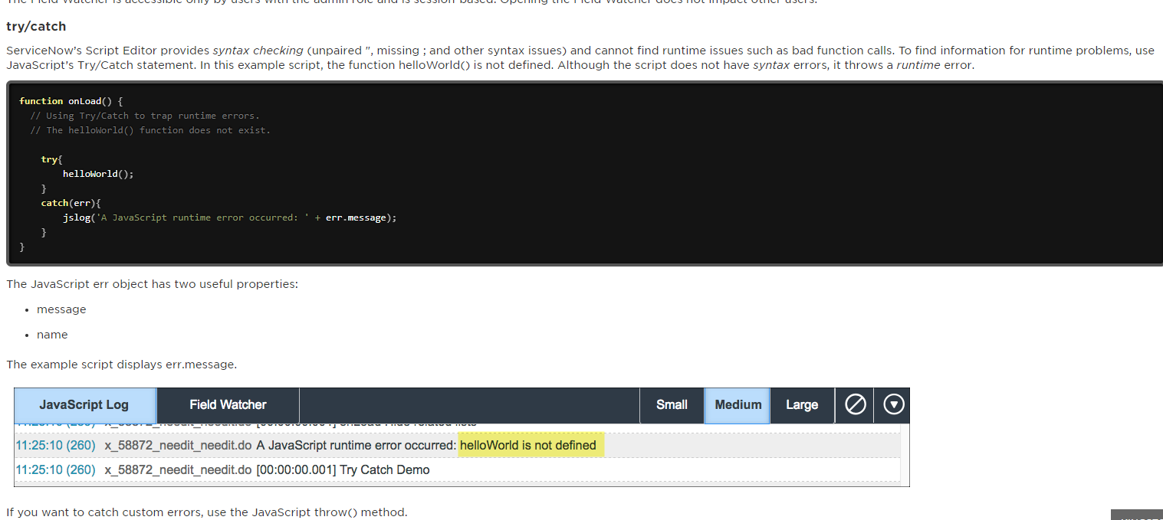
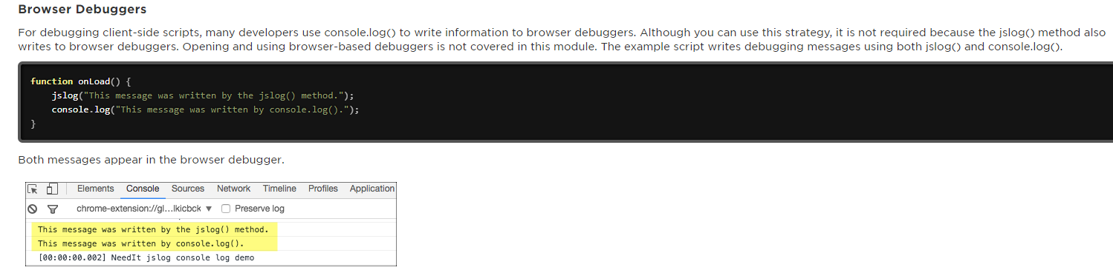
Try/Catch for JavaScript
Write to the Browser’s Log…
console.log()

Slide 31
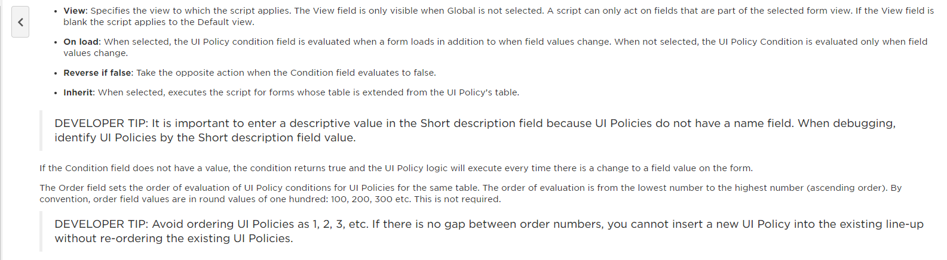
Debugging Tips for UI-Policy
(Policies dont have names, but do have Short Description Fields)

Slide 32
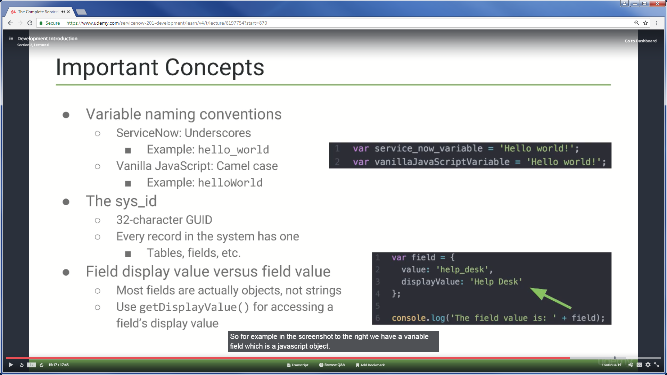

Slide 33
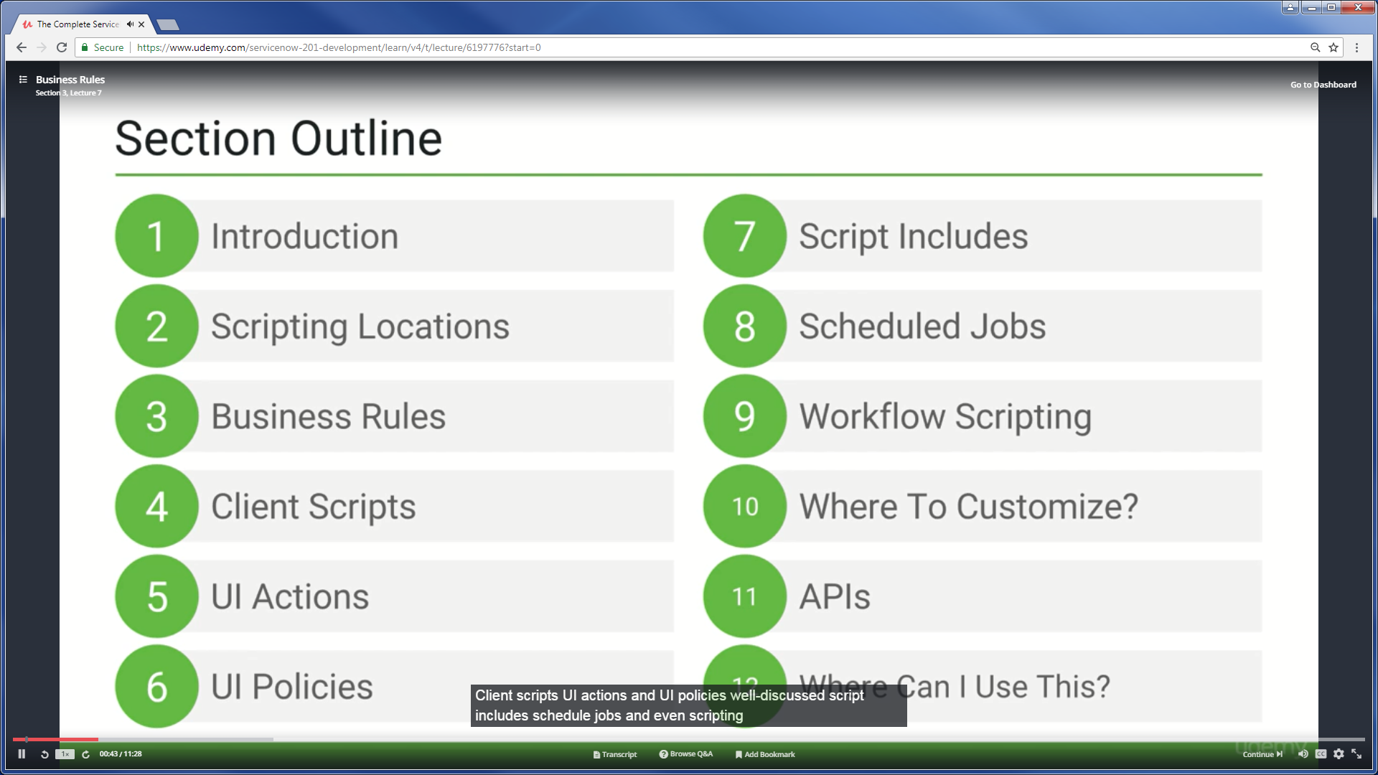

Slide 34
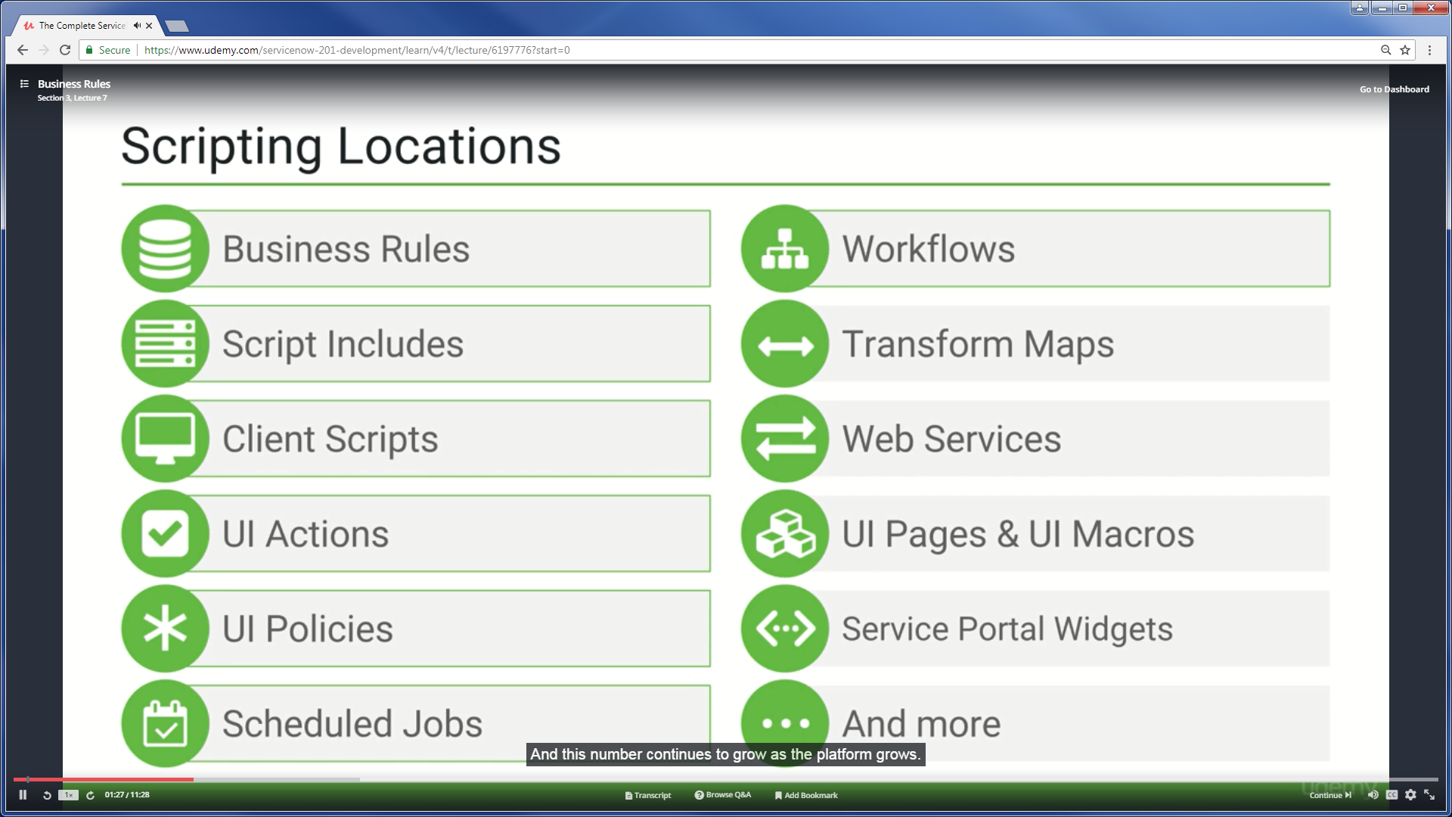

Slide 35
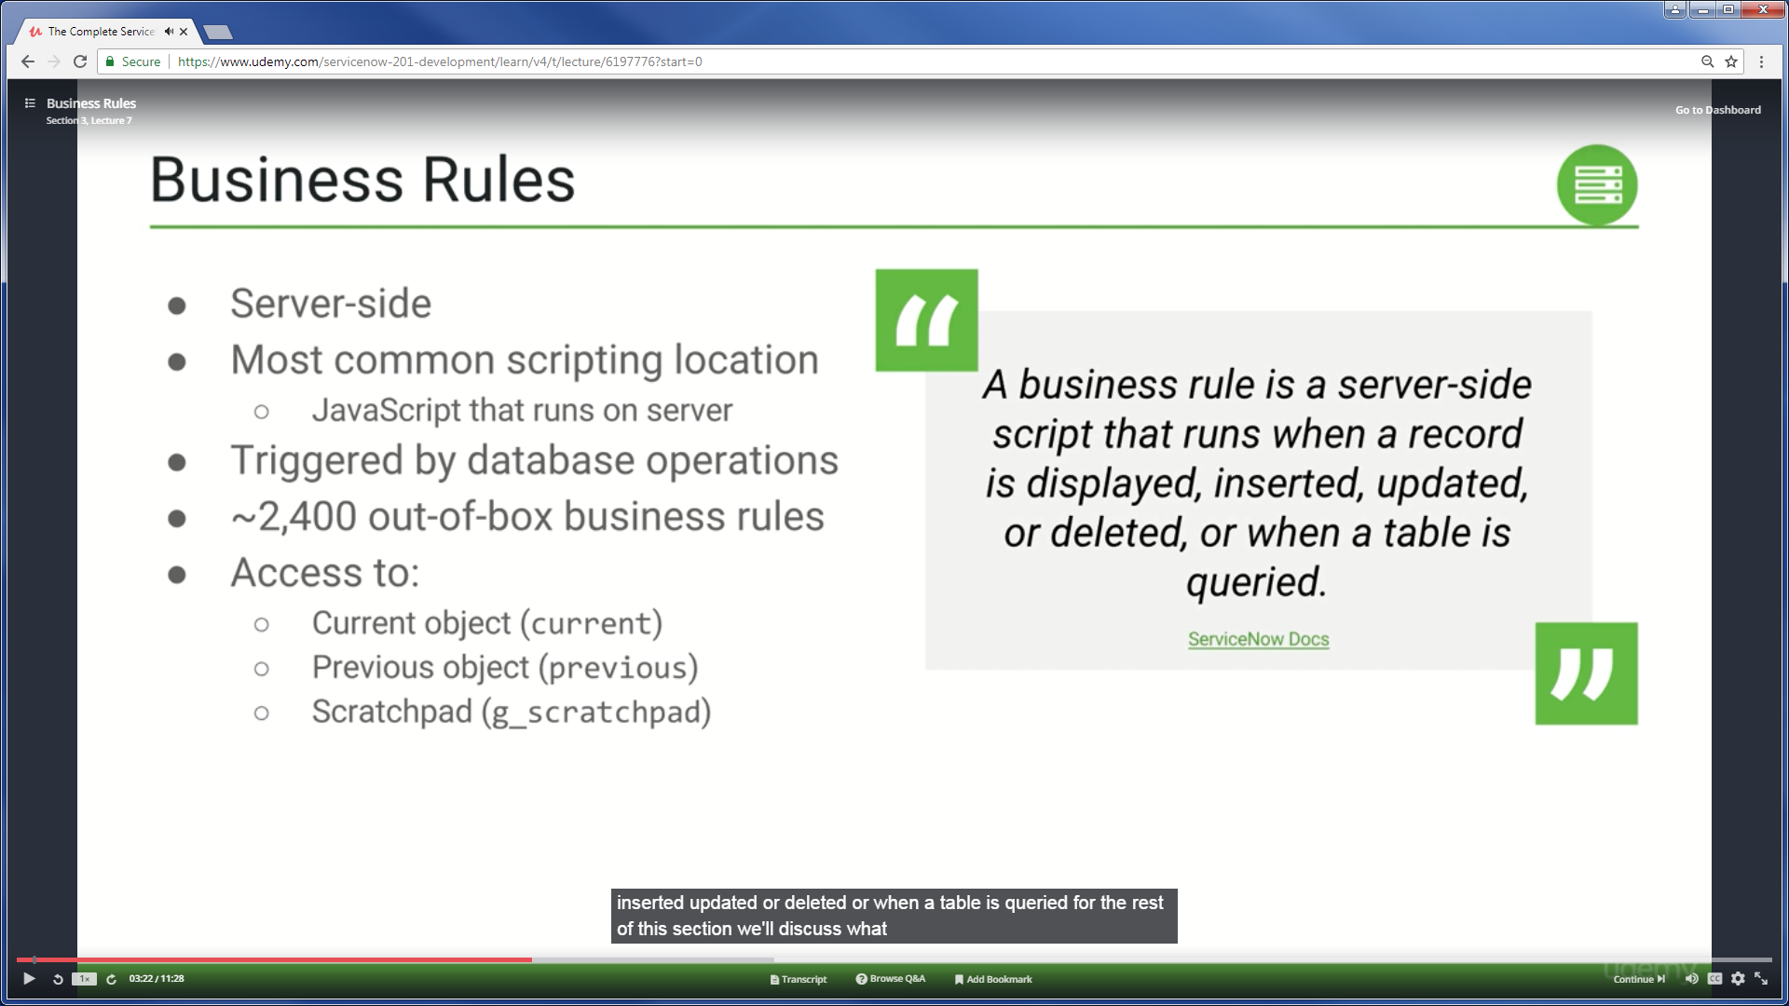

Slide 36
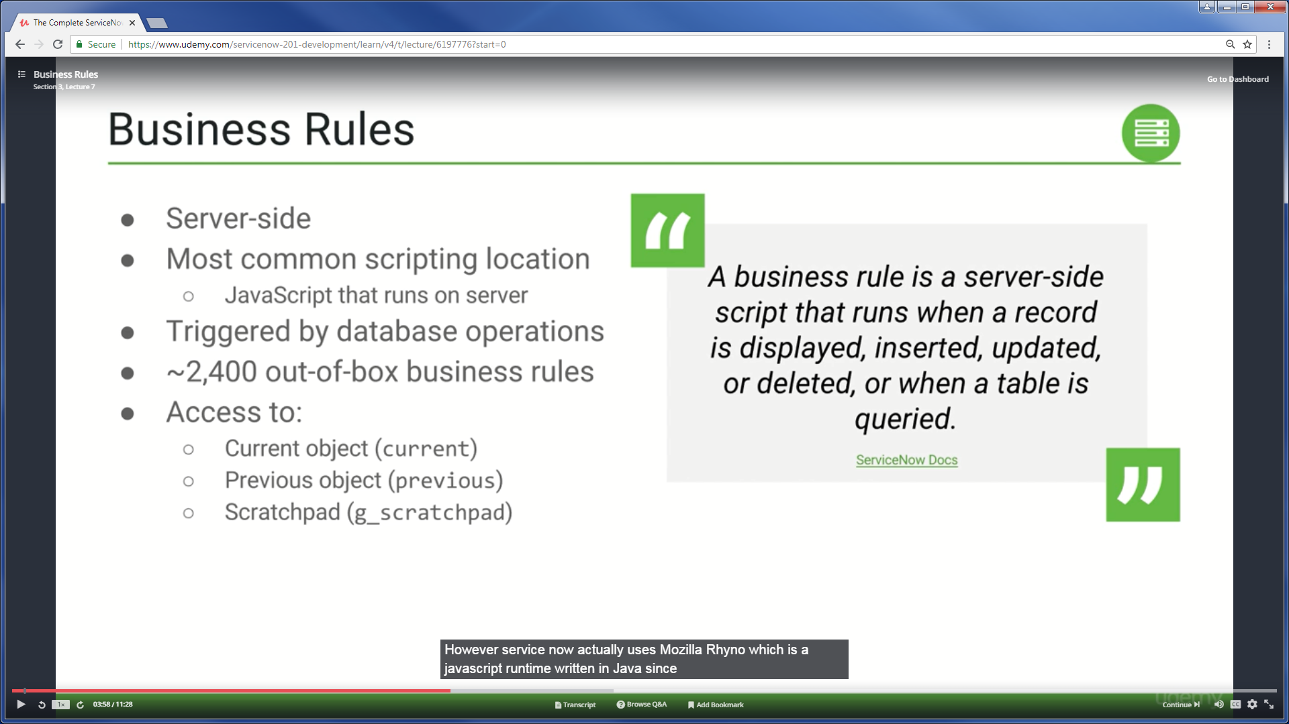

Slide 37
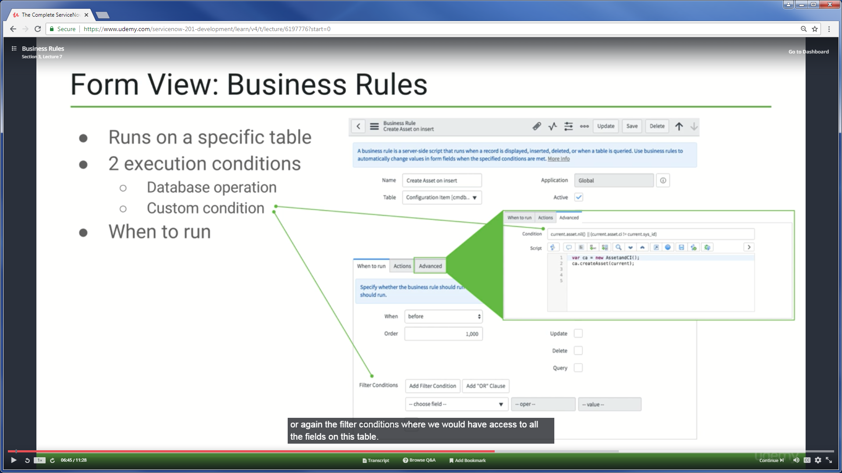

Slide 38
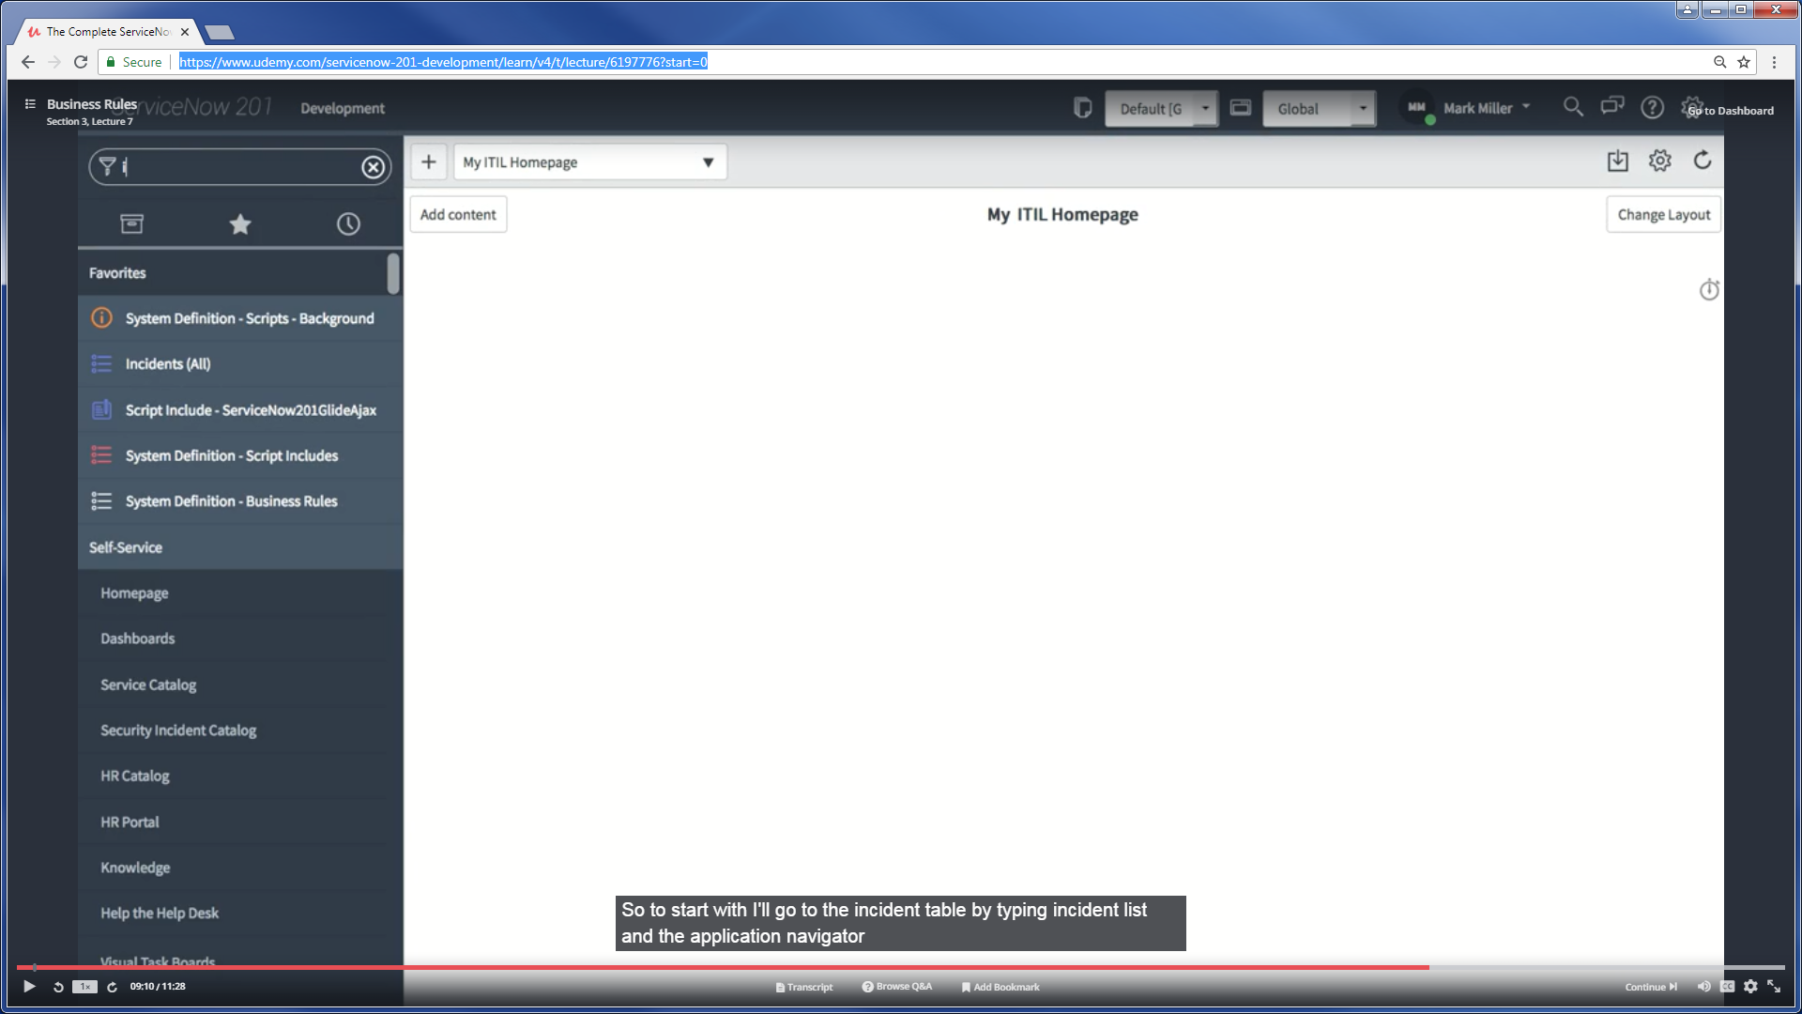
<TableName>.list apparently gets you directly to the
Records in that table…
Clicking the Hamburger on the Record View, then “Configure”
Will allow you pick from the various things related to this Table.
We can select “Business Rules” and see each of the Rules that
Are explicitly tied to this Table.

Slide 39
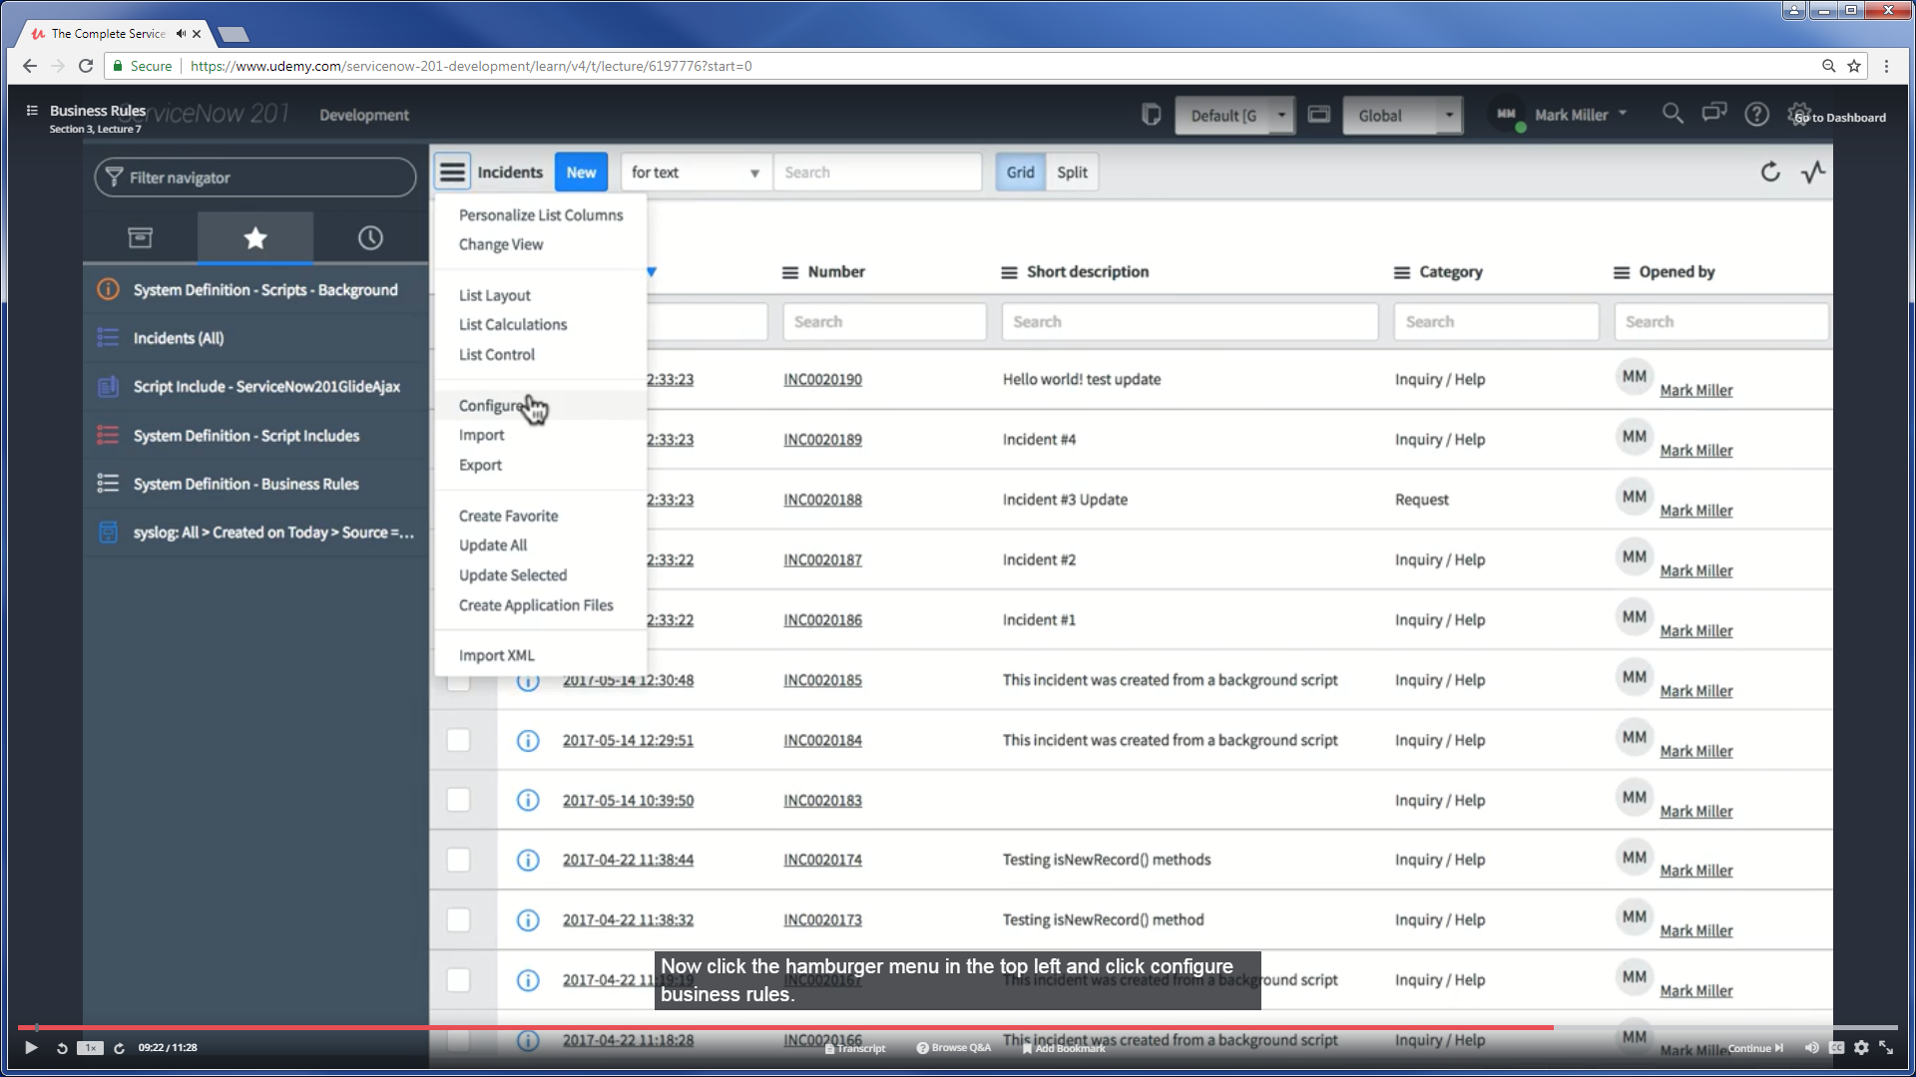

Slide 40
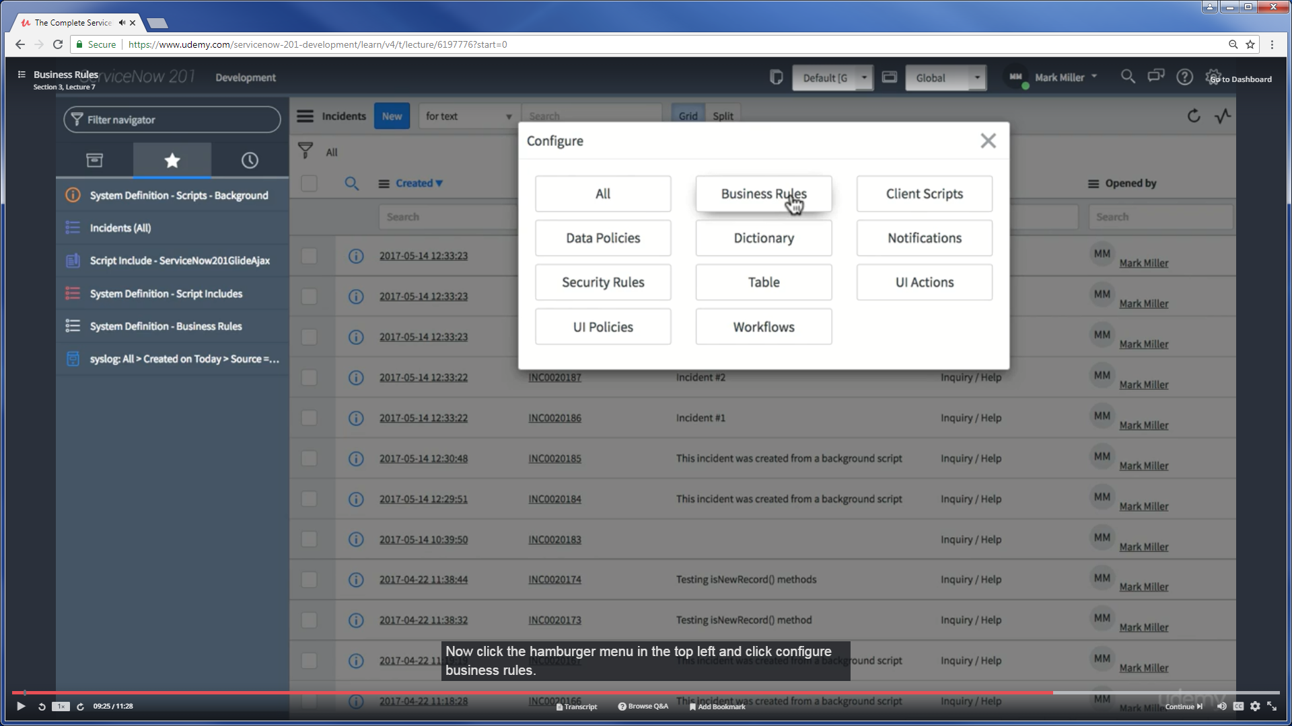

Slide 41
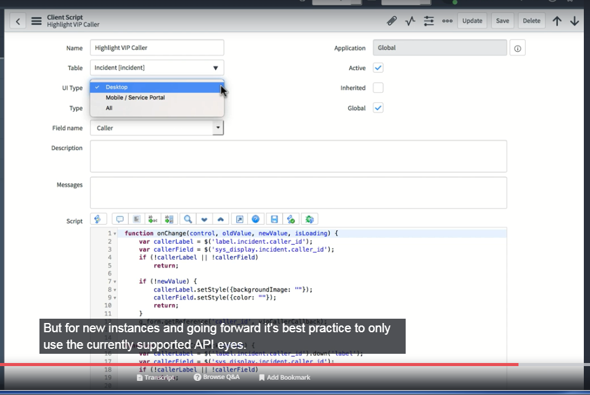
The UI-Type will filter out APIs accordingly. There are apparently DEPRECATED APIs that are still available.. and are accessible in the Code. Best to only use UI Type !!!

Slide 42
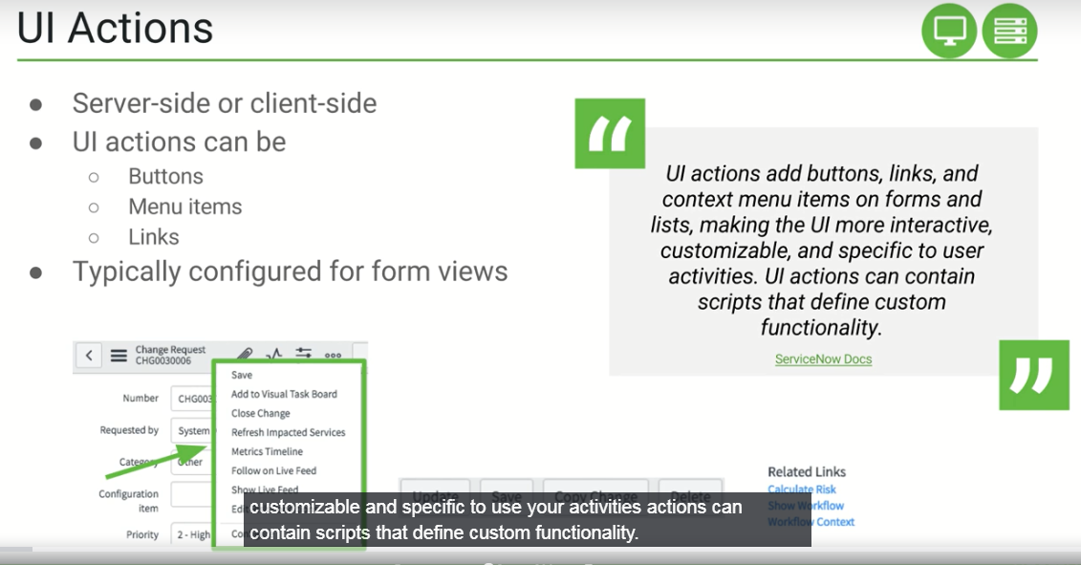
UI Actions can be Server Side ??
Answer: Probably AJAX-ish actions..
To modify the form (controls / content) based on
User Actions.. that is typically AJAX-ish == Server

Slide 43
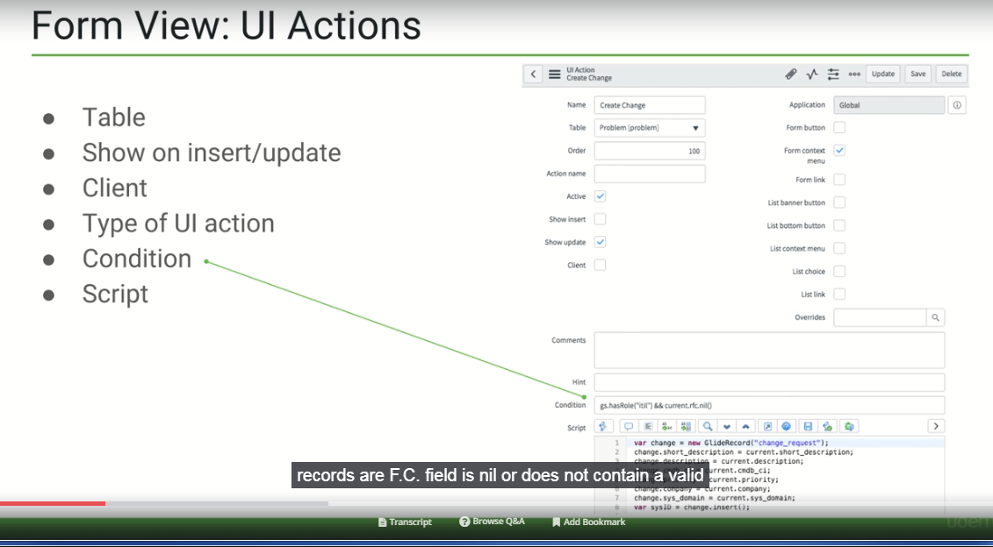
CLIENT-SIDE
UI Action
There is a lot going on with UI Actions. In this example.. we have a Script dedicated for
Taking some kind of Action on a Form that is related to the Problem Table. It will take an
Action during an UPDATE of a Record… Displays the Form Content Menu… but Only
On the explicit condition where User has Role ‘X’ and Current Record’s “RFC” field is Null

Slide 44
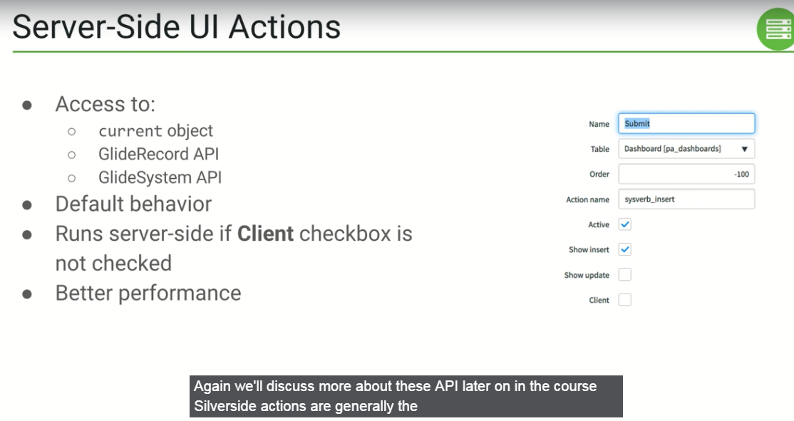
Client
Is not
Checked!
Server Side has access to a few important APIs

Slide 45
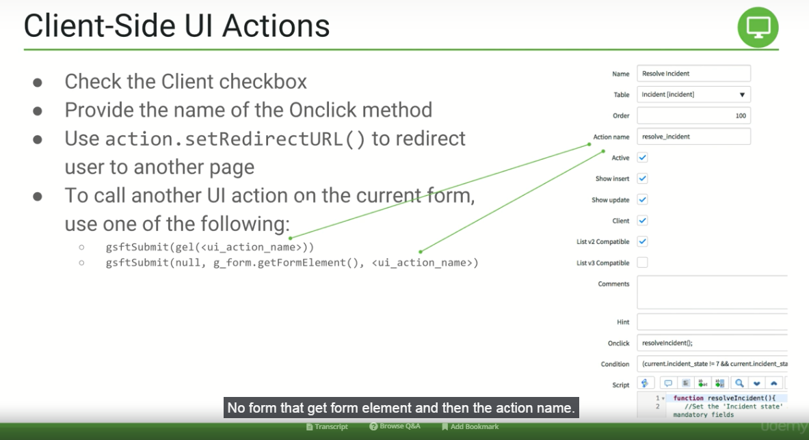
Need more clarity on calling another UI action on the same form..
Is the Action Name field always the Name of THIS Script ??
Or is the Author attempting to indicate you can put a different Name in that field ?

Slide 46
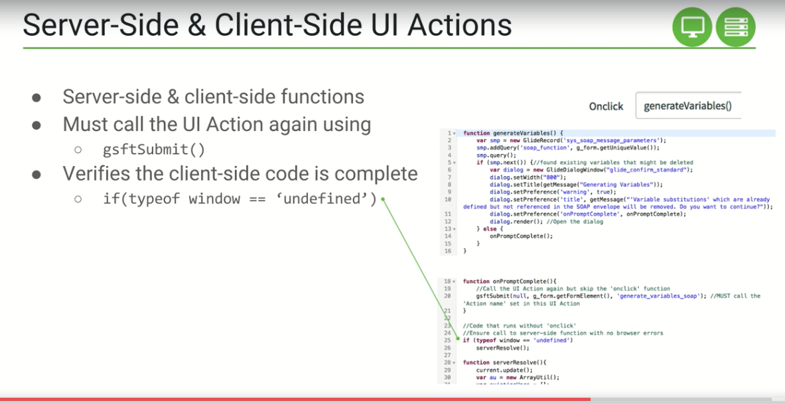
Typical ‘Hack Job’ code common with old school javascript.
Instead of having a method that explicit indicates the purpose…
They just throw in some code that determines the scenario round-about.
If No Window Object.. then Must be Server Side….
Would be better to have a function you call that Wraps this up into a box.
Notice the comment in the code -------→
It explicitly states you MUST use the
‘Action Name’ that was set in the design form
For this UI Action.
That is classic Fragile Programming.
Why should you have to track your own name?
If put some other name.. can you call others?

Slide 47
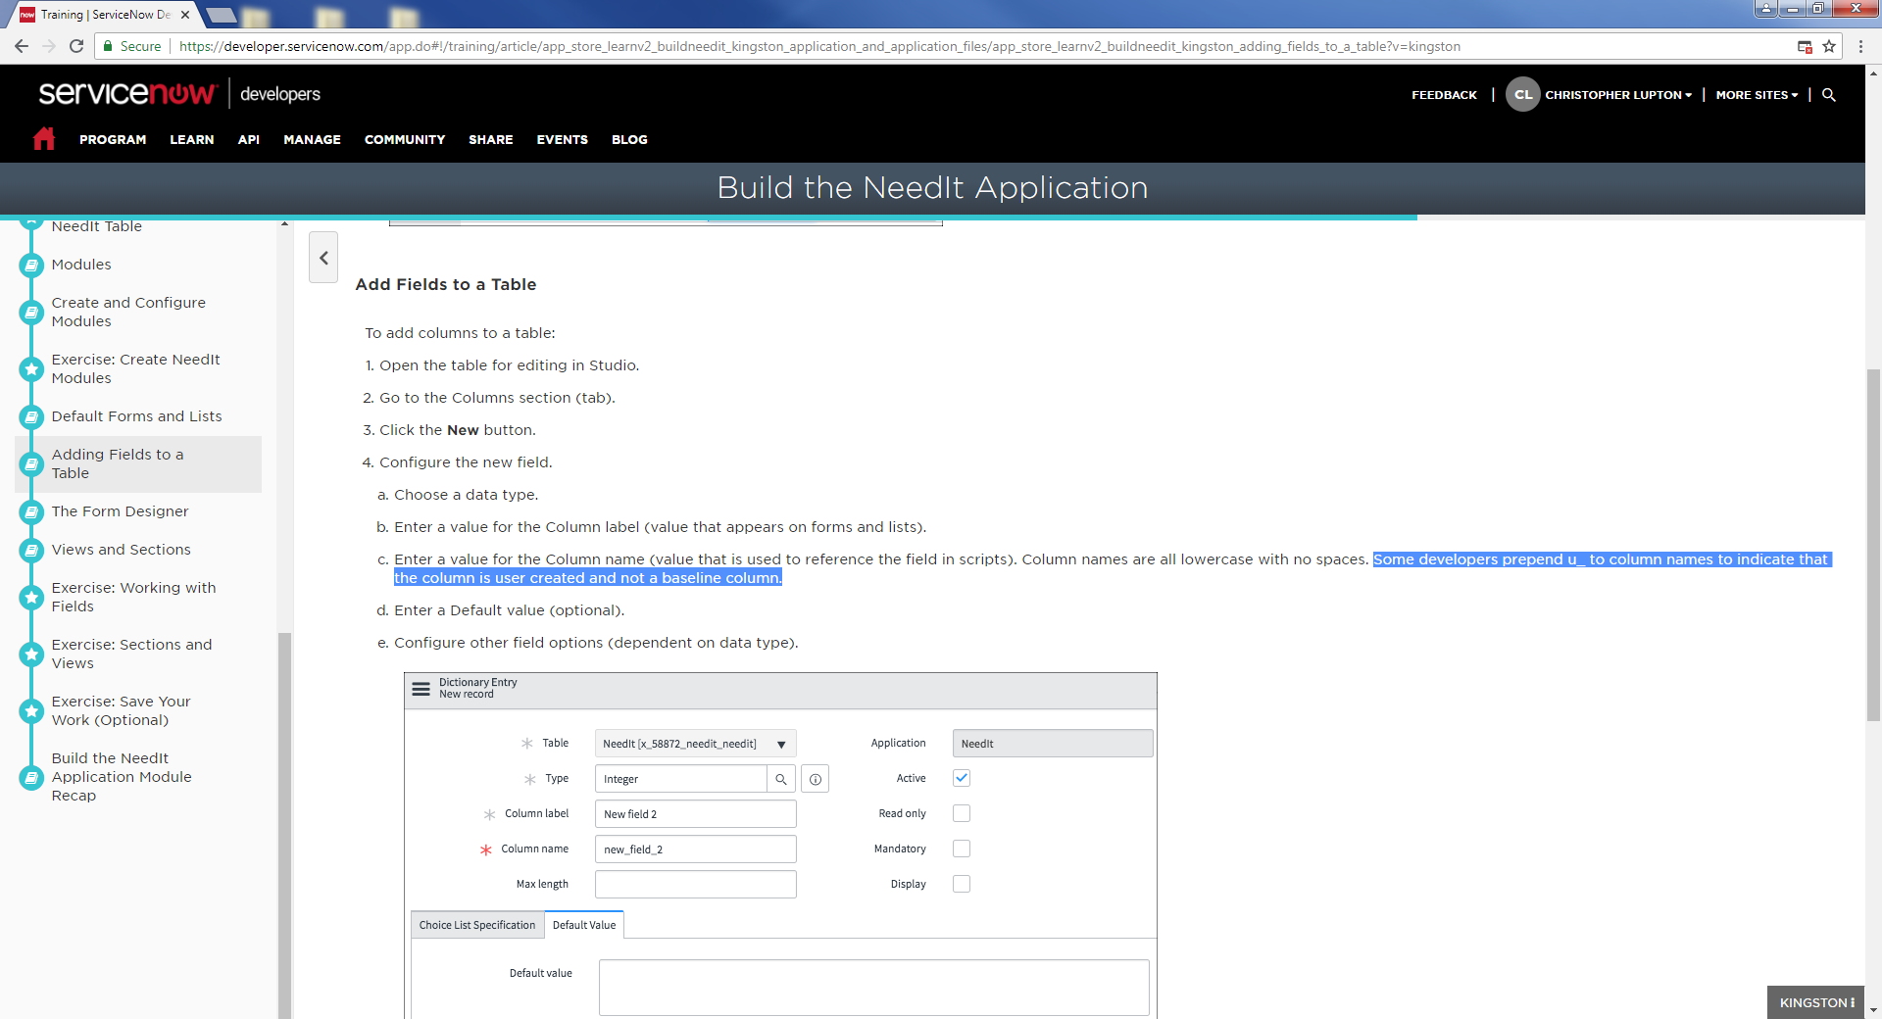
Using a custom prefix to the name of a custom column in a table.. will help you easily locate differentiate between built-in/inherited columns and customs

Slide 48
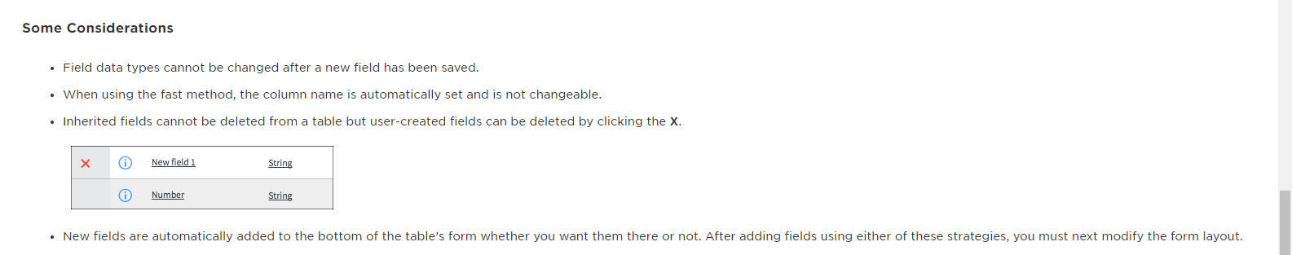
Service Now has some limitations (need UI rewrite in the future)…
The order that columns are added, is the order displayed in the list.
Even though MySQL is used behind the scenes everything seems to be
Treated as though its a flat table and that is how/why columns can be dynamically added to a Table.. just by using the Design Mode of the UI.

