Slide 1
PDF Generation/Modification within ServiceNow
Needs Plugins:
PDF
Managed Documents

Slide 2
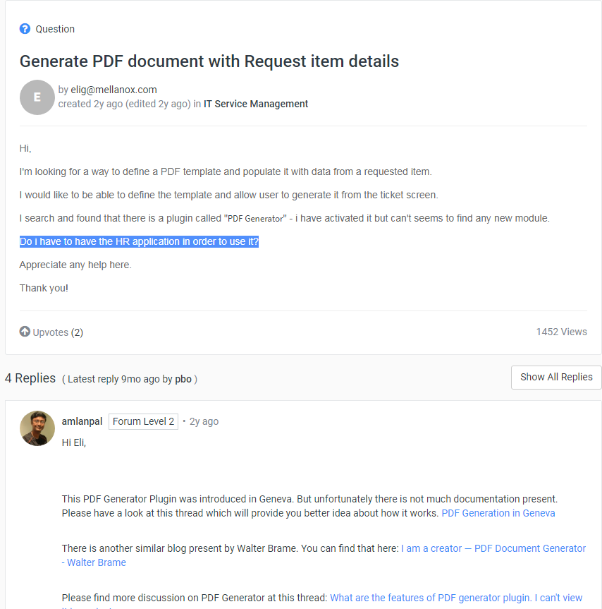
Do you HAVE to use the HR Application in order to make use of the PDF capability ?
https://community.servicenow.com/community?id=community_question&sys_id=e130cb61db98dbc01dcaf3231f961935
No one is directly answering this Question
https://community.servicenow.com/community?id=community_question&sys_id=126887eddb1cdbc01dcaf3231f96199d
https://community.servicenow.com/community?id=community_question&sys_id=a95d83e9db9cdbc01dcaf3231f96198b

Slide 3
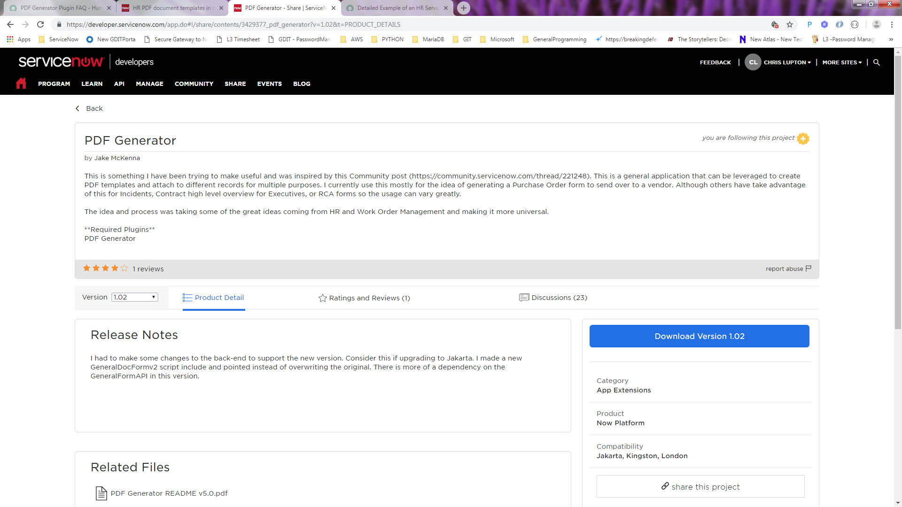
A “potential” answer is “Yes”, however it’s apparently a Custom Application that was made available on the Service Now Developers website:
https://developer.servicenow.com/app.do#!/share/contents/3429377_pdf_generator?v=1.02&t=PRODUCT_DETAILS
You are downloading a self-contained XML file.
This is the format used by Service-Now for “update sets”
UpdateSets are complete units of work (~~ .git branch)

Slide 4
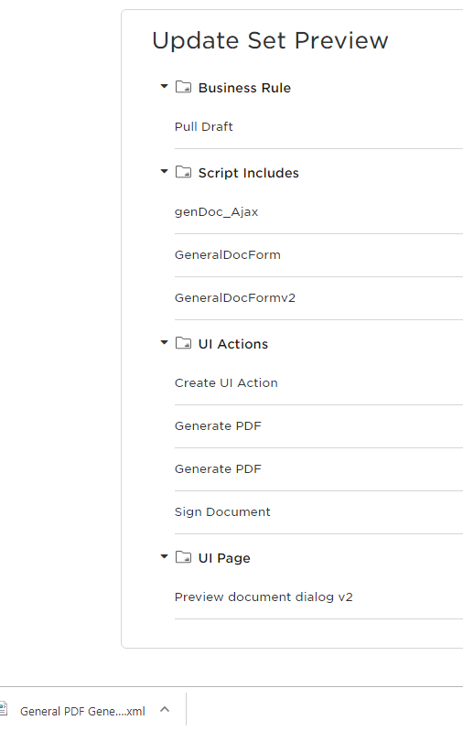
After you commit the update-set,
Your custom app will have access to these objects.
You can search for them within the System Navigator and then Edit them. Or copy/paste them to make your own similar objects.
This is the XML filename that contains all the encoded bits & pieces that make up the Update-Set. The XML file allows for offline xfer between servers that lack network connectivity.

Slide 5
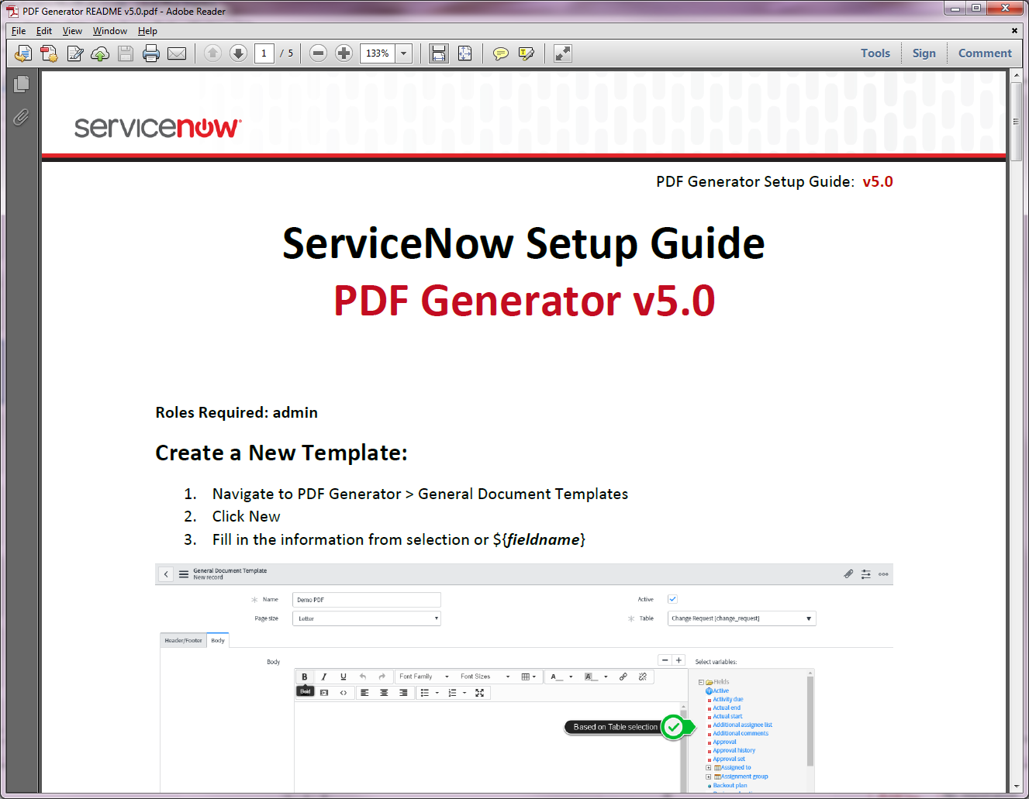
See the ReadMe PDF
(must login to access it)

Slide 6
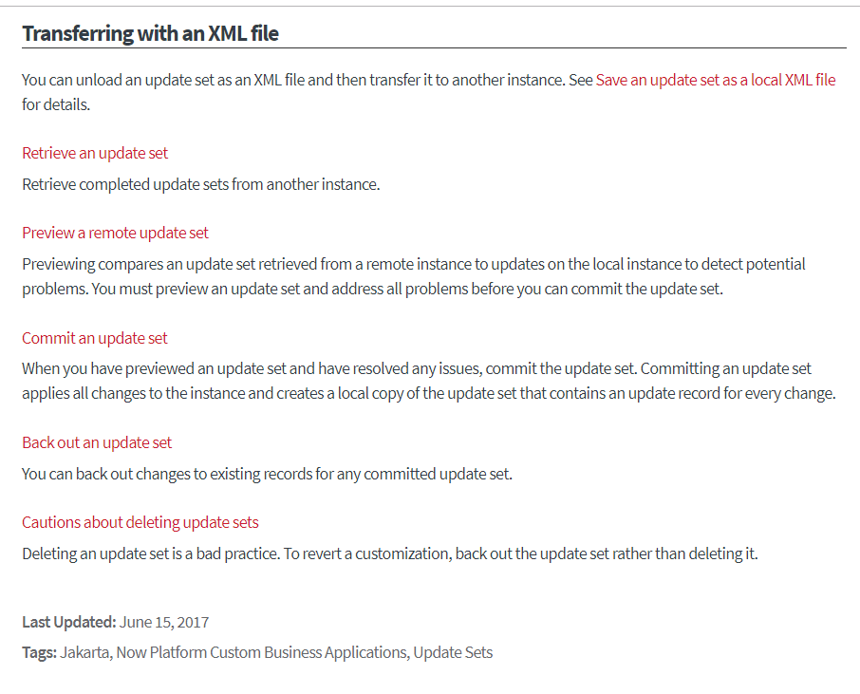
Making use of Update Sets to Save/Deploy to other Instances
https://docs.servicenow.com/bundle/jakarta-application-development/page/build/system-update-sets/reference/update-set-transfers.html
One option for saving and installing an Update Set is via an XML File.
This appears to be what is done on the Developer’s SHARE site on the previous slide..

Slide 7
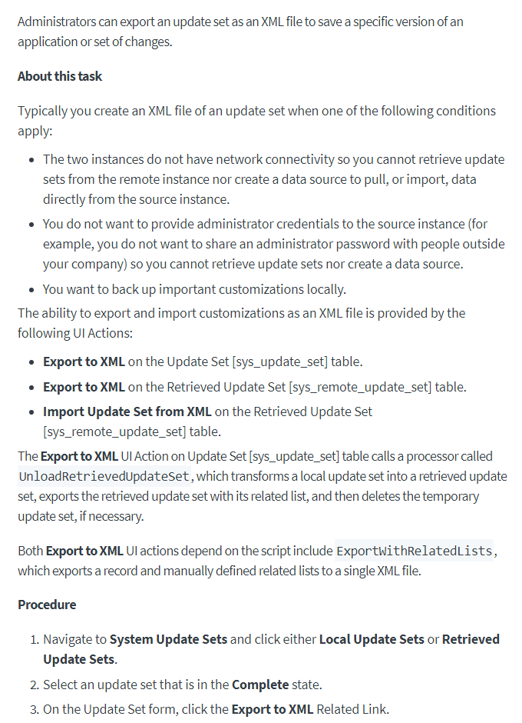
Storing an Update Set as an XML file for Offline Issues

Slide 8
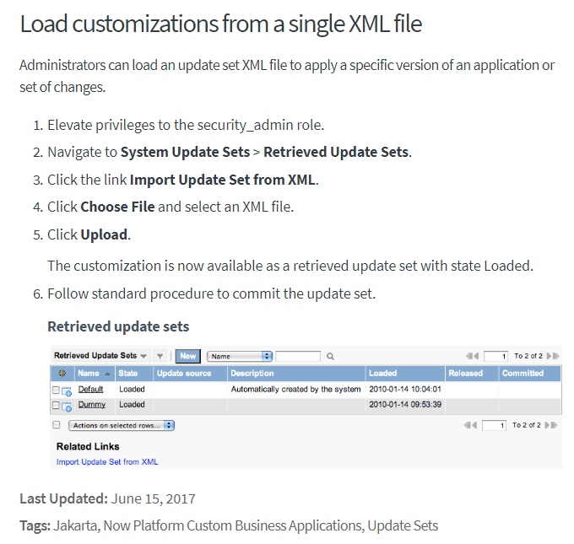
https://docs.servicenow.com/bundle/jakarta-application-development/page/build/system-update-sets/task/t_SaveAnUpdateSetAsAnXMLFile.html#t_SaveAnUpdateSetAsAnXMLFile

Slide 9
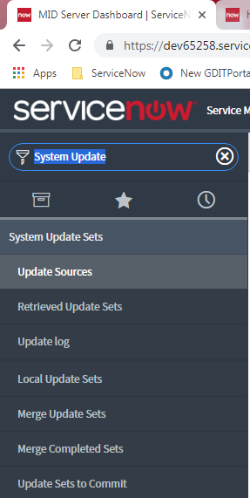

Slide 10
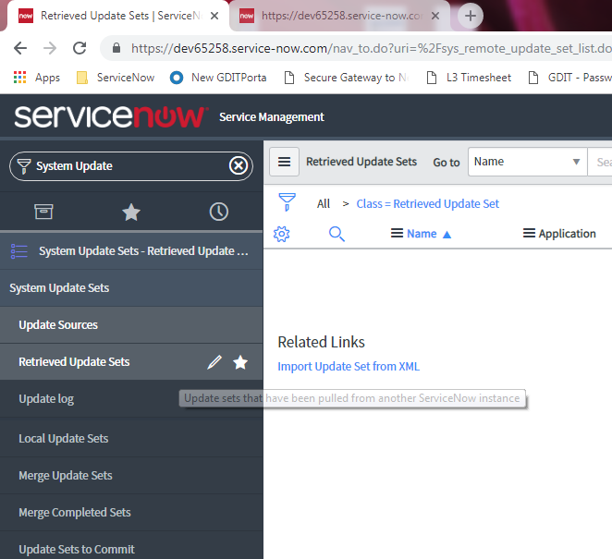

Slide 11
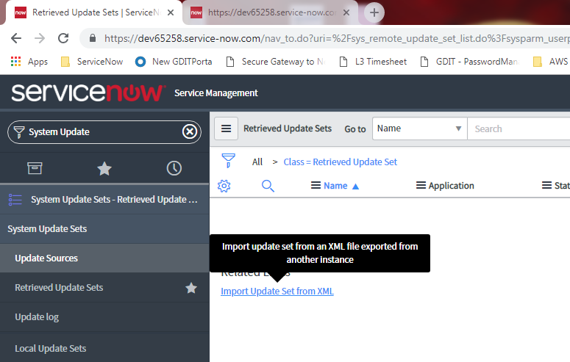

Slide 12
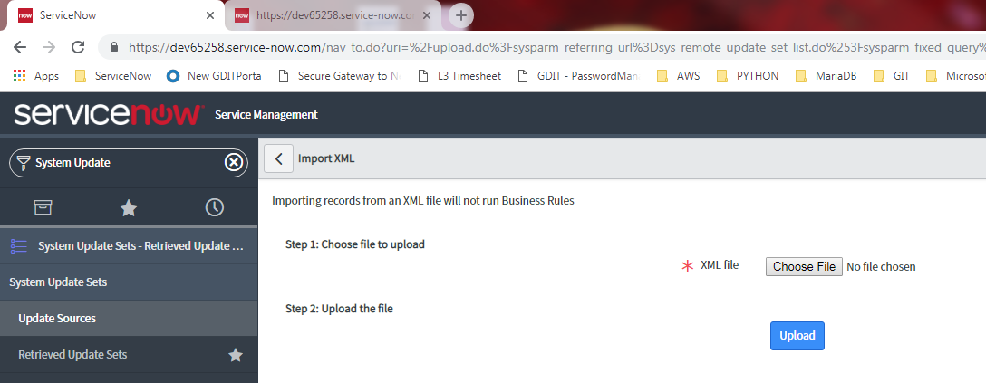

Slide 13
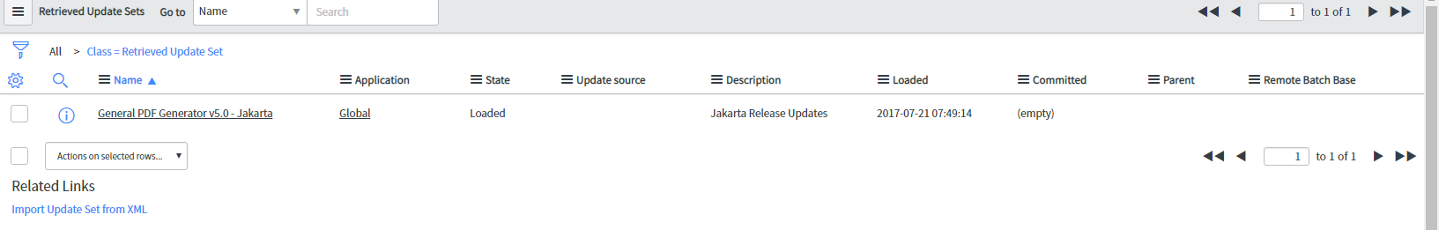

Slide 14
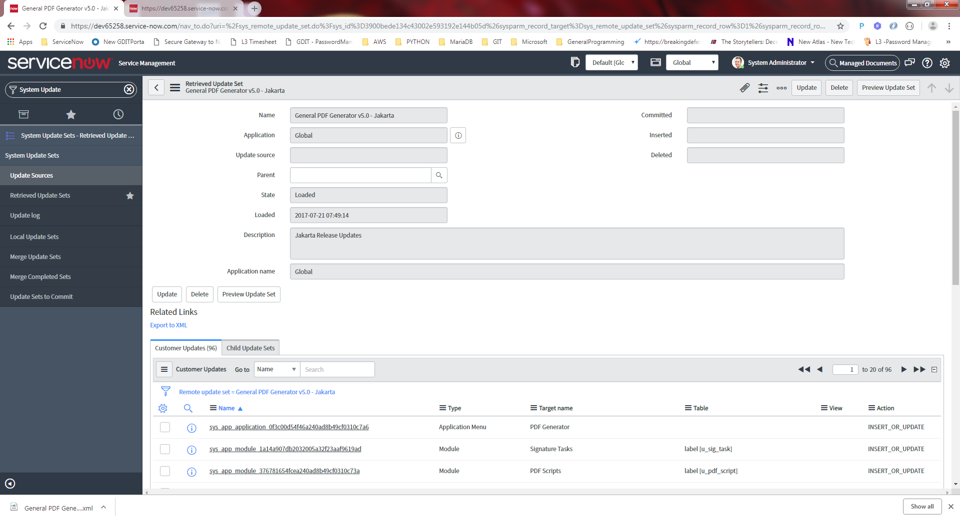

Slide 15
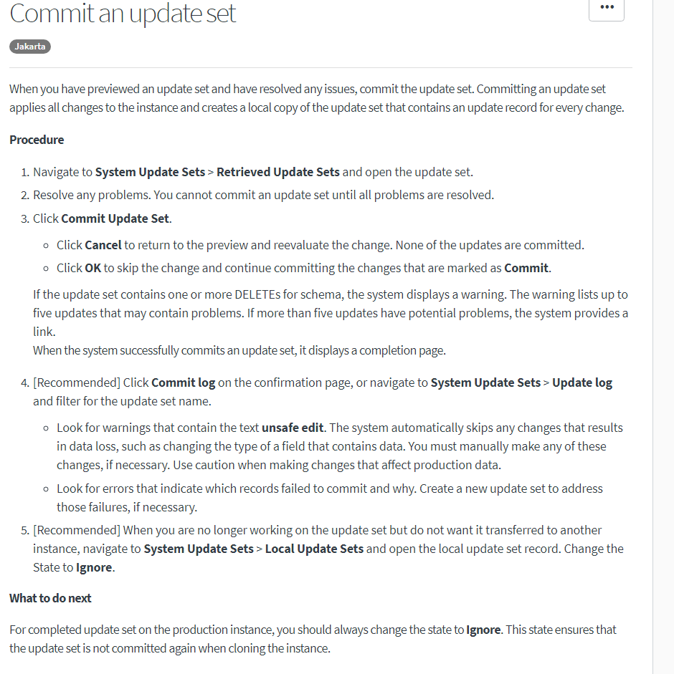
MUST COMMIT the New Update Set from the Developer’s Share Site before use..

Slide 16
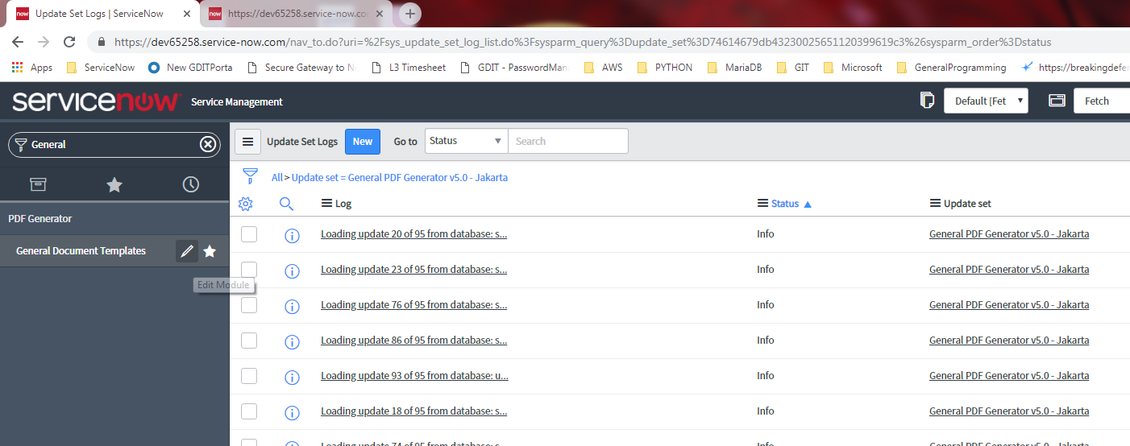
Before the Update Set was COMMITED…
We could NOT find the General Document Templates for this Project…
After the Commit, it’s now easily searchable

Slide 17
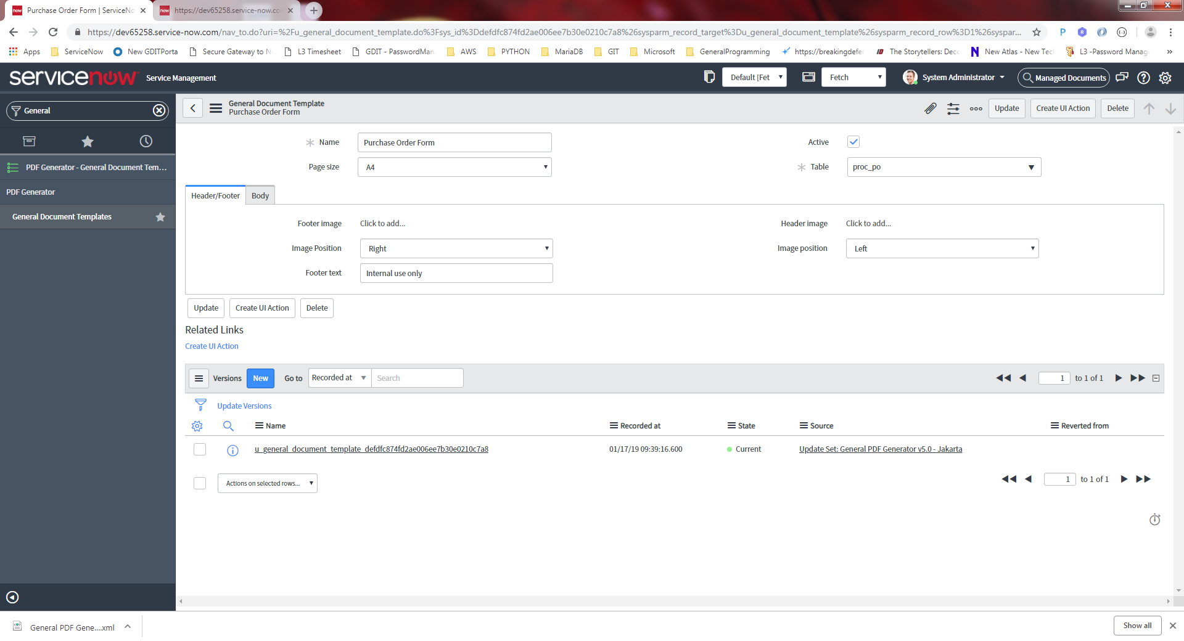
After clicking the entry “General Document Templates..”

Slide 18
Using the PDF Plugin

Slide 19
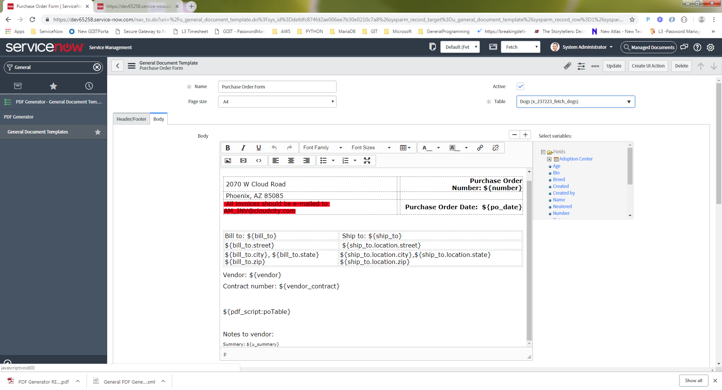
Double clicking on “General Document Templates” opens the form below
Clicking the “Body” tab
Will display the TinyMCE
HTML based Editor
Choosing a Table
auto-populates
the list of Columns

Slide 20
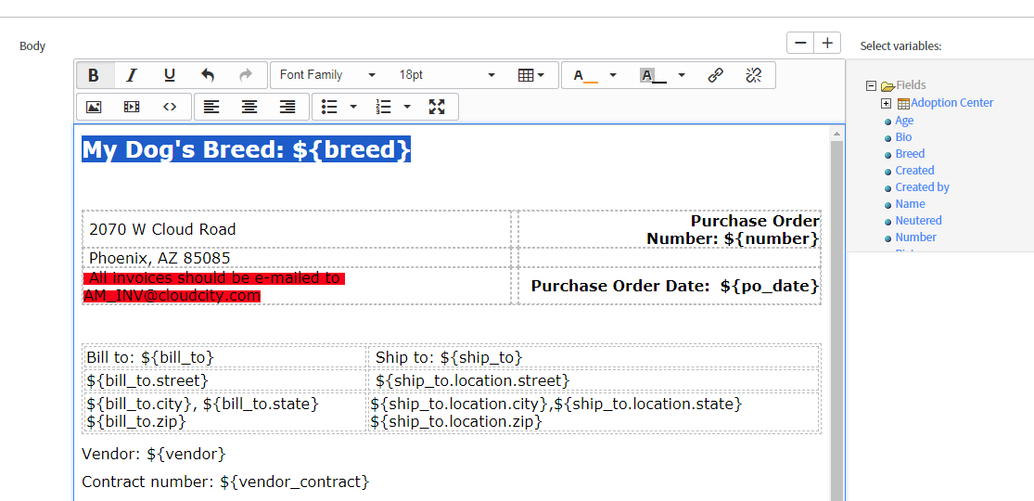
Columns from the List are
drag/drop into the Editor
And will link the Database
Record to template

Slide 26
Plugin Activation

Slide 27
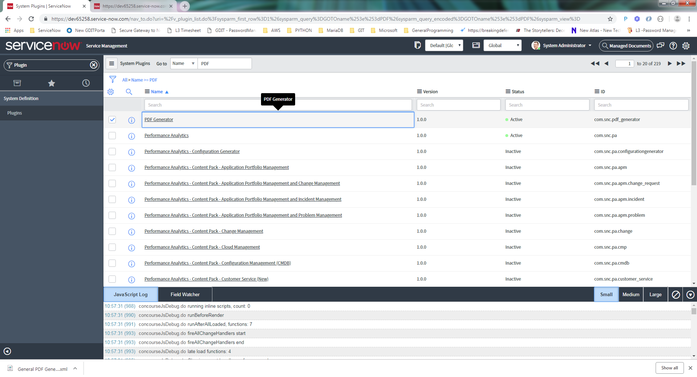
From the Plugin Search Screen…
Search for “PDF”
Right-Click on the Name/Link and choose “Activate” (if not already)

Slide 28
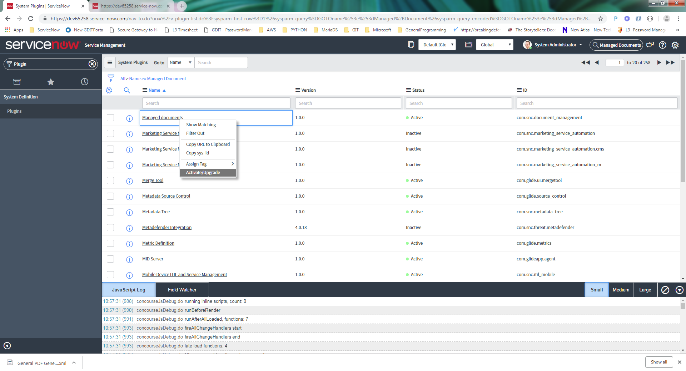
From the Plugin Search Screen…
Search for “Managed Documents”
Right-Click on the Name/Link and choose “Activate”

Slide 29
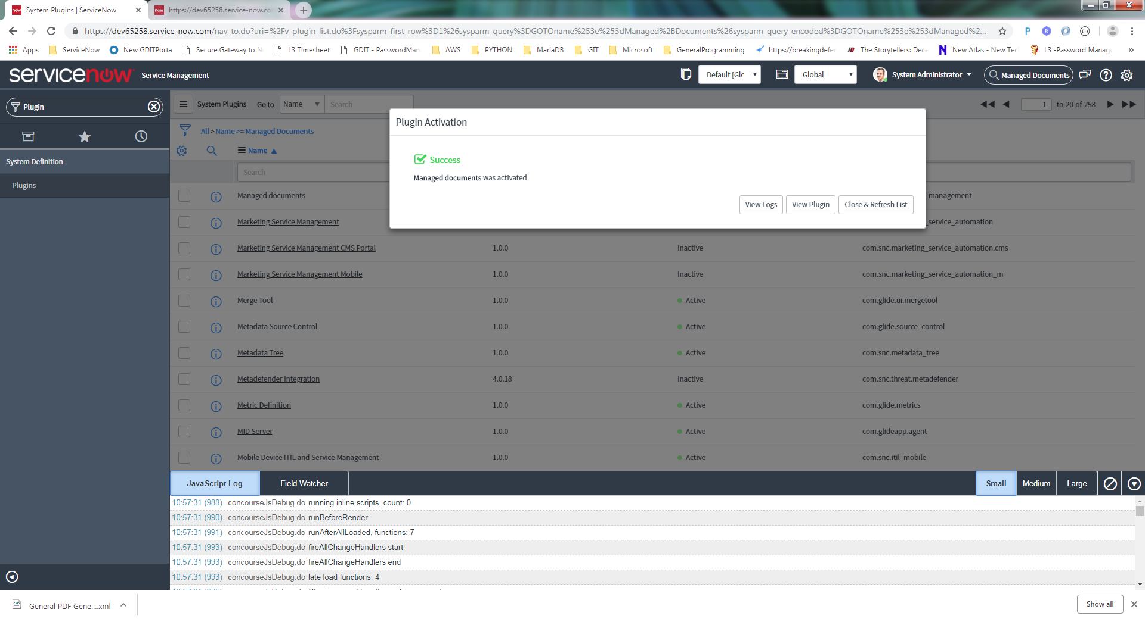

Slide 30
HR Application Specifc ??

Slide 31
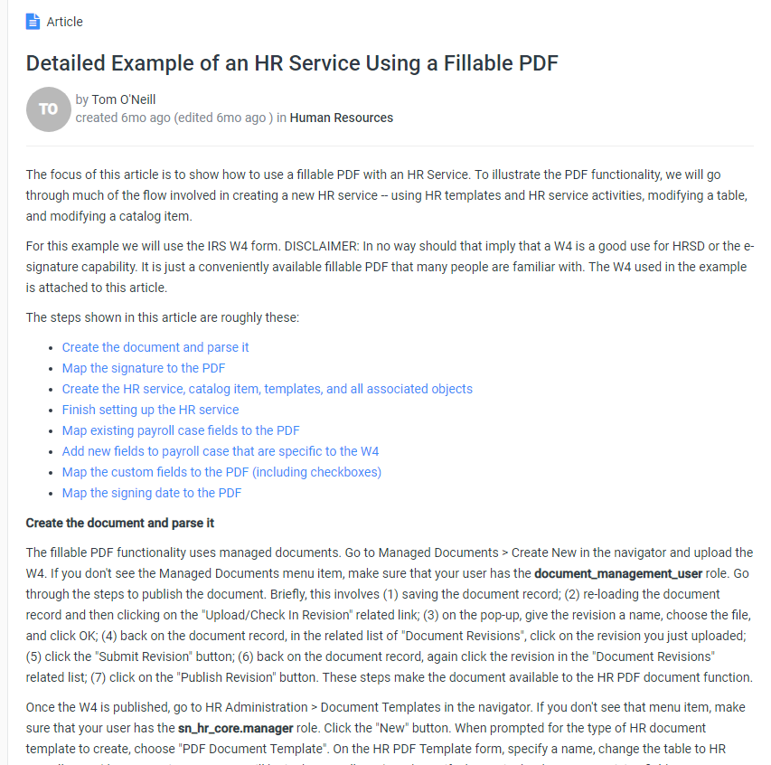
https://community.servicenow.com/community?id=community_article&sys_id=95ef3353db2b1700feb1a851ca961945

