Slide 1
Installation & User Guide
Updated 2025/07/28

Slide 2
Installation Guide

Slide 3
Environment overview
Hardware environment is assumed Apple silicon
Installation requires administrative privileges
Python
Miniconda
LLM environment is Ollama + local LLMs
Default installation location is desktop:
  Path: ~/Desktop/airlift-starter-kit
Color font convention:
  Green – Command line commands
  Blue – Web URL
  Orange – Files and folders
  Red – Keywords, and other important item

Slide 4
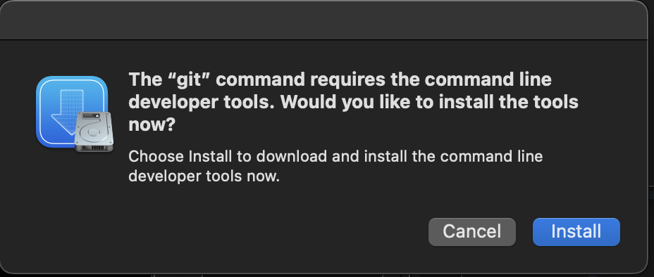
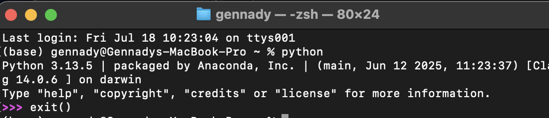
Step 1: Install Mac Developer tools
Open terminal (command line input window)
  Press the ⌘+space bar together to open spotlight search dialog; then type ‘terminal’ and press enter.
In terminal type ‘xcode-select --install’ (without enclosing quotes) and press enter, this should open prompt to install developer tools:
  Choose install and agree.
This should install development tools (includes python).
  To test, open terminal and type: ‘python’ + press return
  You should get output similar to:

Slide 5
Step 2: Ollama – download models
Download and install Ollama:
  https://ollama.com/download/Ollama.dmg
To download models, enter the following commands in terminal window. Note: Downloading models takes time. The following is an example (structure/ call : ollama run model-xyz which is a command is used to run a model in terminal. The same command will also download a model if it is not installed, then will enter into LLM input prompt. You will need to exit the LLM prompt prior to downloading the next model:
ollama pull llama3.1:8b
ollama pull qwen2.5-coder:1.5b-base
ollama pull mistral-nemo:12b
ollama pull gemma3:4b
ollama pull phi4:14b
ollama pull deepseek-r1:8b
ollama pull gemma3:27b
ollama pull gemma3:12b-it-qat
More can be found here: https://ollama.com/searchhttps://ollama.com/searchhttps://ollama.com/search
To test LLM is installed via command line:
ollama run mistral-nemo:12b
Note: Default install path:
~/.ollama/

Slide 6
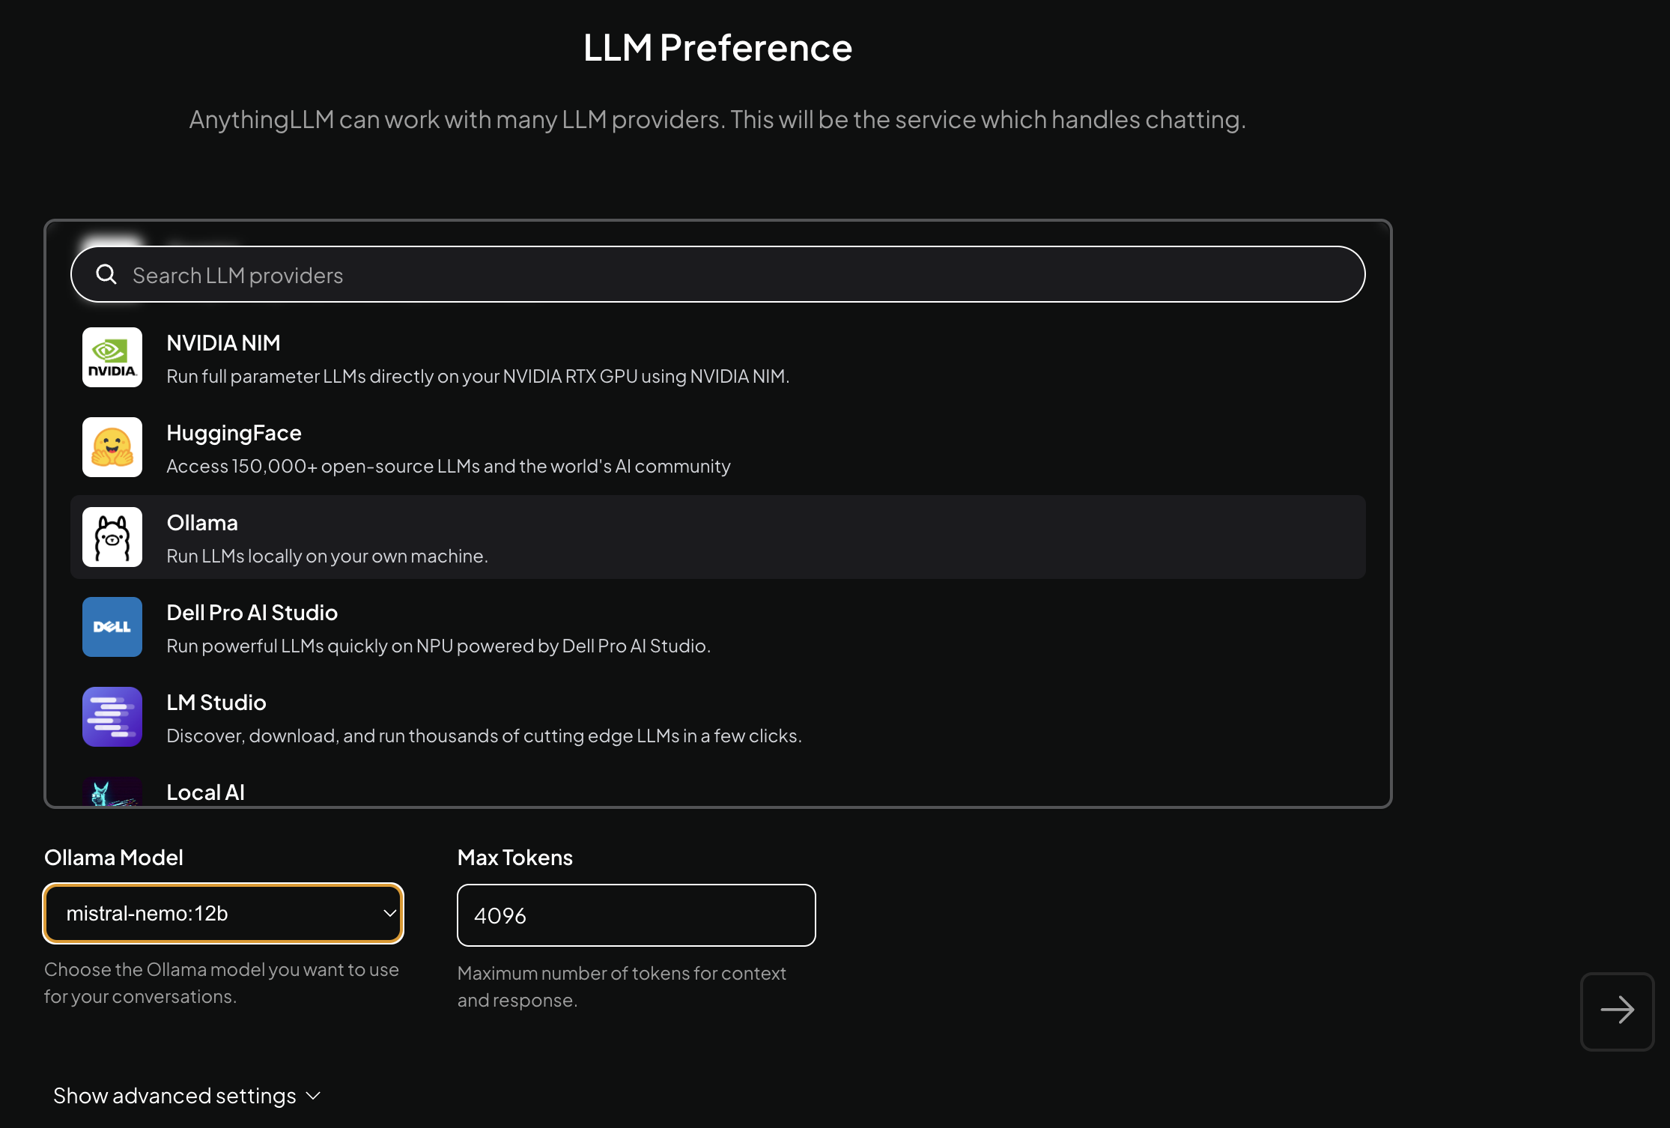
Step 3: Setup AnythingLLM default preferences
Download AnythingLLM & install
  https://cdn.anythingllm.com/latest/AnythingLLMDesktop-Silicon.dmg
When you first start the application click “Continue”
1. Scroll down the list and choose “Ollama”
2. Select the default model.
3. Click next arrow

Slide 7
Step 4: Anything LLM Finish setup
Click right arrow on “Data Handling & Privacy” page
Click “Skip Survey” on the bottom center
Give a name to initial workspace. Use naming convention that works best for you, its only used in this application. I chose “Test-mistral-nemo:12b”. This naming convention helps to remember which model it is using. You can rename the workspaces and change models as well.
Click right arrow after workspace is named.

Slide 8
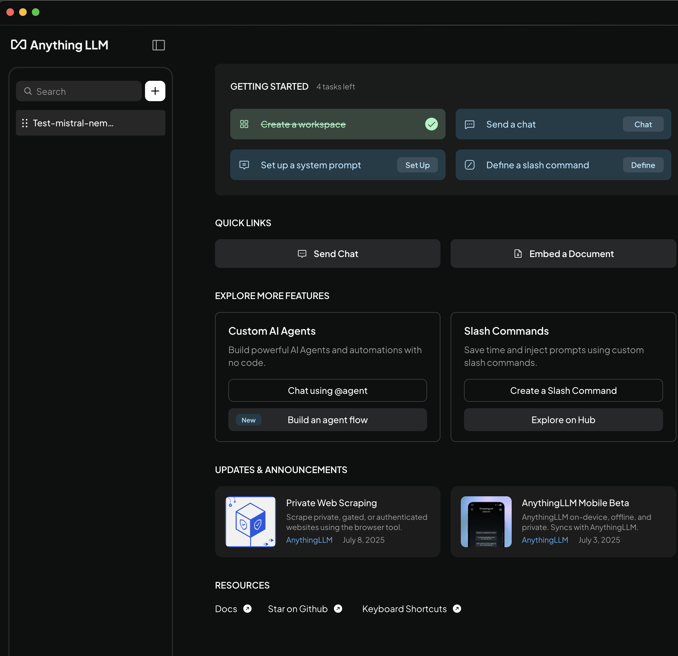
Step 5: Anything LLM – getting started
1. List of tutorials to familiarize with AnythingLLM. I recommend the following tutorials: Send a chat, Embed a document (RAG), Setup a system prompt,
2. This is your workspace. Once selected, the chat window will appear on the bottom
3. To go back to list of tutorials click here

Slide 9
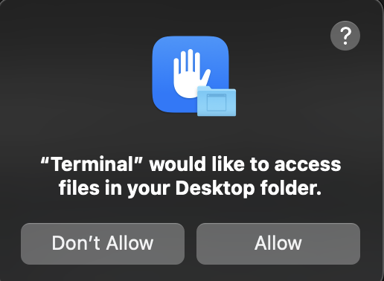
Step 6: Download and install conda:
Two options: Complete distribution (has ui package Navigator) or Miniconda (command line):
  Either option should work. I used Miniconda. Full distribution includes the Navigator, a desktop graphical application that allows you to launch applications and manage conda packages, environments, and channels without using command line interface (CLI) commands. On the other hand miniconda is smaller command line only.
  https://repo.anaconda.com/miniconda/Miniconda3-latest-MacOSX-arm64.pkg
Open terminal and run the following commands:
  conda config --add channels conda-forge
  cd ~/Desktop
  git clone https://github.com/airlift-challenge/airlift-starter-kit
You will likely get a prompt that Terminal is asking access to Desktop. Choose: Allow
This will create a “airlift-starter-kit” folder on your desktop

Slide 10
Step 7: Airlift Conda installation
Step 1:
Copy the environment.yml file to desktop (~/Desktop)
Create conda environment ‘mog’ and load required libraries. Terminal commands are in green.
conda env create -f environment.yml
Activate the environment:
conda activate mog
Download airlift-challenge simulator using git:
git clone https://github.com/airlift-challenge/airlift
Update/repair the installation to the latest packages (terminal commands should do all the steps):
cd airlift
File: …/requirements_dev.txt Delete all contents in the file.
touch requirements_dev.txt && echo "" > requirements_dev.txt
File: …/airlift/envs/generators/cargo_generators.py: Updates function name from self._np_random.randint(…) to self._np_random.integers(…), Lines: 48, 88.
sed -i '' 's/self._np_random.randint(/self._np_random.integers(/g' ./airlift/envs/generators/cargo_generators.py
File: …/airlift/envs/render.py:Line 355: Replaces parameter order from “top_right + bottom_left” to “bottom_left + top_right”. (pillow=9.5 introduced hard check that brakes original code)
sed -i '' '355 s/top_right + bottom_left/bottom_left + top_right/g' ./airlift/envs/renderer.py
Build the airlift package
pip install --use-pep517 -e .
Test installation airlift
airlift-demo

Slide 11
Step 8: MOG Code
Install MOG processing libraries:
pip install ollama seaborn scipy scikit-learn statsmodels
Install new MARP to PDF library prompt when csv_analysis_to_pdf.py is ran for the first time, Type y then press enter
@marp-team/marp-cli@4.2.1
Ok to proceed? (y)
Step
c
Step
g

Slide 12
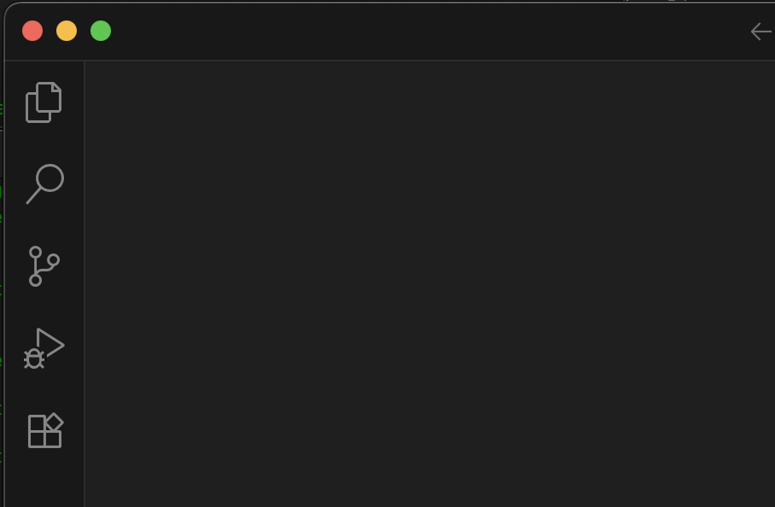
Step 9: VSCodium (or VS Code)
Download and install VSCodium (an Open Source fork of Microsoft VS Code but without telemetry
Make sure to download arm64 version, otherwise it will run very slow
https://github.com/VSCodium/vscodium/releases/download/1.102.14746/VSCodium.arm64.1.102.14746.dmg
1. Start VSCodium
2. Click here to install plugins
(Note: This might take some time to load)

Slide 13
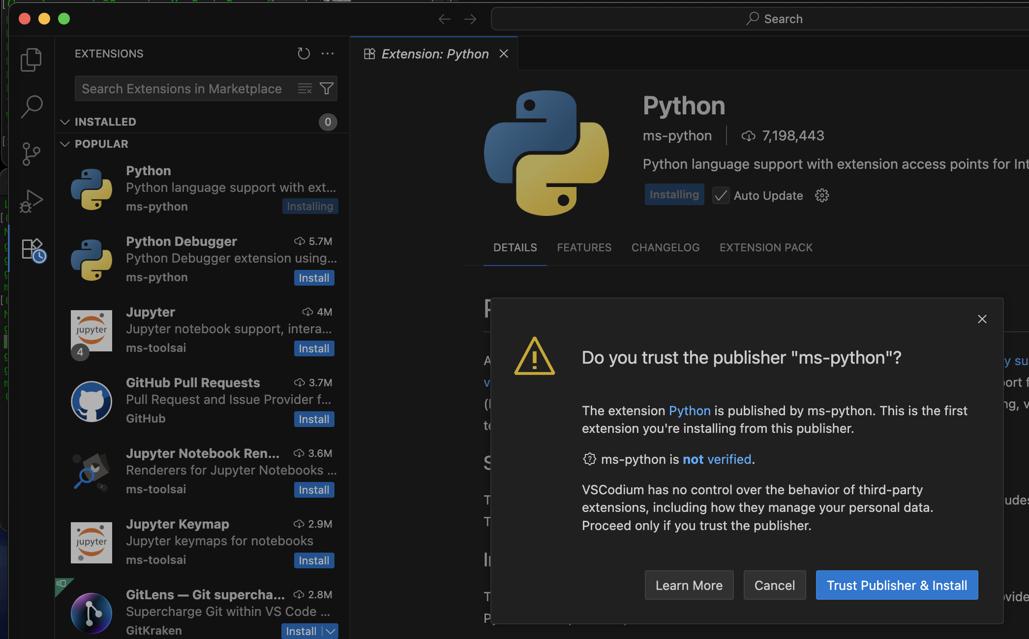
Step 10: Download and install the following:
1. To install package click install button next to package
2. Next, click
Trust Publisher & Install

Slide 14
Step 11: VSCodium – install plugins
Install the following plugins:
Python, Pylint, Continue (open-source AI code assistant)
Restart the app

Slide 15
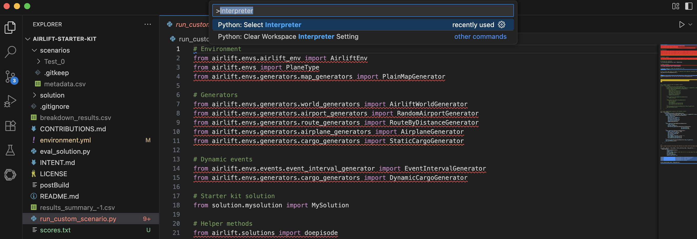
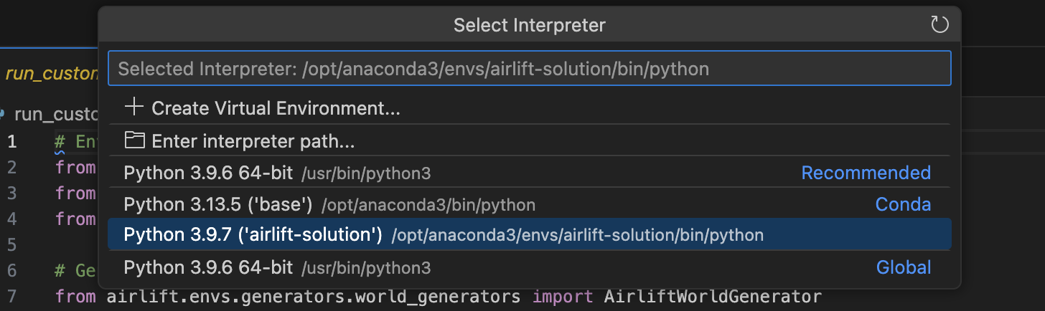
Step 12: VSCodium – configure runtime environment
1. Press Cmd+Shift+P keys, type in the input dialog: Interpreter
2. Select:
Python 3.13.5 (‘mog’) /op...

Slide 16
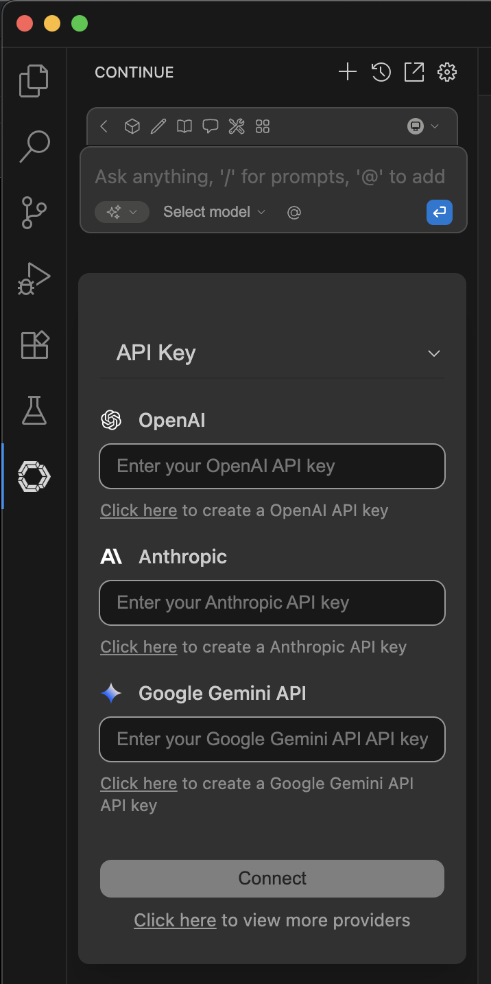
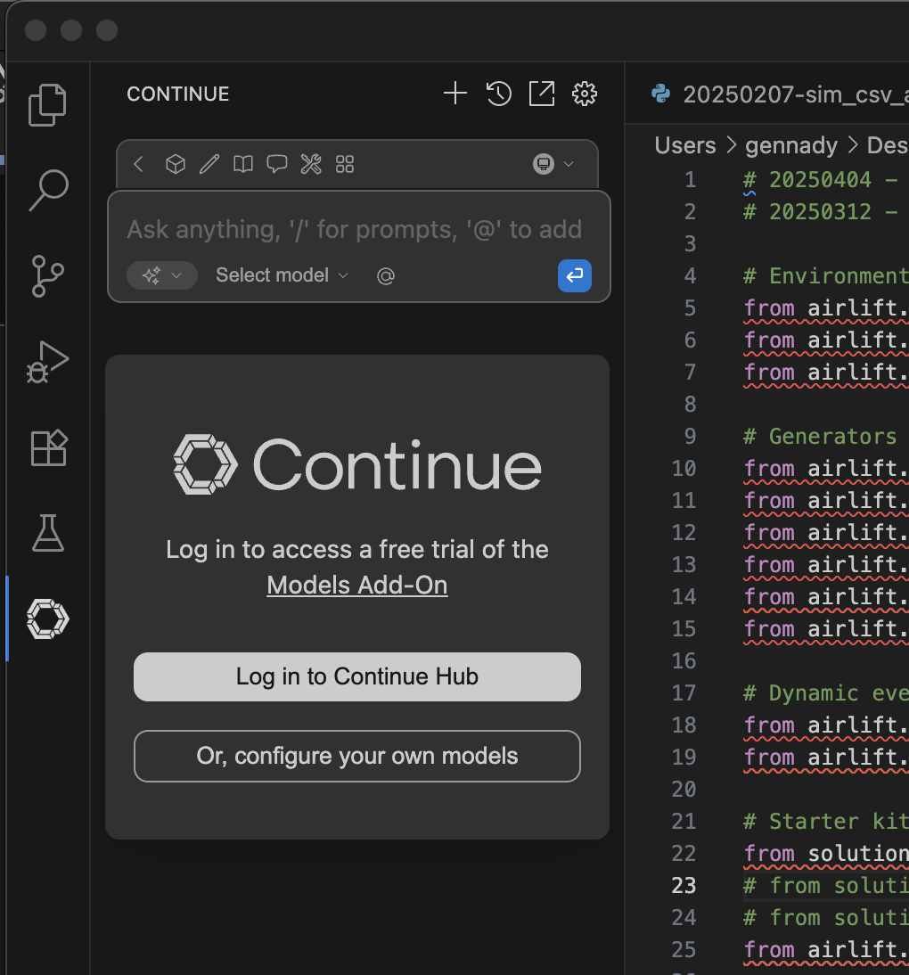
Step 13: Configure the Continue plugin
1. After install, click Continue plugin icon
3. Click on API Key and select Local
2. Select manual configuration

Slide 17
Step 14: Configure the Continue plugin
1. After install, click Continue plugin icon
2. Select manual configuration

Slide 18
Installation Guide

Slide 19
Step 1: Mission context
Download and install VSCodium (an Open Source fork of Microsoft VS Code but without telemetry
Make sure to download arm64 version, otherwise it will run very slow
https://github.com/VSCodium/vscodium/releases/download/1.102.14746/VSCodium.arm64.1.102.14746.dmg
1. Start VSCodium
2. Click here to install plugins
(Note: This might take some time to load)

