Slide 1

Travon Mobile Computing CSCI 5708
Name | Banner ID | Email
Genny Andrea Centeno Metri | B00786201 | gn936133@dal.ca
Richa Khatri | B00792218 | rc801868@dal.ca
Jamuna Loganath | B00811590 | jm284791@dal.ca
Nikhil Tyagi | B00809791 | nikhil.tyagi@dal.ca
Dheeraj Varshney | B00808467 | dh301823@dal.ca
Charley LeBlanc | B00727183 | ch875607@dal.ca
Group 15

Slide 2

ABOUT TRAVON
The mobile application “Travon” is a Travel Companion which helps users to ease their difficulties they may face while moving to a new city.

Slide 3
Who am I?
People who plan to move or travel for a long time to a new city.
Inhabitants of any city including landed immigrants, temporary residents, work permit holders, students, and tourist visa holders.

Slide 5
Where am I?
New city
Actual city

Slide 6
Usability
The application is meant to be used as an assistant to facilitate and accelerate the process of adaptation to a new city
The application will make use mainly of the GPS location features.
Anywhere in the world*
* Except for Finding Rooms, services and immigration.

Slide 7
Usability
User friendly
Voice search
Clickable events

Slide 8
Available features
Welcoming
Weather
News related to the city
Recommended Places
Events
Cost of living

Slide 9
Coming soon
Finding rooms
Services (plumbing, carpenter, moving, etc.)
Immigration

Slide 10


Advantages
All-in-one
Saves time
User friendly
Absolutely free
Avoids redundant information

Slide 11


Delivery and Business model

Slide 12

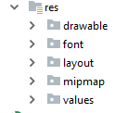
High-level Architecture
Models include the data of the application. For all features we have created a model which contains respective data of that feature.
Controllers - How our model functions. We have created different controllers for different features. Controllers created are: Cost of Living, Recommended Places, News Screen, Weather Screen
Views - They contain a collection of UI components for a given controller.

Slide 13

Technologies Used
Developed using Android, and server for mock APIs is created using node.js which is a new technology used in the market.
Application requires Internet connection
Developed considering future aspects

Slide 14
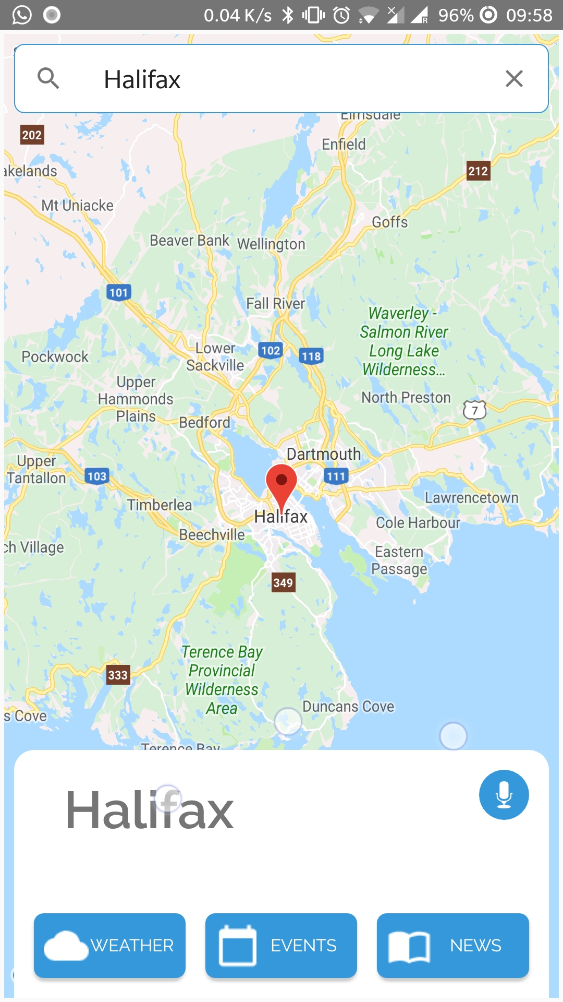
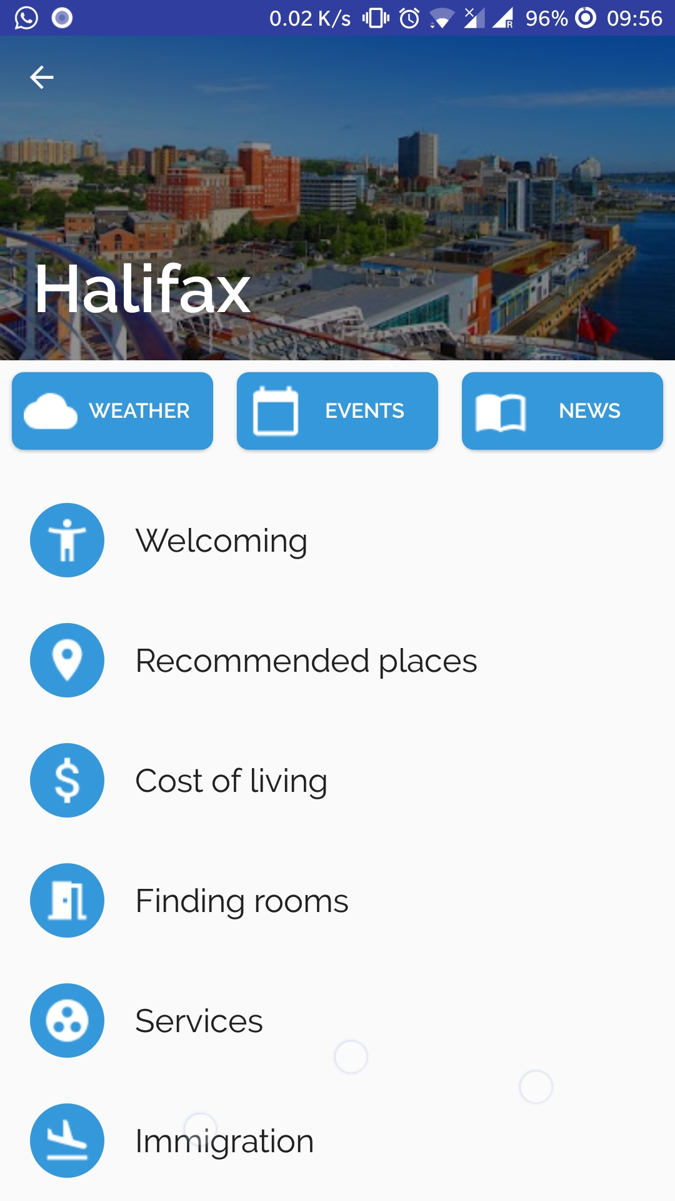
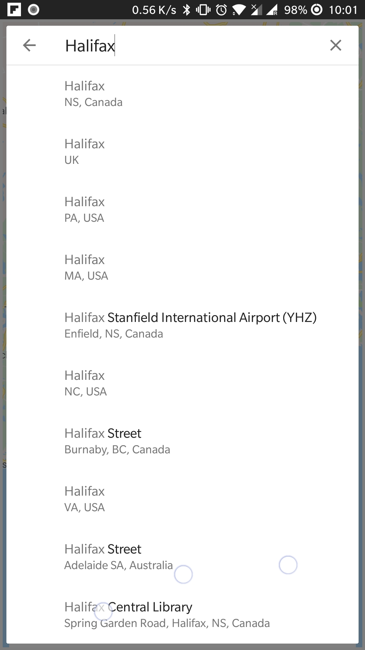
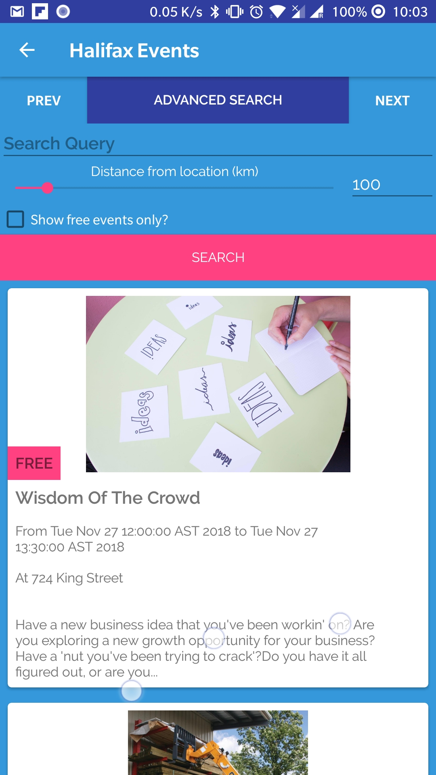
Neilsen’s Heuristics

Slide 15
TRAVON Testing
Testing is an important part of SDLC. Without testing, software or an application cannot be released in the market.
We have performed extensive testing which includes Functional as well as Regression Testing. We have documented the results of the testing done on GIT repository.

Slide 16
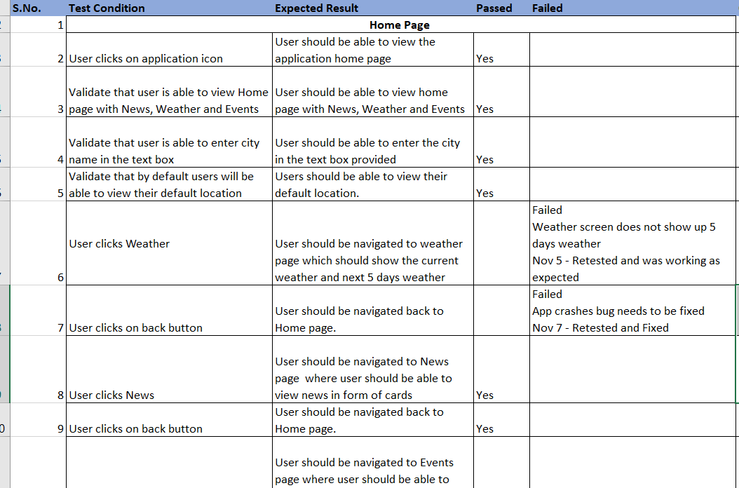
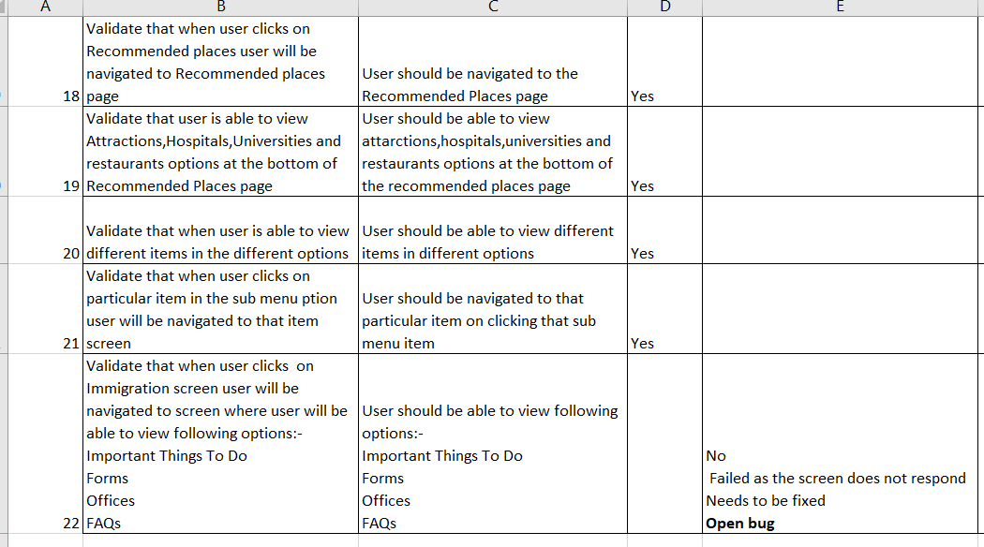
Test Reports
Manual test cases are created for various scenarios for quality testing

Slide 17
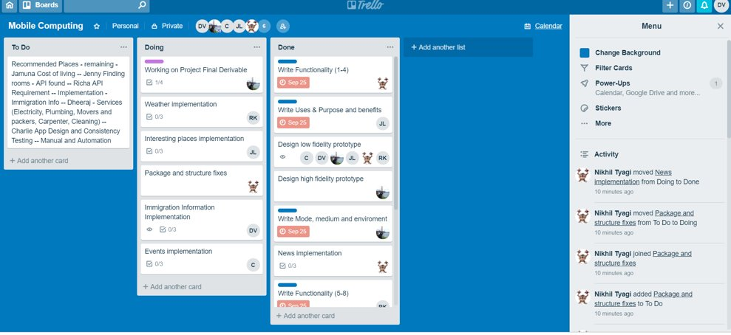
Project Management

Slide 18

Thank You

Slide 19

Any Questions?

