Slide 1
Language Translator Appliction
Breaking Language Barriers

Slide 2
Introduction
Welcome to the future of seamless communication with our Language Translator Application! In a world that thrives on diversity, bridging language barriers is more critical than ever. Our innovative application is designed to break down linguistic obstacles, empowering users to communicate effortlessly across borders and cultures. Whether you're traveling, conducting business, or connecting with friends from around the globe, our Language Translator is your trusted companion. Experience the power of advanced translation technology that goes beyond words, fostering understanding and connectivity in an increasingly interconnected world. Join us on a journey where language is no longer a barrier, but a gateway to a world united by communication.

Slide 3
Objective
To extract effective communication between people around the world.
To provide ability for two parties to communicate and exchange the ideas.
To encourage learners to discuss the meaning and use of language at the deepest possible levels.
To get a challenging position in reputed organization where we can learn a skills by communicating.
To perform and translate our native language.

Slide 4
Software used
Python Flask (backend)
React (frondend)
Googletrans module
Material UI

Slide 5
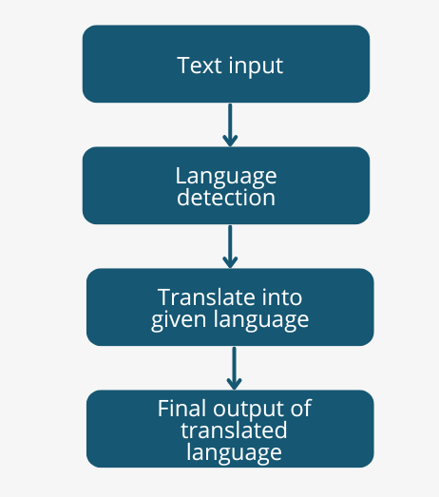
Block Diagram

Slide 6
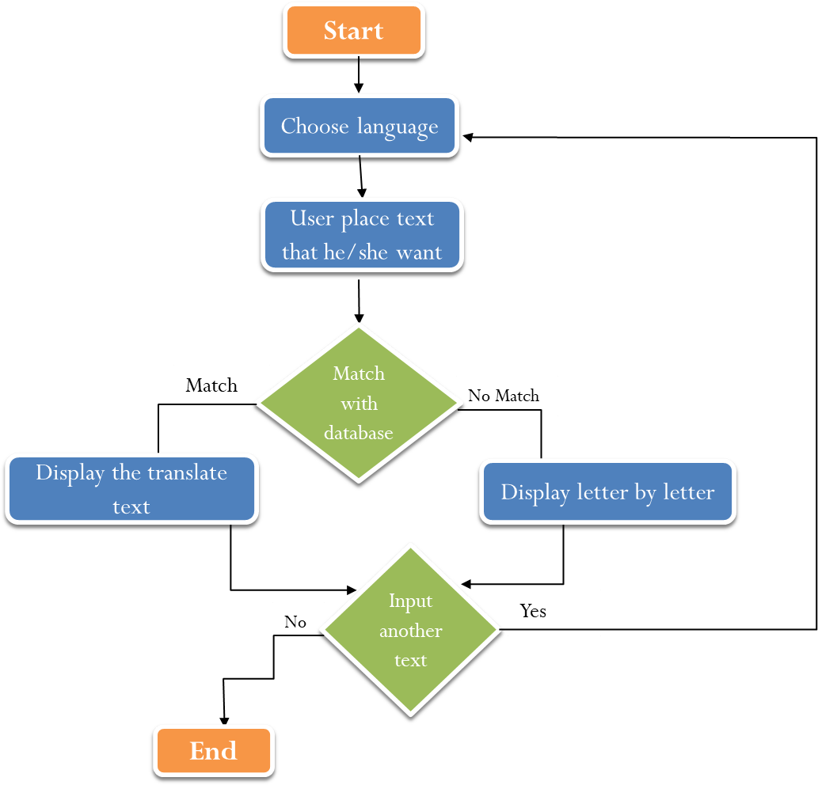
Translation Algorithms

Slide 7
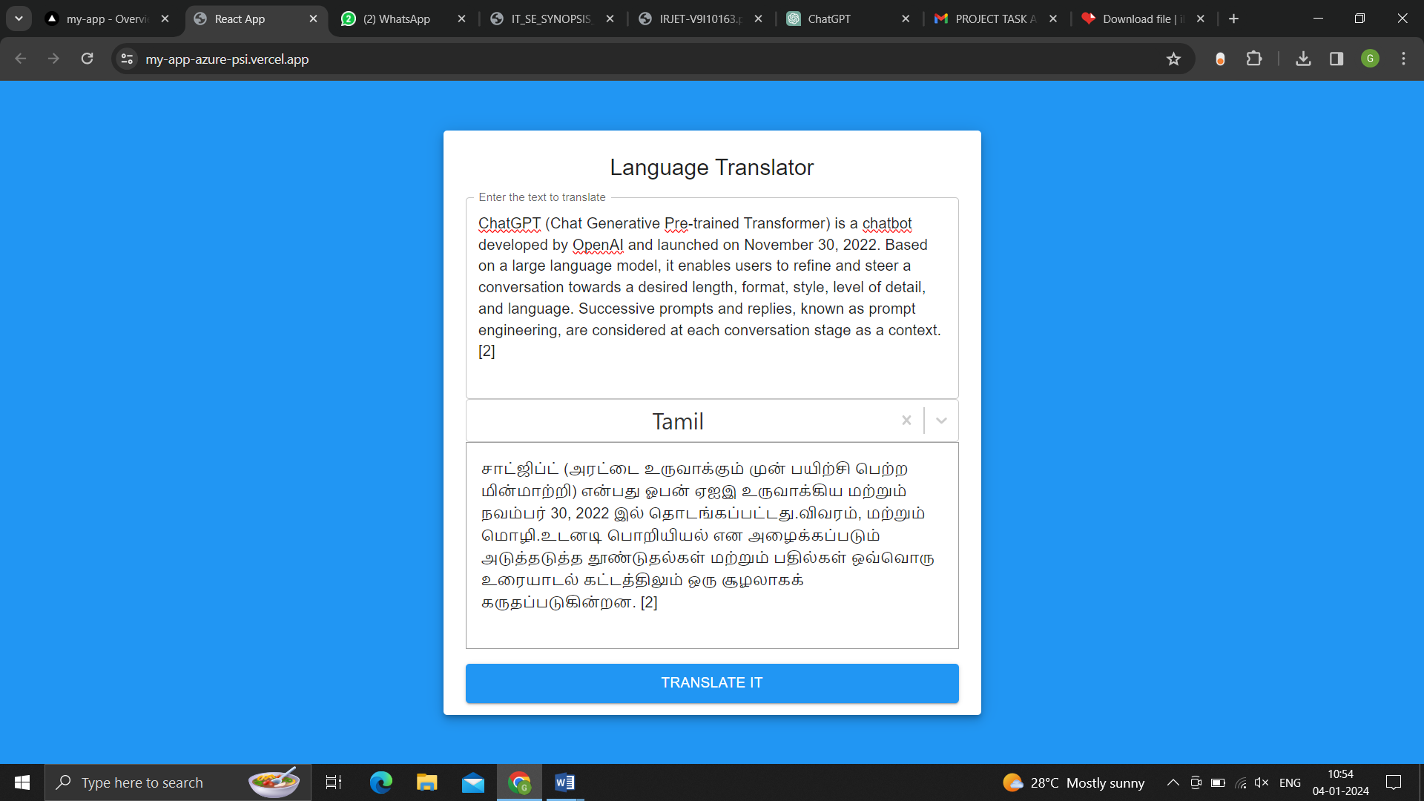
User Interface Design

Slide 8
Demo URL:https://my-app-azure-psi.vercel.app/

