Slide 1
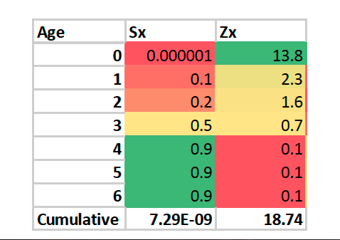
High mortality/low survival
low mortality/high survival

Slide 3
