Slide 1
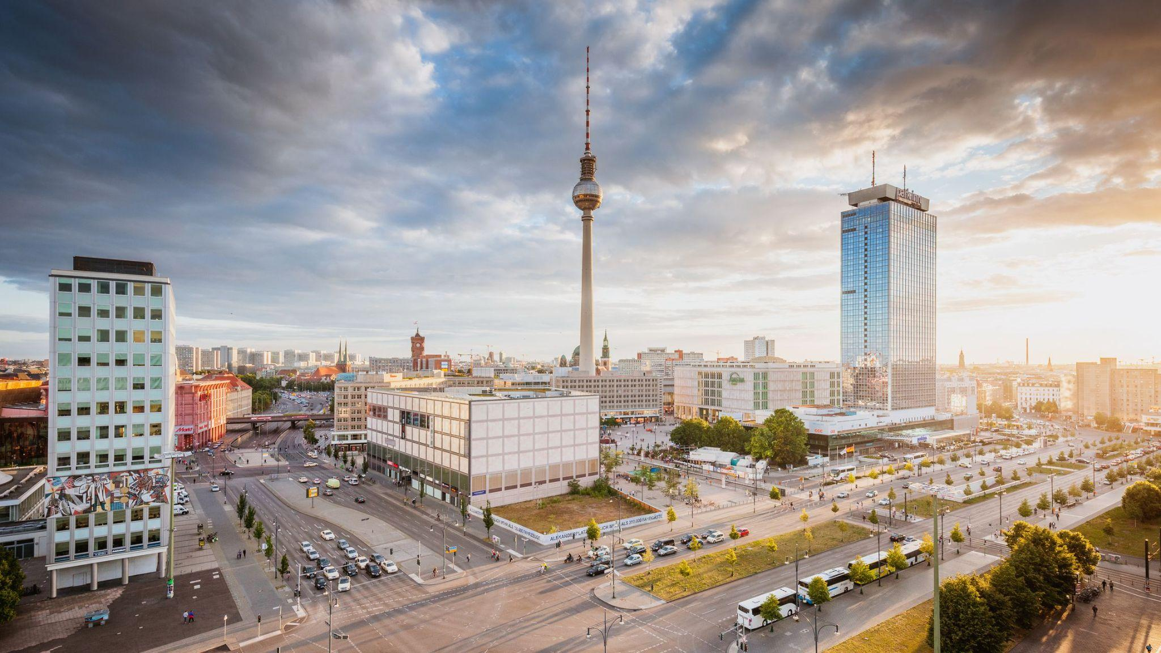
Airbnb pricing in the Berlin region
What insights can we gain from an exploratory data analysis (EDA) and a simple linear regression model?
Oriana Genolet
19.08.2022

Slide 2
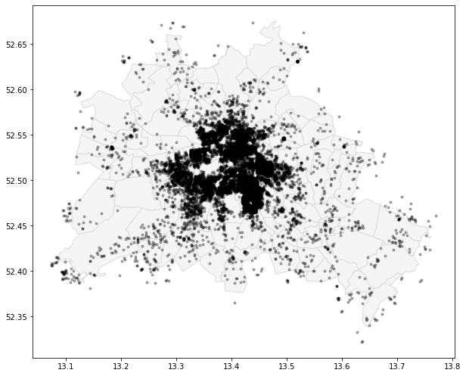
Data: Inside Airbnb
Features:
N° of bathrooms
Bedrooms
N° of people it accommodates
District
Neighbourhood
Room type
Property type
Amenities:
Balcony
Bbq
Kitchen
Washer
Parking
Wifi
Host verification:
Phone
Email
Work email
14711 data points from the Berlin region (AF)

Slide 3
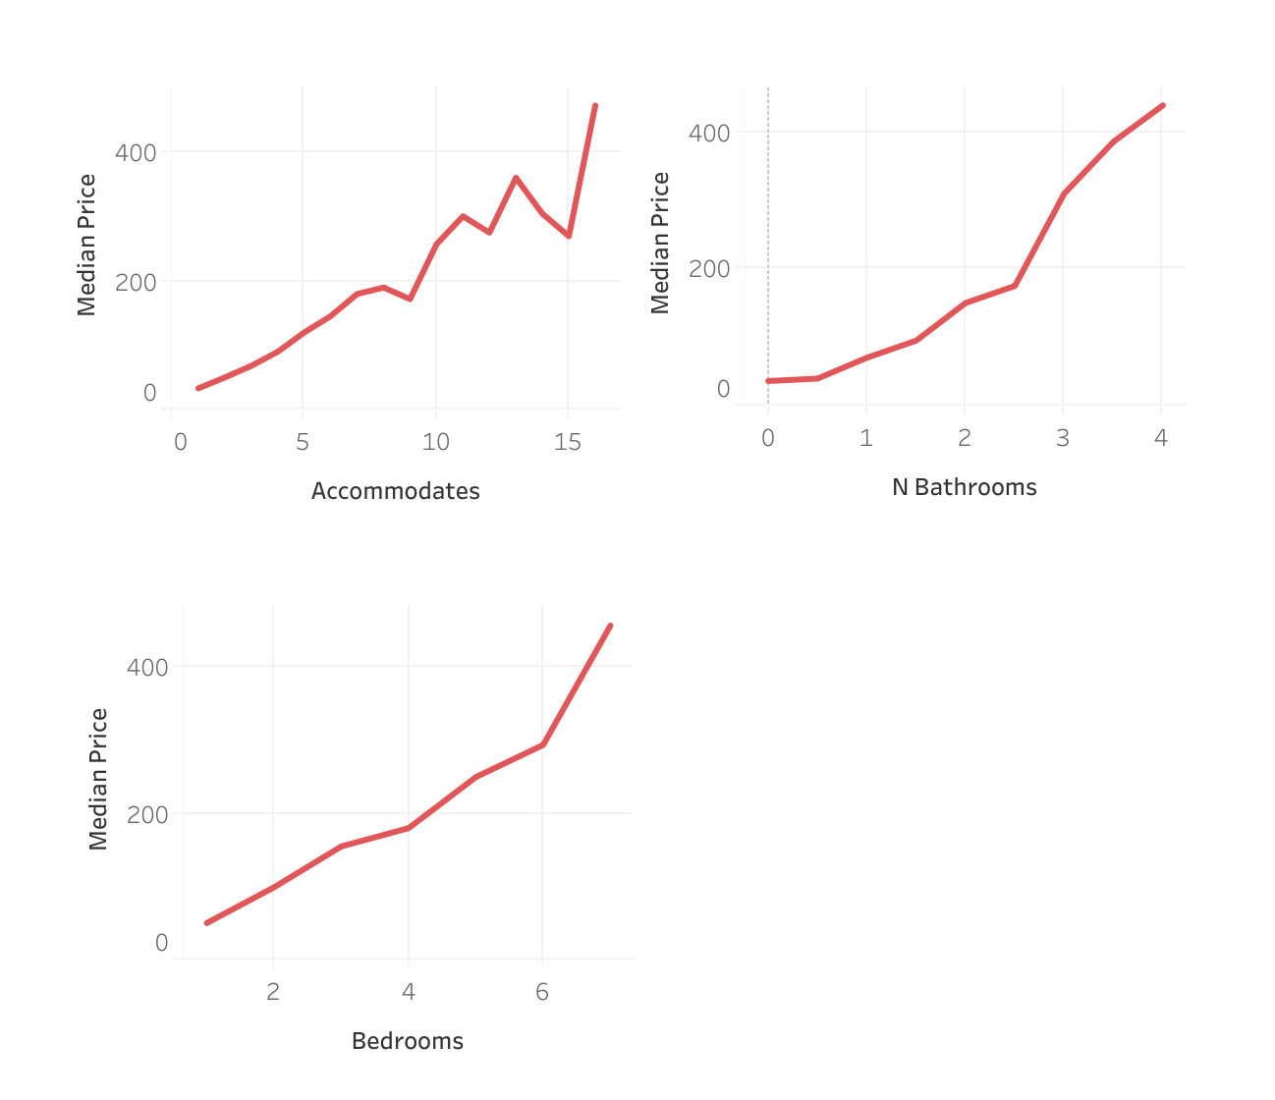
EDA: what are the factors that might influence the Airbnb prices in Berlin?
***
**
*
The higher the number of bathrooms, bedrooms and the more people the object can accommodate, the higher the prices

Slide 4
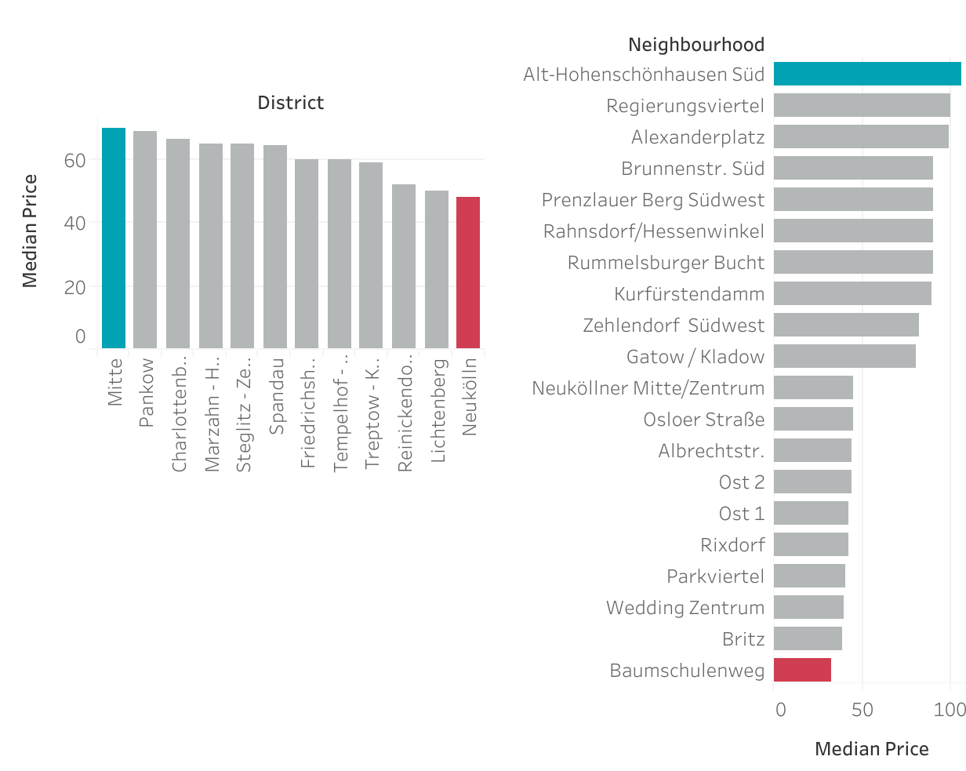
EDA: what are the factors that might influence the Airbnb prices in Berlin?
***
***
District and neighbourhood also seem to have a considerable impact on Airbnb prices

Slide 5
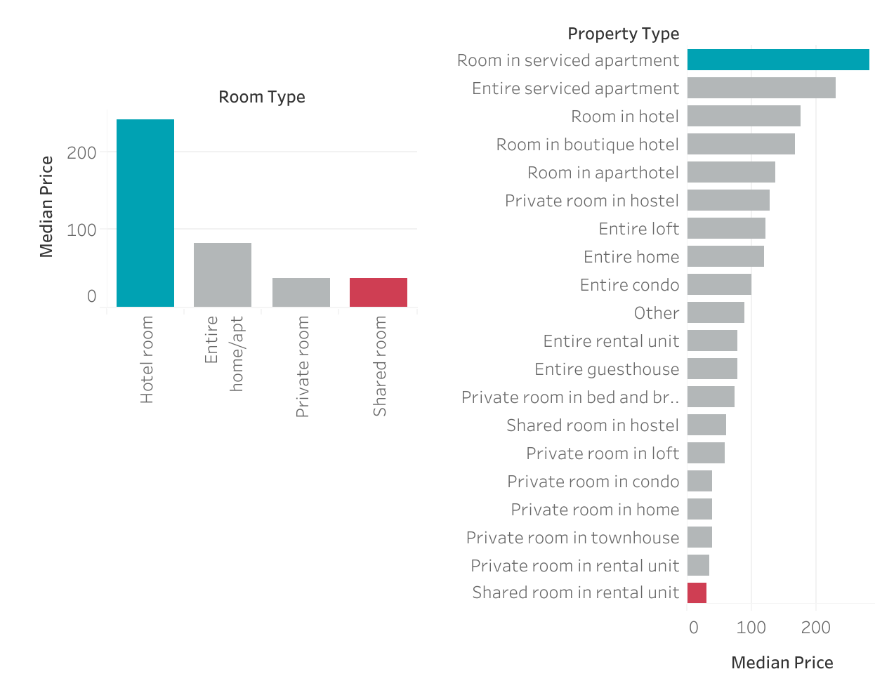
EDA: what are the factors that might influence the Airbnb prices in Berlin?
***
***
Of course, the type of accommodation has a significant influence in pricing

Slide 6
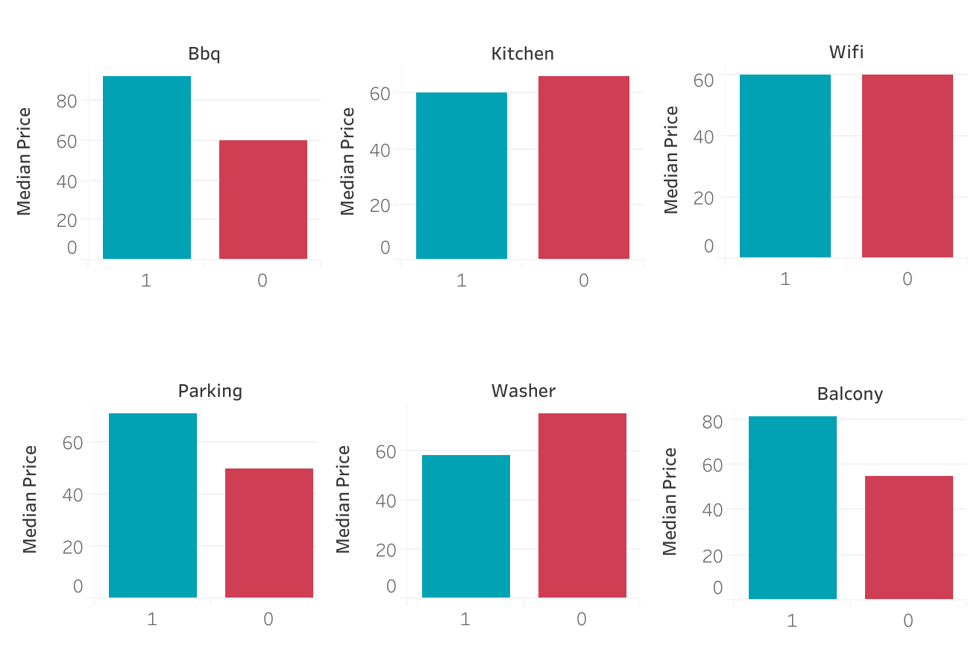
EDA: what are the factors that might influence the Airbnb prices in Berlin?
Bbq
Kitchen
Wifi
True
***
***
ns
False
Having a bbq, a balcony and parking increases Airbnb pricing
Kitchens and washers seem to decrease Airnb prices
Having wifi does not seem to have an impact on prices
Parking
Washer
Balcony
***
***
***

Slide 7
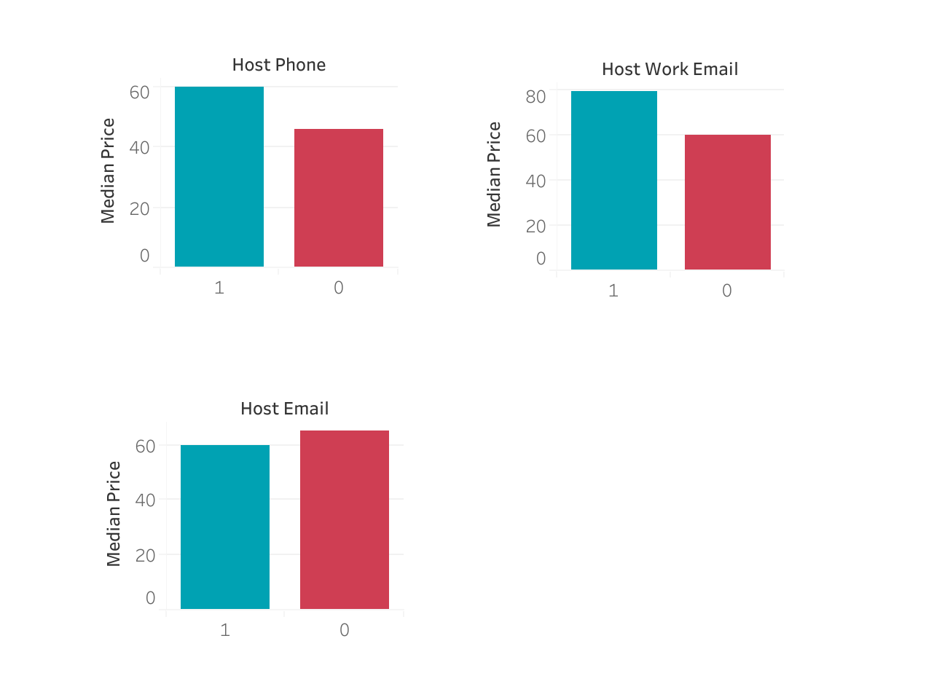
EDA: what are the factors that might influence the Airbnb prices in Berlin?
Host phone
Host work email
True
*
***
False
Host email
*
Whether the host has a phone or work email seems to impact pricing, less whether his email is stated in the description

Slide 8
EDA: what are the factors that might influence the Airbnb prices in Berlin?
Positive effect on price:
Bedrooms: 🛏🛏🛏🛏🛏🛏🛏🛏🛏
Bathrooms: 🚽🚽🚽🚽🚽🚽🚽🚽🚽
Accommodates: 👨🏽‍🦱👩🏻‍🦳👨🏽‍🦱👩🏻‍🦳👨🏽‍🦱👩🏻‍🦳👨🏽‍🦱👩🏻‍🦳👨🏽‍🦱👩🏻‍🦳
Object has a balcony, parking, bbq
Certain districts or neighbourhoods 🌆
Certain room or property types 🏠
Host phone/ work email 📞
Negative effect on price:
Kitchen/ washing machine (?)
Certain districts or neighbourhoods 🌆
Certain room or property types 🏠
No effect:
Whether the object has Wifi 💻
?
Can we get more insights from a linear regression model?:
Which features have a stronger impact on Airbnb pricing?

Slide 9
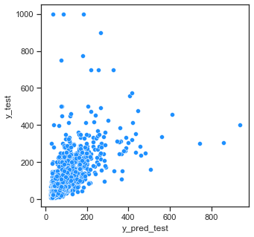
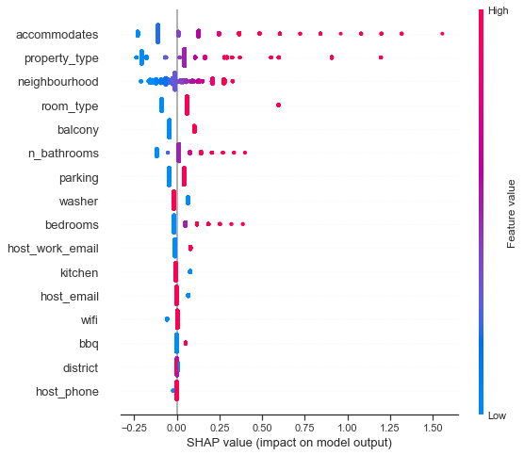
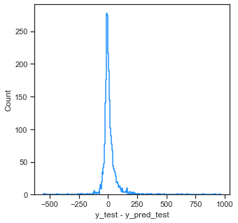
LRM: what are the factors that might influence the Airbnb prices in Berlin?
👎
r2 = 0.40
mape = 0.36

Slide 10
LRM: what are the factors that might influence the Airbnb prices in Berlin?
The LRM gives us additional information about which are the top features in this Airbnb dataset and how they impact pricing
With an EDA is easier to visualize which districts and neighbourhoods are more expensive/cheaper

Slide 11

Thank you for your attention!
Questions?....

Slide 12
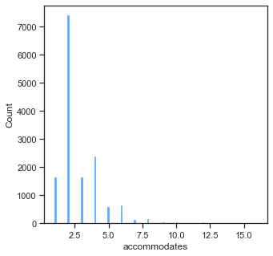
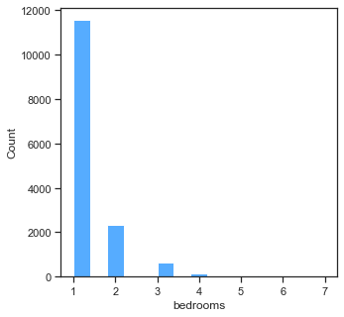
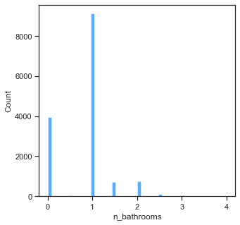
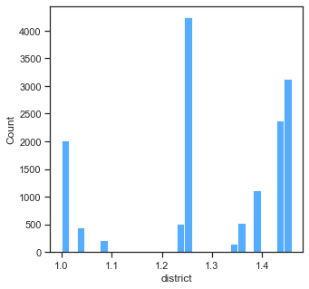
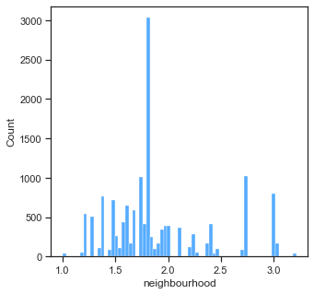
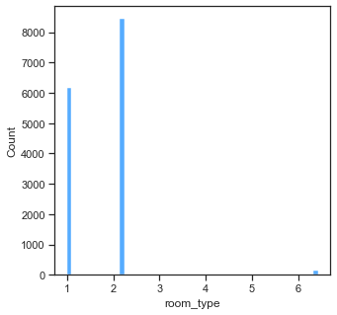
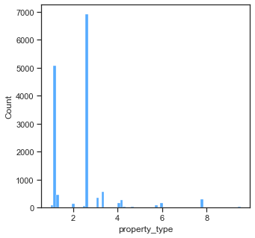
LRM: what are the factors that might influence the Airbnb prices in Berlin?

Slide 13
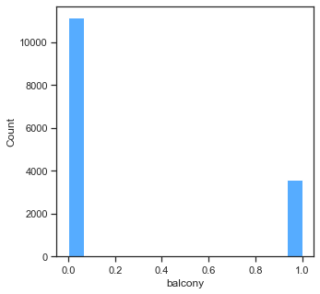
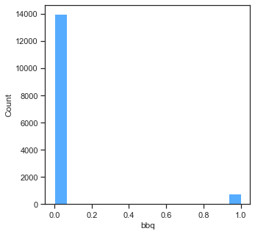
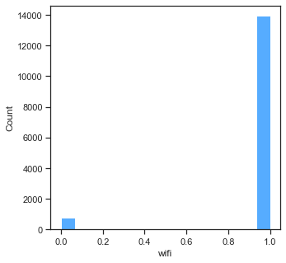
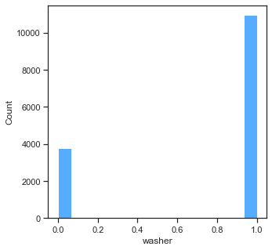
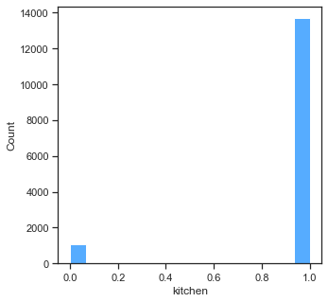
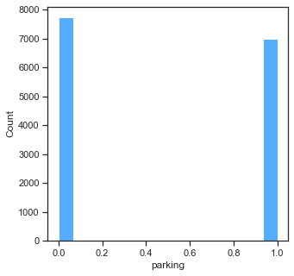
LRM: what are the factors that might influence the Airbnb prices in Berlin?

Slide 14
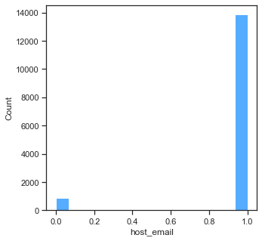
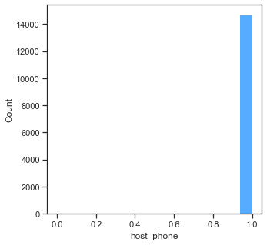
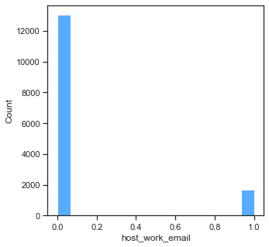
LRM: what are the factors that might influence the Airbnb prices in Berlin?

Slide 15
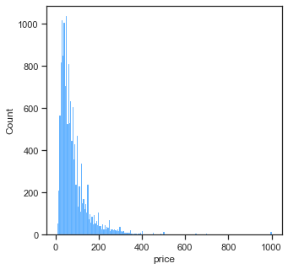
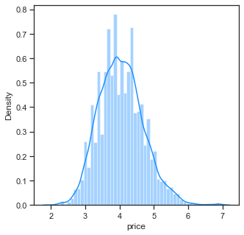
LRM: what are the factors that might influence the Airbnb prices in Berlin?

Slide 16
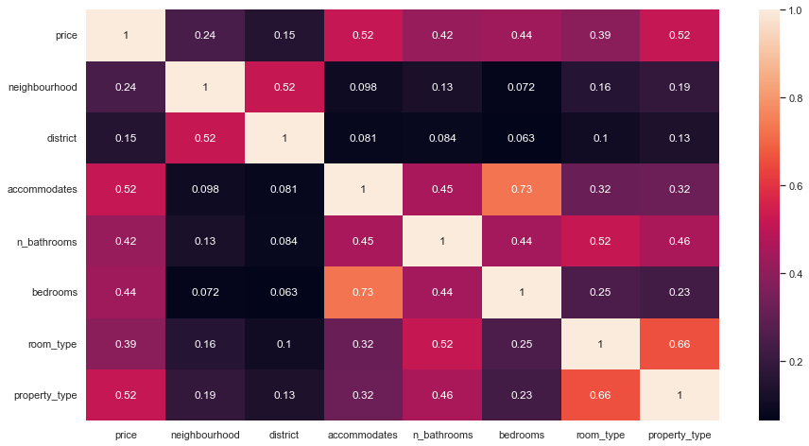
LRM: what are the factors that might influence the Airbnb prices in Berlin?

