Slide 1
Dizi Yerlestirme ve Varyant Tespiti Pratigi
Tugce Bilgin Sonay
UZH, Isvicre
GenomBilim Kis Okulu, 2016, ODTU

Slide 2

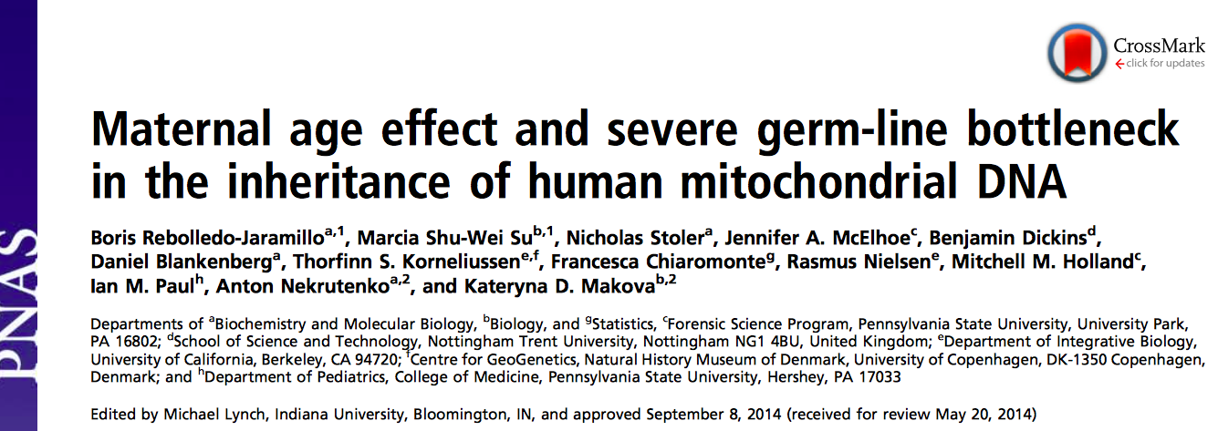
156 kisinin mitokondriyal DNAsi
Agizdan veya kandan ornek
20,000X dizi derinligi
GenomBilim Kis Okulu, 2016, ODTU

Slide 3
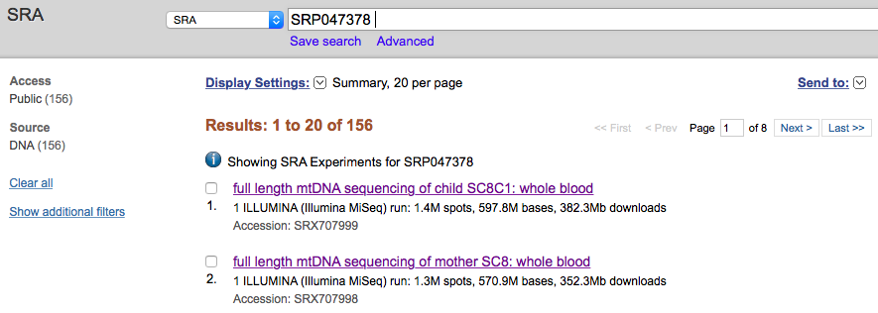
SRA
Short Read Archive
GenomBilim Kis Okulu, 2016, ODTU

Slide 4
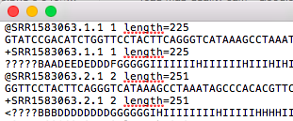
SRA
Short Read Archive
fastQ
fasta ve Quality data
Gene ID, uzunluk
Fasta dizisi
Gene ID, uzunluk
Kalite verisi
SRA toolkit
GenomBilim Kis Okulu, 2016, ODTU

Slide 5
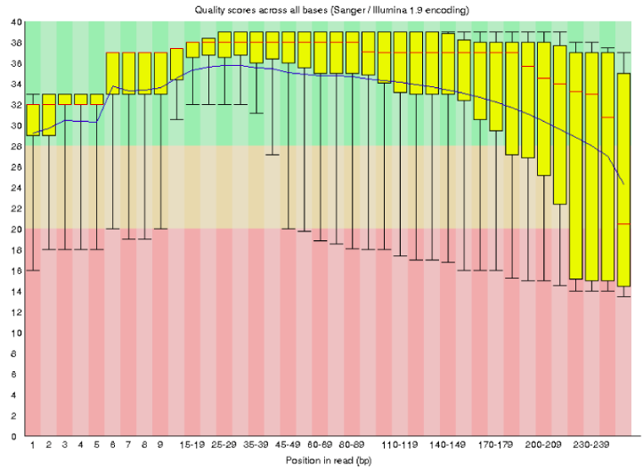
SRA
Short Read Archive
fastQ
fasta ve Quality data
SRA toolkit
FastQC
Bastaki ve sondaki kotu kalite bazlari kes
Aralardaki kotu kalite bazlari filtrele
Kalite Degerleri
Position
GenomBilim Kis Okulu, 2016, ODTU

Slide 6
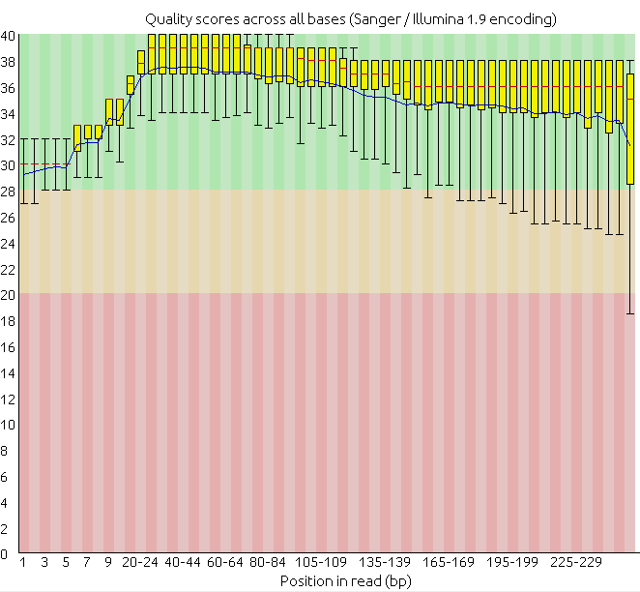
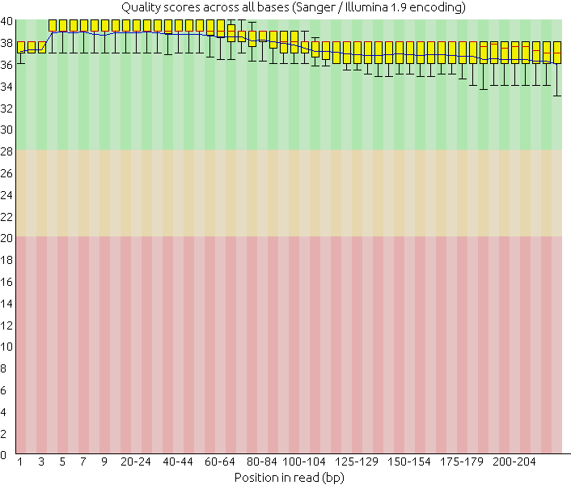
Oncesi
Sonrasi
GenomBilim Kis Okulu, 2016, ODTU

Slide 7
Kisa Diziler
Parcacik yerlestirme
GenomBilim Kis Okulu, 2016, ODTU

Slide 8
Parcacik Yerlestirme
Kisa dizileri bir refereans genomununa gore yerlestirmek
GenomBilim Kis Okulu, 2016, ODTU

Slide 9
Parcacik Yerlestirme
Kisa dizileri bir refereans genomununa gore yerlestirmek
GenomBilim Kis Okulu, 2016, ODTU

Slide 10
Yerlestime Kalitesi
GenomBilim Kis Okulu, 2016, ODTU
Notes:
The aligner cannot always assign a read to its point of origin with high confidence. For instance, a read that originated inside a repeat element might align equally well to many occurrences of the element throughout the genome, leaving the aligner with no basis for preferring one over the others.
Mapping quality is related to "uniqueness." We say an alignment is unique if it has a much higher alignment score than all the other possible alignments. The bigger the gap between the best alignment's score and the second-best alignment's score, the more unique the best alignment, and the higher its mapping quality should be.

Slide 11
Yerlestime Kalitesi
X X
GenomBilim Kis Okulu, 2016, ODTU
Notes:
The aligner cannot always assign a read to its point of origin with high confidence. For instance, a read that originated inside a repeat element might align equally well to many occurrences of the element throughout the genome, leaving the aligner with no basis for preferring one over the others.
Mapping quality is related to "uniqueness." We say an alignment is unique if it has a much higher alignment score than all the other possible alignments. The bigger the gap between the best alignment's score and the second-best alignment's score, the more unique the best alignment, and the higher its mapping quality should be.

Slide 12
Yerlestime Kalitesi
X X
GenomBilim Kis Okulu, 2016, ODTU
Notes:
The aligner cannot always assign a read to its point of origin with high confidence. For instance, a read that originated inside a repeat element might align equally well to many occurrences of the element throughout the genome, leaving the aligner with no basis for preferring one over the others.
Mapping quality is related to "uniqueness." We say an alignment is unique if it has a much higher alignment score than all the other possible alignments. The bigger the gap between the best alignment's score and the second-best alignment's score, the more unique the best alignment, and the higher its mapping quality should be.

Slide 13
Yerlestime Kalitesi
?
GenomBilim Kis Okulu, 2016, ODTU
Notes:
The aligner cannot always assign a read to its point of origin with high confidence. For instance, a read that originated inside a repeat element might align equally well to many occurrences of the element throughout the genome, leaving the aligner with no basis for preferring one over the others.
Mapping quality is related to "uniqueness." We say an alignment is unique if it has a much higher alignment score than all the other possible alignments. The bigger the gap between the best alignment's score and the second-best alignment's score, the more unique the best alignment, and the higher its mapping quality should be.

Slide 14
Yerlestime Kalitesi
Bu parcacik genoma yerlestirilirken ne kadar kesin konusabiliriz?
?
GenomBilim Kis Okulu, 2016, ODTU
Notes:
The aligner cannot always assign a read to its point of origin with high confidence. For instance, a read that originated inside a repeat element might align equally well to many occurrences of the element throughout the genome, leaving the aligner with no basis for preferring one over the others.
Mapping quality is related to "uniqueness." We say an alignment is unique if it has a much higher alignment score than all the other possible alignments. The bigger the gap between the best alignment's score and the second-best alignment's score, the more unique the best alignment, and the higher its mapping quality should be.

Slide 15
SRA
Short Read Archive
fastQ
fasta ve Quality data
Yerlestirme
SAM file
Sequence Alignment Map
BAM file
Binary Alignment Map, compressed
Bowtie2
SRA toolkit
FastQC
SAMTools
GenomBilim Kis Okulu, 2016, ODTU

Slide 16
Parcacik Yerlestirme
Kisa dizileri bir refereans genomununa gore yerlestirmek
Kapsanan Genom: %90
GenomBilim Kis Okulu, 2016, ODTU

Slide 17
Parcacik Yerlestirme
Kisa dizileri bir refereans genomununa gore yerlestirmek
Kapsanan Genom: %90
uclar
uclar
GenomBilim Kis Okulu, 2016, ODTU

Slide 18
Parcacik Yerlestirme
Kisa dizileri bir refereans genomununa gore yerlestirmek
Dizi Derinligi– bir baz kac kere yerlestiildi
Kapsanan Genom: %90
uclar
uclar
2X
3X
1X
GenomBilim Kis Okulu, 2016, ODTU

Slide 19
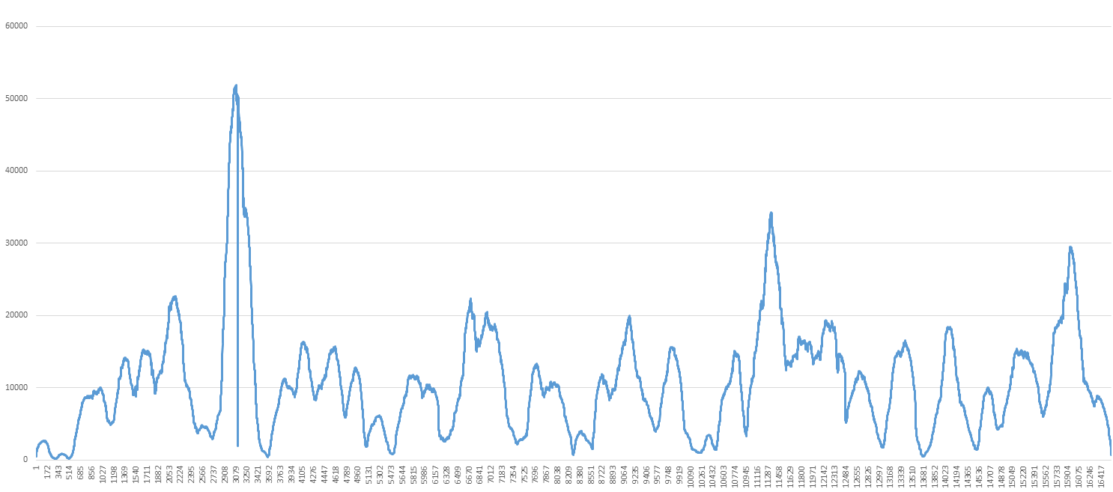
SRA
Short Read Archive
fastQ
fasta ve Quality data
Yerlestirme
SAM file
Sequence Alignment Map
BAM file
Binary Alignment Map, compressed
Bowtie2
SRA toolkit
FastQC
SAMTools
Kapsam
Derinlik
Derinlik
Pozisyon
GenomBilim Kis Okulu, 2016, ODTU

Slide 20
Kisa Diziler
Yerlestirme
Varyant Tespiti
GenomBilim Kis Okulu, 2016, ODTU

Slide 21
Varyant Tespiti
A
A
A
C
Referans Dizisi
GenomBilim Kis Okulu, 2016, ODTU

Slide 22
Varyant Tespiti
A
A
A
C
Reference sequence
GenomBilim Kis Okulu, 2016, ODTU

Slide 23
SRA
Short Read Archive
fastQ
fasta ve Quality data
Yerlestirme
SAM file
Sequence Alignment Map
BAM file
Binary Alignment Map, compressed
Bowtie2
SRA toolkit
FastQC
SAMTools
BCFTools
Varyant Tespiti
Varyantlar
SNPler
indeller
VCF file
Variant Call File
BCF file
Binary Call File
BCFTools
GenomBilim Kis Okulu, 2016, ODTU

Slide 24
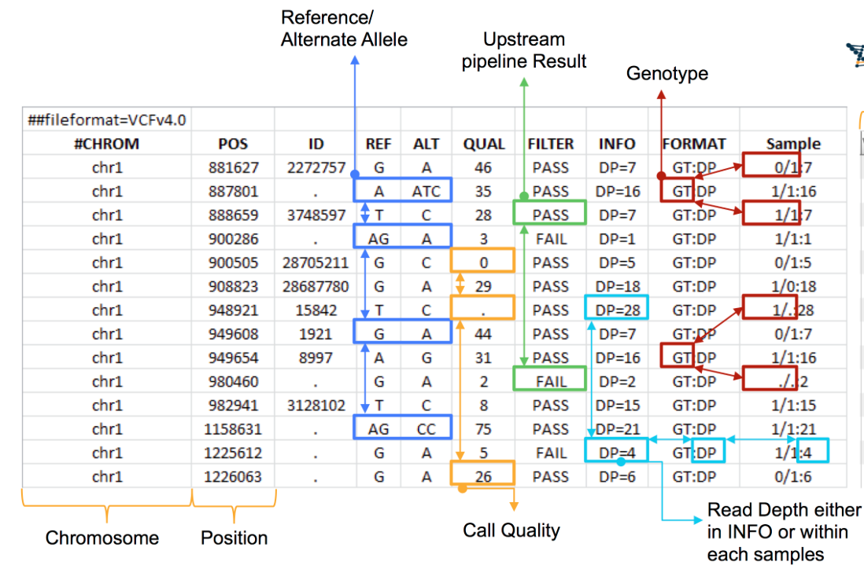
Variant Call File Format

Slide 25
Kisa Diziler
Yerlestirme
Varyant Tespiti
Dizinin son hali
T
C
A
T
GenomBilim Kis Okulu, 2016, ODTU

Slide 26
SRA
Short Read Archive
fastQ
fasta ve Quality data
Yerlestirme
SAM file
Sequence Alignment Map
BAM file
Binary Alignment Map, compressed
Bowtie2
SRA toolkit
FastQC
SAMTools
BCFTools
Varyant Tespiti
Dizinin Son hali
fasta format
VCF file
Variant Call File
BCF file
Binary Call File
BCFTools
BCFTools
GenomBilim Kis Okulu, 2016, ODTU

Slide 27
Dizinin Son Hali
T
C
A
T
son dizi
A
A
A
A
T
C
C
referans dizisi
GenomBilim Kis Okulu, 2016, ODTU

Slide 28
Dizinin Son Hali
T
C
A
T
son dizi
A
T
C
C
referans dizisi
GenomBilim Kis Okulu, 2016, ODTU

