Slide 1
Dizi Yerlestirme ve Varyant Tespiti Pratigi
Tugce Bilgin Sonay
GenomBilim Kis Okulu, 2019, Ege Uni

Slide 2
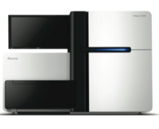
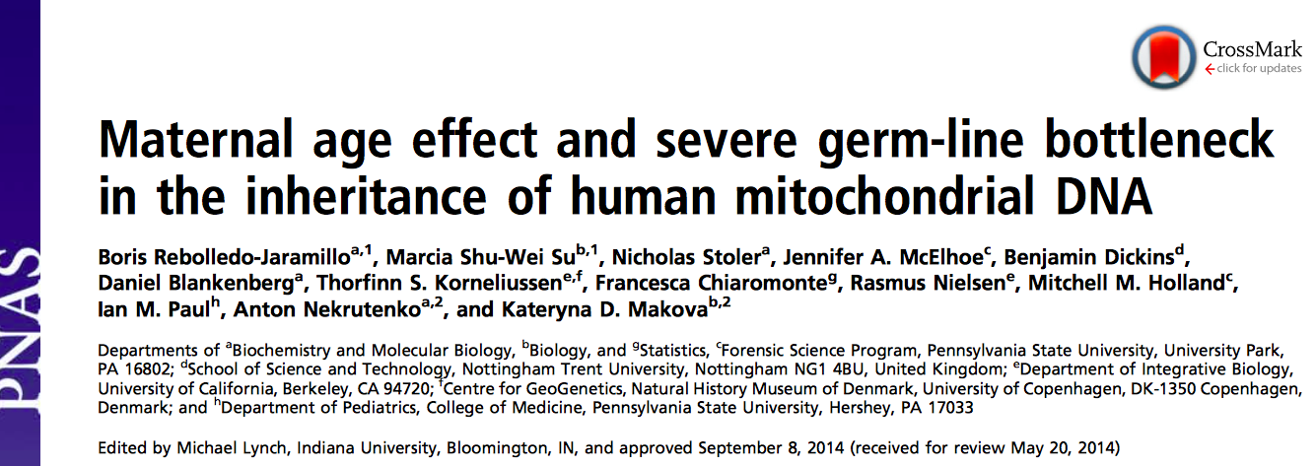
156 kisinin mitokondriyal DNAsi
Agizdan veya kandan ornek
20,000X dizi derinligi

Slide 3
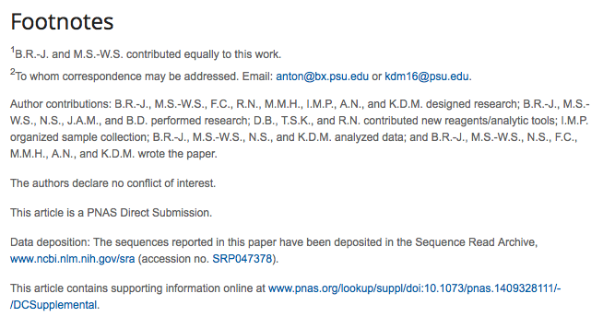

156 kisinin mitokondriyal DNAsi
Agizdan veya kandan ornek
20,000X dizi derinligi
GenomBilim Kis Okulu, 2016, ODTU

Slide 4
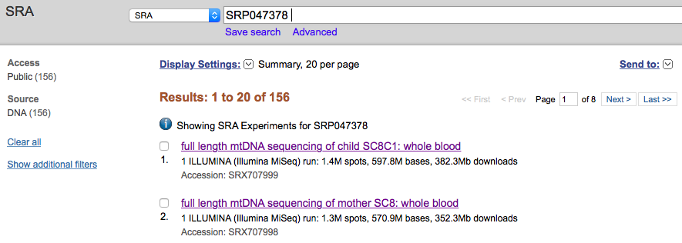
SRA
Short Read Archive

Slide 5
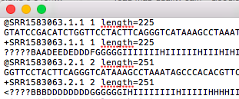
SRA
Short Read Archive
fastQ
fasta ve Quality data
Gene ID, uzunluk
Fasta dizisi
Gene ID, uzunluk
Kalite verisi
SRA toolkit

Slide 6
Dizinin kalite degerleri
kalite degeri: 30 -> baz %99.9 ihtimal dogru
ATGCAGGTTCGGANN
GenomBilim Kis Okulu, 2016, ODTU

Slide 7
Dizinin kalite degerleri
kalite degeri: 30 -> baz %99.9 ihtimal dogru
ATGCAGGTTCGGANN
kalite degeri: 10-> baz %10 yanlis.
GenomBilim Kis Okulu, 2016, ODTU

Slide 8
Dizinin kalite degerleri
kalite degeri: 30 -> baz %99.9 ihtimal dogru
ATGCAGGTTCGGANN
kalite degeri: 10-> baz %10 yanlis.
bazin ne oldugu belirlenemediyse N
GenomBilim Kis Okulu, 2016, ODTU

Slide 9
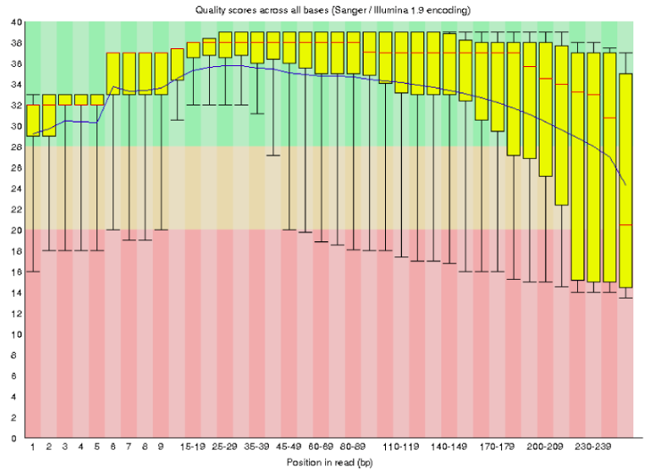
SRA
Short Read Archive
fastQ
fasta ve Quality data
SRA toolkit
FastQC
Bastaki ve sondaki kotu kalite bazlari kes
Aralardaki kotu kalite bazlari filtrele
Kalite Degerleri
Position

Slide 10
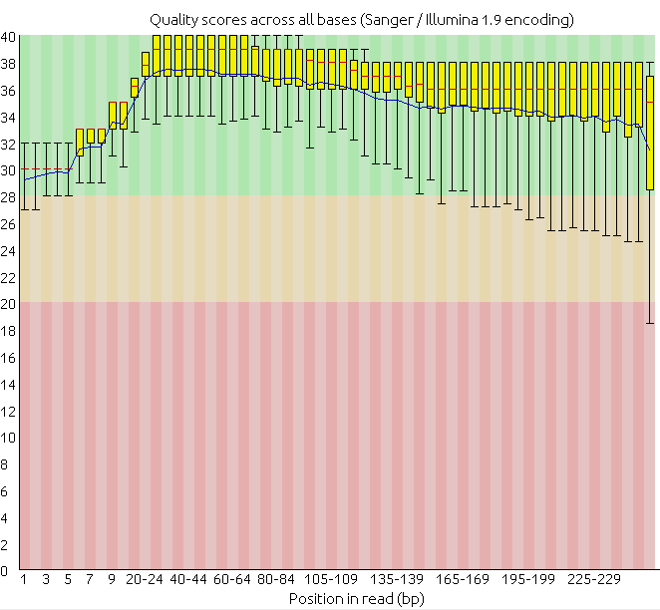
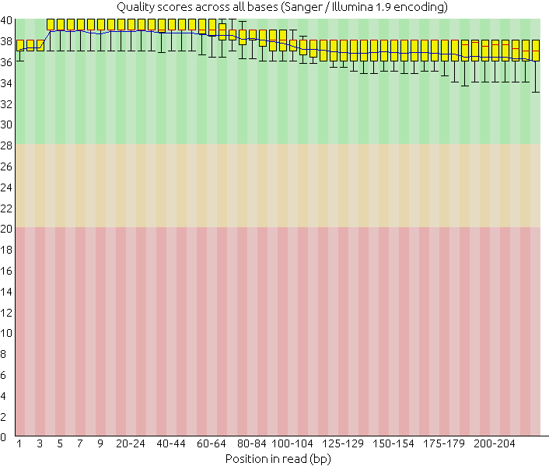
Oncesi
Sonrasi

Slide 11
Kisa Diziler
Parcacik yerlestirme

Slide 12
Parcacik Yerlestirme
Kisa dizileri bir refereans genomununa gore yerlestirmek

Slide 13
Parcacik Yerlestirme
Kisa dizileri bir refereans genomununa gore yerlestirmek

Slide 14
Yerlestime Kalitesi
Notes:
The aligner cannot always assign a read to its point of origin with high confidence. For instance, a read that originated inside a repeat element might align equally well to many occurrences of the element throughout the genome, leaving the aligner with no basis for preferring one over the others.
Mapping quality is related to "uniqueness." We say an alignment is unique if it has a much higher alignment score than all the other possible alignments. The bigger the gap between the best alignment's score and the second-best alignment's score, the more unique the best alignment, and the higher its mapping quality should be.

Slide 15
Yerlestime Kalitesi
X X
Notes:
The aligner cannot always assign a read to its point of origin with high confidence. For instance, a read that originated inside a repeat element might align equally well to many occurrences of the element throughout the genome, leaving the aligner with no basis for preferring one over the others.
Mapping quality is related to "uniqueness." We say an alignment is unique if it has a much higher alignment score than all the other possible alignments. The bigger the gap between the best alignment's score and the second-best alignment's score, the more unique the best alignment, and the higher its mapping quality should be.

Slide 16
Yerlestime Kalitesi
X X
Notes:
The aligner cannot always assign a read to its point of origin with high confidence. For instance, a read that originated inside a repeat element might align equally well to many occurrences of the element throughout the genome, leaving the aligner with no basis for preferring one over the others.
Mapping quality is related to "uniqueness." We say an alignment is unique if it has a much higher alignment score than all the other possible alignments. The bigger the gap between the best alignment's score and the second-best alignment's score, the more unique the best alignment, and the higher its mapping quality should be.

Slide 17
Yerlestime Kalitesi
?
Notes:
The aligner cannot always assign a read to its point of origin with high confidence. For instance, a read that originated inside a repeat element might align equally well to many occurrences of the element throughout the genome, leaving the aligner with no basis for preferring one over the others.
Mapping quality is related to "uniqueness." We say an alignment is unique if it has a much higher alignment score than all the other possible alignments. The bigger the gap between the best alignment's score and the second-best alignment's score, the more unique the best alignment, and the higher its mapping quality should be.

Slide 18
Yerlestime Kalitesi
Bu parcacik genoma yerlestirilirken ne kadar kesin konusabiliriz?
?
Notes:
The aligner cannot always assign a read to its point of origin with high confidence. For instance, a read that originated inside a repeat element might align equally well to many occurrences of the element throughout the genome, leaving the aligner with no basis for preferring one over the others.
Mapping quality is related to "uniqueness." We say an alignment is unique if it has a much higher alignment score than all the other possible alignments. The bigger the gap between the best alignment's score and the second-best alignment's score, the more unique the best alignment, and the higher its mapping quality should be.

Slide 19
SRA
Short Read Archive
fastQ
fasta ve Quality data
Yerlestirme
SAM file
Sequence Alignment Map
BAM file
Binary Alignment Map, compressed
Bowtie2
SRA toolkit
FastQC
SAMTools

Slide 20
Parcacik Yerlestirme
Kisa dizileri bir refereans genomununa gore yerlestirmek
Kapsanan Genom: %90

Slide 21
Parcacik Yerlestirme
Kisa dizileri bir refereans genomununa gore yerlestirmek
Kapsanan Genom: %90
uclar
uclar

Slide 22
Parcacik Yerlestirme
Kisa dizileri bir refereans genomununa gore yerlestirmek
Dizi Derinligi– bir baz kac kere yerlestiildi
Kapsanan Genom: %90
uclar
uclar
2X
3X
1X

Slide 23
Kisa Diziler
Yerlestirme
Varyant Tespiti

Slide 24
Varyant Tespiti
A
A
A
C
Referans Dizisi

Slide 25
Varyant Tespiti
A
A
A
C
Reference sequence

Slide 26
SRA
Short Read Archive
fastQ
fasta ve Quality data
Yerlestirme
SAM file
Sequence Alignment Map
BAM file
Binary Alignment Map, compressed
Bowtie2
SRA toolkit
FastQC
SAMTools
BCFTools
Varyant Tespiti
Varyantlar
SNPler
indeller
VCF file
Variant Call File
BCF file
Binary Call File
BCFTools

Slide 27
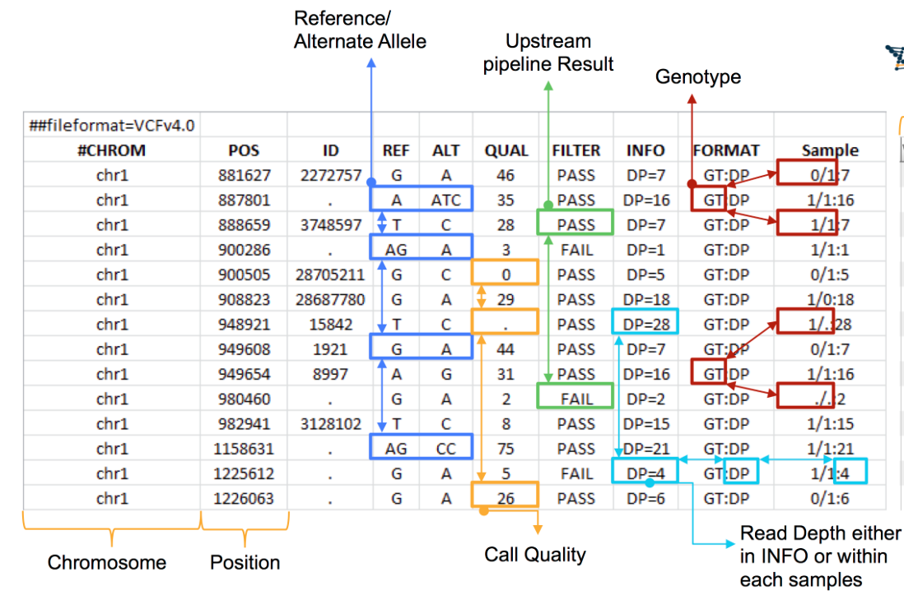
Variant Call File Format

Slide 28
Kisa Diziler
Yerlestirme
Varyant Tespiti
Dizinin son hali
T
C
A
T

Slide 29
SRA
Short Read Archive
fastQ
fasta ve Quality data
Yerlestirme
SAM file
Sequence Alignment Map
BAM file
Binary Alignment Map, compressed
Bowtie2
SRA toolkit
FastQC
SAMTools
BCFTools
Varyant Tespiti
Dizinin Son hali
fasta format
VCF file
Variant Call File
BCF file
Binary Call File
BCFTools
BCFTools
GenomBilim Kis Okulu, 2016, ODTU

Slide 30
Dizinin Son Hali
T
C
A
T
son dizi
A
A
A
A
T
C
C
referans dizisi

Slide 31
Dizinin Son Hali
T
C
A
T
son dizi
A
T
C
C
referans dizisi

