Slide 1
Web-3DPredictor: a Web Interface for High-resolution Prediction of Genome Architecture
Emil Valeev
Polina Belokopytova
Veniamin Fishman
ICG SB RAS, NSU, Novosibirsk, Russia

Slide 2
3D Organization of Chromatin
Levels:
Chromosome territories
Compartments
Topologically associated domains (TADs)
Chromatin loops

Slide 3
3D Organization of Chromatin
Modulation function:
Transcription (EP interactions)
DNA replication
Mitosis and meiosis
Ergo, 3D organization of chromatin plays a significant role in:
cell differentiation,
expression pattern,
organism development as a whole.
TADs are highly conservative, which argued for high importance of 3D chromatin organization.

Slide 4
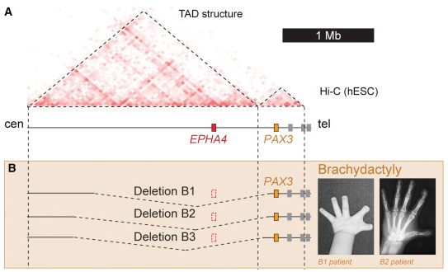
Example
The EPHA4 gene resides between enchancer region and the PAX3 gene. Hi-C data show that the region is organized into two TADs.
In mice, Epha4 is required for normal innervation of the limb, but inactivation of Epha4 does not cause changes in the limb skeleton.
Large deletion was shown to remove boundary between the EPHA4 and PAX3 TADs, resulting in PAX3 expression changes, and later in phenotype of preaxial brachydactyly, PAX3 Type.
(Lupiáñez et al., 2015)

Slide 5
Motivation
Mechanisms of chromatin organization are not completely understood.
ML methods are shown to be useful in predicting chromatin contacts.
Existing prediction tools have low resolution and limited usability in clinics.

Slide 6
Aim
Understanding of mechanisms of 3D chromatin organization
Development of a tool for chromosome rearrangements modelling which could be used in clinical practice

Slide 7
3D Predictor Algorithm

Slide 8
Epigenetic Data Used as Predictors
ChIP-seq
RNA-seq
E1 values
genomic distance

Slide 9
Results
Prediction can be significantly improved by training algorithm on higher resolution data.
Reasonably accurate prediction requires genomic distance and CTCF data only. Additional interchangeable predictors can be used to improve results.
3DPredictor is shown to provide more accurate prediction than most of existing tools. E.g.,
MEGABASE +MiChroM (Di Pierro et al., 2017)
Qi and Zhang, 2019
Rowley et al., 2017
Belokopytova, P., Nuriddinov, M., Mozheiko, E., Fishman, D., & Fishman, V. (2019)

Slide 10
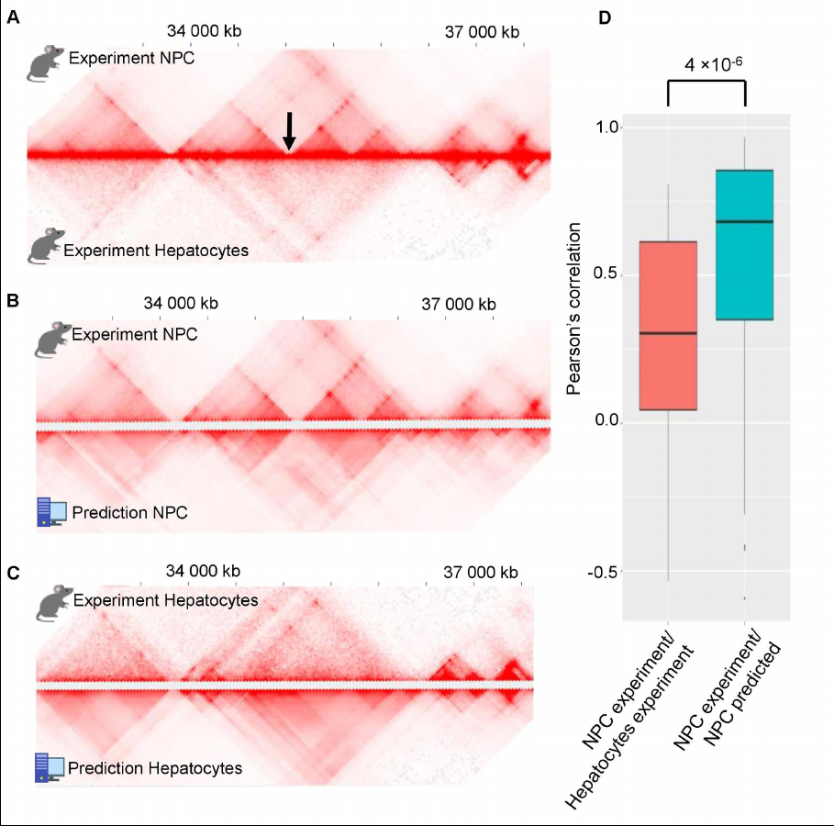
Results
Prediction are cell-type specific.

Slide 11
Web 3D Predictor

Slide 12
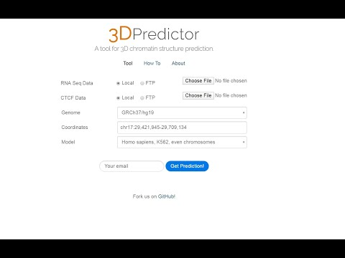
Web Interface

Slide 13
Input Data
CTCF data in NarrowPeak format
RNA-seq data
All data can be downloaded from local storage, or external public resources, e.g. ENCODE, by direct links.

Slide 14
Tools
Front-end: PureCSS framework, PHP
Back-end:
Pipeline: Bash script
Preprocessing CTCF data: gimmemotifs
Preprocessing RNA-seq data: Python 3.7 script
Hi-C map: Juicer Tools

Slide 15
Prediction Models
Homo sapiens, K562, even chromosomes, 5kb
Homo sapiens, K562, odd chromosomes, 5kb
Mus musculus, NPC, even chromosomes, 5kb
Mus musculus, NPC, odd chromosomes, 5kb
Note: Use model which was not trained on the chromosome of interest, to avoid overfitting.

Slide 16

https://genedev.bionet.nsc.ru/Web_3DPredictor

Slide 17
Thank you for your attention!

