Slide 1

Three’s a crowd-source: Observations on Collaborative Genome Annotation.
UNIVERSITY OF
CALIFORNIA
Monica Munoz-Torres, PhD via Suzanna Lewis
Biocurator & Bioinformatics Analyst | @monimunozto
Genomics Division, Lawrence Berkeley National Laboratory
08 April, 2014 | 7th International Biocuration Conference

Slide 2

Outline
Automated and Manual Annotation in a genome sequencing project.
Distributed, community-based genome curation using Apollo.
What we have learned so far.
Three’s a crowd-source: Observations on Collaborative Genome Annotation.
Automated Annotation
Manual annotation
Experimental validation
Assembly
In a genome sequencing project…
Notes:
Outline. The box at the bottom is to give a context of automated and manual annotation as it will be discussed in this talk.

Slide 3
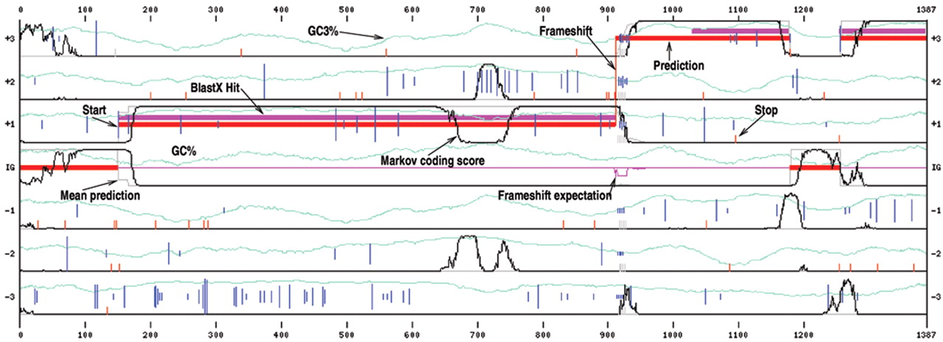
Automated Genome Annotation
Nucleic Acids 2003 vol. 31 no. 13 3738-3741
Gene prediction Identifies elements of the genome using empiric and ab initio gene finding systems. Uses additional experimental evidence to identify domains and motifs.
Notes:
Gene prediction identifies elements of the genome using either empiric or ab initio gene finding systems.
Additional experimental evidence is used to identify domains and motifs, both at DNA and amino acid level.

Slide 4

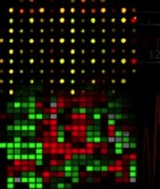
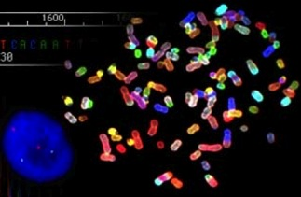
Curation [manual genome annotation editing]
- Identify elements that best represent the underlying biological truth - Eliminate elements that reflect the systemic errors of automated analyses. - Determine functional roles comparing to well-studied, phylogenetically similar genome elements via literature and public databases (and experience!).
Computational analyses
Experimental Evidence:
cDNAs, HMM domain searches, alignments with assemblies or genes from other species.
Manually-curated Consensus Gene Structures
Notes:
Curation here is understood in the context of manual genome annotation editing. It tries to find the best biological representation of gene models, while eliminating the most systematic errors of the automated analysis.
Curation also helps to determine the functional roles of these genetic elements play by comparing them to well-studied, phylogenetically similar elements using literature and public databases, to distinguish orthologs from paralogs, and classifying their membership in families and networks.

Slide 5









Curators strive to achieve precise biological fidelity.
But! A single curator cannot do it all:
- unmanageable scale.
- colleagues with expertise in other domains and gene families are required.
iStockPhoto.com
Notes:
Precise biological fidelity in genome annotation editing cannot be achieved by a single individual. There are too many genes, making it an unmanageable scale, and curators need insights from colleagues with other expertise.

Slide 6







Crowd-sourcing Genome Curation
“The knowledge and talents of a group of people is leveraged to create and solve problems” – Josh Catone | ReadWrite.com
Bring scientists together to:
- Distribute problem solving - Mine collective intelligence - Access quality - Process work in parallel
(“crowdsourcing”, FreeBase.com)
Notes:
SETI@Home tapped the unused processing power of millions of individual computers.
Similarly, distributed labor networks are using the internet to exploit the spare processing power of millions of human brains.
We are trying to empower genome researchers around the world to harness expertise from dispersed researchers.
It could be just 3 researchers working together, that’s already a crowd!

Slide 7
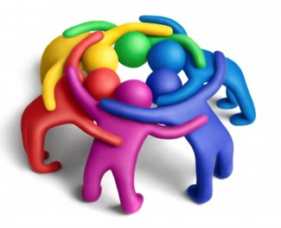

Dispersed, community-based manual annotation efforts.
We* have trained geographically dispersed scientific communities to perform biologically supported manual annotations: ~80 institutions, 14 countries, hundreds of scientists using Apollo.
Education through:
Training workshops and geneborees.
Tutorials.
Personalized user support.
*with Elsik Lab. University of Missouri.
Notes:
Although Computational analyses and experimental evidence from genomic features were available to build manually-curated consensus gene structures, all existent applications at the time imposed communications constrains on the curators. We created the tools to facilitate real-time interactivity and allow extensive changes without server round trips: Web Apollo.

Slide 8
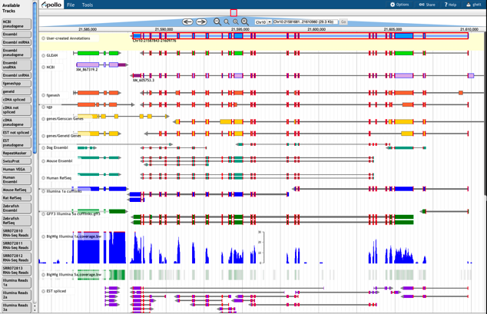

What is Apollo?
Apollo is a genomic annotation editing platform.
To modify and refine the precise location and structure of the genome elements that predictive algorithms cannot yet resolve automatically.
Find more about Web Apollo at http://GenomeArchitect.org and Genome Biol 14:R93. (2013).
Notes:
Apollo is a genomic annotation editing platform, and in its latest inception it is an evolution of a popular desktop version adopted by many research groups (insects, fish, mammals, birds, etc).

Slide 9
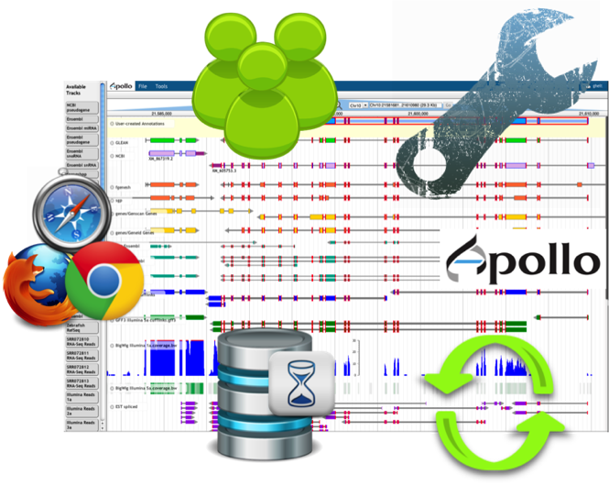
Web Apollo improves the manual annotation environment
Allows for intuitive annotation creation and editing with gestures and pull-down menus to create and modify coding genes and regulatory elements, insert comments (CV, freeform text), etc.
Browser-based, plugin for JBrowse.
Edits in one client are instantly pushed to all other clients.
Customizable rules and appearance.
Notes:
Web Apollo improves the manual annotation environment. (then highlight the bulleted ideas).

Slide 10
Has the collaborative nature of manual annotation efforts influenced research productivity and the quality of downstream analyses?
Notes:
So, what have we learned so far?

Slide 11
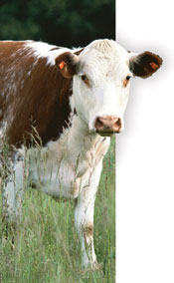

Working together was helpful and automated annotations were improved.
Scientific community efforts brought together domain-specific and natural history expertise that would have otherwise remain disconnected.
Example: >100 bovine cattle researchers ~3,600 manual annotations
Immune function
Reproduction
Lactation
Science. 2009 (324) 5926, 522-528
Metabolism
Nature Reviews Genetics 2009 (10), 346-347
Notes:
Previously disconnected researchers were more productive when obtaining immediate feedback in dialogs with collaborators.
Also, automated annotations were improved as exemplified by discoveries made based on revised annotations, for example, ~3600 manual annotations contributed to a better understanding of immune function, reproduction, lactation, and metabolism in cattle.

Slide 12
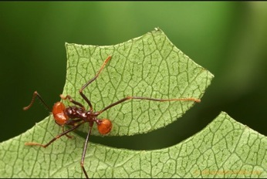
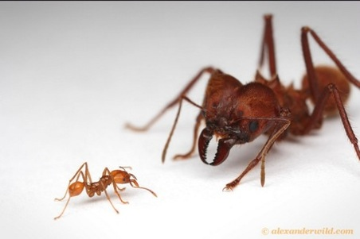
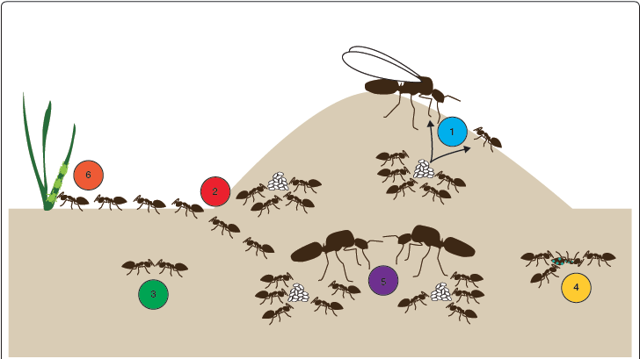
The work of groups of communities led to new insights.
Example:
Understanding the evolution of sociality.
Compared seven ant genomes for a better understanding of evolution and organization of insect societies at the molecular level.
Insights drawn mainly from six core aspects of ant biology:
Alternative morphological castes
Division of labor
Chemical Communication
Alternative social organization
Social immunity
Mutualism
Libbrecht et al. 2012. Genome Biology 2013, 14:212
Notes:
This is an example of how the collaborative nature of manual annotation has brought together an enormous group of scientists with very diverse interests, for the purpose of propelling discovery and a better understanding on the evolution and organization of insect societies at the molecular level. ~2800 manually annotated genes from three species of ants granted further insight into the evolution of sociality in this group.

Slide 13
New sequencing technologies pose additional challenges.
Lower coverage leads to
frameshifts and indel errors
split genes across contigs
highly repetitive sequences
To face these challenges, we train annotators in recovering coding sequences in agreement with all available biological evidence.
Notes:
Unlike earlier genome projects, which had the advantage of more highly polished genomes, recent projects usually have lower coverage. Therefore curators now face additional work correcting for more frequent assembly errors and annotating genes that are split across multiple contigs.

Slide 14
Other lessons learned
You must enforce strict rules and formats; it is necessary to maintain consistency.
Be flexible and adaptable: study and incorporate new data, and adapt to support new platforms to keep pace and maintain the interest of scientific community. Evolve with the data!
A little training goes a long way! With the right tools, wet lab scientists make exceptional curators who can easily learn to maximize the generation of accurate, biologically supported gene models.
Notes:
Highlight that the distributed nature of these efforts still demands strong, goal-oriented (i.e. publication of findings) leadership and coordination, as these are crucial to the success of each project.

Slide 15


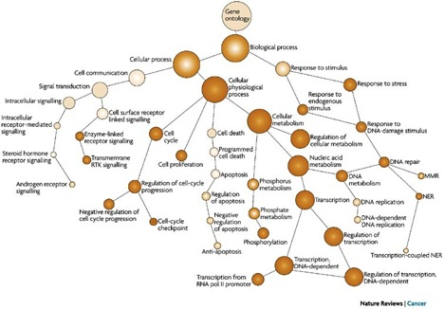
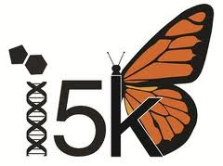
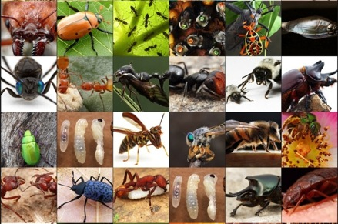



The power behind community-based curation of biological data.
Notes:
This slide brings together a collection of collaborative efforts, close to the work of many of the members of ISB, and other communities.
i5K is the initiative to sequence the genomes of 5,000 arthropods. It currently is collaboratively – and simultaneously! - annotating the genomes of 6 insects using Web Apollo.

Slide 16
Thanks!
Berkeley Bioinformatics Open-source Projects (BBOP), Berkeley Lab: Web Apollo and Gene Ontology teams. Suzanna Lewis (PI).
The team at Elsik Lab. § University of Missouri. Christine G. Elsik (PI).
Ian Holmes (PI). * University of California Berkeley.
Arthropod genomics community, i5K http://www.arthropodgenomes.org/wiki/i5K (Org. Committee, NAL (USDA), HGSC-BCM, BGI), and 1KITE http://www.1kite.org/.
Web Apollo is supported by NIH grants 5R01GM080203 from NIGMS, and 5R01HG004483 from NHGRI, and by the Director, Office of Science, Office of Basic Energy Sciences, of the U.S. Department of Energy under Contract No. DE-AC02-05CH11231.
Insect images used with permission: http://AlexanderWild.com
For your attention, thank you!
BBOP
Web Apollo
Ed Lee
Gregg Helt
Justin Reese §
Colin Diesh §
Deepak Unni §
Chris Childers §
Rob Buels *
Gene Ontology
Chris Mungall
Seth Carbon
Heiko Dietze
Web Apollo: http://GenomeArchitect.org
GO: http://GeneOntology.org
i5K: http://arthropodgenomes.org/wiki/i5K
ISB: http://biocurator.org
Notes:
Thank you!

