Slide 1
RNA-seq Analysis
María Santos Romero; María Santos Galindo
Servicio de Análsis Biocomputacional (SABio); Centro de Biología Molecular (CBM)

Slide 2
RNA-seq is used for…
Quantifying the abundance of transcripts
Identify and quantify expression changes among conditions
Splicing analysis
Non-coding RNA quantification
SNVs detection
Transcriptome assembly
…

Slide 3
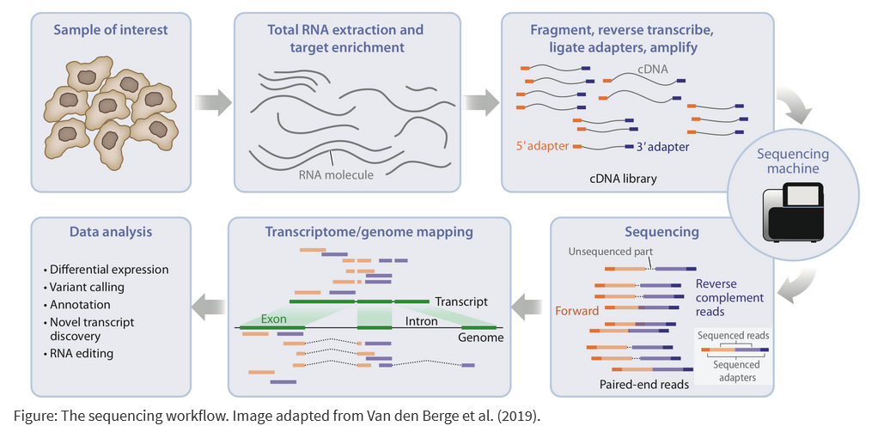
RNA-seq protocol
Single-end
or
Paired-end

Slide 4
Stranded RNA-seq
rRNA depleted mRNA
Fragment
Random prime + RT
2nd strand synthesis (+ U)
A-tailing
Adapter Ligation
(U strand degradation)
Sequencing
NNNN
u
u
u
u
u
u
u
u
A
A
T
u
u
u
u
A
A
T
A
T

Slide 5
Introduction to Linux

Slide 6
Terminal layout
user@server:~$ ls
01_reads 02_reference 03_hisat2 04_featureCounts 05_deseq2 06_GSEA cheat_sheet.md deseq2_env.yml rnaseq_env.yml
user@server:~$
Command prompt - you can't enter a command unless you can see this
The command we're going to run (ls in this case, to list files)
The output of the command - just text in this case

Slide 7
Structure of Unix commands
# Comments that are not executed
command --options (-o) arguments
Command/Program name: instruction to be executed.
Options/Switches: modifiers of command behaviour.
Arguments/Data: objects on which the command acts.
Example:
# Show the first 10 lines of a file.
head my_text.txt
# Show the first 100 lines of a file.
head --lines 100 my_text.txt
# Show the first 100 line of a file
head -n 100 my_text.txt
Notes:
Comando: instrucción que quieres ejecutar.
Opciones: modifican el comportamiento del comando.
Argumento: objetos sobre los que el comando actúa.

Slide 8


Specifying file paths
home
user
If I’m in /home/user
Absolute path:
/home/user/Data/big_data.fq.gz
Relative path:
Data/big_data.fq.gz
Data
big_data.fq.gz

Slide 9
Command line completion
Command line completion is achieved by typing a partial path and then pressing the TAB key (to the left of Q).
You should use TAB completion to fill in paths for locations which exist so you can't make typing mistakes.

Slide 10
RNA-seq analysis

Slide 11
Analysis flowchart
Reference genome
(FASTA)
DATA ACQUISITION
Download from repository
READS PREPROCESSING
ALIGNMENT
Initial QC (FastQC)
Trim reads (Trim-Galore)
Post-trimming QC (FastQC)
Map reads to genome (HISAT2)
Convert and sort alignments
(SAMTools)
Read files
(FASTQ)
Pre-processed read files
(FASTQ)
Own sequencing data
Genome
annotation
(GTF)
Alignment files
(BAM)
QUANTITATION
STATISTICAL AND
FUNCTIONAL ANALYSIS
Count reads
per gene (featureCounts)
Pathway enrichment analysis
Differential expresión
(DESeq2)
Normalized counts
Count normalization
Notes:
Comando: instrucción que quieres ejecutar.
Opciones: modifican el comportamiento del comando.
Argumento: objetos sobre los que el comando actúa.

Slide 12

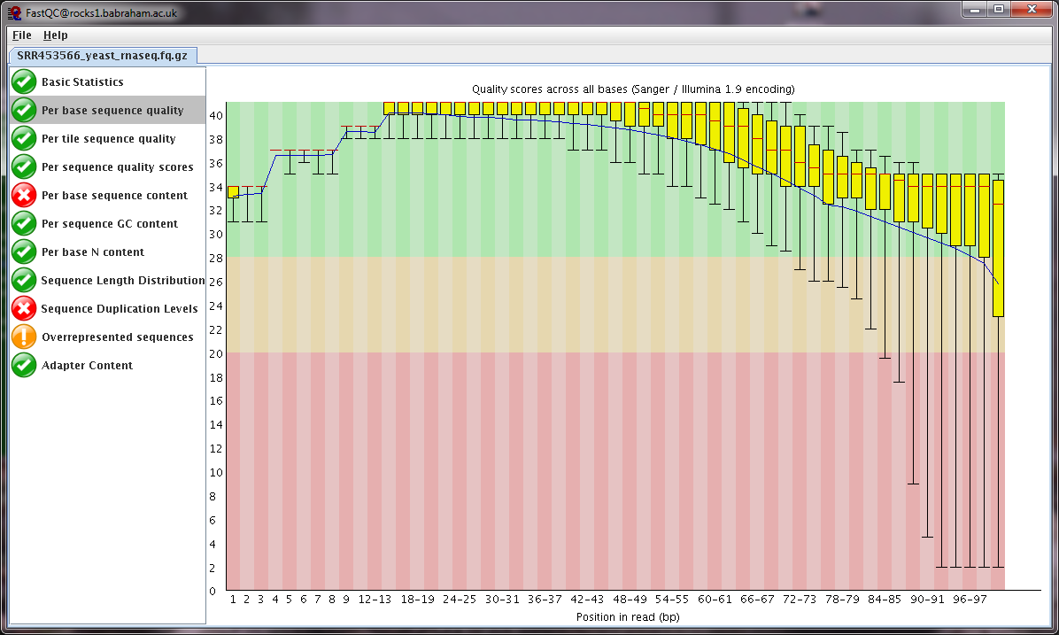
1. Raw sequence quality control (QC)
Base call quality
Composition
Duplication
Contamination

Slide 13
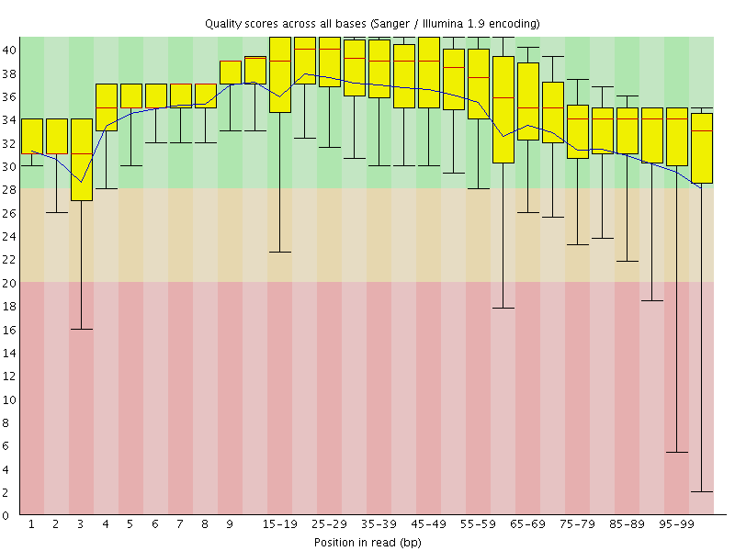
1. Raw sequence quality control (QC)
Call Quality
(Phred score)
Read Position

Slide 14
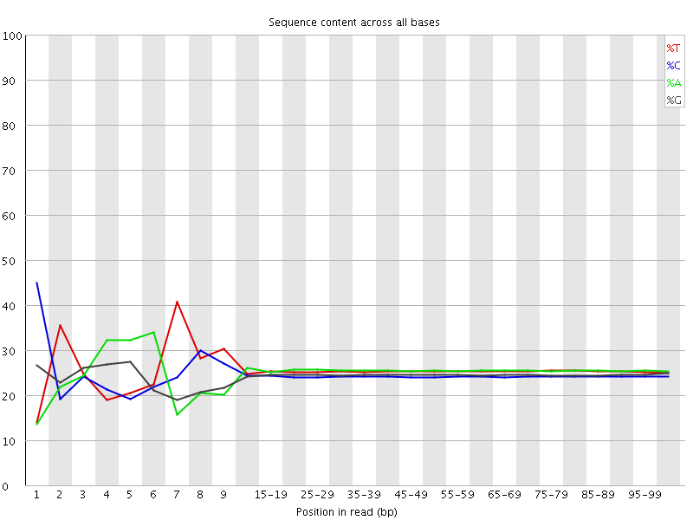
1. Raw sequence quality control (QC)
Read Position

Slide 15
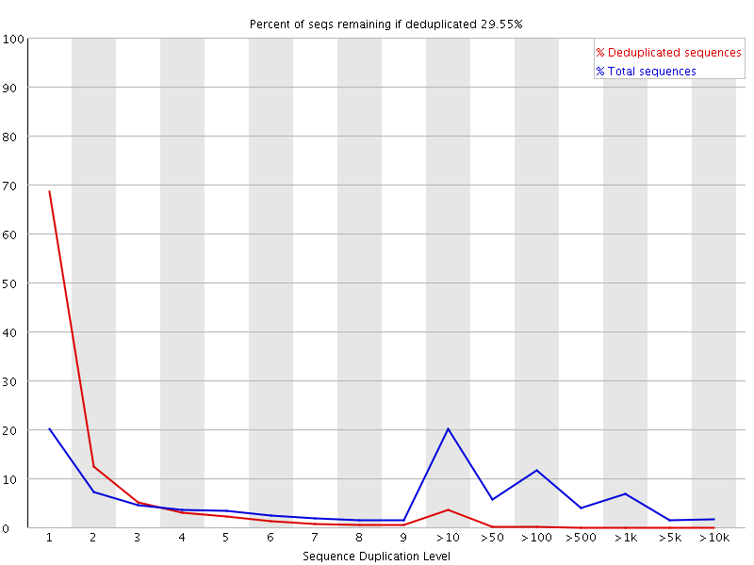
1. Raw sequence quality control (QC)
Percentage
of library
Level of duplication

Slide 16
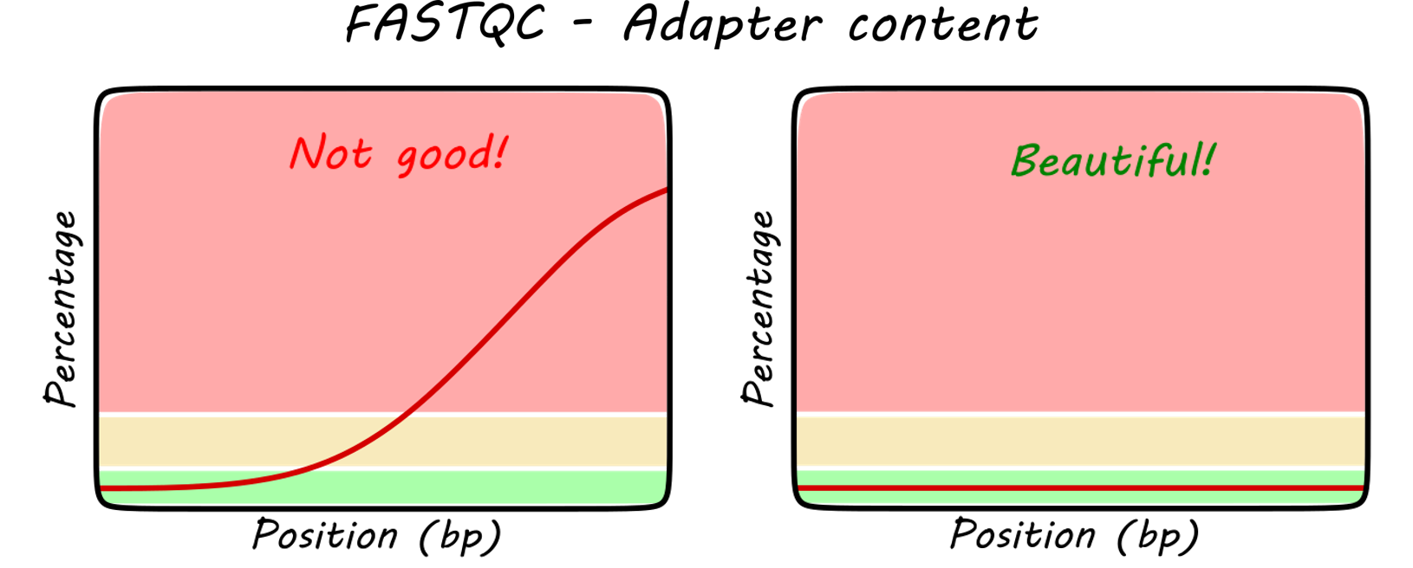
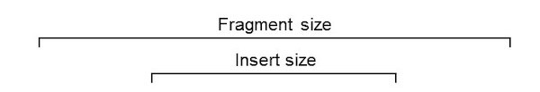
2. Trimming
Removes adapter sequences
Remove very short sequences (default: < 20bp)
Read 1
Adapter 1
Insert
Adapter 2
Reads without adapters
Read 2
Read 1
Adapter 1
Insert
Adapter 2
Reads WITH adapters
Read 2

Slide 17
3. Alignment
Exon 1
Exon 2
Exon 3
Genome
Simple mapping within exons
Mapping between exons
Spliced mapping
Splice-aware software:
HISAT2
STAR
…
Discarded by non-splice-aware software

Slide 18
4. Reads per gene quantification
Counting the number of reads per gene (sum of reads per exons)
Gen en el GTF
--type gene
+
+
--type exon

Slide 19
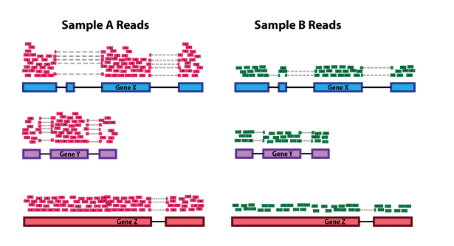
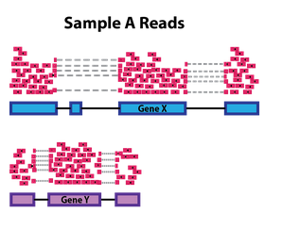
5. Differential expression
5.1. Read counts normalization
Sequencing depth
Gene length
Notes:
Count based is natural fit for raw count quantitation
Continuous would work with cufflinks or other transcript level quantitation.
Binomial stats are very powerful with good power to detect changes.

Slide 20
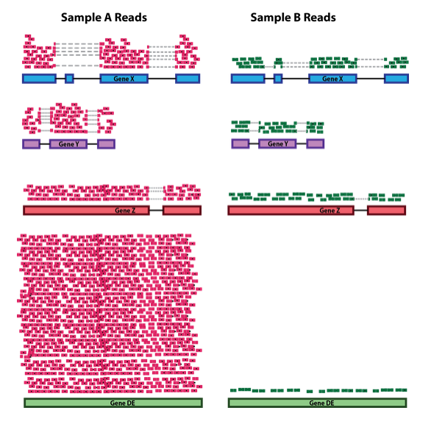
5. Differential expression
5.1. Read counts normalization
RNA composition
Orange cell
Blue cell
Gene A: 10 transcripts (10%) 10 transcripts (50%)
Gene B: 10 transcripts (10%) 10 transcripts (50%)
Gene C: 80 transcripts (80%) no expressed
We sequence the two cells with 10 reads (same number of total reads)
Gene A and B are expressed 5 more times in the blue cell
Notes:
Count based is natural fit for raw count quantitation
Continuous would work with cufflinks or other transcript level quantitation.
Binomial stats are very powerful with good power to detect changes.

Slide 21
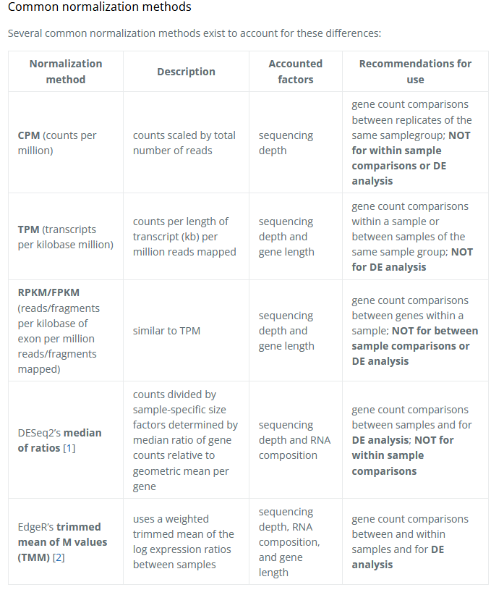
5. Differential expression
5.1. Read counts normalization

Slide 22



6. Pathway enrichment analysis
Over-representation análisis (ORA)
Evalúa si ciertos conjuntos de genes (gene sets, ontologías, rutas) están sobrerrepresentados en tu lista comparado con un background de referencia (todas los genes posibles).
Input: lista de genes asociados a DARs (por ejemplo, genes cercanos a regiones accesibles diferencialmente).
Output: listado de ontologías o rutas enriquecidas, sin considerar dirección o magnitud de cambio.
Gene set enrichment análisis (GSEA)
Ordena todos los genes por su magnitud de cambio y evalúa si los genes de un conjunto específico tienden a aparecer al inicio o al final de la lista.
Input: lista de genes asociados a DARs con valores cuantitativos (p. ej., log2 fold change de accesibilidad o expresión).
Output: listado de rutas o ontologías enriquecidas en genes up- o down-regulados, considerando dirección y magnitud del cambio.
http://geneontology.org/
https://www.genome.jp/kegg/
https://reactome.org/

Slide 23

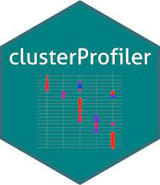
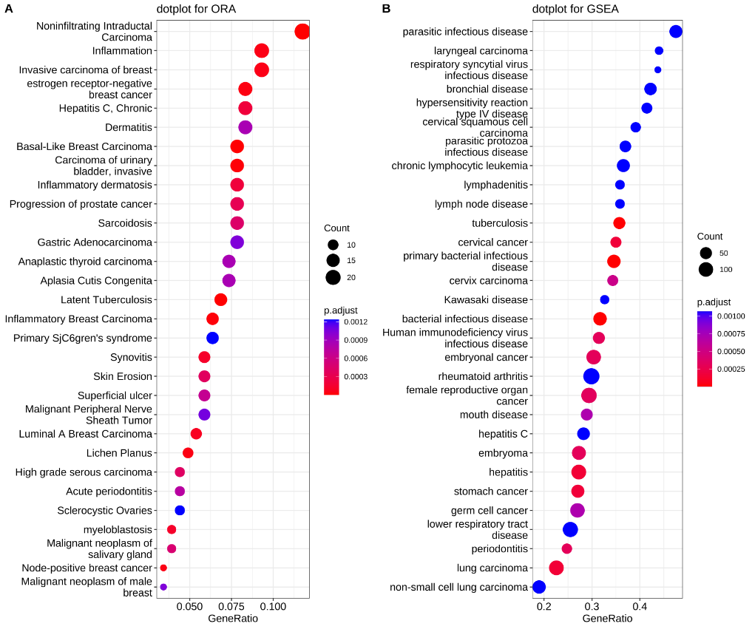
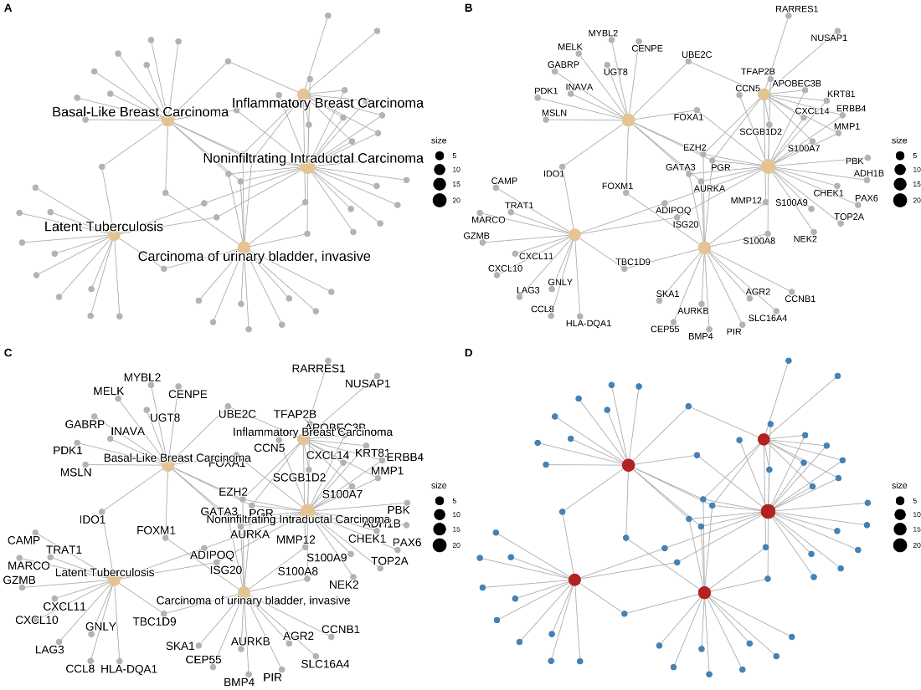
6. Pathway enrichment analysis

